Slide 1
F2F2
UNIT 1 Community Food Service
Lesson 1: Conservation Techniques of Soil

Slide 2
Soil Erosion Obj. TSW learn about soil erosion and damaging impacts on farming and the environment.
Look at the picture, how would you describe soil erosion?
What problems could this create for farmers?
What problems could develop down stream?

Slide 3
The Unfortunate Homeowner
View the following picture taken off the coast of Nantucket, near Boston, Massachusetts. Clearly, the homeowner was not happy at the time the photo was taken. In your notebook, title a page “The Unfortunate Homeowner” and attempt to identify the factors that led up to the unfortunate situation. How did the house end up in the ocean? What did the homeowner fail to understand? How could situations like the one in the picture be avoided? Should people be allowed to build homes in similar conditions? Why? Why not? Upon what type of soil do you think the house was built upon

Slide 4
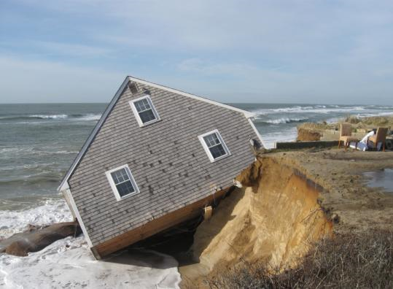
The Unfortunate
Homeowner

Slide 5
Soil – It’s running away… Obj. TSW learn about stream flow, soil erosion, and nutrient depletion during a Stream table activity.
Describe the word conservation in terms of soil.
Describe the word deterioration in terms of soil.
Why is soil management important in agroecosystems

Slide 6
Activity – Soil it’s running away
STEP 1: In your group at your table, fill your tray with 1, 1000 ml of sand poured into the shallow end of the tray.
STEP 2: Get a water bottle ½ - full of water.
STEP 3: Spray the shallow end of the sand and describe what happens in your notebook.
Answer the following questions:
How does the soil erosion happen? Describe your observations in detail.
Why is erosion unhealthy for the agroecosystems?
What steps/ practices could prevent or reduce soil erosion?

Slide 7
Activity- Nutrients – Where did they go?
Introduction/ Discussion:
What are the main plant nutrients and where are they obtained?
What can happen to plants if nutrients become depleted?
How can nutrient depletion occur?

Slide 8
Activity- Nutrients – Where did they go? P. NB
Directions:
Apply food coloring (1 drop only) to three different areas of your tray of sand. On or under the sand. (describe different soil types).
Simulate rain with the hand sprayer.
Describe your general observations of the demonstration.
Explain how nutrient depletion can happen in relation to erosion.
Hypothesize how crops planted year after year without any replenishment or rest become depleted of nutrients.

Slide 9
Soil Degradation Obj. TSW learn about how healthy soil supports life and itself needs to be properly cared for.
What is soil degradation?
Monocropping, Soil compaction, Salinization, Amount of Organic matter, Too Basic, Too Acidic are some examples of how soil can be degraded. Choose one and explain what you think it is.
How could you test to see if the soil is bad?

Slide 10
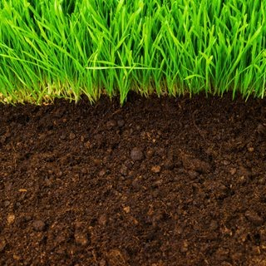
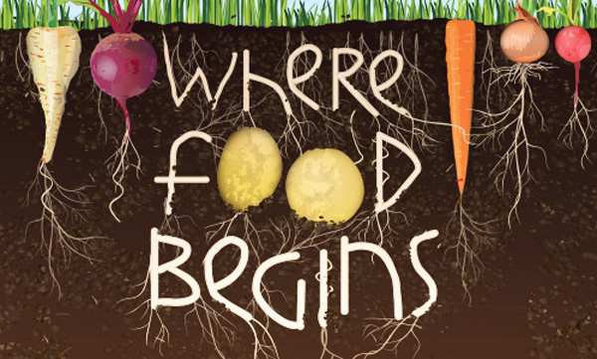
It can’t be all that bad. Obj. TSW learn about healthy characteristics of soil to help grow healthy food.
What is soil?
What does soil have that plants need to grow?
What does it mean when a seed germinates?
Get Books from the Library

Slide 11
Soil Degradation World Wide What is Soil Degradation? What are some examples of it? How do we correct it?

Slide 12
At a Loss? Let’s find Nutrients? Obj. TSW watch some best management practices from a Journey 2050 video.
What is the difference between biotic and abiotic factors in an environment?
What are the three main nutrients plants need to grow?
Name 3 -5 abiotic factors plants need to grow.

Slide 13
Best Management Practices
Tape your WS to page Notebook
Answer the questions from watching the video.
We will discuss the answers after the video.

Slide 14
Activity: It can’t be that bad.
Choose to work by yourself or a partner or in a group of three.
Get one planting container.
Fill the 1st row with healthy compost/ soil from the garden about ¾ full. (Control)
Fill the 2nd row with Clay soil, or add salt to it or compact the soil really tight when planting the seeds, or add lemon juice, or ammonia. Take note of the quantity that you use. Fill the pot ¾ full. When making the soil degraded, only add 1 -2 pipettes of solution.
Plant 4 Mung seeds in each pot. Read the directions on the packet to plant them at the proper depth.
Record data daily for germination, and growth rate of your seeds/ plant.

Slide 15
Activity: It can’t be all that bad. Data Table
Days/ Dates | Germination/ Growth in the Control group | Germination / Growth in the Experimental Group
Day 1 1/26 | 0 | 0
Day 2 1/27
Day 3 1/28
Day 4 1/29
Day 5 2/1
Day 6 2/2
Day 7 2/3
Day 8 2/4
Day 9 2/5

Slide 16
What is the impact of degraded soil on plant growth? Conclusion of Lab

Slide 17
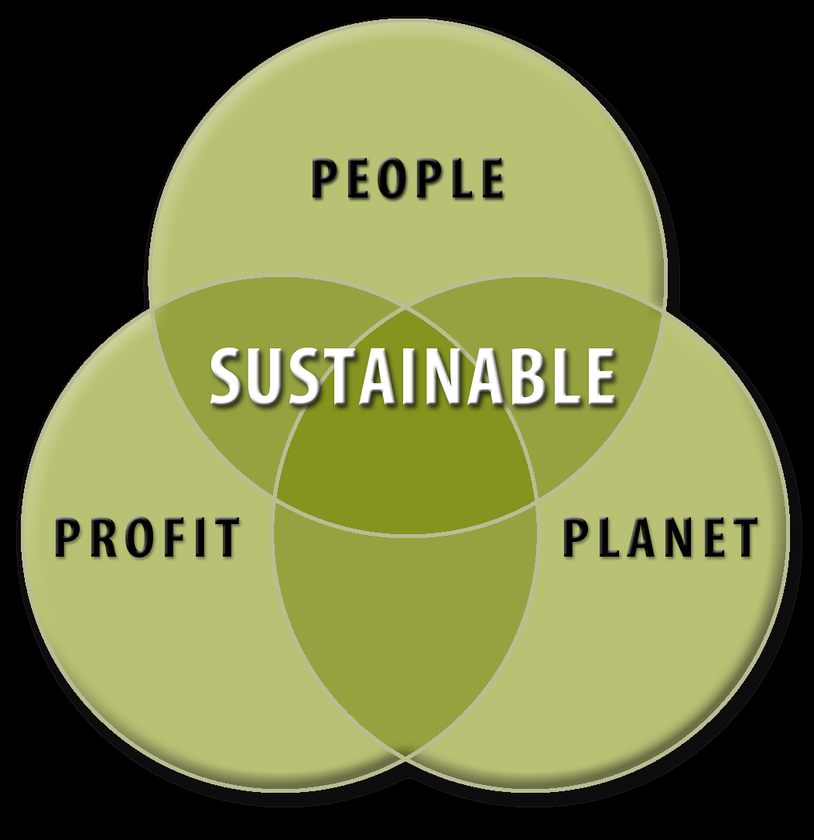
Sustainability Obj. TSW apply sustainability practices with experience out in the garden.
What does sustainability mean?
What three factors are considered in a sustainable system?
What is a limiting factor?

Slide 18
Abiotic factors in the Garden
pH
Temperature of soil
Soil Moisture
Rocks
Sand
Compost

Slide 19
Measuring Abiotic factors in the garden
Garden Bed # | pH of Soil 0-14 | Soil Moisture (mV) | Surface Temperature | 5 cm deep Temperature | 10 cm deep Temperature
1
2
3
4
5
6
7
8
9
10
11
12
13
14
15

Slide 20
Ground Rules for the Garden
Walk out together (so I can see everyone).
GO to the bathroom before we walk out to the garden
NO Cell phones on in garden.
Everyone takes part in cleaning up.
NO one leaves the garden area until the teacher says it’s clean and everyone can go.
Everyone waits at the gate.
Safety! No unsafe behavior, especially with tools.

Slide 21
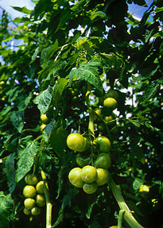
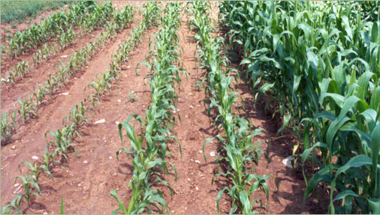
Test those nutrients! Obj. TSW learn how to test the Nitrate, Phosphate, and Potassium of the soil in the garden.
How does Nitrogen help plants?
How does Phosphate help plants?
How does Potassium help plants?

Slide 22
Apply those Nutrients
Were you deficient in any of the 3 Macronutrients?
Nitrogen?
Phosphorus?
Potassium?
Research online how to amend the soil. Make a list of the resources you are using. List the amendments that would best improve the soil. Tell why these amendments should be effective.
After adding the amendments, retest the soil.
Be prepared to share your responses in a class discussion.

Slide 23
Ewh! Why is the water so gross? Biomonitoring Study for Biodiversity

Slide 24
Effects of Eutrophication

Slide 25
This water is making me thirsty!

Slide 26
To Suds or not to Suds

Slide 27
Water, Water Everywhere, not a drop to drink

Slide 28
Design and Build a Miniature Aquaponics System

Slide 29
Aquaponics in North Carolina & Haiti

