Slide 1
Lesson 2
Resources in the Region
UNIT 4 Career Exploration & Guidance

Slide 2

5/2 Review our F2F Goals
Obj. TSW review our three goals for F2F. P. 58 NB
List our original 3 goals for F2F.
What other accomplishments would you like to have before the end of the year.
Besides the Bee Presentation guest speaker, who else would you like to speak?

Slide 3
Bryte Campus Garden Building
West Sacramento Rotarian Day & RCHS Service Learning

Slide 4
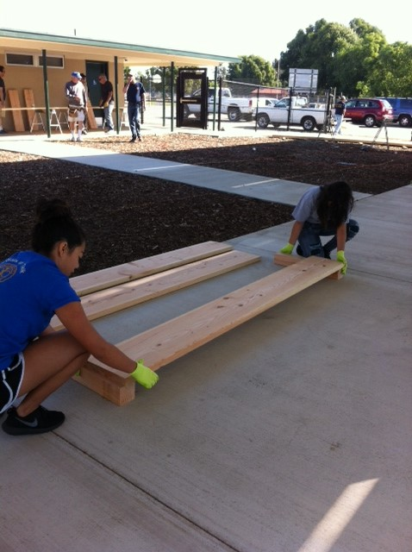
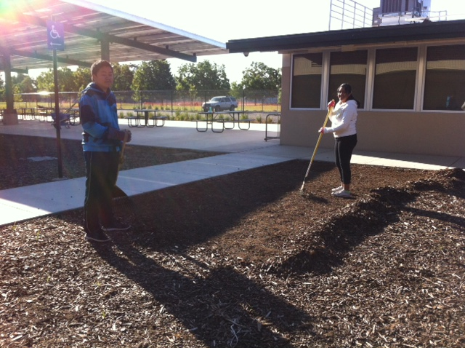
In the Morning… at Bryte

Slide 5
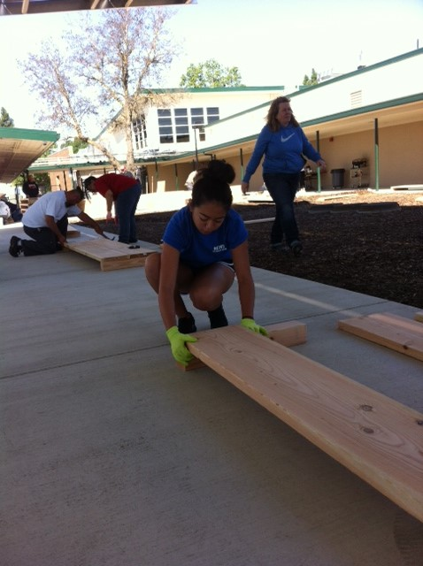
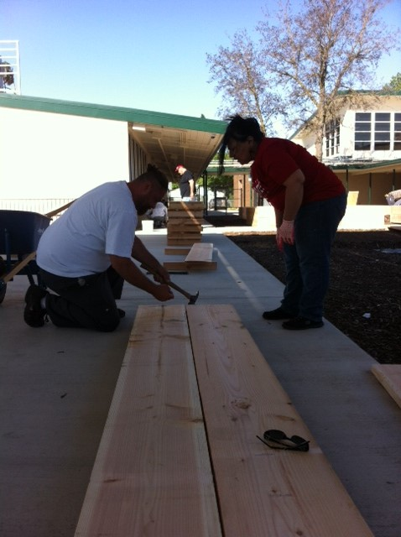
Assembling the Garden Beds

Slide 6
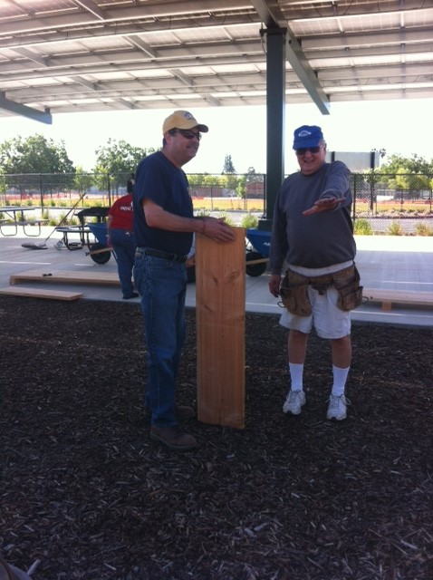
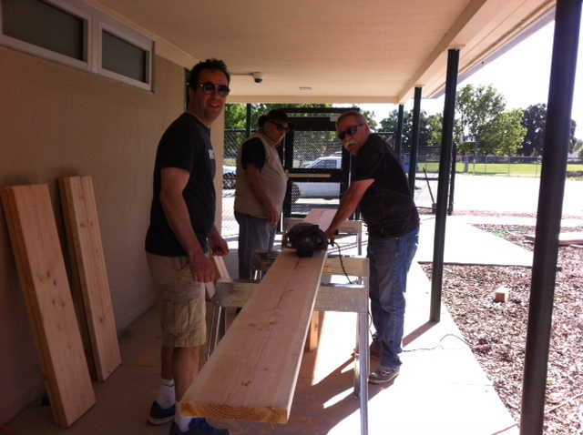
See, Our principal works ☺

Slide 7
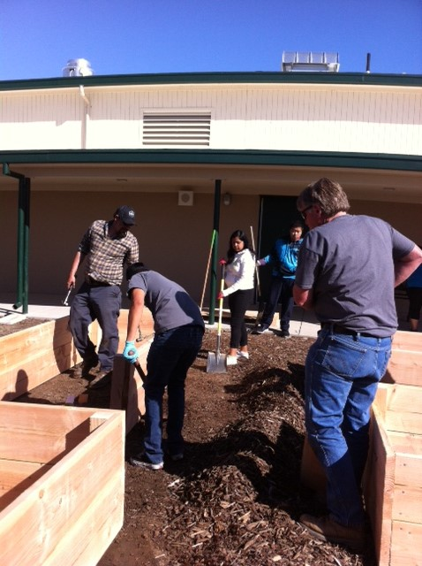
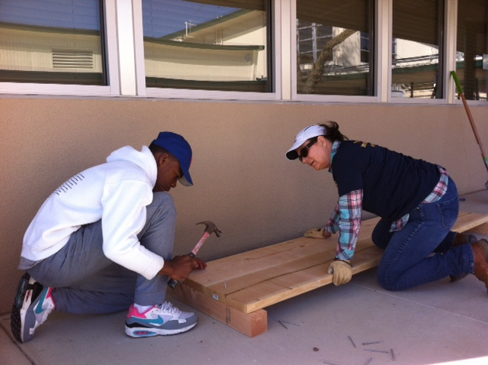
Hard at work.

Slide 8
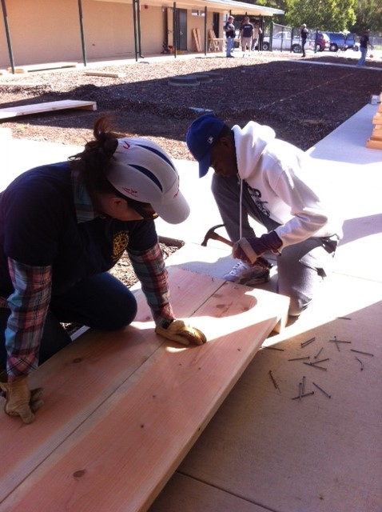
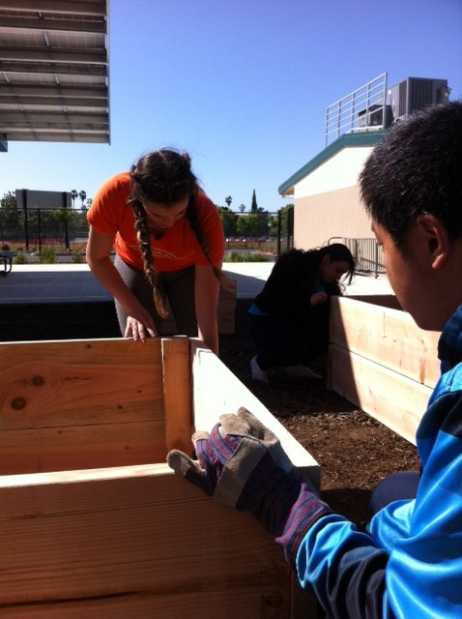
Gettin’ ‘er done!

Slide 9
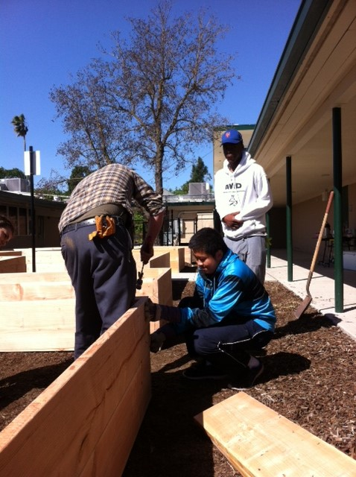
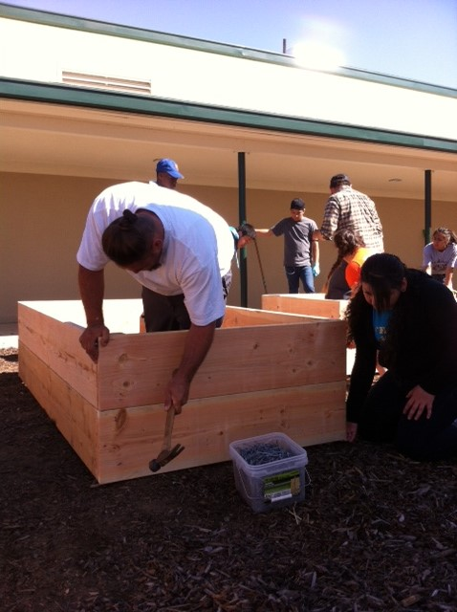
Learning carpentry skills.

Slide 10
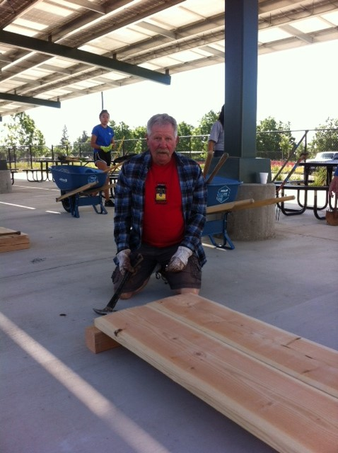
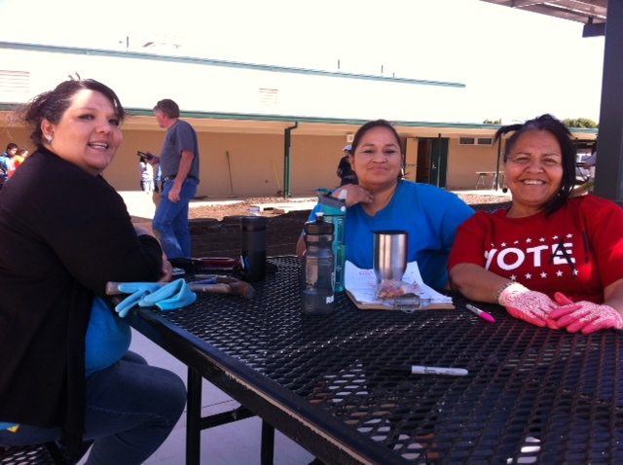
Broderick is a community and it cares.

Slide 11
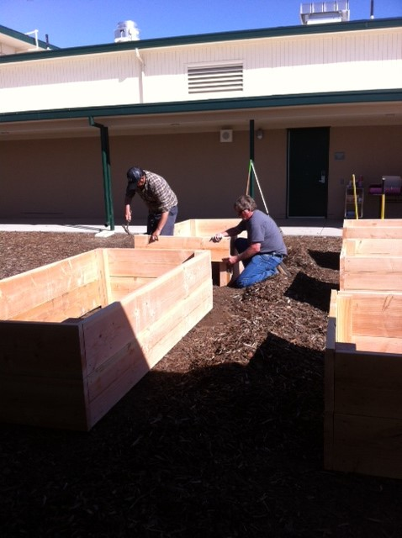
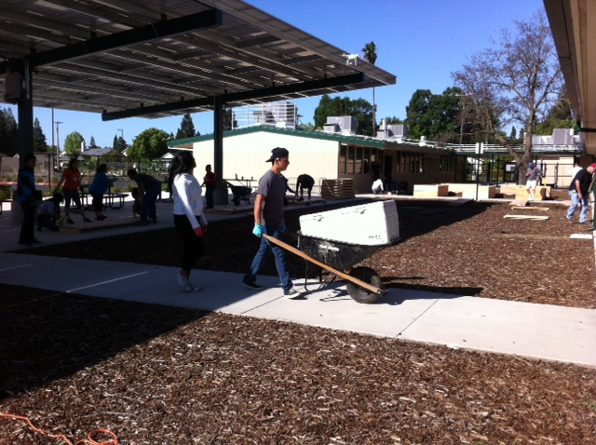
Still working…

Slide 12
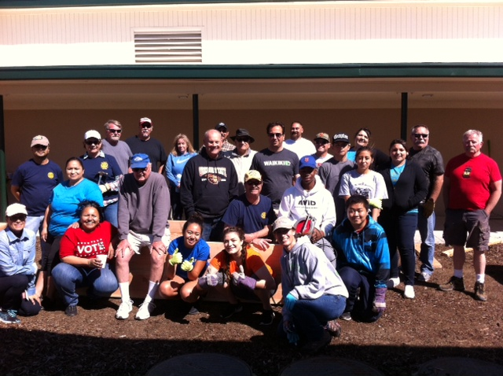
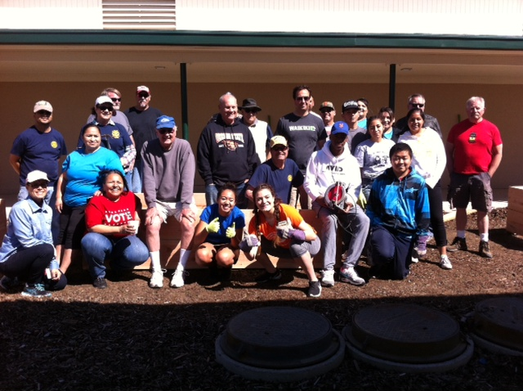
Farm to Fork is more than just a movement it allows our community to come together to create opportunities for young people to learn about growing healthy nutritious food.

Slide 13
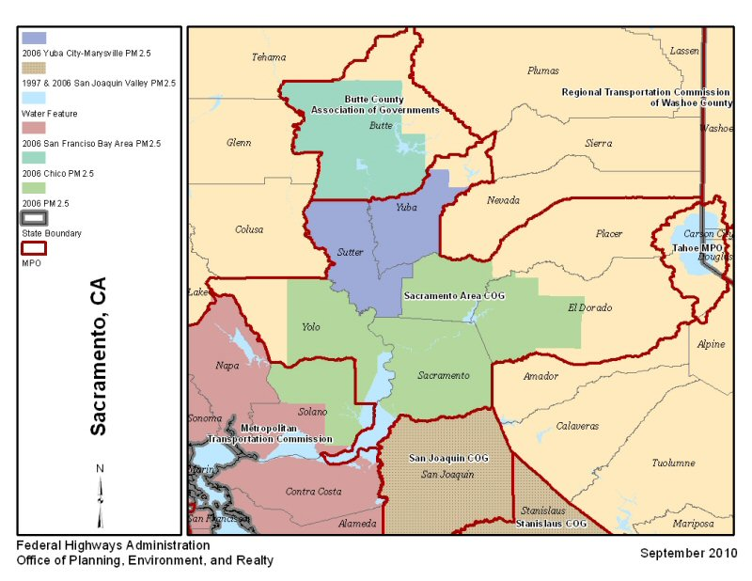
5/3 Resources in the Region
Obj. TSW realize all the resources that go into helping develop a successful program. P. 60 NB
If West Sacramento is our Community, where and how big is the Sacramento Region?
What possible resources could be have in our Sacramento Region?
When would you like to do a Garden tour for elementary or go to Stonegate?

Slide 14
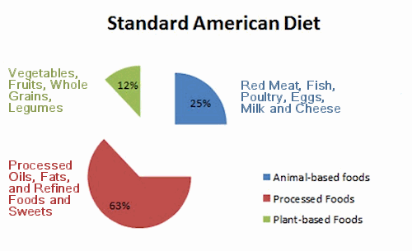
Draw this on p.37NB

Slide 15
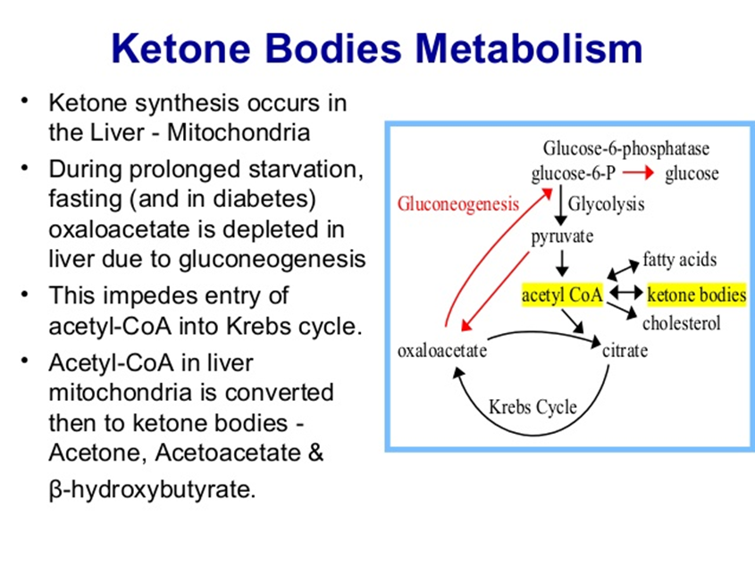
Chemistry in Agriculture P. 39 NB
Find 3 interesting factoids about animals that can be included in your 1 -2 page paper. P. 39 NB

Slide 16
What other local businesses support the Farm to Fork movement? P. 41 NB
Research 3 businesses with in 100 miles that raise, grow, sell, buy, and distribute local produce and meat, including dairy cattle?
Explain what they do and how they do it.
Some of this information can be included in your 1 – 2 page paper.

Slide 17
Omnivore’s Dilemma
The secrets behind what we eat
Michael Pollan p. 47 NB
Read the Introduction by Monday P.1 - 6
What is Monitor?
How are commercial Potatoes grown in Idaho?
Where does the meat come from for most fast food?

Slide 18
How Corn Took Over America & The Farm
How is the supermarket like a field of corn? P.10
Name some ingredients made from corn. P 11
How much biodiversity was lost from 1920 – 2002? P. 26 NB
Discuss a result of growing so much corn. P. 26 - 27

Slide 19
1 – 2 page paper Due May 12th
Where does your food come from?
Where does your food come from?
  Discuss where your family buys food. Discuss what Farm to Fork is and it’s benefits.
Why is it important to know where your food comes from?
  Include examples, explanations, and show the significance of where our food comes from.
    Maybe include ingredients such as High Fructose Corn Syrup, salt, fat, sugar in our diet.
  Include the difference between processed and natural foods. Why is that important?
  Include companies, businesses that are part of the solution to eat healthier, and companies that could improve to become part of the solution. How are companies trying to change their image?
APA Style: purdue.owl.edu

Slide 20
www.cacareerzone.org p.49
Begin the Career Assessment
Write an occupation you are interested in.
One sentence describing the job in your own words
Describe the preparation required for that occupation
What is the range of salary?
What is that occupations outlook? Expanding, stagnant, decreasing?
What are the common College Majors?

Slide 21
www.cacareerzone.org
P. 51NB
Read: “Things they need to be able to do”
Write one - three skill(s) or job description that you are good at.

Slide 22
Entry Level Research P. 53 NB
Find 3 Entry – Level employment opportunities from the Skills Profiler of California Career Zone
State your skill that will be an asset to that type of work.

Slide 23
Omnivore’s Dilemma
CH 3 From Farm to Factory
Turning bombs into Fertilizer
What is Agribusiness? P. 29 NB
What is the main ingredient in fertilizer?
How is recycling fertilizer in a natural loop different than applying ammonium nitrate?

