Slide 1
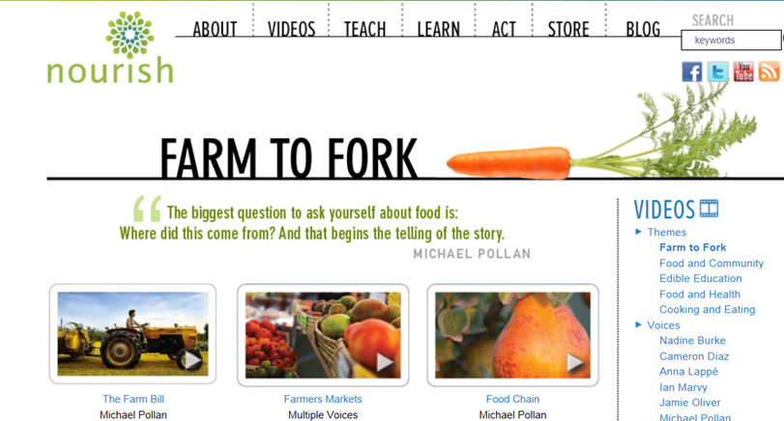
Week 18 Farm to Fork

Slide 2
January 4th From the Soil Obj. TSW gain a better perspective of the importance of healthy soil. P. 80 NB
What are the components of healthy soil?
Why is Farm to Fork important?
Explain what you have learned about growing healthy food for RCHS students and Culinary?

Slide 3
Second Barcode
Take 3 – 4 Notes in the 2 minute video.
After watching the short video clip, what are your thoughts?
How realistic is a second barcode?

Slide 4
Activity: The Story of Food nourish.org
Objective: Students examine food labels and conduct research to trace food paths from the original plant or animal source. They then make posters describing the story of a particular food.
Question: How does the way food is raised, processed, transported, and eaten impact both people and the environment?
Read the background information.

Slide 5
11/5 Bayer Crop Science Obj. TSW learn about local companies that play a role in our Agricultural success. p.82 NB
What association do you have with Bayer?
Why would a Pharmaceutical company get involved with Crops and growing Food?
How does what you have learned about Bayer Crop Science under score the importance to growing healthy food worldwide?

Slide 6
Final Presentation –PPT
Farm to Fork Project PART 2 DUE McAllister needs to review your progress of your project before January 8TH.
PPT Individual: 10 – 15 Slides PPT Two students: 15 – 20 Slides
Introduction: Briefly review your project for us.
Data
Qualitative Data: Words, Descriptions, Pictures, Video
Quantitative Data: Tables, Charts, Graphs
Data Analysis
What does the data mean?
What were some things that you learned from mistakes you made?
What would you do differently next time?
Conclusion
Explain what your project meant to you and how the class Farm 2 Fork has helped you gain a better understanding of your project/ gardening caring for plants/& or soil . If you were in charge of feeding the world, or creating more sustainable practices worldwide how you would go about it?
Works Cited Title. Author. Website link.
Yolo Farm to Fork. By Dorthy Peterson. Dir. Dominic Machi. Perf. Beth Harrison. Yolo Farm To Fork. Yolo Farm to Fork.org, n.d. Web.

Slide 7
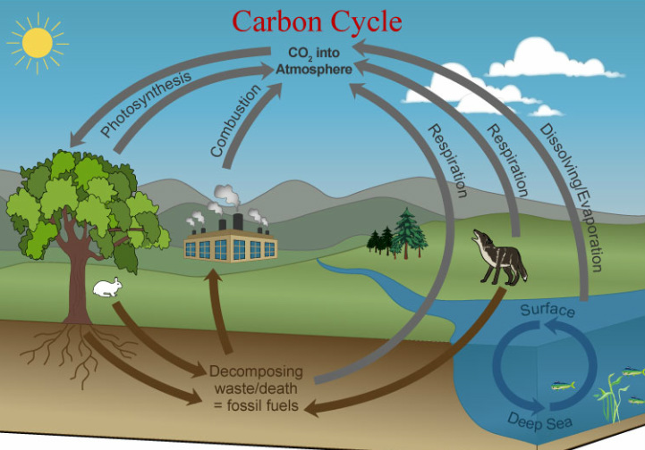
Carbon Cycle Review P. 84 NB Obj TSW review how important the carbon cycle is to us.
What is the Carbon Cycle?
How does CO2 cycle through the Biotic and abiotic factors?
List 6 processes of the Carbon cycle.

Slide 8
Greenhouses & Carbon Cycle Activity. p. 85NB
"What happens to the carbon dioxide you breathe out or the carbon dioxide released from a burning paper?”
How does the carbon cycle influence the greenhouse effect?
How do greenhouses utilize the greenhouse effect to promote plant growth?
How is greenhouse plant cultivation a sustainable practice?

Slide 9
Students will draw the carbon cycle. Labeling the 6 processes that take place: Photosynthesis, Cellular Respiration, Exchange, Sedimentation & Burial, Extraction and Combustion. Students will gain a better understanding of how carbon cycles between the atmosphere, geosphere, hydrosphere, and biosphere form their graphical simulation of the carbon cycle.

Slide 10
Bayer Crop Science P. 85 NB
Where is Bayer Crop Science in West Sac?
What does Bayer Crop Science do concerning agriculture?
Give 3 examples of how they are involved in agriculture.
How does it relate to Farm to Fork?

Slide 11
11/8 Food Inc. Obj. TSW make connections between how food is produced and why Farm to Fork is so important. 86 NB
What impression was left on you by the movie Food Inc.?
What did you learn from Food Inc. that changes how you think about food?
If you got to meet Micheal Pollan in person, what would you like to ask him?

Slide 12
11/12 Nourish.org Obj. TSW learn p. 88 NB
Name three things about the video that you learned.
How does Nourish relate to Food Inc. and to Farm to Fork?
How has Nourish changed your thinking about food? And what is healthy.

Slide 13
11/13 Understanding where our food comes from Obj. TSW explain three aspects of how this class has impacted themselves, or the school or the community. P. 90 NB
If someone were to ask you, “What was the Farm to Fork” class like? How would you describe what was taught in the class?

