Slide 1
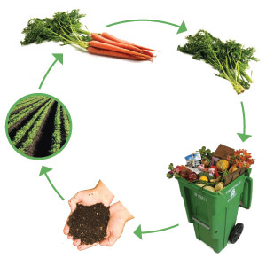
Farm to Fork
Unit 1
How to build Healthy Soil

Slide 2
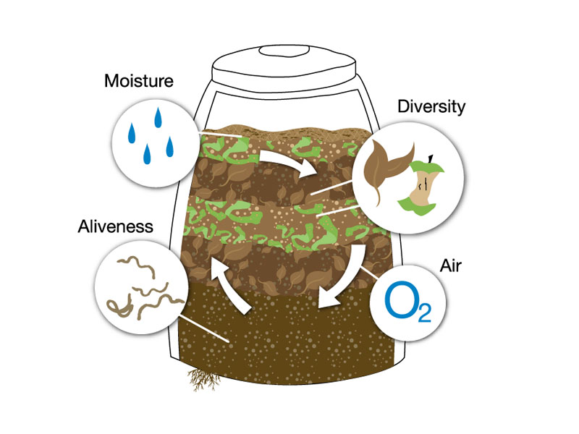
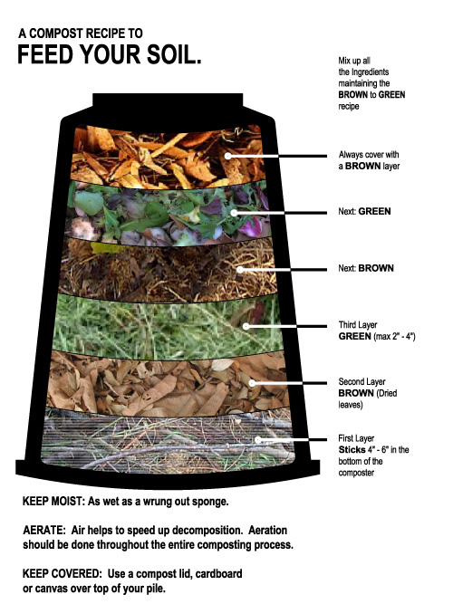
Composting
Materials:
2 – Liter bottle
Cut holes in it
Cut off the top
Soil
Fill 2 inches
Compost
Fill 1 inch
Add a little fertilizer water
Repeat these steps 3 times
Lastly, add three worms
Red Wigglers
Sprinkle water 2 -3 times/ wk
DO NOT over water!
Aerate the soil with a scoopula
1x/wk
Record the Temperature of the Soil
Record the Temperature of the Air

Slide 3
Composting – 20 days to healthy productive soil Data Table 1
Days | Temperature °F | Odor of Compost | Texture of Compost | Changes in organic waste (Size, color, etc.)
Start Compost Day 1
Day 2
Vocabulary to Learn:
Aerate: To turn the soil, add oxygen to the soil
Compost: The natural breakdown of material to its basic form to be recycled into soil
Organic: Natural, no pesticides, insecticides, herbicides
Texture: The feel of something, rough, smooth, slimy

Slide 4
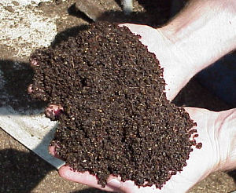
Conclusion
What happened to the original organic wastes added to the compost pile?
Which organic material were decomposed fastest?
Which decomposed the slowest? Why?
Did the size of the compost matter? How?
Did the temperature of the compost pile change over time? Why?
Why did you have to aerate the compost every few days?
How do you think composting is a useful strategy for reducing the volume of wastes sent to landfills?

