Slide 1
Farm to Fork
Week 5
September 12 - 16

Slide 2
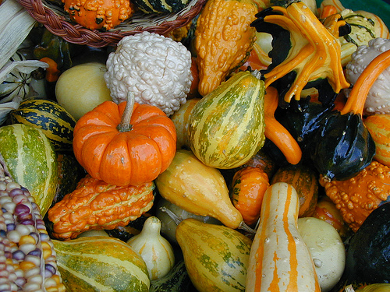
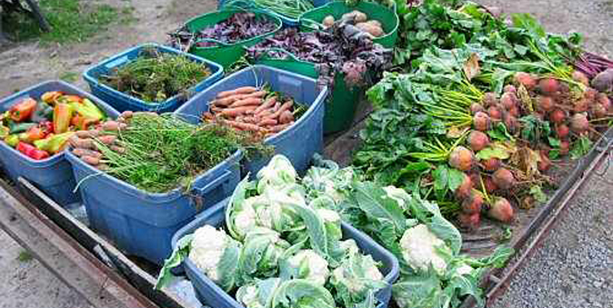
9/12 Seasonal Crops Obj. TSW differentiate between seasons of when certain crops are grown. P. 36 NB
Do we have strawberries in the grocery store year round? Why?
Do the strawberries cost the same year round? Why?
Name 6 Warm Season and 6 Cool Season Crops.

Slide 3
Activity: Farm to Fork Trifold
What is Farm to Fork?
How can you benefit?
Explain What we learn in class.
Seasonal plants, Compost, Sustainability- Triple Bottom Line, Soil & Texture, Porosity & Permeability, Farm to Fork Restaurants.
What we Do.
Our Success Stories.
Add a Quote from yourself about the class
Contact Information
Pictures!, Pictures!, Pictures!

Slide 4
9/14 Creating Community Food Security Obj. TSW learn about why Sacramento is the Farm to Fork Capital for the Nation. P. 38 NB
Why is Sacramento and the surrounding area considered the Farm – to Fork capital of the country?
What was a positive experience you had yesterday at Fiery Ginger Farms?
What would you like the “common” person on the street to understand about food?

Slide 5
Jacob’s baby chicks

Slide 6
YES!

Slide 7
More little chicks

Slide 9
9/15 Farm to Fork Trifold Obj. TSW advertise our F2F Program and educate others about it’s benefits. P. 40 NB
Describe a success story from your farm to fork class.
If someone had to quote you about the class or Farm to Fork in general, what would you say?
List three benefits of the Farm to Fork movement.

Slide 10
Activity: Research Seasonal Crops
Students will research season crops in the Sacramento Region. In addition to writing basic information about these seasonal crops, include answers to these two questions:
If a restaurant wants to support Farm to Fork and advertises itself as such, what roadblocks might they encounter?
What benefits come along with only serving food that is locally grown within 50 – 100 miles of the restaurant.

Slide 11
Activity: Plate it UP!
Students will create a flyer to advertise the food prepared by the culinary class.
Example: Take and Bake Pizza
Which ingredients are local? Why is that important?

Slide 12
9/16 Inviting Others to learn about Farm To Fork Obj. Teach the younger students about Farm to Fork. P. 42 NB
What schools around here could visit us and our program?
What might they see here that they won’t see on a Rural or Urban Farm?
What might student see at a Rural Farm that they won’t see at an Urban Farm?

Slide 13
Activity: Diego Rivera Obj. TSW learn about how agriculture can influence art. P. 43 NB
Visit the Diego Rivera website and examine two of his paintings: El Vendedor de Alcatraces and El Vendedor de Flores.
How are the two paintings similar?
What does Rivera seem to be saying about the workers?
Extra Credit: Write a one page biography on Diego Rivera. Focus your paper on his concern for the farm workers and their welfare.

Slide 14
Notes – 1 page, Dust Bowl Video P. 37NB
Or if you attended the FT – 1 page summary of what you saw at the Fiery Ginger Urban Farm, how you used your knowledge learned in class, or what you learned on the fieldtrip.

Slide 15
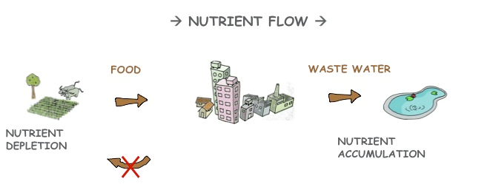
Testing for Nutrients Activity Using the materials below, gather a soil sample from any garden bed/ or ground/ or chicken coop. Using a 1:1 ration of soil to water test the sample for available nitrogen in the soil. P. 37 NB
Using the PASCO equipment:
Nitrogen Ampule
Colorimeter
Air Link
Chrome Book

