Slide 1
Farm to Fork
Our Carbon Footprint
Resource Management Week 11

Slide 2
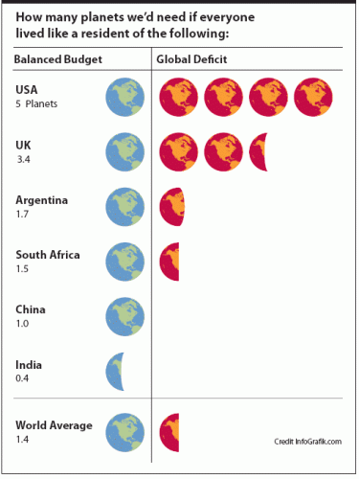
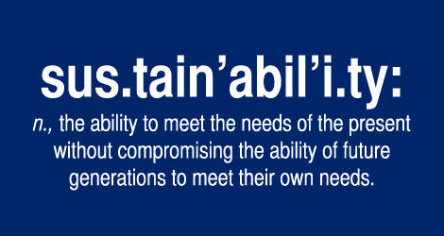
10/23 How many more Earths? Obj. TSW learn about how we need to conserve our resources now to have resources for future generations. P. 14 NB
How close was your prediction as to the number of Earth’s you thought you would use?
What ways can you be more conservative in your day to day life?
What are chapters 6 & 7 about in Omnivores Dilemma?

Slide 3
Page 13NB

Slide 5
Garden
I’m taking roll when I get out there. If you are not there, I will call for a campus aide to find you, escort you to the office. I will write a referral later.
Vocabulary list is due Wednesday.

Slide 6
10/26 Reflection Obj. TSW reflect on what they have done for the garden and what the garden can do for them. P. 16NB
What message do you want the School Board to take away from their visit to the Garden?
What are some of our areas of improvements?
What are we proud of?

Slide 7
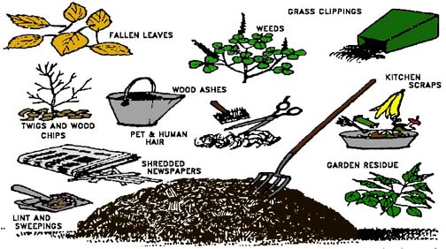
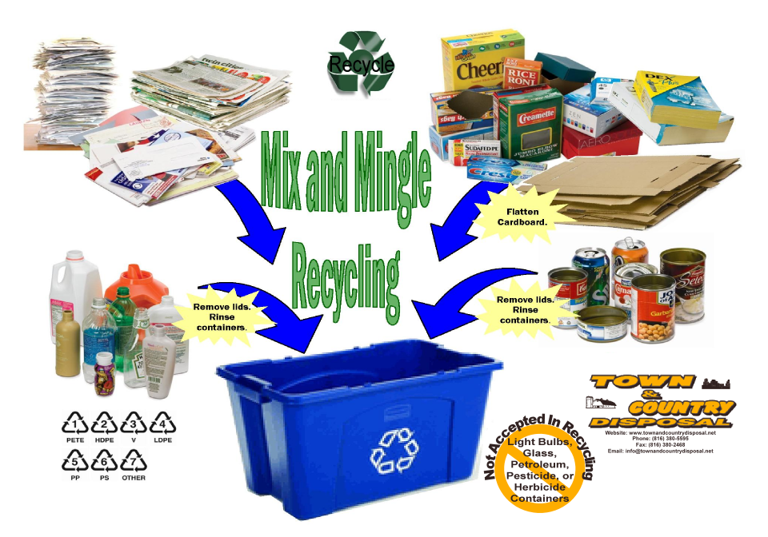
10/27 What if… Obj. TSW think about ways we produce products and how they become obsolete. P. 18NB
What is planned obsolescence?
How can we reduce, reuse & recycle products?
What if everything we produced could be biodigested, composted or recycled at the end of it’s life?

Slide 8
Activity: As a Class Brainstorm Major Pollution Situations in the World p. 15 NB
Pacific Garbage Patch

Slide 9
Tuesday: Computer Lab Activity: P. 17 NB
Individual Research on a Pollution Situation in the World:
Where, What, How does it impact our available resources?
How does it impact our growing food to feed families?
Don’t forget to do your vocabulary!!!

Slide 10
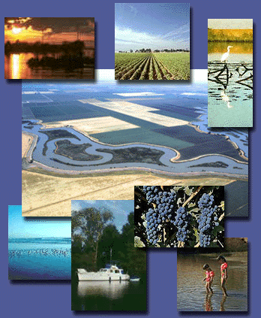
10/28 Land as a Resource Obj. TSW learn about organizations that protect our land. P. 20 NB
What benefits does land (Parks, Nature Reserves) provide for us?
What organizations manage our land?
What would you do differently?

Slide 11
Rangelands Trust
http://www.rangelandtrust.org/
Watch Video on Rangeland Trust
Randy Gustuvus - Director

Slide 12
Notebook Check Tuesday 10/27 P. 8 – 15 40 points
Date | Title/ Topic | Page #
10/19 | WU – Our Carbon Footprint: Resource Management | 8
10/23 | Vocabulary List – Our Carbon Footprint | 9
10/20 | WU – Our Carbon Footprint | 10
10/20 | Video - GATTACA | 11
10/22 | WU – Our Carbon Footprint | 12
10/22 | Activity: # of Earth’s | 13
10/23 | WU – How many more Earth’s? | 14
10/26 | Brainstorm – Major Pollution Situation World Wide | 15 Notebook Check p. 8 – 15 40 points

Slide 13
Name those Plants! P. 19 NB
Strawberry’s
?

Slide 14
Land is a Resource How is it managed? P.21 NB
Research Bureau of Land Management
National Park Service
Fish and Game
National Forest Service
Choose one of these 4 Organizations and explain it’s history. Why it was created, its purpose, how they educate the public about their purpose? Name 3 interesting facts.
Be prepared to share out.

Slide 15
10/29 Harvest Festival & Open House Obj. TSW create ideas for the Harvest Festival November 10th at 5:30 at Bryte Campus. P. 22NB
Our Goal with F2F is to educate others about the benefits of eating locally, produce food for the RCHS cafeteria and the Bryte Campus. Create ideas for a vender booth- How can we make $?
Create ideas for an informational booth that is fun for all ages.

Slide 16
10/30 Omnivore’s Dilemma Obj. TSW learn how corn is processed into other food. P. 24NB
CH 6: What does it mean to process corn?
CH 6: What products are made from processed corn?
CH 7: Childhood Obesity is on the rise, what is Michael Pollan’s explanation for our epidemic?

Slide 17
Processed Corn Products 10% of US corn p. 68 – 69 Omnivore’s Dilemma
Sweetener for soft drinks
Starch for hamburger bun
Corn oil, used for cooking or salad oil
Margarine – hydrogenated trans fats
Mill starch make animal feed
Cornstarch is made
High Fructose Corn Syrup discovered by Japanese chemists
Maltodextrin – used to make pudding & gravy
Fermented starch can be used to make plastic

Slide 18
Wet Mill – industrial digestive system
Corn is broken down into different parts.
25 major wet mills in the US
Cargill and Archer Daniel Midland own the majority of them
At the mills the corn is grinded , soaked in acid & reduced to sugars

Slide 19
$ Breakfast Cereal & Fast Food $
General Mills – a box od cereal contains 4 cents worth of corn, but sells for $4.
McDonalds make $ by selling a “Chicken Nugget” not a recognizable piece of chicken because it is processed.
“ There’s money to be made in food, unless you’re trying to grow it.” George Naylor
For every $1 the consumer spends on eggs, the farmer earns 40 cents.
For every $1 the consumer spends on HFCS in Soft drinks, or cereal, the farmer only earns 4 cents.

