Slide 1
Testing Nutrients and Abiotic Factors
Farm to Fork 2 Week 3

Slide 2
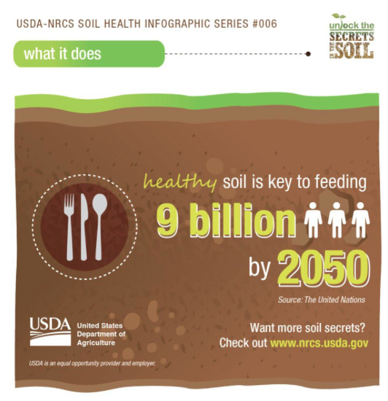
2/2 Keeping Soil Healthy Obj. TSW watch a Journey 2050 video on nutrients and impacts on the productivity of the soil if they are not replaced. P. 24 NB
How do nutrients in the soil help grow food?
What is the impact on humans when the nutrients are not replace in the soil?
What are some natural ways nutrients can be replaced in the soil?
Guest Speaker today
Turn in FT Forms ASAP

Slide 3
Journey 2050 Nutrient Video Class Discussion P. 25 NB
What % more food will we need to grow to feed 2 Billion (2,000,000,000) more people by 2050?
We know nitrogen helps plants grow tall and green, but how does Nitrogen help us?
We know that phosphorus helps plant roots grow, but how does Phosphorus help us?
We know that potassium helps protect plants from disease, but how does Potassium help us?
What happens to people when they don’t get the nourishment they need?
How many nutrients do plants require?
Why is soil not just dirt?
Why is soil like a bank?
By plants taking key nutrient through their roots, what key processes are they performing?
What are some of the symptoms of nutrient deficient plants?
What three factors have to be considered when trying to achieve our goals for Sustainability? (Triple Bottom Line)
When nutrients are not used an applied properly, they can be lost to the environment, what damaging effects can this have on the environment?
What are two ways we can prevent nutrient loss to the environment?
To achieve sustainability what has to be achieved?

Slide 4
Activity: Gather Data on Soil Degradation Page 19 NB
Write down how many of your seeds germinated in your healthy soil.
Write down how many of your seeds germinated in your degraded soil.
What trends do you see between the two groups?
What do you attribute the difference to?
Was this what you were expecting?

Slide 5
Computer Lab Room 801 Tomorrow! Wednesday Feb. 3rd.
Sorry about Monday☹ Family illness…..
We will work on your trifolds, Hopefully I will have some to show the 8th graders for recruitment night Tonight! Wednesday and Thursday.
I need to grade your notebooks. P. 8 – 21
Work on your new vocabulary sheet #2. Page 27 NB

Slide 6
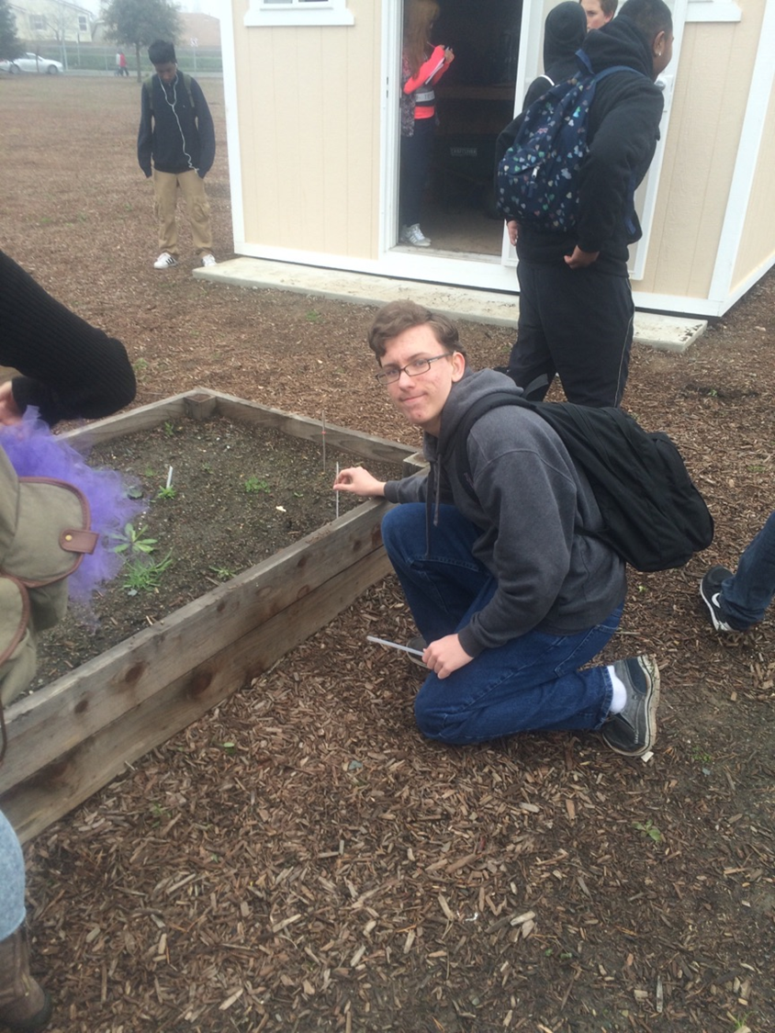
2/3 Measuring abiotic factors in the soil Obj. TSW learn healthy parameters for soil to grow healthy food. P. 26 NB
Last week, out at the garden, What was the temperature of the soil on the surface? What was it 5 cm deep? What was it at 10cm deep? 15 cm?
Did it change temperatures with the depth?
Do the Math: C x 9/5 + 32 = F
Convert each of your data points from Celcius into Fehrenheit.

Slide 7
Extra Credit Opportunity!!!
Come be a spokes person for Farm to Fork, or at least show up and smile☺
Yes! you will get 10 extra credit points. If you don’t already have them from BTSN.
Send McAllister any pictures you have of yourself in the garden to help with recruitment for the 2016 – 2017 school year.
2016 – 2017 Ag Biology, Farm to Fork 1 & 2 Recruitment is:
Wednesday Feb. 3rd and Thursday Feb. 4th at 6 pm in the RCHS Cafeteria.

Slide 8
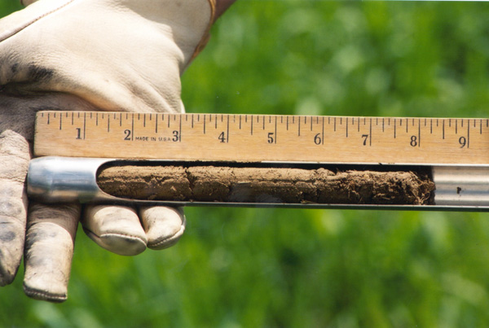
2/4 Testing the soil for nutrients Obj. TSW learn how to test the soil for Nitrogen, Phosphorus and Potassium, and pH. P. 28 NB
What is N-P-K?
Why are they important?
Where and Why should be measure for them in the soil?

Slide 9
Garden! Thursday & Friday
Make sure you gather your data on soil temperature, write it in your notebook, page 21.
Measure the pH of the soil, How should we number the garden beds? Stakes with #'s, paint it on the garden bed?
Take pictures of your selves in the garden to add to your Farm to Fork Brochure for Recruitment night.
Harvest garden vegetables for recruitment & Rosie.
Measure the Nitrogen, Phosphorus and Potassium of a garden bed.

Slide 10
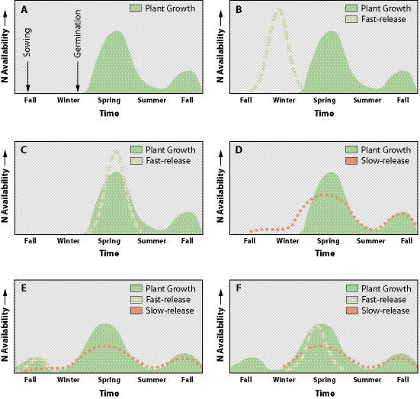
2/5 Apply the Nutrients Obj. TSW learn how to apply the right amount of the right nutrient in the right place at the right time. P. 30 NB
What beds were tested? What were the results? Nutrients tested?
When should we apply the nutrients if they are deficient?
After analyzing your data from your Soil degradation lab, what nutrient do you think you need to add, if any?

Slide 11
Why is the pH of soil important?
Alkaline = Basic (High pH)
Examples:
Bleach
Drain Cleaner
Ammonia
Ocean water
Acid = Acidic (Low pH)
Examples:
Lemon Juice
Pine Needles

Slide 12
pH and Nutrient Relationship
What can the pH of the soil tell you about nutrient absorption?
What is the optimum pH range?
Make sure to write in your NB Page 29 what the pH is and if it is within our acceptable range.

