Slide 1
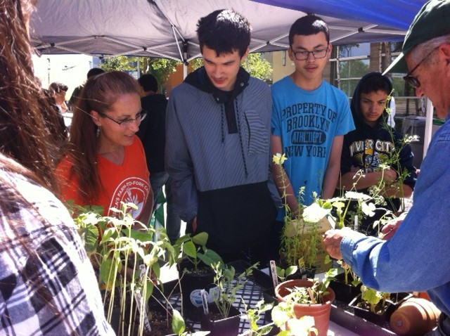
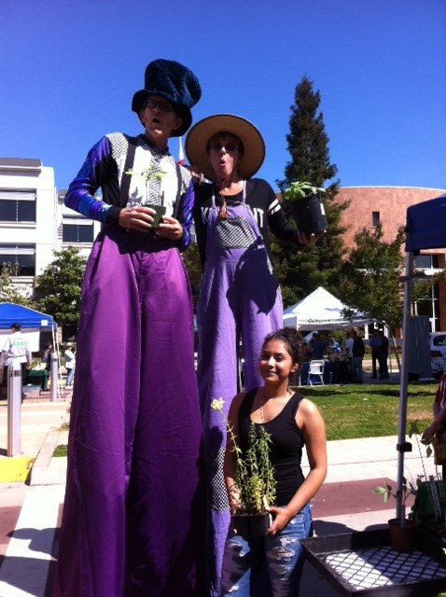
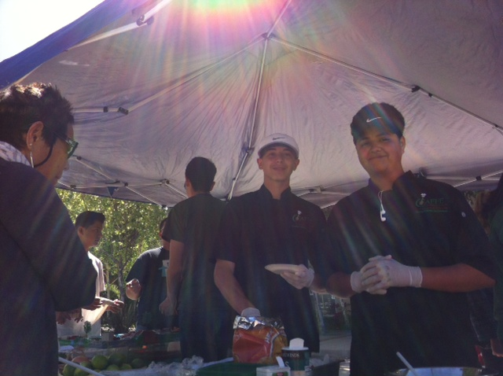
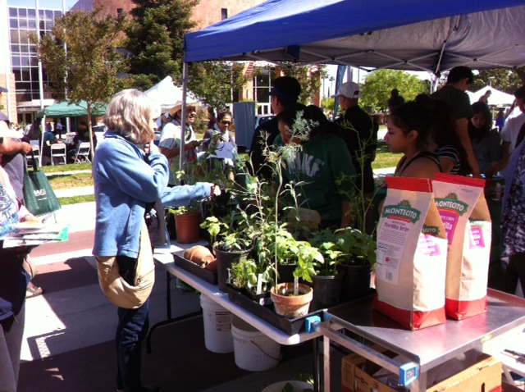
Resources in the Community
UNIT 4 Career Explorations & Guidance

Slide 2
4/25 Farm to Fork Obj. TSW apply concepts learned in class to community events/support. P. 48 NB
Explain the Farm to Fork movement in your own words.
Explain what makes the Farm to Fork movement sustainable in the Sacramento area.
How is our garden using conservation methods that promote sustainability?

Slide 3
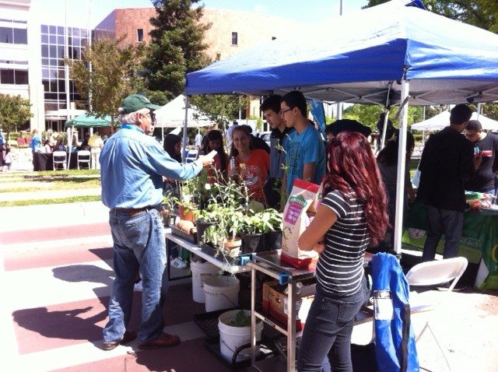
Selling our plants and making money at Earth Day – City Hall 2016

Slide 4
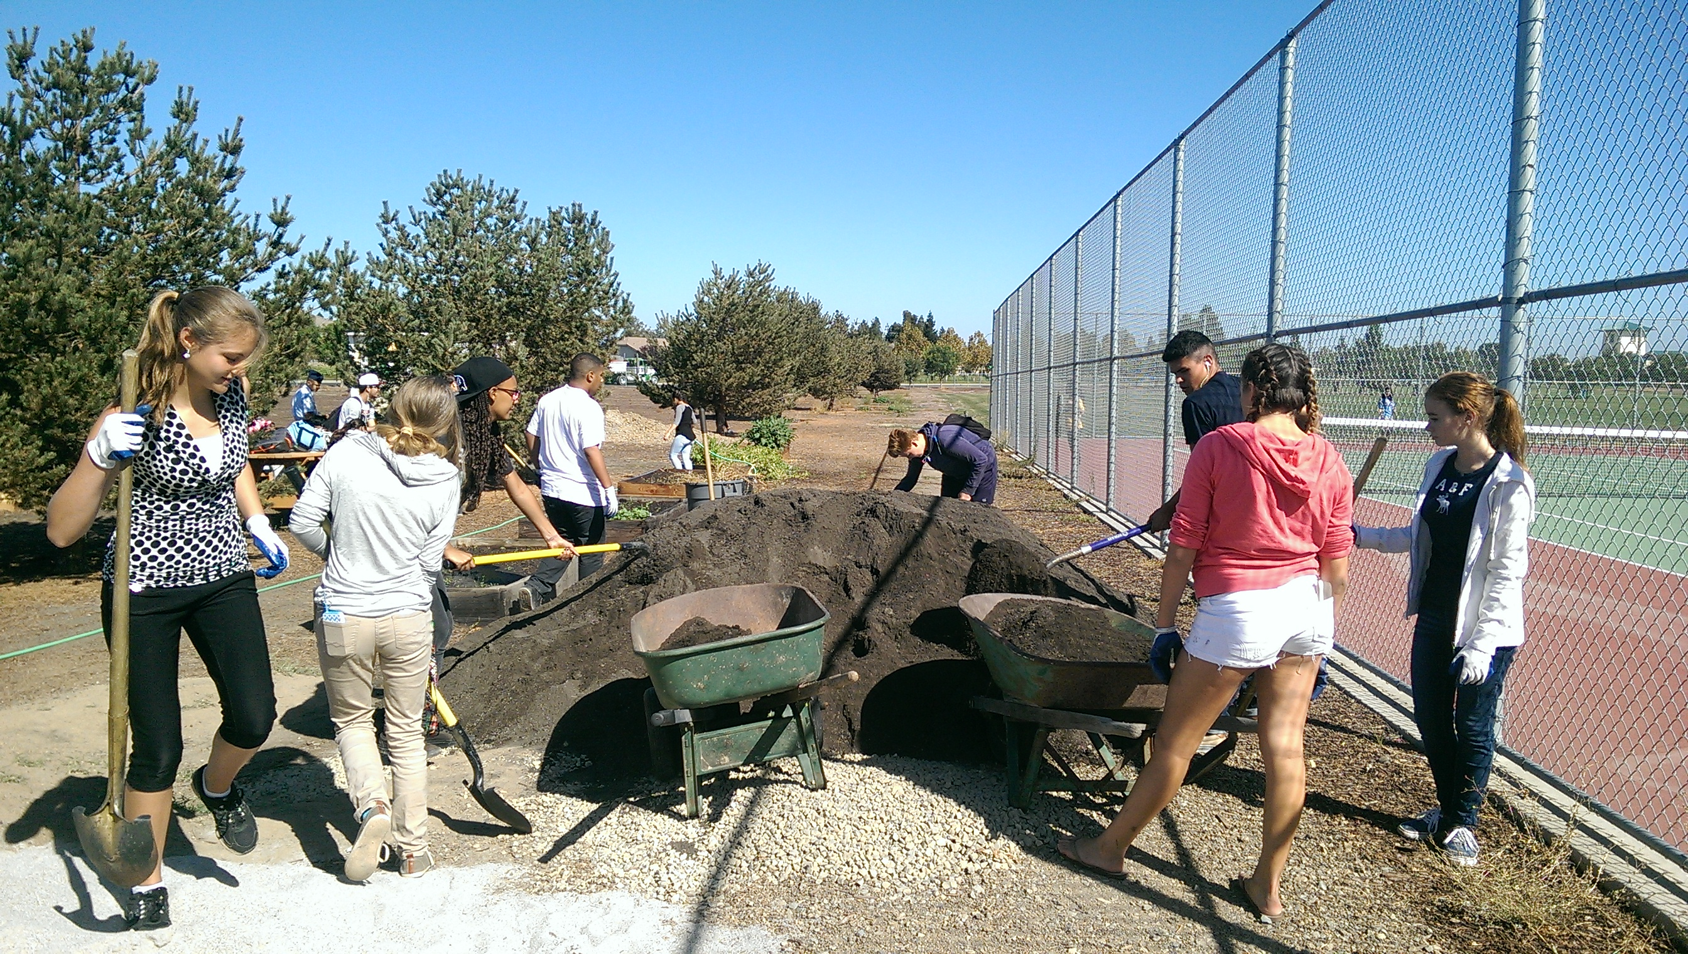
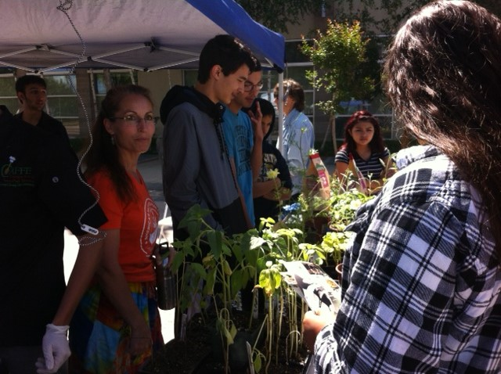
Service Learning Opportunities
Tuesday April 26th RCHS Showcase night 4pm – 8 pm Sell plants, Educate the public about Farm to Fork.
Thursday April 28th Greenhouse & Environmental Club. 3:30 – 5:30
Saturday April 30th, Build a Garden Day at Bryte CCT on Todhunter
8 am – 2 pm, Build Garden Beds, Move Soil.
Biodigestion – Everyday after school collecting Food waste 20 minutes.

Slide 5
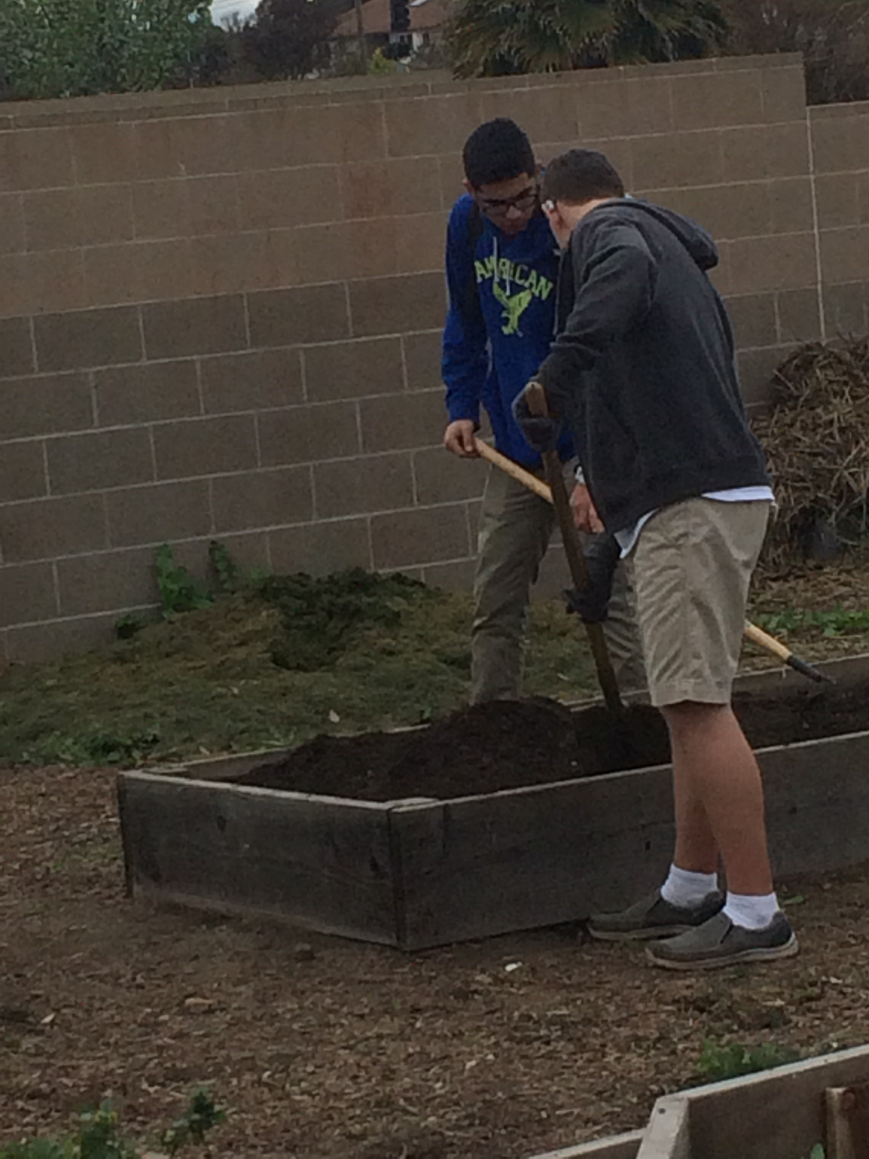
Garden Planning Sheet P. 45 NB
Students: Who are you going to work with?
Project: Transplanting, Turning Compost, Moving Soil, Watering, Weeding, Seed planting
Expected Results: Greenhouse will be weeded, Shed will be Organized, Hose will be wrapped up, A new Compost pile will be Created & Turned
Approximate Work Time: 45 minutes

Slide 6
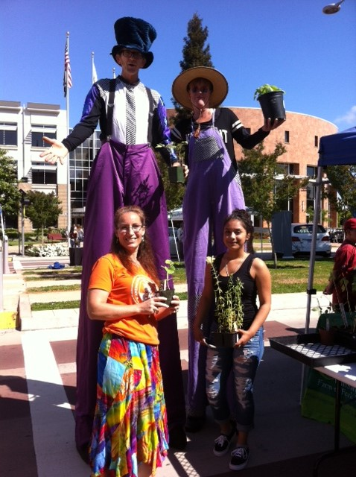
Fill out the Garden Planning Sheet P. 45 NB
1. Add your project name
Write your work description in steps
How & who are responsible for cleaning up?
Write the equipment for each Project.

Slide 7
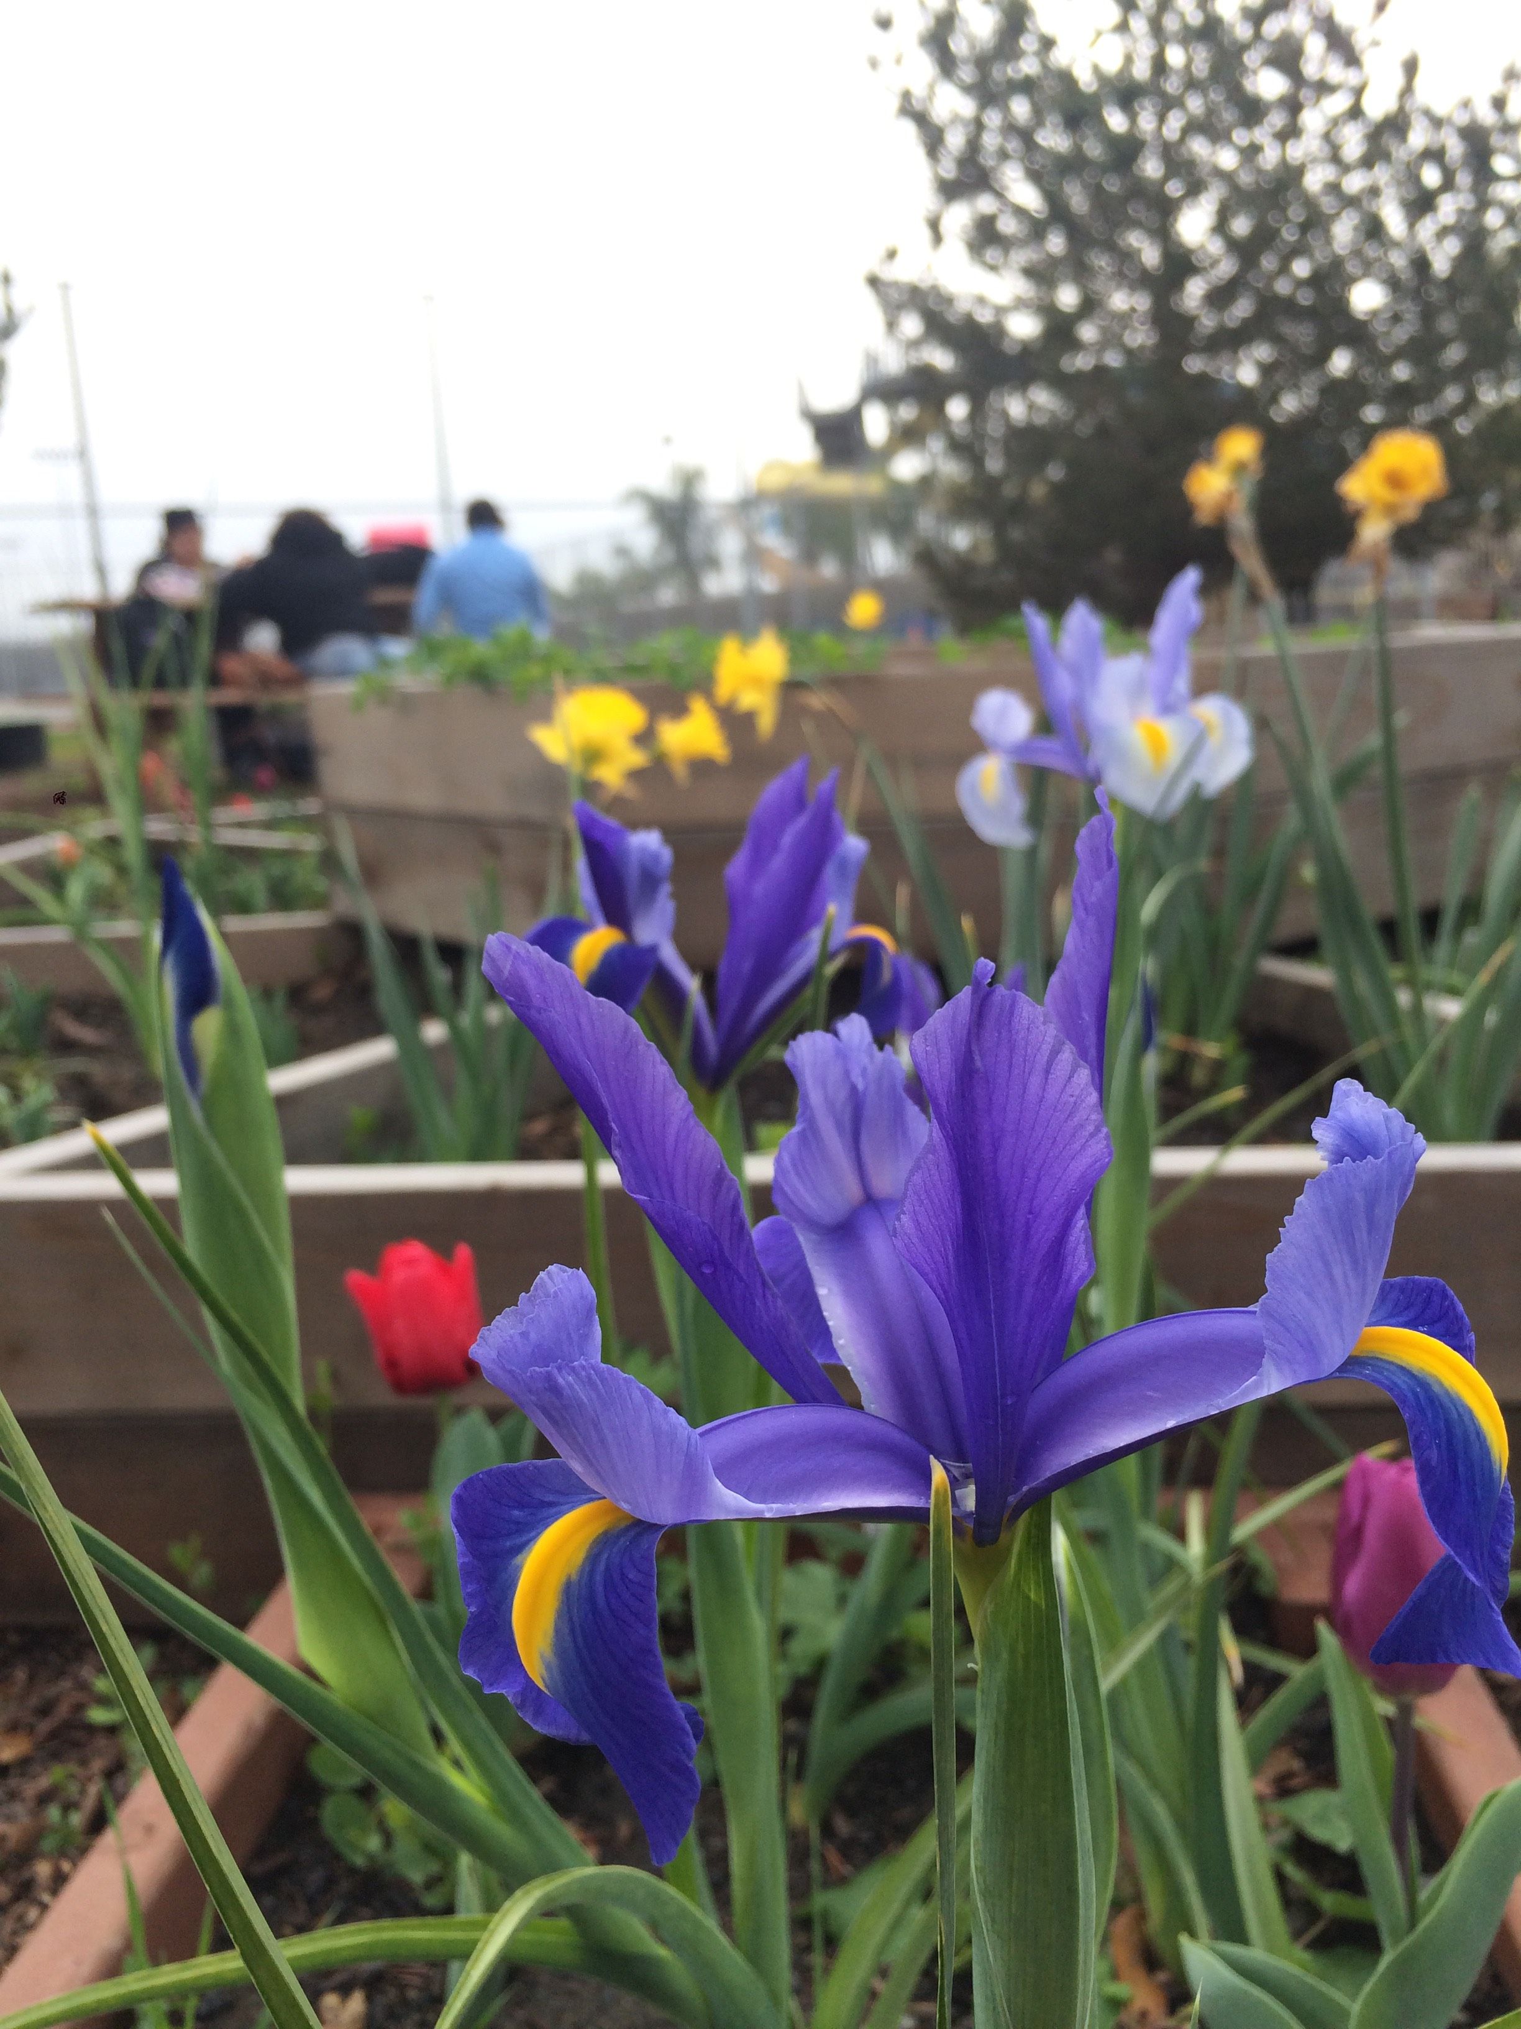
4/26 Sourcing Healthy Food Obj. TSW learn what goes into planning and feeding thousands of youth daily in Washington Unified School District and how it is becoming more sustainable. P. 50 NB
What sustainable concepts, practices do we have on campus already?
What healthy food would you like to see in our cafeteria.
How can we grow more food for our Cafeteria?

Slide 8
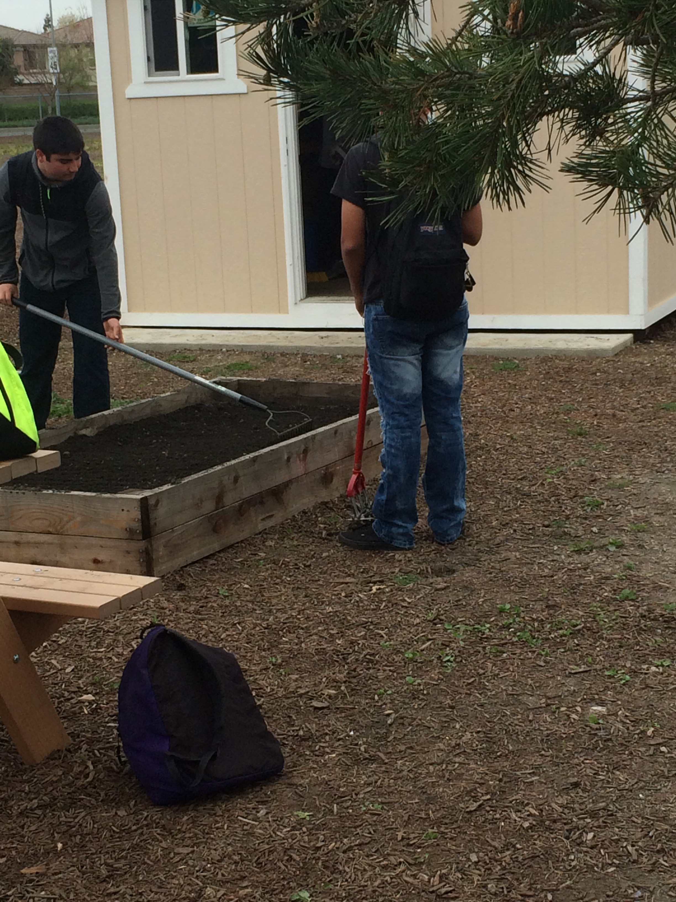
Tuesday April 26th Guest Speaker – Karri Pina p. 43 NB
Sourcing Local Farms to feed RCHS students
Take notes in your Notebook, page 43
This will be included in your 1 – 2 page paper.
Where does healthy food come from?

Slide 9
Fertilizing the Garden Beds & the Greenhouse

Slide 10
Caring for and Planning our Garden Beds

Slide 11
Our hard work pays off

Slide 12
Garlic and Carrots

Slide 13
Preparing more garden beds

Slide 14
Out at the Garden
River City
Farm to Fork

Slide 15
Draw this on p.37NB

Slide 16
Chemistry in Agriculture P. 39 NB
Find 3 interesting factoids about animals that can be included in your 1 -2 page paper. P. 39 NB

Slide 17
What other local businesses support the Farm to Fork movement? P. 41 NB
Research 3 businesses with in 100 miles that raise, grow, sell, buy, and distribute local produce and meat, including dairy cattle?
Explain what they do and how they do it.
Some of this information can be included in your 1 – 2 page paper.

Slide 18
4/27 Resources in the Community Obj. TSW remember all the people who have helped us throughout the year. P. 52 NB
Who has helped us in F2F this term?
What Career so you think you will go into?
What skill(s) will that career require?

Slide 19
4/28 Fed Up Video Obj. TSW make a connection between how our Food Services director sources healthy food from local farms and the Fed Up video showing the food industry pushing unhealthy types of food onto the shelves. P. 54 NB
What was the McGovern Report?
Why is Obesity a form of malnutrition?
What was the result of decreasing fat in food?

Slide 20
Omnivore’s Dilemma The secrets behind what we eat Michael Pollan p. 47 NB
Read the Introduction by Monday P.1 - 6
What is Monitor?
How are commercial Potatoes grown in Idaho?
Where does the meat come from for most fast food?

Slide 21
1 – 2 page paper Due May 5th Where does your food come from?
Where does your food come from?
Discuss where your family buys food. Discuss what Farm to Fork is and it’s benefits.
Why is it important to know where your food comes from?
Include examples, explanations, and the significance of where our food comes from.
Maybe include ingredients such as High Fructose Corn Syrup, salt, fat, sugar in our diet.
Include the difference between processed and natural foods. Why is that important?
Include companies, businesses that are part of the solution to eat healthier, and companies that are part of the problem. Or companies that are trying to change their image and how.
APA Style: purdue.owl.edu

Slide 22
www.cacareerzone.org p.49
Begin the Career Assessment
Write an occupation you are interested in.
One sentence describing the job in your own words
Describe the preparation required for that occupation
What is the range of salary?
What is that occupations outlook? Expanding, stagnant, decreasing?
What are the common College Majors?

Slide 23
www.cacareerzone.org P. 51NB
Read: “Things they need to be able to do”
Write one - three skill(s) or job description that you are good at.

Slide 24
Entry Level Research P. 53 NB
Find 3 Entry – Level employment opportunities from the Skills Profiler of California Career Zone
State your skill that will be an asset to that type of work.

