Slide 1
Farm to Fork
UNIT 4 Feed the World
Economics, Poverty, Population and Carrying Capacity, Genetically Modified Organisms

Slide 2
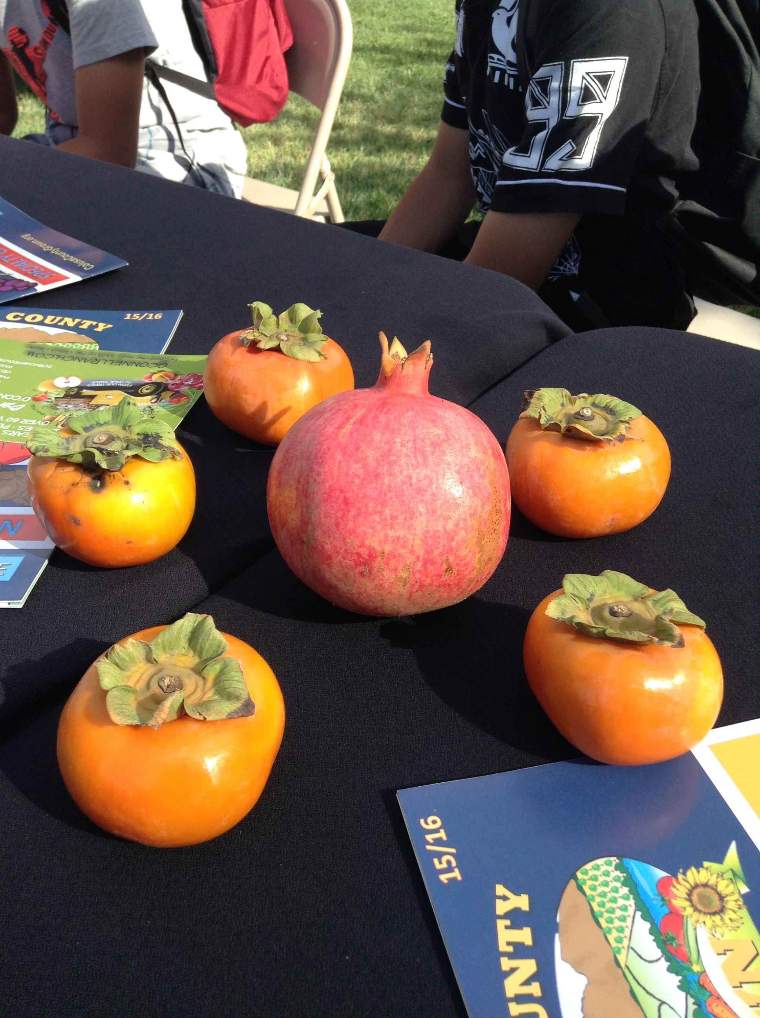
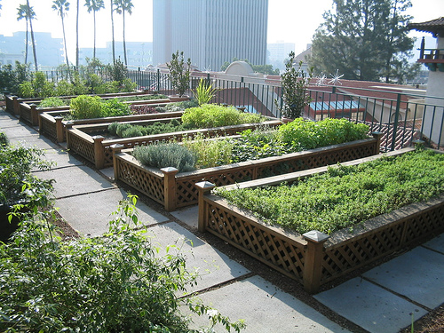
Urban and Rural Food Practices Obj. TSW learn about the different types of growing food to meet market demands. P. 42NB
Describe a Rural Farm, what are some of it’s attributes?
How is the Urban Farm different, yet beneficial?
Rooftop gardening is happening in densely urban cities, how is it beneficial?

Slide 3
School Grown Greenhouse

Slide 4
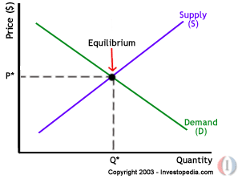
Supply & Demand Copy this Graph

Slide 5
If demand is constant, how does an increase in supply impact the price of the product?

Slide 6
If supply is constant, how does the increase in demand impact the price of a product?

Slide 7
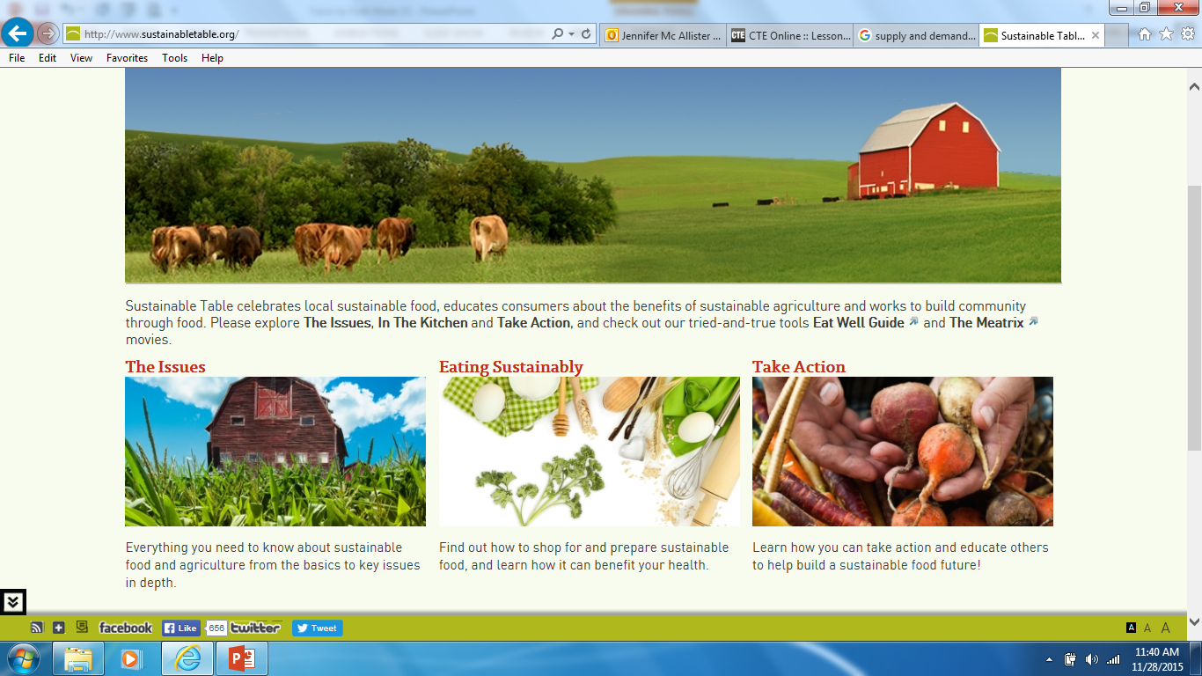
Eating Foods in Season Obj. TSW learn about the seasonality of food. P. 44 NB
http://www.sustainabletable.org/seasonalfoodguide/
What are five fresh food choices you love to eat?
What months are they in season?
In a typical grocery store, are those same foods available all year round? Why?

Slide 8
Recording your SAE
Log on to: http://www.theaet.com
Click Student
Enter Chapter #: CA0577
Username:
Password:
Profile Set Up:

Slide 9
The Future of Farming Obj. TSW learn about Sustainable Agriculture in America. P.46 NB
Describe farming in California, how is it different possibly from other states?.
Name 5 products (other than your favorite) we grow in California.
How might farming in California change in the next twenty years? Think of climate, technology, resources.
2012 Census of Agriculture

Slide 10
Vacaville Skating Center has confirmed our slot for 5:30-7:30 on December 9th.
FFA Sectional Team Building

Slide 11
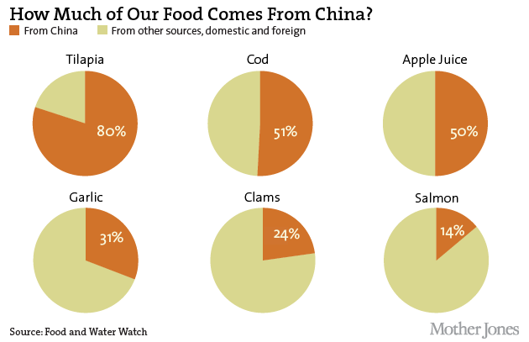
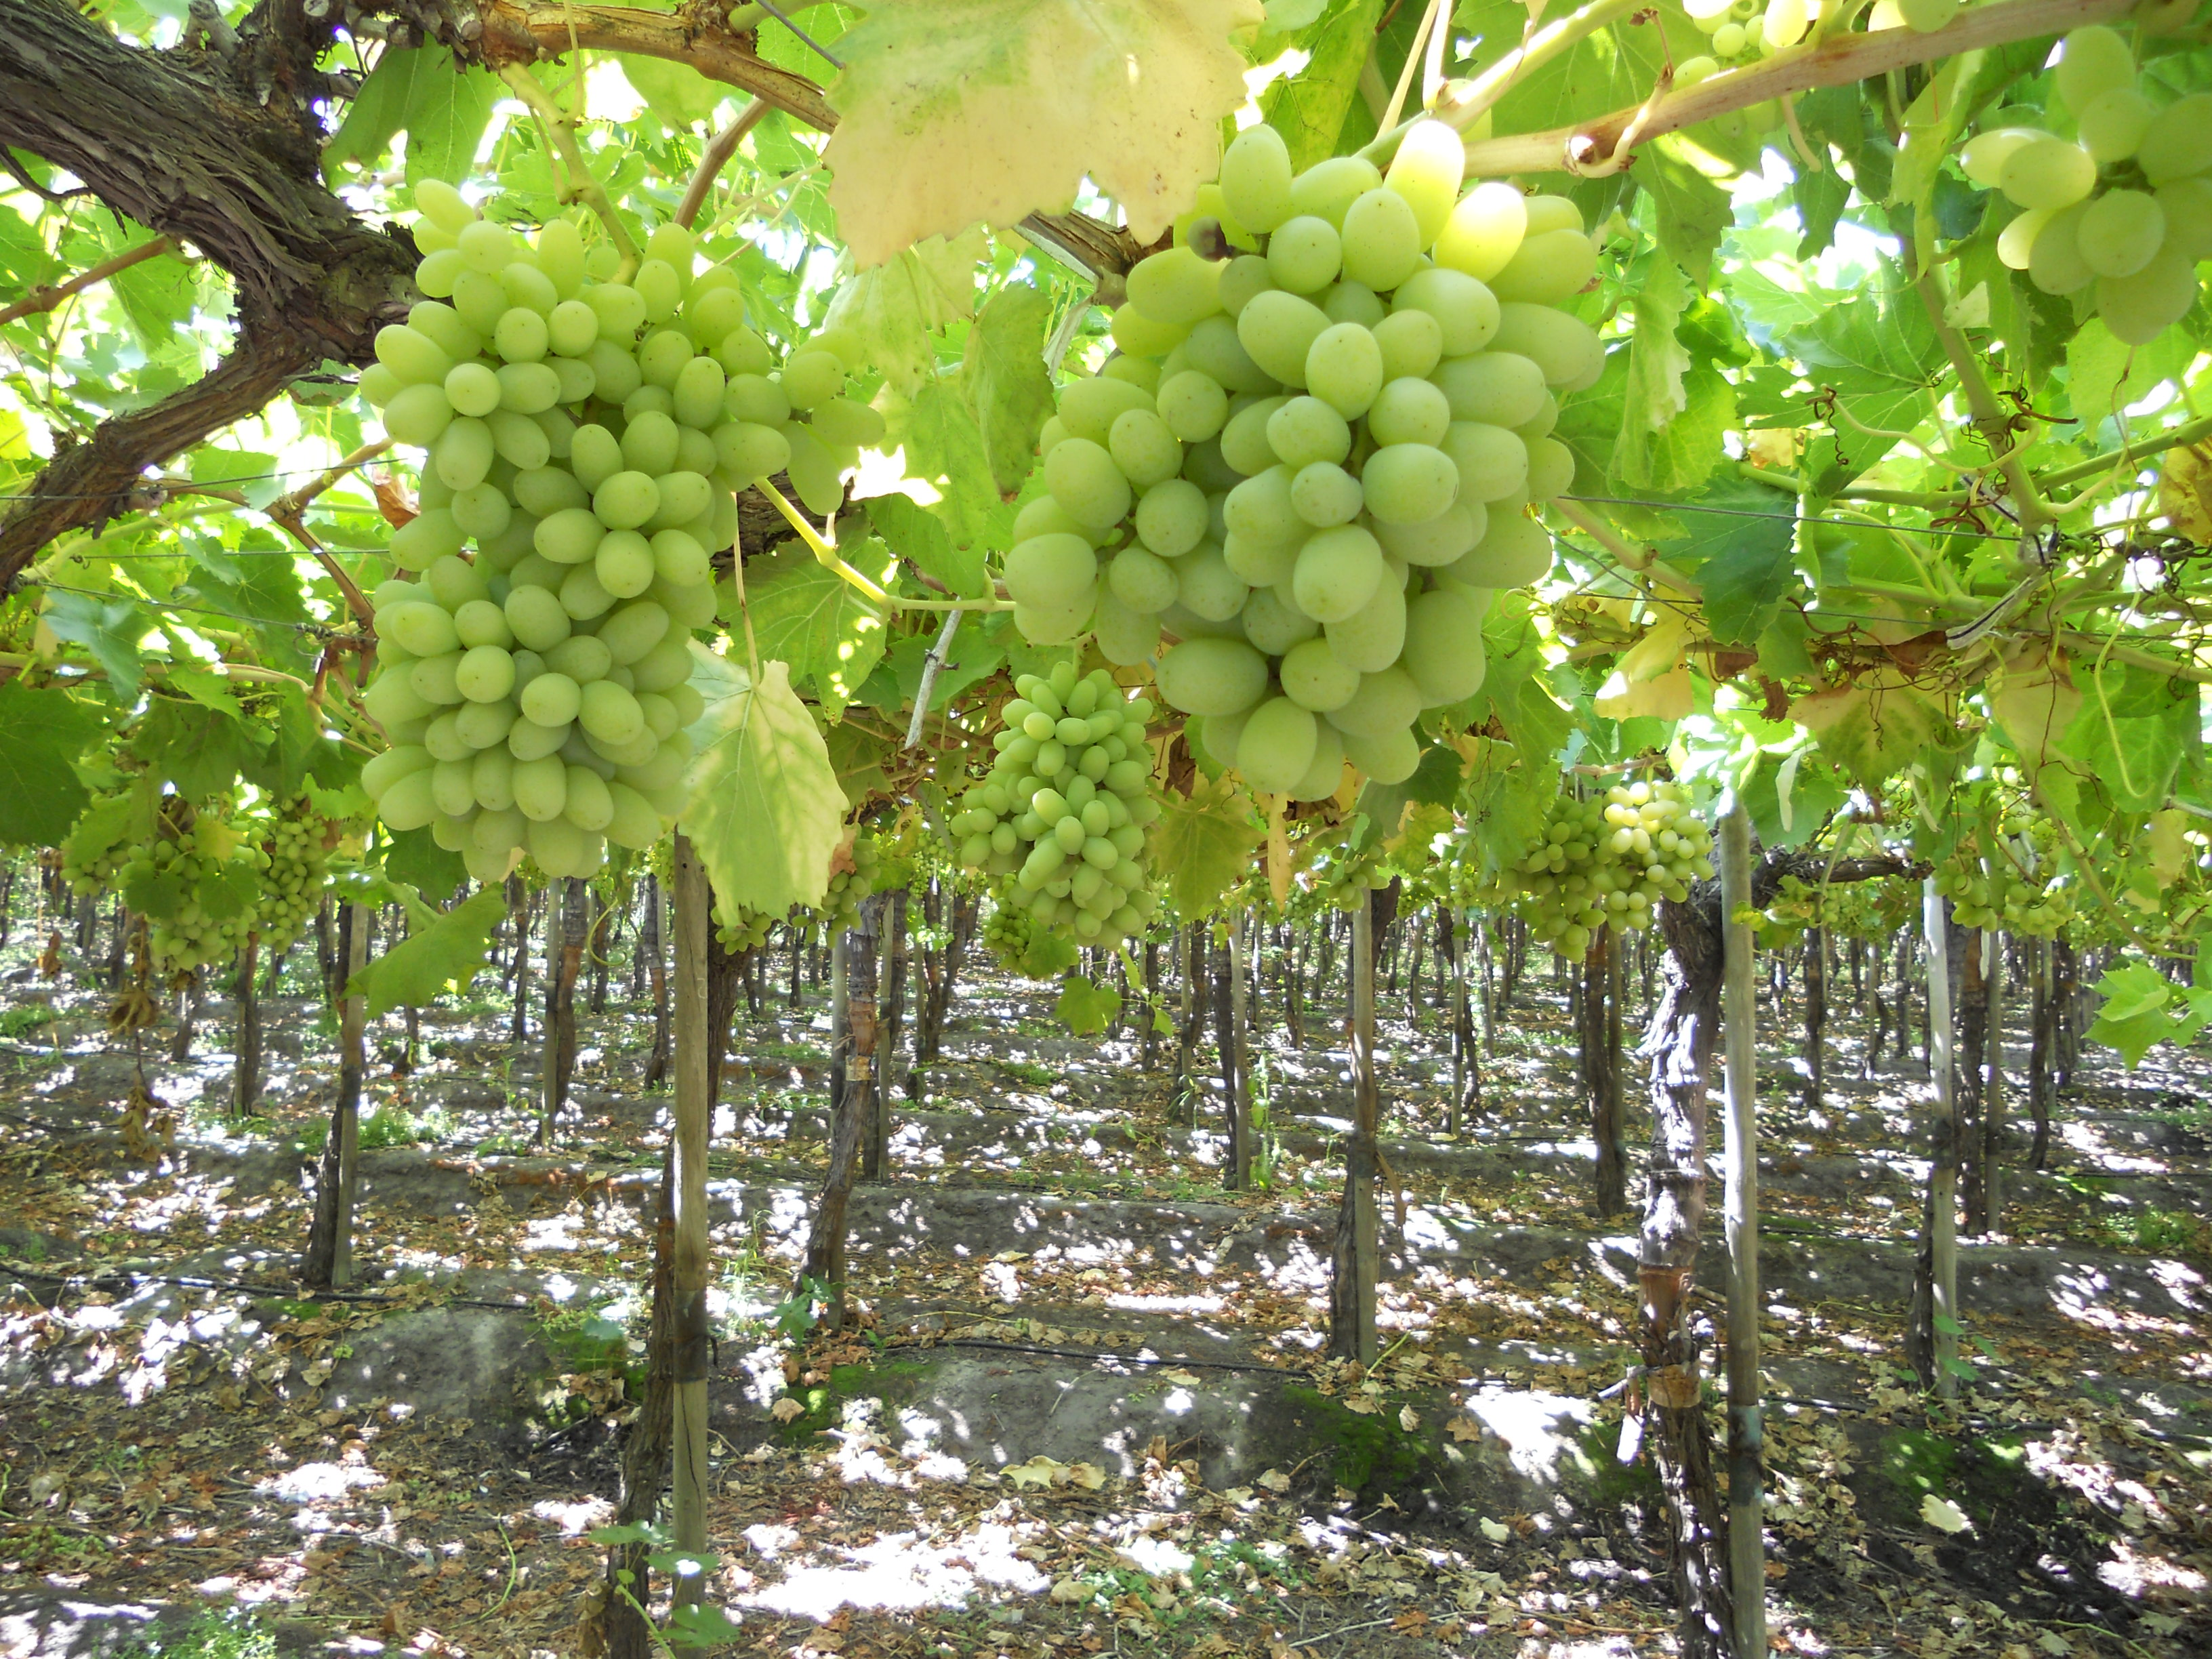
Economics of Food Obj. TSW understand why and how food is imported. P. 48 NB
Imported food
Name an imported food.
Where is it imported from?
How do agricultural imports impact our Biocapacity as a country?

Slide 12
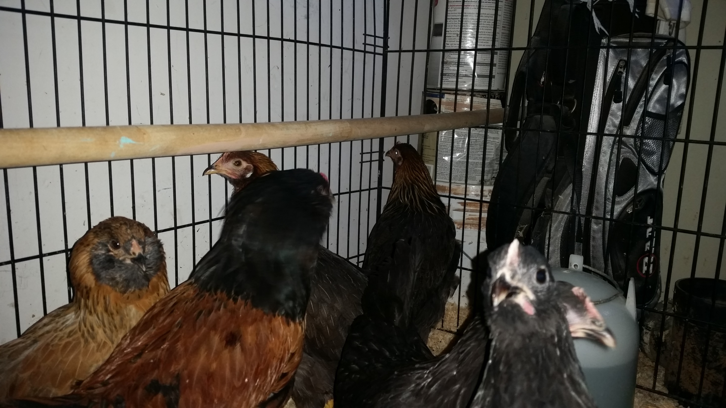

Slide 13
Out to Pasture –The Future of Farming p.45 NB
Students will take notes on the video & Answer the following questions:
What are confinement facilities?
What are some external costs to industrial agriculture?
Out of 8 billion animals raised in the US per year, how many are chickens?
What is the biggest problem with large poultry houses on the eastern shore?
How is Duane Cleckner’s farm different from an industrial farm?
How are smaller dairy farms different from industrial dairy farms?
Sustainable agriculture is really __________________agriculture.
How does the amount of sewage created by a hog compare to that of a human?
How is this sewage treated?
How are hogs treated on the small farm?
What is raised at Cane Creek Farm?
Would you be willing to pay more for food if it is grown sustainably? Why? Or Why not?

Slide 14
Computer Lab Activity
Research current videos about sustainable agriculture in the West, preferably California.
Take 5 Notes on West Coast Sustainable Agriculture.
Write a summary paragraph about the concepts from the video.
The best video will be viewed in class. Thursday?☺

Slide 15
Computer Lab Activity A grape from Chile p. 49 NB
Where in Chile is the Grape grown?
How is it transported from the field? Where does it go?
How does the grape get through customs?
How is it stored along the way?
How long does it take from the time it is picked to the time it can arrive on your table?
How do agricultural imports impact our Biocapacity as a country?

Slide 16
How much would you pay? Obj. TSW apply the basics of supply and demand at a local grocery store. P. 50 NB
As a Class, choose 5 total food/ drink items.
Come to a consensus as to the predicted cost and maximum price you would be willing to pay for each.
Do you always buy the cheapest product? Why?

Slide 17
Greenhand Test
Jacob, Miguel, Quincy look at the test and figure out which questions you got wrong and why.
Students get into one of the 3 groups of Jacob, Miguel and Quincy.
Get a Official FFA Manual
Page 47 Notebook – Write down the questions you got wrong, find the answer in the FFA Manual, Write the answer in the Notebook. Discuss the correct answer with your team leader.
Then students can retake the test again.
Must earn a 20 or > to be Proficient to earn your Greenhand degree.

Slide 18
Sustainable Agriculture Video 25 minutes p. 47 NB
UC Davis Agricultural Sustainability Institute
Sustainable Family Farming
Agriculture, Resources and the Environment

Slide 19
Take a trip to the local grocery store. Find your original 5 food/ drink items. Answer the following questions…p. 51NB
Was the product you wanted the cheapest? If it was not, how much more expensive was it? Were you surprised by this?
Was there any product that was more money than you originally said you would not spend on it?
Using your individual bottle of water as an example, if you were to buy a case of water containing a 24 pack for $4.99, how much money would you save?
Why does it pay to buy in bulk? Is there a downside?
How does this relate to Supply and Demand?

Slide 20
Lesson 2: Poverty, not just a lack of Money
F2F1
UNIT 4
Global Food

Slide 21
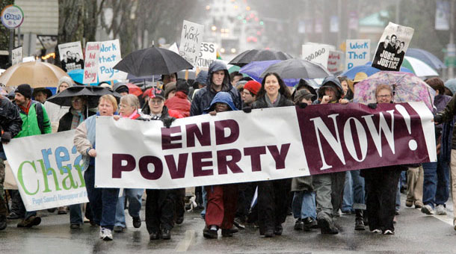
Poverty, Not Just a lack of $ Obj. TSW learn about poverty and why it still exists.
What is poverty?
What does poverty look like?
How are food insecurity and poverty related?

Slide 22
Feed the Need Obj. TSW research local, state-wide, country-wide, and international programs that work to feed people.
Off the top of your head, what are some organizations that feed people in poverty.
Would you volunteer at some of these organizations?
How can we be part of the feed the need?

Slide 23
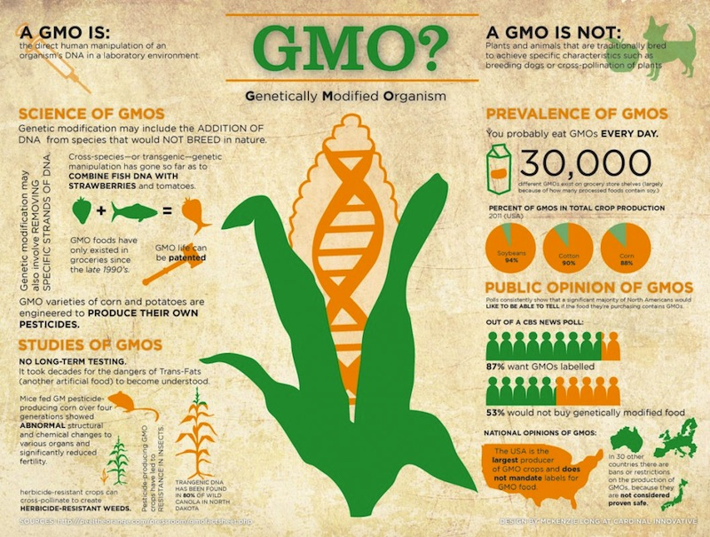
Genetically Modified Organisms Obj. TSW learn the pro’s and con’s of producing/ growing GMO’s by reading a articles about GMO’s.
What was your article about?
What are some concerns about GMO’s after reading this article?
What are some benefits about producing GMO?

Slide 24
Solutions to Feed the Need: GMO’s Obj. TSW research the pro’s and con’s of GMO’s as a solution to decrease poverty.
Look at the picture to the left. Compare the two types of tomatoes. Which one is GMO?
What examples of GMO do you know about?
Explain Genetically Modified Organisms in your own words.

Slide 25
GMO Video Obj. TSW watch a video about GMO’s and take notes about some benefits and concerns about Genetically Modified Organisms.
What does GMO stand for?
Before you watch the video, what do you think you know about GMO’s
What do you want to learn about GMO’s?

Slide 26
Who Controls the Food? Obj. TSW have a greater understanding of why countries import and export food.
What country has the most people?
What country has the least amount of food?
What country has the most food?

Slide 27
Activity: Who Controls the food?
You will be assigned a country/continent: Africa, Europe, America, South America, Asia,
Stand Next to your country.
Then the food (Small Carrots, Grapes) will be handed out in proportion to the amount of food that country has.
How did you feel about the amount of food your received?
Is it fair that North America has the majority of the food but not the majority of the people?
Write a ½ page reflection describing your feelings about this experience. For example, how did it feel to have minimal food when others had more than they needed?
What can be done to Feed the Need?

Slide 28
Lesson 3: Genetically Modified Organisms
F2F1 UNIT 4
Global Food

Slide 29
GMO Research Activity
Pro GMO
Find 6 Arguments for GMO’s Con GMO Find 6 Arguments against using GMO’s

Slide 30
Guest Speakers = GMO

Slide 31
Pro’s & Con’s GMO’s Obj. TSW create an argument for or against GMO’s.
From your research yesterday, write three arguments for GMO’s.
From your research yesterday, write three arguments against GMO’s.
What is your opinion about GMO’s. Support your opinion.

Slide 32
The Great GMO Debate Split the class in ½, facing each other. Present opening arguments, opinions and rebuttals.
Write a reflection about the GMO debate. State your claim and include evidence for support.
Evaluate what could have been improved for individuals, or group performance?

Slide 33
Lesson 4: Populations-People & Carrying Capacity
F2F1 UNIT 4
Global Food

Slide 34
Earth’s Carrying Capacity Obj. TSW learn how the increase in world population will have an impact on them.
Approximately how many people live in CA?
Approximately how many people live in the US?
Approximately how many people live on the Planet?

Slide 35
Earth’s Human Population Growth

Slide 36
Activity: Population Growth Analysis
Introduction of Reindeer to St. Matthews Island in Alaska.
Analyze the graph of the growth of Reindeer from the original 29 that were introduced to St. Matthew’s Island.
Answer the 5 Preview questions.
Answer the analysis questions in complete sentences.
Finally, is there any relevance between this example of overpopulation and the human population on the Planet? 2 – 3 sentence answer.

Slide 37
United Nations Integrating Population Issues into Sustainable Development
Students research the website:
Who are the United Nations?
What do they do?
How are they part of the solution for sustainable development?

Slide 38
Earth’s Carrying Capacity Obj. TSW understand that Biocapacity of countries and the carrying capacity of the planet are interlinked.
What are limiting factors in a Carrying Capacity graph?
What are some Density Dependent Factors?
What are some Density Independent Factors?

Slide 39
Sustainability Worldwide Obj. TSW apply and discuss why it is important for sustainable practices to be enforced worldwide.
Describe sustainability.
Describe 3 sustainable practices you have learned in this class.
What are the implications of increased population growth if sustainable practices are not enforced?

Slide 40
Online Article: Has Earth reached its Carrying Capacity?

Slide 41
Maxine Abrulo – Coit Tower
Answer questions from the WS.

Slide 42
Summative Assessment
Students should answer the following questions after they have gathered all their research:
Which of your five foods did you find for sale in other circulars? Why do you think they were for sale in more than one place?
Which of your 5 foods were more expensive or less expensive? Why do you think that is?
Notice and write about any trends that developed at certain grocery stores. For example, was the Dollar Store always the cheapest? Why?
Finally, the class will have a discussion about the supply and demand of food in our grocery markets.
What drives the economy of food?
Students will write a reflective 1 page paper summarizing all the activities from this key assignment, tying in the biocapacity of countries, the imports of food from other countries, and changes they may make in their lifestyle as a result.

Slide 43
Sustainability

Slide 44
January 4th From the Soil Obj. TSW gain a better perspective of the importance of healthy soil. P. 80 NB
What are the components of healthy soil?
Why is Farm to Fork important?
Explain what you have learned about growing healthy food for RCHS students and Culinary?

Slide 45
Second Barcode
Take 3 – 4 Notes in the 2 minute video.
After watching the short video clip, what are your thoughts?
How realistic is a second barcode?

Slide 46
Activity: The Story of Food nourish.org
Objective: Students examine food labels and conduct research to trace food paths from the original plant or animal source. They then make posters describing the story of a particular food.
Question: How does the way food is raised, processed, transported, and eaten impact both people and the environment?
Read the background information.

Slide 47
11/5 Bayer Crop Science Obj. TSW learn about local companies that play a role in our Agricultural success. p.82 NB
What association do you have with Bayer?
Why would a Pharmaceutical company get involved with Crops and growing Food?
How does what you have learned about Bayer Crop Science under score the importance to growing healthy food worldwide?

Slide 48
Final Presentation –PPT
Farm to Fork Project PART 2 DUE McAllister needs to review your progress of your project before January 8TH.
PPT Individual: 10 – 15 Slides PPT Two students: 15 – 20 Slides
Introduction: Briefly review your project for us.
Data
Qualitative Data: Words, Descriptions, Pictures, Video
Quantitative Data: Tables, Charts, Graphs
Data Analysis
What does the data mean?
What were some things that you learned from mistakes you made?
What would you do differently next time?
Conclusion
Explain what your project meant to you and how the class Farm 2 Fork has helped you gain a better understanding of your project/ gardening caring for plants/& or soil . If you were in charge of feeding the world, or creating more sustainable practices worldwide how you would go about it?
Works Cited Title. Author. Website link.
Yolo Farm to Fork. By Dorthy Peterson. Dir. Dominic Machi. Perf. Beth Harrison. Yolo Farm To Fork. Yolo Farm to Fork.org, n.d. Web.

Slide 49
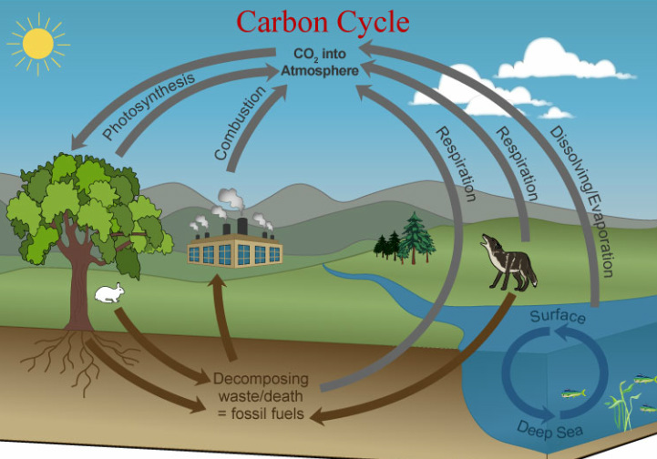
Carbon Cycle Review P. 84 NB Obj TSW review how important the carbon cycle is to us.
What is the Carbon Cycle?
How does CO2 cycle through the Biotic and abiotic factors?
List 6 processes of the Carbon cycle.

Slide 50
Greenhouses & Carbon Cycle Activity. p. 85NB
"What happens to the carbon dioxide you breathe out or the carbon dioxide released from a burning paper?”
How does the carbon cycle influence the greenhouse effect?
How do greenhouses utilize the greenhouse effect to promote plant growth?
How is greenhouse plant cultivation a sustainable practice?

Slide 51
Students will draw the carbon cycle. Labeling the 6 processes that take place: Photosynthesis, Cellular Respiration, Exchange, Sedimentation & Burial, Extraction and Combustion. Students will gain a better understanding of how carbon cycles between the atmosphere, geosphere, hydrosphere, and biosphere form their graphical simulation of the carbon cycle.

Slide 52
Bayer Crop Science P. 85 NB
Where is Bayer Crop Science in West Sac?
What does Bayer Crop Science do concerning agriculture?
Give 3 examples of how they are involved in agriculture.
How does it relate to Farm to Fork?

Slide 53
11/8 Food Inc. Obj. TSW make connections between how food is produced and why Farm to Fork is so important. 86 NB
What impression was left on you by the movie Food Inc.?
What did you learn from Food Inc. that changes how you think about food?
If you got to meet Micheal Pollan in person, what would you like to ask him?

Slide 54
11/12 Nourish.org Obj. TSW learn p. 88 NB
Name three things about the video that you learned.
How does Nourish relate to Food Inc. and to Farm to Fork?
How has Nourish changed your thinking about food? And what is healthy.

Slide 55
11/13 Understanding where our food comes from Obj. TSW explain three aspects of how this class has impacted themselves, or the school or the community. P. 90 NB
If someone were to ask you, “What was the Farm to Fork” class like? How would you describe what was taught in the class?

