Slide 1
Healthy Soil
Farm to Fork 1
Healthy soil
Week 3 August 29th – Sept 2nd

Slide 2

Science Notebook
Front Cover:
Name, (Ag)Biology, F2F Rm.3 Bryte McAllister, Fall Term, 2016
Table of Contents: page 1 - 7:
Date, Title, Page #
Page 8, 1st Warm – Up
Ag Biology - Agriculture
Biology – Levels of Organization

Slide 3
Healthy Soil
What does it take to create healthy soil?
Does it drain well? Can it hold onto nutrients that plants need? What temperature should it be? How does Compost help?

Slide 4
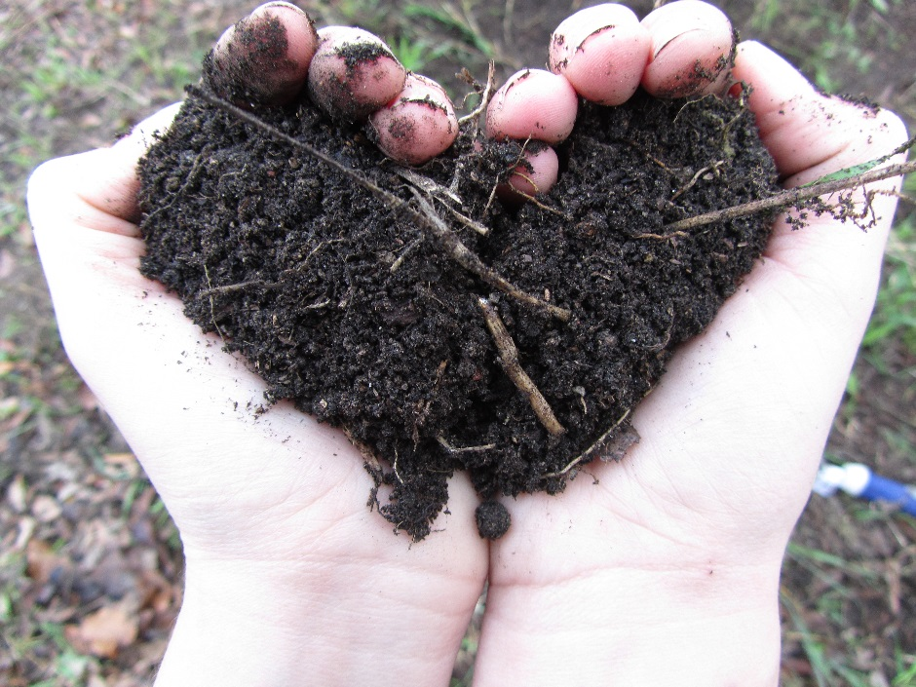
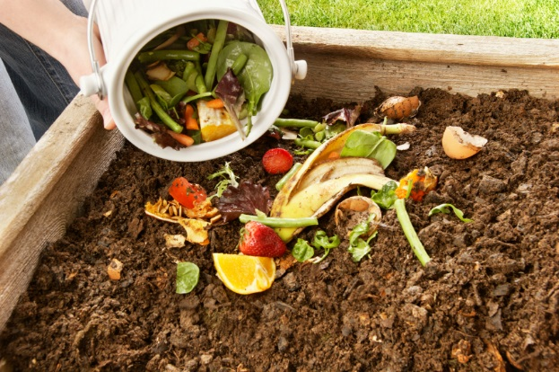
8/18 Compost
Obj. TSW examine the process of decomposition by adding compost to soil. P. 8NB
What is the difference between dirt and soil?
What is compost?
Why is it good for the garden?

Slide 5
Edible Plant Game
Have 1 or 2 partners.
Get 1 card to share among the 2 – 3 of you.
Someone starts by reading the description at the bottom.
Whoever’s description is on someone else’s card Identifies what it is: “ Carrot”
Then the “Carrot” reader reads the description on the bottom of their card, etc.

Slide 6
California Agriculture Quiz Answers
T
T
R
T
T
California $43 B, Iowa $29.9B, Texas $22.7 B
Milk & Cream, Almonds, Grapes, Cattle & Calves, Nursey Products, Strawberries, Hay, Lettuce, Walnuts, Tomatoes
78
81
312
420
43.5

Slide 7
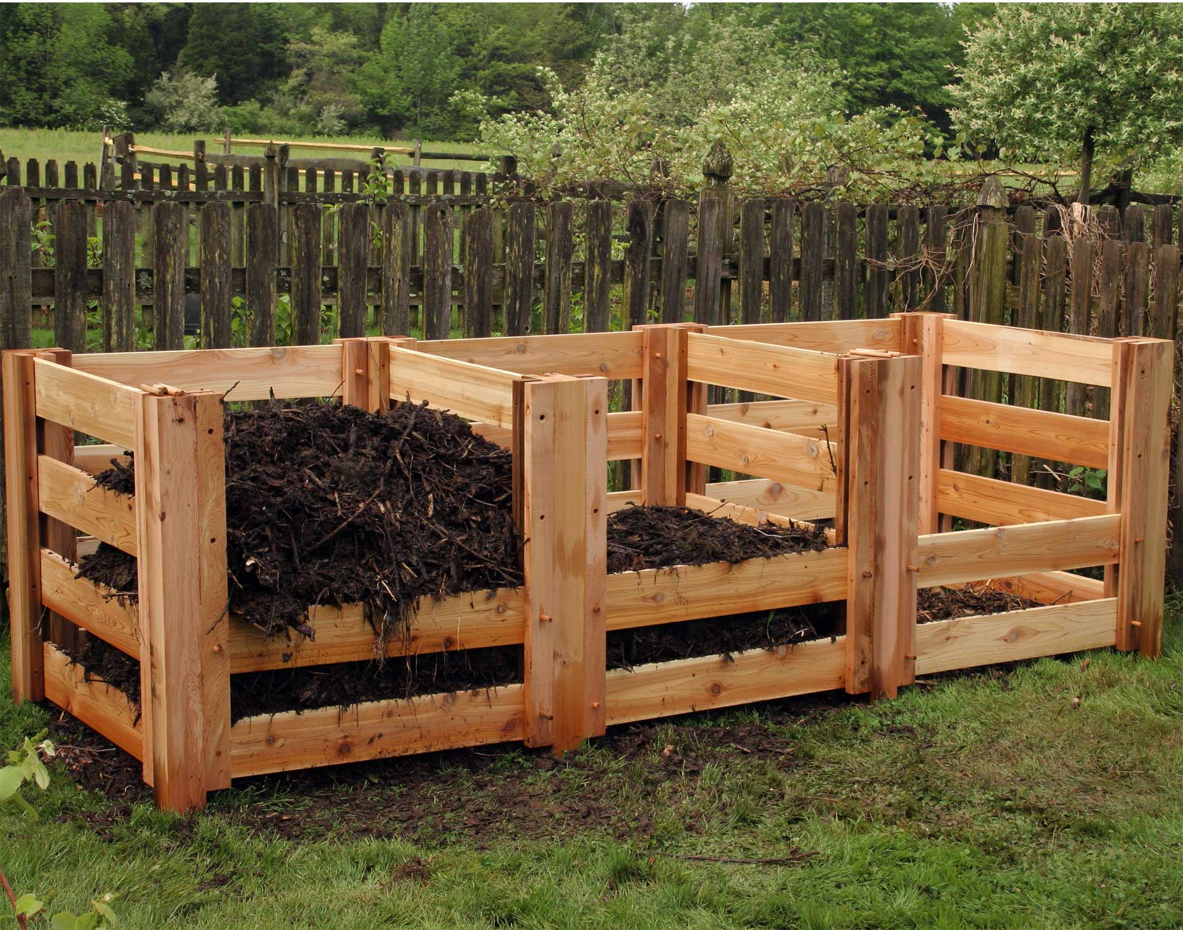
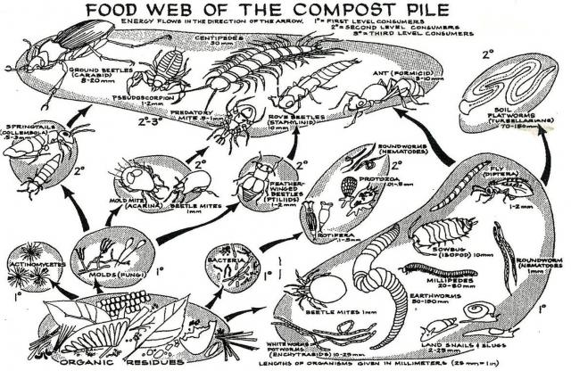
Compost
It happens in stages
It starts out layered
2/3 Brown, Dried Matter
1/3 Green, wet, fresh Matter
Add worms and water
Turn 1x, maybe 2x/ week.

Slide 8
Compost Notes p. 9NB
Compost – any plant material that can be broken down by microbes, insects, and worms.
Adds moisture, nutrients, and biodiversity to garden bed.
30% Green Nitrogen containing Compost
70% Brown Carbon containing Compost
Keep moist, turn regularly
Add red wiggler worms, worm castings are good for the soil
  More productive
  Aerate the soil
  Help breakdown organic matter into usable nutrients for plants

Slide 9
New Compost Pile
What can we add to our new compost pile?
What are the ingredients for healthy compost?

Slide 10
Worms
How do worms help the soil?
Aerate the soil
Provide a habitat for worms
Worms recycle nutrients from decomposed organic matter to the soil
Worm casting add fresh matter to the soil

Slide 11
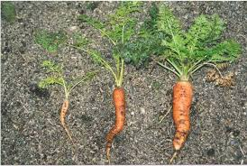
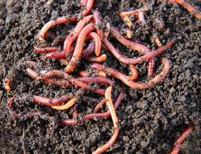
Worms help loosen the soil so plants can get at more nutrients and grow bigger

Slide 12
Watering
How do you know if you are watering enough?
Hand check – Use your finger
Water in the Morning – give plants a drink before temp. or wind increase
Watering with purpose – seedlings and transplants need more frequent watering, can be more shallow
  But more established plants need deep watering so roots can grow deep into the soil.
Adding Compost – increases the moisture content
Mulching – adding a top layer of rice hulls, dried grass clippings, straw
  Prevents evaporation from the surface layers of the soil

Slide 13
How to write an AXES Paragraph
Assertion – Statement or claim
eXample – Write an 1 – 3 examples of your statement/ claim
Explanation – How does your statement or claim or example happen?
Significance – Why is it important? Why do we care?

Slide 14
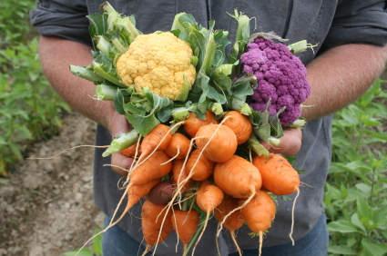
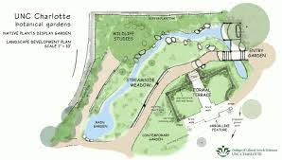
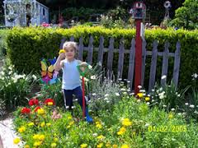
HW - AXES Paragraph F2F
Email to me: jmcallister@wusd.k12.ca.us
Using your knowledge of how to write AXES, write a paragraph about what F2F is, what it means to you and how it is a sustainable practice.

Slide 15
Yolo Tomato Production & Sustainability
Resource Management

Slide 16
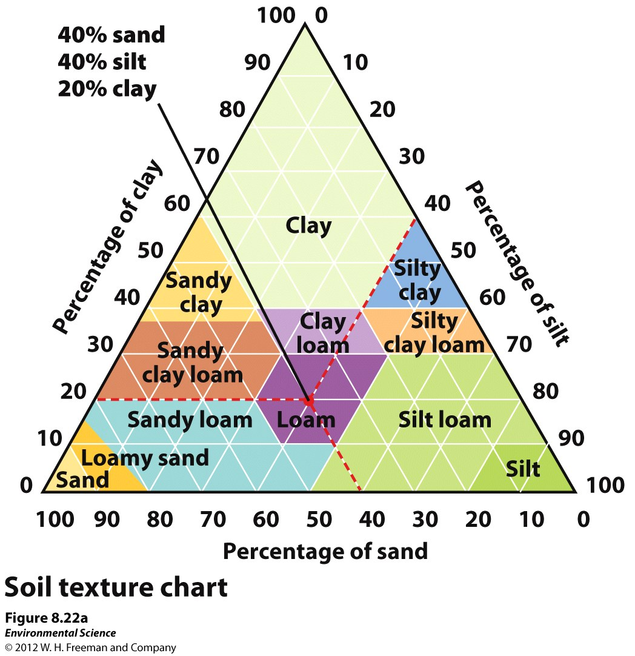
How to read a Soil Texture Chart
Your % must add up to 100%
Start with Clay on the left.
Read the % line horizontally.
Next, Read the % line for Silt.
Read the % Silt line diagonally down.
Last Read the % line for Sand up diagonally left.

Slide 17
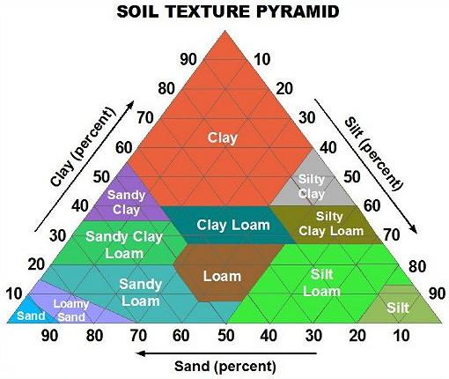
Ribbon Test
8/19 Obj. TSW identify different types of soils. P. 10 NB
Types of soil Video
Name the three soil textures.
2. Name three soil types.
3. What soil is 20% Clay
30% Silt, 50% Sand?

Slide 18
Ag in the Classroom
Notes from Video Ag in the Classroom- It’s all about you!
5 min. 30 sec.

Slide 19
Three Textures of Soil
Obj. TSW learn about sand, silt and clay to understand how nutrients are held.
What are the three textures of soil?
How properties might the three soil textures differ in? What would sand be good for?
How could you determine your type of soil?

Slide 20
Notes from Video - Soils
Activity in the Garden:
  Name your soil. How do you know what it is? Use your Flow Texture Chart to help identify your soil.
  What type of soil do garden plants grow well in?

Slide 21
Name that Soil
8/22 Obj. TSW name the type of soil from the % texture & visa versa. P. 12 NB
What type of soil is 30% Clay, 30% Silt,
And 40% Sand?
If you were to make a Silt Loam, What %
of each of the soil textures would your need?
3. If you were to make a Sandy Clay Loam,
What % of each soil texture would you need?

Slide 22
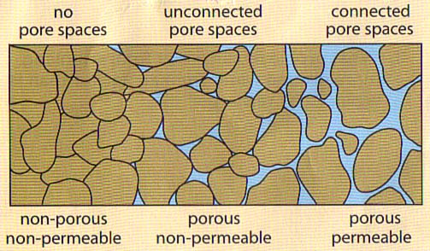
Porosity & Permeability
8/23 Obj. TSW Learn about Porosity and Permeability of soils and how to create healthier soils. P. 14 NB
What do you think porosity is?
What do you think permeability is?
How might they be important to soils?

Slide 23
6 Types of SAE’s
Ownership/ Entrepreneurship – caring for Chickens, Bunnies
Placement/ Internship – Fiery Ginger Farms, Dave Vierra Farms, Andrew Codd
Research- best fertilization methods in plants, Aquaculture project
Exploratory - Exploratory – Research possible Careers in AFNR
School Based Enterprise – After or before school, managing working school garden, fresh food drive, research in a greenhouse, Biodigestion, Composting, Tower Gardens, Recycling program
Service Learning – Farm to Fork Festival

Slide 24
Learning about FFA Activity
Match each of the following FFA words to what they are: P. 15 NB
SALUTE
Written By E. M. Tiffany
I believe in the future of agriculture,…
National Blue and Corn Gold
MOTTO
This consists of 5 symbols: cross section of Corn, the rising Sun, the Plow, the Eagle, the Owl
EMBLEM
Learning to Do, Doing to Learn,
Earning to Live, Living to Serve.
CREED
I pledge allegiance to the Flag of the United States of America and to the Republic for which it stands, …
COLORS

Slide 25
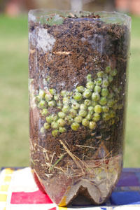
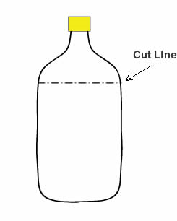
Compost Lab
Materials: 1 – 2 Liter empty bottle of soda with top 1/3 cut off & slits cut in sides.
  Soil, vegetable matter, water, red wigglers. Large spoon or spatula for turning compost. Thermometer, paper, pen
  Take pictures of your before and after compost bottle. 21 days.

Slide 26
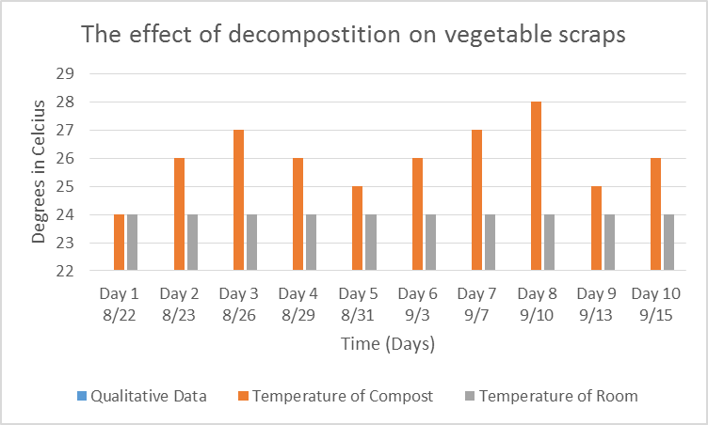
Compost Lab
Data:
Graph 1:
Over time the temperature in the 2 liter bottle is higher. (10 font)

Slide 27
FFA Officer Responsibility Activity
Use FFA.org
FFA Manual
Page 48 in online Manual
Write down 3 key responsibilities for each of the offices on 3x 5 cards
We will use flashcards and travel around to say the responsibilities and see if another person can name that officer postion.

Slide 28
Compost Lab p. 17 NB
Data:
Table 1: The temperature of the compost is higher than the room temperature. Quantitative Data

Slide 29
Characteristics of Soils
Obj. TSW learn how to create healthy productive soils.
What did you observe yesterday during the porosity/ permeability demonstration?
The 2-liter bottle that had gravel with dirt allowed the water to flow faster than our beautiful healthy compost, why?
What else could we add to our compost that we are improving that might improve drainage/permeability?

Slide 30
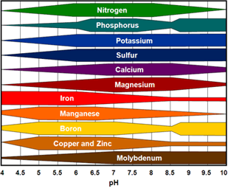
Nutrient Availability
8/24 Obj. TSW learn the relationship between pH and nutrient availability of soils.
P. 16 NB
1. What is pH?
2. What pH is the most beneficial nutrient availability?
3. How do you know?

Slide 31
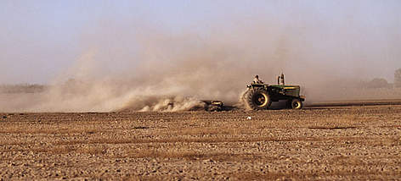
Erosion
8/25 Obj. TSW learn how erosion by wind and water can carry away valuable nutrients. P. 18 NB
What is erosion?
How can erosion degrade the land?
What are some solutions to prevent erosion?
Soil Erosion document

Slide 32
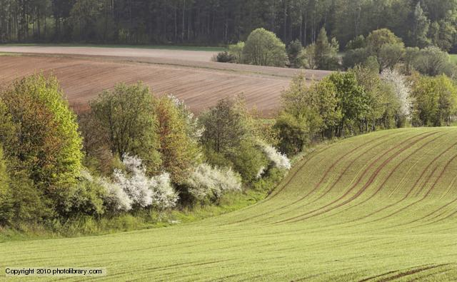
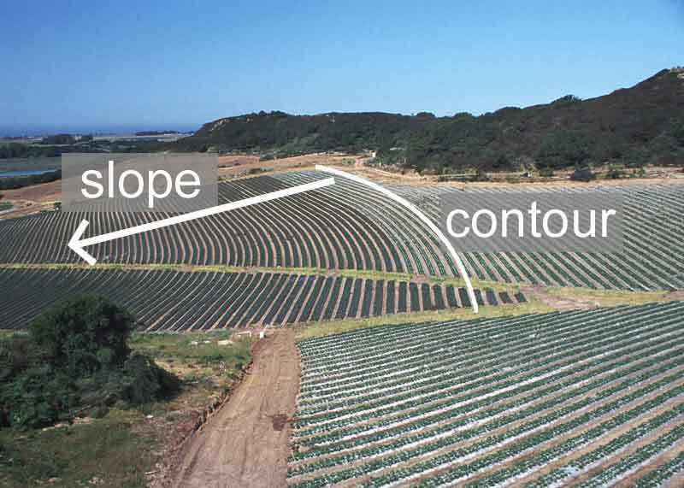
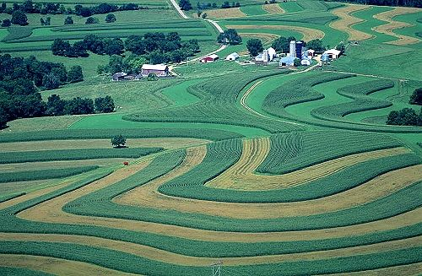
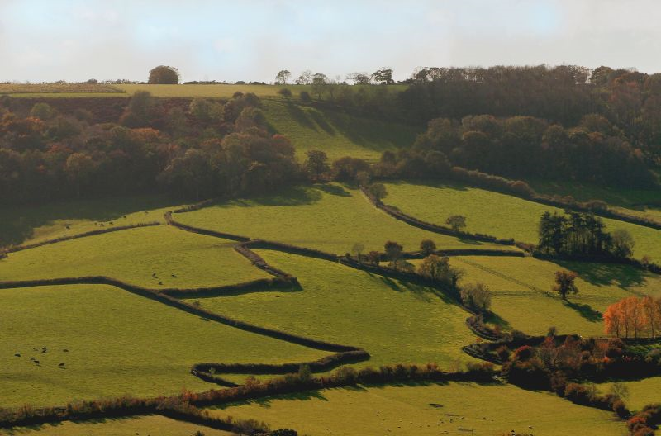
Hedgerows
Contour Farming

Slide 33
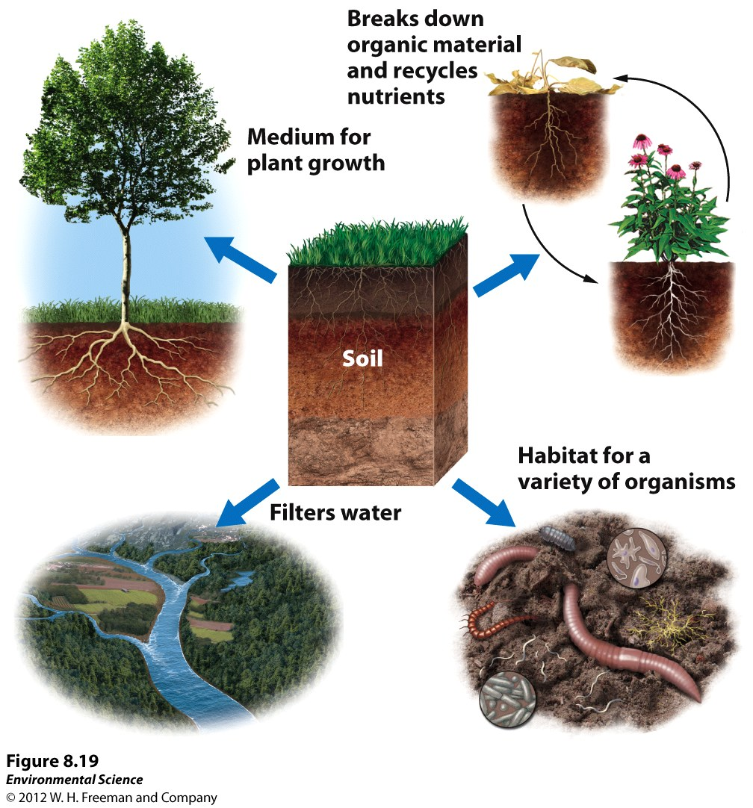
Purposes of Soil
Look at this picture.
What are the purposes of soil?

Slide 34
SAE Project Contacts
Sheep and Goats- Kathryn MacRoberts
  http://laughing-duck-farm.blogspot.com/
Show Rabbits
  http://oharafamilyfarm.com/show-rabbits
Karen Chestnut:
  karensmc@earthlink.net
    4 – H Contact

Slide 35
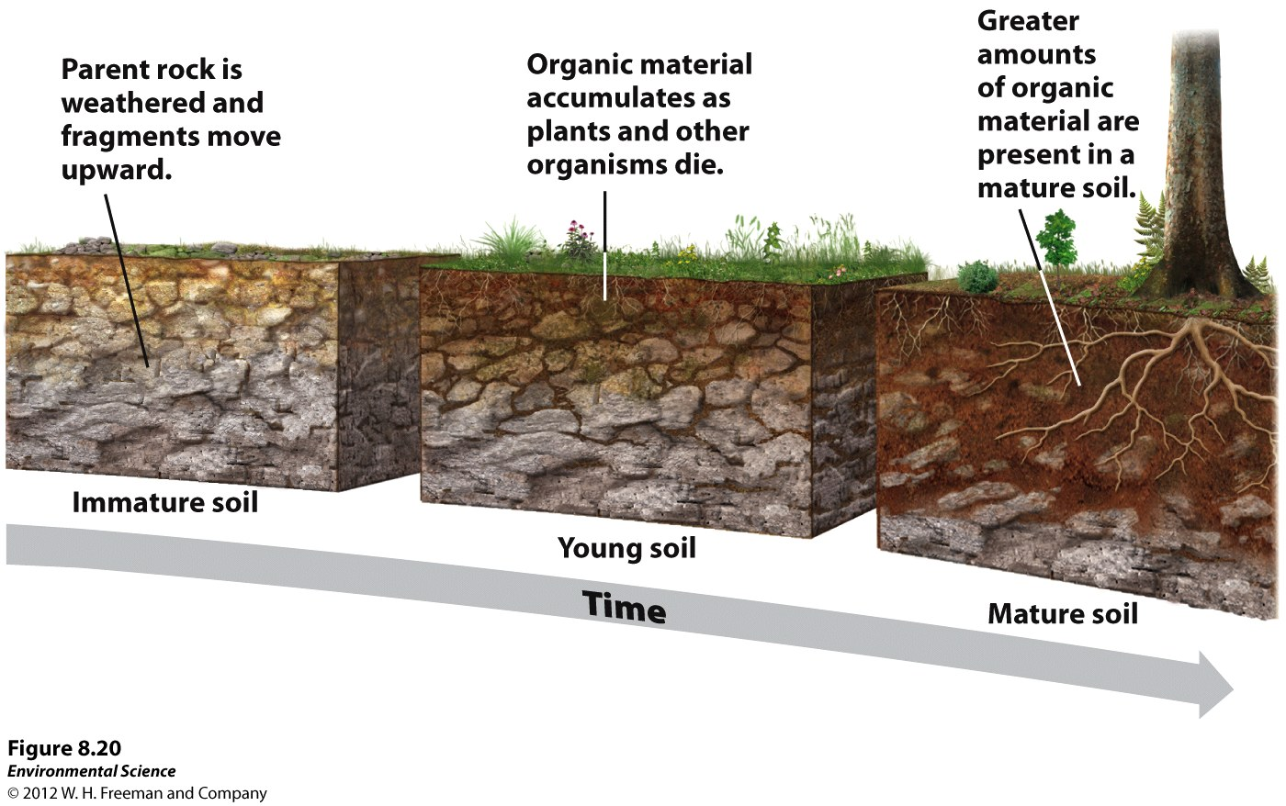
How Soil is Made…

Slide 36
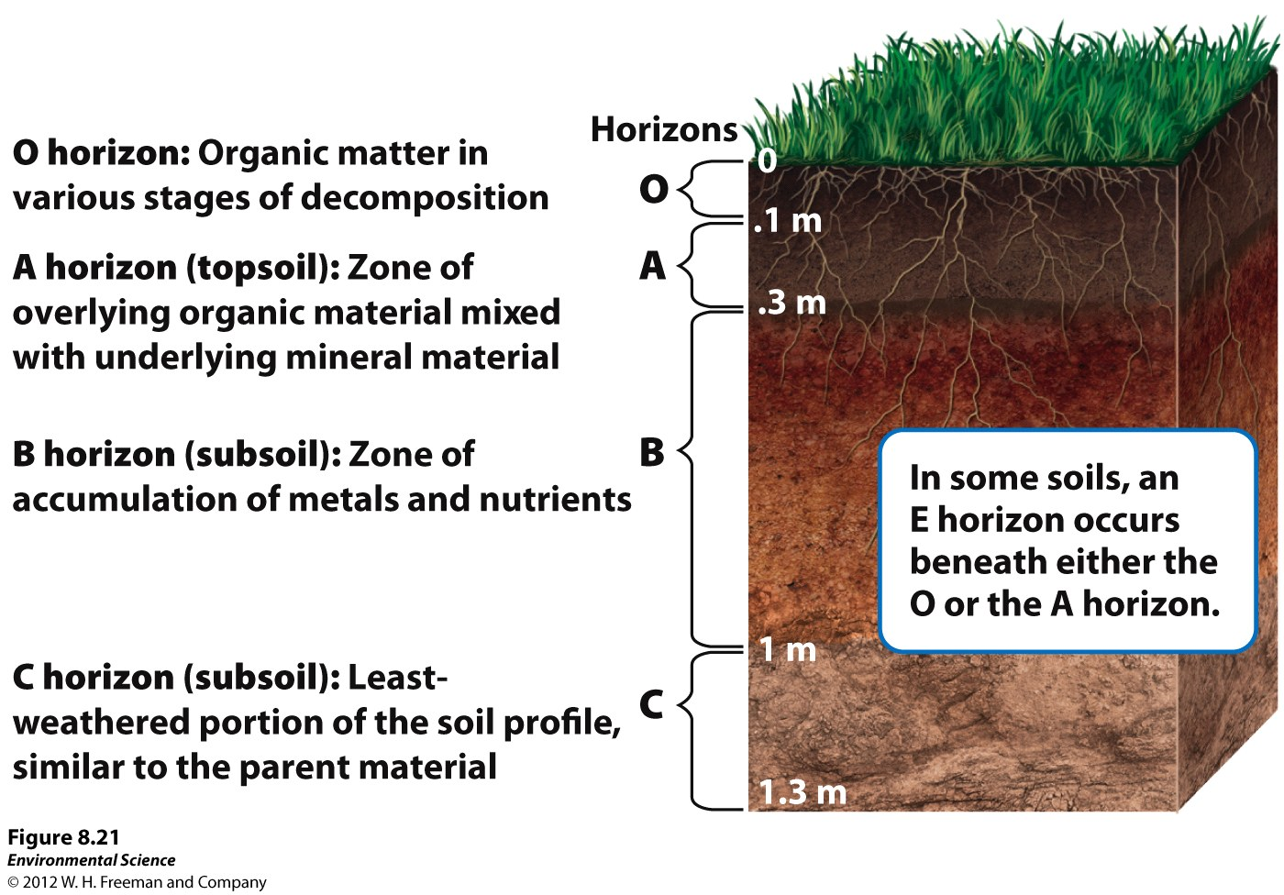
Soil Horizons

Slide 37
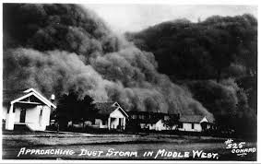
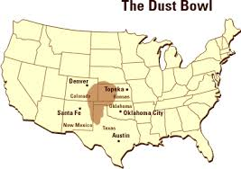
The Dust Bowl
8/26 Obj. TSW understand how soil must be maintained to continue being productive. P. 20 NB
Humans have made mistakes in farming, especially if they don’t understand how the natural world works. What was the Dust Bowl in October 1929?
What caused the Dust Bowl?
How did farming practices change?

Slide 38
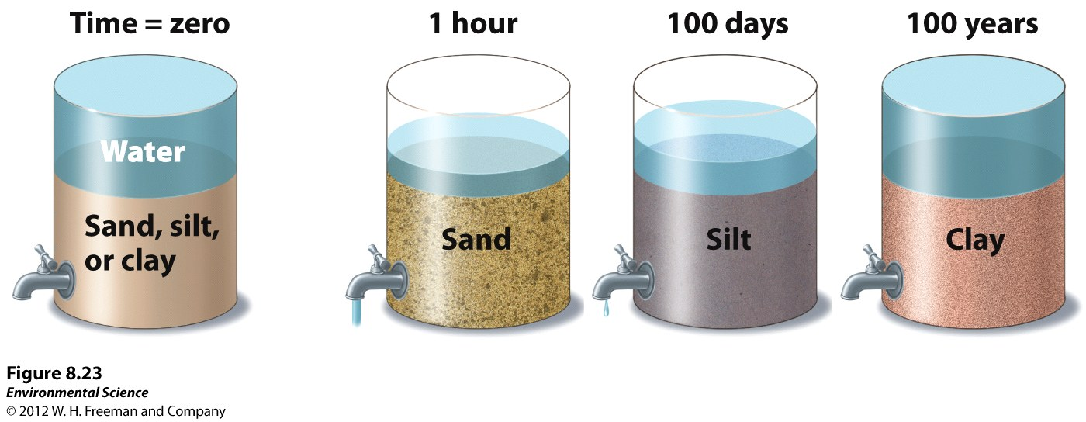
8/31 Porosity & Permeability
Obj. TSW learn to distinguish characteristics of soil by it’s porosity and permeability. P. 22 NB
Which soil type has the best drainage?
Which one holds water best?
Compare and Contrast with soil has the most porosity and which has the most permeability.

Slide 39
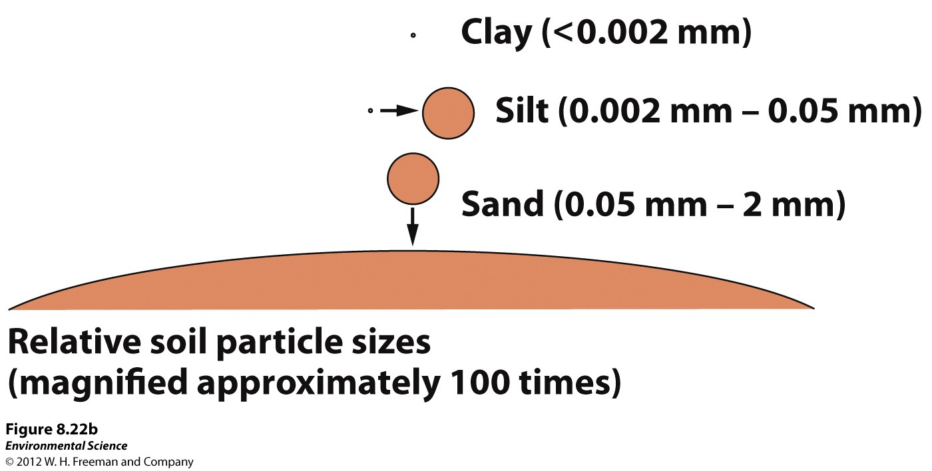

Slide 40
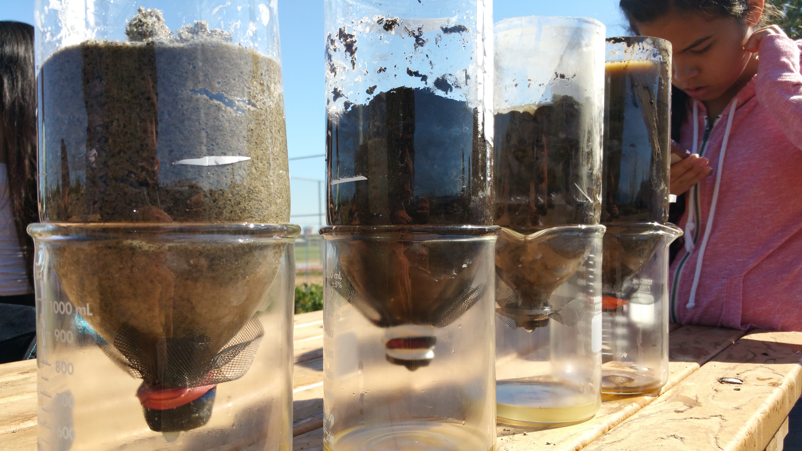
Porosity & Permeability Demonstration

Slide 41
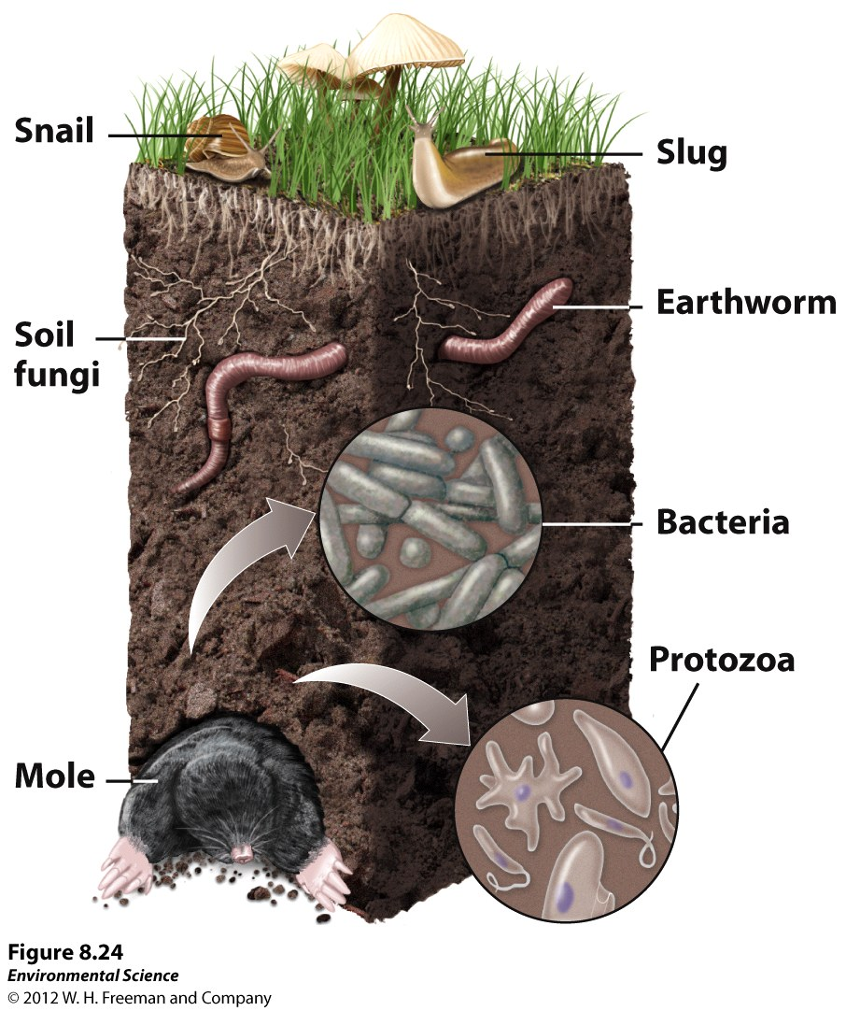
Soil is an Ecosystem
Notes P. 23 NB
Soil is alive.
Healthy Soil has Biodiversity,
The more biodiversity, the more resiliency soil has in the event of a natural or man made disaster.
Soil is a renewable resource.
Soil is an ecosystem service, we depend on the soil to grow most of our food.

Slide 42
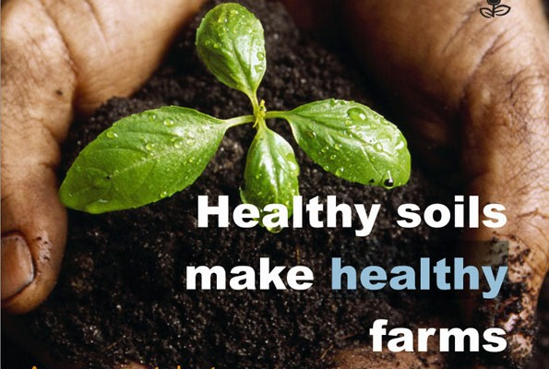
9/1 Characteristics of Soils
Obj. TSW learn how to create healthy productive soils. P. 24NB
What did you observe yesterday during the porosity/ permeability demonstration? Where are my pictures? ☺
The 2-liter bottle that had gravel allowed the water to flow faster than our beautiful healthy garden soil, why?
What else could we add to our compost that might improve drainage/permeability?

Slide 43
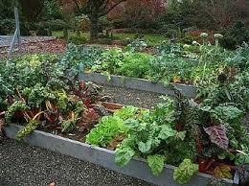
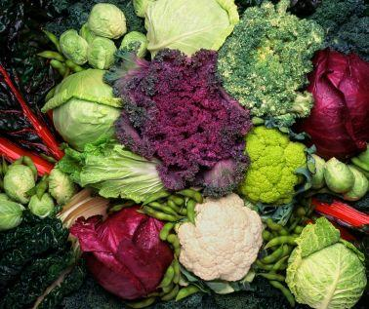
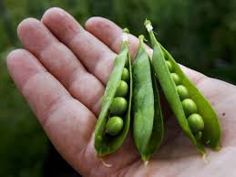
Vegetable Planting Guide
Tape to page 23 NB

Slide 44
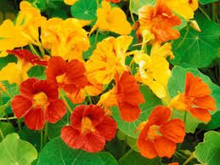
Fall Season Crops Warm Season Crops
Broccoli
Cauliflower
Garlic
Onions
Radishes
Carrots
Cilantro
Sweat Peas
Fava Beans
Watermelon
Strawberries
Peppers
Tomatoes
Squash
Pumpkins
Flowers
Beans
Copy this list on page 11 NB
What Fall Crops do we want to plant?
Nasturtium

Slide 45
Farm-to-Fork Festival
Saturday September 24th
^{Counts as Service Learning}
Please sign the sign up sheet, with your contact information next week.

Slide 46
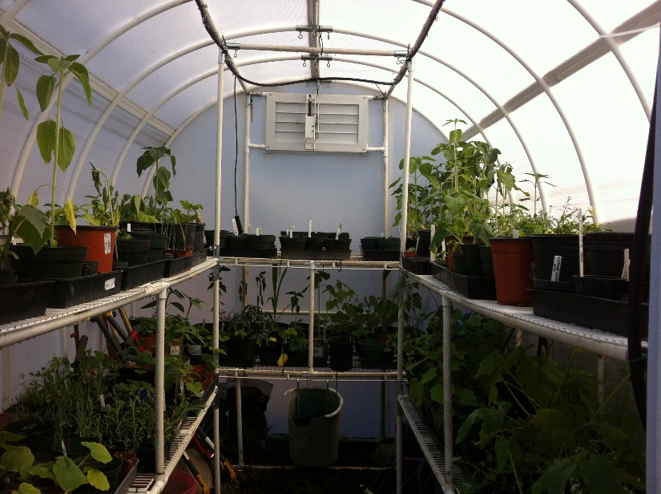
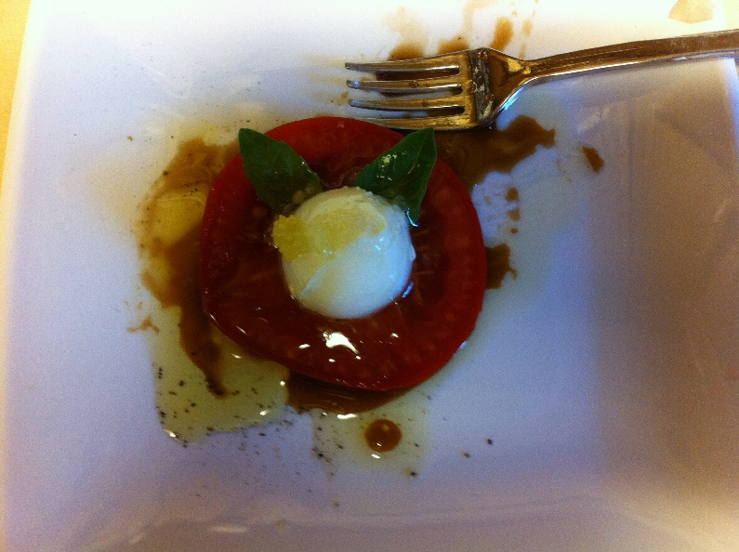
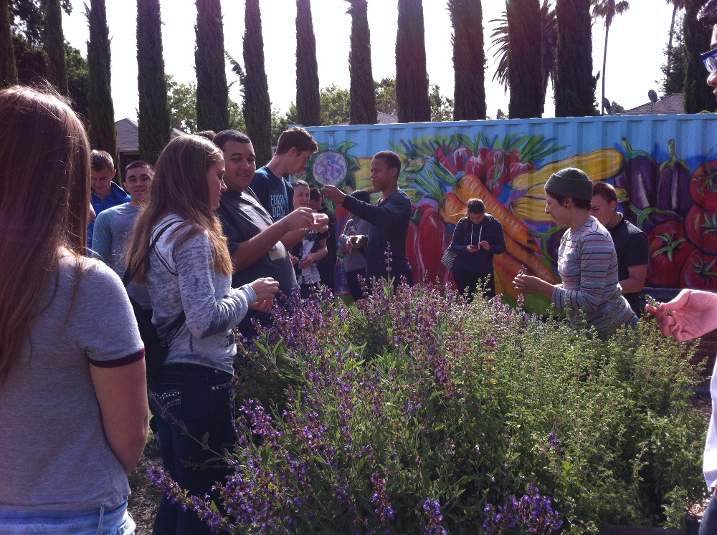
9/2 Omnivores Dilemma
Obj. TSW develop a better perspective of where their food comes from. P. 28 NB
What is you impression of Omnivore’s Dilemma?
What are the four categories of how food is raised?
What was one thing you learned or did not realize before reading the first 6 pages of the book?

