Slide 1
Environmental Science
Week 3
UNIT 2: Ecology CH 4 – 7
CH 4 The Organization of Life 8/31 – 9/4

Slide 2
8/31 Ecosystems: Everything is Connected UNIT 2 Chapter 4 Obj. TSW learn how everything is connected by understanding biotic and abiotic resources needed in habitats. P. 22 NB
What is the difference between biotic and abiotic factors?
Write the level of organization in an Ecosystem.
Explain how habitats are important to organisms.

Slide 3
8/31 Agenda
Tomorrow we walk to the garden. Farm to Fork
Aeries log in – (5 points)
Today finish entering data for Salinization Lab
Have title page done.
Start research for why Salinization is important. How does it affect agriculture?

Slide 4
9/1 Evolution CH 4.2 Obj. TSW explain the process of evolution and how it impacts our environment. P. 24NB
Explain the process of evolution by means of Natural Selection.
Explain adaptation as it relates to evolution.
How do pests and weeds develop a resistance to insecticides and herbicides?

Slide 5
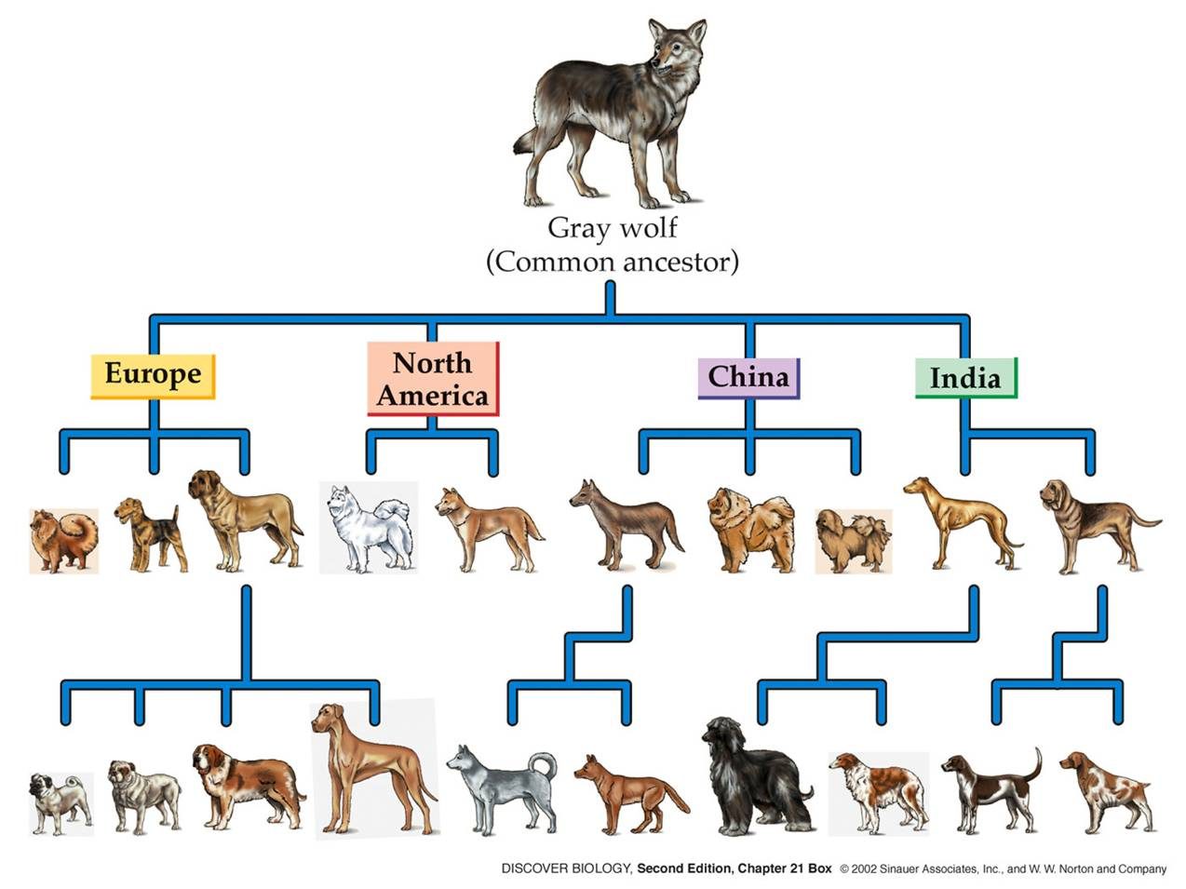
9/2 Adaptation to the environment CH 4.2 Obj. TSW learn how Natural Selection and Artificial Selection are different. P. 26 NB
Why are Darwin’s Finches a good example of Natural Selection?
Explain Coevolution and give an example.
Explain Artificial Selection and give an example.

Slide 6
Salinization Lab - Today
Work with a Partner
Explain what Salinization is and why it is important? Use this for your Background Information part of your lab.
Make your Title Page
Research Background information
Enter data into Excel

Slide 7
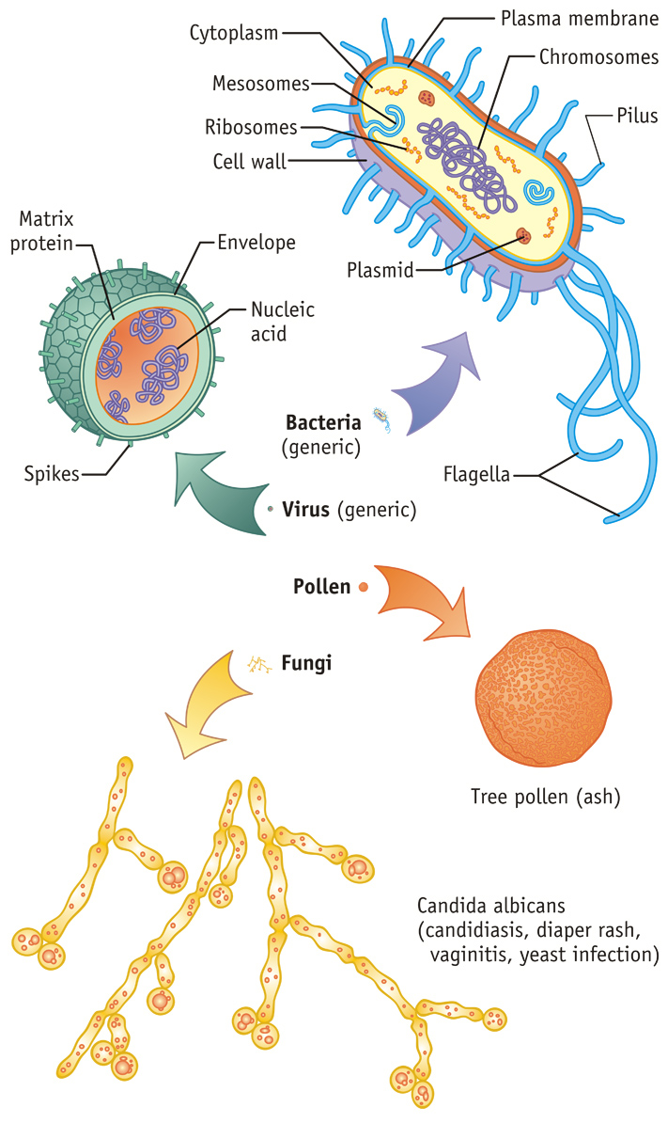
9/3 The Diversity of Living Things CH 4.3 Obj. TSW explain how important it is to encourage Biodiversity in everyday life. P. 28NB
How are Bacteria and Fungi important in the environment?
How can insects affect humans in positive and negative ways?
Describe how organisms interact and depend on each other for survival?

Slide 8
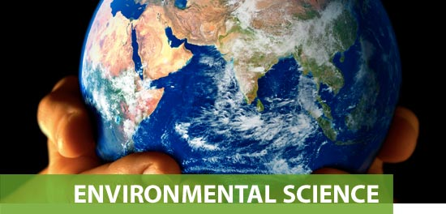
9/4 Review for Quiz CH 2 – 4 Obj. TSW score well on their quiz to make their environmental science teacher proud☺ P. 30 NB
CH 3 What are the 4 layers that make Earth an integrated system?
CH 3 There is an Earthquake in Zimbabwe with a magnitude of 4.0, then there is an Earthquake in San Francisco with a magnitude of 7.0, how many more times. How many times greater in magnitude is the san Francisco Earthquake?
CH 4 What are the levels of organization for an Ecosystem.

