Slide 1
Agenda 9/4
Warm Up
Review/ Quiz each other
Final Words
Topic I, Earth Systems & Resources Test

Slide 2
Review for Earth Systems & Resources Test 9/4 Obj. TSW review for the Test today by studying and quizzing each other. P. 24NB
Compare & Contrast an open and closed system on Earth.
Section 3.2 Why does cool air sink and warm air rise in the atmosphere?
Section 3.3 If cold water from melting polar ice were to shut down the Gulf Stream, what would happen to the climate of the British Isles?

Slide 3
Review for Test Describe the word or phrase without “sounds like”.
Partner 1 look at the screen
Partner 2 look at the back wall
Tragedy of the commons
Agricultural Revolution
Industrial Revolution
Sustainability
Global Climate Change
Ozone

Slide 4
Review for Test Describe the word or phrase without “sounds like”.
Partner 1 look at the back wall
Partner 2 look at the screen
Hydrosphere
Lithosphere
Stratosphere
Troposphere
Geosphere
Athenosphere

Slide 5
Review for Test Describe the word or phrase without “sounds like”.
Partner 1 look at the screen
Partner 2 look at the back wall
Erosion
Plate Tectonics
Weathering
Ring of Fire
Rule of 70
Percent Change

Slide 6
Review for Test Describe the word or phrase without “sounds like”.
Partner 1 look at the back wall
Partner 2 look at the screen
Open System
Closed System
Gas Concentration in Atm
Salinization
Climate
Coriolis Effect

Slide 8
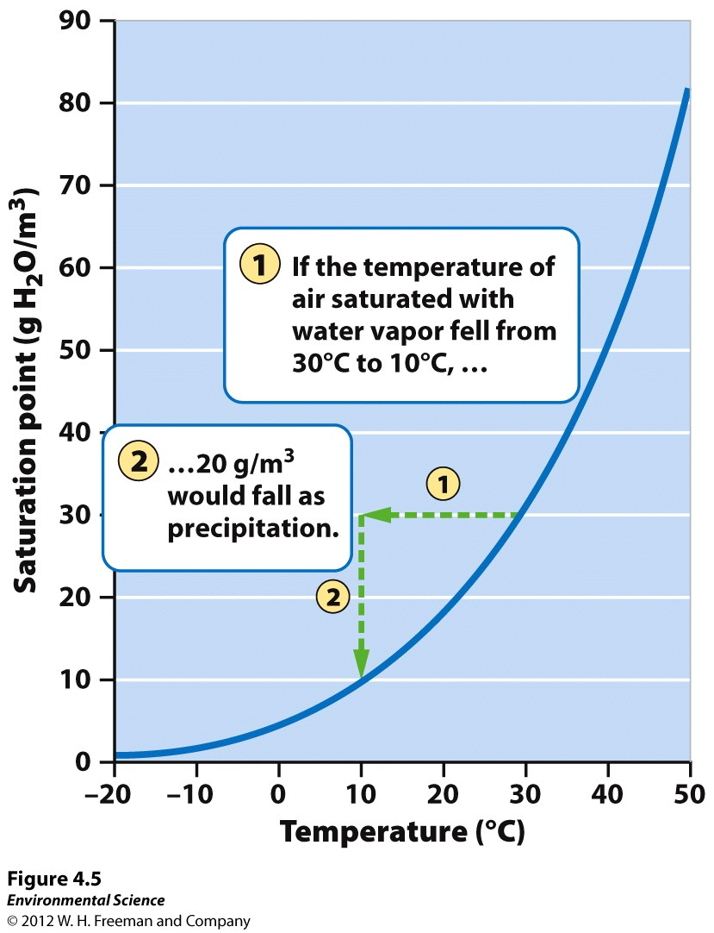

Slide 9
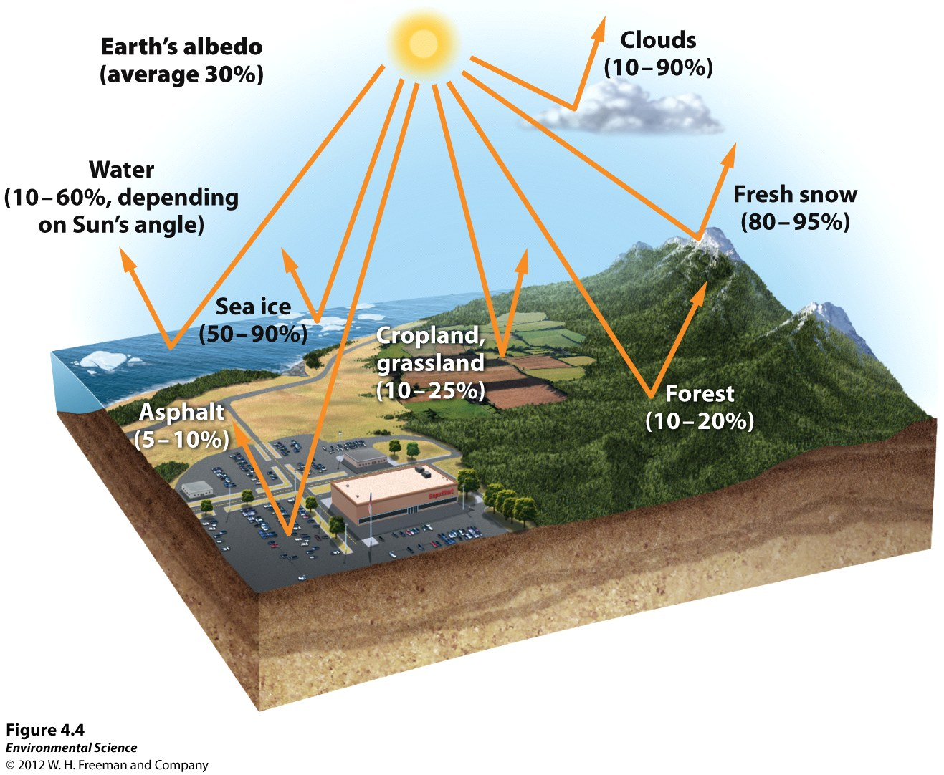

Slide 10
Coriolis Effect

