Slide 1
Environmental Science Unit 4: Water, Air, and Land CH 13 Atmosphere and Climate Change
Week 12

Slide 2
Agenda Monday November 2nd
WU – Climate CH 13.1
Read Article on EPA: Cruise Ships P. 25 NB
Work on Ground Water Filter Lab (60 Points)
Go through Rubric with class
Individual Lab report! Turn it in.com
Time to work on Lab – Students may add additional data to lab
Computer Time
FT – Outside to dump soil contents by a tree, water on ground.
Clean ground water filters.

Slide 3
Ground Water Filter Lab Due: November 10th
Title page
Introduction: Discuss Ground Water (Where? Why?) and Aquifers what, where, how are they polluted?
Materials
Procedure: Look in your Environmental science book
Data Table
Data Analysis – Did your filter, filter out the pollutants? How do you know? How would you improve it? Refer to your data!!
Conclusion

Slide 4
11/2 Climate CH 13.1 Obj. TSW learn the difference between weather and climate. P. 26 NB
Explain the difference between weather and climate.
Identify four factors that determine climate.
Explain why different parts of Earth have different climates.
Greenland Melting Ice Sheets
Rainfall across US

Slide 5
6 Factors of Climate
Latitude
Global Air circulation Patterns
Oceanic Circulation Patterns (El Nino?)
Topography – Mountains? Elevation?
Solar Activity – Sun – Solar Flares?
Volcanic Activity – PM in the air to decrease temp?

Slide 6
NASA Armstrong airborne Science Mission Directorate
What jobs are involved in determining weather and climate?
Cruise Ship Discharge

Slide 7
11/3 Circulation Patterns & Rain Shadow Effect CH 13.1 Obj. TSW learn how the global air and ocean circulation patterns play a role in our climate. P. 28NB
Draw and describe the pattern of Global Air Circulation.
Why does the ocean currents have a great effect on climate?
Explain the Rain Shadow Effect.

Slide 8
Global Air Circulation Patterns

Slide 9
Oceanic Circulation Patterns

Slide 10
El Nino Event

Slide 11
Normal Oceanic Circulation

Slide 12
Department of Water Resources
Flood Management
Phone # 916 653-4893
California Department of Water Resources
P.O.Box 942836
Sacramento, CA 924936-0001
Attention: Video Library, Room 204-22
In Person: 1416 Ninth Street in Sacramento. Room 204 - 22

Slide 13
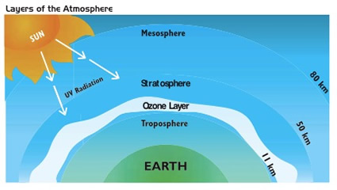
11/4 Ice Cores & Ozone CH 13.1 & 13.2 Obj. TSW explain why ice cores provide insight to our climate, and how the Ozone protects us. P. 30 NB
Read the Case Study- Ice Cores: Reconstructing Past Climates. What have scientists learned about Earth’s climatic history from ice cores?
What is the Ozone Layer?
What is the threat to the Ozone?
Glacier

Slide 14
Cruise Ship Article – EPA p. 27 NB
I will stamp your AXES.
Work on your Ground Filter Lab Report
If you did not get to use a computer yesterday – You get to use one first today.
If you are not using a computer, write your notes for CH 13 on page 31 NB, Finish your AXES paragraph for the article. Find/ research information for your lab on your cell phone – remember your works cited page.
http://www.easybib.com/reference/guide/apa/website

Slide 15
Quiz CH 12 & 13 on Thursday
Develop 5 points of questions for your quiz.
Turn in today.

Slide 16
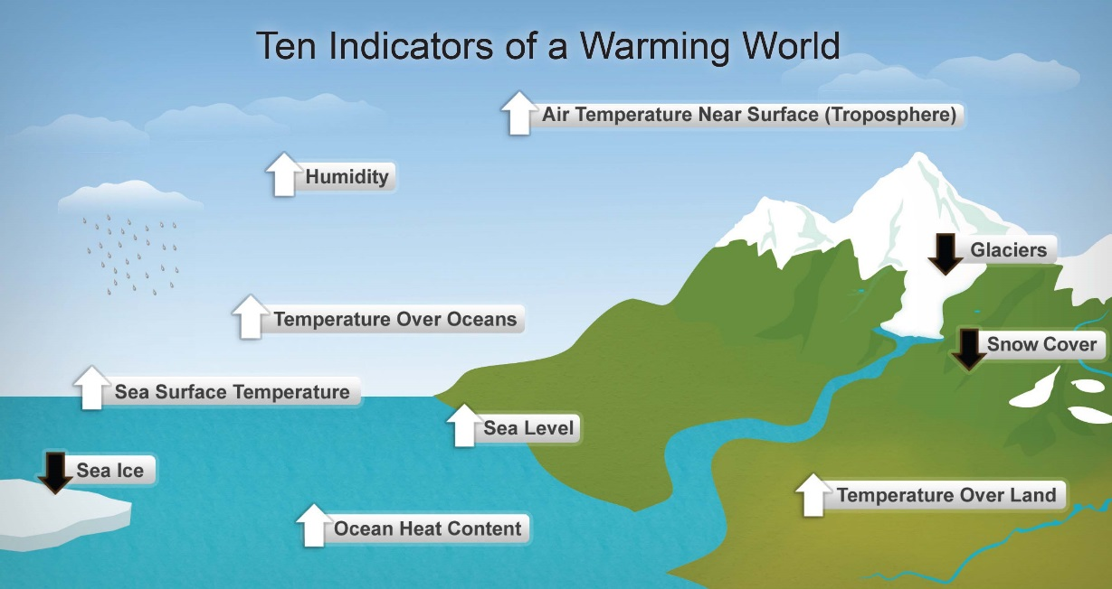
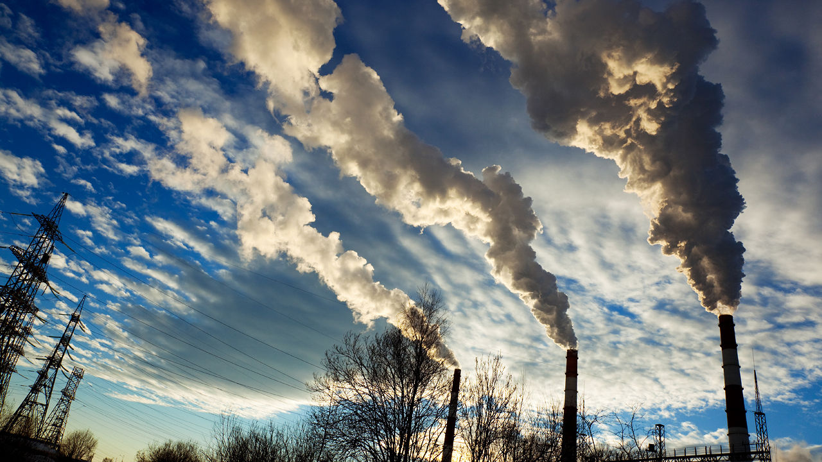
11/5 Climate Change CH 13.2 Obj. TSW discuss what climate change is, it’s causes and effects. P. 32 NB
Explain why Earth’s atmosphere is like the glass on a greenhouse.
How is the [CO2] increasing?
Hypothesize what a warmer Earth might be like?

Slide 17
Climate Change
10,000 years ago, there was 5,280 feet approximately of ice over our east coast of America.
Factors that influence Climate: solar flares,
Volcano eruption
UV Radiation - Ozone

Slide 18
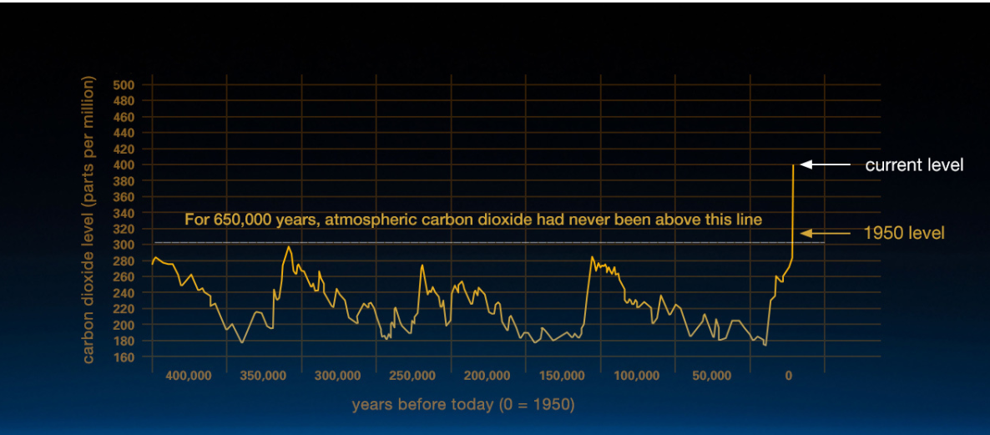
11/6 Global Climate Change CH 13.3 Obj. TSW explain the consequences of global climate change. P. 34 NB
What are 5 consequences of Global Climate Change?
Explain the importance of the recent findings.
Discuss some ways to reduce the risk of Global Climate Change.

Slide 19
The Endangered Waters Beneath Our Feet
Read the article
Write an AXES Paragraph at the end of the article.
Use this to reference in your Lab report.

Slide 20
Learning how to do a “Works Cited” page References (3-5) need be in alphabetical order.
In the lab report, you reference the Article from your discussion: (Postel, 2012)
In the Works Cited page your references will look like this:
Last, F. M. (Year, Month Date Published). Article title. Retrieved from URL
Write the correct works cited at the bottom of the second page of the article.
Postel, S. (2012, May 22). The Endangered Waters Beneath Our Feet.
Retrieved from http://voices.nationalgeographic.com/2012/05/22/the- endangered-waters-beneath-our-feet
Don’t forget to use your Environmental Science book as a reference.

