Slide 1
CH 6 Biomes
Agenda:
Finish Cycles in Nature (need videos)
Start CH 6 biomes
Start Project: Ecosystem Due September 22nd
Quiz CH 5 & 6 Thursday September
CH 2 – 4 Quiz Corrections turn in by Thursday
Notebook Check – Thursday

Slide 2
9/14 Biomes CH 6.1 Obj. TSW compare and contrast biotic and abiotic factors of different biomes in an ecosystem project. P. 38 NB
What is a Biome?
Explain how a Tropical Rain Forest is different from a Tiaga
How might any of the “cycles” you have learned impact a Biome?

Slide 3
Levels of Questions – You write your next quiz CH 5 & 6
Level 1- What is, List, Recall, Name (What is salinization?)
Easy to find in the book, usually a definition in bold, one word/ sentence answer.
Only 1 point
Level 2- Explain, Compare & Contrast (Explain the Nitrogen Cycle)
Still in the book, yet you have to read and gather information maybe in different places to answer the question. Answer in a sentence or two.
2 points
Level 3 – How and/or why of a big concept, or argument or idea (How does the Nitrification contribute to Acid Rain?)
May not be in your book, may need to research several chapters, internet, or community for answers, maybe debatable. Answer in several sentences or a paragraph.
3 points
Everyone must turn in 5 points of questions by Wednesday – HW (5 points)

Slide 4
Carbon Cycle
Notes Page 39 NB
Nitrogen Cycle

Slide 5
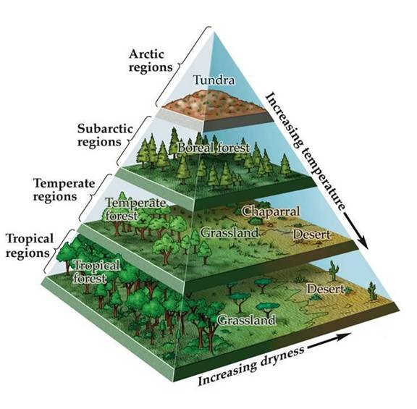
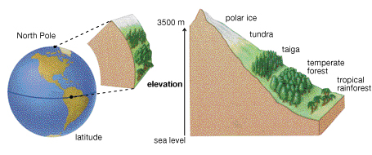
9/15 Biomes & Climate & Forests CH 6.1 & 6.2 Obj. TSW learn how to read a climatogram to determine an areas temperature and precipitation. P. 40 NB
What is the climate relationship between Temperature and Precipitation?
How do biomes and vegetation change with Latitude and Altitude?
Explain how to read a climatogram.

Slide 6
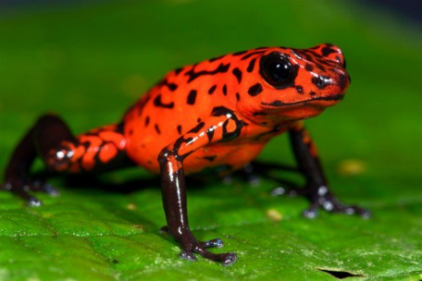
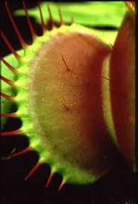
9/16 Forests CH 6.2 & 6.3 Obj. TSW learn characteristics, adaptations and conservation methods of the forest. P. 42NB
What are the layers of a Rainforest?
What are some adaptations plants and animals make to live in the Forest.
Read the Case Study: Deforestation Climate, and Floods. Write an AXES paragraph about deforestation and it’s impacts for the planet.

Slide 7
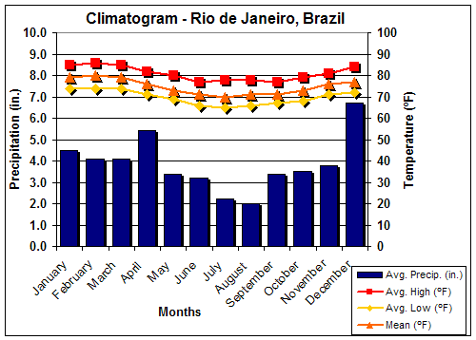
How to read a Climatogram…

Slide 8
Activity: Latitude & Longitude
Locate the following Cities on a Map: Singapore, Buenos Aires, Juno, Alaska
Identify the Biome by:
Identify the precipitation and temperature
Identify the altitude and the latitude
What type of animals and abiotic factors might you find?

Slide 9
Ecosystem Poster Project
Due Friday September 25th

Slide 10
9/17 Grassland, Desert, and Tundra Biomes Obj. TSW describe adaptations and threats to biomes. P. 44 NB
Describe the climate of a chaparral biome.
Describe adaptations of desert organisms.
Discuss one threat to tundra biome.

