Slide 1
CH 6 Review, CH 3,14: Eutrophication 9/29 Obj. TSW review for the Topic II Test tomorrow and identify the effects of nitrogen-based fertilizers from run-off from agricultural land, pg. 60
1. CH 6: Describe how the removal of a keystone species can negatively affect an ecosystem.
2. CH 6 Describe two types of succession with examples and how they are different.
3. Explain Eutrophication, the effect it has on organisms in a body of water, and give an example of how it can happen

Slide 2
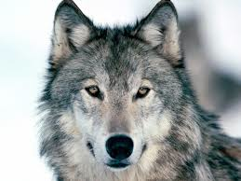
Keystone Predators
Wolf= Top Predator= important to many habitats
Keep deer populations in check→ too many deer will eat small trees→ leads to fewer trees→ leads to fewer birds and beavers
Entire ecosystem would change
http://sfglobe.com/?id=14064&src=share_fb_new_14064

Slide 3
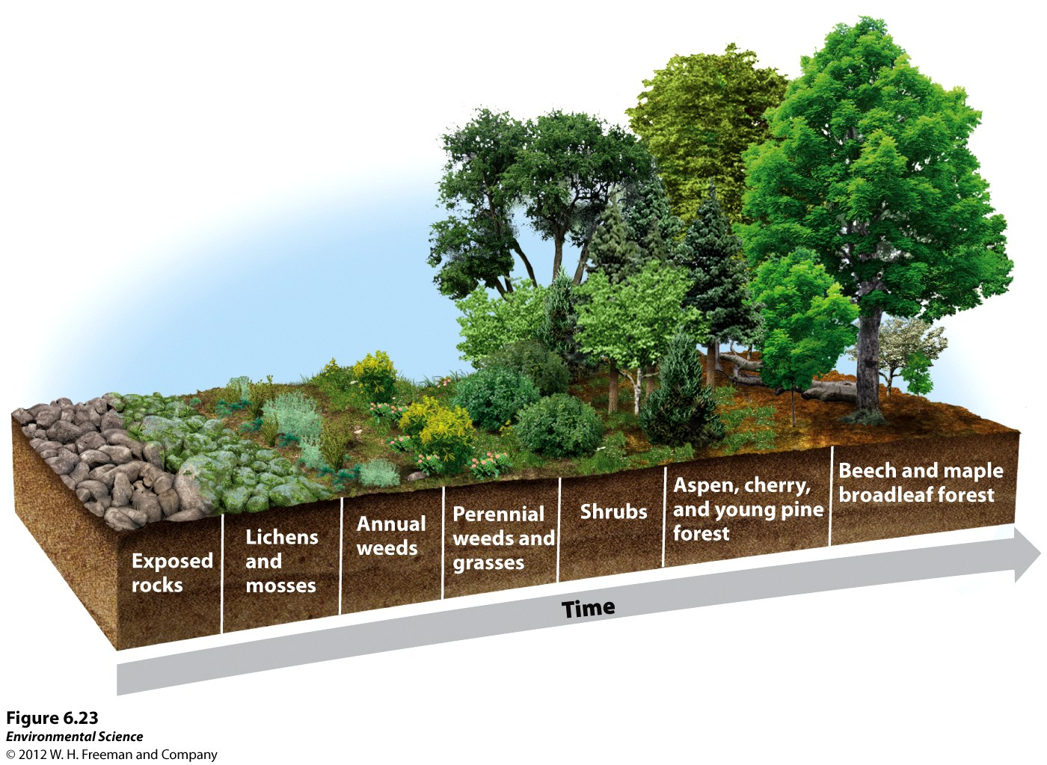
Primary Succession
Occurs on ground which had no previous vegetation
EX: New island formation, Volcanic Eruption – Krakatau 1883
Primary succession
to still occurring there
today
Pioneer species-
Lichen
Fungi + Alga

Slide 4
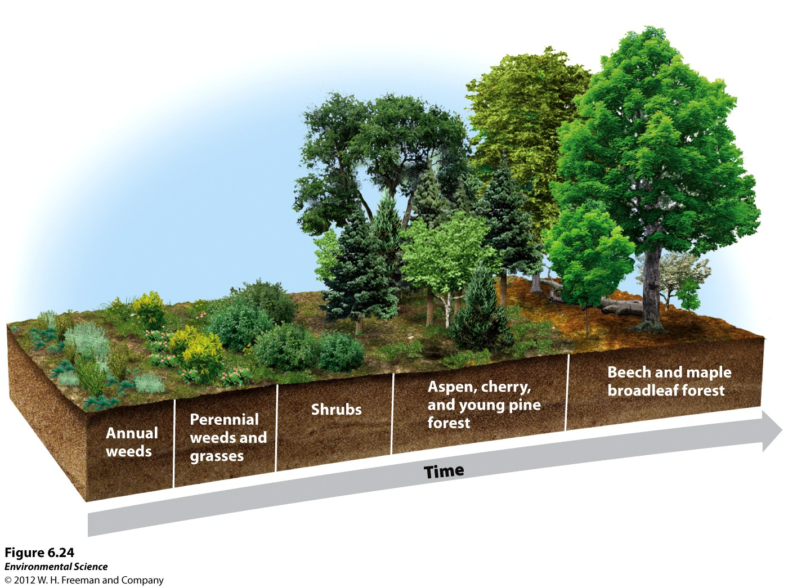
Secondary Succession
Occurs in areas of destruction or modification of existing vegetation, either naturally or by human activity
Soil is already present but plants are not
Example: Forest Fire,
Earthquake, Hurricanes,
Abandoned parking lots,
former Farms, single tree
falling.

Slide 5
Eutrophication
Decomposition of wastewater (adds elements such as Nitrogen and Phosphorus)
Caused by an increase in nutrients, such as fertilizers
EX: Mississippi River dumps into Gulf of Mexico= creates a huge dead zone, decrease in oxygenated water= lots of fish die
EX: Fertilizer-containing runoff from agriculture
EX: Residential areas/household soaps or detergents

Slide 6
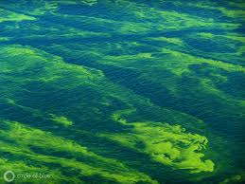
Too Much!
Leads to a lack of O2 and creation of dead zones
Rapid Growth of Algae= Algal Bloom
Eventually die= increase in decomposition= increase in microbes consumes most of the O2 in the water=
Reduce dissolved oxygen= Hypoxic conditions (low oxygen)=
Death to fish and shellfish
Lake Erie
Notes:
little is available naturally in rivers and streams

Slide 7
Eutrophication Demo!
DO & Organisms observed | 9/26 | 9/29 | 9/30
Control + Pond Water
Pond Water + 1 tsp Fertilizer
Pond Water + 10 tsp Fertilizer
Observation
Hypothesis
Prediction
Data
Measure DO
Observations
Conclusion
Why is it necessary in the experimental design to have a bottle without any fertilizer
What happened to dissolved oxygen concentration over time?
Explain any patterns you observed

Slide 8
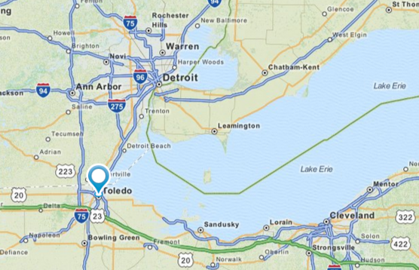
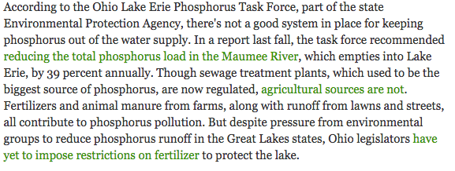
In the News…

