Slide 1
Environmental Science
CH 10 Biodiversity

Slide 2
Activity:

Slide 3
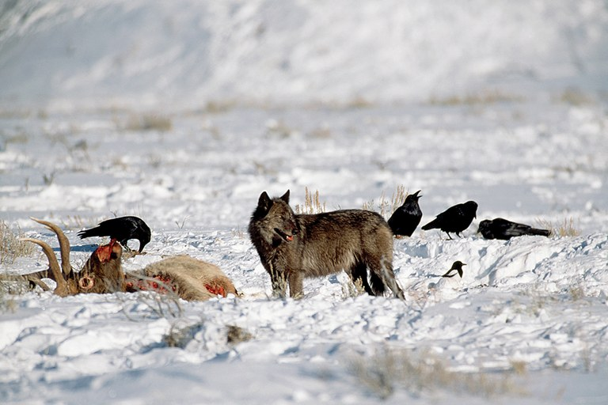
10/12 What is Biodiversity? CH 10.1 Obj. TSW understand how important Biodiversity is. P. 76 NB
What is Biodiversity?
What is a keystone species?
Name 3 Common Medicines derived from plants.

Slide 4
Keystone Species
Sea Otters
Wolves
How wolves changed the Rivers (Yellowstone)

Slide 5
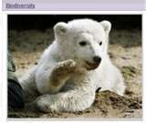
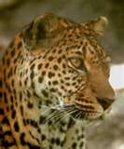
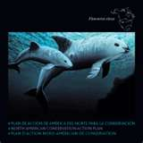
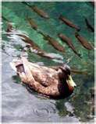
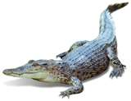
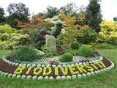
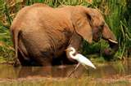
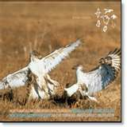
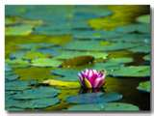
10/13 Biodiversity at Risk CH 10.2 4/30 Obj. Stds. will know biodiversity is the sum total of different kinds of organisms and how it is threatened. P.78NB
Explain the difference between threatened species and an endangered species.
Why is biodiversity important?
Explain how humans cause extinctions.

Slide 6
Section 5.1 Summary – pages 111-120
Importance to nature
#1. Biodiversity is the variety of life or the different types of species
Living things are interdependent.
Living things can be niches for other living things.
Populations are adapted to live together in communities.

Slide 7
Section 5.1 Summary – pages 111-120
#2. Biodiversity brings stability
Biodiversity can bring stability to an ecosystem.
A pest could easily destroy all the corn in a farmer’s field, but it would be far more difficult for a single type of insect or disease to destroy all individuals of a plant species in a rain forest.
Ecosystems are stable if their biodiversity is maintained.

Slide 8
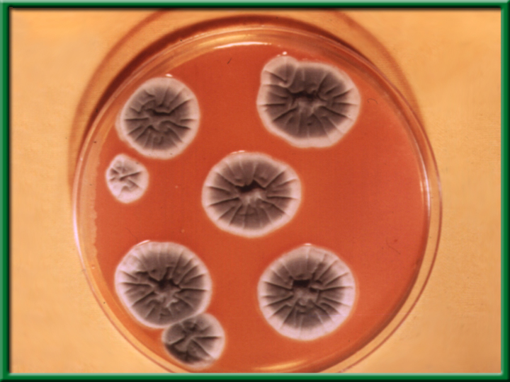
Section 5.1 Summary – pages 111-120
#2. Importance to people
Preserving biodiversity ensures there will be a supply of living things, some of which may provide future drugs.
Penicillium

Slide 9
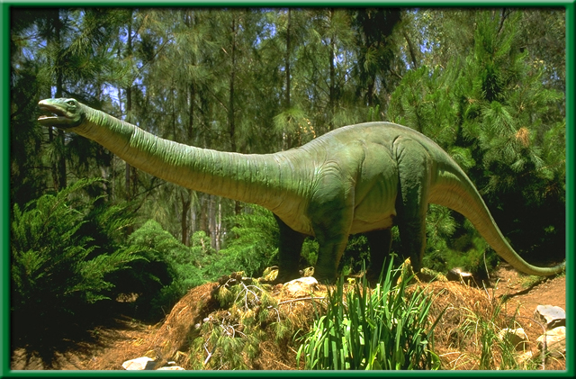
Section 5.1 Summary – pages 111-120
Loss of Biodiversity
Extinction is the disappearance of a species when the last of its members dies.
Extinction is a natural process and Earth has experienced several mass extinctions during its history.

Slide 10
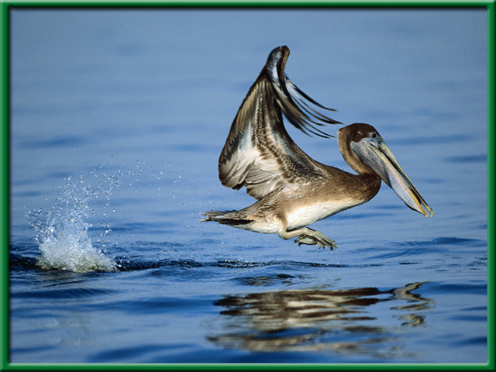
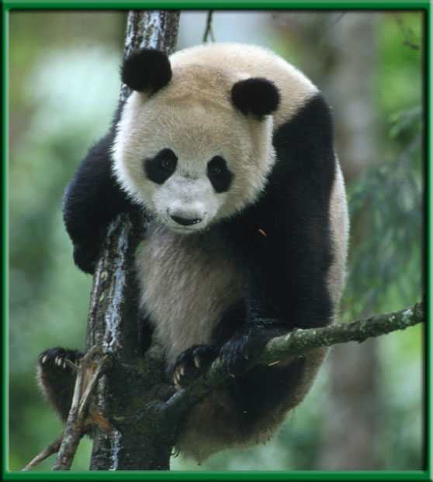
Section 5.1 Summary – pages 111-120
Loss of Biodiversity
A species is considered to be an endangered species when its numbers become so low that extinction is possible.

Slide 11
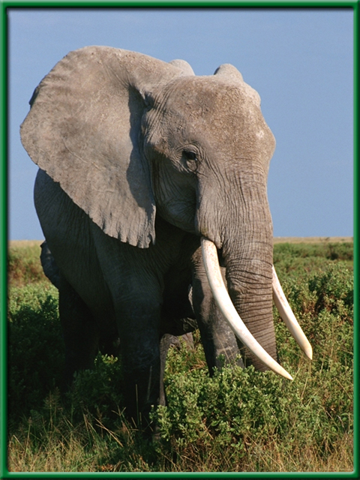
Section 5.1 Summary – pages 111-120
Loss of Biodiversity
When the population of a species is likely to become endangered, it is said to be a threatened species.

Slide 12
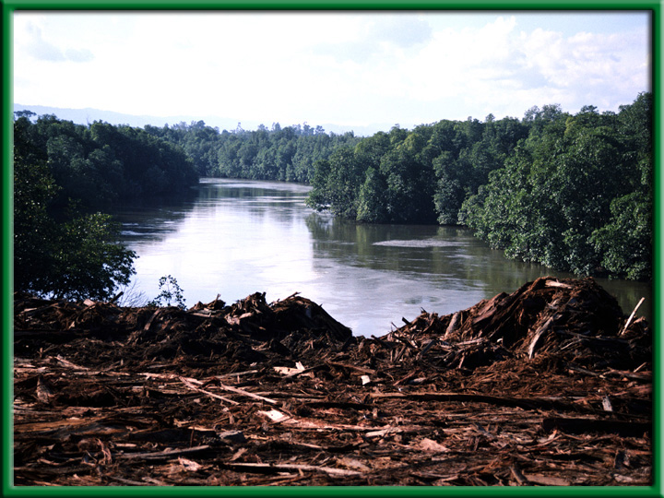
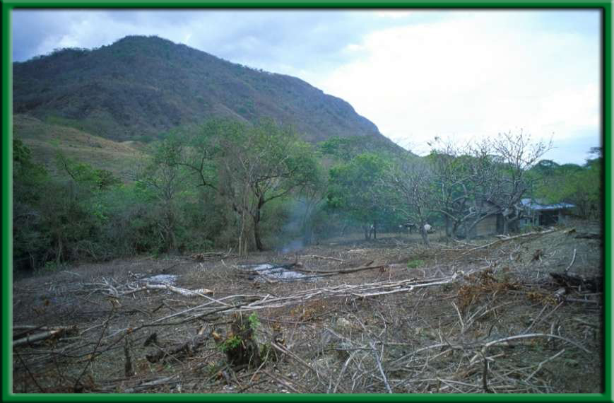
Section 5.1 Summary – pages 111-120
#3. Habitat loss
One of the biggest reasons for decline in biodiversity is habitat loss.

Slide 13
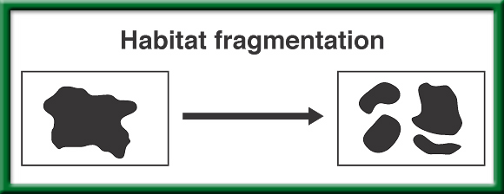
#3. Habitat
Fragmentation
To return to the chapter summary click escape or close this document.

Slide 14
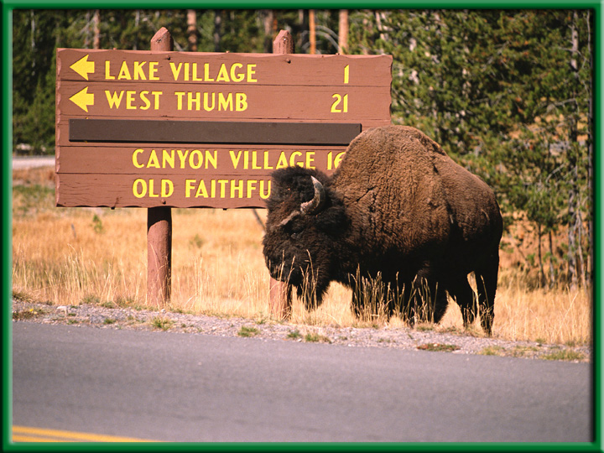
Section 5.1 Summary – pages 111-120
Habitat fragmentation
Habitat fragmentation is the separation of wilderness areas from other wilderness areas.

Slide 15
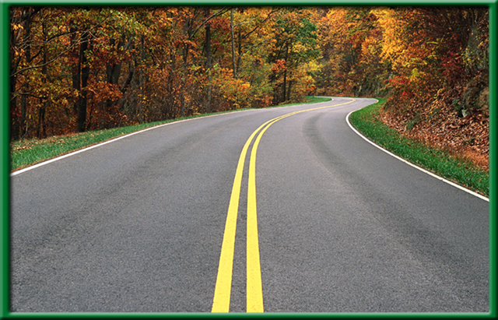
Section 5.1 Summary – pages 111-120
Edge and size
The edge of a habitat or ecosystem is where one habitat or ecosystem meets another.

Slide 16
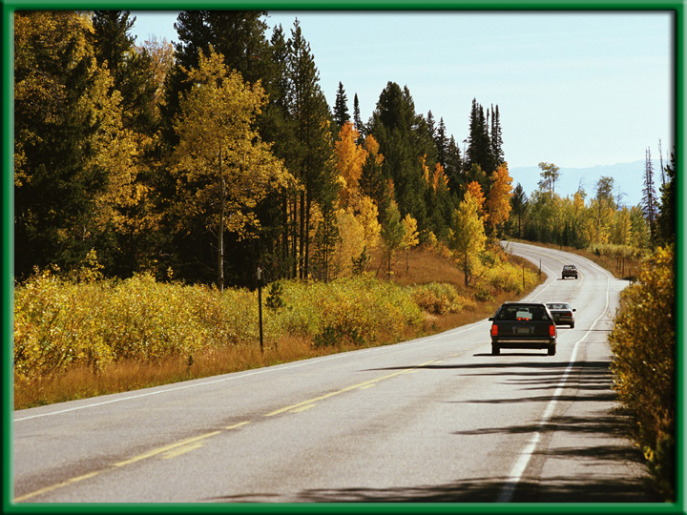
Section 5.1 Summary – pages 111-120
Edge and size
If a road is cut through a wooded area, the shape of the wooded area changes and the edge is changed.
Now there is less distance between the edge and the interior. Some plants might die out.

Slide 17
Section 5.1 Summary – pages 111-120
Habitat degradation
Another threat to biodiversity is habitat degradation, the damage to a habitat by pollution.
Three types of pollution are air, water, and land pollution.

Slide 18
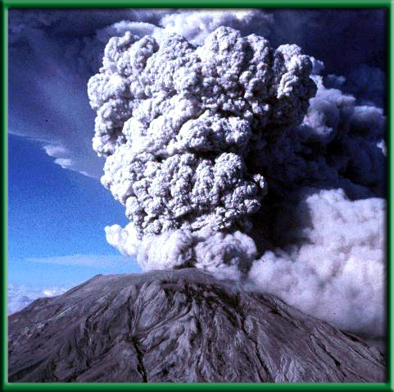
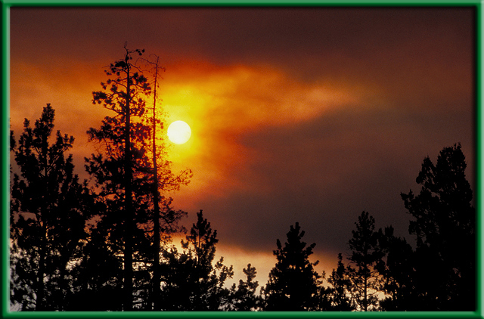
Section 5.1 Summary – pages 111-120
#3. Habitat degradation
Pollutants enter the atmosphere in many ways—including volcanic eruptions and forest fires.

Slide 19
Section 5.1 Summary – pages 111-120
Habitat degradation
Burning fossil fuels is also a major source of air pollutants such as sulfur dioxide.
Acid precipitation—rain, snow, sleet, and fog with low pH values—has been linked to the deterioration of some forests and lakes.

Slide 20
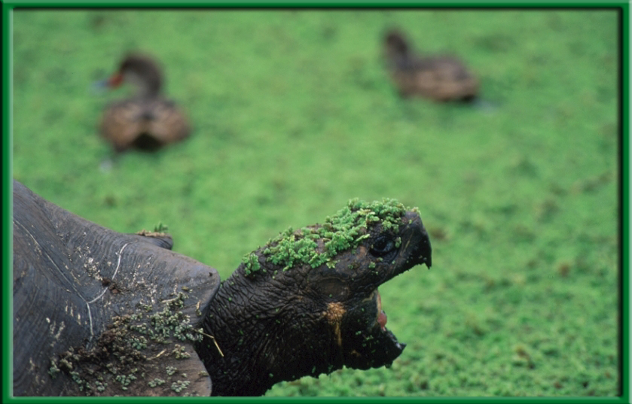
Section 5.1 Summary – pages 111-120
Water pollution
Water pollution degrades aquatic habitats in streams, rivers, lakes, and oceans.
A variety of pollutants can affect aquatic life.

Slide 21
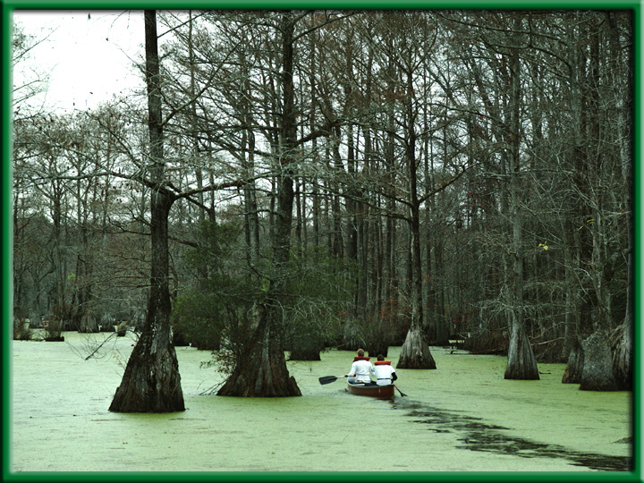
Section 5.1 Summary – pages 111-120
Water pollution
Excess fertilizers and animal wastes are often carried by rain into streams and lakes.
The sudden availability of nutrients causes algal blooms, the excessive growth of algae.

Slide 22
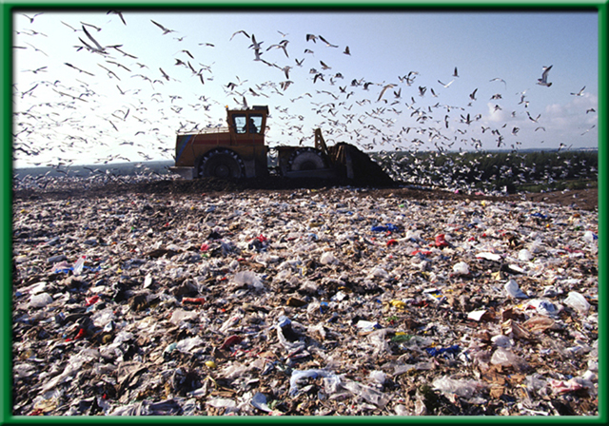
Section 5.1 Summary – pages 111-120
Land pollution
Trash, or solid waste, is made up of the cans, bottles, paper, plastic, metals, dirt, and spoiled food that people throw away every day.

Slide 23
Section 5.2 Summary – pages 121-125
Habitat corridors
A general strategy for protecting the biodiversity of an area probably is to protect the largest area possible.
However, research is showing that keeping wildlife populations completely separate from one another may be resulting in inbreeding within populations.

Slide 24
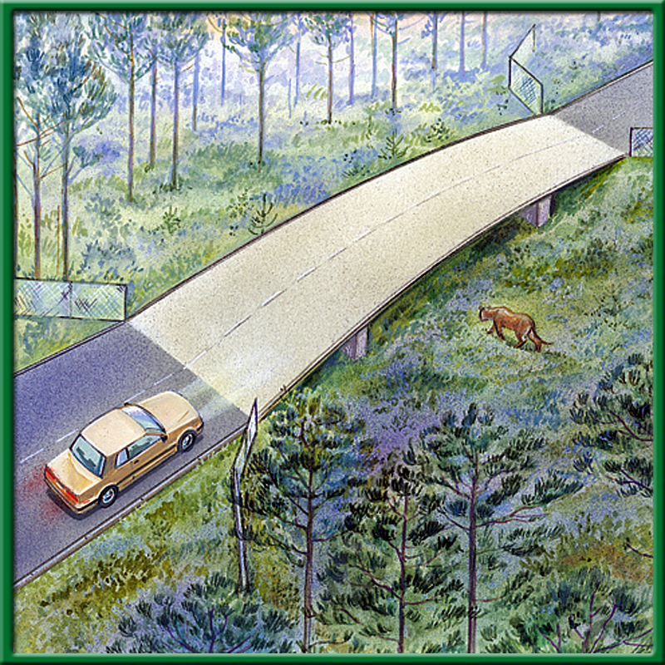
Section 5.2 Summary – pages 121-125
Habitat corridors
Therefore, another strategy for preserving biodiversity is to connect protected areas with habitat corridors.

Slide 25
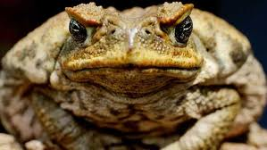
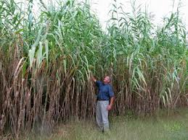
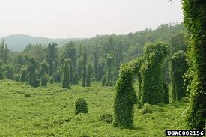
#3. Invasive species
Species that do not belong, and take over, crowding out or out competing the native species.

Slide 26
#3. Global Warming – Climate Change
Rise in CO2 concentration
Increase melting of Polar ice caps
Increase average temperature of ocean
Increase in severe weather events

Slide 27
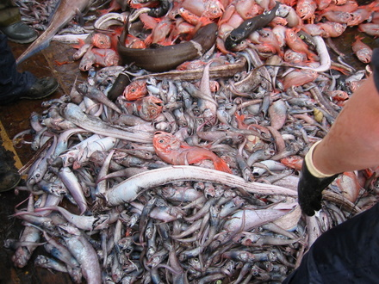
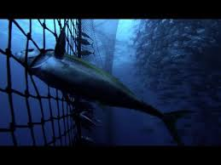
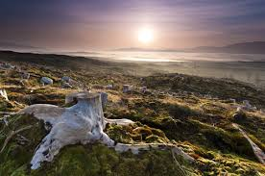
#3. Overharvesting of Resources

Slide 28
Biodiversity Activity Page 43 NB Read your article, take notes on the white board. Present your findings about the Biodiversity in your Ecosystem
What are some abiotic & biotic characteristics of your ecosystem?
What is an example of Biodiversity in your Ecosystem?
What does it say about California’s Biodiversity?

Slide 29
10/14 The Future of Biodiversity CH 10.3 Obj. TSW explain the advantage of protecting entire ecosystems rather than individual species. P. 80 NB
List some efforts to save individual species.
How is preserving ecosystems and habitats effective?
What are some international efforts to preserve Biodiversity?

Slide 30
Ecology Vocab A to Z
Decomposer
Producer
Competition
Biotic
Habitat
Niche
consumer
Population Size
Abiotic
Ecology
Community
Biome
Limiting Factors
Predator

Slide 31
5/4 Ecosystems 2.1 Obj. TSW demonstrate that a vital part of an ecosystem is the stability of its producers, consumers and decomposers in their Ecology Study Guide and class discussion & Problem Solving Lab. P.46NB
Compare and Contrast Heterotrophs and Autotrophs with examples of each.
What factors make this picture an Ecosystem, name 3?
How are decomposers important to an ecosystem, name 3.
Trees
Bear
Turtle
Deer
Sleeping
Forever Fish

Slide 32
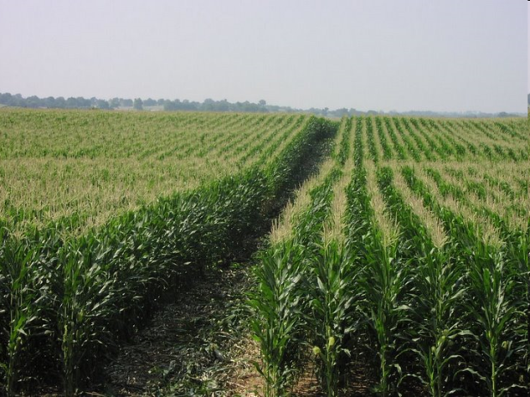
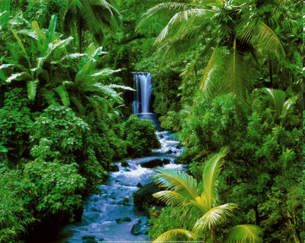
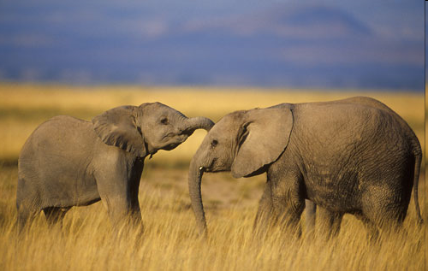
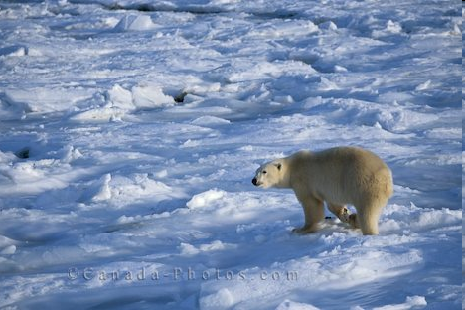
Biodiversity
The number of species in a specific area
Biodiversity increases as you move toward
the equator
Where are some places that would have
more biodiversity?

Slide 33
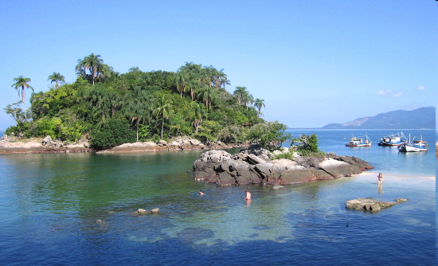
Studying Biodiversity: Islets
If I removed all of the organisms, minus the trees, from below what would happen? What organisms would come back first?
*Insects and spiders would return first
The farther away the islet was from the mainland, the longer it will take to re-populate (Less biodiversity)
*larger the islet=more biodiversity! (draw graph)

Slide 34
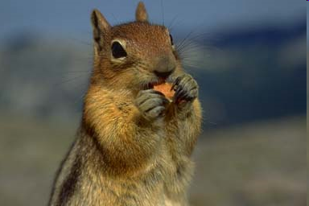
Importance of Biodiversity
*Important to nature
*Living things → interdependent
(animals could not exist without
green plants)
Populations are adapted to
live together in communities
*biodiversity brings stability
A pest could easily destroy all of a farmer’s corn crops, but it would be difficult for just one pest to destroy multiple kinds of vegetation.
Think about this like variation…
*importance to people
Humans depend on other organisms for their needs…
Can you name some?

Slide 35
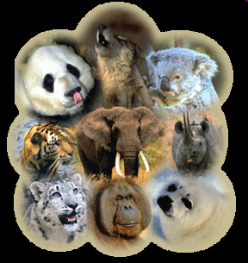
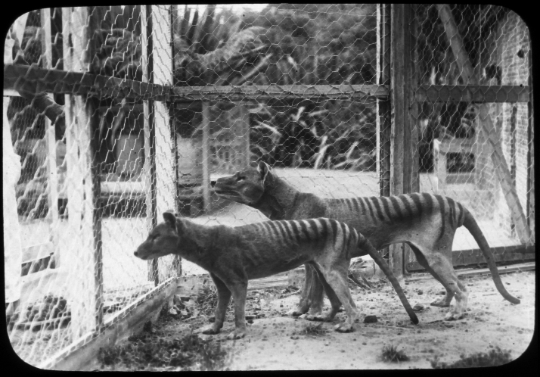
Loss of Biodiversity
Extinction: the disappearance of a species when the last of its members dies
Natural process
But today its exceeding the rate it should be at due to: human needs, habitat loss, and land exploitation
Endangered species: when its numbers become so low that extinction is possible

Slide 36
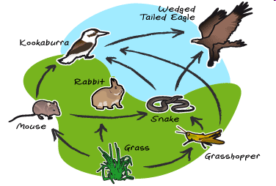
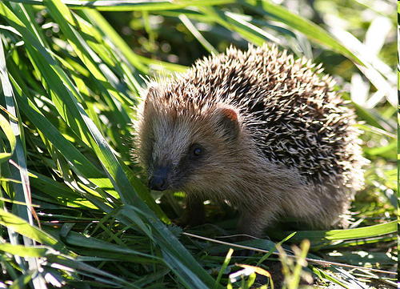
Ecosystem
*ecosystem: made up of interacting populations (communities) and the abiotic factors
An ecosystem is generally an area within the natural environment

Slide 37
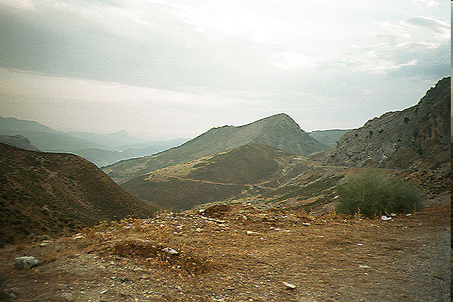
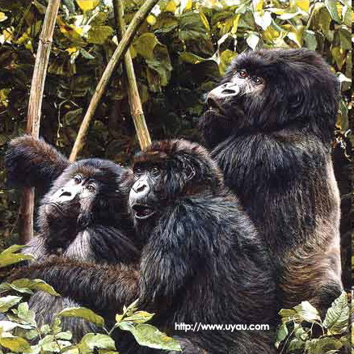
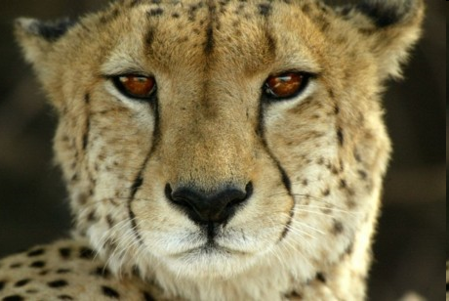
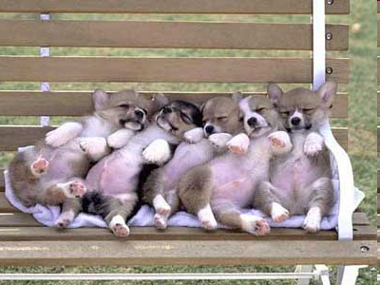
Abiotic and Biotic Factors
*abiotic components are non-living chemical and physical factors in the environment
Ex. Rocks, soil, oxygen, carbon
*biotic components are living factors
Ex. Plants, animals

Slide 38
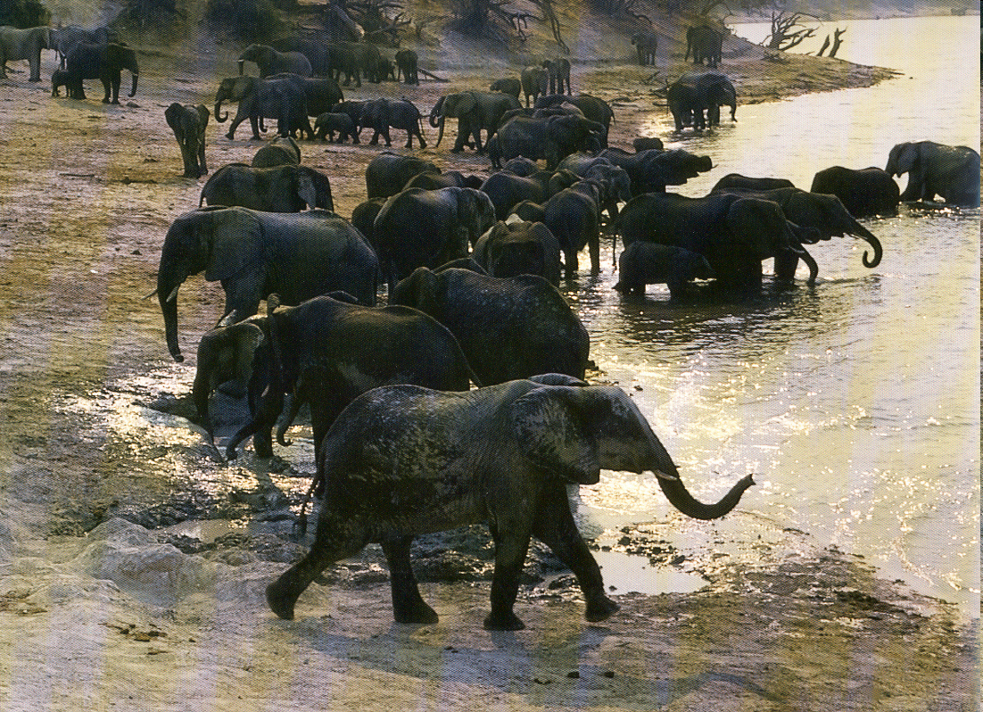
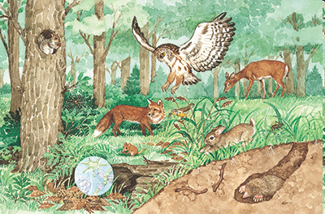
Communities vs Populations
*community→ collection of several interacting populations that inhabit a common environment
*population→ group of organisms all of the same species which interbreed and live in the same place at the same time

Slide 39
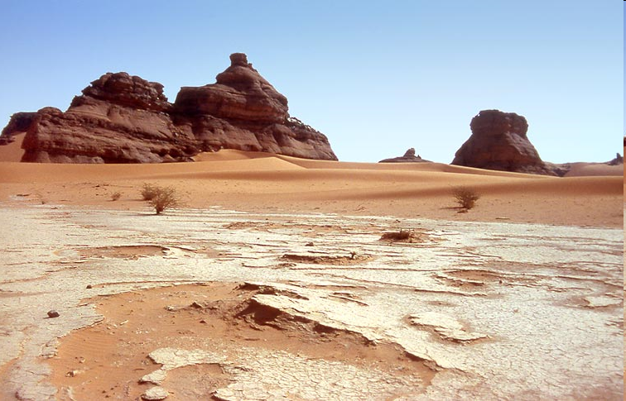
Limiting Factors
*any biotic or abiotic factor that restricts the existence, numbers, reproduction, or distribution of organisms
*Ex. Sunlight, climate, temperature, water, nutrients/food, fire, soil chemistry, space, other organisms

