Slide 1
Environmental Science
Water and Air Pollution Week 11

Slide 2
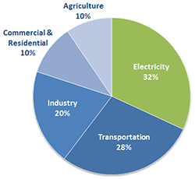
10/26 What Causes Air Pollution? CH12.1 Obj. TSW understand the causes of air pollution and the hazards to health. P. 16 NB
Name 5 primary air pollutants and give sources for each.
Name two major sources of air pollution in urban areas.
Describe the way in which smog forms.

Slide 3
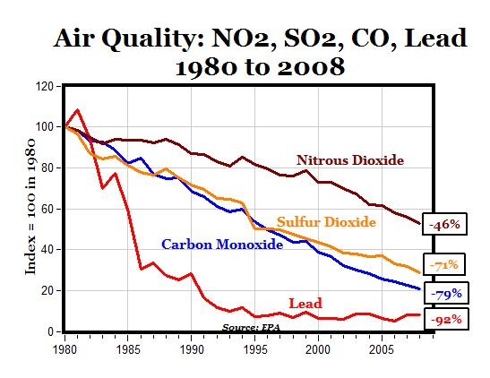
Primary Air Pollutants
Carbon Monoxide (CO)
Nitrogen Oxides (NOx)
Sulfur Dioxide (SO2)
Volatile Organic Compounds (VOC’s)
Particulate Matter (PM)
Mark J. Perry @Mark_J_Perry
March 23, 2010 6:42 am | AEIdeas

Slide 4
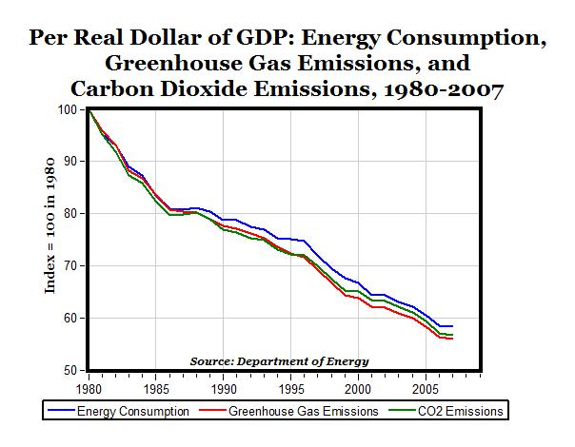
Mark J. Perry @Mark_J_Perry
March 23, 2010 6:42 am | AEIdeas

Slide 5
Lab – Ground Water Filters p. 300 – 301 ESBK page 17 NB
Contaminant | Before Filtration Description | After Filtration Description
Water (Control) | Water Clean, no smell | Water, dirty
Water (Control) | Water, clear, clean, no smell | Water mixed, dirty, brown, smells like dirt
Sodium Chloride (Salt) 1 TSP | It is opaque, (white) smells salty, feels like denser water | Brown, feels like muddy water
Sodium Bicarbonate (Baking Soda) 1 TSP | Brown river, sewage water | Dirty green, smells like dirty sand
Food Coloring (Blue) 5 drops | Liquid Blue | Light green, yellow
Food Coloring (Green) 5 drops | Dark Green Water | Mountain Dew color, dirty green
Maple Syrup 1 TSP | Thick deep amber strong scent | Thin yellow amber, barely smells
Vegetable Oil 1 TSP | Clean water bubbles, from oil | No signs of oil, soil filtered oil

Slide 6
Ground Water Filters

Slide 7
Lab Report – Porosity and Permeability of Soils impact filtration of pollutants.
How will you test the result of filtering your pollutant?
What procedure will you use to test the filtration of your pollutant?
What does the porosity and permeability of the soil mean for highly toxic substances like perchlorates? Or metals?
How much water was filtered out the first time?
The second time, how much water was there and how was it different?

Slide 8
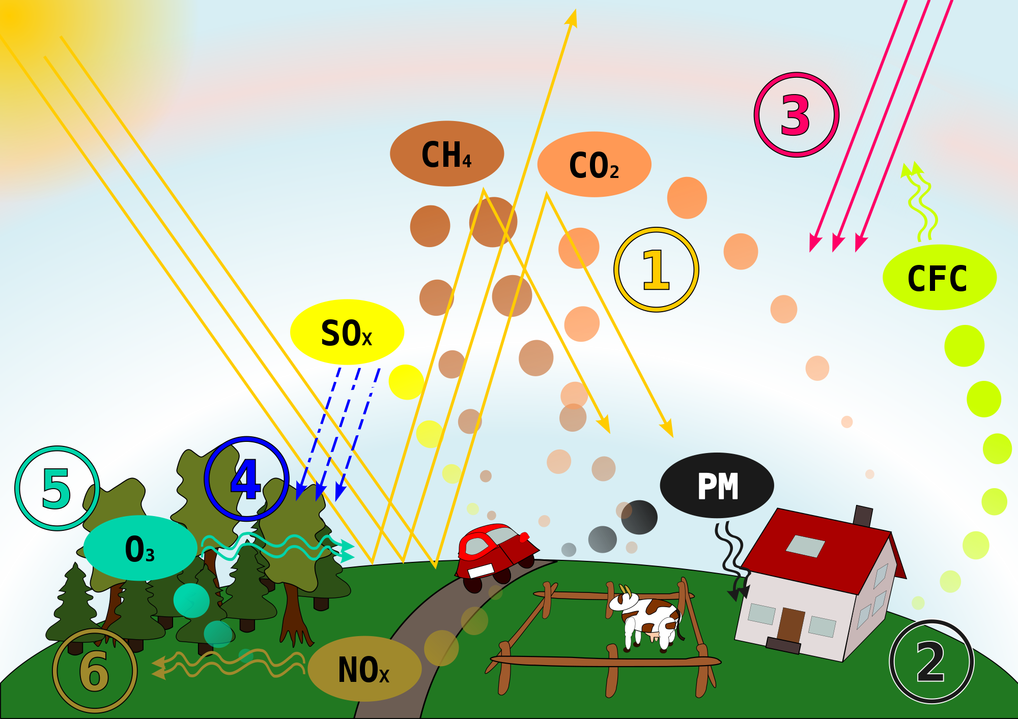
10/27 Air Pollution CH 12.1 & 12.2 Obj. TSW learn how primary pollutants contribute to secondary pollutants. P. 18 NB
Describe a temperature inversion and list what cities have them.
What are the short term and long term effects of air pollution on health.
Describe some indoor air pollutants.

Slide 9
Temperature Inversion

Slide 10
Create your questions for your Quiz CH 11
Level 1: only 1 point, 1 word, short phrase answer
Level 2: 2 points, 1 – 2 complete sentences for an answer
Level 3: 3 points, Includes a definition, and example and an explanation or significance

Slide 11
Point Source and Non-Point Source Pollution 19NB
Write an AXES Paragraph about our topic.
Define each.
Give an Example of how they are similar and how they are different.
Explain what happens.
Show why is it important to us.
Maybe include or reference some of the Laws or Acts Page 293. ESBK

Slide 12
Taboo
Ground Water
Watershed
Potable
Dam
Water pollution
Clean Water Act

Slide 13
Taboo
Aquifer
Porosity
Permeability
Desalinization
Point source Pollution

Slide 14
Cruise Chip Discharge

Slide 15
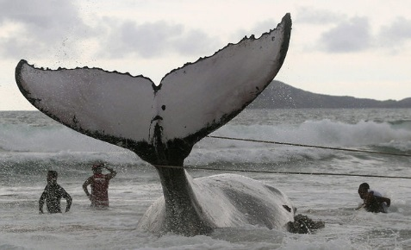
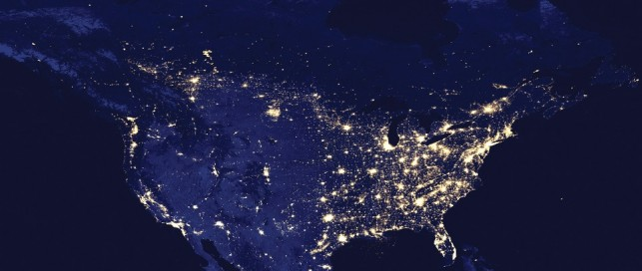
10/28 Air, Noise & Light Pollution CH 12.2 Obj. TSW learn about pollution caused by noise and light. P. 20 NB
Describe Sick Building Syndrome.
Noise Pollution can cause harm, What is the threshold for pain? What are some activities that cause this?
Light pollution is an environmental concern. Why?

Slide 16
Agenda 10/29
WU
Go over quiz
Finish WS
Discuss article
Watch How the Universe was made – cars
Students will write 3 open ended questions.

Slide 17
WS P. 21 NB
IV – paper clips/ Mass
DV – Distance it would fly
Control – Paper airplane w/out paper clips
Constants- Paper, paperclips
IV – Calculators
DV – speed working with math problems
Control – students w/o calculators
Constants- math problems, same calculators
3. IV – Ages of students
DV – Puzzle assembly time
Control - ?
Constants – Puzzle
4. IV – Amount of Coffee Grounds
DV – the taste of the coffee
Control – The minimum amount of coffee used.
Constants- type of water, same percolator, electrical sources, coffee

Slide 18
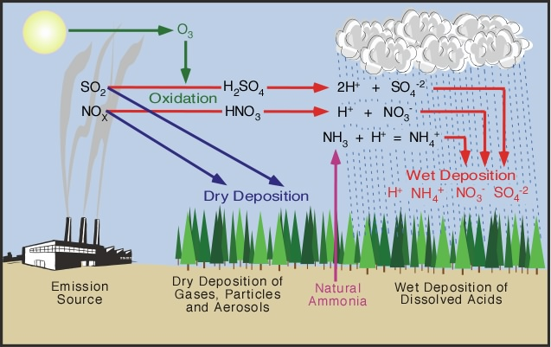
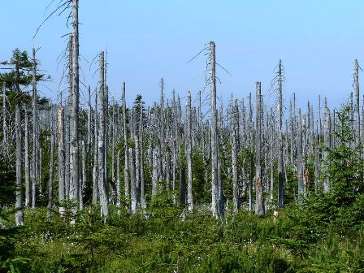
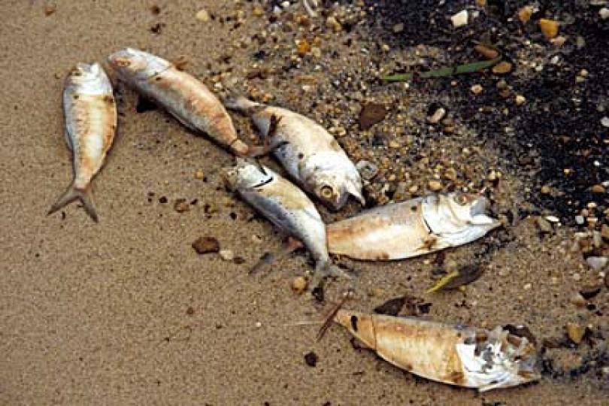
10/29 Acid Precipitation CH 12.3 Obj. TSW understand the causes and effects of acid precipitation. P. 22 NB
Explain the cause of Acid Precipitation.
Draw the Acid Precipitation cycle in figure 3.2.
Explain how acid precipitation affects plants soils and aquatic systems.

Slide 19
10/30 Acid Precipitation Conflicts & Cooperation CH12.3 Obj. TSW learn how air pollutants affect humans and how countries have to act together to decrease the harmful affects on the environment. P. 24 NB
How does Acid precipitation affect humans?
How can pollutants from the US produce acid precipitation in Canada?
What is the result of the Canada-U.S. Air Quality Agreement I 1991?

Slide 20
How the Universe Built your car p. 25 NB
Create 3 open ended questions, you can not find the answer to in your book

Slide 21
Ground Water Filter Lab
Introduction: Discuss Ground Water and Aquifers.

