Slide 1
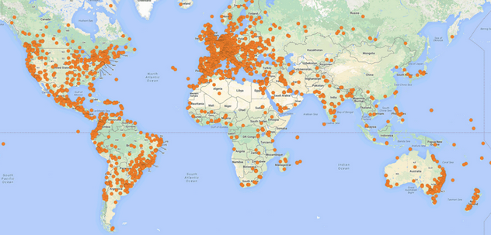
Sunday’s Marchs Around the World

Slide 2
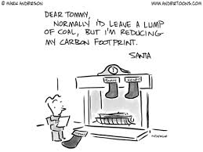
Carbon, Hydrologic, Phosphorus Cycle 9/24 Obj. TSW identify the parts of the Carbon, Hydrologic and Phosphorus Cycle
1. Explain how the carbon cycle and global warming are connected.
2. List the steps for the Hydrologic Cycle and how Humans can alter the cycle
3. List the steps for the Phosphorus Cycle and explain what happens when there is excess phosphorus?

Slide 3
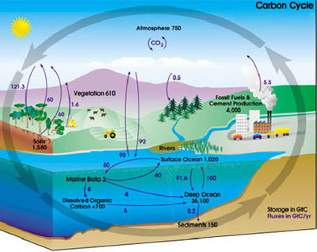

Slide 4
Carbon Cycle and GHG
Industrial Revolution
Combustion of fossil fuels
Tree harvesting
Cutting and burning
Replanting trees
-Increased carbon= upsets balance between carbon pools and atmosphere
-Increases heat retention= Greenhouse Gas Effect
-Normally a good thing

Slide 5
Why is this happening?!?
-Some heat trapped/some reflected back into space
-BUT increase in CO2 & other greenhouse gases= blanket the earth
-Heat cannot reflect back into space, now trapped in the atmosphere
Notes:
Normally some heat is trapped and some is reflected back into space
But with an increase in CO2 and other gases (greenhouse gases) these gases essentially blanket the earth and the heat cannot reflect back into space so that heat is now trapped in the atmosphere
Essentially these gases are acting as a blanket for the earth

Slide 6
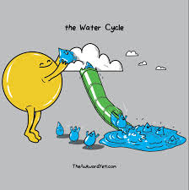
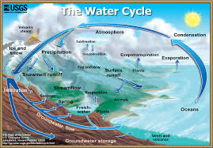
Hydrologic Cycle
1. Water Stored in Ocean
Heats up and turns from liquid to gas= Evaporation
Rise up, float into atm.= Condensation
Cools→ forms Clouds→ produces precipitation
2. Precipitation
Snow, Rain, Sleet, Hail, etc.
Particles too heavy to remain suspended= fall back to Earth
1) Earth porous enough to absorb H2O
2) Earth isn’t porous enough= does not get absorbed
(4) Runs off! = Goes to streams or river and eventually reaches ocean
3. Evapotranspiration
Combo of evaporation from land & transpiration from plant life
H2O released back into atm.
Cools→ forms clouds→ produces precipitation
3. Transpiration
Plants release water from their leaves into atm.
Cools→ forms clouds→ produce precipitation

Slide 7
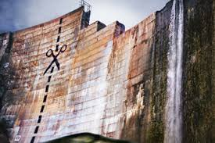
Human Activities
Harvesting Trees
Reduces evapotranspiration→ runoff increases→ landslides/erosion/flooding
Paving over land surfaces to build
Increases runoff and evaporation
Diverting water
Dams

Slide 8
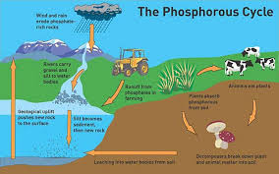
Phosphorus Cycle
5. Moves through food web
6. Returned to soil by decomposition or excretion
Most is found in lithosphere, hydrosphere and biosphere
Unlike carbon and nitrogen
1. Weathering or mining of phosphate rocks/ use of phosphate fertilizer
2. Releases phosphorus into soil and water
3. Producers take up phosphates
4. Eaten by consumers

Slide 9
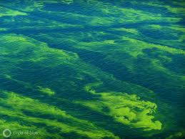
Too Much!
Fertilizer-containing runoff from agriculture or residential areas/household detergents
Limiting nutrient
Alter plant communities
Rapid Growth of Algae= Algal Bloom
Eventually die= increase in decomposition=
Reduce dissolved oxygen= Hypoxic conditions (low oxygen)=
Death to fish and shellfish
Lake Erie
Notes:
little is available naturally in rivers and streams

Slide 10
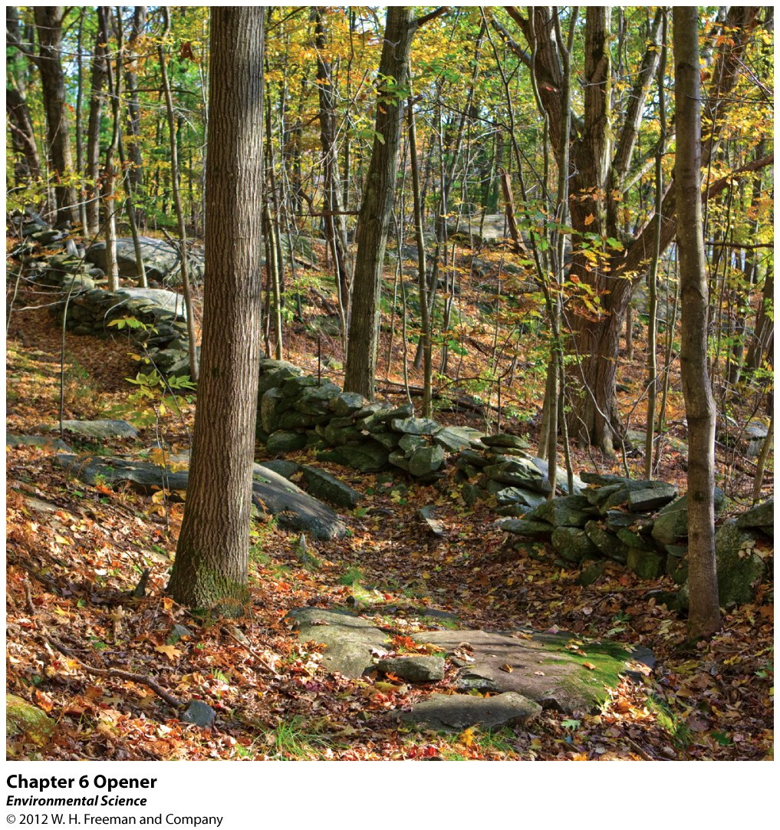
Chapter 6
Community Ecology

Slide 11
In the News…

Slide 12
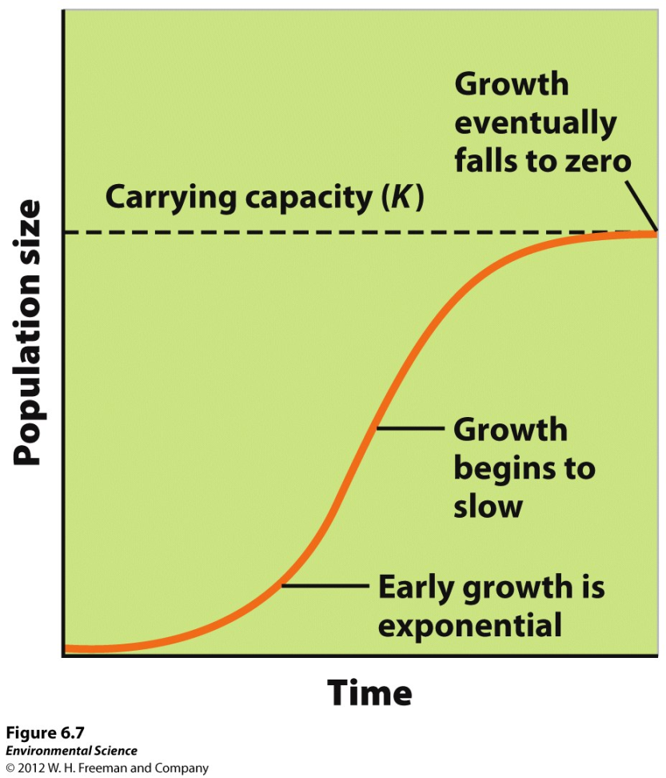
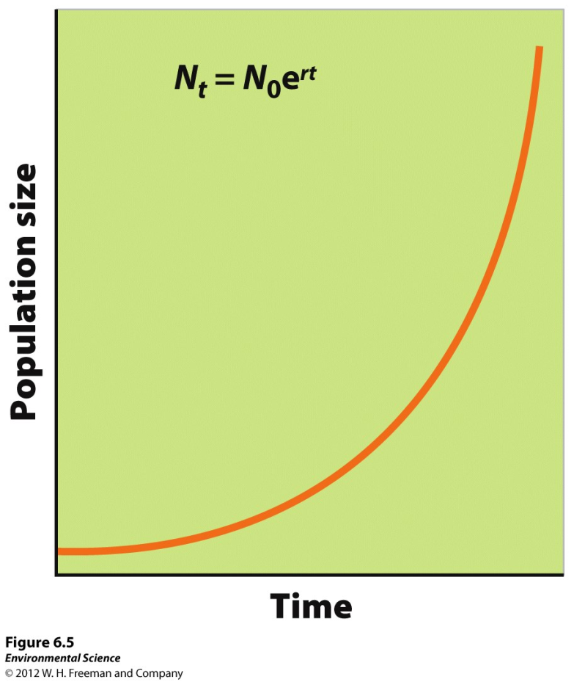
Starting CH 7: Understanding Populations: 9/25 Obj. TSW learn about how populations growth rate is measured, and how graphs can represent how populations grow. P. 56NB
How is Growth rate measured?
Draw a graph of Exponential growth, what shape is the curve and give an example of an organism with this pattern.
Compare and Contrast a K- selected species and a r-selected species, how are their graphs different, how are the organisms they represent different?

Slide 13
How do Populations change in size
Global Scale: Birth rate – death rate = growth rate
b - d = r growth rate (r) can be + or –
Local Scale: movement from one region to another
Immigration – # individuals entering a population
Emigration - # individuals leaving a population
r = (b – d) + (i – e)

Slide 14
Factors that Regulate Population Abundance and Distribution
Population size- the total number of individuals within a defined area at a given time.
Population density- the number of individuals of the same species per unit geographic area at a given time.
Population distribution- how individuals are distributed with respect to one another.
Population sex ratio- the ratio of males to females
Population age structure- how many individuals fit into particular age categories.

Slide 15
Exponential Growth Model
Growth rate- the number of offspring an individual can produce in a given time period, minus the deaths of the individual or offspring during the same period.
Intrinsic growth rate- under ideal conditions, with unlimited resources, the maximum potential for growth.

Slide 16
Exponential Growth Model
J-shaped curve
Even though Humans are a K-Selected species, this is our current Growth rate
Bullfrogs, Hogs
Notes:
Technology= we have not hit our carry capacity curve but believed that by 2050 we will= run out of resources

Slide 17
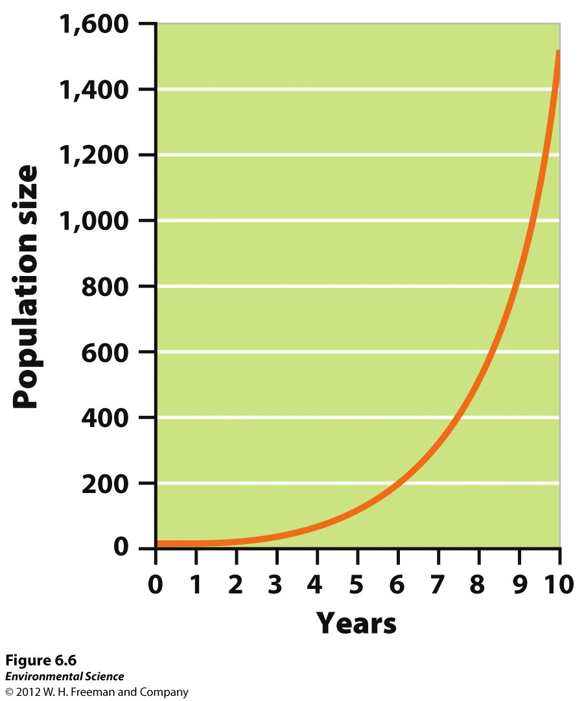
Do the Math
What is the % change in the population from year 6 to year 9?

Slide 18
Answer!
200 – 800 x 100%
200
600 x 100% = 3 x 100% = 300%
200

Slide 19
Reproductive Strategies
K-selected species- the population of a species that grows slowly until it reaches the carrying capacity.
Ex. elephants, whales, and humans*.
R-selected species- the population of a species that grows quickly and is often followed by overshoots and die-offs.
Ex. mosquitoes and dandelions

Slide 20
Logistic Growth Model
Logistic growth- when a population whose growth is initially exponential, but slows as the population approaches the carrying capacity.
S-shaped curve- when graphed the logistic growth model produces an “S”.
Usually “K” selected species.

Slide 21
Growth and decline of Reindeer population
25 Reindeer were introduced to St. Paul Alaska in 1910.
What Growth pattern does it show?
Why did the population crash?

Slide 22
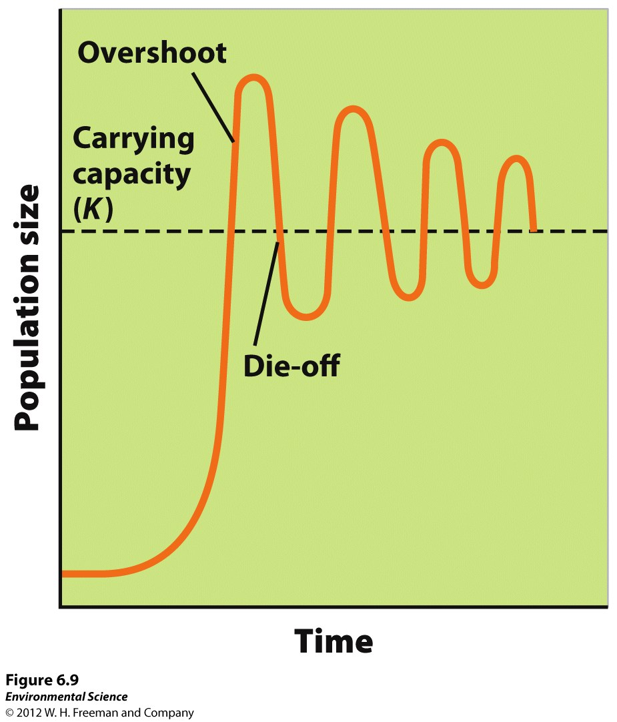
Variations of the Logistic Model
If food becomes scarce, the population will experience an overshoot by becoming larger than the spring carrying capacity and will result in a die-off, or population crash.

Slide 23
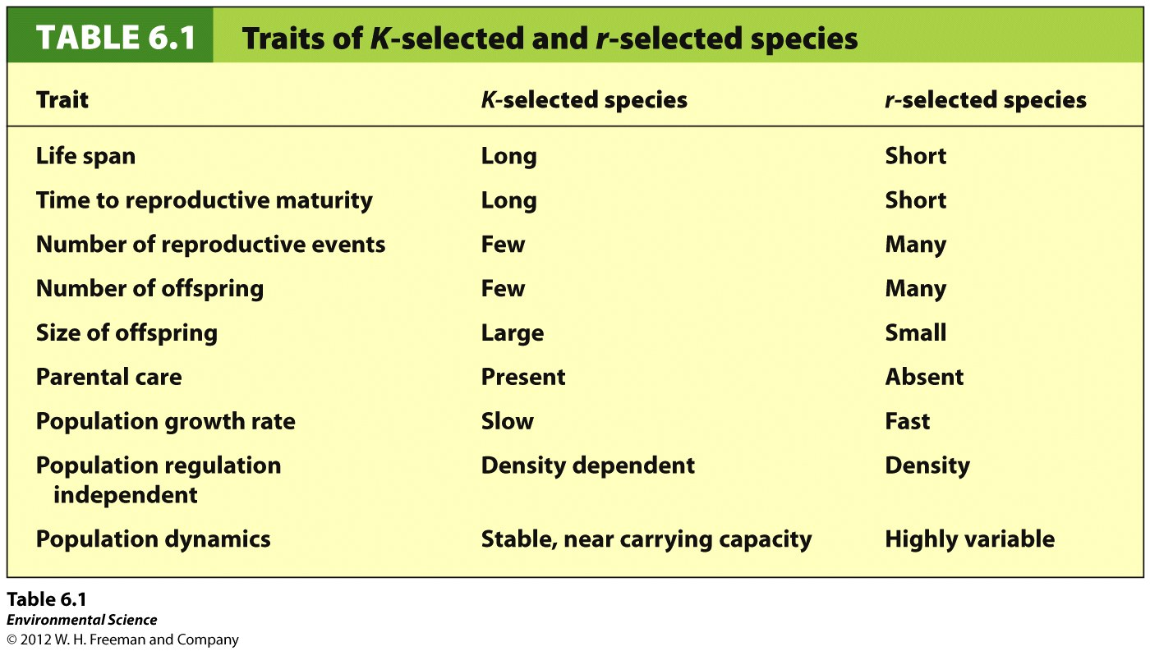
Notes:
R selected= don’t take care of their offspring, bacteria, mosquitos, etc.
K selected= fewer offspring, use resources well

Slide 24
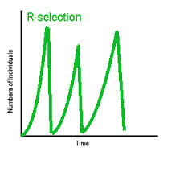
K- selected vs. r-selected

Slide 25
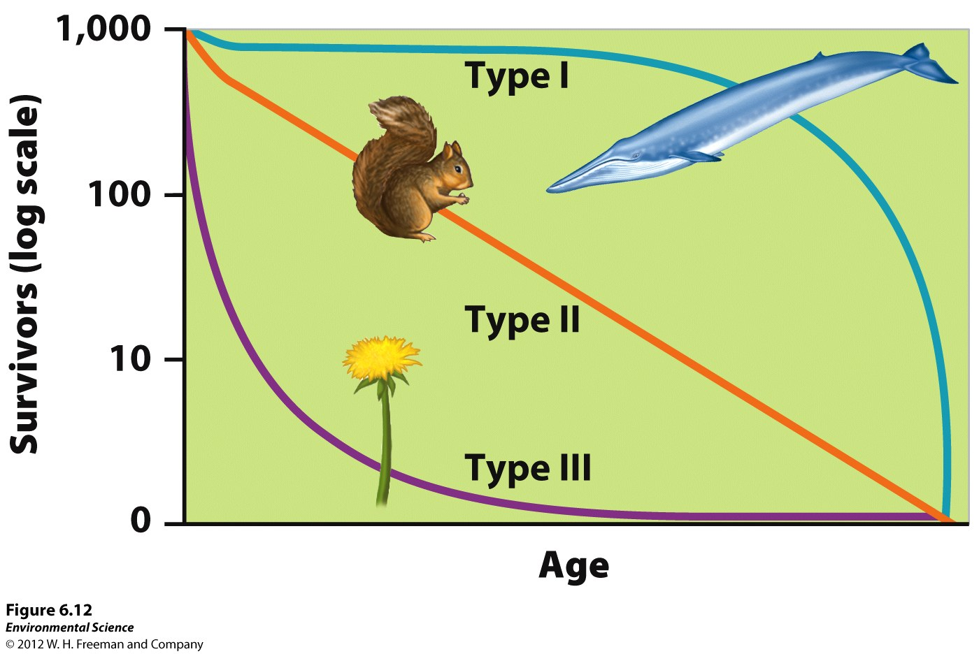
Survivorship Curves
Type I survivorship – Has excellent survivorship until old age. K – selected species.
Type II survivorship –
Exhibiting a relatively constant decline in survivorship over time.
Type III survivorship –
Has low rates of survivorship early in life. r-selected species

Slide 26
Eutrophication 9/26 Obj. TSW identify why nitrogen-based fertilizers are heavily used in industrial practices and effects of run-off from agricultural land pg. 58
1. Explain Eutrophication and give an example of how it can happen
2. What effect does Eutrophication have on organisms in a body of water?
3. What role did the “Green Revolution” play on the industrialization of farming practices using Nitrogen?

