Slide 1
Environmental Science
Aquatic Ecosystems Chapter 7
Ecosystem Poster Project Due Sept. 25th

Slide 2
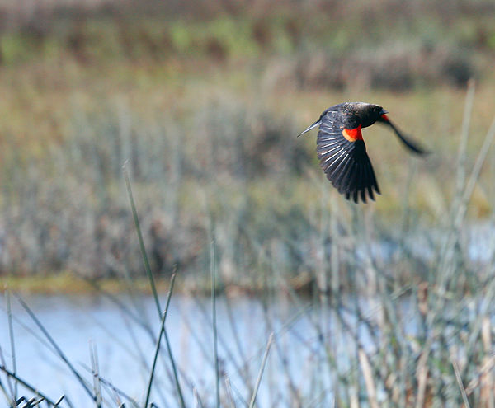
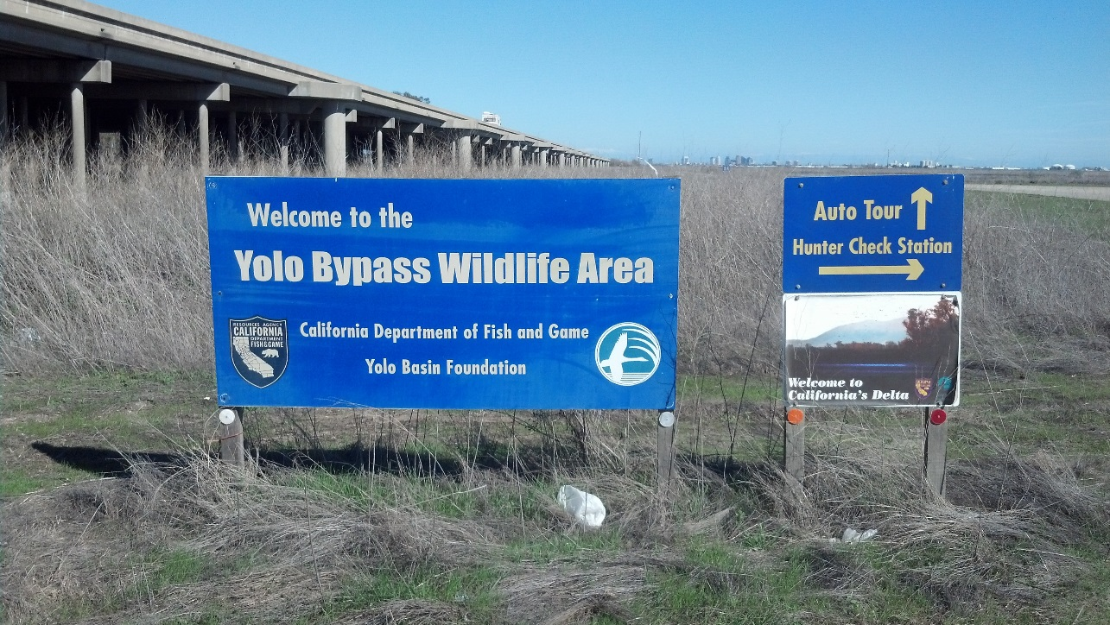
9/21 Freshwater Ecosystems CH 7.1 Obj. TSW explain environmental benefits of wetlands. P. 48 NB
What is salinity?
Describe a Wetland.
What are 3 functions or benefits of a wetland?

Slide 3
EEI Curriculum Liquid Gold: California‘s Water Articles
Get into groups according to your row
Read the article assigned to you.
Write an AXES paragraph on the White Boards & page 49 NB
Share out and take notes on others presentations.
Assertion – Statement about your article
Example – An example of what your article is discussing
Explanation – Explain that example
Significance – Show, describe why your example is important to us?

Slide 4
9/2 Marine Ecosystems CH 7.2 Obj. TSW explain why marine ecosystems are very productive. P. 50 NB
What are some names of Coastal wetlands?
Explain why an estuary is a very productive ecosystem.
Describe two threats to coral reefs.

Slide 5
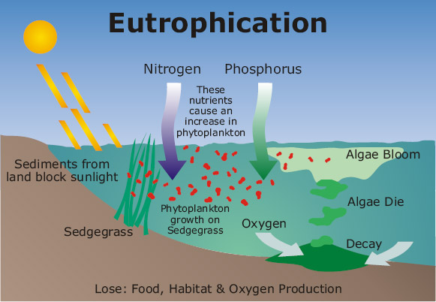
9/23 Eutrophication & Pond Water CH 7.1 Obj. TSW learn how humans can inadvertently pollute natural waterways. P. 52 NB
What is Eutrophication?
What nutrients are involved?
Explain the process of eutrophication.

Slide 6
Monsters in the Pond Water

Slide 7
Eutrophication Demonstration &
Monsters in the Pond Water Lab
Page 192 – 193 Environmental Science Book
Notes/ Data Page 51 NB
What is the Control?
What are the Experimental Groups
In your Experimental Group, What is your Independent Variable
What is your Dependent Variable?
Write a prediction as to what you think will happen in each of the three beakers.

Slide 8
Steps to Eutrophication
Fertilizer (Nitrogen and Phosphorus) get into the water.
There is an increase in algae.
Increase competition for fertilizer.
Some of the plants/ algae die
Bacteria start to decompose the dead plants/ algae
Bacteria consume the Oxygen in the water
Fish and other organisms suffer and die.
Water quality decreases more.

Slide 9
Homework Week 6 CH 7 Aquatic Ecosystems
Read CH 7
Finish and turn in your Ecosystem Poster
1 page of Notes page 53 NB

Slide 10
Biome Activity Page 47 NB
For you Biome 10 Biotic
5 Abiotic
5 ways they affect each other
Make an energy pyramid
Discuss Succession
How does the cycles in nature impact your ecosystem?

Slide 11
Class Time to Work on Ecosystem Project
Crash Course Ecology
Bozeman Science
Ecosystem Poster Project is due tomorrow☺

Slide 12
Thursday Ecosystem Projects due
Notes – Ocean Acidification page 57NB
NOAA
The Acid Test

Slide 13
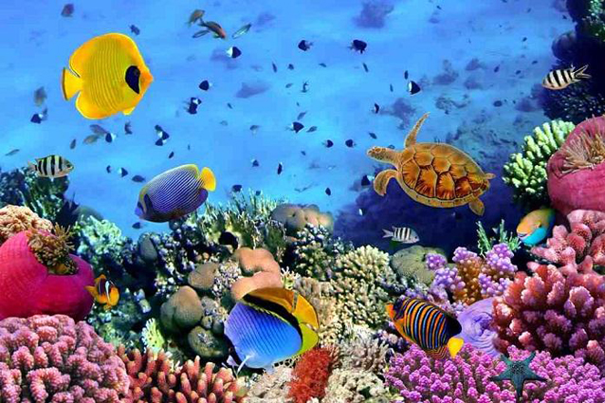
9/24 Threats to Marine Ecosystems CH 7 Obj. TSW understand how threats to marine ecosystems impact us. P. 54NB
What are some threats to Ecosystems?
What are some threats to the Oceans?
Viewing Wetlands Historically P. 186, What might have caused Florida’s and Louisiana’s wetlands to decrease?

Slide 16
What helps prevent flooding?

Slide 17
Friday – Video I will grade your Notebook Check P. 46 - 57 60 points
Hurricane Katrina

Slide 18
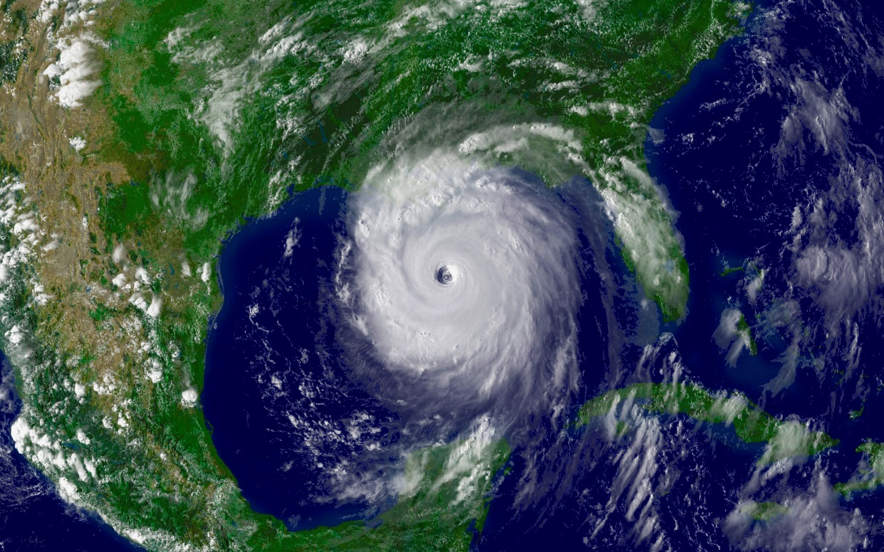
9/25 Hurricane Katrina & New Orleans CH 7 Obj. TSW learn how society and the environment are related. P. 56 NB
What structures were supposed to protect New Orleans from flooding?
How do the wetlands help prevent flooding?
Should a city have been built in an environment known to be so unstable?

