Slide 1
Agenda 8/26
Warm up & Intro Ms. Funk
PPT: ATM & Soils
Quiz
Greenhouse & gardens when meet?
Bring soil, sand, gravel, shoe boxes, hoola hoops, spoons, 2 – liter bottles

Slide 2
Percent Change Percent change can be defined as the amount of change over time based on a starting point. The following formula can be used. Percent change is looking at V = Value; T = Time V2 – V1 V1 x 100 =
Whole – part x 100 =
Original
Doubling Time / Rule of 70
70/rate = years

Slide 3
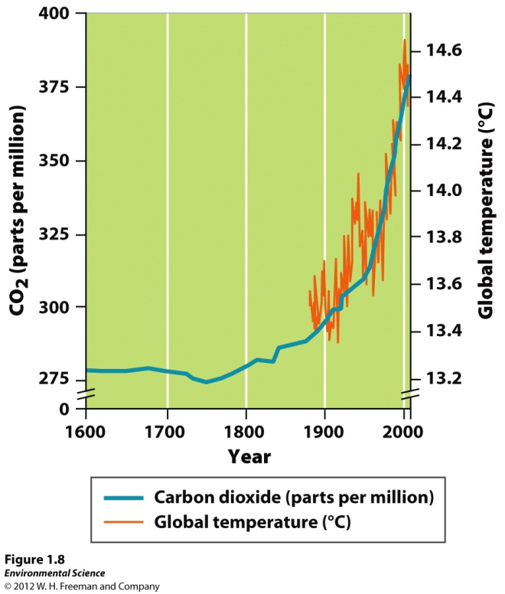
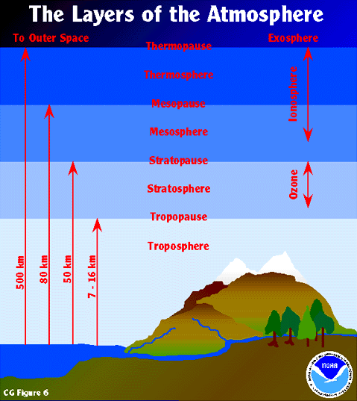
Atmosphere & Soils 8/26 Obj. TSW review how to do math problems involving Env. Sci, take notes on Atm. & Soils ppt, then do well on the quiz. P. 12NB
Since the Industrial Revolution CO₂ has increased from 280 ppm to 380 ppm. What is the percent change?
Parts of an old growth forest were cleared, in vacant groves, seedlings were planted. If the seedlings double in size every fourteen years, what % growth can the Forest service expect to see each year?
List the Regions of the Earth’s atmosphere. Which region does global warming to occur?

Slide 4
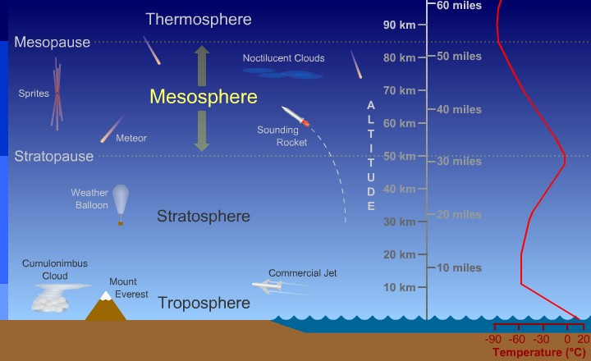
Layers of the Atmosphere
Exosphere in the highest & is above the thermosphere.
Stratosphere & Thermosphere increase in temperature.
Trophosphere is lowest & where global warming occurs & where the most oxygen is found.
Stratosphere is where the Ozone (O₃) is.
Composition
of the Atm:
21% O₂
78% N₂
1% CO₂

Slide 5
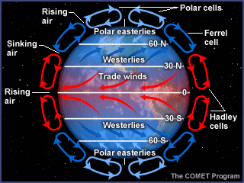
Atmosphere Circulation

Slide 6
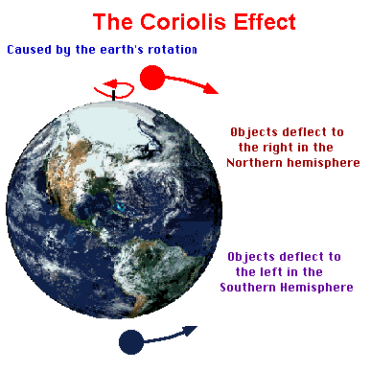
Coriolis Effect & Global Air Circulation
Effects wind patterns and air currents.
Three important properties of Air Circulation:
Cold air sinks, due to its density
Warm air rises, it expands & cools
Warm air can hold more water vapor
When it cools the vapor phase changes
To liquid water in the form of rain,
snow, or fog.
Air moves from high pressure to low pressure,
WIND.

Slide 7
Weather & Climate
Factors that determine climate: latitude (distance from the equator), global air circulation patterns oceanic circulation patterns, topography, solar activity & volcanic activity (SO₂ + H₂O + dust = ↓Temp.). Equator 0° Latitude, North Pole 90° North, South Pole 90° South
Low latitudes receive more solar energy
High latitudes receive the least and have the greatest fluctuation in solar energy with respect to temperature.

Slide 8
Composition of Soils
Soils are generally classified according to the percentage of SAND, SILT, and CLAY is in the sample.
SAND is generally classified as particles that range from 1/16 to 2 mm in size
SILT is generally classified as particles that range from 1/256 to1/16 mm in size
CLAY is generally classified as particles that are smaller than 1/256 mm in size

Slide 9
Types of Soils
Soils are named by their composition. Some are easy:
Silty Clay…
Sandy Clay…
Loam:
Soil that is composed of a relatively even conc. of sand, silt, and clay, usually about 40-40-20%.

Slide 10
The Soil Triangle
Use Soil Triangle to triangulate and pinpoint type of soil based on the (separated) sand, silt, and clay %.
Determine first the clay percent
Then the silt…
Then the sand

Slide 11
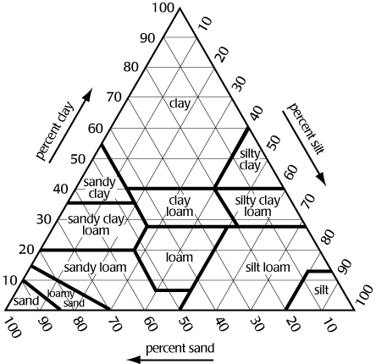
The Soil Triangle
OK, let’s try it:
Determine the type of soil if it has 30% clay
60% silt
and 10% sand
Silty Clay Loam

Slide 12
The Soil Triangle
OK, you try it:
Determine the type of soil if it has 25% clay, 35% silt, and 40% sand.
What is it?

Slide 13
ENSO El Niño –Southern Oscillation
Conditions where the water near the equator in the Pacific Ocean are warmer than normal
Increased rainfall in the southern US.
La Niña is the colder phase along the equator of the Pacific Ocean, with less rainfall.

