Slide 1
Environmental Science
Week 7 Unit 3 Populations Chapter 8
Understanding Populations

Slide 2
9/29 How Populations Change in Size CH 8 Obj. TSW understand populations, how they grow, and are regulated by limiting factors. P. 58 NB
What are the three main properties of a population?
Describe Exponential growth?
What is Carrying Capacity?

Slide 4
Oh, Deer!
What do you think happens to a population when resources change?
½ of you will start as RESOURCES; ½ of you start as DEER.
Each generation the resources choose if you are “water,” “food,” or “shelter.”
Water = hands on throat Food = hands on stomach Shelter = make a tent shape with hands
Each generation the deer choose if you’re searching for “water,” “food,” or “shelter.”
Water = hands on throat Food = hands on stomach Shelter = make a tent shape with hands
All deer and all resources will start in lines facing AWAY from each other.
When we say go, deer will race to get to the resource they need! NO CHEATING! Stick to the resource that you started with!
If a deer “catches” the resource that they were looking for, the resource they caught becomes a deer for the next generation! (The deer that got the resource “reproduced” and the resource became its offspring).
If a deer does NOT get the resource they were looking for, they die. ☹ Any dead deer become a resource during the next generation.
Before each generation we will record the # of deer and the # of resources, and see what happens over time!
Predators! One person will be the Wolf. The Wolf will stand in the middle between the resources & the deer. If the wolf catches you then you become a wolf also.

Slide 5
pHET – Natural Selection Activity Page 61 NB Answer the following questions in complete sentences.
What bunny did you select?
What Environment did you choose?
What mutation did you add?
What selection factor did you choose?
What does it mean if your Bunnies have
“Taken over the World!”
How does Natural Selection work?
Give an example of a Producer and Two Consumers. What level are they?
Draw a Food Chain of the ecosystem.

Slide 6
9/29 What limits Population Growth? CH 8.1 Obj. TSW learn to draw a carrying capacity graph and calculate growth rate of a population. P. 60NB
Draw a Carrying Capacity graph.
Choose an ecosystem. Label 5 Limiting Factors for that graph.
Calculate the Growth rate of a population that has a starting population of 100 individuals, there are 10 births, 5 deaths in a given year, What is the growth rate for the year?

Slide 7
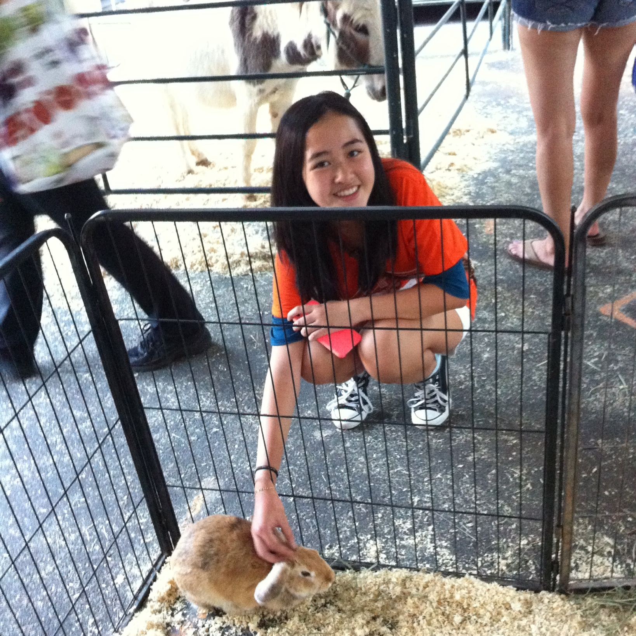

Slide 8
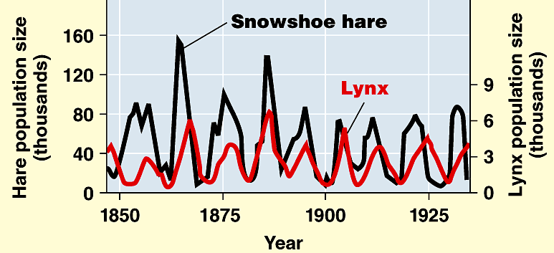
9/30 Limiting Factors CH 8.2 Obj. TSW learn the difference between types of limiting factors. P. 62NB
Limiting factors in the carrying capacity of an area can be density dependent or density independent. Write an example of each factor.
Explain how each factor impacts the population.
Calculate the growth rate of a population of a 1150 individuals, where 25 are born and 5 deaths.

Slide 9
Finish Acid Test: Ocean Acidification P. 57NB
What is the problem of Ocean Acidification?
How does it effect shell life?
What is the solution to Ocean Acidification?

Slide 10
Data Table Graph Write an explanation sentence for each of these examples of data. P. 59NB
Generation | Deer | Resource | Wolf
1 | 12 | 12
2 | 16 | 8
3 | 10 | 16
4 | 14 | 12
5 | 2 | 22
6 | 4 | 20
7 | 6 | 18
8 | 10 | 16
9 | 8 | 16 | 1
10 | 8 | 16 | 2
11 | 7 | 16 | 3
Write a summary of how the carrying capacity was maintained in the population of deer. P. 59 NB

Slide 11
Parachuting Cats in Borneo
The Day They Parachuted Cats into Borneo
Some time ago, World Health Organization sent supplies of DDT to Borneo to Fight mosquitoes that spread malaria among the people. The mosquitoes were quickly wiped out. But billions of roaches moved into the villages and they simply stored the DDT in their bodies. One kind of animal that fed on the reaches was a small lizard. When these lizards ate the roaches, they also eat a lot of DDT. Instead of killing them, DDT only slowed them down. This made it easier for the cats to catch the lizards, one of their favorite foods. About the same time, people also found that hoards of caterpillars had moved into feed on the roofing materials of their homes. They realized the lizards that previously had kept the caterpillars population under control had been eaten by the cats. And now, all over North Borneo, cats that ate the lizards died from DDT poisoning. Then rats moved in because there were no cats to control their population. With the rats came a new danger, THE Plague,. Officials sent out emergency call for cats. Cats were sent in by airplane and dropped by parachute to control the rats.
Biomagnification
Human activity with the best of intentions can have untended consequences.
Map of Borneo
Page 63NB
storybook

Slide 12
Video: Carrying Capacity & Populations p. 65 NB
How does energy flow in an ecosystem?
Draw an energy pyramid for any ecosystem.
Label the Trophic levels: P, C1, C2, C3
Add your decomposers: Worms, bacteria, fungi
Where is energy lost? What is the lost energy?
How does the loss of energy at each trophic level affect the carrying capacity of these populations?

Slide 13
10/1 How species interact with each other Obj. TSW identify symbiotic relationships and how they develop an ecosystem. P. 64 NB
What is a niche?
List the 4 types of interactions between species.
Write how the species interact with each other for each type of interaction.

Slide 14
Activity Foldable: Symbiosis For each type of Symbiosis, Give an example. Explain whether they benefit or are harmed by the symbiosis.
Competition Mutualism Parasitism Commensalism
Explain Symbiosis here:

Slide 15
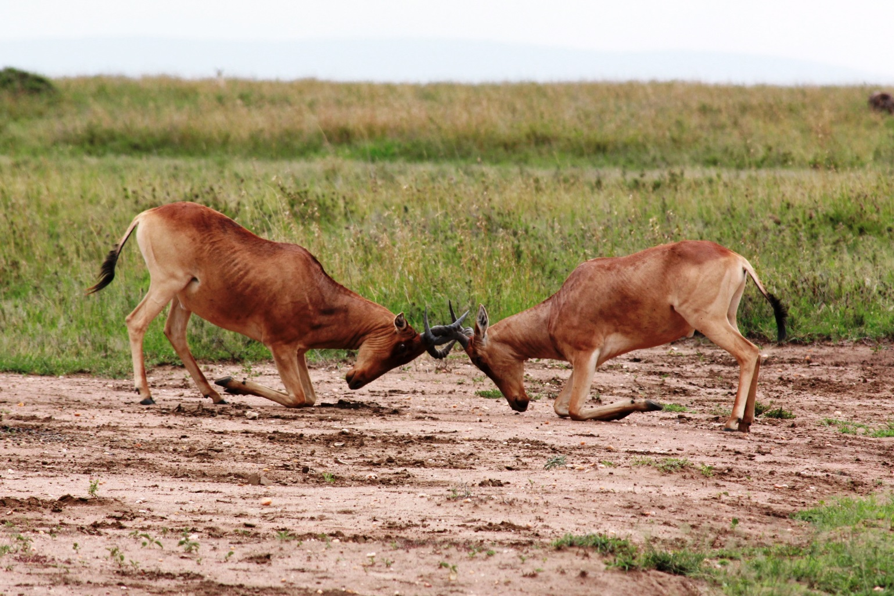
Competition

Slide 16
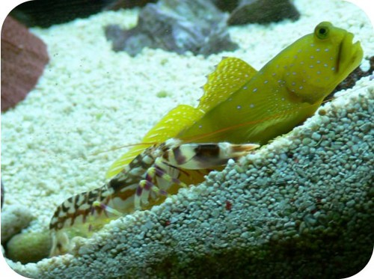
Mutualism

Slide 17
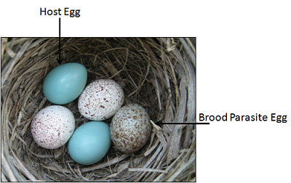
Parasitism

Slide 18
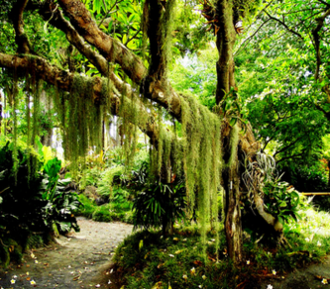
Commensalism

Slide 19
Time to write your 5 Points of Questions for Chapter 8
Level 1 – Easy, one word answer
Level 2 – Medium difficulty, write a sentence or two.
Level 3 – Challenging, explain, give examples show the significance of the concept or topic.
QUIZ tomorrow ☺

Slide 20
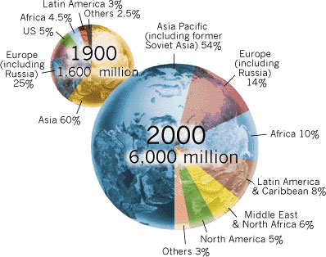
10/2 The Human Population CH 9.1 Obj. TSW learn about the growth pattern of the human population. P. 66NB
What is demography?
What growth pattern is the Human Population?
What shape curve is this? What should the curve be?

Slide 21
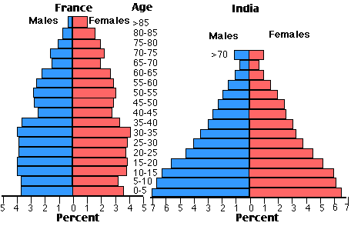

Slide 22
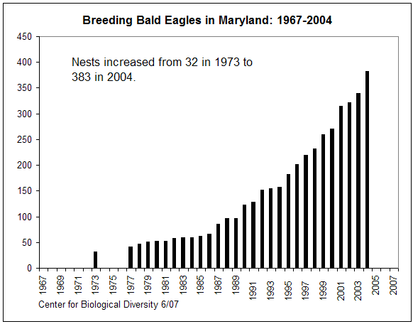

Slide 23
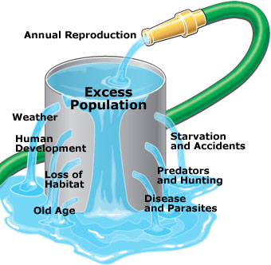

Slide 24
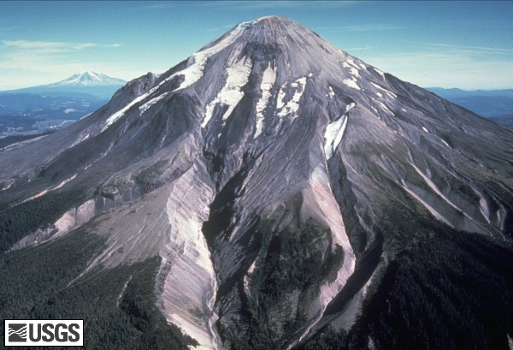
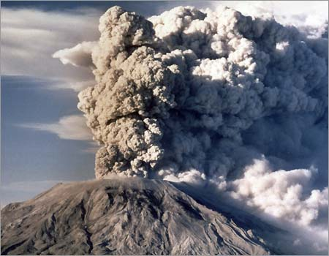
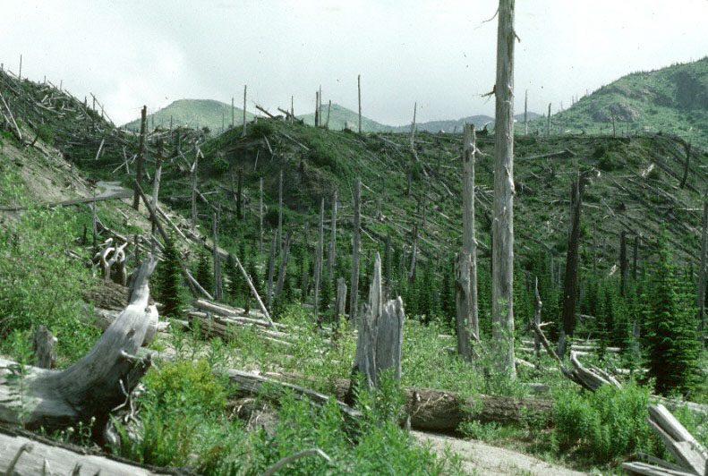
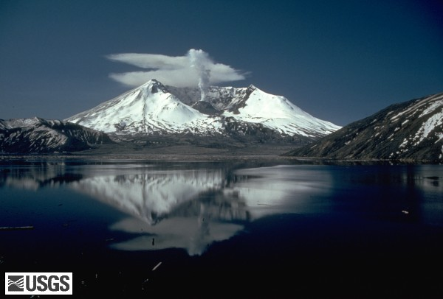
Succession Mt. St. Helens
2010
Pre 1980
2010
Eruption 1980

Slide 25
Succession – Mt. St. Helens
WS – Mt. St. Helens
Back from the Dead
Follow along with the movie in order to fill in the blanks & answer the questions on this worksheet. The answers appears in the order they will appear on screen. I will grade this worksheet on Friday when you take your quiz for a grade.

Slide 26
Succession
*Primary succession→ the colonization of barren land by communities of organisms
Takes place on land where there are NO other organisms
Ex. Volcanoes errupting
*secondary successions→ sequence of changes that take place after an existing community is severely disrupted in some way
*Ex. Lichens→grasses→shrubs→trees
*Climax community→ stable, mature community that undergoes little/no change

Slide 27
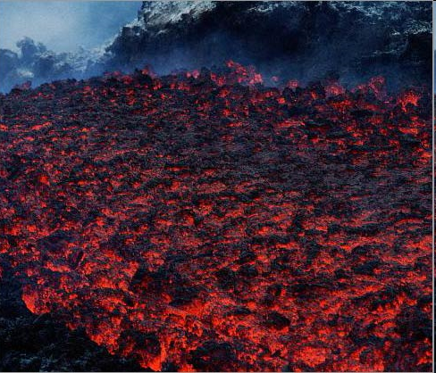
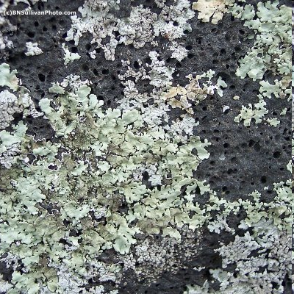
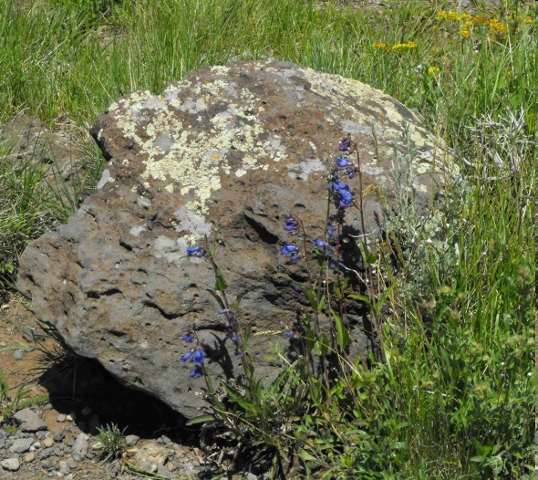
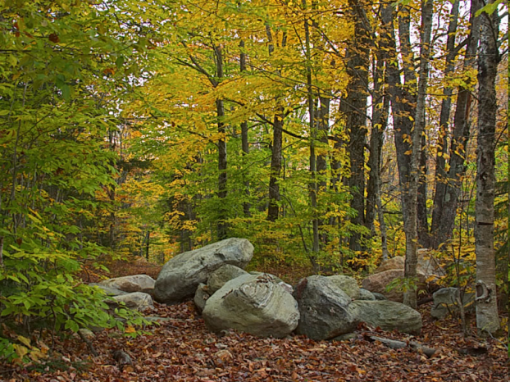
Succession
PRIMARY SUCCESSION
SECONDARY SUCCESSION
LAVA
LAVA COOLED WITH LICHEN
GRASSES/SHRUBS
FOREST
CLIMAX COMMUNITY!

Slide 28
Taboo Partner 1 look at screen Partner 2 Look away!
Populations
Growth rate
Carrying Capacity
Exponential growth
Density dependent

Slide 29
Taboo
Niche
Competition
Predation
Parasitism
Mutualism

Slide 30
taboo
Commensalism
Symbiosis

