Slide 1
Agenda 8/21
Warm up & Gather Data on Salinization Lab
Go over Experimental Design.
Sort through Newspaper Articles: 7 Topics/ Web Site
Tragedy of the Commons
Review Article: The worst mistake humans ever made.
Format of the AP Test.
Math: V2 – V1/ V1 x 100 & Rule of 70, Doubling time.
HW – Study Guide. Quiz tomorrow. Study scientific method, Atmosphere, know each of the layers, what the [ ] of gases are.
Get books.

Slide 2
APES 8/22 Obj. TSW develop a focused understanding of the 7 topics in APES, Explain the Tragedy of the Commons, and discuss the article. P. 8 NB
1. Explain an open system & closed system with respect to matter & energy on Earth.
List the steps to the Scientific Method. Why is the control important?
What are the approximate concentrations of the atmosphere?

Slide 3
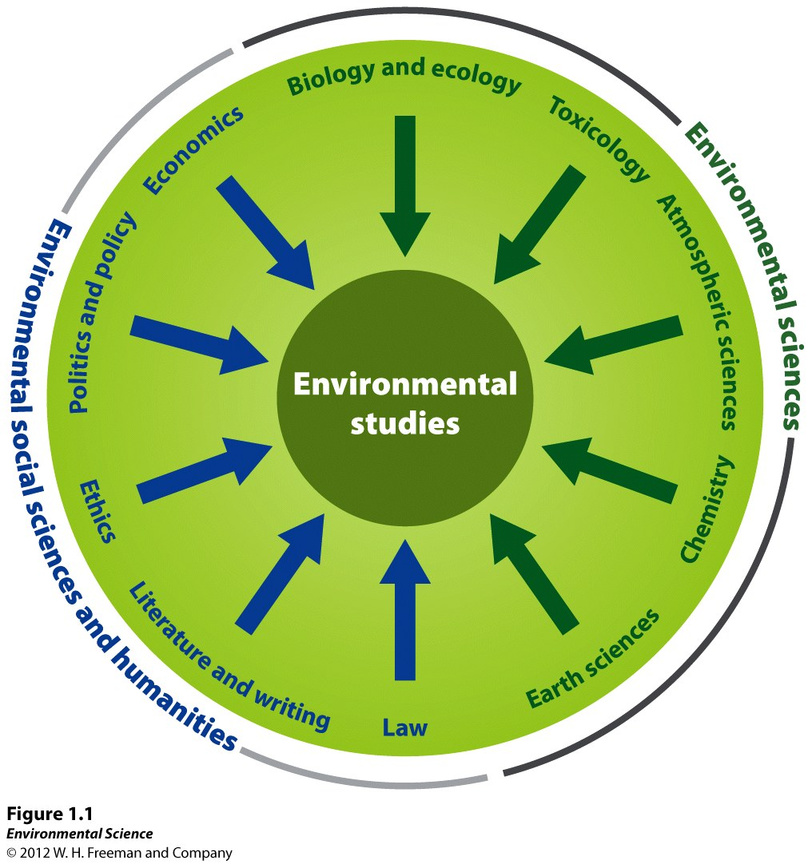

Slide 4
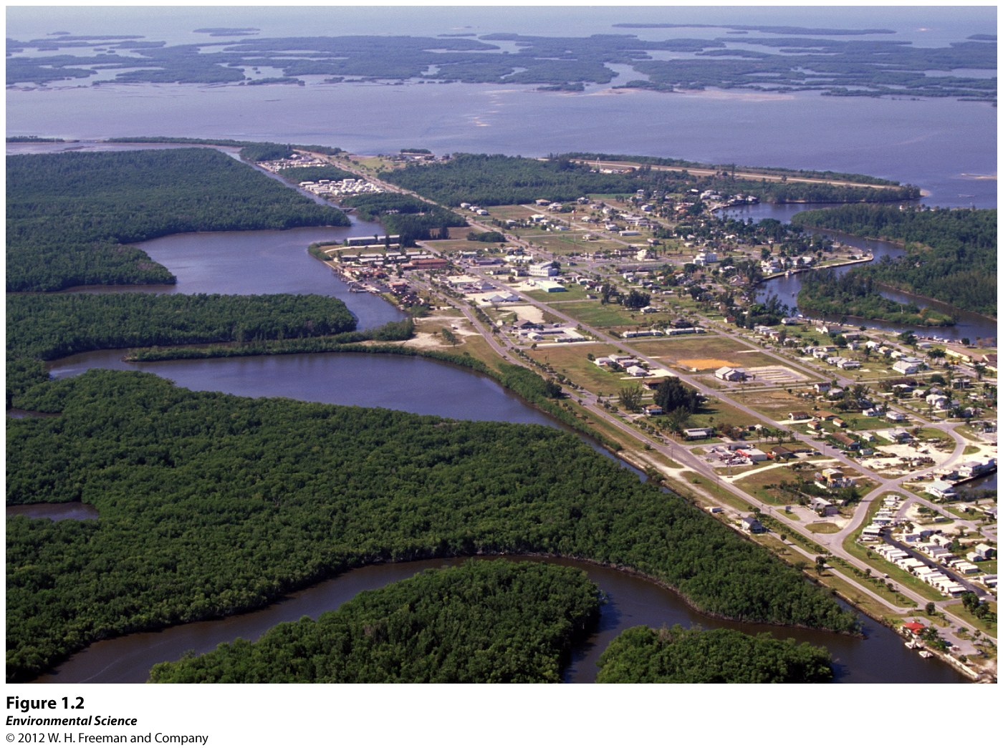

Slide 5
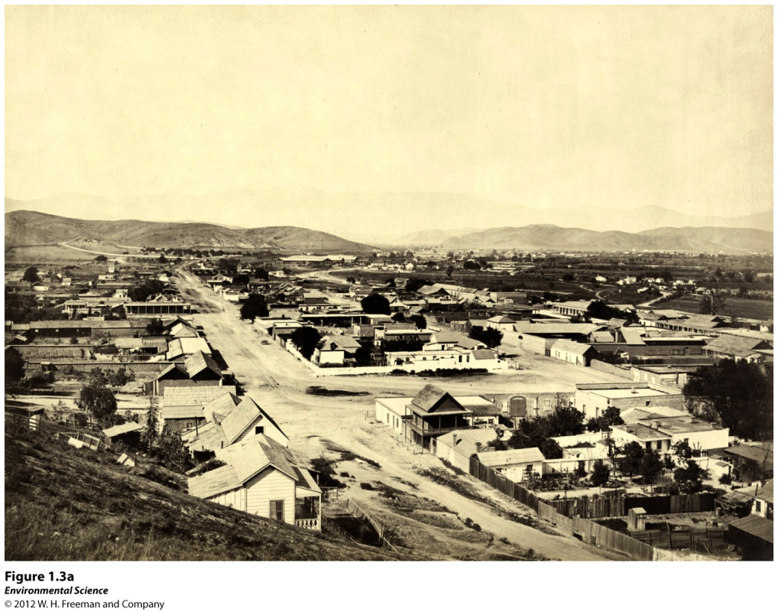
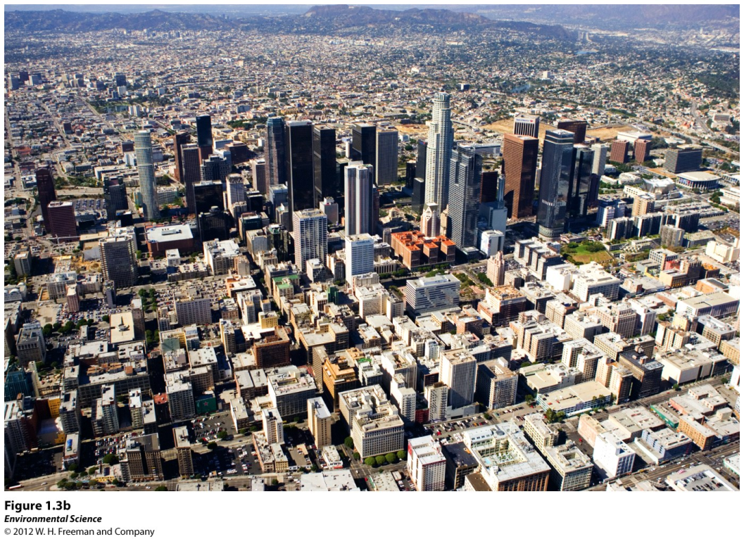

Slide 6
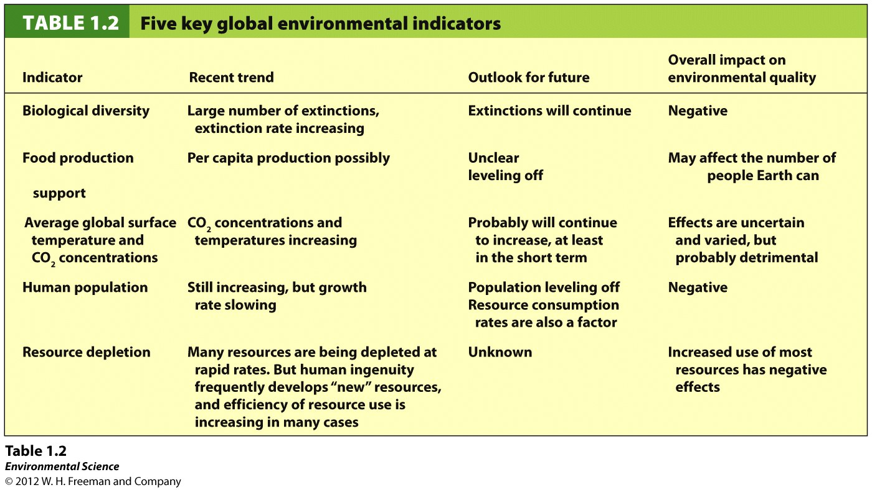

Slide 7
Average Global Surface Temperatures and Carbon Dioxide Concentrations
Greenhouse gases- gases in our planets atmosphere that act like a blanket, trapping heat near Earth's surface.
The most important greenhouse gas is carbon dioxide.
Anthropogenic- caused by human activities.

Slide 8
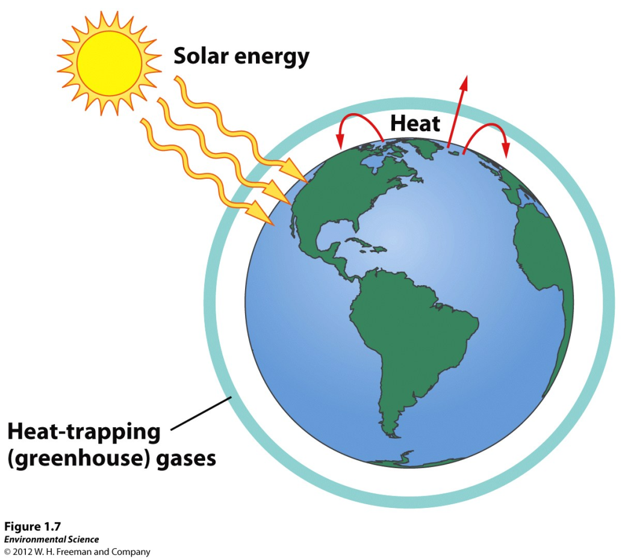
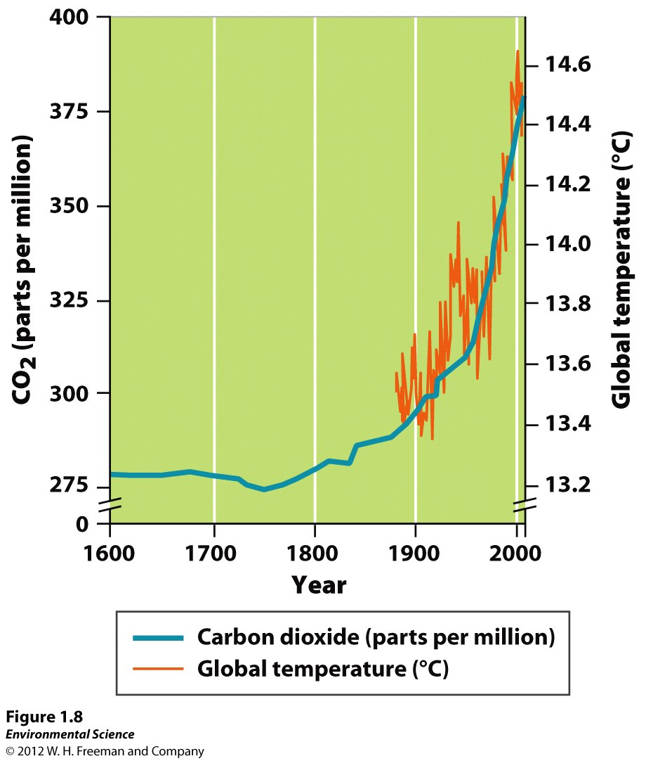

Slide 9
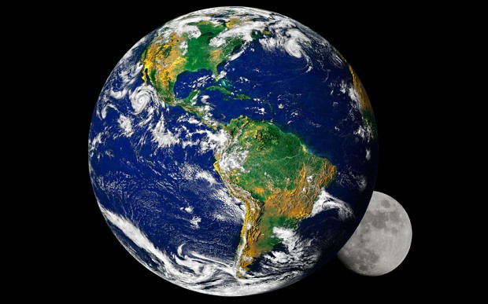
Earth
Closed system: Matter does not leave. Exception: Asteroid hitting the Earth.
Open system: Energy can come & go. Light Energy, Heat Energy are absorbed by the planet & escape the planet.

Slide 10
Matter- anything that occupies space and has mass.
Mass- a measure of the amount of matter an object contains.
Weight- the force that results from the action of gravity on mass.

Slide 11
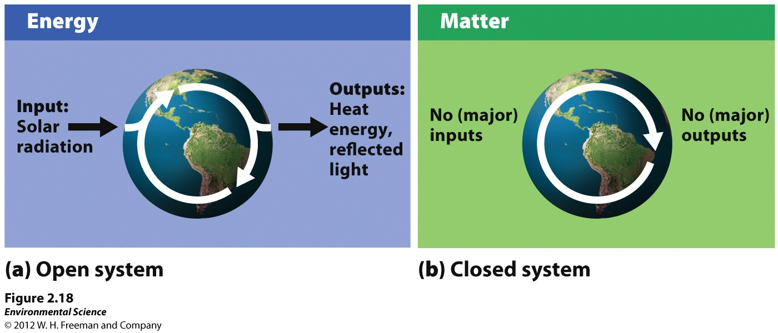
Open system- exchanges of matter or energy occur across system boundaries.
Closed system- matter and energy exchanges across system boundaries do not occur.

Slide 12
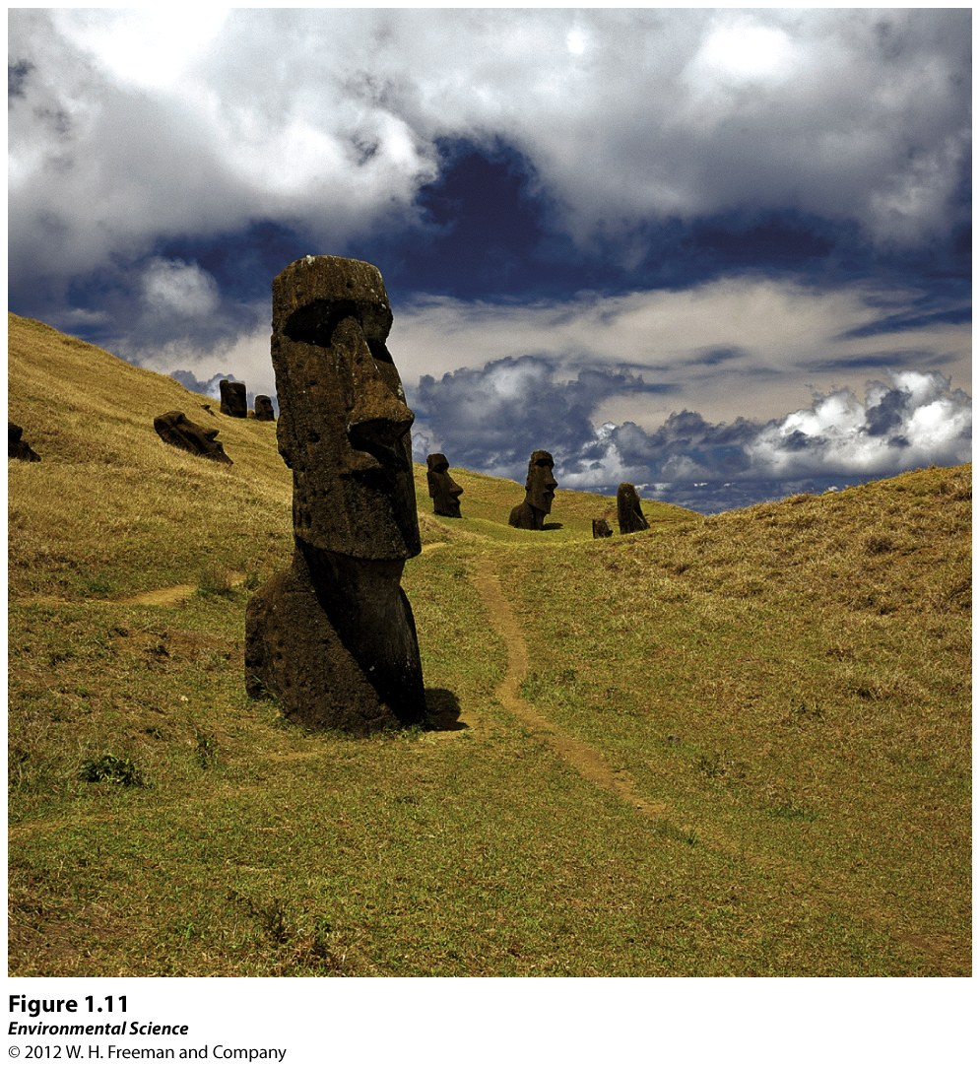
Tragedy of the Commons – Easter Island

Slide 13
What were some of the ramifications of “Tragedy of the Commons” on Easter Island?

Slide 14
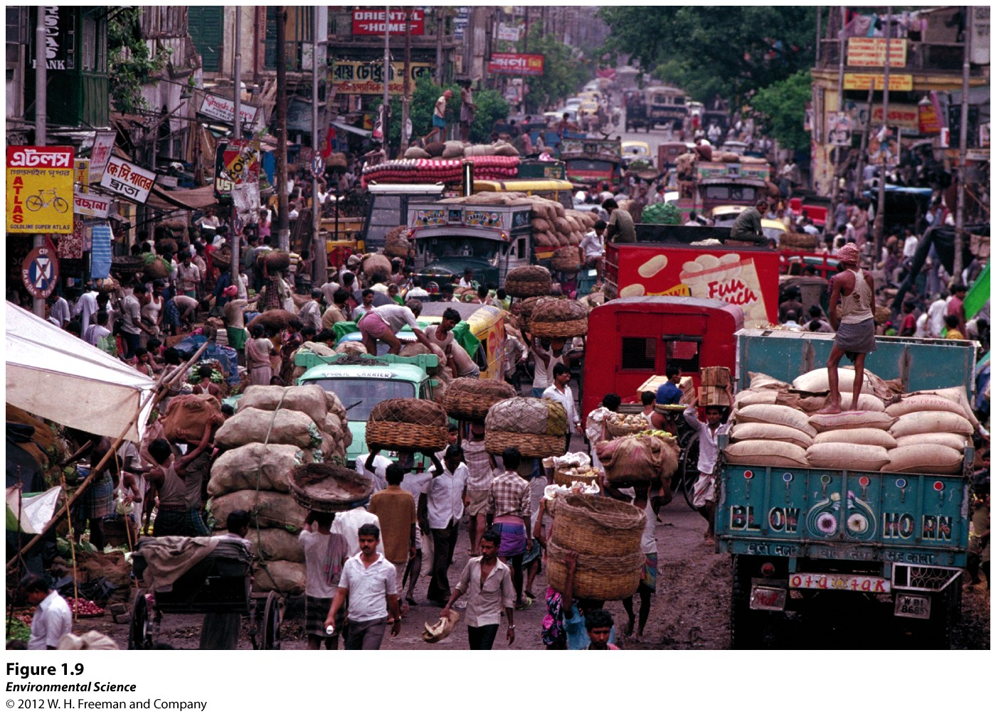

Slide 15
Resource Depletion How does Easter Island relate to today?

Slide 16
Where do we see “Logic of the Commons” today?

Slide 17
How does the “Tragedy of the Commons” relate to the article you read about the “Worst mistake in the History of the Human Race”?

Slide 18
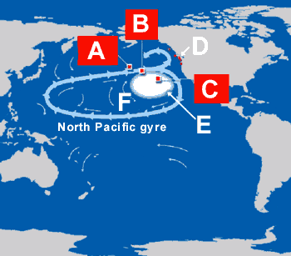
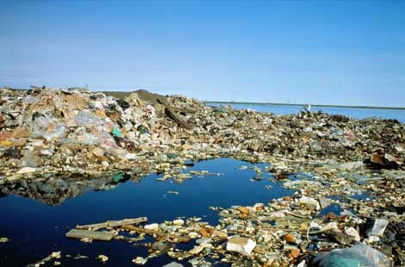
How is this an example of “Tragedy of the commons”?
Great Pacific Garbage Patch

Slide 19
Biological molecules and cells
Inorganic compounds- compounds that do not contain carbon or do contain carbon, but only carbon bound to elements other than hydrogen.
ex. NH3, NaCl, H2O, and CO2
Organic compounds- compounds that have carbon-carbon and carbon-hydrogen bonds.

