Slide 1
Environmental Science
Week 2
UNIT 1 – Understanding environmental science, Agricultural Revolution, Industrial Revolution, Environmental Challenges

Slide 2
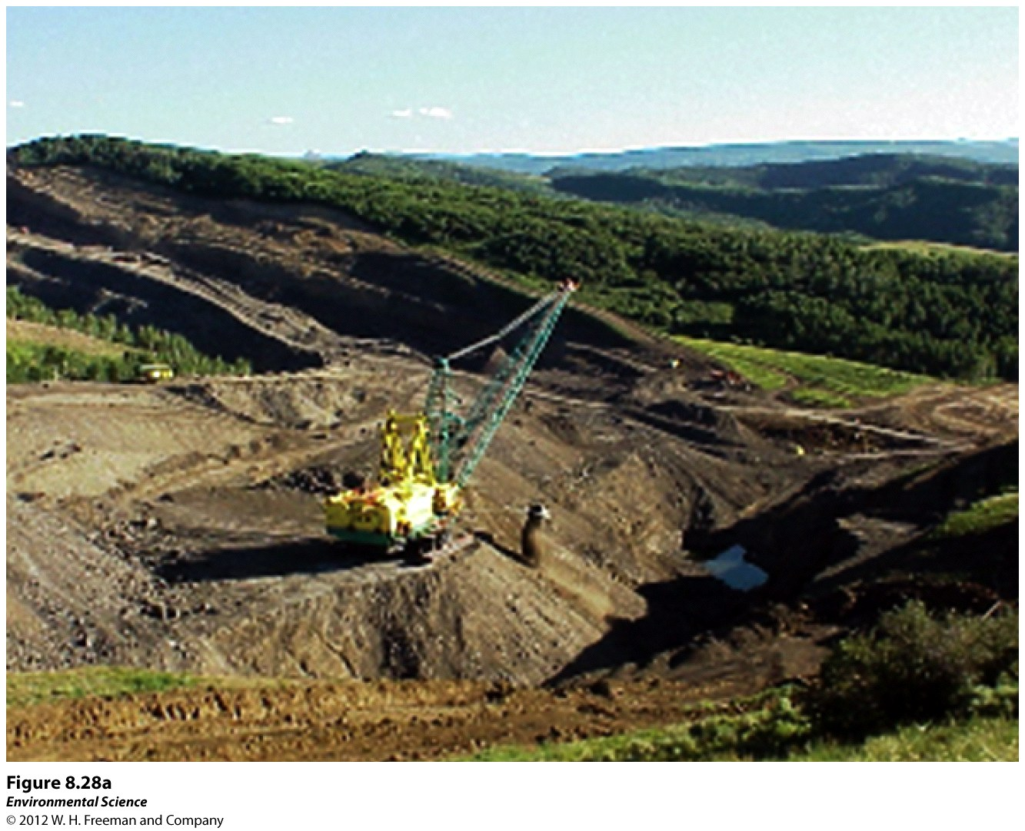
8/24 Science & the Environment CH 1 Obj. TSW learn what environmental science is and events that led to it’s development. P. 12 NB
Explain the Agricultural Revolution.
What three ways did the Industrial Revolution change society?
Name 3 Environmental Problems facing us today.

Slide 3
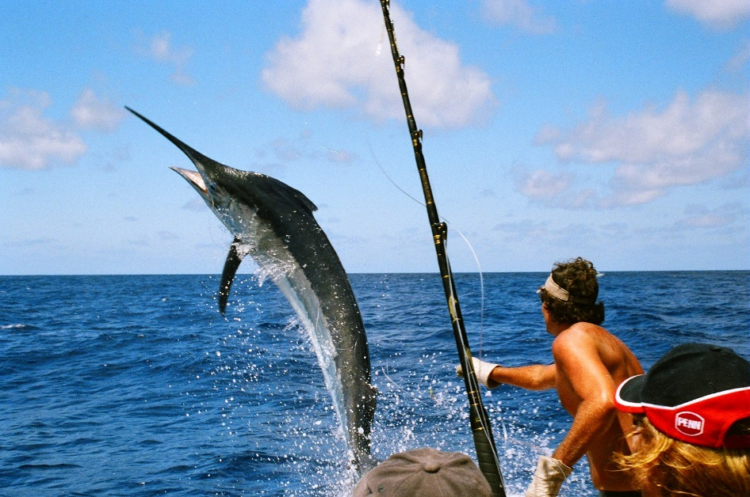
Tragedy of the Commons Activity P. 13 NB
Materials:
Goldfish cracker, Straw, large plate, Small plate, Worksheet (P. 13 NB)
Procedure:
Groups of 4 students/lab station. Each Lab station is a “Nation.” You are catching fish to feed the people of your country.
You will have 30 seconds to catch your fish with your straw.
You suck on the straw to catch your fish from the Ocean (large plate), to your small plate in front of you.
Start with 30 goldfish in the center large plate.
You must catch at least 1 fish or you perish.
Count your fish and record on your worksheet.

Slide 4
Procedure: Tragedy of the Commons p. 13 NB
At the end of 30 seconds, count the remaining fish in the large plate.
Write each members name in the data table.
Record their total and the remaining total to equal 30 in the last column.
For every fish you have left in the large plate, add one fish
Add all the fish on the large plate and write that number in the first column for round 2.

Slide 5
Results: Tragedy of the Commons p. 13NB
Yes, eat your fish.
What happened the first time you went “fishing”?
How does it relate to overfishing?
Why have a time limit? What does the time limit represent?
How did your group discuss your actions and strategies before each harvest?
Mathematically, what is the best strategy for harvesting our natural resources?
How is this a model for sustainability?
Discuss with your group and write three real world resources that need to be managed sustainably.

Slide 6
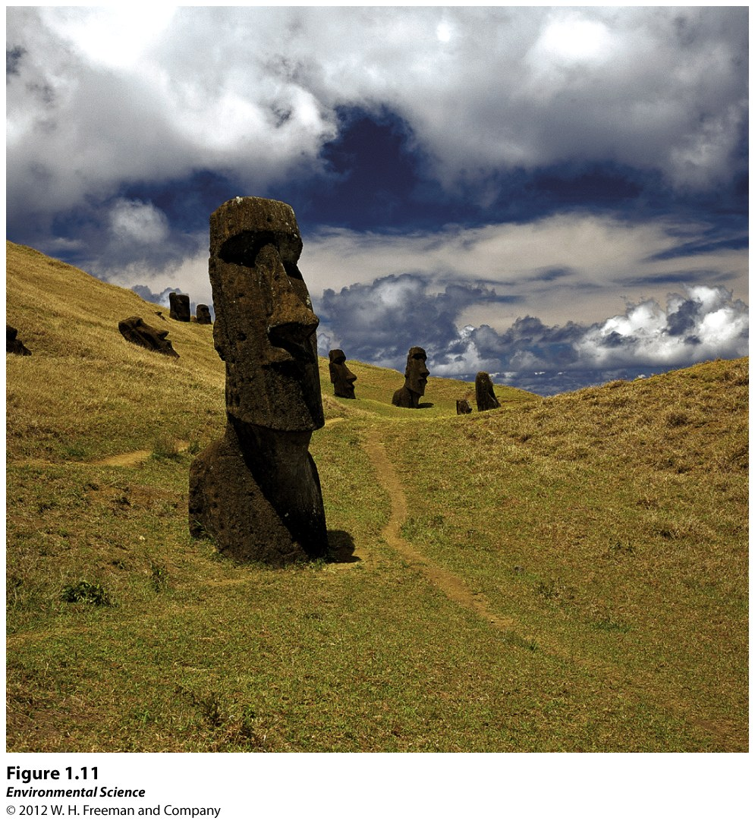
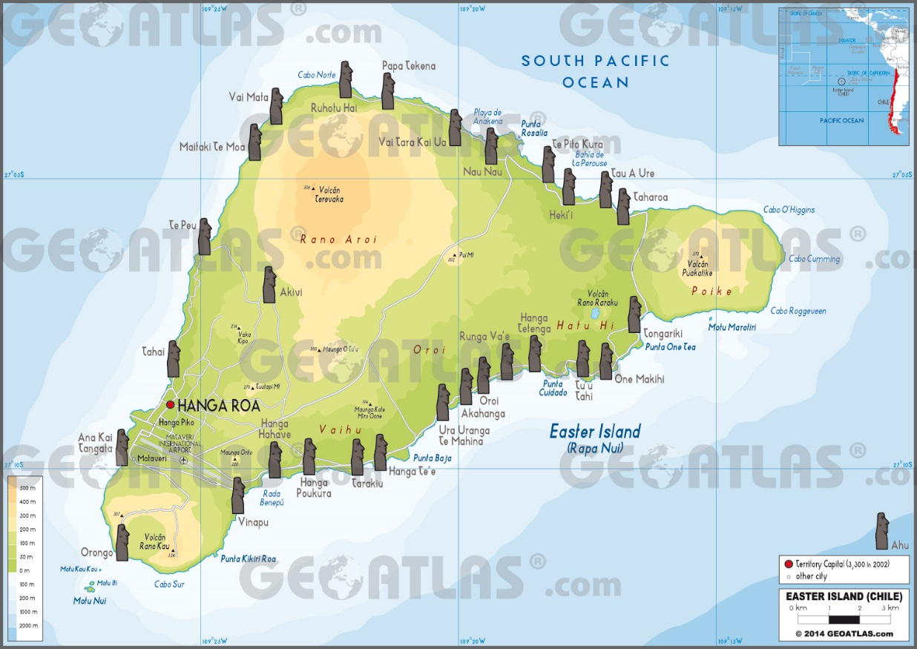
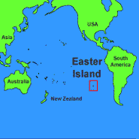
Real World Example:
Easter Island – South Pacific
Over use of resources
Palm trees
Led to the demise of that civilization

Slide 7
Classroom discussion: Tragedy of the Commons
What are the Commons?
What is the logic of the Commons?
How does the Commons work?
Why does the Commons continue?
How is the Tragedy of the Commons a good argument for renewable resources?

Slide 8
The take away…
Environmental systems must not be damaged beyond their ability to recover.
Renewable resources (Trees, soil, etc.) must not be depleted faster than they can recover.
Nonrenewable resources must be used sparingly.
The main difficulty in solving environmental problems is the conflict between the short-term interests of individuals with the long-term welfare of society.
Works Cited: Friedland and Relyea, Environmental Science for AP 2nd Ed., P. 15.

Slide 9
Resources Activity P. 15 NB Write on the board a list of nonrenewable and renewable resources.
Nonrenewable
Renewable

Slide 10
Agenda 8/25
Collect syllabus
Warm up
Collect Books
Lab - Salinization

Slide 11
8/25 The Environment & Society CH 1.2 Obj. TSW explain the tragedy of the commons and how it relates to sustainability. P. 14 NB
Describe the Tragedy of the commons.
Analyze the chart in Figure 2.4 “Indicators of development for the US, Japan, Mexico, and Indonesia. Write 3 facts from the chart in complete sentences.
Explain sustainability.

Slide 13
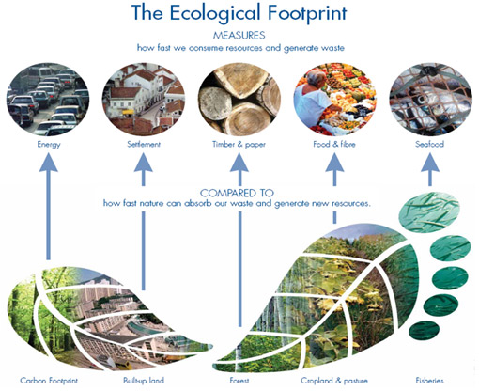
Indicators of Development for Four Countries
Health
Population Growth
Wealth
Living Space
Energy Use
Pollution
Waste
Which Countries are doing the best in each category?

Slide 14
A Sustainable World
What does it mean to be sustainable?

Slide 15
Salinization Lab
Salt buildup is an existing or potential hazard on almost all of the 42 million acres of irrigated farmland in the United States. Much of the world’s unused land is in arid and semiarid regions where irrigation will be necessary. Excessive salinity is presently costing the U.S. billions of dollars in lost food crops. This is becoming a huge problem in our own Central Valley, running from Bakersfield, CA to Fresno, CA.

Slide 16
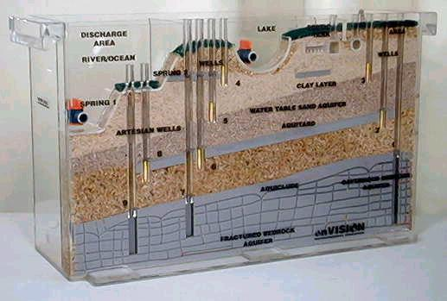
Ground Water Water Model Demonstration
Salt water intrusion to field crops along the central valley.

Slide 17
1.0 % = 1 g NaCl Calculate the % [NaCl] in 300 ml H₂O
 | 100 ml H₂O | 300 ml H₂O | Germination # | % Germination
Dates | % NaCl | % NaCl | 1 – 10 seeds
8/25 8/26 8/27 | 0 %
8/25 8/26 8/27 | 0.5%
 | 1%
 | 1.5%
 | 2%
 | 2.5%
 | 3%
 | 3.5%
 | 4%

Slide 18
Salinization
Irrigated water contains salt. The ground where the crops are planted increases in salt concentration.
Evaporation
In our Lab, what is the control? 0% [NaCl]
Independent Variable: [NaCl] (what you changed)
Dependent Variable: Germination Rate

Slide 19
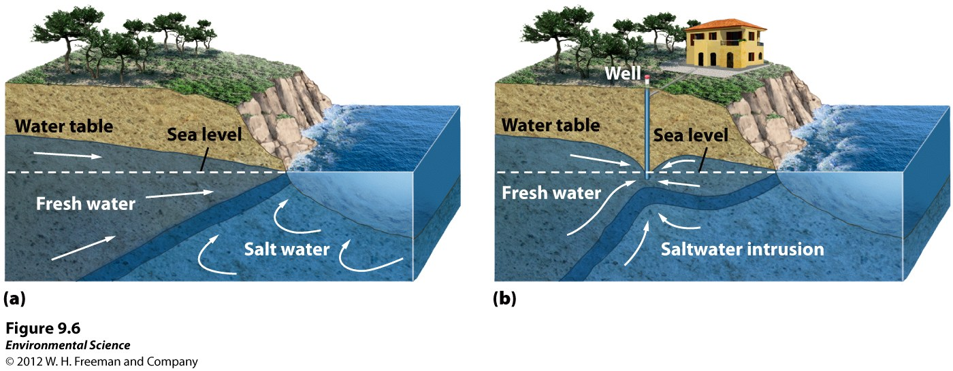
Groundwater
Salt water intrusion
Saltwater intrusion- when the pumping of fresh water out of a well is faster than the recharge. Near coastal areas this can cause salt water to infiltrate the aquifer.

Slide 20
8/26 Agenda
Warm up
Gather Data on Petri Dishes – Write on boards and share with the group next to you.
Log onto the computers
Learn how to create a Title Page for a scientific paper.

Slide 21
8/26 Scientific Methods CH 2.1 – 2.2 Obj. TSW apply their knowledge of the experimental method to a real world problem for the Salinization lab. P. 16 NB
Write the steps to the scientific method.
Why is the control in an experiment important?
What is a variable in an experiment?

Slide 22
1. Experimental Parts of a lab
Observation
Hypothesis
Experiment
2. Control group – the part of the experiment that you are testing against.
3. Experimental Group (Variable) – the part of the experiment that we have changed
Analysis
Conclusion

Slide 23
Scientific Paper – Create a Title Page p. 19 NB
Salinization Lab
Student’s First and Last Name
August 26th, 2015
Mrs. McAllister
Environmental Science
NO page number on Title page, top right on every other page.

Slide 24
Biodigestion Videos
Week of September 8th – 11th
Farm to Fork Festival September 26th.
Service Learning Credit

Slide 25
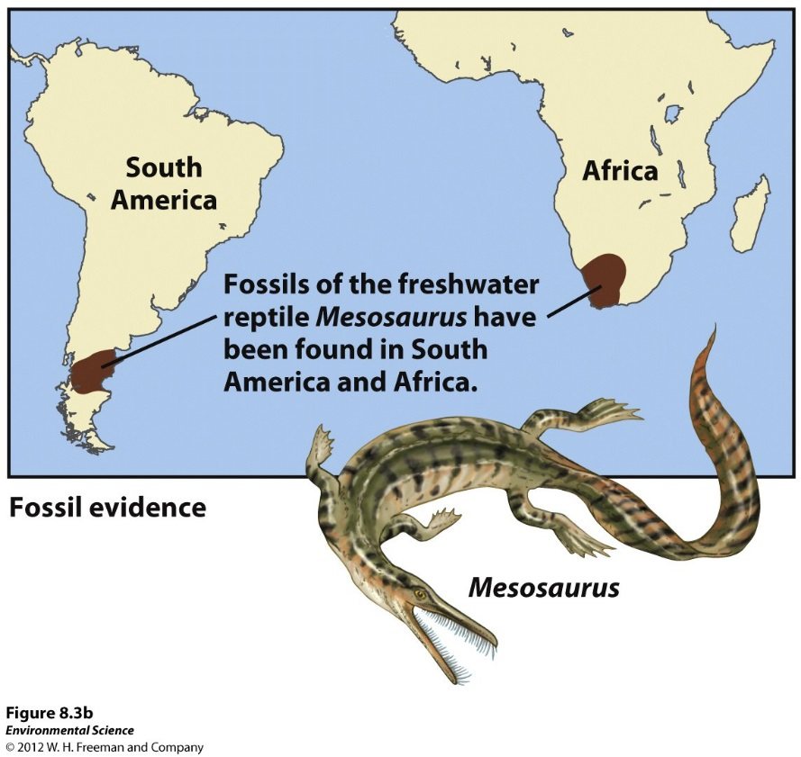
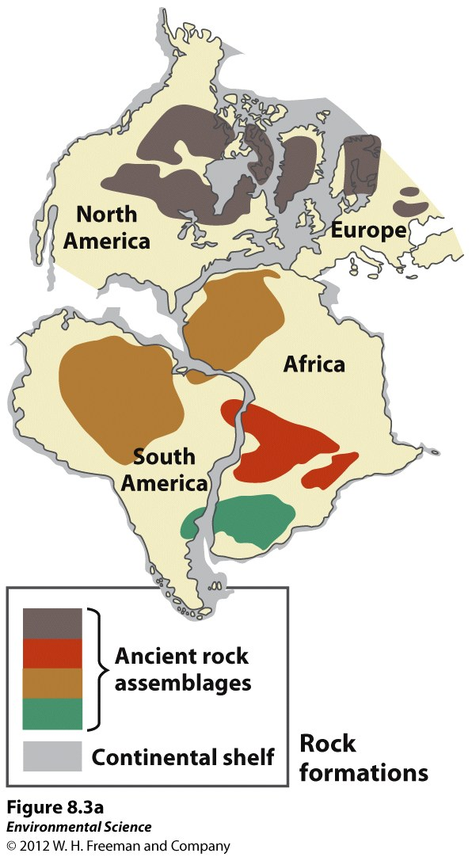
8/27 Geosphere & Atmosphere CH 3.1 & 3.2 Obj. TSW describe Earth’s tectonic plates, earthquakes and the layers of the atmosphere. P. 18 NB
Explain how the movement of tectonic plates can cause earthquakes.
Write the five layers of the atmosphere in order.
Explain the Greenhouse Effect.

Slide 26
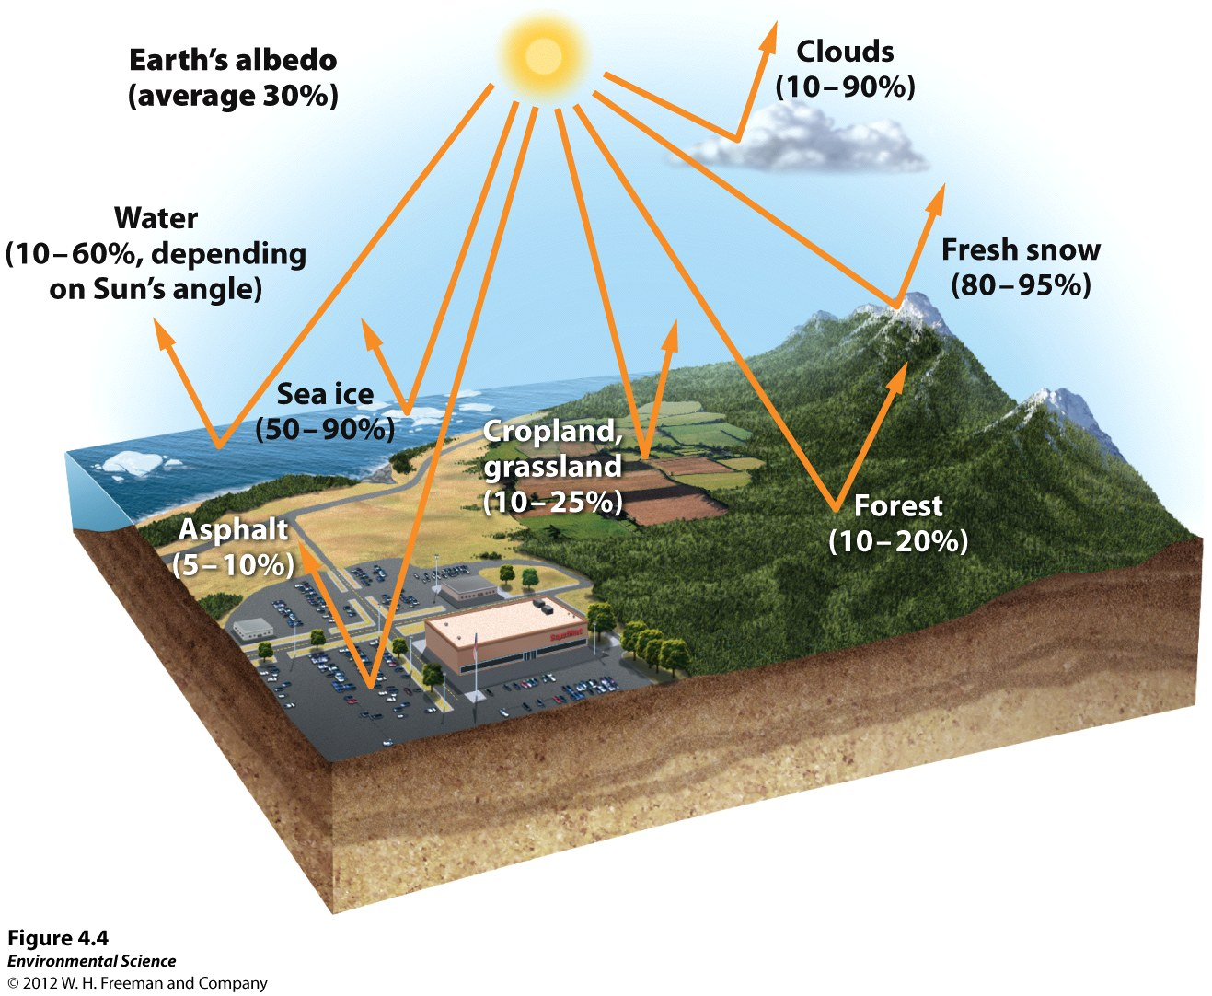
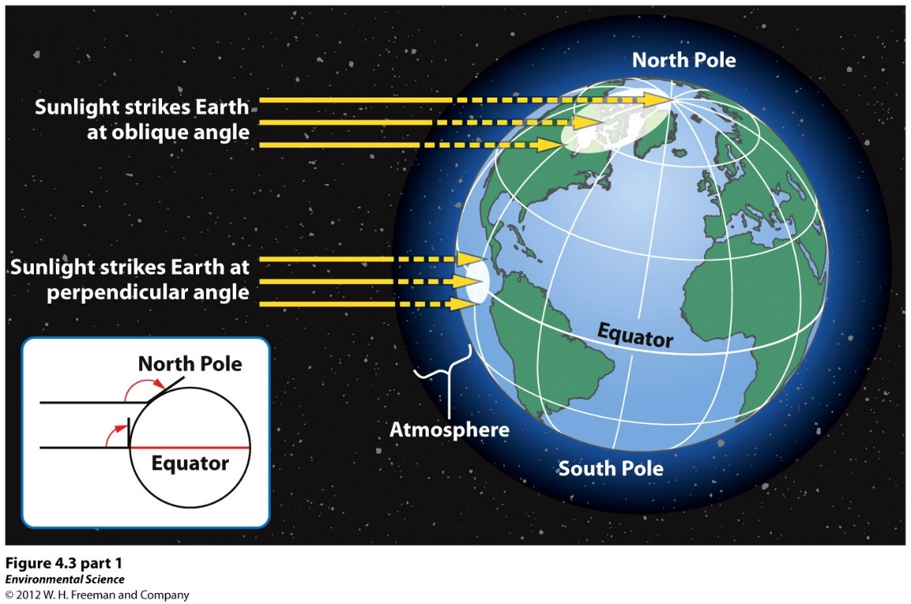
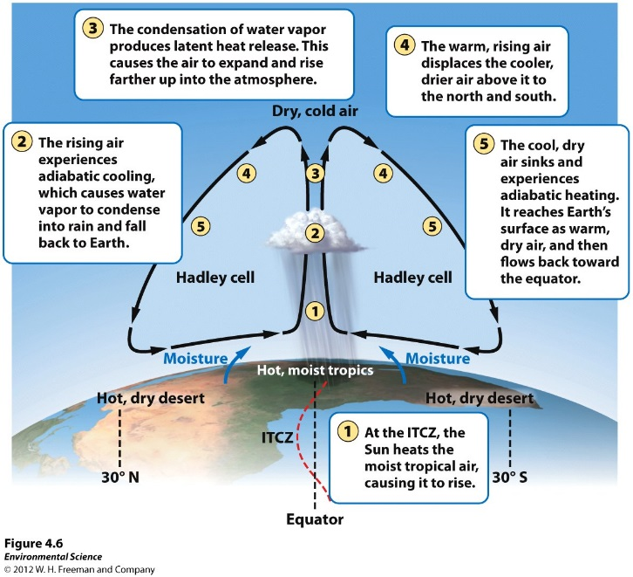
How the Earth is heated

Slide 27
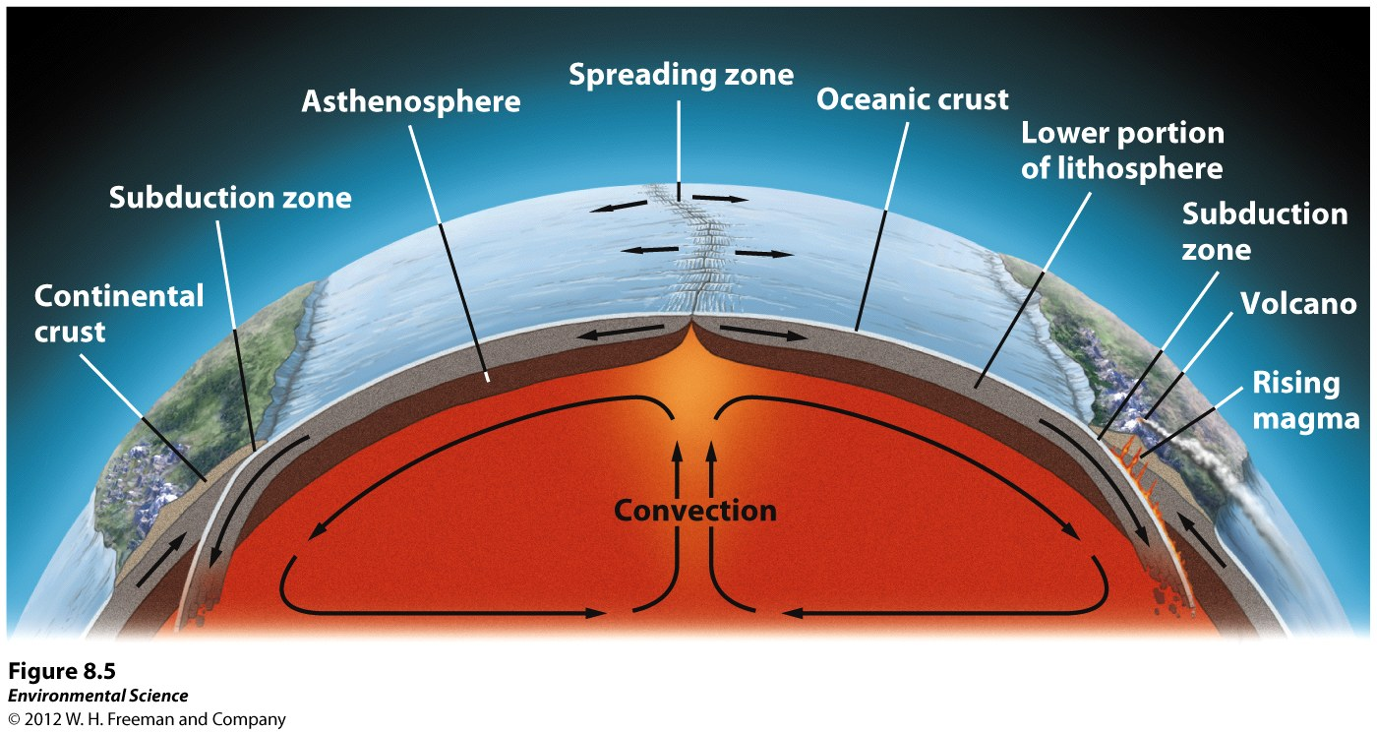
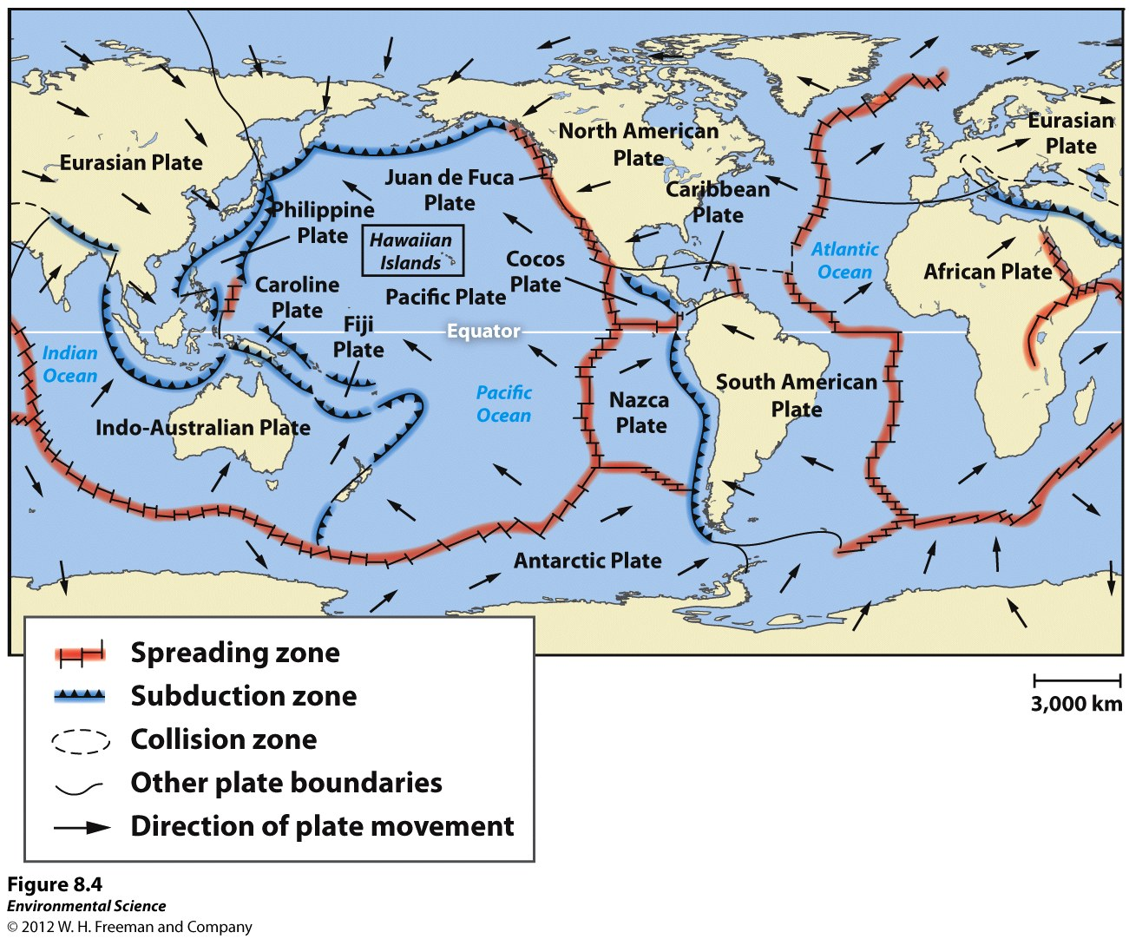

Slide 28
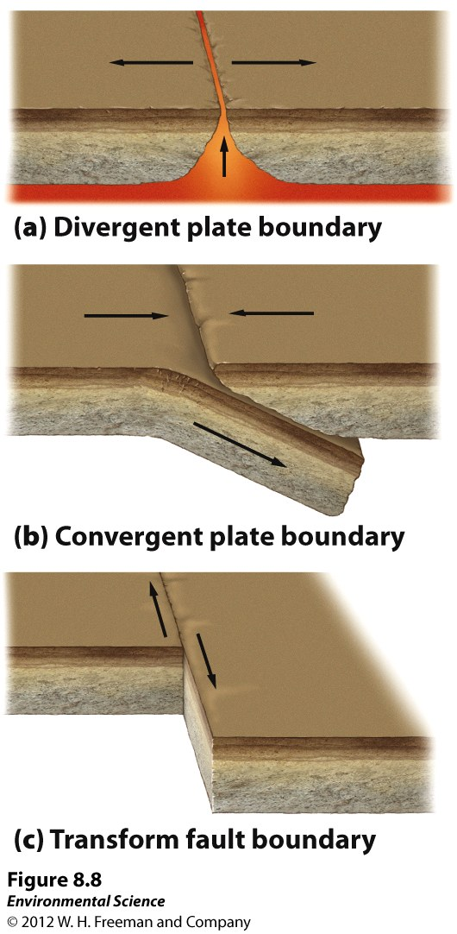
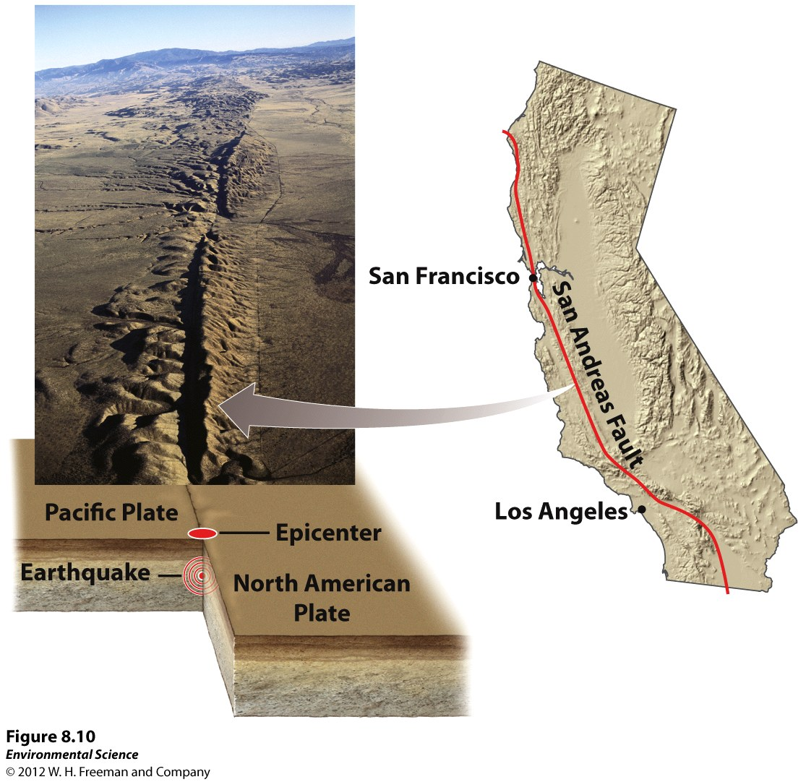
Tectonic Movement
Which one is the San Andreas Fault?

Slide 29
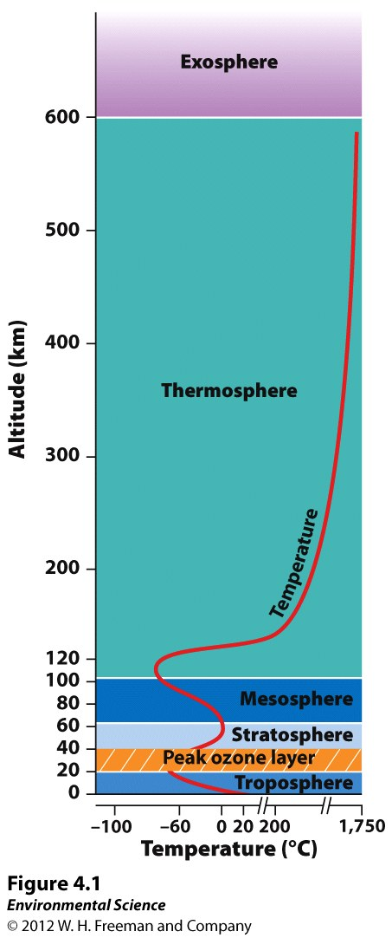
Layers of the Atmosphere

Slide 30
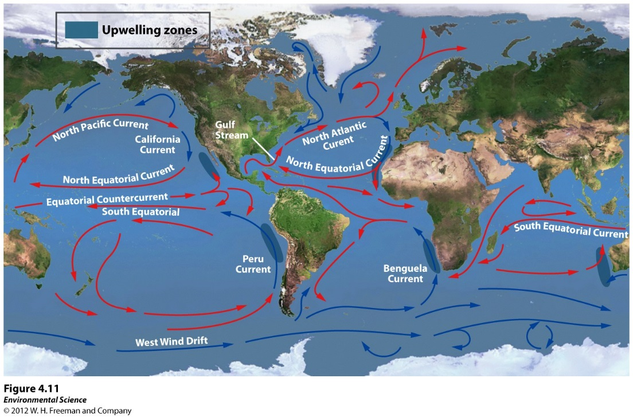
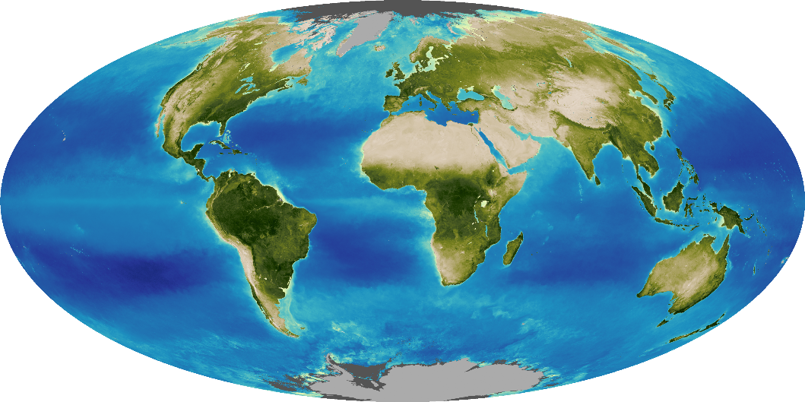
8/28 Hydrosphere and Biosphere Obj. TSW examine details of the hydrosphere and the biosphere. P. 20 NB
Explain how the ocean regulates Earth’s temperature.
Discuss the factors that confine life to the biosphere.
Explain the difference between open and closed systems.

Slide 31
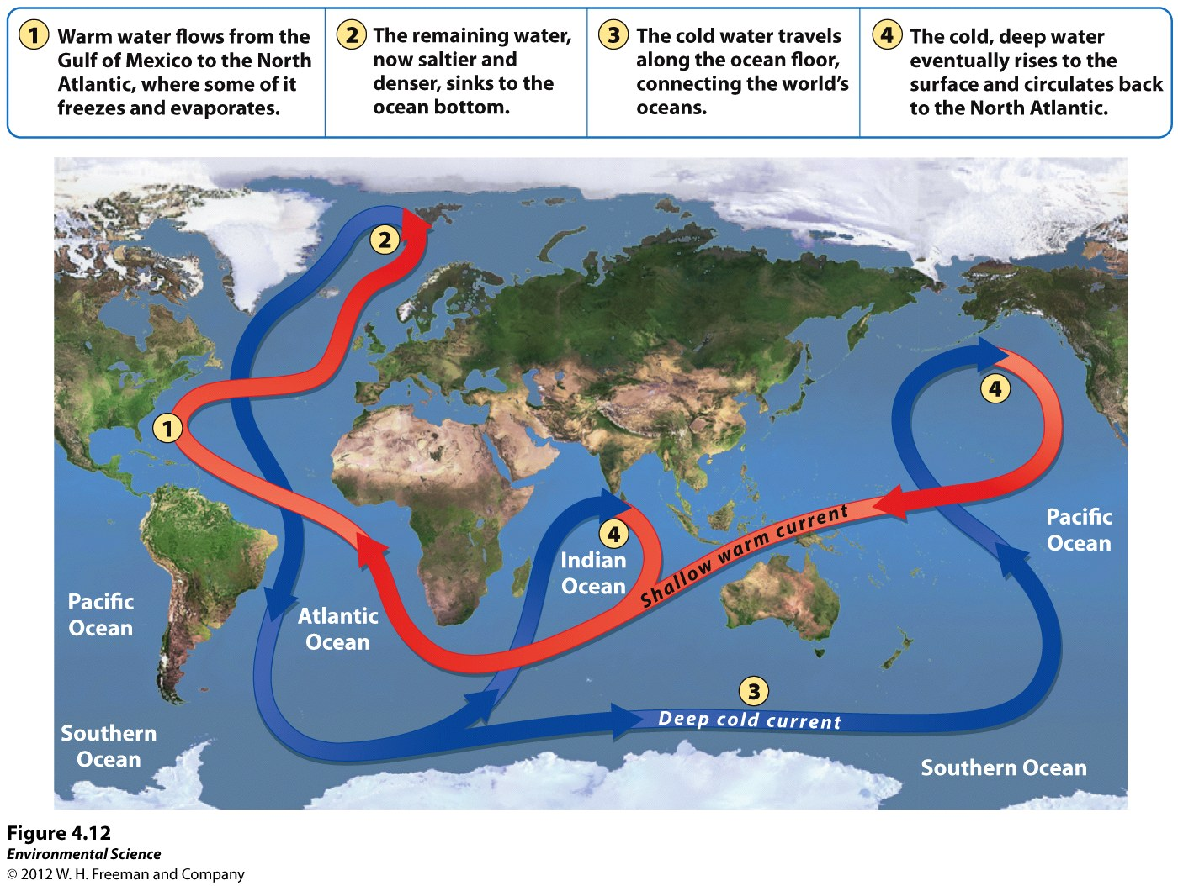
Ocean Circulation

Slide 32
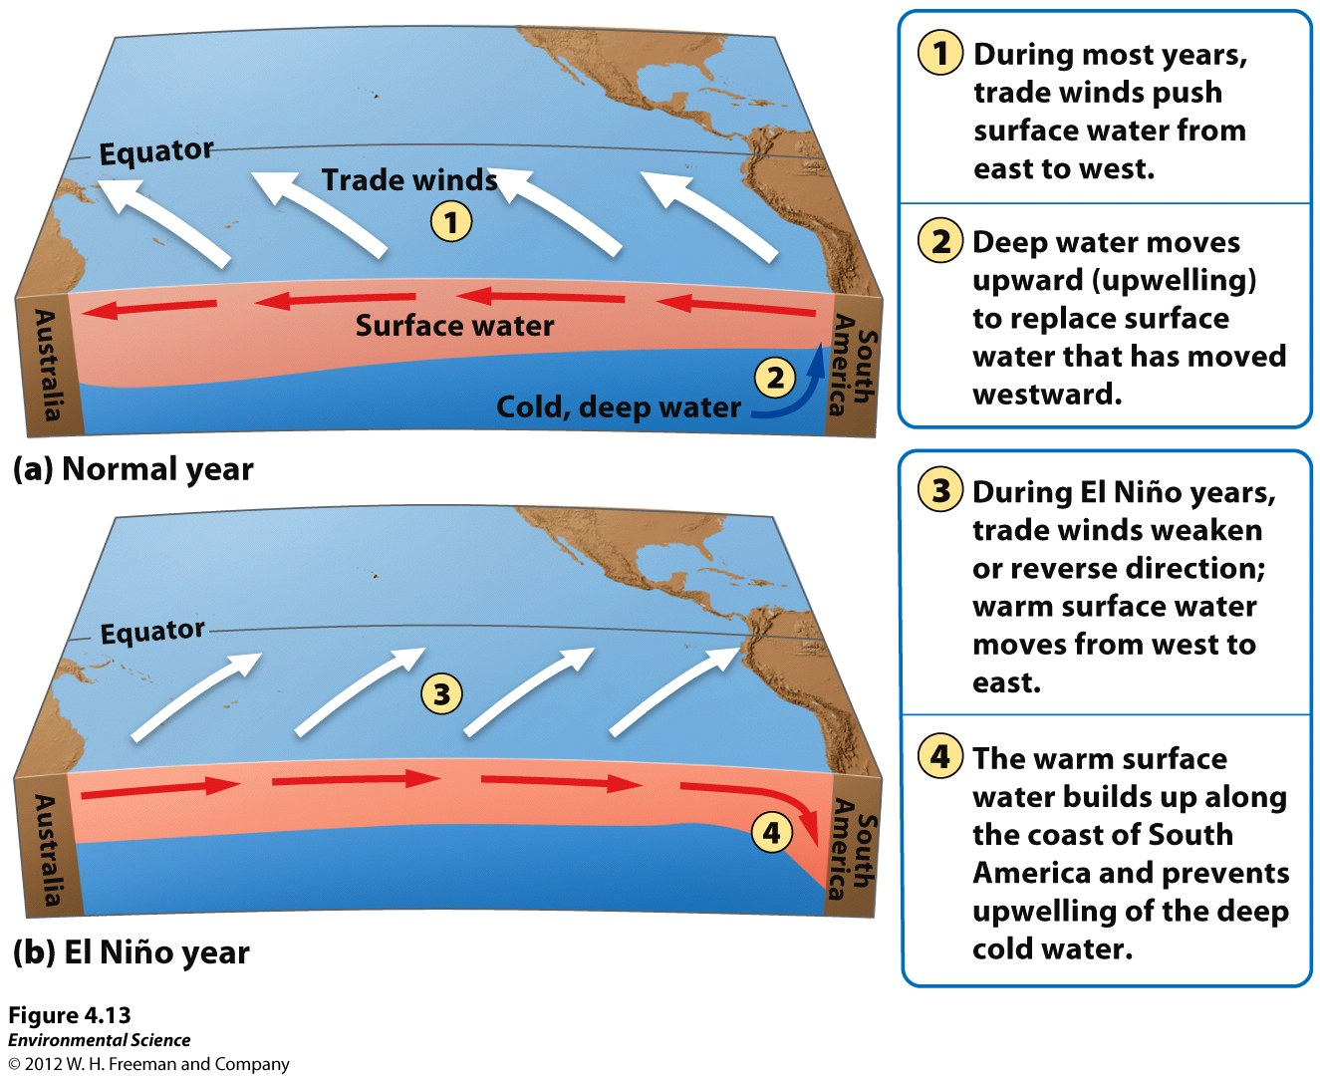
El Nino

Slide 33
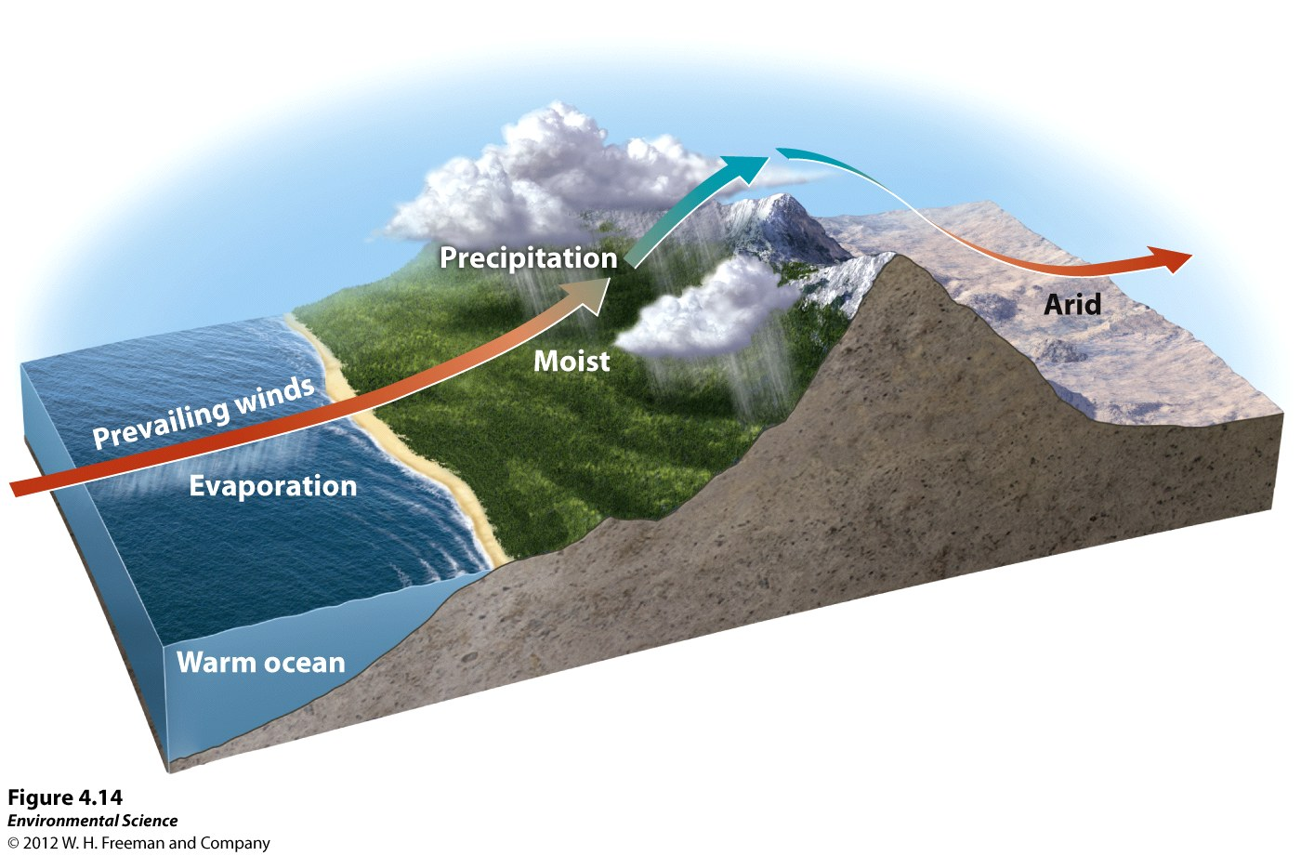
Rain Shadow Effect

Slide 34
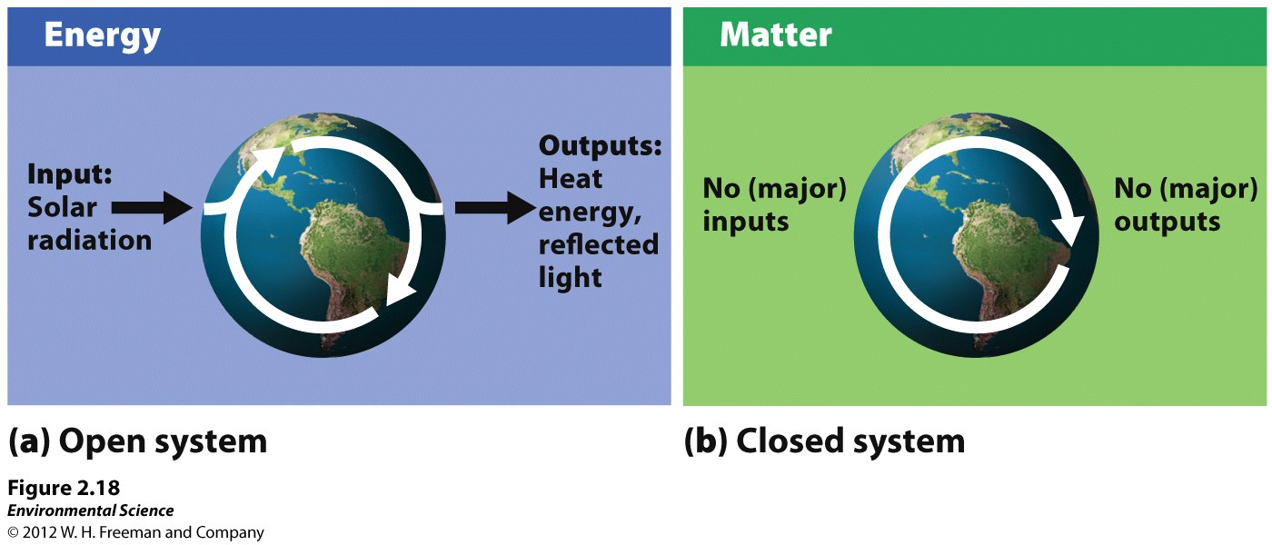
Open & Closed Systems

