Slide 1
Salinization Lab
Salt buildup is an existing or potential hazard on almost all of the 42 million acres of irrigated farmland in the United States. Much of the world’s unused land is in arid and semiarid regions where irrigation will be necessary. Excessive salinity is presently costing the U.S. billions of dollars in lost food crops. This is becoming a huge problem in our own Central Valley, running from Bakersfield, CA to Fresno, CA.

Slide 2
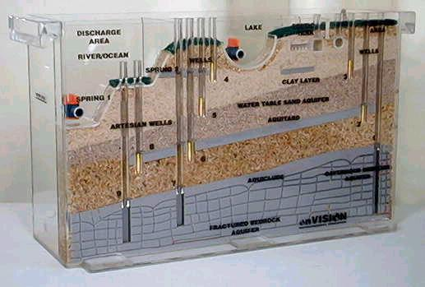
Ground Water Water Model Demonstration
Salt water intrusion to field crops along the central valley.

Slide 3
Calculate the % [NaCl] in 300 ml H₂O
100 ml H₂O | 300 ml H₂O | Conductivity | Germination # | Germination Rate
% NaCl | % NaCl | µS/g | 1 – 10 seeds | V2 – V1/V1 x 100
0
0.5
1
1.5
2
2.5
3
3.5
4

Slide 4
Salinization
Irrigated water contains salt. The ground where the crops are planted increases in salt concentration.
Evaporation

