Slide 1
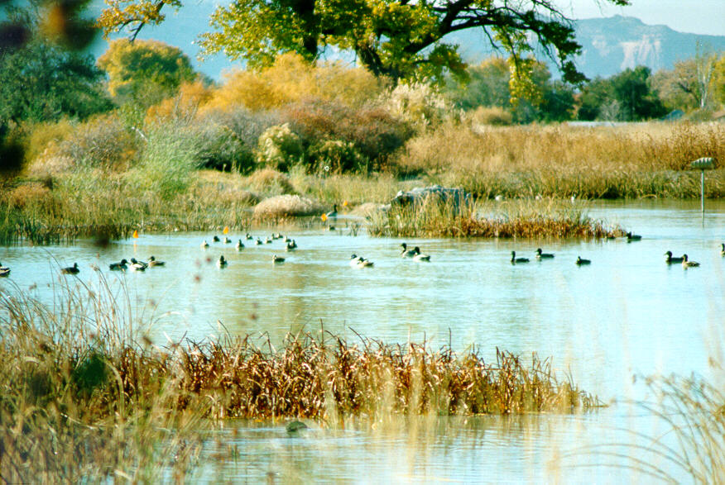
10/1 Population Characteristics CH 6 Obj., TSW identify population characteristics, other factors that influence them, and identify factors that affect wetland diversity, pg. 64
1. Explain metapopulations
2. What are some population characteristics?
3. What are some factors that affect wildlife diversity in wetlands? (answer later!)

Slide 2
Factors that Regulate Population Abundance and Distribution
Population size- the total number of individuals within a defined area at a given time.
Population density- the number of individuals per unit area at a given time.
Population sex ratio- the ratio of males to females
Population age structure- how many individuals fit into particular age categories.
Population distribution- how individuals are distributed with respect to one another.

Slide 3
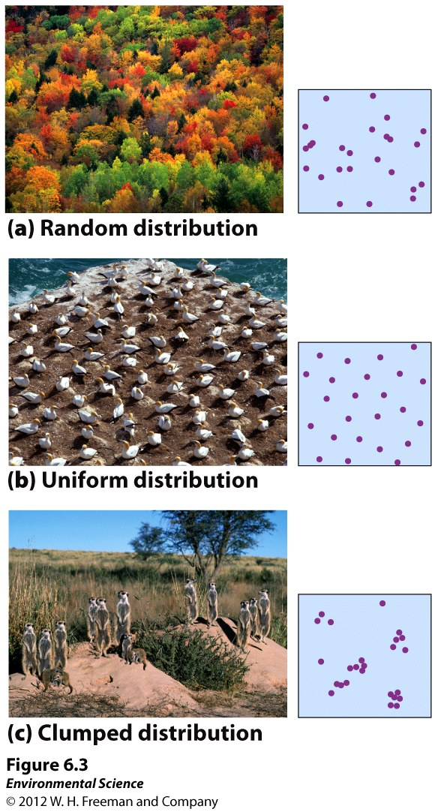
How Populations are distributed.

Slide 4
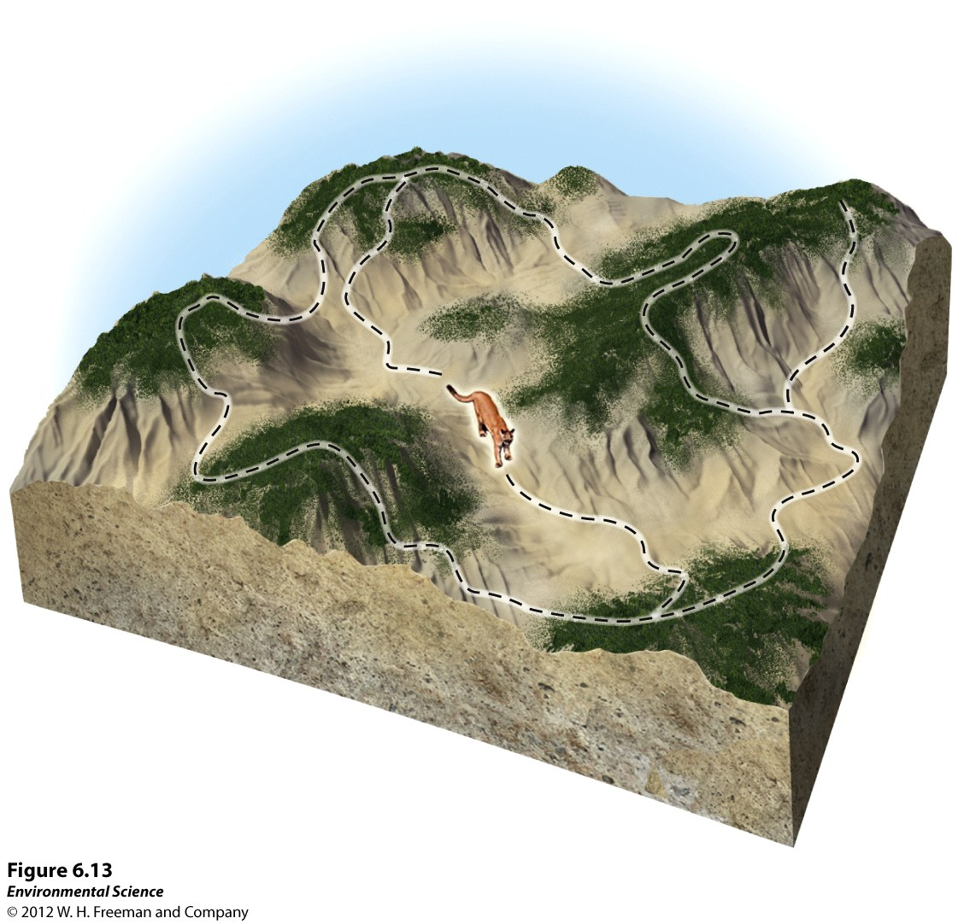
Metapopulations
Metapopulations- a group of spatially distinct populations that are connected by occasional movements of individuals between them.

Slide 5
Wetland Presentation pg. 63
Groups of 3 or 4
(1) Intro, Wetland Formation, California’s Wetlands
(2) The Salt Marsh, Adaptations, Why they Matter?
(3) Great Basin
(4) Mojave Desert
(5) Sonoran
Include:
1. What are some factors that affect wildlife diversity in wetlands or your specific wetland?
2. Why is California considered a biodiversity hotspot?
3. Important information in your section, you are the expert!

Slide 6
In the News...

Slide 7
10/2 Human Population CH 7 Obj. TSW learn about age structure graphs, demographic transition & practice population questions. P. 66 NB
Draw an Age Structure graph of a growing population.
RCHS population is 1976 students, 27 transfer in, 5 get expelled. What is the population growth of the high school?
Ecosystem question from yesterday!
AGE STRUCTURE GRAPHS

Slide 8
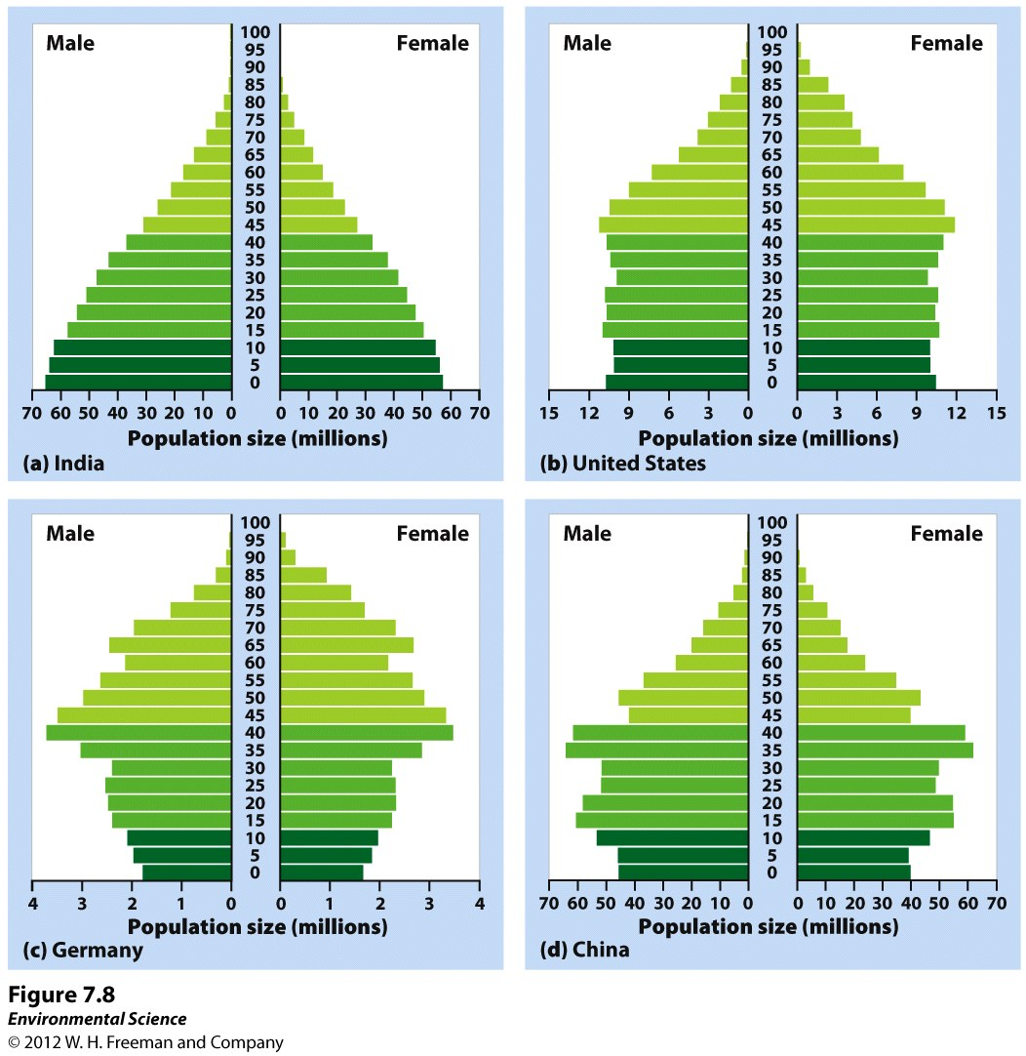
Age Structure
Age structure diagrams (population pyramids)- visual representations of age structure within a country for males and females.

Slide 9
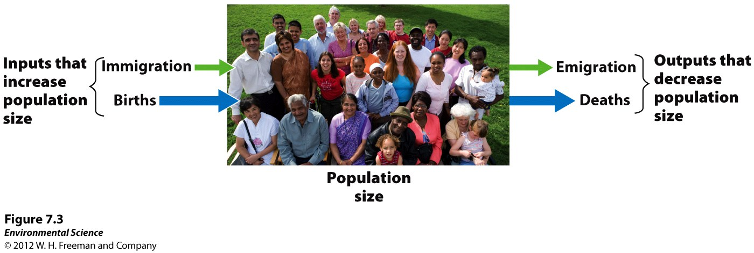
Changes in Population Size
Immigration- the movement of people into a country
Emigration- the movement of people out of a country.
Net migration rate- the difference between immigration and emigration in a give year per 1,000 people in the country.

Slide 10
Growth Rate
Growth Rate = Births – Deaths
Movement of individuals =
Immigration
Emigration
(births + immigration) – (deaths + emigration) = population change

Slide 11
#2.
Population Growth, NOT Growth rate
(B + I) – (D + E) = 27 – 5 =
The population of RCHS has increased by 22 people.

Slide 12
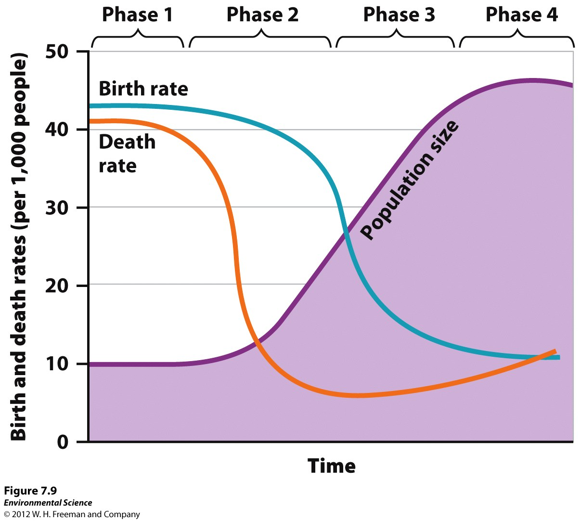
10/3 Human Population CH 7 Obj. TSW identify demography/factors that drive human population, identify the stages of demographic transition, and identify why scientists disagree about reaching the human carrying capacity, pg. 68
1. Explain demography and name the factors that drive human population growth
2. What are the four stages (Names) of demographic transition?
3. Explain the differing views scientist hold on if humans will reach a carrying capacity or not.

Slide 13
Factors that Drive Human Population Growth
Demography- the study of human populations and population trends.
Changes in Population Size
Fertility
Life Expectancy
Age Structure
Migration

Slide 14
The Demographic Transition
The theory of the demographic transition is the theory that as a country moves from a subsistence economy to industrialization and increased affluence, it undergoes a predictable shift in population growth.

Slide 15
The Stages of the Demographic Transition
Phase 1: Slow population growth because there are high birth rates and high death rates which offset each other.
Phase 2: Rapid population growth because birth rates remain high but death rates decline due to better sanitation, clean drinking water, increased access to food and goods, and access to health care.
Phase 3: Stable population growth as the economy and educational system improves and people have fewer children.
Phase 4: Declining population growth because the relatively high level of affluence and economic develop encourage women to delay having children.

Slide 16
Theory of Demographic Transition
Phase1 – Pre-Industrial – Before the industrial Revolution
Phase 2 – Transitional - India
Phase 3 – Industrial – US & Canada
Phase 4 – Post Industrial – UK, Germany, Russia, Italy, Japan

Slide 17
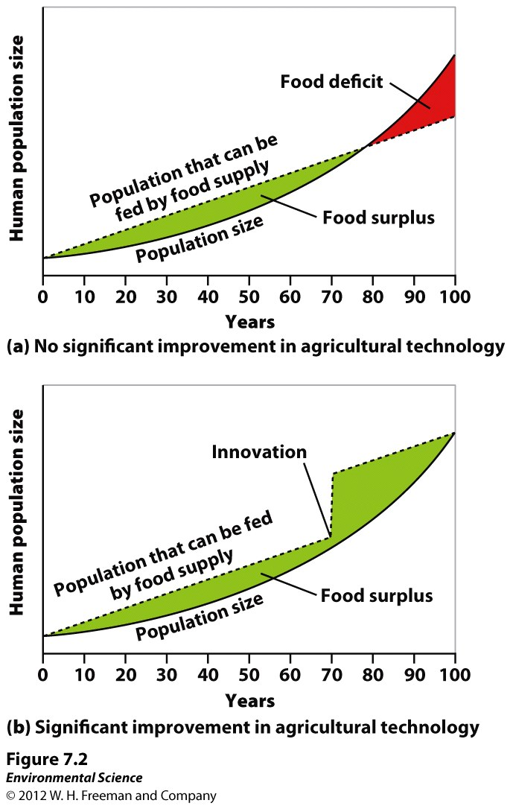
Scientists Disagree on Earth’s
Carrying Capacity
The following graphs show theoretical models of food supply and population size.

Slide 18
Why Scientists Disagree about the Carrying Capacity?
Do not believe there is a carrying capacity for humans
Growing population provides an increasing supply of intellect that leads to increasing amounts of innovation
Inventions/technological advances increase carrying capacity over time
Ex: Development of arrow made hunting more efficient
Believe outgrown OR will eventually outgrow available supply of resources such as food, water, timber, fuel, etc.
Malthus= Human population growing exponentially but food supply growing linearly
Environmental Scientists still believe that we will reach our carrying capacity= human population growth will decline

Slide 19
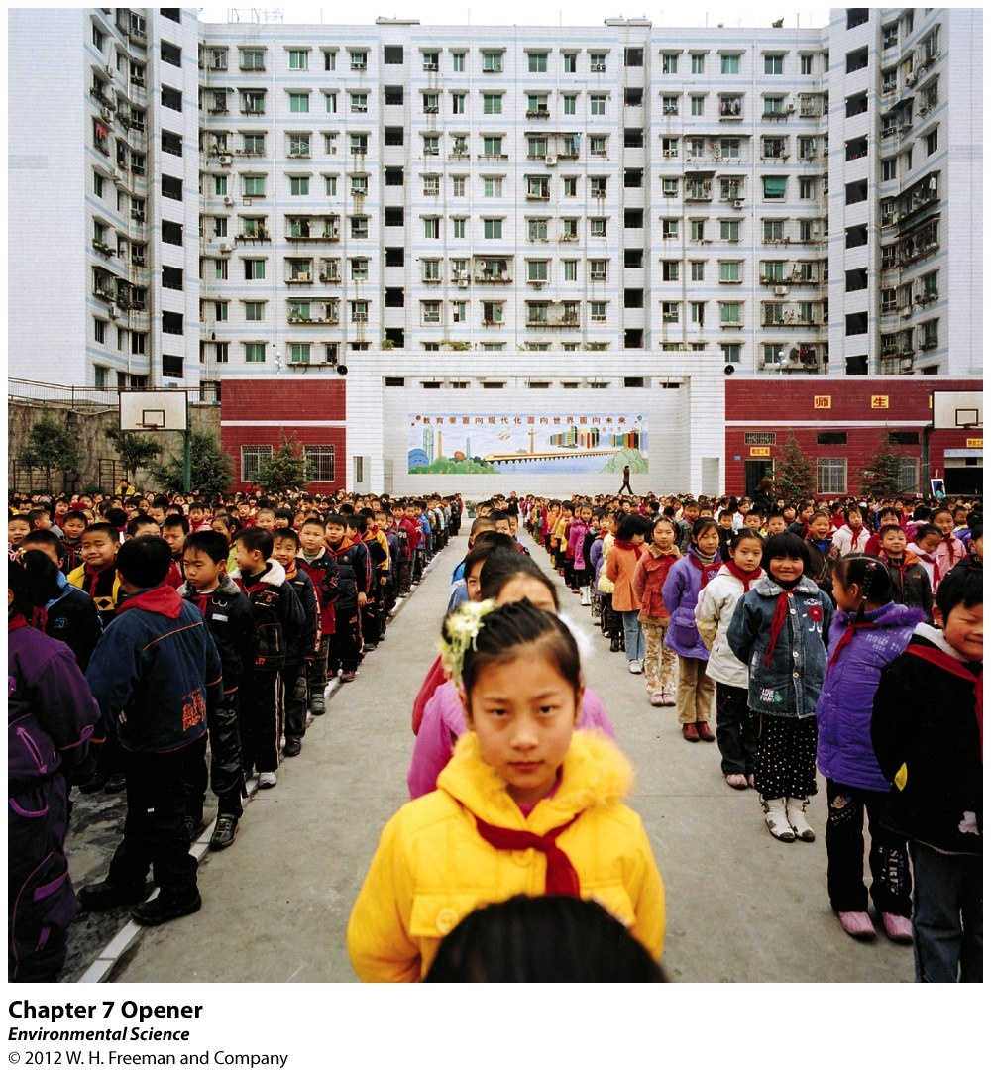
Chapter 7 The Human Population

Slide 20
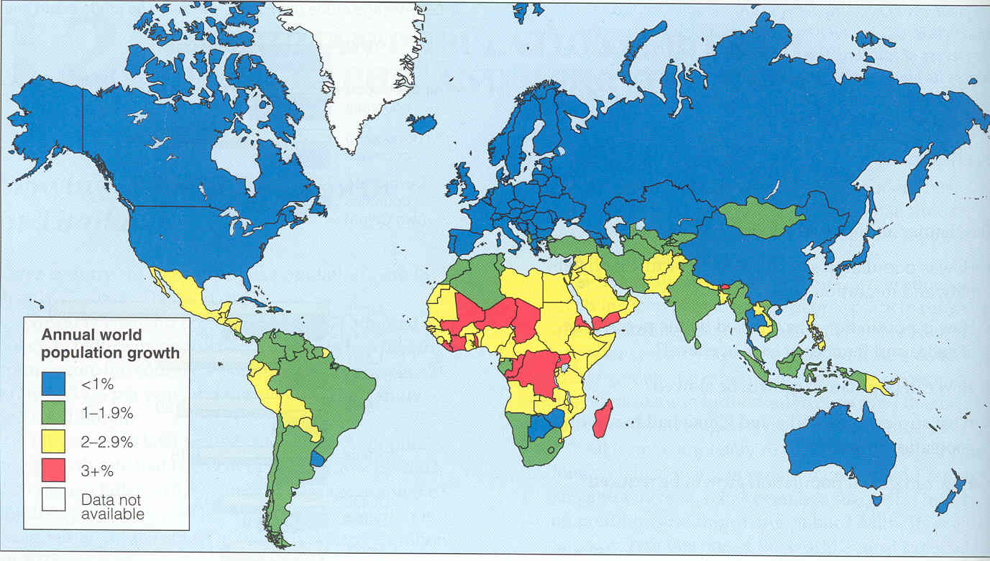
10/6 Human Population CH 7 Obj. TSW be able to explain the relationship between economic development and affluence, the crude birth and death rate at the national and global level, and perform a practice problem, pg. 70
1. Explain both the crude birth and death rates, include the Equation at both the global and national level.
2. In 2050 there are 40 births and 18 deaths per 1,000 people. By what percentage did the global population increase? At that percentage about how many years will it take for the population to double?

Slide 21
Changes in Population Size
Special measurement to determine yearly birth and death rates
Crude Birth Rate (CBR)= # of births per 1000 individuals per year
Crude Death Rate (CDR)= # of deaths per 1000 individuals per year
“Crude”= Does not take age or sex differences among the population
Divide by 10 to represent value as a %

Slide 22
Changes in Population Size
Global population growth rate =
(CBR- CDR)/ 10
National population growth rate =
(CBR+ immigration) –
(CDR + emigration)/ 10
If we know growth rate of pop.= can calculate the # of years it takes for a population to double
Doubling time (in years)= 70/ growth rate

Slide 23
#3
Global Population Growth Rate=
[CBR- CDR] = [40 -18] = 2.2 percent
10 10
Doubling Time (in years)=
70 = About 32 years
2.2

Slide 24
10/7 Human Population CH 7 Obj. TSW identify how fertility, family planning, and life expectancy all affect population size and growth,
1. Explain how total fertility rate (TFR) is measured and what is used to gauge changes in population size?
2. Explain what “life expectancy” means and what it is a good predictor of?
3. Why do people produce fewer children as their income increases?

Slide 25
Total Fertility Rate
Estimate of the average number of children that each woman in a population will bear throughout her childbearing years
Measure of births per woman
EX) US is just over 2 children
Replacement-Level Fertility
The

Slide 26
Life Expectancy

Slide 27
Family Planning

Slide 28
Fertility
TFR= Estimate of the average number of children that each woman in a population will bear

Slide 29
10/8 Human Population CH 7 Obj. TSW identify how ecological footprints are measured and the parts of the IPAT equation, pg. 72
1. Explain per capita ecological footprint. How do China’s, the US’s, & Haiti ecological footprint compare?
2. What is the IPAT equation?

Slide 30
Ecological Footprints
Affluence - having a lot of wealth such as money, goods, or property.
Provides a way to measure the effect of affluence on the planet

Slide 31
Ecological Footprint
One person in a developed country can have a greater impact than two or more people in a developing country
EX) Person living in US has more than 5X the environmental impact of a person living in China
18X that of a person living in Haiti
World average= 6.7 acres per capita
US= 22 acres per capita
China= 4.5 acres per capita
Haiti= 1.2 acres per capita

Slide 32
IPAT Impact= Population X Affluence X Technology
Hard to quantify the total environmental impact of the world:
Some people live “green” or unintentionally (poverty)
Some people consume large amounts of resources
Estimates the impact of human lifestyles on Earth
Representation of the three major factors that influence environmental impact

Slide 33
10/9 Population Review, CH 6 & 7
Compare and Contrast a K- selected species and a r-selected species
Explain the different survivorship curves.
Explain the following countries population based on the age structures:
(a) India (b) US (c) Germany (d) China

Slide 34
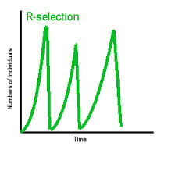
K- selected vs. r-selected

Slide 35
Reproductive Strategies
K-selected species- the population of a species that grows slowly until it reaches the carrying capacity.
Ex. elephants, whales, and humans*.
R-selected species- the population of a species that grows quickly and is often followed by overshoots and die-offs.
Ex. mosquitoes and dandelions

Slide 36
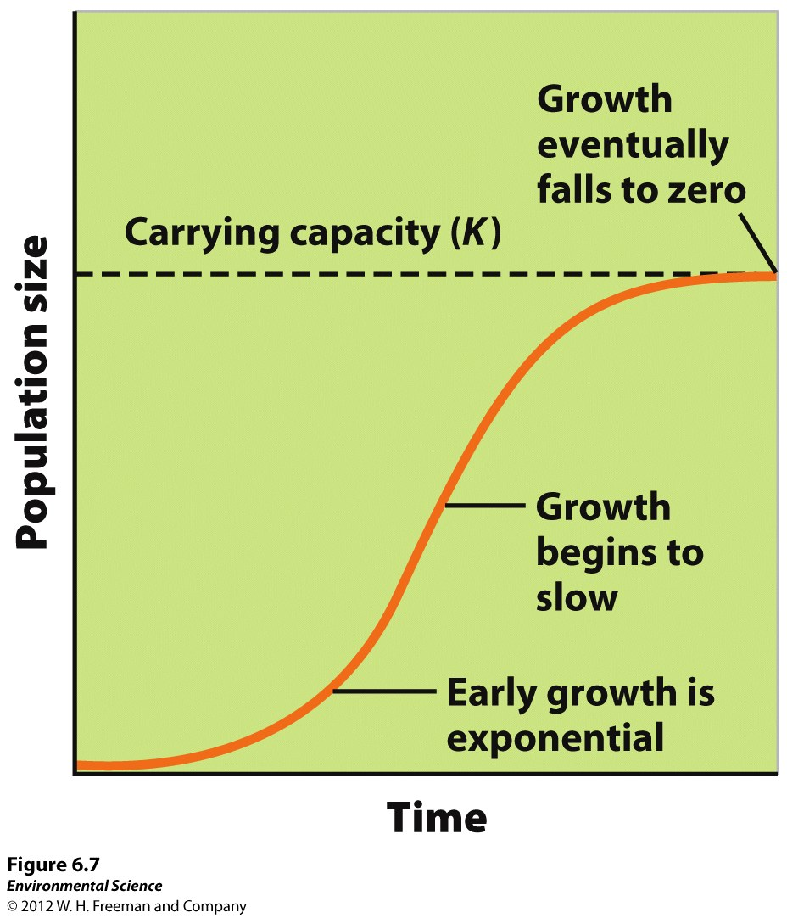
Logistic Growth Model
Population whose growth is initially exponential, but slows as the population approaches the carrying capacity.
S-shaped curve- when graphed the logistic growth model produces an “S”.
Usually “K” selected species.

Slide 37
Growth and decline of Reindeer population
25 Reindeer were introduced to St. Paul Alaska in 1910.
What Growth pattern does it show?
Why did the population crash?

Slide 38
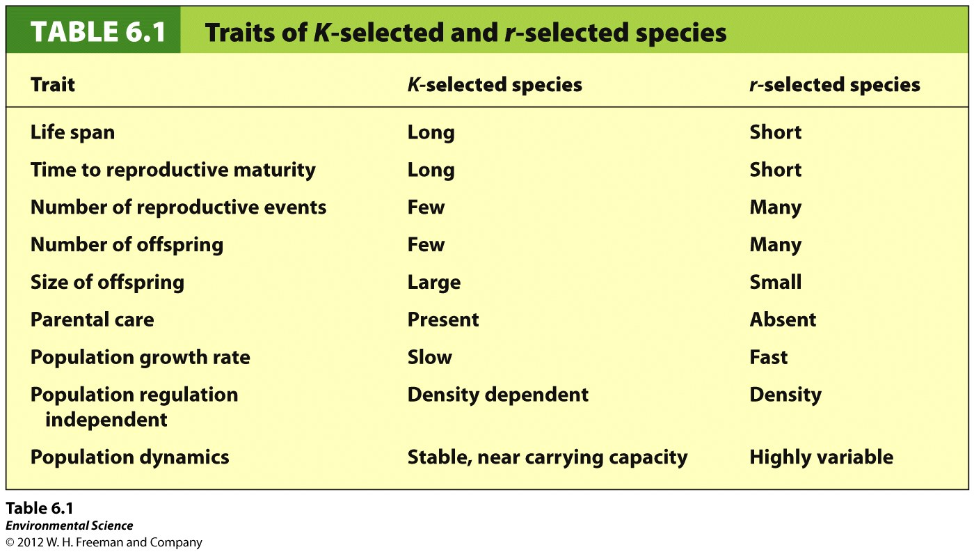
Notes:
R selected= don’t take care of their offspring, bacteria, mosquitos, etc.
K selected= fewer offspring, use resources well

Slide 39
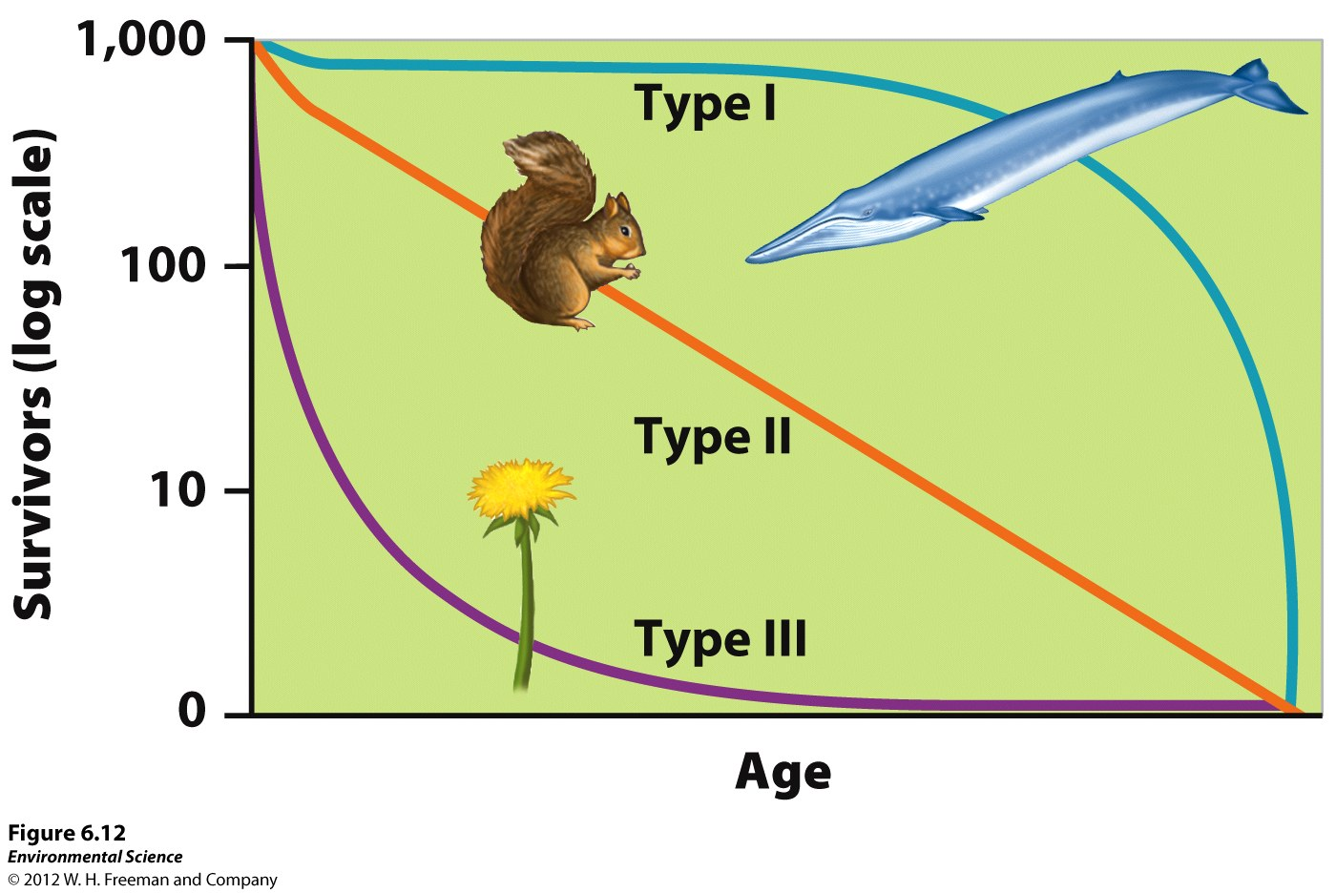
Survivorship Curves
Type I survivorship – Has excellent survivorship until old age. K – selected species.
Type II survivorship –
Exhibiting a relatively constant decline in survivorship over time.
Type III survivorship –
Has low rates of survivorship early in life. r-selected species

Slide 40
Age Structure Graphs
(a) India (2)= (Developing countries) Pyramid shape= Growing populations, more births than deaths
(b) US (3) = Rectangular shape= Stable, similar number of individuals in each age group, deaths and births equal each other, slow population growth
(c) Germany (4)= Declining populations, Narrower at the bottom than at the top, more deaths than births
(d) China= Early stages of a declining population→ pop. control

Slide 41
In the News…
http://www.thedailybeast.com/articles/2014/10/05/glaciers-lose-204-billion-tons-of-ice-in-three-years.html?utm_content=buffer66e36&utm_medium=social&utm_source=facebook.com&utm_campaign=buffer

Slide 42
Friday:
What are the four stages (Names) of demographic transition?
Crude birth and death rate
Monday: 10/6
Population problem (check)
Relationship between economic development and population
Explain the different viewpoints scientists have on if humans will reach our carrying capacity or not? Pg. 180-181
Tuesday: 10/7
Fertility
Family Planning
Life Expectancy
Wednesday: 10/8
Ecological footprint
IPAT equation
Impact of Affluence
Thursday: 10/9
Review of CH 6, CH 7

