Slide 1
Environmental Science
Week 17 CH 19 Waste Dec. 14 - 17

Slide 2
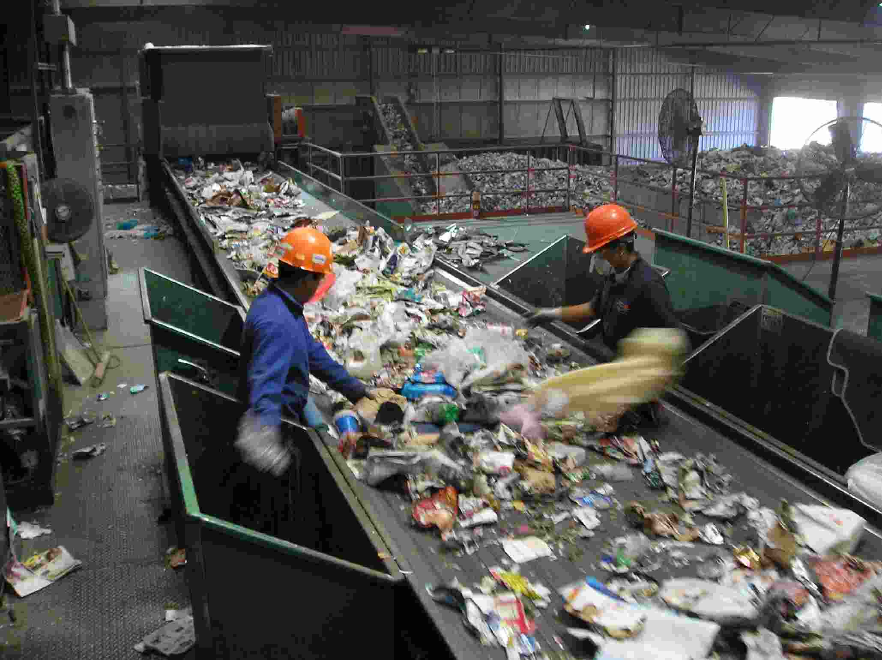
12/14 Reducing Solid Waste CH 19.2 Obj. TSW be inventive with ideas to create recycled materials. P. 74 NB
How can you use your customer buying power to reduce solid waste?
What steps must an item go through to be recycled?
What are the benefits to composting?

Slide 3
12/15 Hazardous Waste CH 19.3 Obj. TSW find solutions to decrease the exposure to hazardous waste. P. 76 NB
What are two characteristic of hazardous waste?
Describe a Law that helps protect you from hazardous waste.
How can hazardous waste be treated safely?

Slide 4
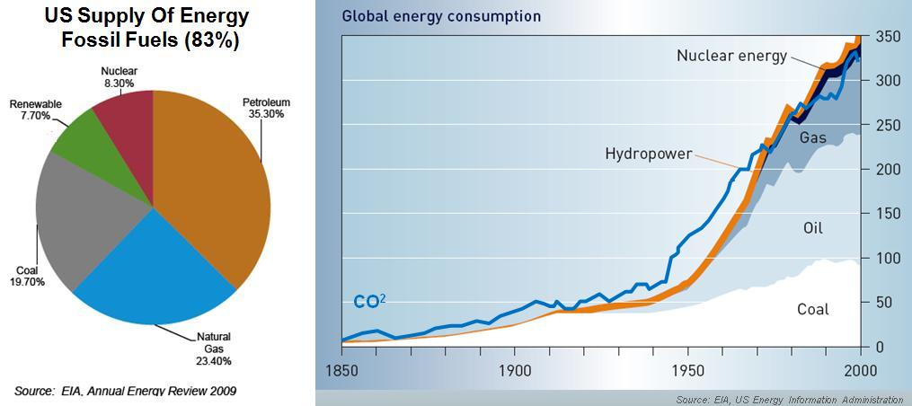
12/16 Review UNIT 5 Obj. TSW score well on the UNIT Test today. P. 78 NB
What are 2 types of Mining, and consequences of that type of mining?
Explain Nonrenewable and Renewable Energy, give examples for both.
Landfills are permanent waste-disposal facilities. What steps do we have in place to protect ourselves from the toxins put into them?

Slide 5
Energy Conservation Project Create a Brochure of Doable Energy saving techniques that could be used by our local City Hall to help people conserve energy.
Show examples from the mail.

