Slide 1
REVIEW CH 3, 4, 5

Slide 2
TEST CORRECTIONS
WHY your answer as WRONG?
WHY the right answer is RIGHT?
Do not rewrite the questions, EXPLAIN
NO MORE PEN
Grammar, sentence structure
If I can’t read it I am not grading it…

Slide 3
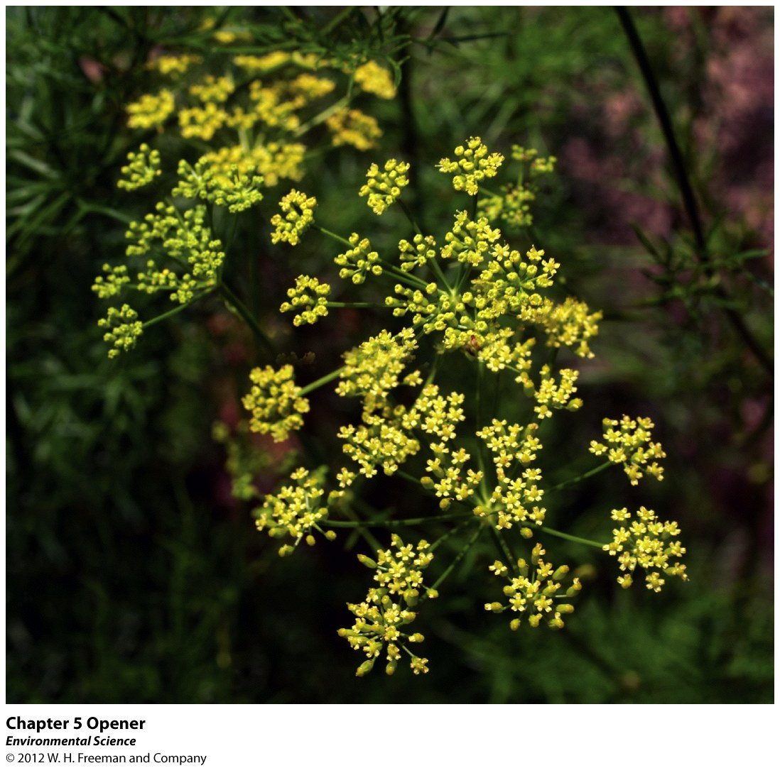
Opening Story CH 5

Slide 4
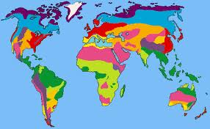
9/17: Ch. 3 Ecosystem Ecology, Ch.4 Biomes, Ch.5 Evolution; pg. 44NB Obj. TSW review for CH 3, 4, 5 quiz and do well on their quiz ☺
1. Draw a trophic pyramid, label each level, and label which direction energy flows.
2. How does climate affect the distribution of species around the globe.
3. Explain a fundamental niche.

Slide 5
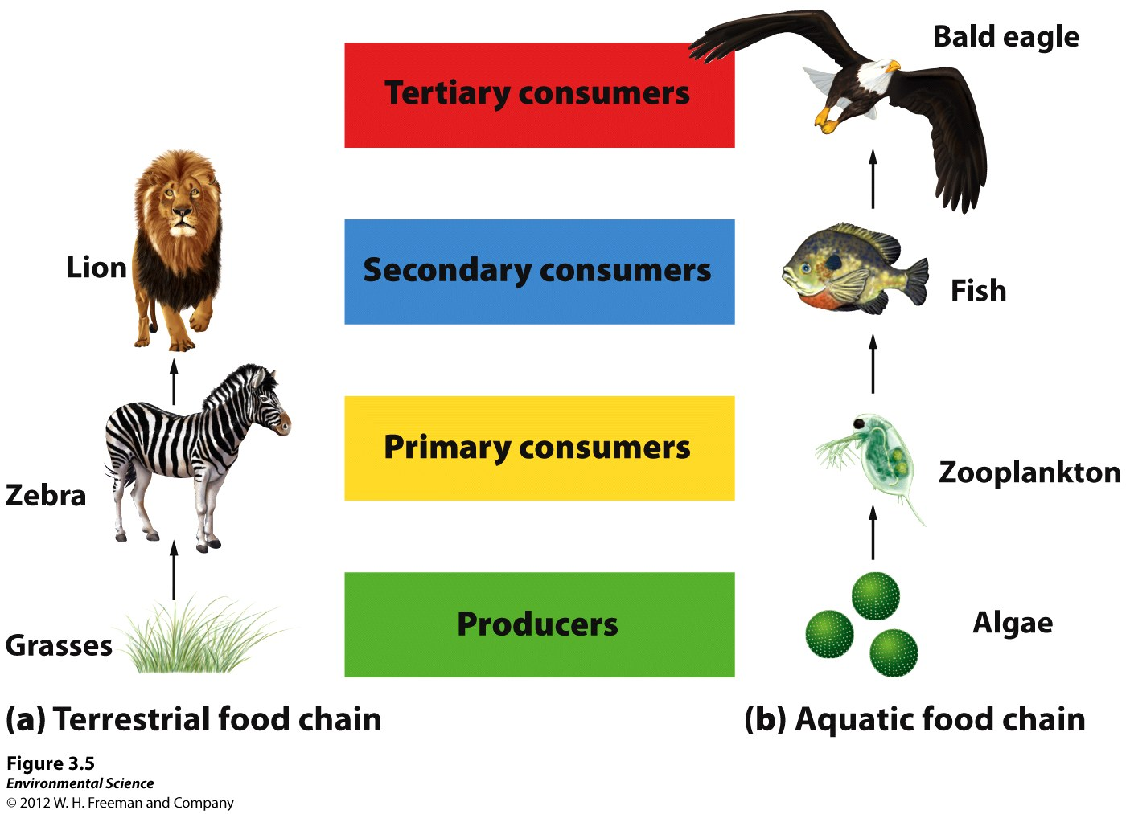

Slide 6
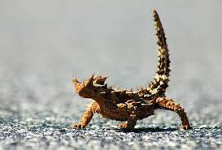
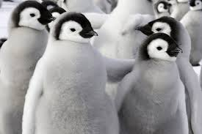
Species around the Globe
Precipitation
Temperature
Ex: Rainforest vs. Antarctica vs. Desert
Species adapt to different environments

Slide 7
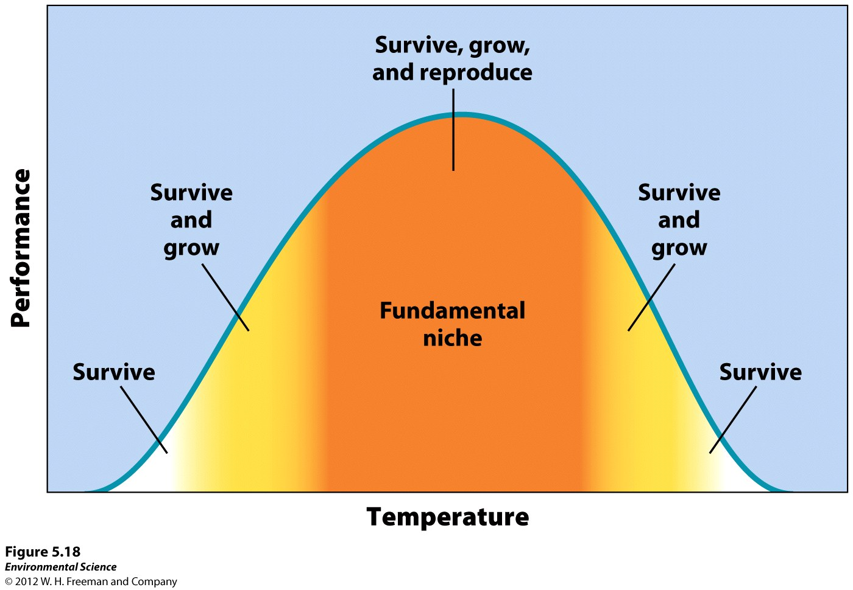
Fundamental Niche
Range of Tolerance: Optimal environment in which a species performs particularly well
Suite of ideal conditions for a particular species

Slide 8
TABOO REVIEW
Team up with a partner
Decide who is partner A and who is partner B
A vocab word will appear on the board!
Partner A will turn away from the board
Partner B will describe the word to partner A
Partner A will have to guess the word!
Then switch ☺

Slide 9
ITCZ
Autotroph
Abiotic
Recombination
Second Law of Thermodynamics
NPP= GPP- cellular respiration
Mutation
Species richness

