Slide 1
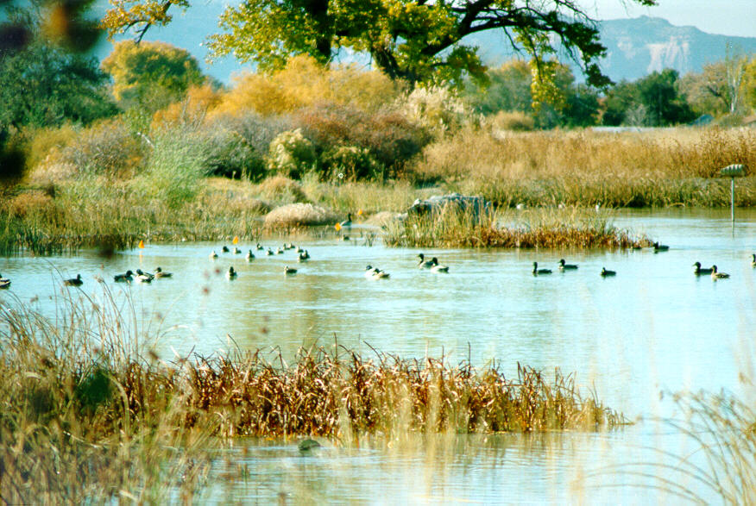
10/1 Population Characteristics CH 6 Obj., TSW identify population characteristics, other factors that influence them, and identify factors that affect wetland diversity, pg. 64
1. Explain metapopulations
2. What are some population characteristics?
3. What are some factors that affect wildlife diversity in wetlands? (answer later!)

Slide 2
Factors that Regulate Population Abundance and Distribution
Population size- the total number of individuals within a defined area at a given time.
Population density- the number of individuals per unit area at a given time.
Population sex ratio- the ratio of males to females
Population age structure- how many individuals fit into particular age categories.
Population distribution- how individuals are distributed with respect to one another.

Slide 3
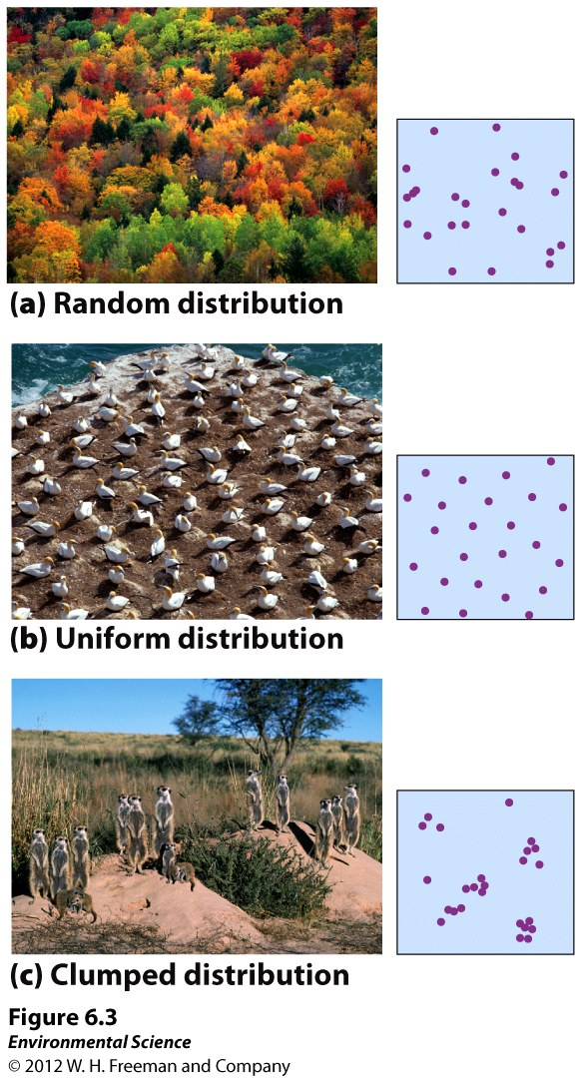
How Populations are distributed.

Slide 4
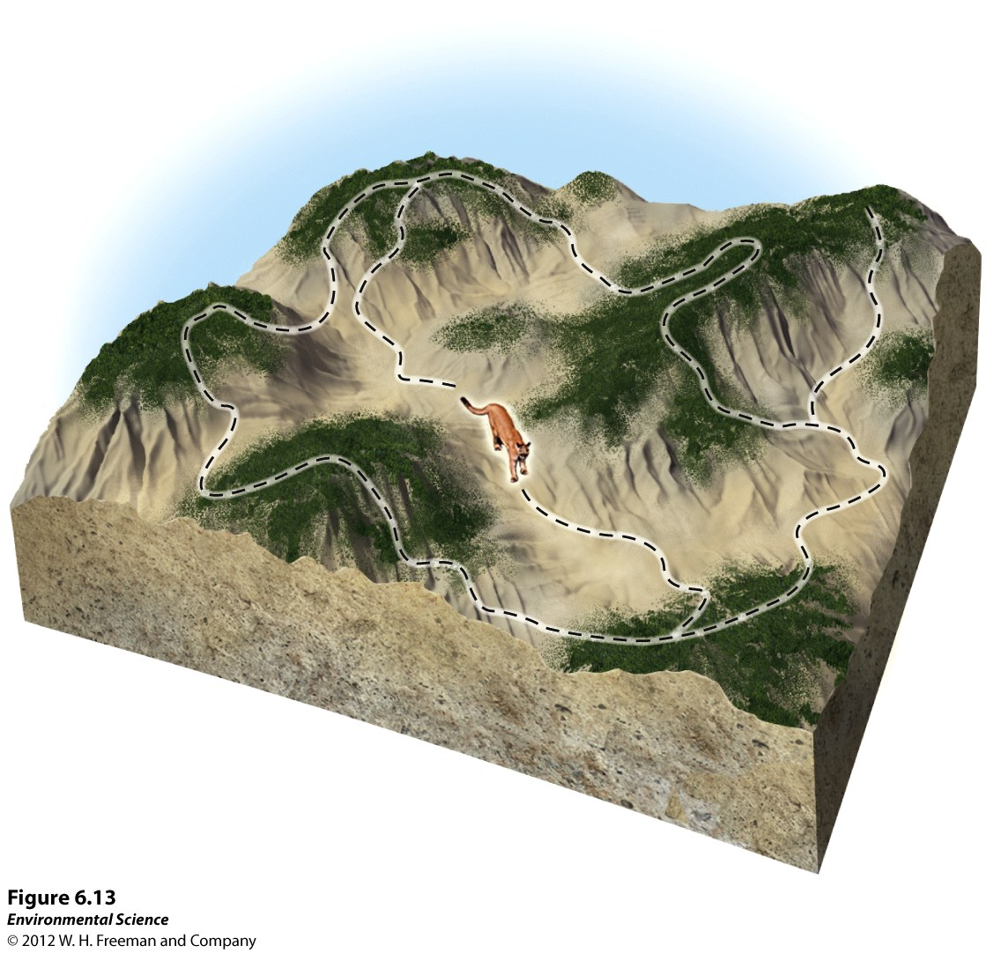
Metapopulations
Metapopulations- a group of spatially distinct populations that are connected by occasional movements of individuals between them.

Slide 5
Wetland Presentation pg. 63
Groups of 3 or 4
(1) Intro, Wetland Formation, California’s Wetlands
(2) The Salt Marsh, Adaptations, Why they Matter?
(3) Great Basin
(4) Mojave Desert
(5) Sonoran
Include:
1. What are some factors that affect wildlife diversity in wetlands or your specific wetland?
2. Why is California considered a biodiversity hotspot?
3. Important information in your section, you are the expert!

Slide 6
In the News… Ebolaaaa!

Slide 7
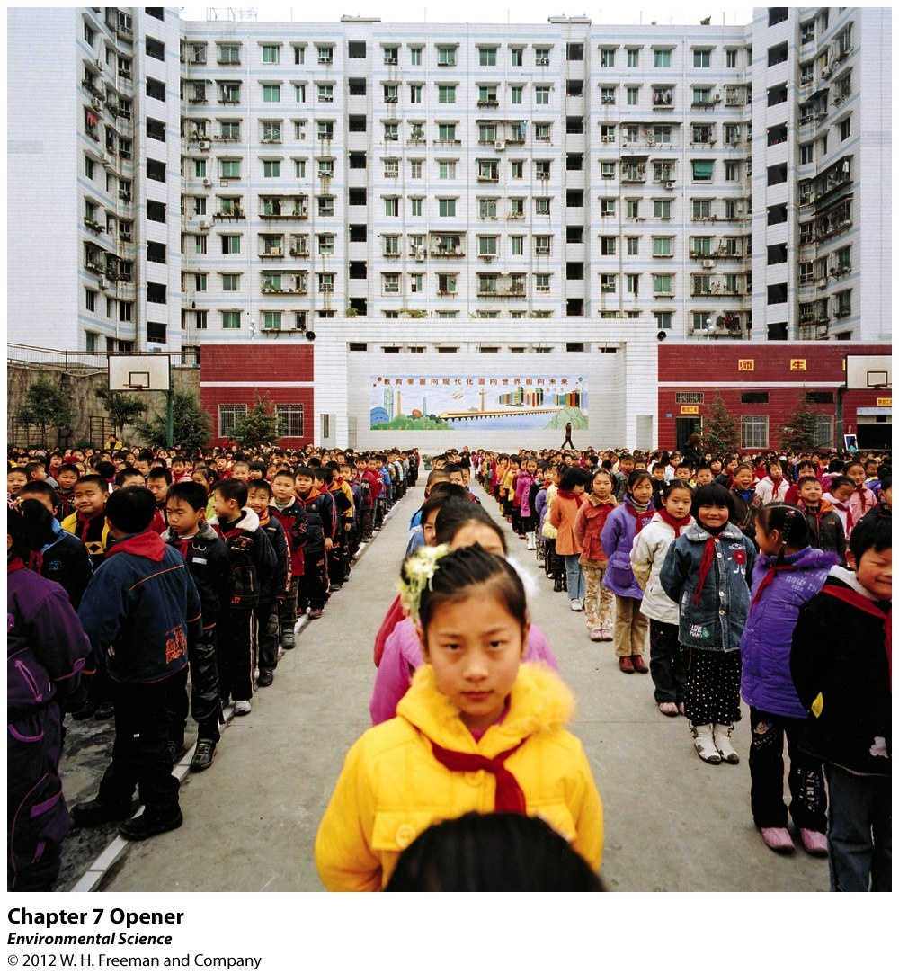
Chapter 7 The Human Population

Slide 8
10/2 Human Population CH 7 Obj. TSW learn about age structure graphs, demographic transition & practice population questions. P. 62 NB
Draw an Age Structure graph of a growing population.
RCHS population is 1976 students, 27 transfer in, 5 get expelled. What is the population growth of the high school?
Ecosystem question from yesterday!
AGE STRUCTURE GRAPHS

Slide 9
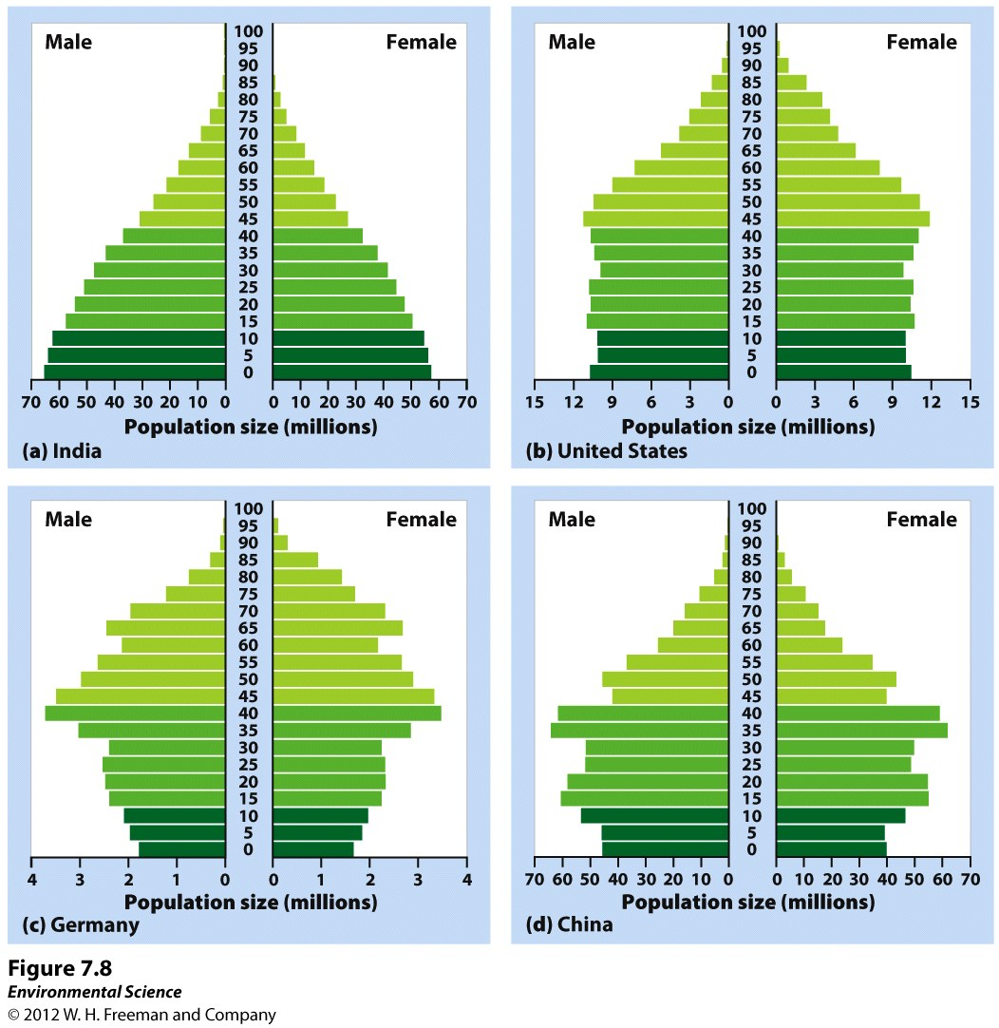
Age Structure
Age structure diagrams (population pyramids)- visual representations of age structure within a country for males and females.

Slide 10
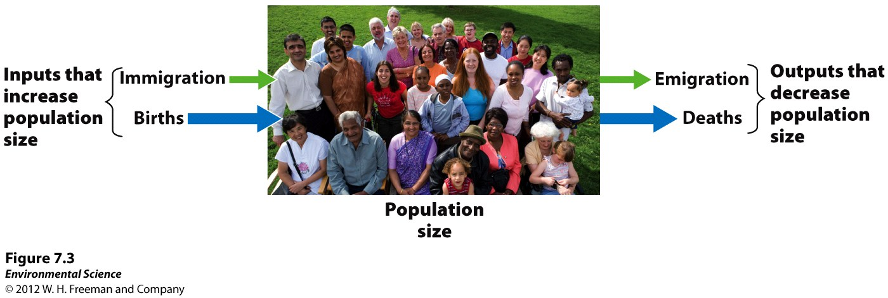
Changes in Population Size
Immigration- the movement of people into a country
Emigration- the movement of people out of a country.
Net migration rate- the difference between immigration and emigration in a give year per 1,000 people in the country.

Slide 11
Growth Rate
Growth Rate = Births – Deaths
Movement of individuals =
Immigration
Emigration
(births + immigration) – (deaths + emigration) = population change

Slide 12
#2.
Population Growth, NOT Growth rate
(B + I) – (D + E) = 27 – 5 =
The population of RCHS has increased by 22 people.

Slide 13
10/3 Human Population CH 7
What are the four stages (Names) of demographic transition?
Crude birth and death rate

Slide 14
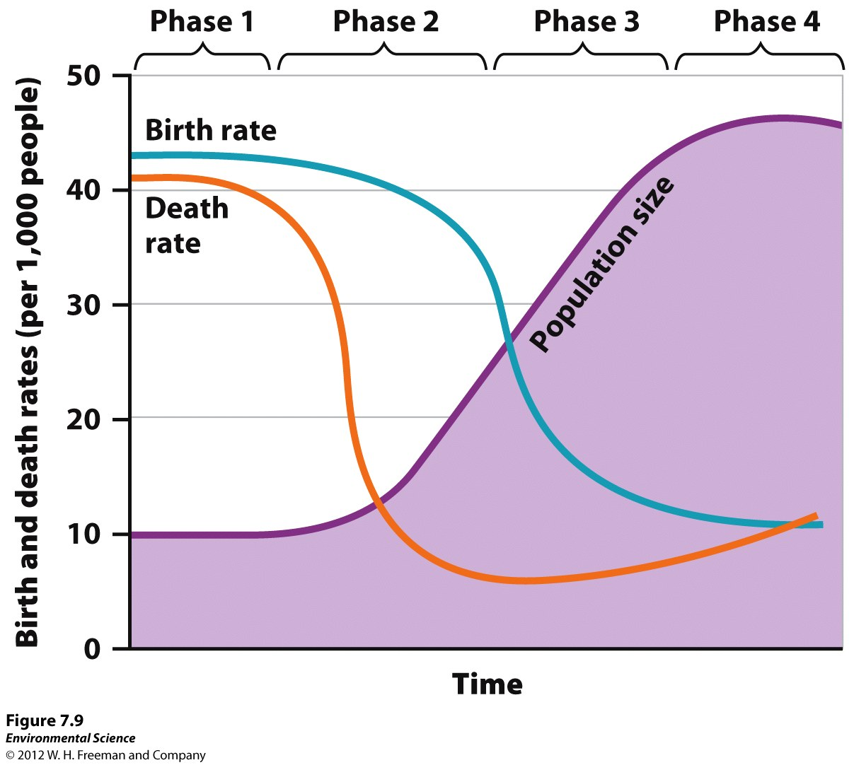
The Demographic Transition
The theory of the demographic transition is the theory that as a country moves from a subsistence economy to industrialization and increased affluence, it undergoes a predictable shift in population growth.

Slide 15
Theory of Demographic transition
Phase1 – Pre-Industrial – Before the industrial Revolution
Phase 2 – Transitional - India
Phase 3 – Industrial – US & Canada
Phase 4 Post Industrial – UK, Germany, Russia, Italy, Japan

Slide 16
The Stages of the Demographic Transition
Phase 1: Slow population growth because there are high birth rates and high death rates which offset each other.
Phase 2: Rapid population growth because birth rates remain high but death rates decline due to better sanitation, clean drinking water, increased access to food and goods, and access to health care.
Phase 3: Stable population growth as the economy and educational system improves and people have fewer children.
Phase 4: Declining population growth because the relatively high level of affluence and economic develop encourage women to delay having children.

Slide 17
Changes in Population Size
Crude birth rate (CBR)= the number of births per 1,000 individuals per year.
Crude death rate (CDR)= the number of deaths per 1,000 individuals per year.
Global population growth rate =
(CBR- CDR)/ 10
National population growth rate =
(CBR+ immigration) - (CDR + emigration)/ 10
Doubling time (in years)- 70/growth rate

Slide 18
In the News... For our Cover Letter!

Slide 19
Must include this problem in our Cover Letter!

Slide 20
10/6 Human Population CH 7
Population problem (check)
Relationship between economic development and population
Explain the different viewpoints scientists have on if humans will reach our carrying capacity or not? Pg. 180-181

Slide 21
10/7 Human Population CH 7

Slide 22
10/8 Human Population CH 7

Slide 23
Ecological Footprints
Affluence - having a lot of wealth such as money, goods, or property.

Slide 24
Friday:
What are the four stages (Names) of demographic transition?
Crude birth and death rate
Monday: 10/6
Population problem (check)
Relationship between economic development and population
Explain the different viewpoints scientists have on if humans will reach our carrying capacity or not? Pg. 180-181
Tuesday: 10/7
Fertility
Family Planning
Life Expectancy
Wednesday: 10/8
Ecological footprint
IPAT equation
Impact of Affluence
Thursday: 10/9
Review of CH 6, CH 7

