Slide 1
Environmental science
Mrs. McAllister
Fall 2015 – 2016
Room 757 Period 4

Slide 2
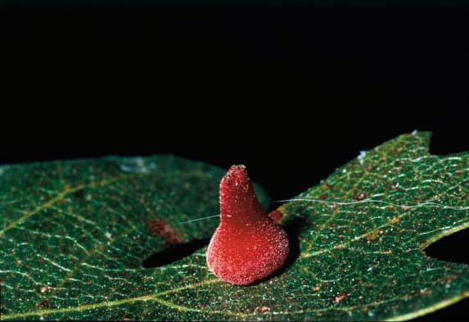
What is this? Write your best guess on the 3x5 card

Slide 3
Oak Trees and Wasp galls
The wasp choose an oak tree as a host and their larvae grow on the underside of the leaf
The wasps deposit reddish urchin galls
antron quercusechinus
Article in bay nature magazine

Slide 4
Interactions in Nature
Describe some interactions in nature that you have noticed or discuss your thoughts about the wasps and oak galls.
How do living things interact with each other?

Slide 5
How are you part of the natural system / environment?
Write your thoughts down on paper. You will tape this in your notebook tomorrow.
Watch the following video.
Now what? How has your perception changed regarding how you are part of the environment?
One more video.

Slide 6
The secret Life of crows
Facial recognition
Alarm call
How do humans and Crows work together to solve problems?
What is the real problem?
How do humans interact with nature?

Slide 7
Annotate the Text
Read the “Will El Nino Make a Difference? Maybe not July 2015
As you read underline the vocabulary words you know
Circle any vocabulary words you don’t know.
Write you thoughts I the margins.
Answer the following questions after having a discussion about the article on page 11 NB.

Slide 8
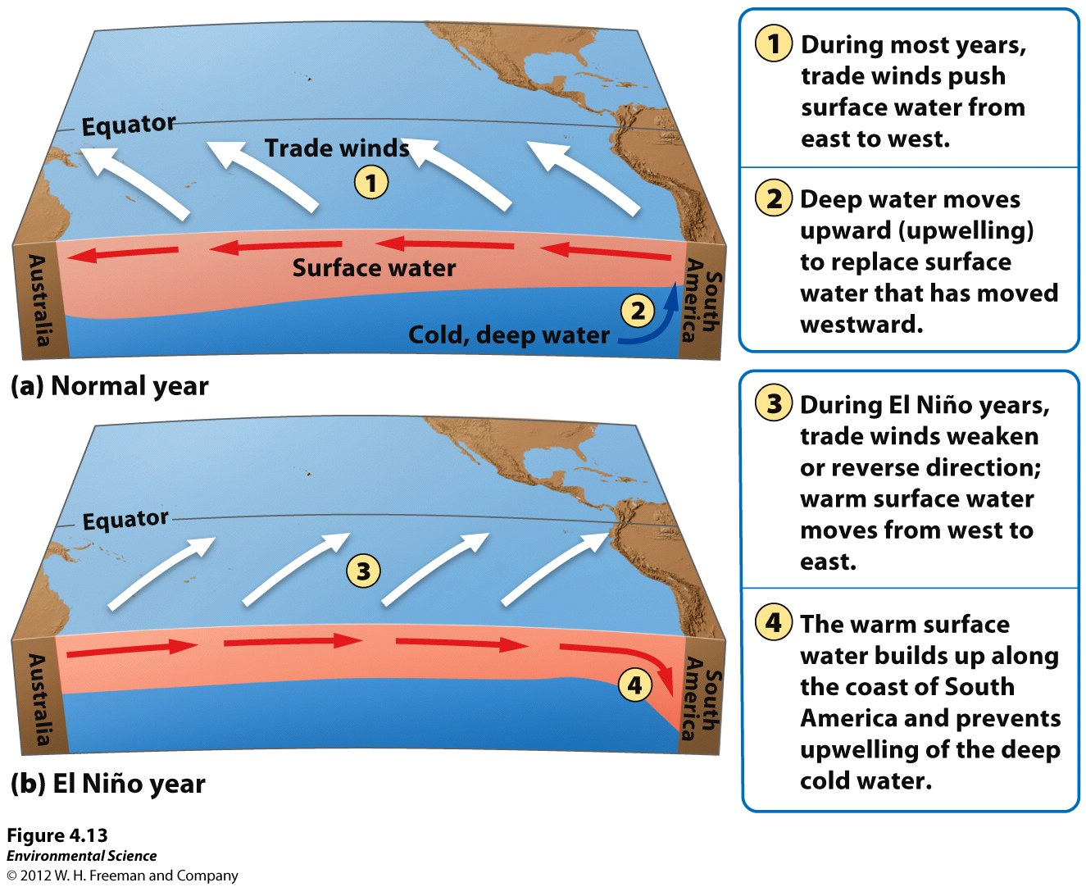

Slide 9
What about our Drought?
http://ca.gov/drought/
Will El NiÑo make a difference, Maybe not
Read the following article, write your answers on binder paper.
What is ENSO?
Why is it one of the most studied climate phenomena?
What is the claim of the article?
What is the evidence for that claim?
List the support for that evidence.
Why is this important? How does it effect our lives?
How is the environment important to us?

Slide 10
Environmental Science
Sustainability

Slide 11
8/20 Sustainability Obj. TSW learn how RCHS incorporates sustainable practices by walking on a campus tour and participating in a class discussion after. P. 8NB
How are you part of the natural environment?
What would you like to learn about environmental science?
What do you think sustainability means?

Slide 12
8/21 Environmental Science Obj. TSW better understand weather systems and impacts of a drought by reading an article and discussing it in a group. P. 10 NB
What is Environmental Science?
Have you noticed more Crows on campus each day?
What do you think Salinization is, as it relates to agriculture?

Slide 13
Eating food locally Farm-to-Fork
What do you think farm to fork is?
How is it a sustainable practice?

