Slide 1
Agenda
Warm up
CM CH 8 – 10
Data on Primary Productivity lab

Slide 2
10/1 Understanding Populations Obj. TSW learn about how populations growth rate is measured, and how graphs can represent how populations grow. P. 62NB
How is Growth rate measured?
Draw a graph of Exponential growth, what shape is the curve and give an example of an organism with this pattern.
Compare and Contrast a K- selected species and a r-selected species, how are their graphs different, how are the organisms they represent different?

Slide 3
Growth Rate
Growth Rate = Births – Deaths
Movement of individuals = Gene Flow
Immigration
Emigration
(births + immigration) – (deaths + emigration) = population change

Slide 4
Factors that Influence Population Size
Density-dependent factors- the size of the population will influence an individual’s probability of survival.
Density-independent factors- the size of the population has no effect on the individual’s probability of survival.

Slide 5
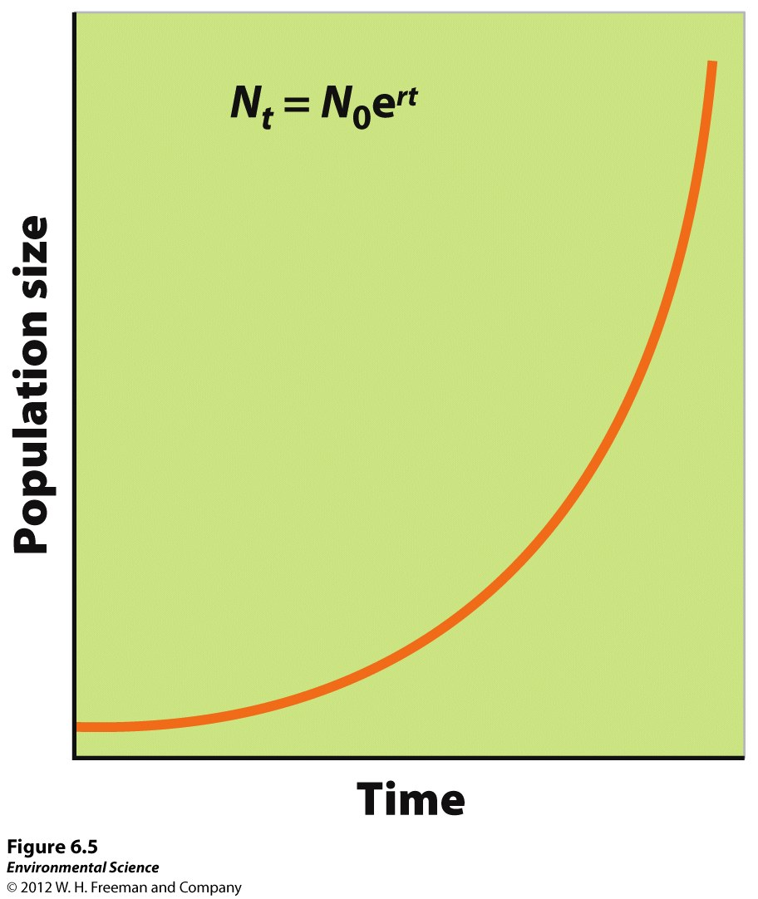
Exponential Growth Model
Growth rate- the number of offspring an individual can produce in a given time period, minus the deaths of the individual or offspring during the same period.
Intrinsic growth rate- under ideal conditions, with unlimited resources, the maximum potential for growth.
J-shaped curve- when graphed the exponential growth model looks like this.

Slide 6
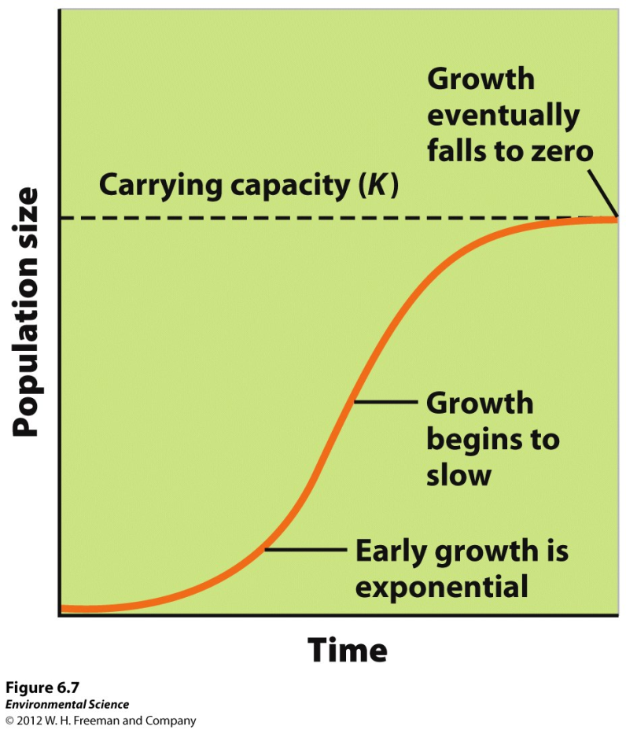
Logistic Growth Model
Logistic growth- when a population whose growth is initially exponential, but slows as the population approaches the carrying capacity.
S-shaped curve- when graphed the logistic growth model produces an “S”.

Slide 7
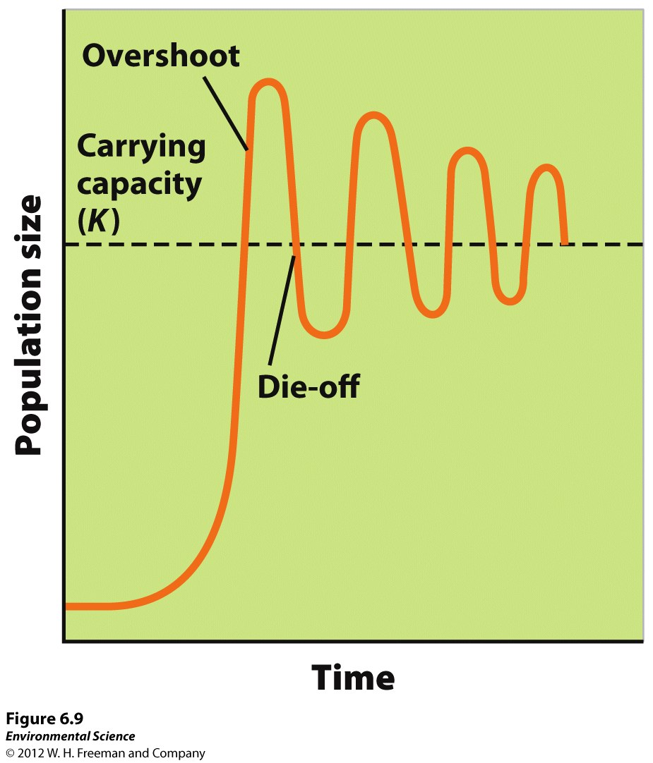
Variations of the Logistic Model
If food becomes scarce, the population will experience an overshoot by becoming larger than the spring carrying capacity and will result in a die-off, or population crash.

Slide 8
Reproductive Strategies
K-selected species- the population of a species that grows slowly until it reaches the carrying capacity. Ex. elephants, whales, and humans.
R-selected species- the population of a species that grows quickly and is often followed by overshoots and die-offs. Ex. mosquitoes and dandelions

Slide 9
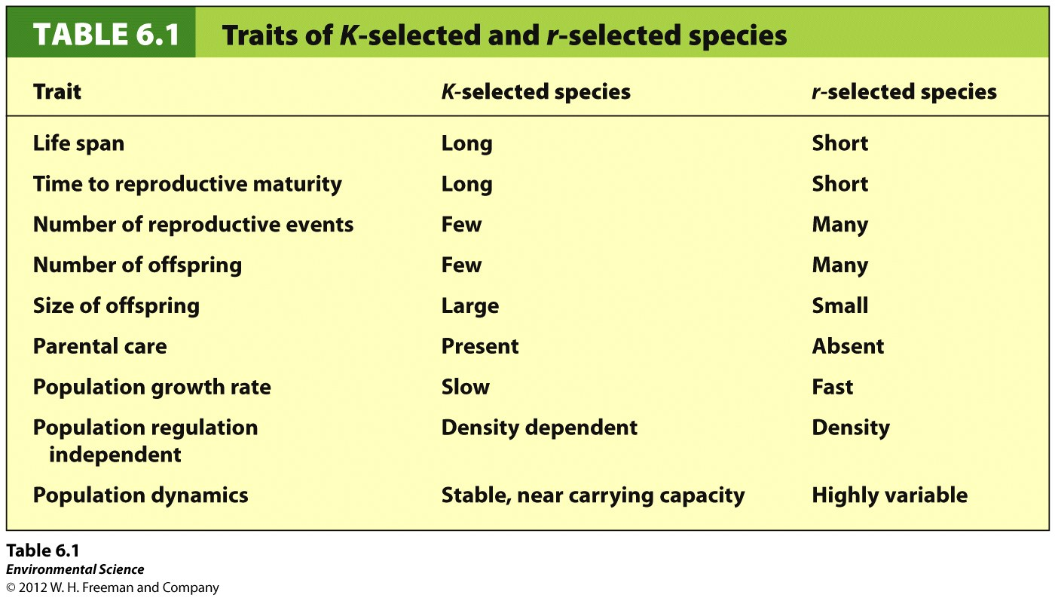

Slide 10
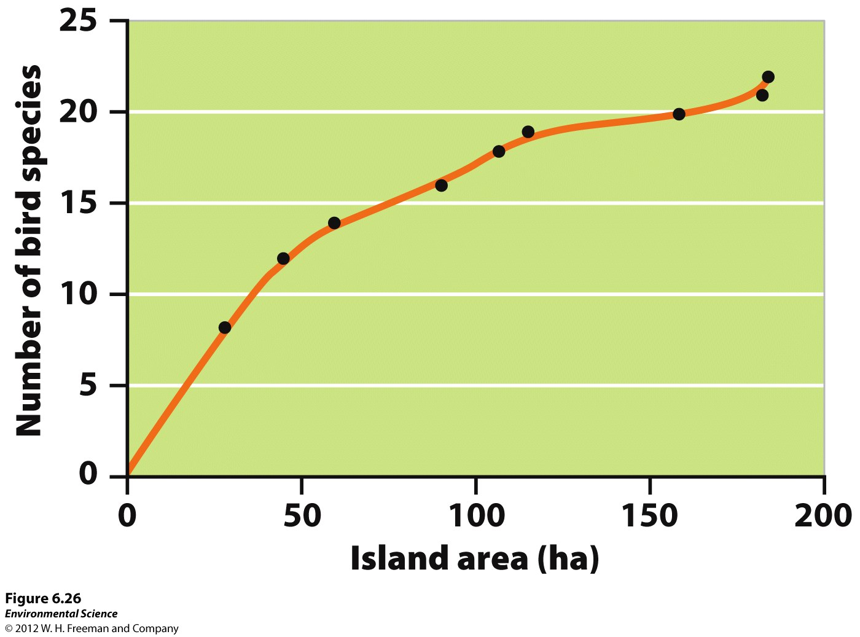
Theory of Island Biogeography
Theory of island biogeography- the theory that explains that both habitat size and distance determine species richness.

Slide 11
Eutrophication p. 53 NB
8. Life forms existed in the original pond water.
Life forms existed in the control for a least two days.
No life forms were found in the fertilizer water.
9. A larger sample of water was needed to collect data
Analysis
1.The 10 tsp of fertilizer would have the most algae
2. Our sample showed no signs of life.
3. Did obs. Match predictions?
4****** Artificial eutrophication can be prevented by stop the run off of farms & ranches by building a natural watershed – wetlands.

Slide 12
Agenda
Warm up
Test Answers
Test correction due Monday
Monday – Population Quiz
Environmental Science Current Event
Transecting – Biodiversity
Species Richness
Species Evenness

Slide 13
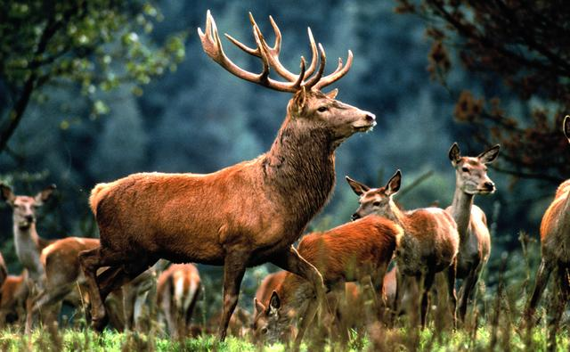
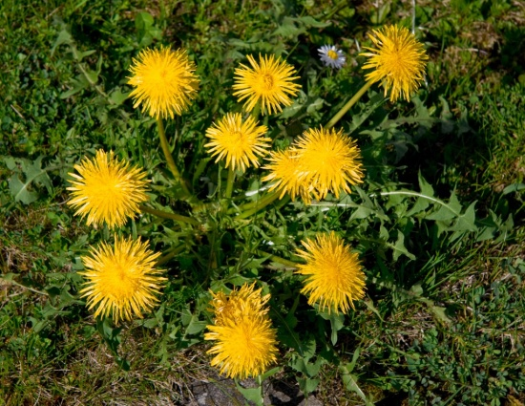
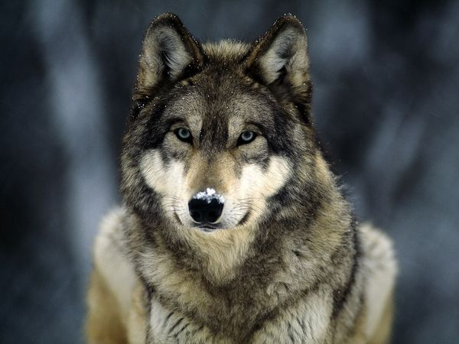
9/30 Population Growth Rate Obj. TSW learn how to use doubling time and population change problems. P. 62NB
In the spring time, the population of Dandelion weeds explodes in your yard. If you start with a population of 12 weeds, and the rate is 30%, what is the doubling time of your dandelion population?
You are fed up with these weeds, and don’t have time to pull them out by hand. So you spray a pesticide, this slows the rate to 5%, how many days does it take for the little buggers to grow now?
Population Change A herd of 5 deer, have 4 fawns, and one buck. One doe without a fawn joins the herd. Two fawns sleep forever from a wolf invasion. One doe leaves the herd as a result. What is the population change?

Slide 14
Answers!
Doubling time!
(1) 70 = 70 = 2.3 days to get to 24 weeds
x 30%
(2) 70 = 70 = 14 days to get to 24 weeds
x 5%
(3) Herd= 5 + (4+1- 2) + (1-1)
= 8 deer

Slide 15
How do Populations change in size
Global Scale: Birth rate – death rate = growth rate
b - d = r growth rate (r) can be + or –
Local Scale: movement from one region to another
Immigration – # individuals entering a population
Emigration - # individuals leaving a population
r = (b – d) + (i – e)

Slide 16
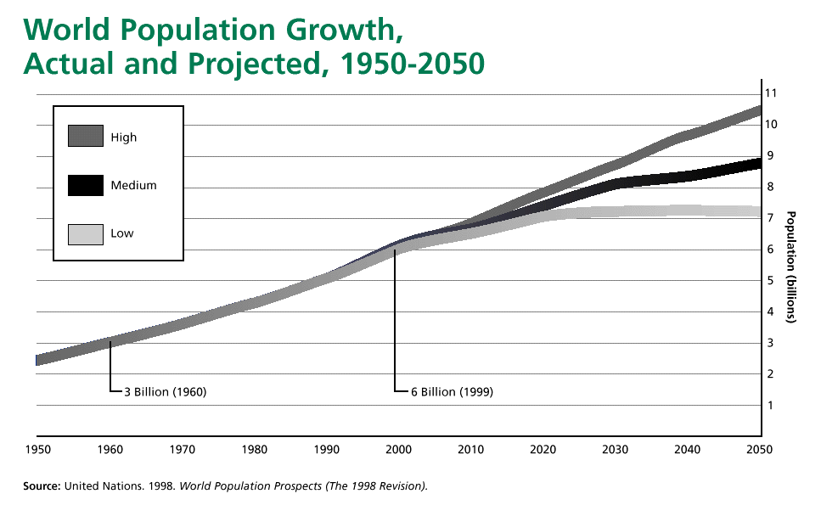
10/1 Population problems Obj. TSW learn how to proficiently perform population problems. P.64NB
1.Doubling Time –The world population is growing at 1.16%, What year will it double from today?
http://www.worldometers.info/world-population/
2. Percent Change – What is
the percent change in population
From 1960 – 2020?
3. Population Change – CA has
521,265 births, approx. 270,000
immigrate to CA/year. Deaths in
CA are 233,143. The Growth
rate in CA is 0%, how many people emigrated?
Notes:
Population distribution???

Slide 17
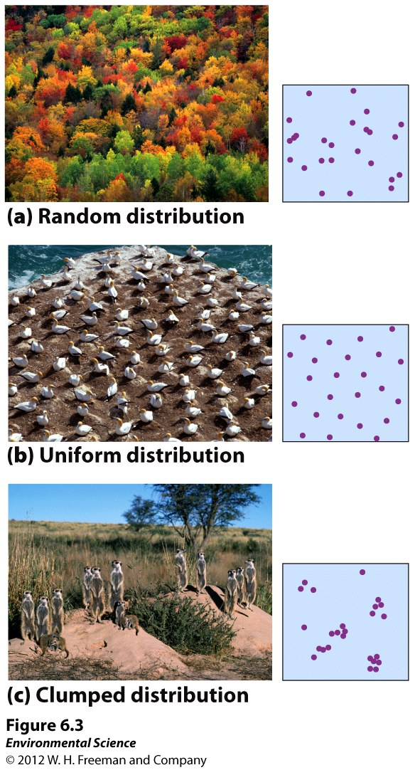
How Populations are distributed.

Slide 18
Wetland Presentation
Groups of 3 or 4
(1)
(2)
(3)
(4)
(5)
Include:

