Slide 1
Environmental Science
Week 10 UNIT 4 CH 11 Water

Slide 2
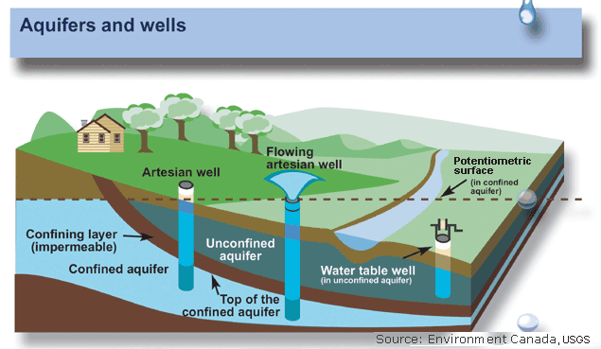
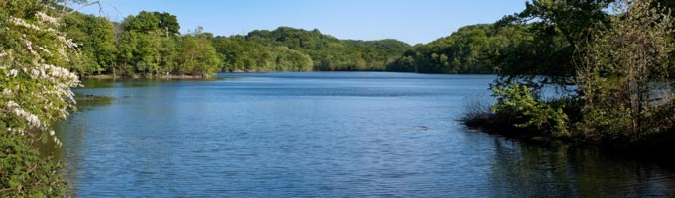
10/19 Water Resources CH 11.1
Obj. TSW learn about water as a limited resource and how water is distributed. P. 8 NB
Explain the water cycle.
Give three examples of surface water.
Explain ground water and why it is important.

Slide 3
Bangladesh – Clean Water page 11 NB (bottom ½ page)
What are your impressions?
What does it mean to you to have clean water?
What diseases pose a threat if water is not clean?
Where is the pollution coming from?
What is being done to decrease pollution?

Slide 4
HW – CH 11 Read
1 page Notes CH 11 Page 13 NB

Slide 5
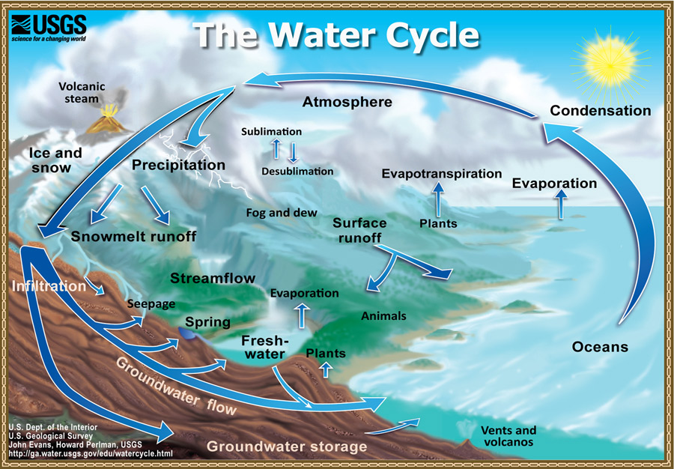
Water Cycle

Slide 7
Flood Prevention Week
Activity: Flood Risk p. 9
What is a levee?
Name all the levees that surround West Sacramento
What bodies of water surround West Sacramento?
What are some Levee improvements (4)?
What is erosion?
Why is erosion a concern during the rainy season?
What is seepage?
Why is a setback levee being built & where?
Who is doing the work?
http://www.spk.usace.army.mil/Portals/12/documents/civil_works/WestSac/Draft%20EIS-EIR%20-%20July%202014/EIS%20EIR%20Appendix%20B%20West%20Sacramento%20Southport%20Combined%20BA.pdf

Slide 8
Build your own flood Page 11NB
Add sand to the pan
Saturate the sand with water
Make a river (Winding) with your probe and scoopula
Add water to the mouth of your river
What happens to your river with water flow?
Use your vocabulary words.
Build your levees to protect west Sacramento
Did they hold? Why or why not?
Where do you think the weakest link in the levee?

Slide 9
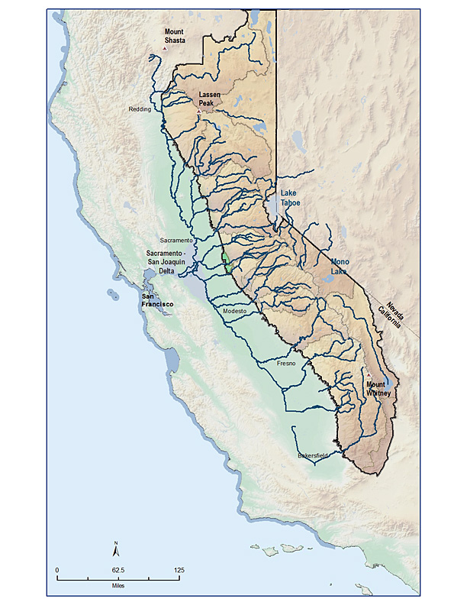
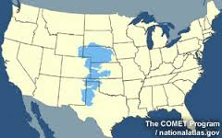
10/21 Watersheds, & Aquifers CH 11.1
Obj. TSW learn the importance of a watershed, and how an aquifer can be an underground treasure. P. 10 NB
What is a watershed?
Name 3 watersheds on three different countries.
Why is the Ogallala Aquifer an underground treasure?

Slide 10
Activity: Watersheds of the World P. 15 NB
Choose a watershed
Explain what a watershed is.
What rivers are part of your watershed?
Who depends on your water?
How does most of your water originate: snow, rain, glacier?
Does your watershed feed into an underground Aquifer?

Slide 11
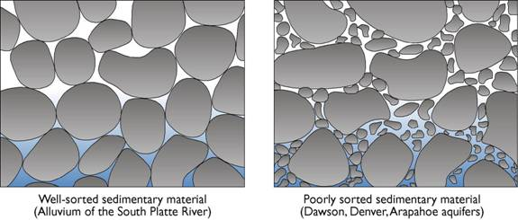
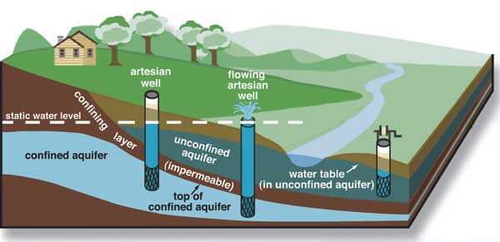
10/22 Ground Water CH 11.1
Obj. TSW understand the mechanics of how water flows underground. P. 12NB
What is Porosity?
What is Permeability?
Explain a recharge zone?

Slide 12
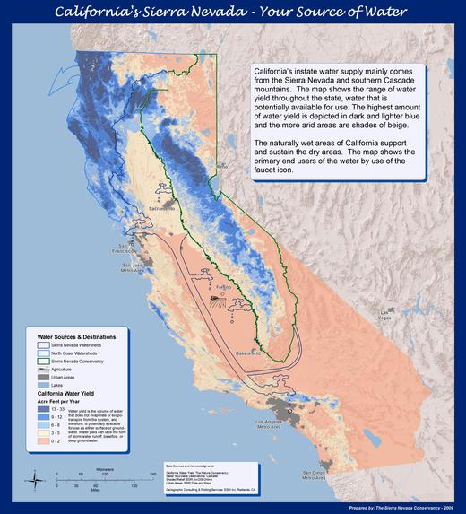
http://www.sierrawaterworkgroup.org/why-the-sierra.html

Slide 13
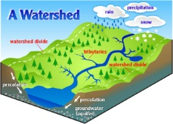
Activity: Color Me a Watershed p. 15 NB
Choose different colors for Forest, Grasslands, Wetlands, Residential, Agricultural, and Stream
Color the 3 Maps: A, B, C
Calculate the area for each, and write how each has changed in the last 100 years.

Slide 14
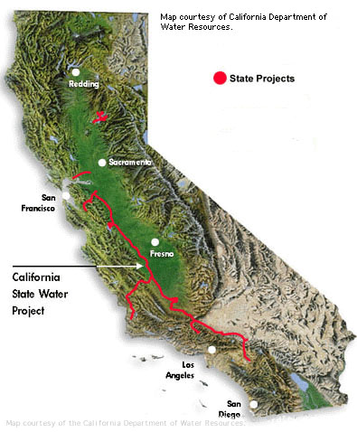
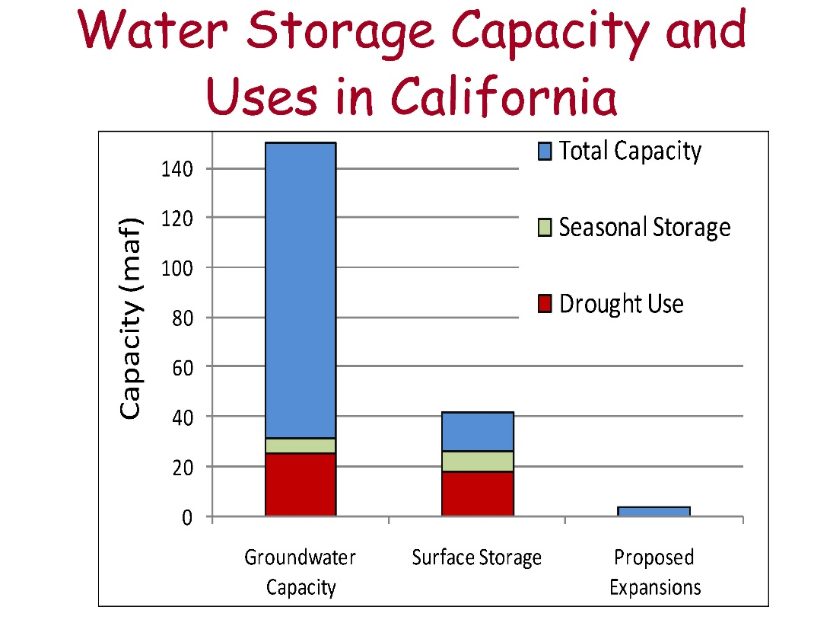
10/23 Water Use & Management
Obj. TSW Explain how water is treated and used. P. 14 NB
How is drinking water treated?
Name at least three ways water is used.
How is water conserved?

Slide 15
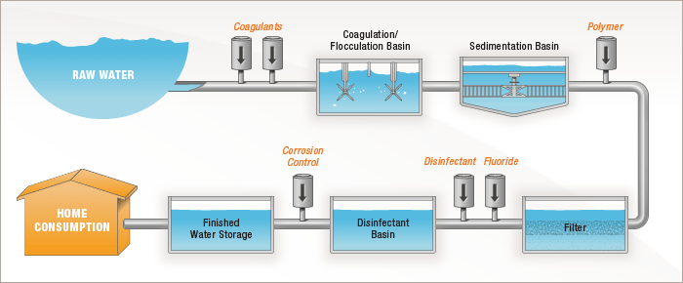
Water Treatment

Slide 16
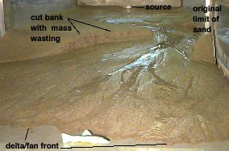
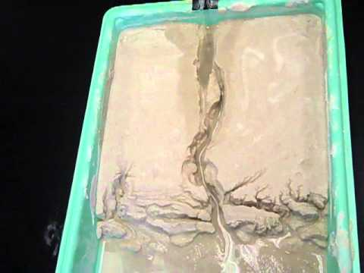
Stream Table

