Slide 1
Agenda 8/27
Warm Up
Hand Back Quiz
Greenhouse

Slide 2
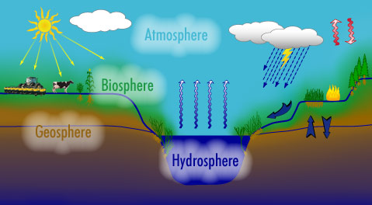
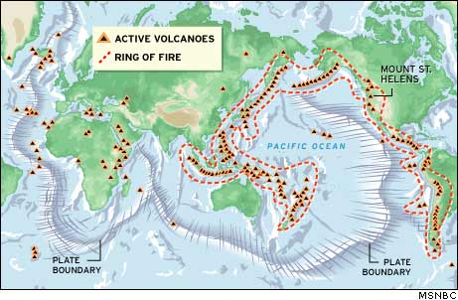
Earth Science Concepts 8/27 Students will walk to the greenhouse and learn about gardening and the idea of sustainability. P. 14NB
Compare & Contrast Hydrosphere and Atmosphere.
Why is the Ring of Fire significant?
How can lessons learned from the “Tragedy of the Commons” and example of Sustainability?

