Slide 1
Mining and Mineral Resources
Environmental Science Week 15
November 30th – Dec. 3rd
UNIT 5 TEST December 16th CH 16 - 19

Slide 2
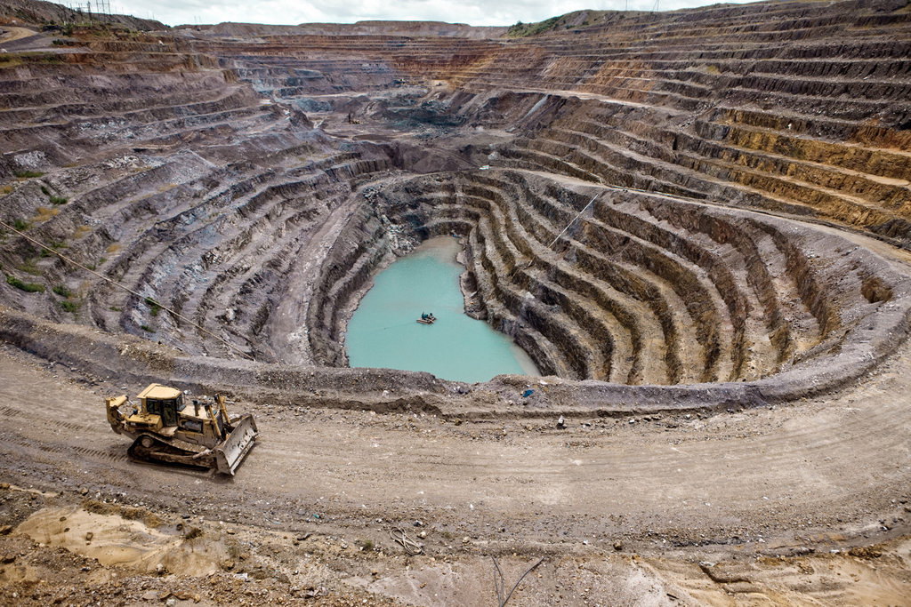
11/30 Minerals and Mineral Resources CH 16.1 Obj. TSW learn about minerals, how they are formed and why they are valuable. P. 54 NB
What is a mineral?
Compare and contrast a metal and a nonmetal with examples of each.
Describe three processes by which ore minerals form.
HW – Read CH 16. Write 1 page Notes Page 55 NB Due Thursday
Quiz CH 16 & 17 next week
UNIT 5 Test December 16th

Slide 3
Backfilling of Open Pit Metallic Mines

Slide 4
Mining in CA p. 57 NB
Sand & Gravel, Perlite
Mining for Gold
Yuba Gold

Slide 5
Managing Oil Gas & Mining - Africa
Read the article above.
How does this Progress Report for “Managing Oil, gas, and mining” in Africa meet the Triple Bottom Line? Balance between Society, Environment and Economic?
Write an AXES paragraph and be ready to share out.
Page 57 NB

Slide 6
Activity: Maps in Action P. 426 Page 59 NB Mineral Production in the United States Top 10 mineral Commodities Produced in the United States.
Read the Map Skills
Using a Key. Find California on the map. Which of the top 10 minerals commodities were produced in CA in 2009?
Which state(s) did not have any top 10 mining commodities in 2009?
Evaluating Data. Gold, Copper, Iron Ore and Molybdenum are metal in the top 10 mineral commodities produced in 2009. Reading the key to the right on page 426, What percentage of total 2009 production value do these metals represent? Which states were the principal producers of these metals in 2009?
Stone, sand, and gravel are collectively known as aggregates. What percentage of the total 2009 production value do aggregates represent? Which states were the major producers of aggregates in 2009?
Which states produced salt in 2009?

Slide 7
Activity: Where are Metals and minerals mined? p. 59NB
Choose a metal &/or mineral from Figure 1.1
Explain why it is a metal &/or a mineral.
Research your metal or mineral: Where is it mined?, How is it mined? What is the economic value of it.?
Aluminum, Copper, Iron Ore, Lead, Zinc, Clays, Phosphate, Salt, Other Metals

Slide 8
12/1 Mineral Exploration & Mining CH 16.2 Obj. TSW learn how minerals are found, and how they are extracted. P. 56NB
How do Mining company’s explore for minerals?
Describe three methods of subsurface mining.
Describe tow methods of surface mining.
International Mining

Slide 9
12/2 Mining Regulation & Mine Reclamation CH 16.3 Obj. TSW understand the impact mining has on the environment, laws to mine and reclaim that land to it’s original condition. P. 58 NB
List 7 important potential environmental consequences of mining.
List the four Federal laws that relate to mining and the reclamation of mined land.
Describe reclamation in your own terms.

Slide 10
Chocolate Chip Mining Activity
Mining and Land Reclamation

Slide 11
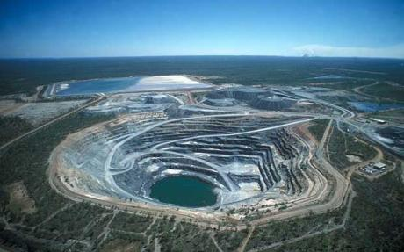
Uranium Mining

Slide 12
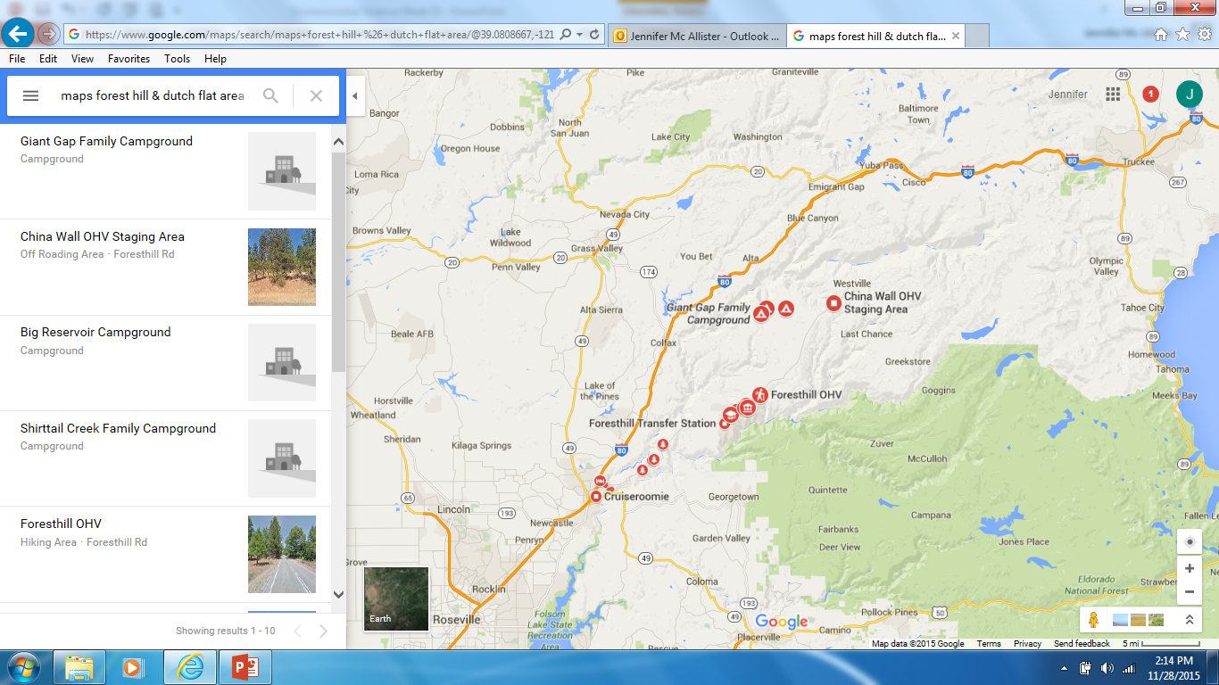
Hydraulic Mining in the California Goldfields
Forest Hill, CA

Slide 13
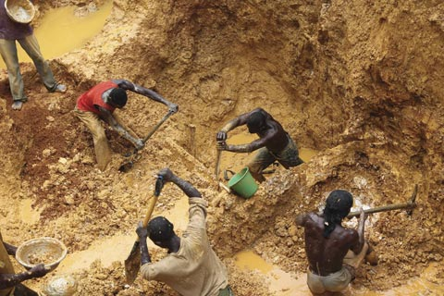
12/3 Review of Mining and Mineral Resources CH 16 Obj. TSW read about the social and environmental consequences of mining. P. 60 NB
Read the article Gold from Ghana. P. 427 ES BK.
Explain some social and environmental consequences of mining.
What are some strategies that you think would help reduce the environmental damage caused by gold extraction?

Slide 14
12/4 Nonrenewable Energy CH 17.1 Obj. TSW learn about our energy resources and how they are limited. P. 62 NB
List the 5 factors that determine a fuels application.
Use Figure 1.3 in CH 17, How a Coal-Fired Power Plant Works. Explain the steps taken to ensure we have electricity when we flip the light switch.
Name our 3 Fossil Fuels. Where in the United States are our Fossil Fuels deposited?

