Slide 1
CH 10: Land Resources

Slide 2
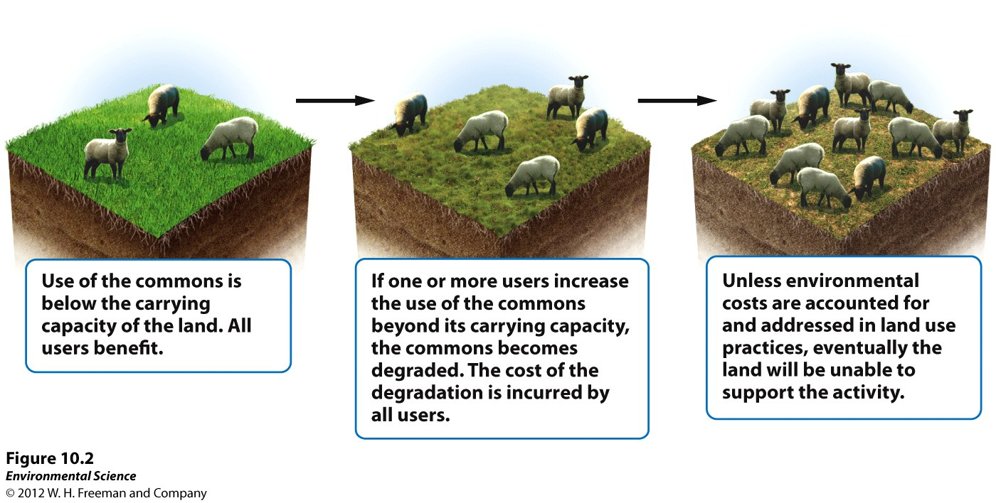
10/27 Human Land Use CH 10 Obj. TSW identify and explain the Tragedy of the Commons, externalities and maximum sustainable yield pg. 18
Explain the Tragedy of the Commons. What is an example for today’s world?
Explain an externality.
Copy the Maximum Sustainable yield (10.3), what graph does it remind you of?

Slide 3
The Tragedy of the Commons
1968: Garrett Hardin described the “Tragedy of the Commons”
The tendency of a shared, limited resource to become depleted because people act from self-interest for short-term gain
Observed that when many individuals share a common resource without agreement on or regulation of its use, likely to become overused very quickly

Slide 5
Externalities
A cost or benefit of a good or service that is not included in the purchase price of the product or service
We are concerned about negative externalities because of the environmental damage for which no one bears the cost
EX) Factory Polluting surrounding areas
Solutions:
Privatization
Regulation

Slide 6
(EX) Unicorn Populations
Unicorn population not checked= Population grows so much, not enough food to support it= population crashes
Hunting is unregulated= unicorn population depleted to point of endangerment
Intermediate Amount of Regulation= Leave enough to reproduce at a rate that main the population but not have competition for food

Slide 7
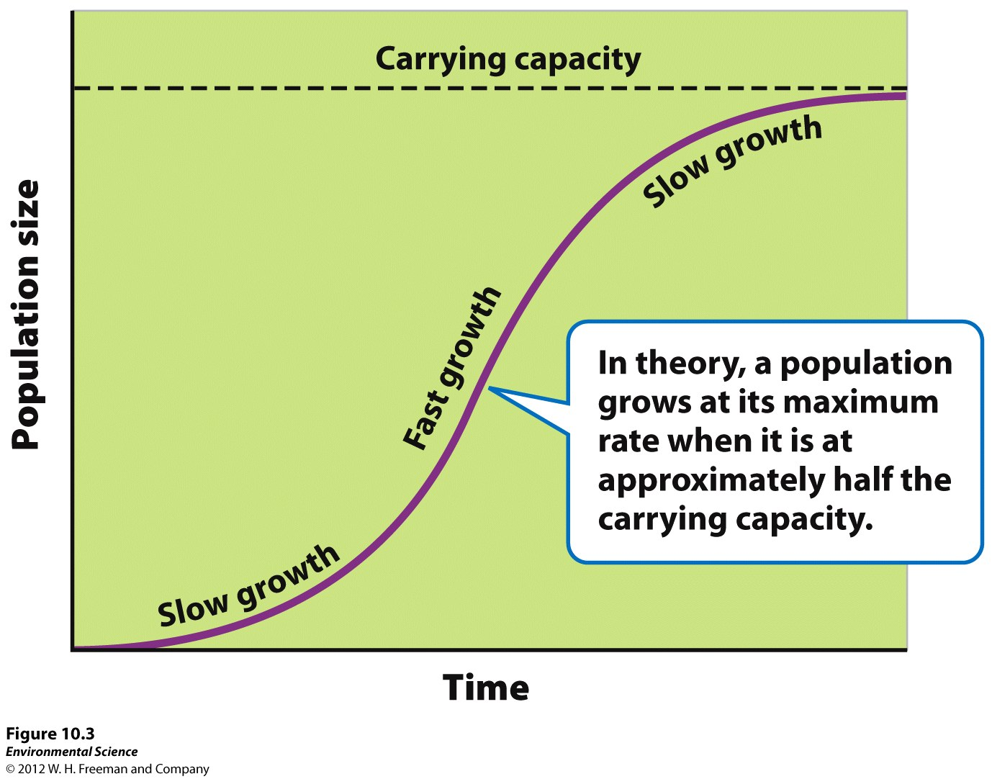
Maximum Sustainable Yield
The maximum amount of a renewable resource that can be harvested without compromising the future availability of that resource.
Sustainable harvesting
Hard to calculate but...
Notes:
Maximum harvest that will be adequately replaced by population growth

Slide 8
Surface Mining Activity pg. 23
Groups of 4, go over to the shoe boxes
Each group (company) needs a name; Distribute the jobs accordingly
Field Geologist/Accountant
Miner
Process Engineer
Environmental Engineer
Complete activity and then answer Questions and Analysis for homework, answer on pg. 23 or separate page if no room

Slide 9
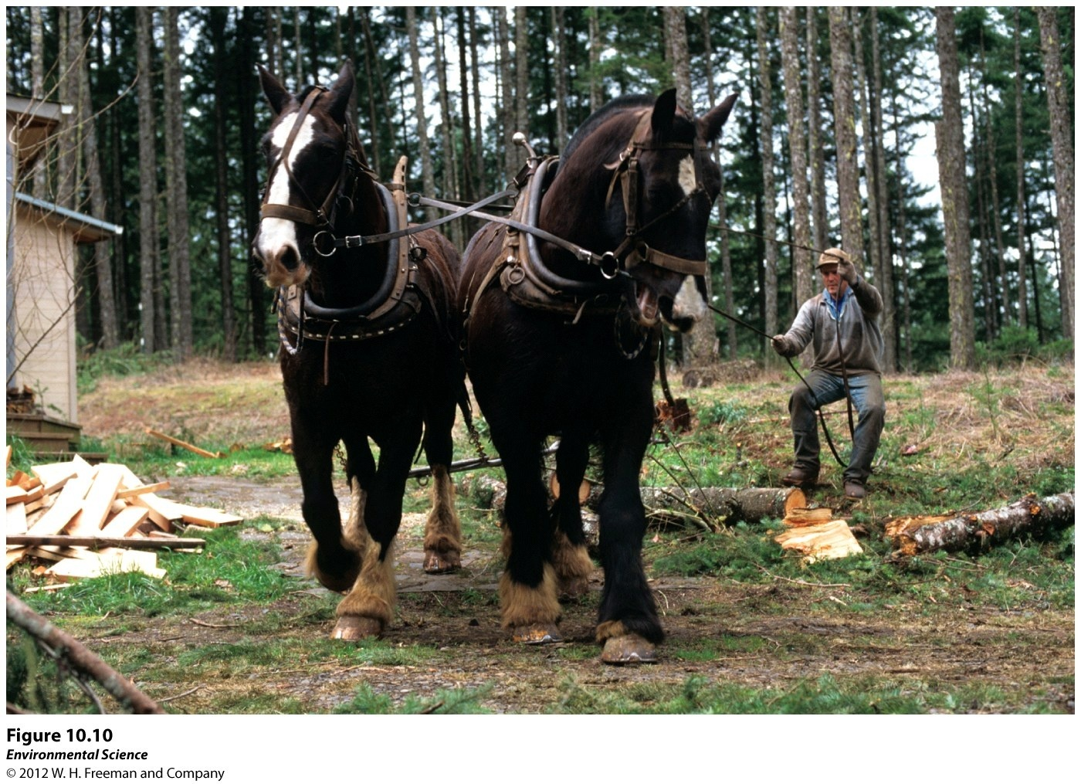
10/28 CH 10 Land Management Obj. TSW identify and explain how land is classified, how land is used, and what the impacts of our use are. P. 20 NB
Explain how our use of land affects the environment.
What are the main uses of public lands in the US?
What is resource conservation ethic and how does it relate to multiple use lands?

Slide 10
Tragedy of the Commons Clarification
Oil→ Because there is a limited supply, oil companies know that in order to maximize profit, they have to extract as much as they can
Idea of Tragedy of the Commons is “common pool resources”
Air, water, other natural resources that people DON’T own
People at some point own the oil because they own the land
But you can’t ever really own air or the ocean

Slide 11
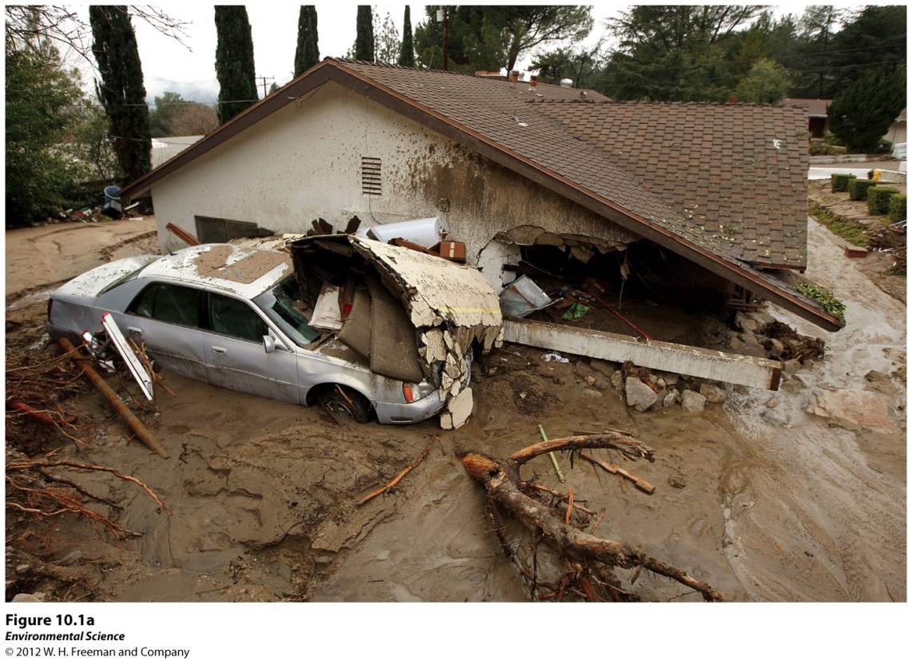
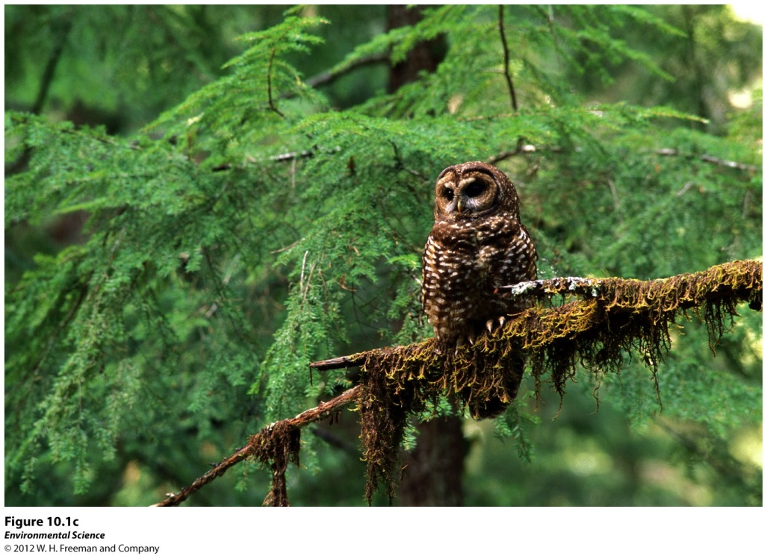
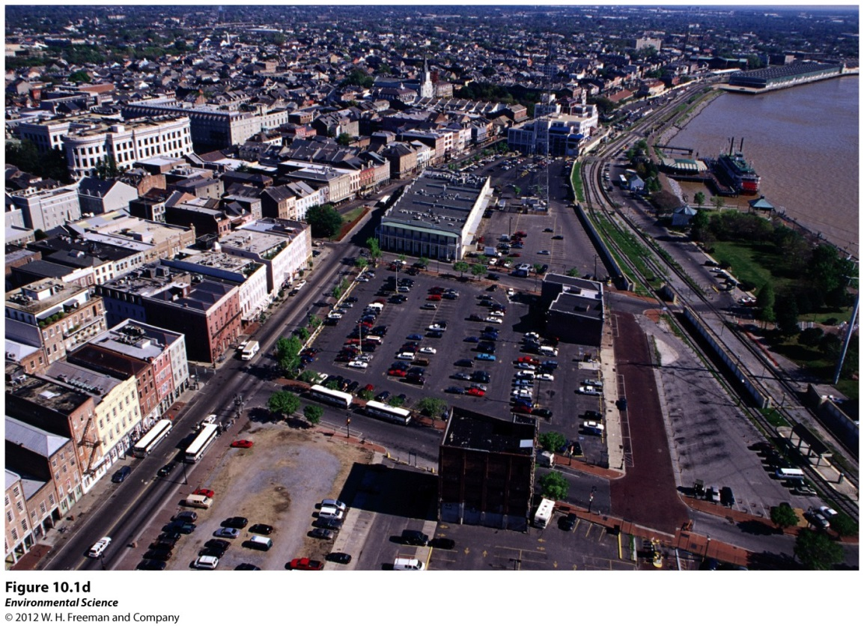
Negative consequences of land use
Mudslide caused by logging & poor land management.
Habitat conversion & land degradation due to shifting agriculture.
Extensive paving of land decreases the amt of land for vegetation and water infiltration.
Logging and other habitat alteration can adversely affect species like the spotted owl.

Slide 12
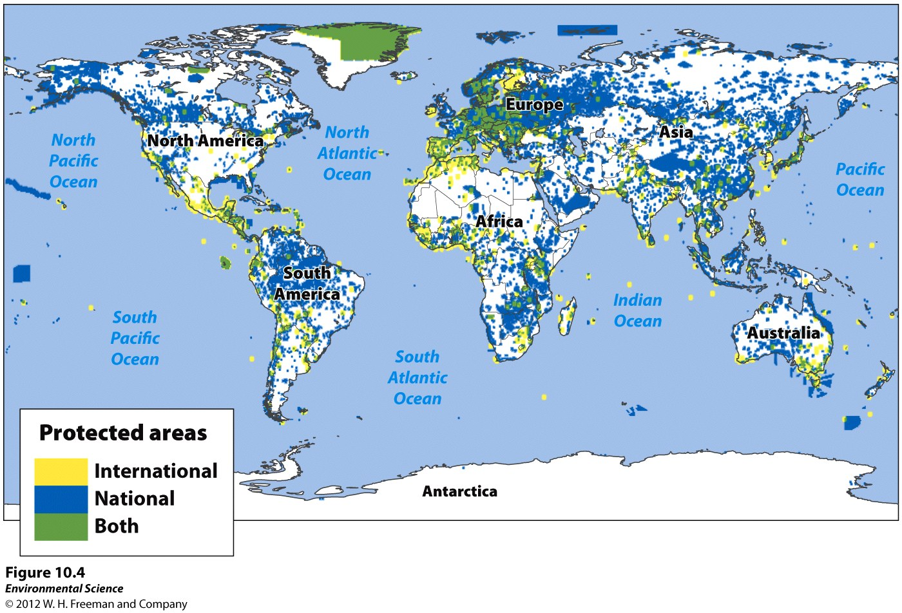
Protected land and marine areas of the world

Slide 13
Public Lands
National Parks
Managed Resource Protected Areas
Habitat/Species Management Areas
Strict Nature Reserves and Wilderness Areas
Protected Landscapes and Seascapes
National Monuments

Slide 14
Public Lands
National Parks- managed for scientific, educational, and recreational use, and sometimes for their beauty or unique landforms.
Managed Resource Protected Areas- managed for the sustained use of biological, mineral, and recreational resources.
Habitat/Species Management Areas- actively managed to maintain biological communities.
Strict Nature Reserves and Wilderness Areas- established to protect species and ecosystems.
Protected Landscapes and Seascapes- nondestructive use of natural resources while allowing for tourism and recreation.
National Monuments- set aside to protect unique sites of special natural or cultural interests.

Slide 15
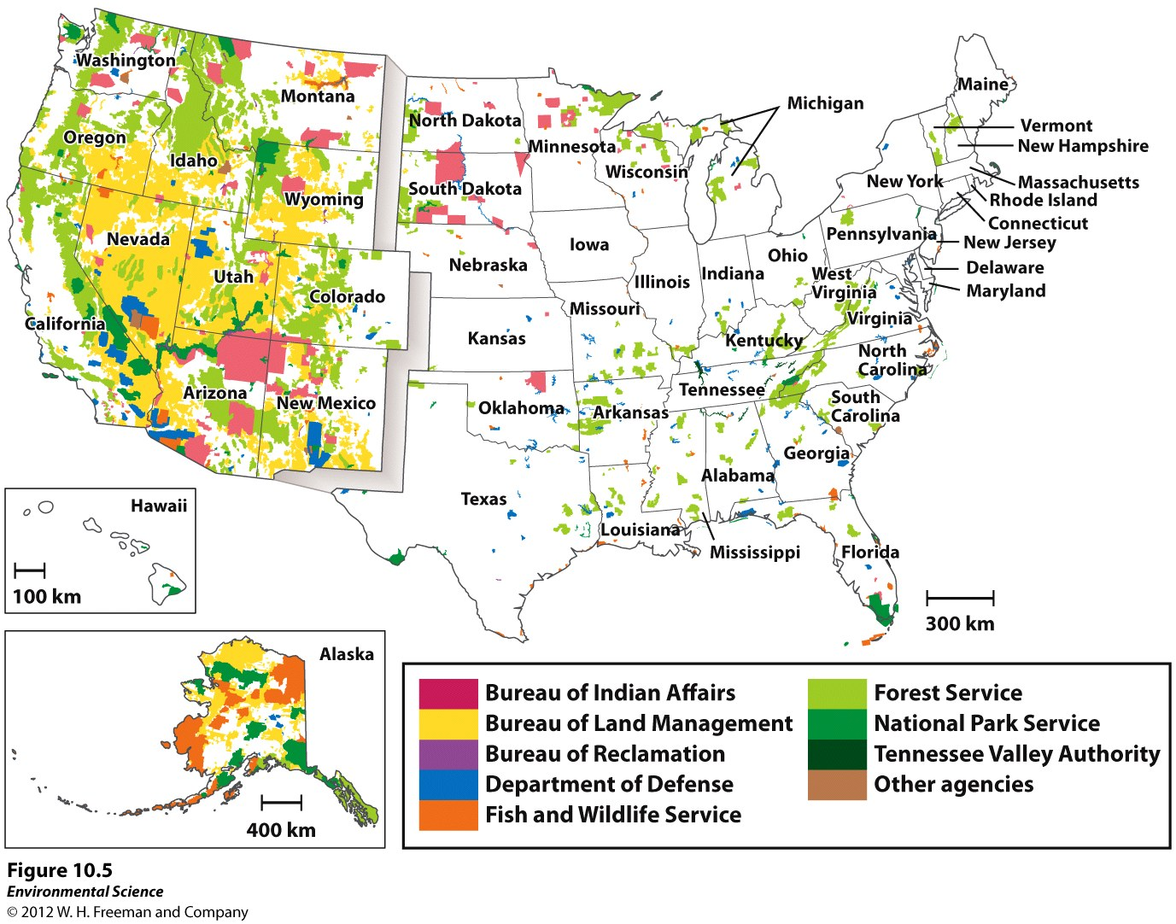
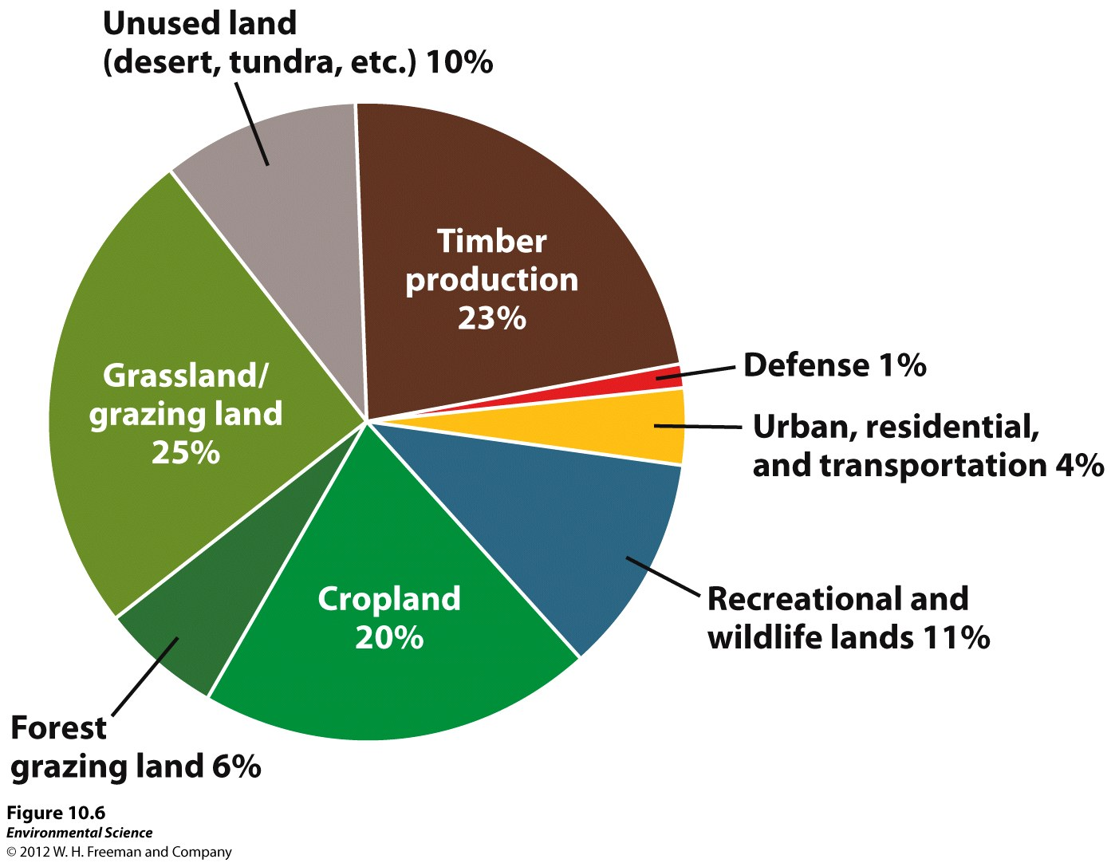
Federal Lands in the US
42% of land in US is Publically owned
25% is owned by the Federal Government
Land Use in the US
Rangelands, National forests, National parks, National Wildlife Refuges, Wilderness areas

Slide 16
Public Land Classification
Most environmental policies, laws, and management plans have been based on Resource Conservation Ethic
Calls for policy makers to consider the instrumental value of nature
People should maximize resource use based on the greatest good for everyone
Areas are preserved and managed for economic, scientific, recreational, and aesthetic purposes
Multiple-Use Lands:
Because purposes conflict → adopted principle of multiple use in managing its public resource
Can be used for recreation, grazing, timber, harvesting, and mineral extraction

Slide 17
Agencies
Bureau of Land Management (BLM):
Grazing, Mining, Timber harvesting, Recreation
United States Forest Service (USFS):
Timber harvesting, Grazing, Recreation
National Park Service (NPS):
Recreation, Conservation
Fish and Wildlife Service (FWS):
Wildlife conservation, Hunting, and Recreation

Slide 18
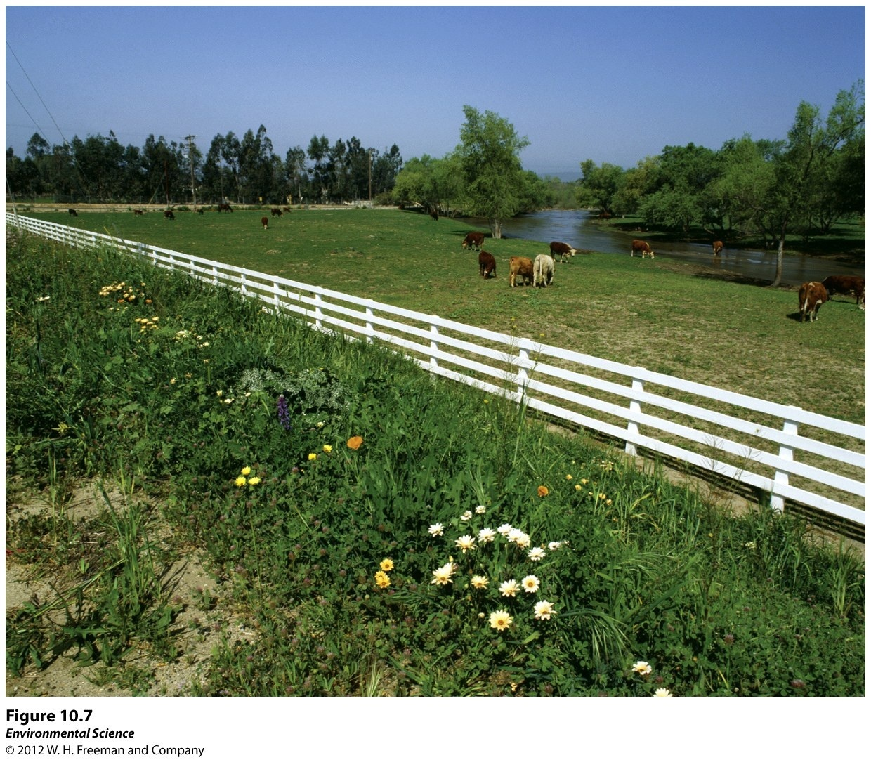
10/29 Human Land Use CH 10 Obj. TSW identify and explain how rangelands and forests are managed and which agency manages them P. 22 NB
Explain how Rangelands are managed and who manages them if they are public land?
What are the ways in which timber is harvested in US forests? Who manages them if they are public land?

Slide 19
Rangelands (BLM)
Dry, open grasslands that are primarily used for cattle grazing.
When it is poorly managed, overgrazing can strip the land of vegetation, decrease the rate of regrowth, & increase compaction of soil.
Lack of vegetation increase the rate of erosion by wind and valuable nutrients and soil can blow away.

Slide 20
Forests (USFS, BLM)
Areas dominated by trees and other woody vegetation.
Sustainable forestry, although not profitable using a team of Shire horses.
Commercial logging companies allowed to use US National Forests, in exchange for a royalty (% of revenues)

Slide 21
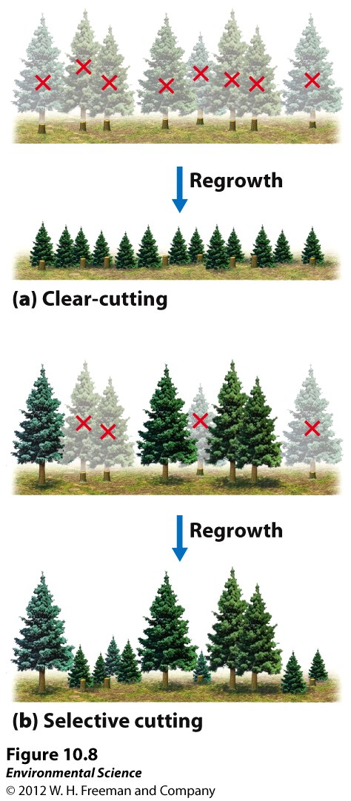
Timber Harvest Practices
Clear-cutting- removing all, or almost all the trees in an area.
Selective cutting- removing single trees or relatively small numbers of trees from a forest.

Slide 22
Clear Cut Forest
Eureka CA
Damaging Effects of clear cutting: Increased erosion, decreased regeneration of vegetation, habitat destruction, sensitive species are threatened.

Slide 23
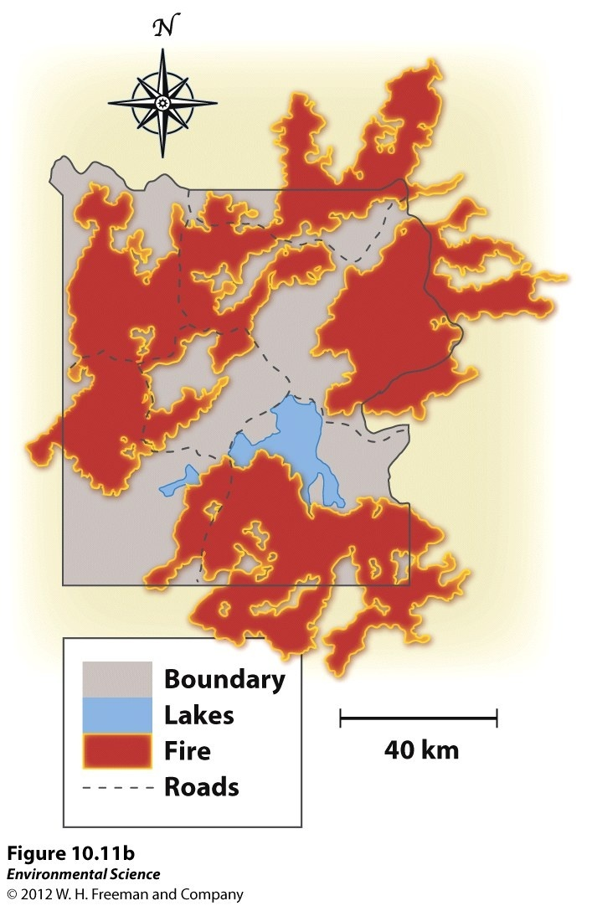
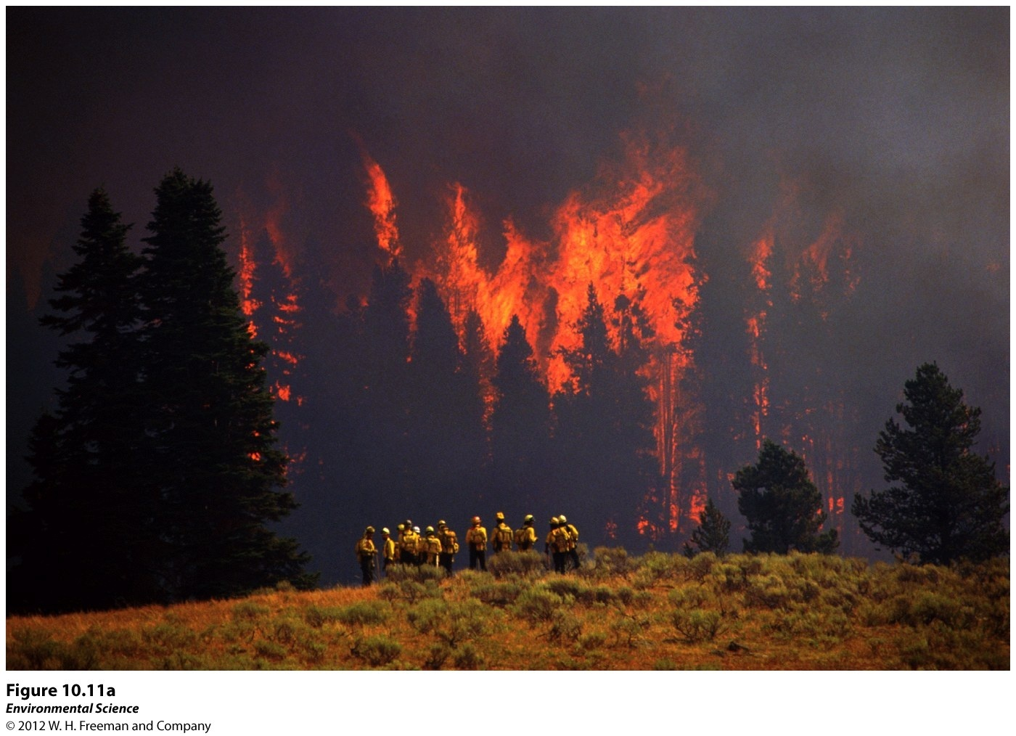
Fire Management
Prescribed burns- A fire is deliberately set under controlled conditions.
Yellowstone 1988 fire was started by a combination of human activity and lightning strikes.
More than 1/3 of Yellowstone burned.
Created new, nutrient rich habitat= fire provided many benefits to the ecosystem

Slide 24
After Quiz Pick up...
Notebook: 35 points
CH 11 MC SG, pg. 29 NB, due Tuesday (11/4)
CH 11 Vocab/2 AXES paragraphs, pg. 31 NB, due Wednesday (11/5)
How Many Planets? Worksheet, pg. 27
Reminder: Permeability and Porosity Labs Due Tomorrow!!!

Slide 25
How Many Planets? (25 points total)
(5 points) Pre-reading “World Footprint” Article
Work individually (BUT 3 groups of 2)
Worksheet and How Many Earths? Google Form
Fill out worksheet (5 points)
Google form (5 points)
Individually complete answers at the end of worksheet(8 points)
Ticket out turn to me before leaving (2 points)
Turn everything in to ME by Friday (10/31)!
Notes:
http://www.footprintnetwork.org/en/index.php/GFN/page/world_footprint/
(Article)
https://docs.google.com/a/ucdavis.edu/forms/d/1QkJhi8Q3xHddAV5IiA2wLN4RBw8yPLU_b_IdCcGmOUM/edit
(google form)
http://www.footprintnetwork.org/en/index.php/GFN/page/calculators/
(footprint calculator)

Slide 26
Question 10e (Instead of pie chart, will look like this):

Slide 27
Ticket out
On a scratch piece of paper, answer the following:
What about this activity did you like?
What about this activity would you improve for classes next year?

Slide 28
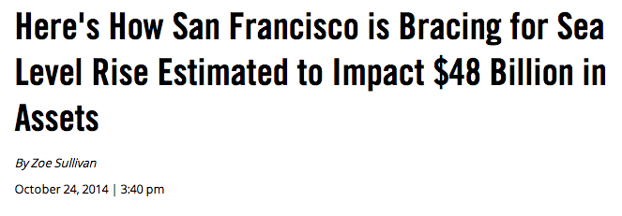
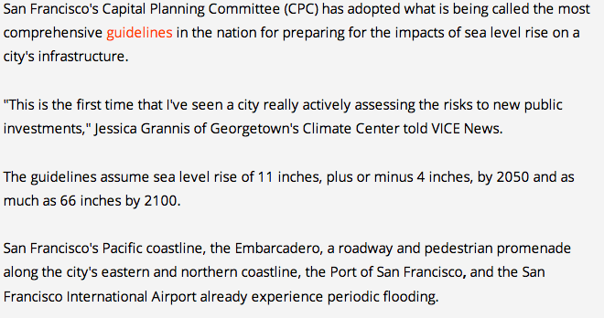
In the News...

Slide 30
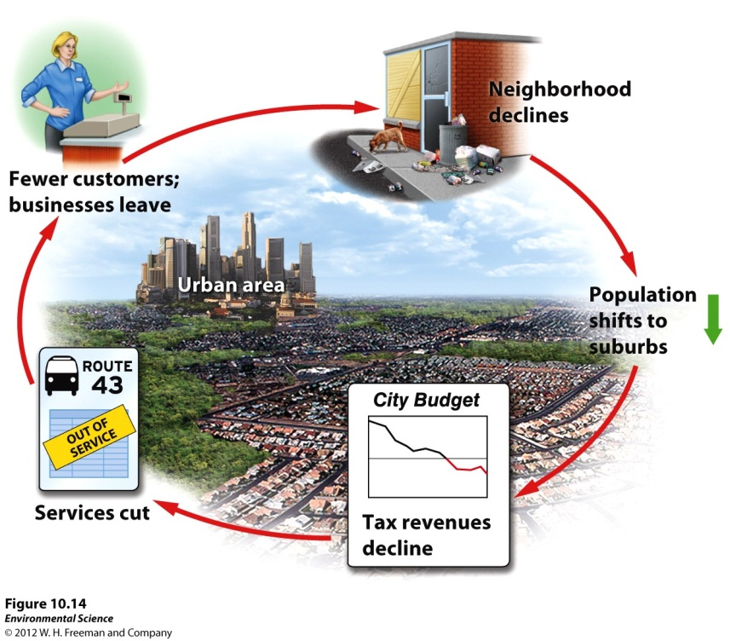
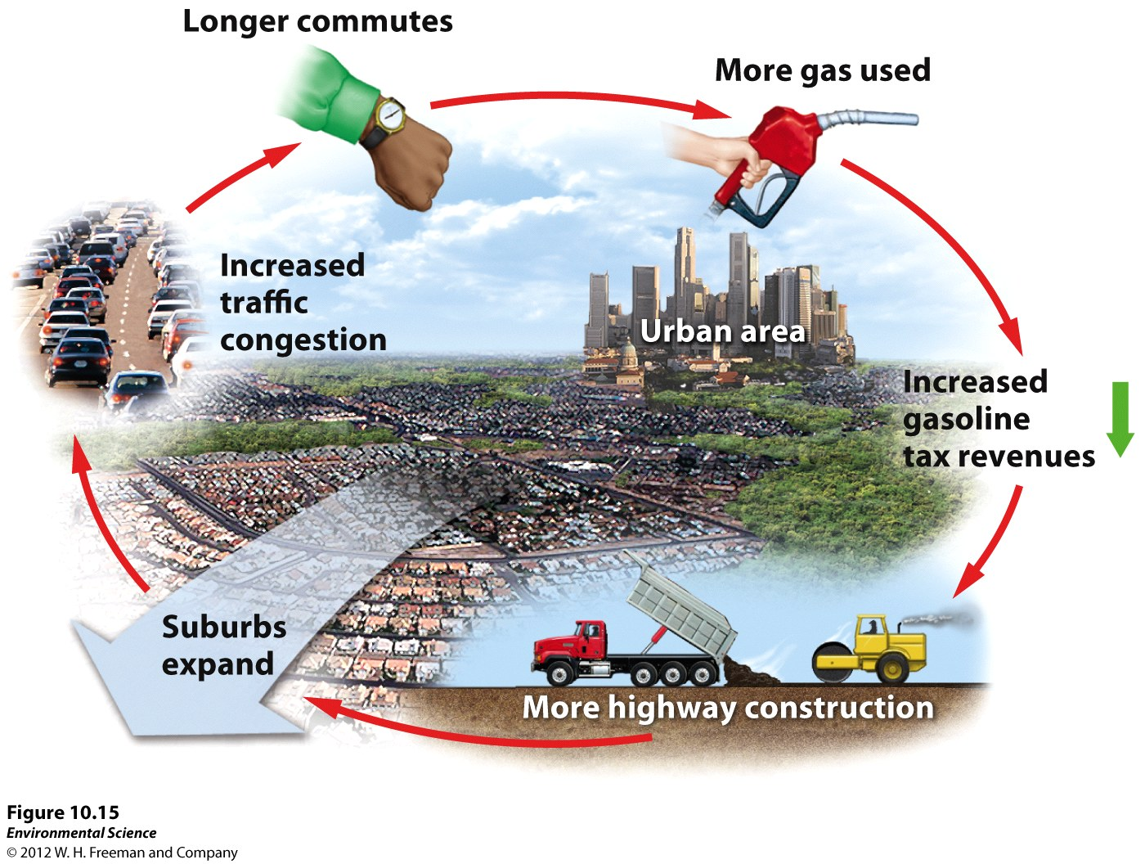
10/30 Residential Land Use is Expanding CH 10 Obj. TSW explain and distinguish between urban, rural, and suburban areas and relate the causes and effect of urban sprawl to smart growth practices in new development. P. 24NB
Explain NEPA and what they require before a project can begin.
Identify and explain what the 4 main causes of Urban sprawl?
List 3 of the 10 basic principles of smart growth.

Slide 31
Federal Regulations
National Environmental Policy Act (NEPA)- mandates an environmental assessment of all projects involving federal money or permits.
Environmental impact statement (EIS)- outlines the scope and purpose of the project.
Environmental mitigation plan- outlines how the developer will address concerns raised by the projects impact on the environment.

Slide 32
Residential Land
Suburban- areas surrounding metropolitan centers with low population densities.
Exurban- similar to suburban areas, but are not connected to any central city or densely populated area.

Slide 33
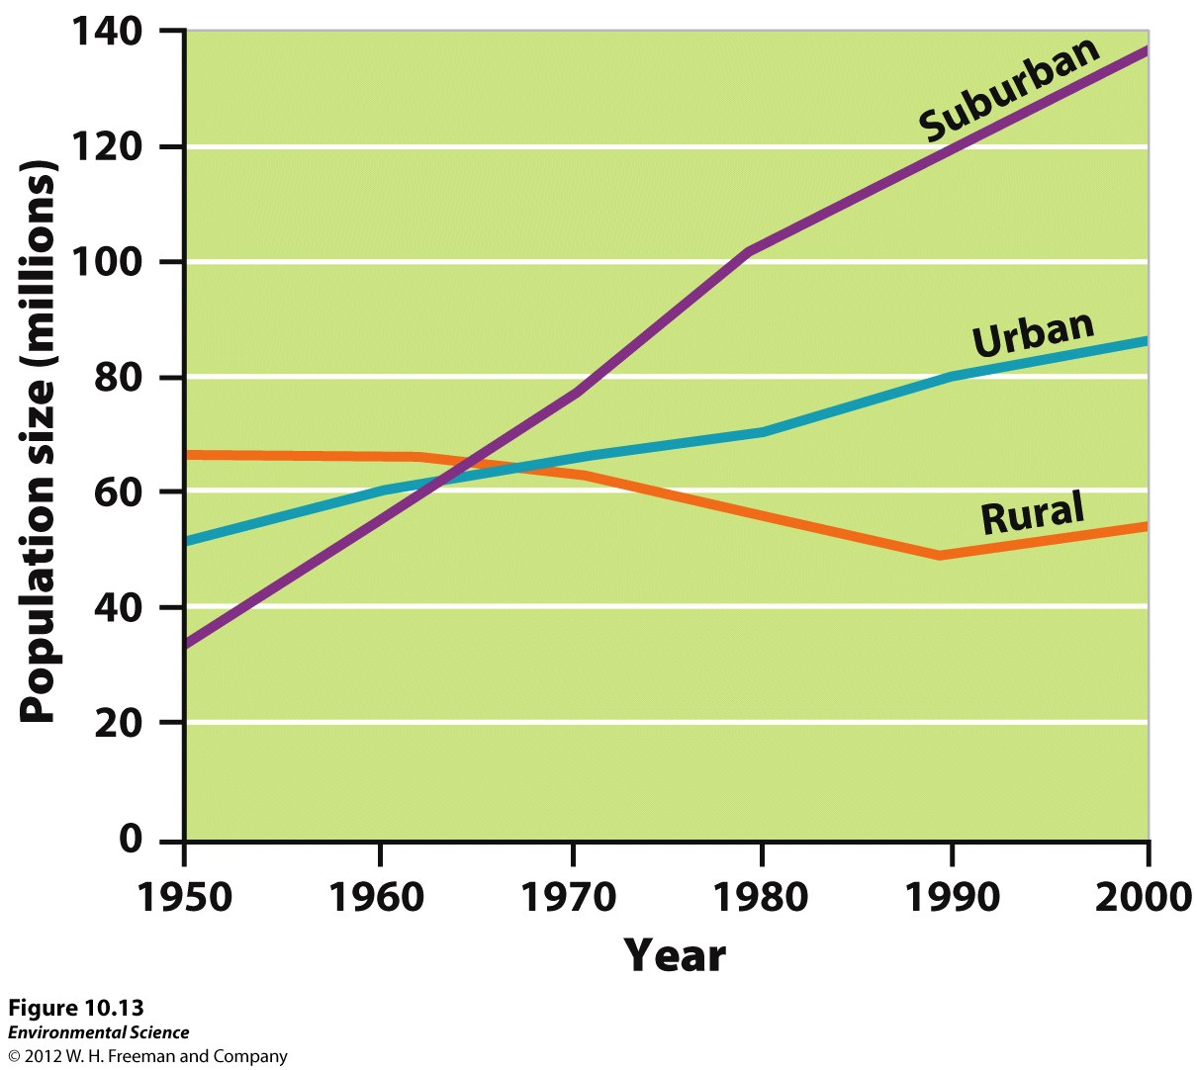

Slide 34
Urban Sprawl
Urban sprawl- the creation of urbanized areas that spread into rural areas.
The four main concerns of urban sprawl in the U.S. are:
Automobiles and highway construction
Living costs (people can get more land and a larger house in the suburbs for the same amount of money)
Urban blight (city revenue shrinks as people move to the suburbs)
Government policies

Slide 35
Smart Growth
Mixed land uses
Create a range of housing opportunities and choices
Create walkable neighborhoods
Encourage community and stakeholder collaboration in development decisions
Take advantage of compact building design
Foster distinctive, attractive communities with a strong sense of place
Preserve open space, farmland, natural beauty and critical environmental areas
Provide a variety of transportation choices
Strengthen and direct development toward existing communities
Make development decisions predictable, fair and cost-effective

Slide 36
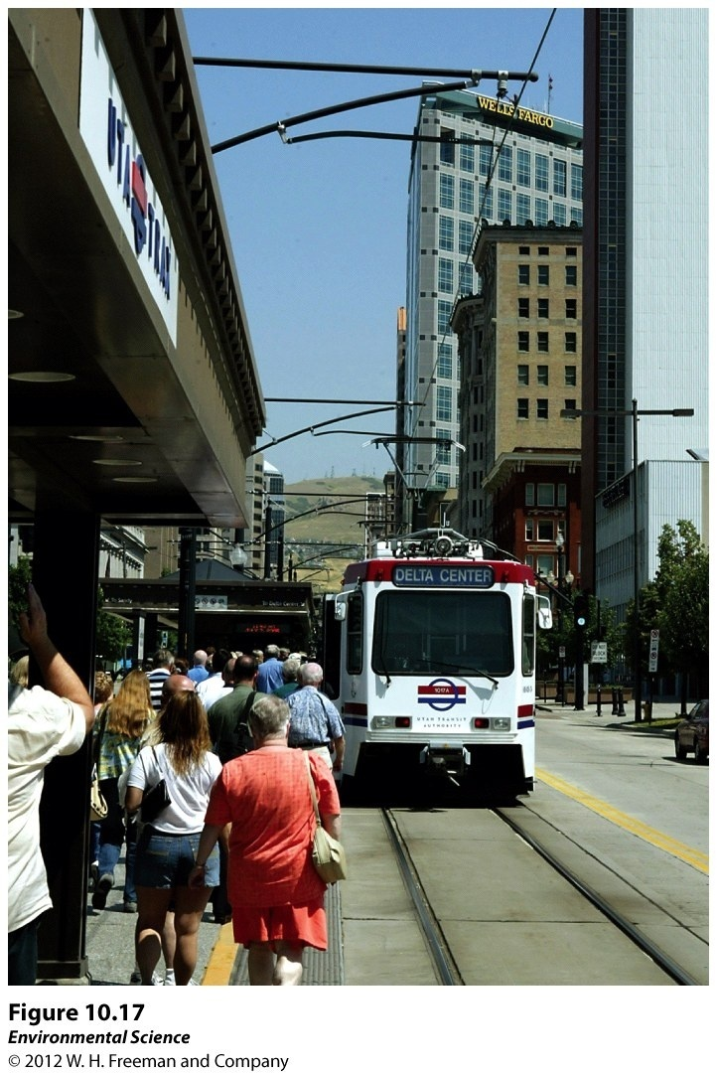
Light Rail System

Slide 37
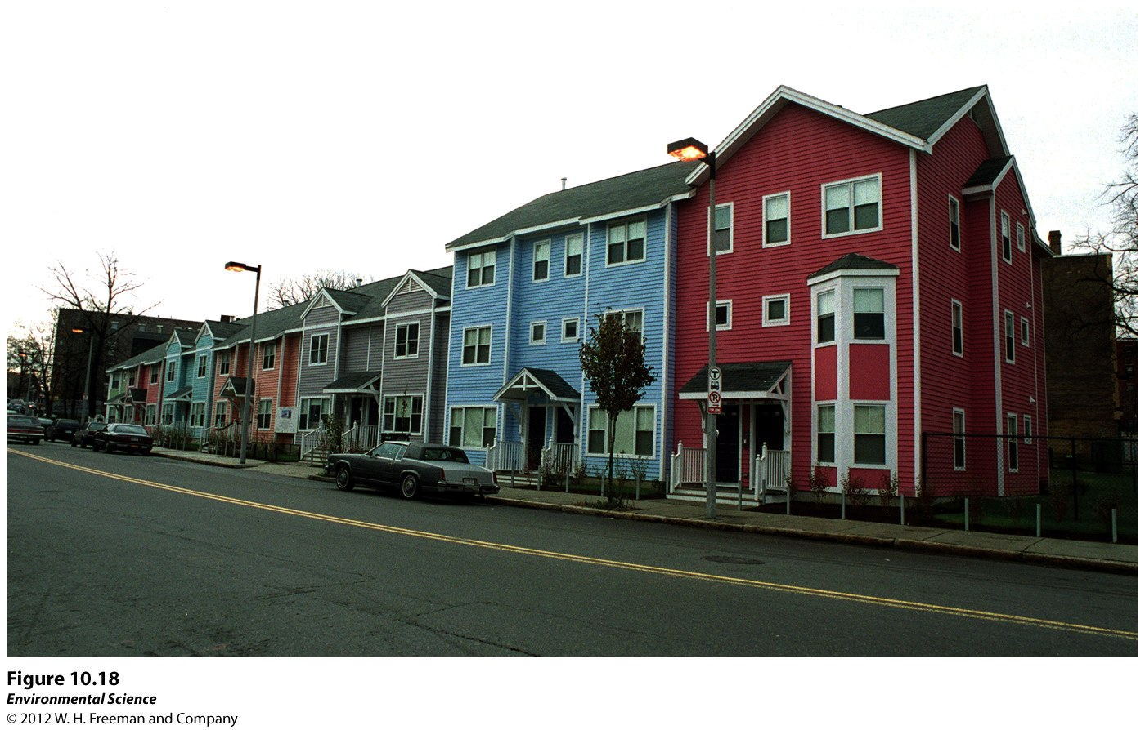
10/31 Sustainability CH 10 Obj. TSW explain and give examples of how individuals, communities, & cities can work toward being sustainable. P. 26 NB
What is urban blight, what examples can you come up with in West Sac?
Describe in your own words “Eminent domain.”
What actions did the Dudley Street Neighborhood Initiative do?

Slide 38
Urban Blight
Urban Sprawl

Slide 39
Eminent Domain

Slide 40
The Dudley street neighborhood in Boston, MA
High Density housing.

Slide 41
Government Policies
Highway Trust Fund- a federal gasoline tax to pay for construction and maintenance of roads and highways.
Zoning- a planning tool to create quieter and safer communities. For example, prohibiting the development of a factory or strip mall in a residential area.
Multi-use zoning- allows retail and high-density residential development to coexist in the same area.
Subsidized mortgages- low interest rates offered to people to purchase a home that would otherwise not be able to do so.

Slide 42
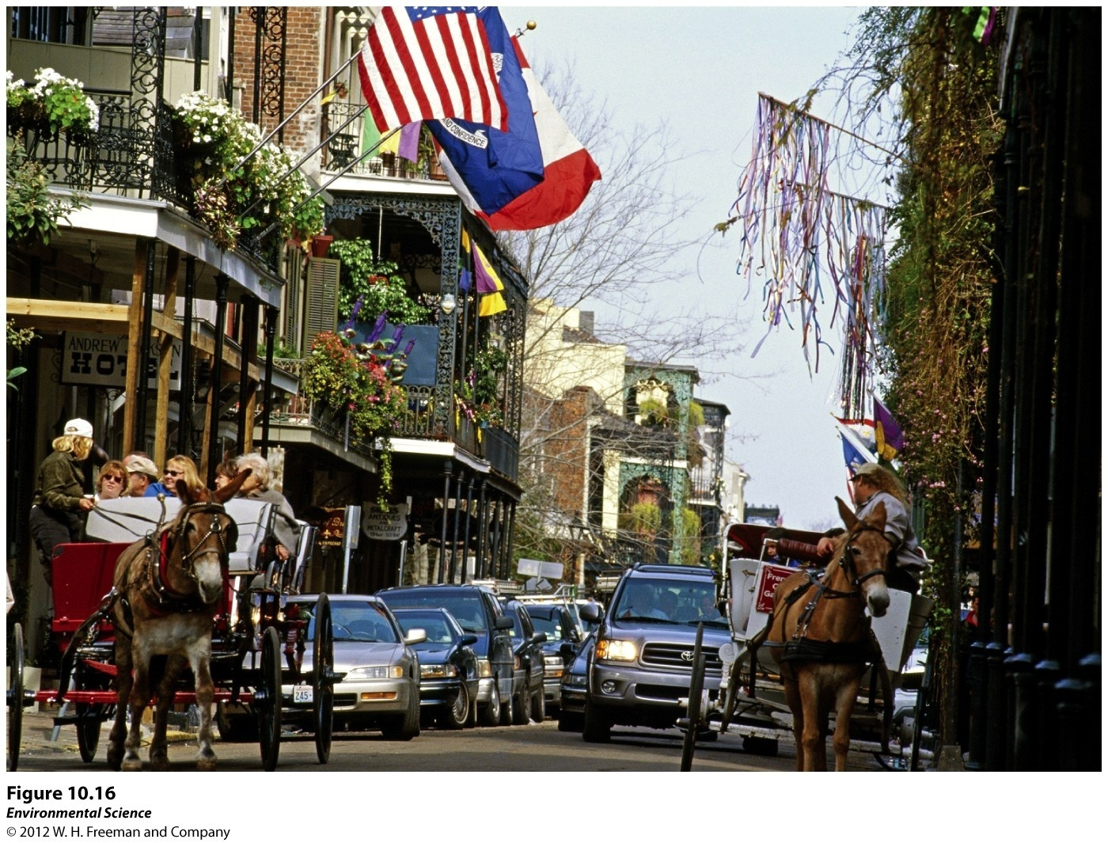
The French Quarter of New Orleans

Slide 43
Emerald Jewel Wasp Video

Slide 44
TED Talk

