Slide 1
Warm-Up 2/20
PARASITISM ?
1. Possible definition
2. An example or two (think of the characteristics a parasitic relationship should have)
http://www.youtube.com/watch?v=4Mb0GOITRUU

Slide 2
Community Ecology

Slide 3
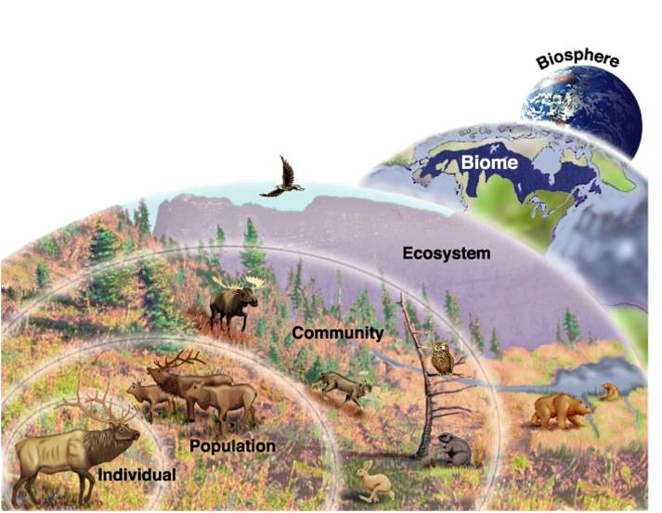
Levels in Nature
Biosphere
Ecosystem
Community
Population
Individual

Slide 4
What is Community Ecology?
Community= incorporates the populations of organisms within a given area.
Community Ecology= the study of the interactions within species in a community
Why does this matter?
Brainstorm?
Endangered species
Global warming effects
Effects of human development…etc.

Slide 5
Types of Species Interactions
Can you match them?
Predation
Mutualism
Commensalism
Competition

Slide 6
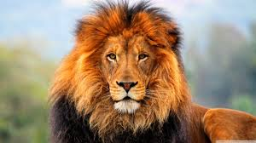
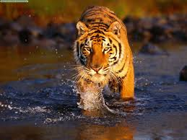
1. Competition -/-
The struggle of individuals to obtain a limiting resource
What does this tell you about these two species?
They must share a similar niche.

Slide 7
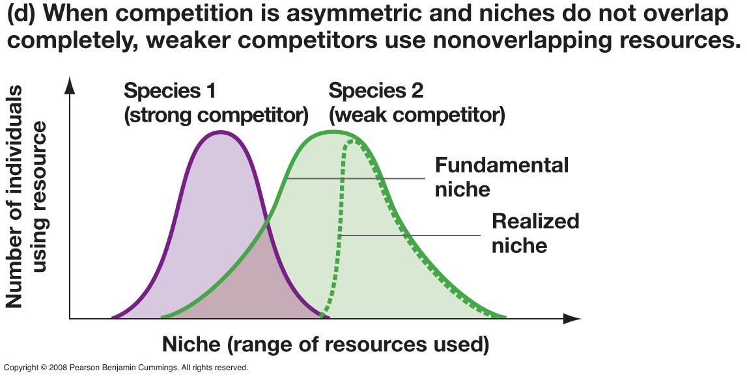
Competitive Exclusion Principal
Two species competing for the same limiting resource cannot exist.
Also described as two species cannot survive if they occupy the same niche.

Slide 8
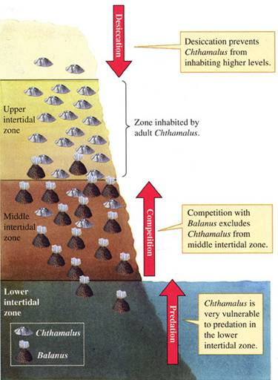
Resource Partitioning
Resource partitioning often results in resource partitioning.
When two species divide a resource based on differences in the species’ behavior or morphology.
This is evolutionarily favorable because it lessens the niche overlap.
Spatial, temporal, or morphological

Slide 9
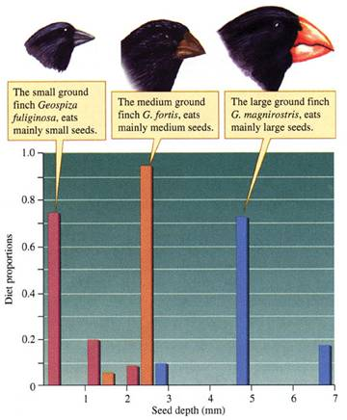
Character Displacement
The tendency for characteristics to be more divergent in sympatric populations of two species than allopatric populations of the same two species.

Slide 10
2. Predation
The use of one species as a resource for another.
True Predators: typical idea of a predator. Kill their prey and consume it.
Herbivores: consume plants as their prey.
Parasites: organisms that live on or in another organism at the cost of their host.

Slide 11
Predation Drives Evolution
Predators and prey are constantly adapting in an attempt to evade the other.
What might be some predator adaptations?
Speed
Camouflage
What about some prey adaptations?
Toxins
Camouflage

Slide 12
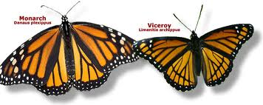
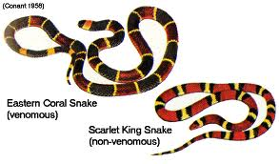
Anti-predator adaptations
Batesian Mimicry
Palatable/harmless species mimics a harmful one
Mullerian Mimicry
Two or more protected species evolve to look alike.

Slide 13
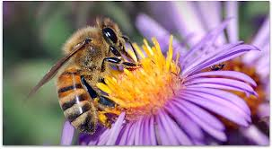
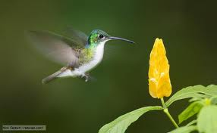
3. Mutualism
An interaction benefitting both species by increasing their chances of survival or reproduction
Plants and pollinators

Slide 14
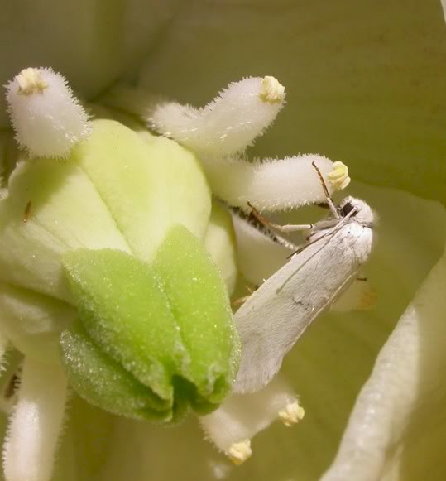
Convergent Evolution
How can we apply the idea of convergent evolution to parasitic, mutualistic, and predator/prey relationships?

Slide 15
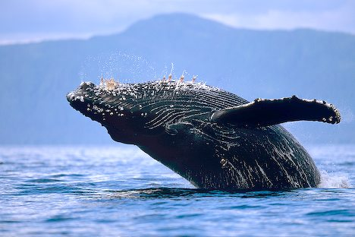
4. Commensalism
A relationship where one species benefits but the other is neither harmed nor helped.

Slide 16
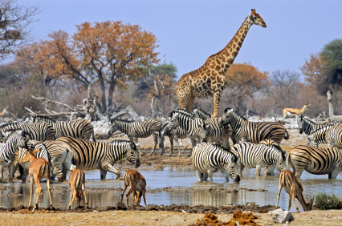
Characterizing a Community
To examine community structure we can look at:
Species diversity
Examine dominance of species
Keystone species
Food chains

Slide 17
Keystone Species
A species that plays a role in its community that is far more important than its relative abundance might suggest.
Presence of them greatly increases community diversity
Also includes species that provide food for a community when scarce
Ecosystem engineers

Slide 18
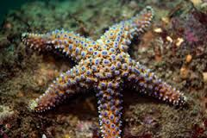
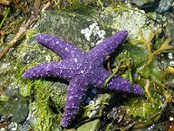
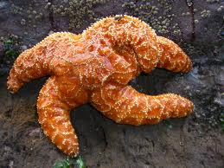
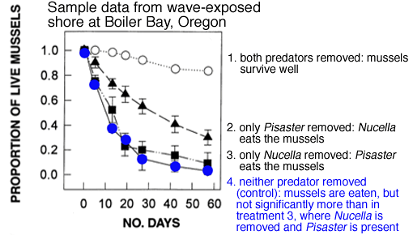

Slide 19
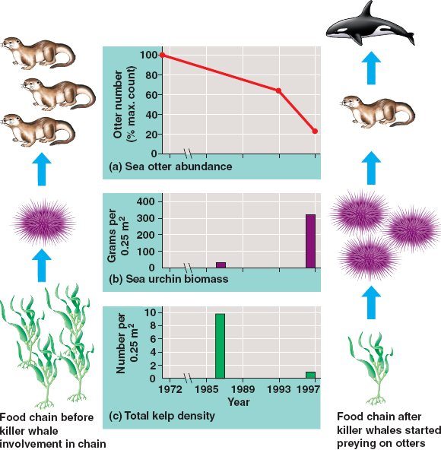
The sea otter is a keystone predator in the Northern Pacific
What impact does the
Orca Whale have on this food chain?

Slide 20
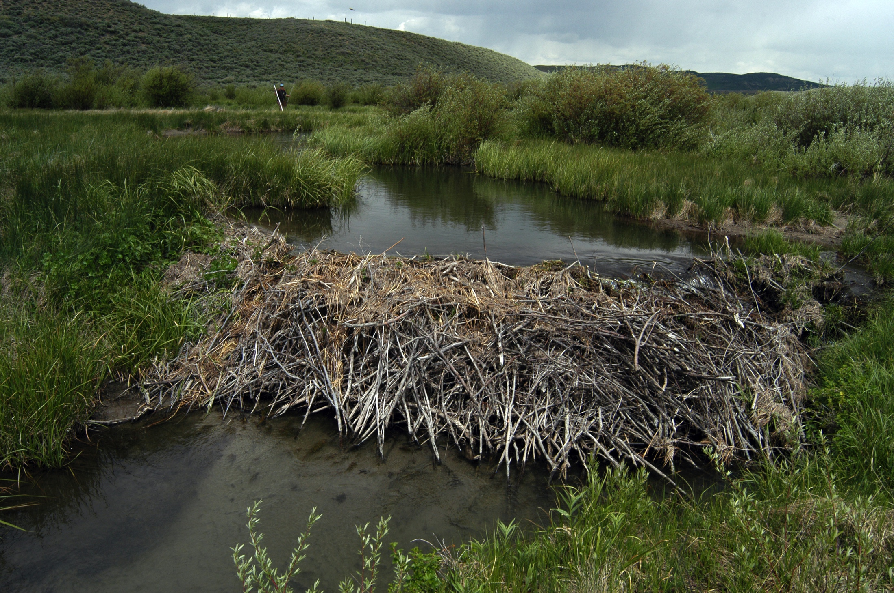
Ecosystem Engineer
A species that creates or maintains a habitat for other species.
Beavers
Dams create large ponds
Essentially create a new habitat

Slide 21
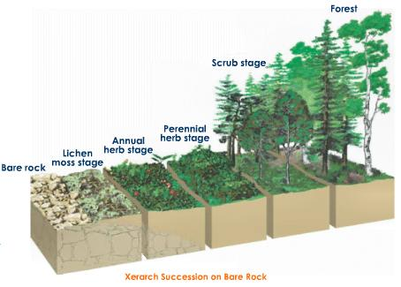
Community Composition
Communities naturally change over time, even without human impact.
Ecological Succession- the predictable replacement of one group of species by another group of species over time.
Primary Succession
Secondary Succession
Most commonly after a natural disturbance

Slide 22
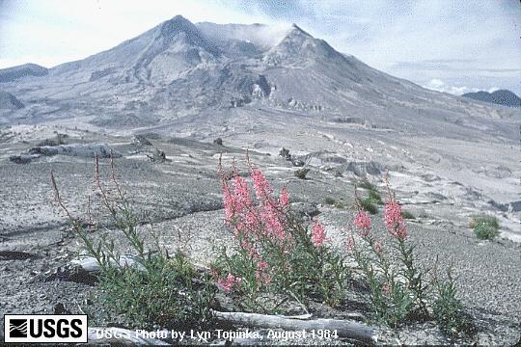
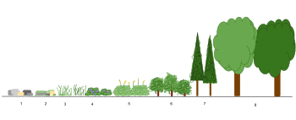
Primary Succession
Key requirements
On surfaces devoid of soil
Base is usually rock
Virtually lifeless
Natural progression
Bacteria
Lichens and mosses
Soil
Grasses
Shrubs
Trees
What kind of trees might establish first?

Slide 23
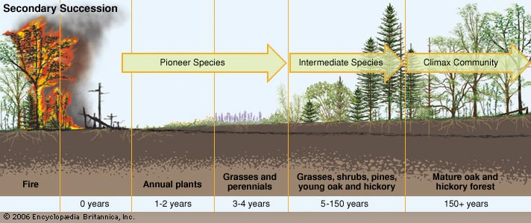
Secondary Succession
Key requirements
Disturbed areas that still have their soil
Often occurs after fire or hurricane
Little vegetation but intact soil
Natural Progression
Annual Plants
Grasses
Shrubs
Trees

Slide 24
Successional Species
Pioneer species- species that can colonize new areas rapidly and grow well in full sunlight
What qualities might a pioneer species have?
R-selected species
Facilitate other species
Why do they eventually get outcompeted? What traits might the next generation of species have?

Slide 25
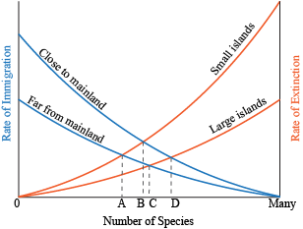
Theory of Island Biogeography

Slide 26
What’d you learn in school today?
interactions
Community Ecology= the study of the within in a community
What are two examples of why it matters?
What type of relationship is -/+?
Two competing species share the same
What is the difference between true predators, herbivores, and parasites?
What example did we use for commensalism?
species
niche

Slide 27
Keystone Species= A species that plays a in its community that is far more than its might suggest.
What is the difference between primary and secondary succession? After what kind of disturbance might each occur?
Summarize briefly the theory of island biogeography.
role
important
relative abundance

Slide 28
Activity
In groups of two or three go online and research the following relationships. Identify the interaction between the animals paying particular attention to what each animal receives from the relationship.
1. Cuckoo bee and yellow jacket
2. Acacia tree and ants
3. Cattle egrets and water buffalo
4. Algae and fungus
5. Lynx and snowshoe hare

