Slide 1
APES
Evolution
http://evolution.berkeley.edu/evolibrary/article/evo_01

Slide 2
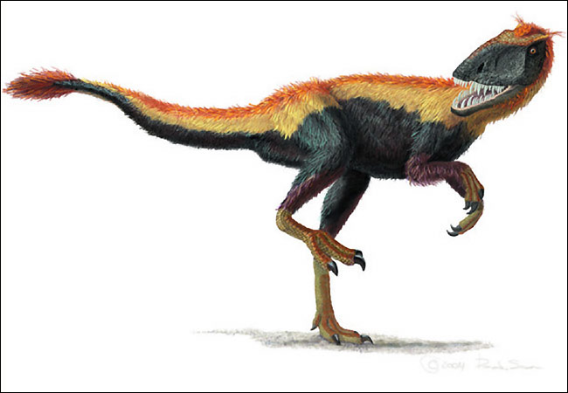
Evolution 9/11
Obj. TSW learn form mistakes made on the quiz, and take notes about evolution after the Environmental Science Current Events. P. 34NB
Make a food chain for the following organisms showing the energy arrows and the trophic levels for each one.
Grasshopper, fox, grass, bird
2. Watch video on % change. If the original population of badgers was 250 in 1980, and due to habitat loss the population is now 50 in 2013, what is the % change in the population?
3. When discussing evolution, why do we say population evolve, not individuals?

Slide 3
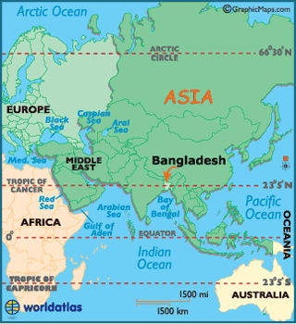
Bangladesh

Slide 4
Agenda 9/12
Warm up – Natural Selection
Alicia Current Event
After school room 757 – 4 students take quiz
Evolution Notes
Into the Universe …
Questions about Project?
Time Line – Geologic Time scale Activity
Water composed soil.

Slide 5
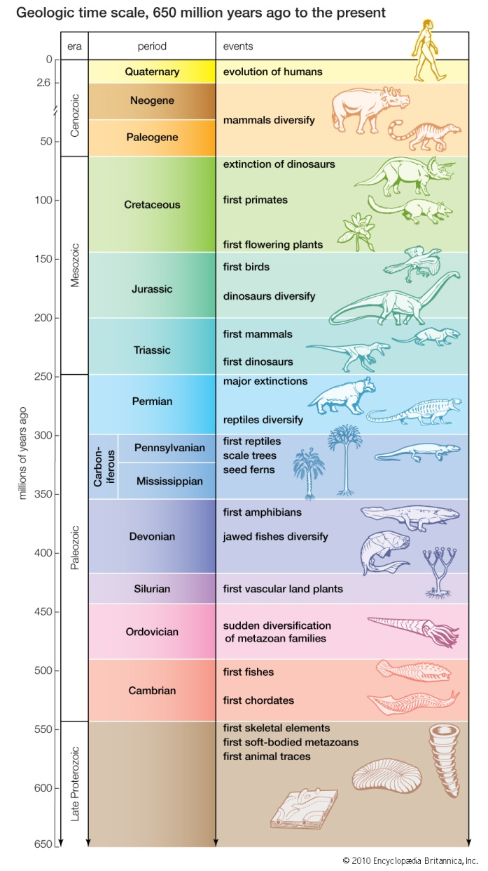
Natural Selection 9/12
Obj. TSW understand and discuss the random process of Evolution and the key ideas of Natural Selection P. 36 NB
Evolution can be random. Describe each of the following in your own words: Mutation, Genetic Drift, Bottle Neck Effect & Founder Effect.
Write the key ideas to Darwin’s Theory of Evolution by Natural Selection.
Draw the graphs and describe the three types of Selection.

Slide 6
Evolution- A change in species over time
Evolution happens by Natural Selection
  The population evolves over time not the individual.
  Environment is the selective pressure
Factors that Affect Natural Selection are:
  Organisms have more offspring than can survive
  Random gene mutations creating new Variations
  That Variation gives the individual an advantage
  Individual lives long enough to breed passing on the successful trait
  Population changes over time due to selective advantage brought on by environmental pressures

Slide 7
Evolution is the mechanism underlying biodiversity
Evolution- a change in the genetic composition of a population over time.
Microevolution- evolution below the species level. Evolution of different types of potatoes, apples.
Macroevolution- Evolution which gives rise to new species or new genera, family, class or phyla. Speciation – new species has evolved

Slide 8
Creating Genetic Diversity
Genes- physical locations on chromosomes within each cell of an organism.
Genotype- the complete set of genes in an individual. The letters that represent the trait, BB, Bb, bb.
Mutation- a random change in the genetic code.
Phenotype- the actual set of traits expressed in an individual. The physical characteristic – Brown hair.

Slide 9
Evolution by artificial and natural selection
Evolution by artificial selection- when humans determine which individuals breed.
Evolution by natural selection- the environment determines which individuals are most likely to survive and reproduce.

Slide 10
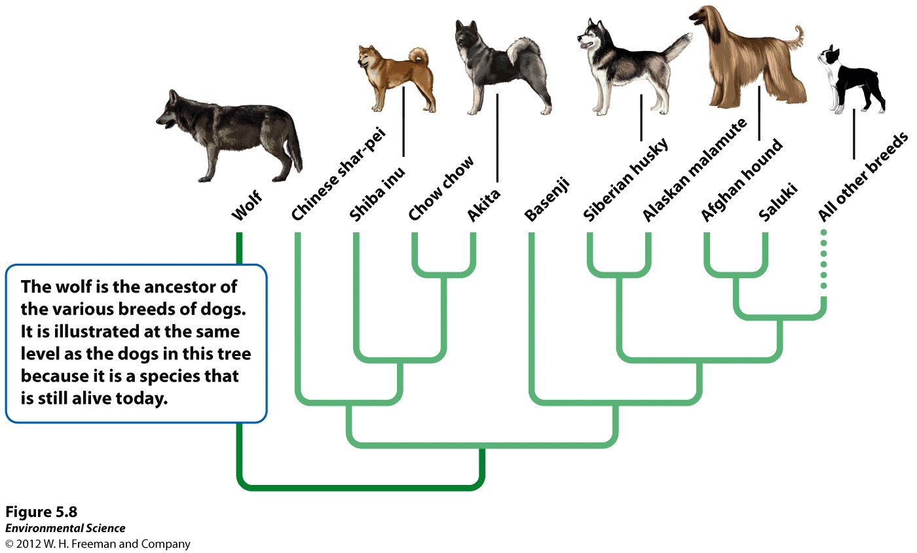

Slide 11
Darwin’s theory of evolution by natural selection
Individuals produce an excess of offspring.
Not all offspring can survive.
Individuals differ in their traits.
Differences in traits can be passed on from parents to offspring.
Differences in traits are associated with differences in the ability to survive and reproduce.

Slide 12
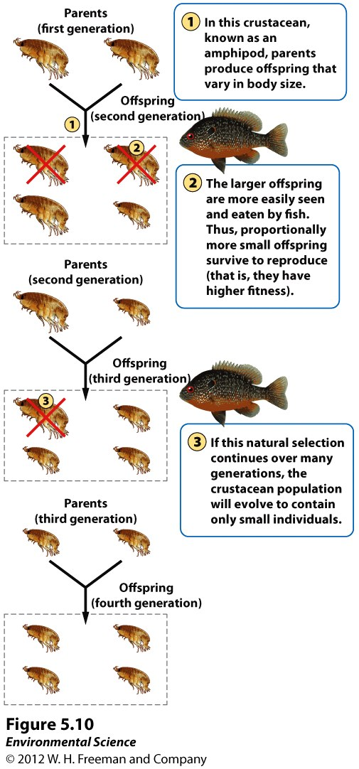
Evolution is affected by the environmental pressures, in this case, it is the predator that is putting pressure on the population of Amphipods.

Slide 13
Evolution by Random Processes
Mutation- occur randomly and can add to the genetic variation of a population. Blond Hair
Genetic drift- change in the genetic composition of a population over time as a result of random mating. Amish Population
Bottleneck effect- a reduction in the genetic diversity of a population caused by a reduction in its size. Cheetah, Sea Lions, Northern Elephant Seal
Founder effect- a change in a population descended from a small number of colonizing individuals. Afrikaner Population of Dutch settlers in South Africa, higher incidence of Huntington’s disease.

Slide 15
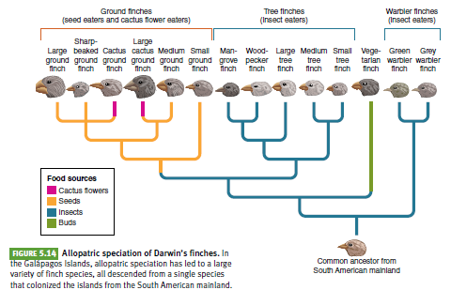
Speciation and extinction determine biodiversity
Allopatric speciation- when new species are created by geographic or reproductive isolation.

Slide 16
Sympatric speciation- the evolution of one species into two species in the absence of geographic isolation, usually through the process of polyploidy, an increase in the number of sets of chromosomes.

Slide 17
The pace of evolution

Slide 18
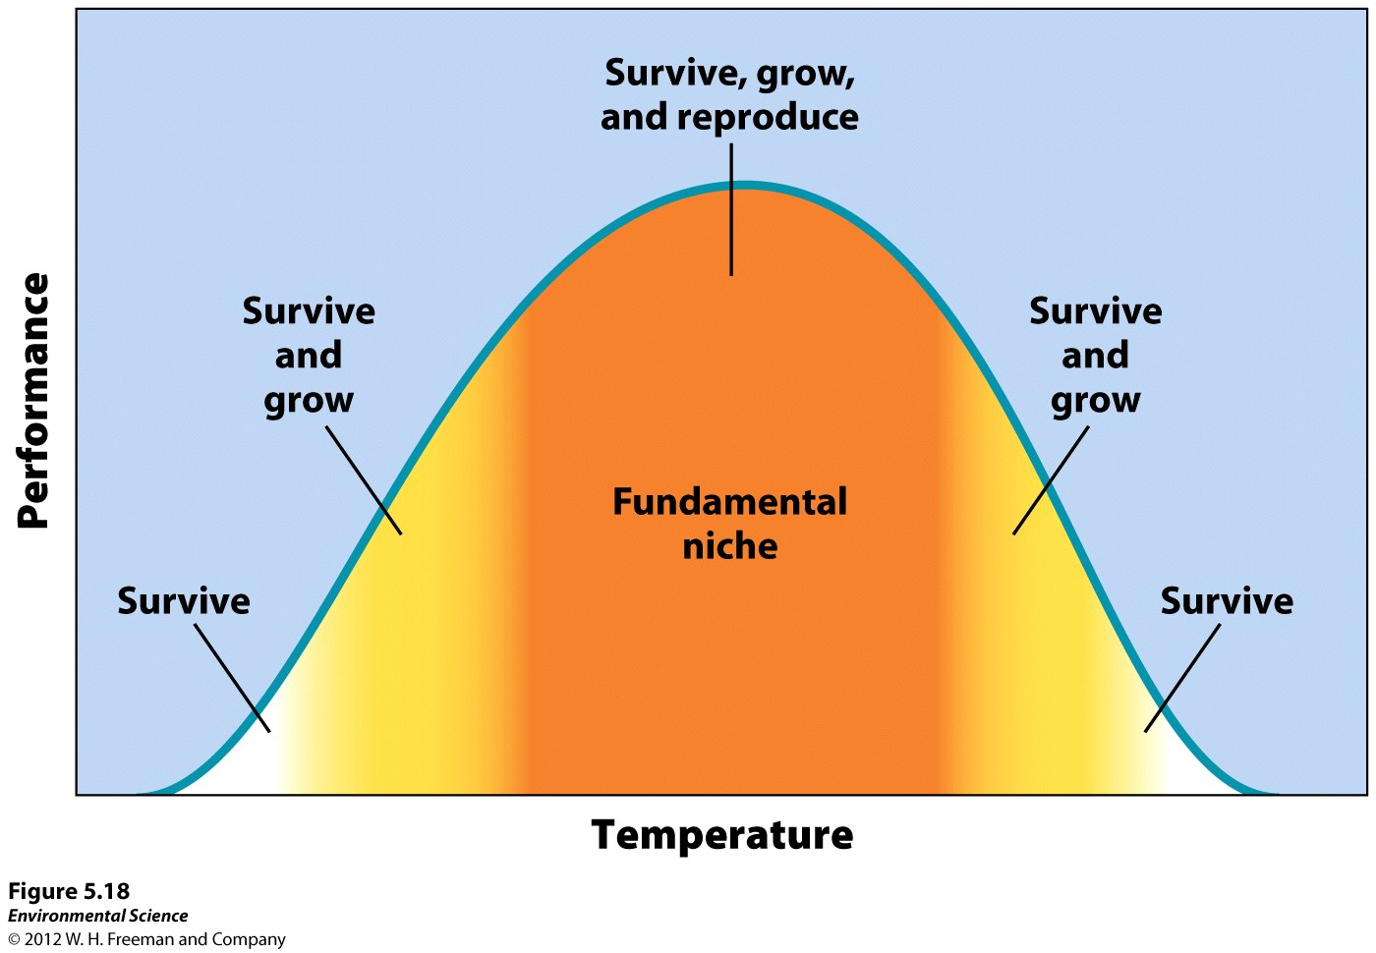
Evolution shapes ecological niches and determines species distributions
Range of tolerance- all species have an optimal environment in which it performs well. The limit to the abiotic conditions they can tolerate is known as the range of tolerance.
Fundamental niche- the ideal conditions for a species.

Slide 19
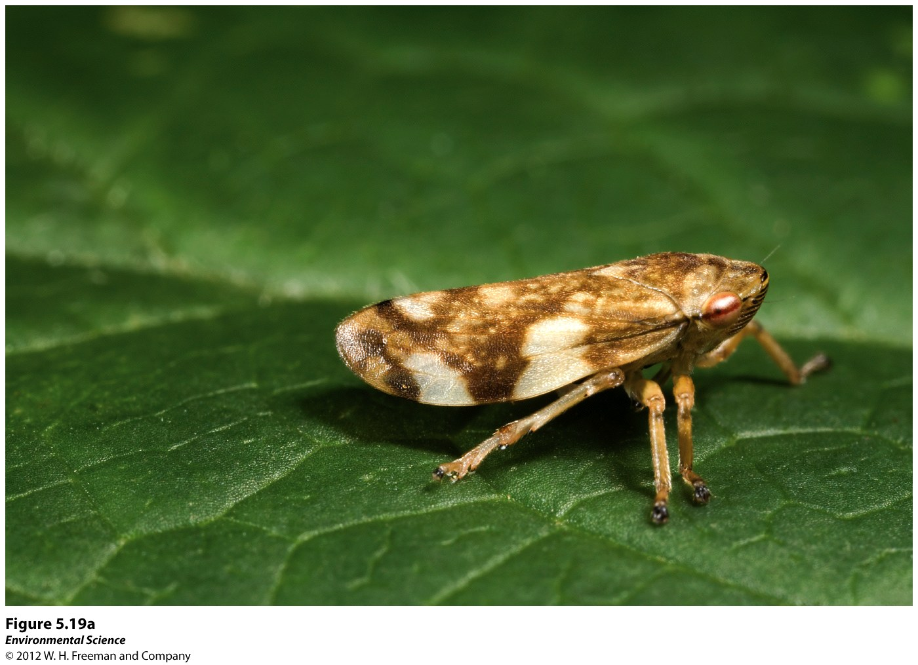
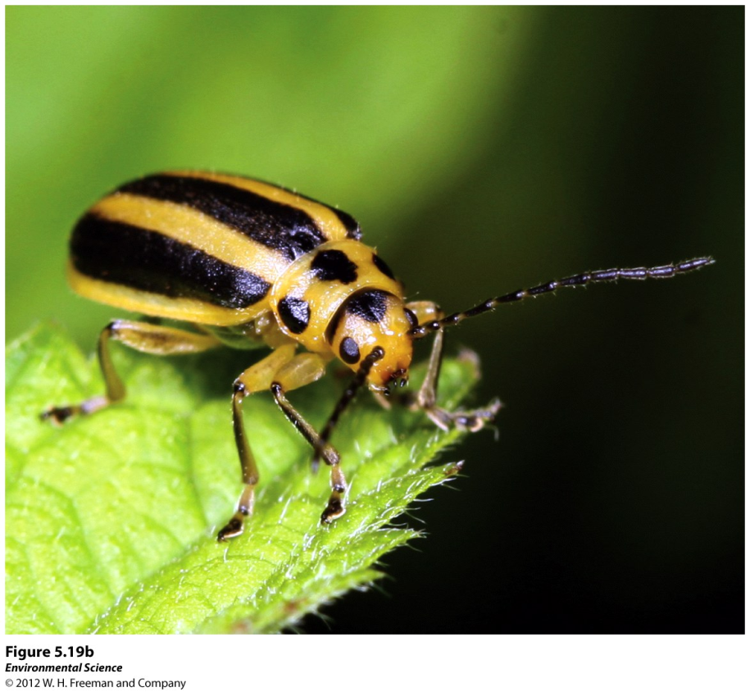
Niches
Realized niche- the range of abiotic and biotic conditions under which a species lives. This determines the species distribution, or areas of the world where it lives.
Niche generalist- species that live under a wide range of conditions.Meadow Spittlebug: broad diet, wide habitat
Niche specialist- species that live only in specific habitats. Skeletonized Leaf Beetle, Narrow diet, specific habitat preferences.

Slide 20
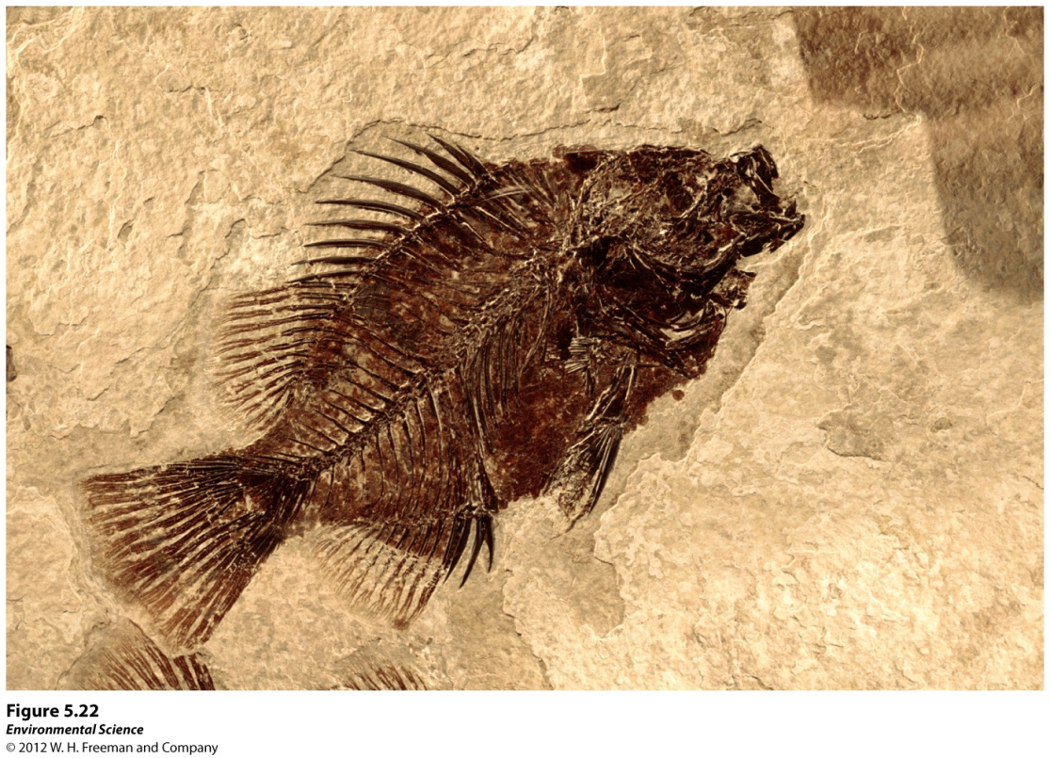
The Fossil Record
Fossils- remains of organisms that have been preserved in rock. Much of what we know about evolution comes from the fossil record.

Slide 21
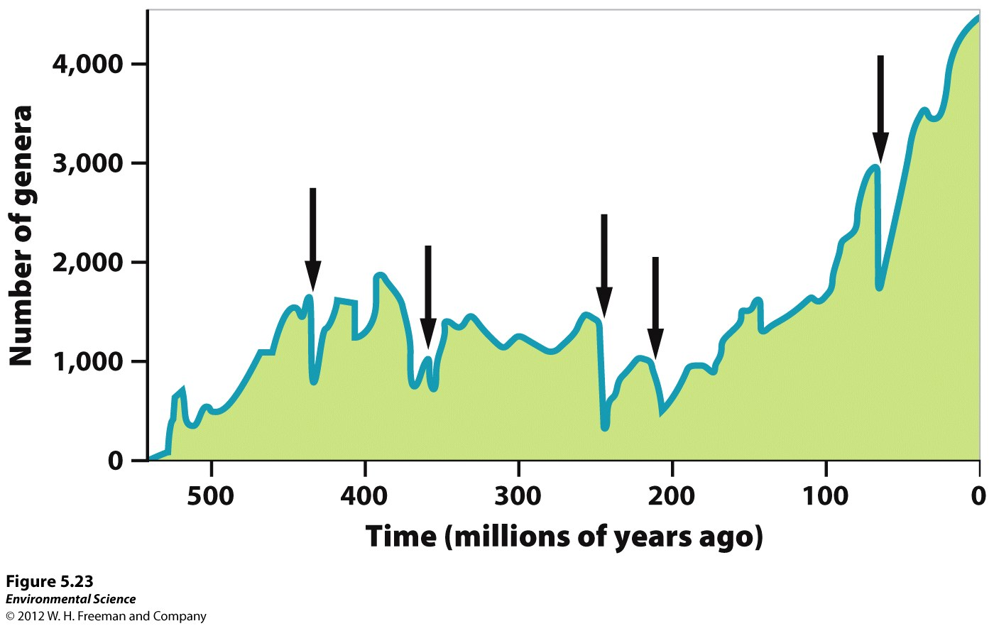
The Five Global Mass Extinctions
Mass extinction- when large numbers of species went extinct over a relatively short period of time.

Slide 22
The Sixth Mass Extinction
Scientists feel that we are in our sixth mass extinction, occurring in the last two decades.
Estimates of extinction rates vary widely, from 2 % to 25% by 2020.
In contrast to previous mass extinctions, scientists agree that this one is caused by humans.

Slide 23
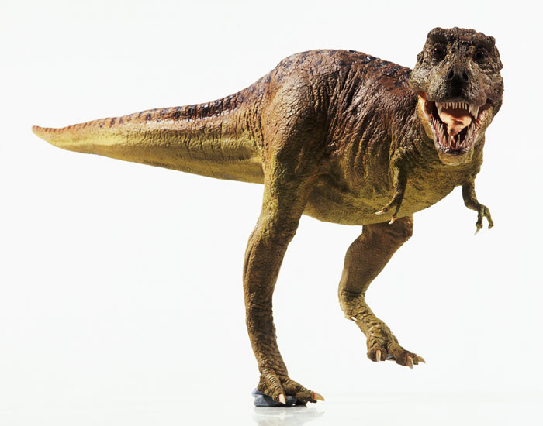
Evidence for feathers
Tyrannosaurus rex
Dilong paradoxus

Slide 24
Geologic Time Scale Activity
8 groups
Each group cuts a roll of receipt paper, 1 meter = 1 Billion Years
It must be the length that the Earth is old.
How long should it be?
Mark each Billion years, each Era, each Significant Event: Prokaryotes, Eukaryotes, First Skeletonized fossils, Invertebrates, Vertebrates- (Fish, amphibian, reptile, bird, Mammals), Vascular Plants, Flowering Plants, Land animals, Land Mammals, Humans.
Label the 5 Mass Extinctions
Color and draw the events on your timeline.
If the entire Geologic Time Scale were a Calendar year, When would humans appear?

Slide 25
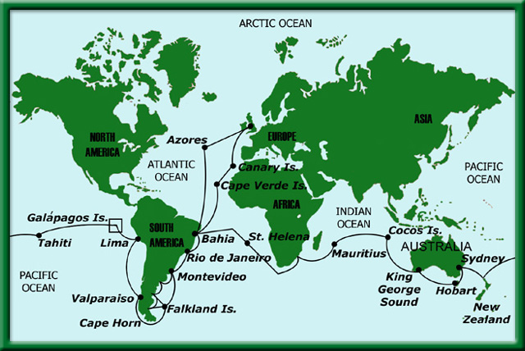
Charles Darwin Galapagos Islands

Slide 26
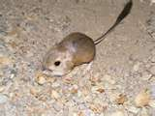
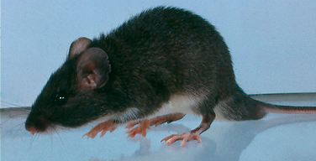
Variations can be advantageous
The pocket mouse population lives in the desert
Originally they were white, but a mutation turned them black.
Pocket mouse video

Slide 27
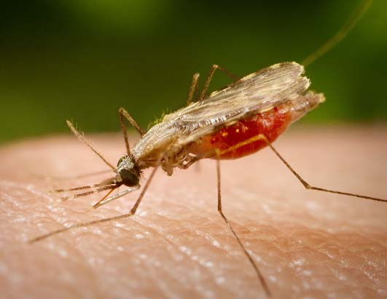
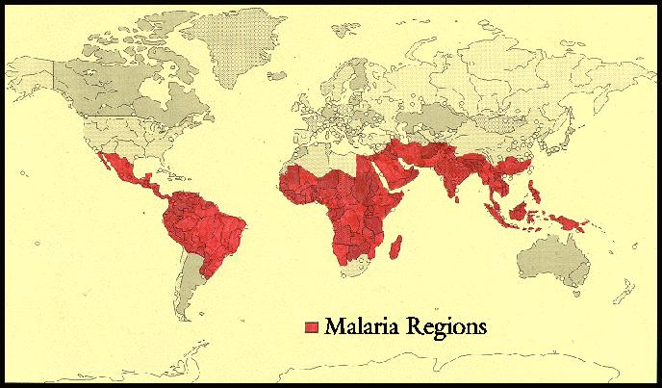
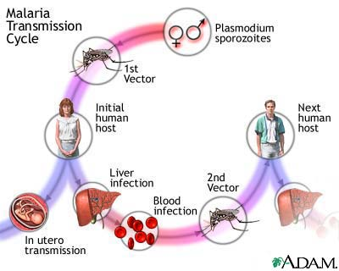
Malaria

Slide 28
Stickleback Fossil Record

Slide 29
Salamander Evolution

Slide 30

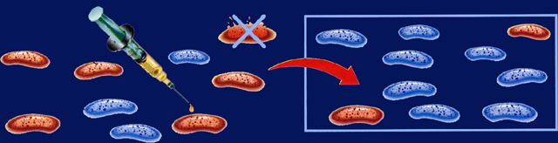
Section 15.1 Summary – pages 393-403
Physiological adaptations can develop rapidly and show direct evidence for Evolution.
Non-resistant
bacterium
Antibiotic
Resistant
bacterium
The bacteria in a population vary in their ability to resist antibiotics.
When the population is exposed to an antibiotic, only the resistant bacteria survive.
The resistant bacteria live and produce more resistant bacteria.

Slide 31
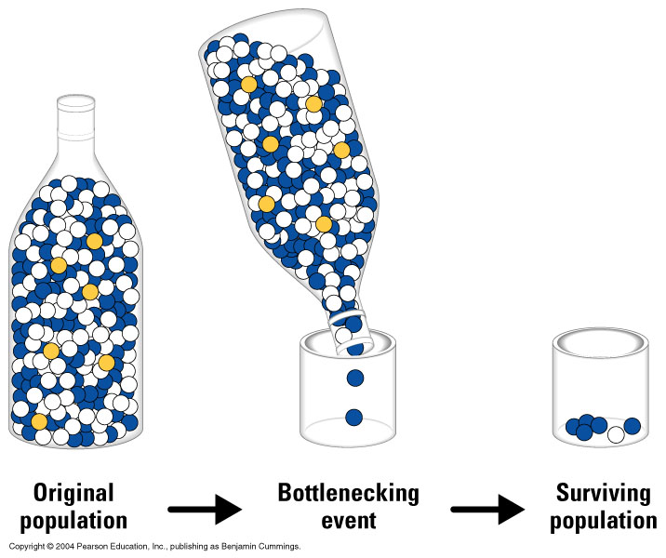
Genetic Bottleneck

Slide 32
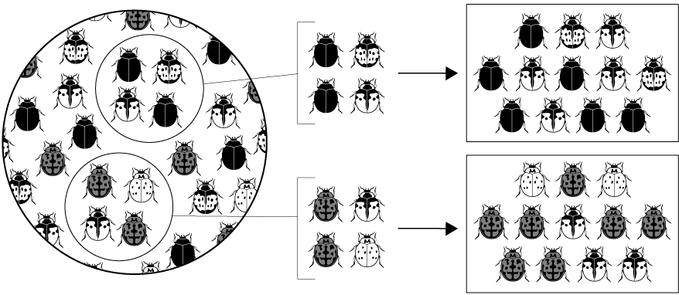
Figure 16-9: Founder Effect
Sample of
Original Population
Descendants
Founding Population A
Founding Population B

Slide 33
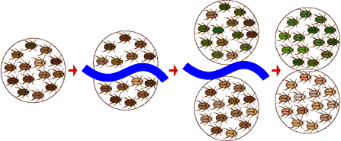
Allopatric Speciation

