Slide 1
Agenda 9/3
Warm up/ pass back lab reports
Study Guide CH 4 answers
Activity – World Map Find Cities: Latitude
CM CH 1,2,3
Go to website and study power points

Slide 2
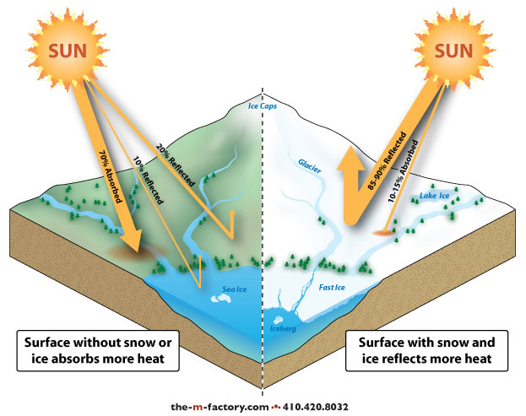
Earth Systems & Resources Review 9/3 Obj. TSW review for tomorrow’s Unit Test by reviewing answers on the CH 4 study guide, concept maps, and an Activity. P. 22NB
What was the Agricultural Revolution, how did it impact the world?
What are the layers of the Geosphere, why is the inner core of the Earth solid?
Albedo is the percentage of incoming sunlight reflected from a surface. What latitude would have the highest albedo?

Slide 3
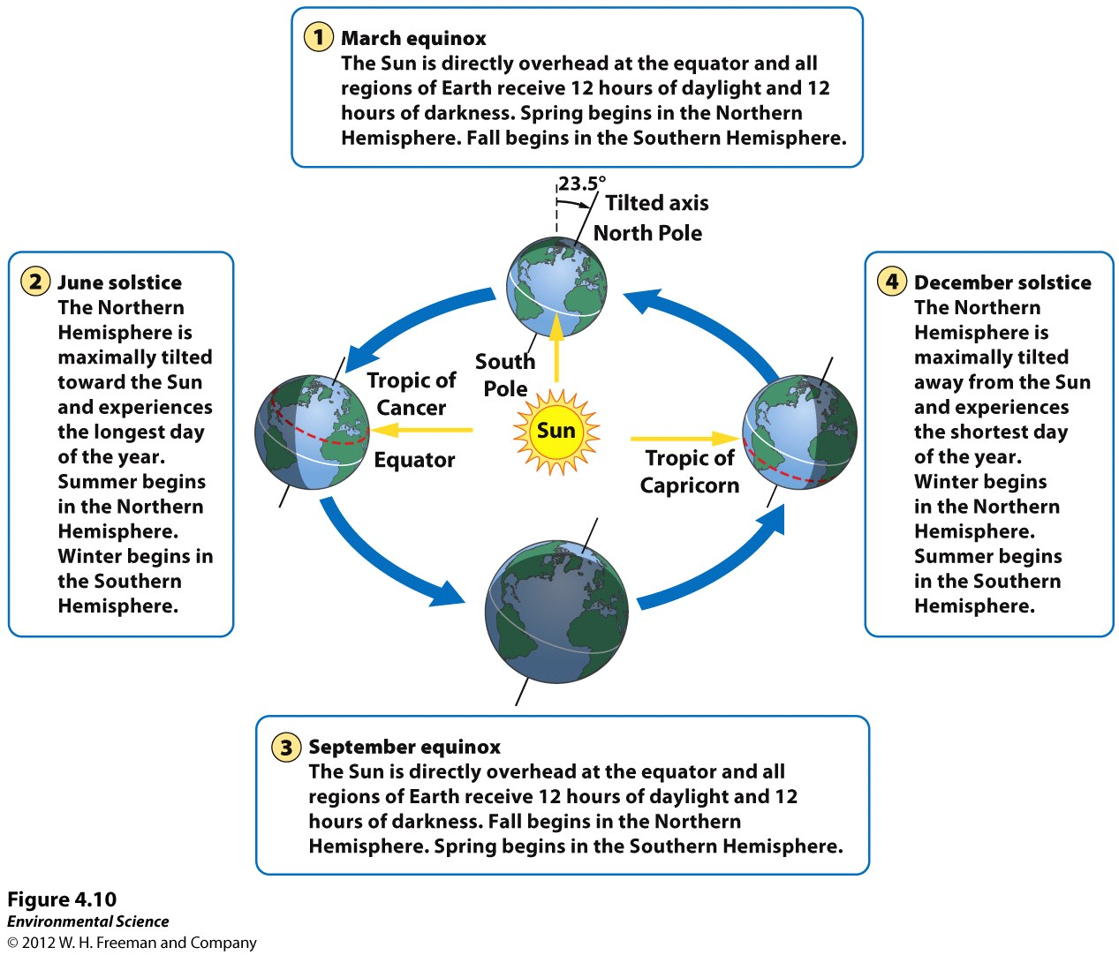

Slide 4
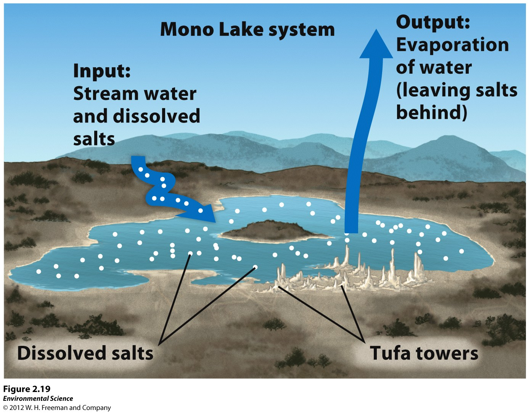

Slide 5
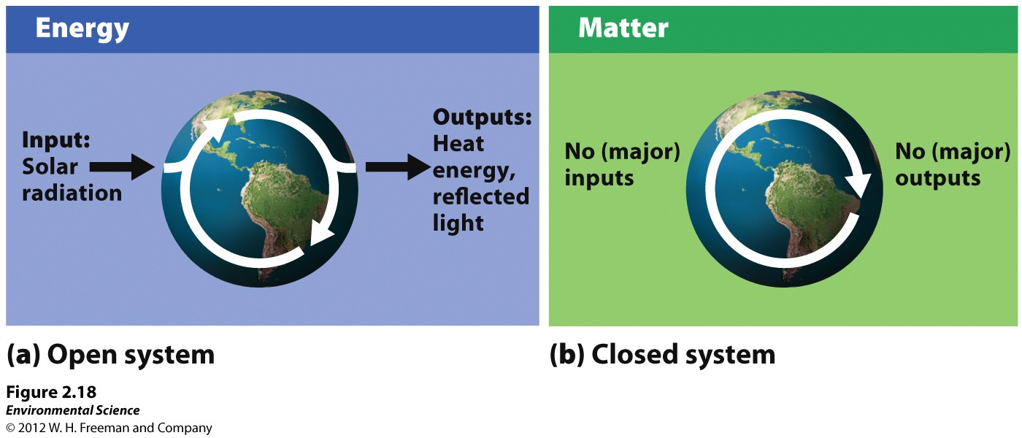

Slide 6
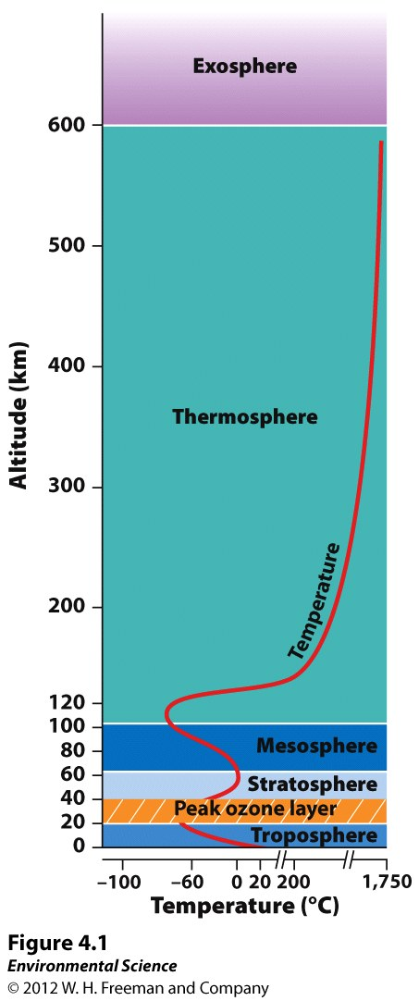

Slide 7
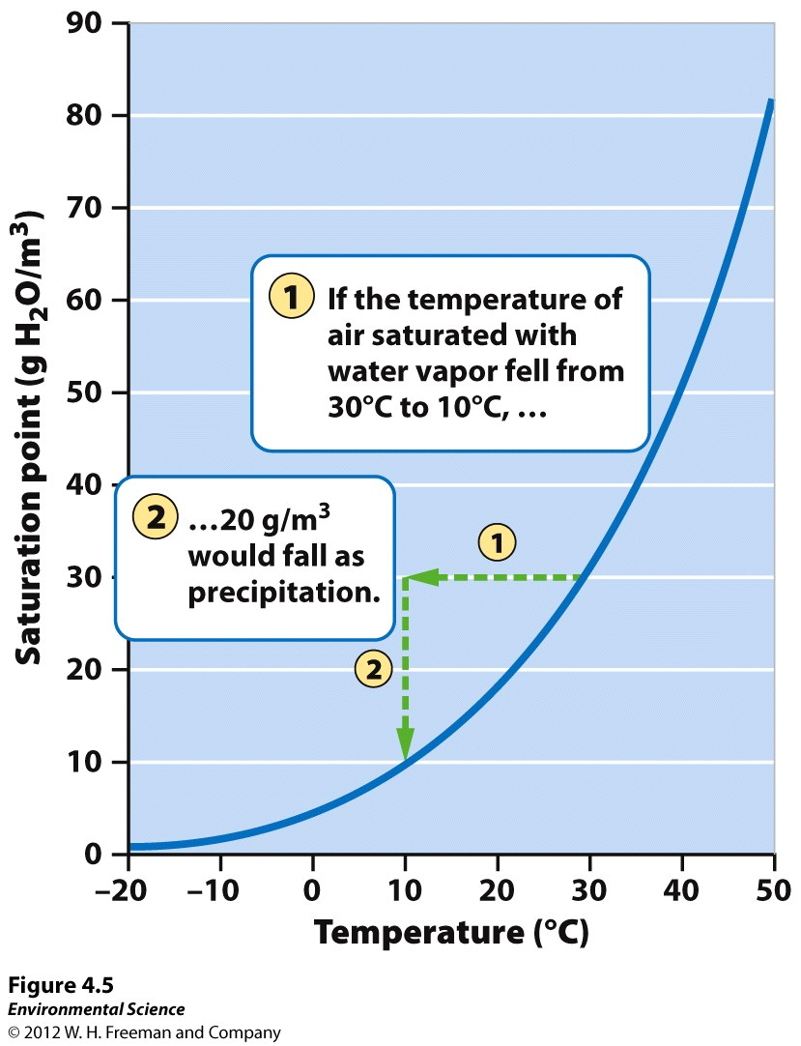
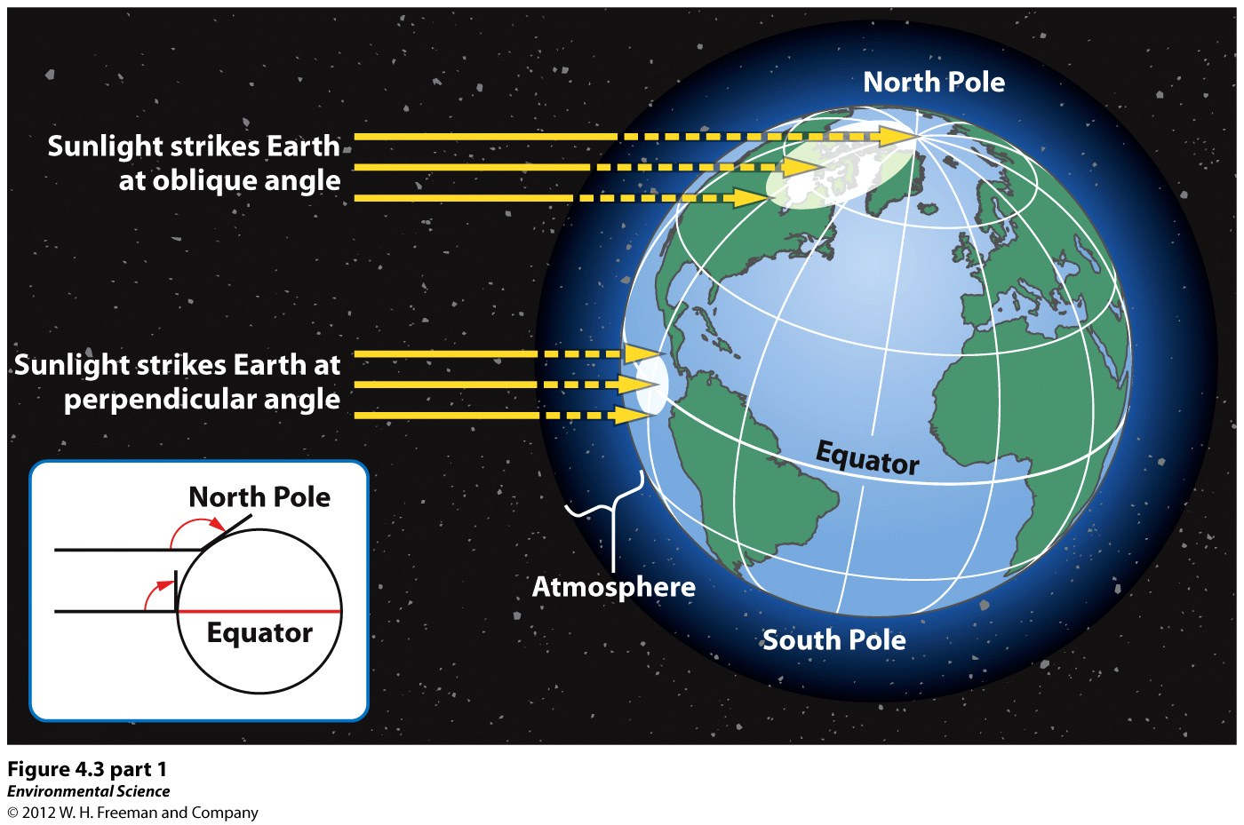

Slide 8
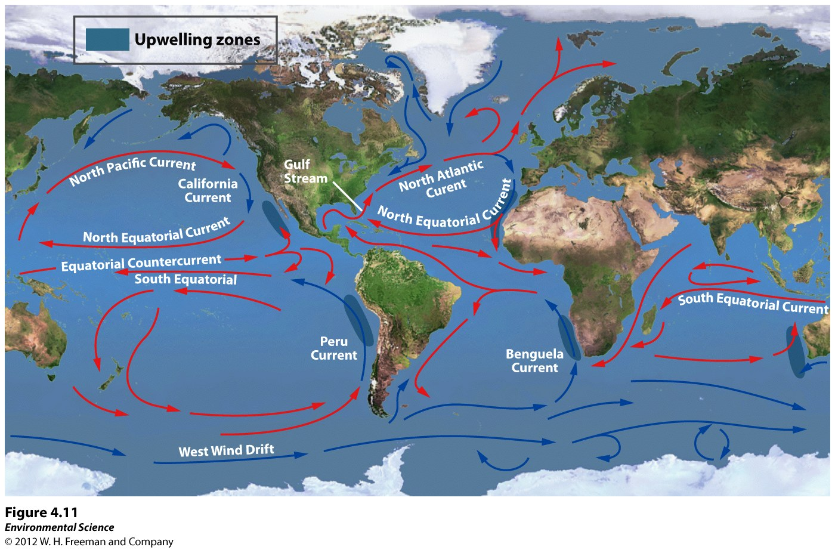

Slide 9
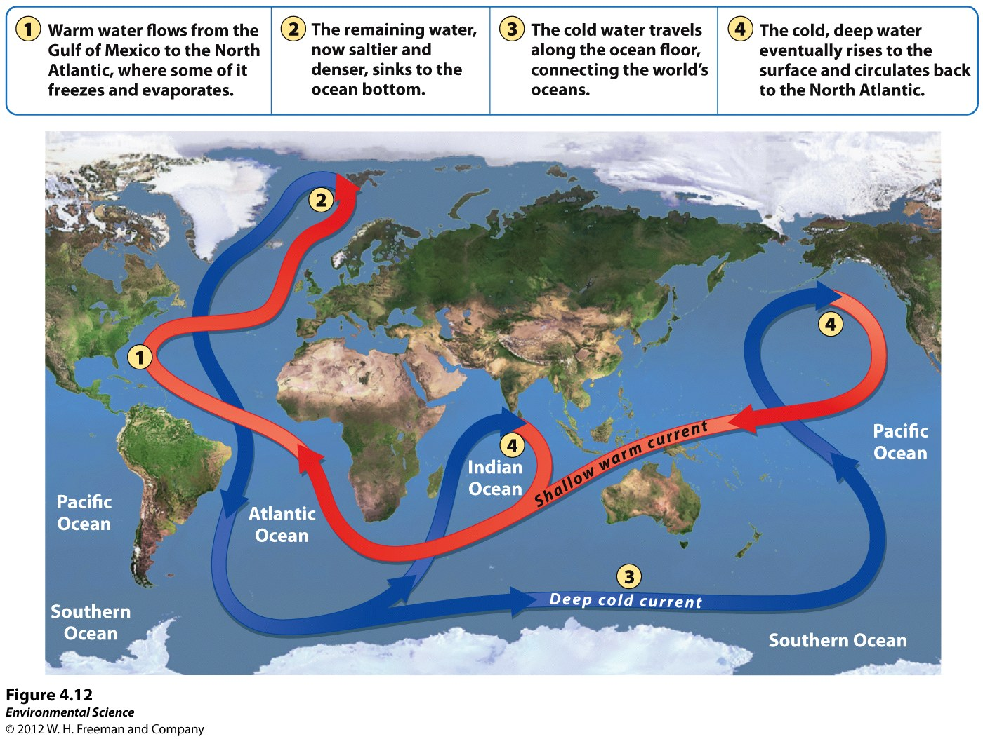

Slide 10
