Slide 1
Nonrenewable Energy CH 17
Week 16 UNIT 5
Dec. 7th – 11th

Slide 2
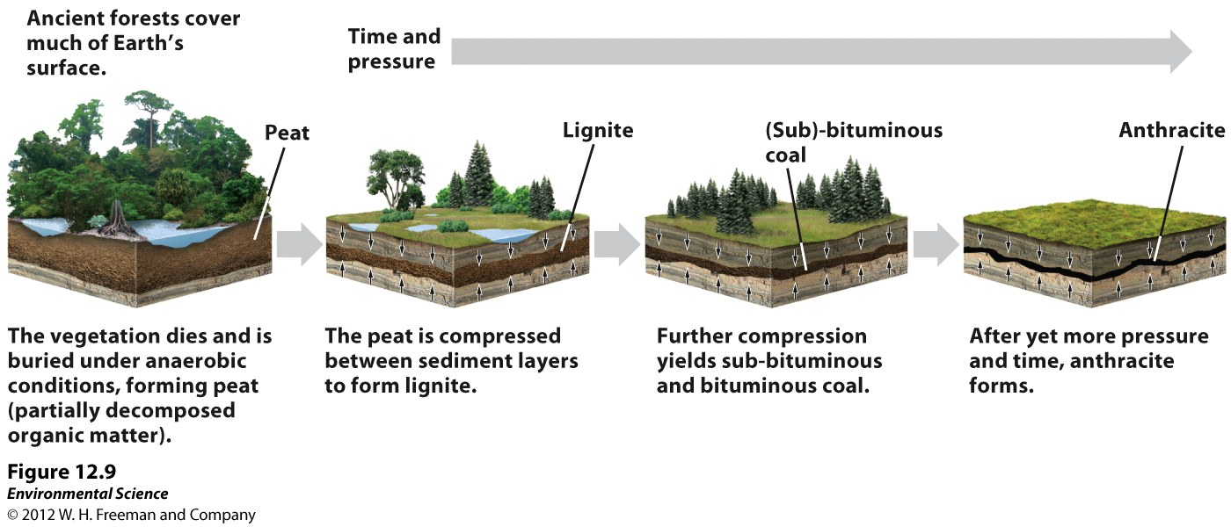
Four types of Coal Page 69NB

Slide 3
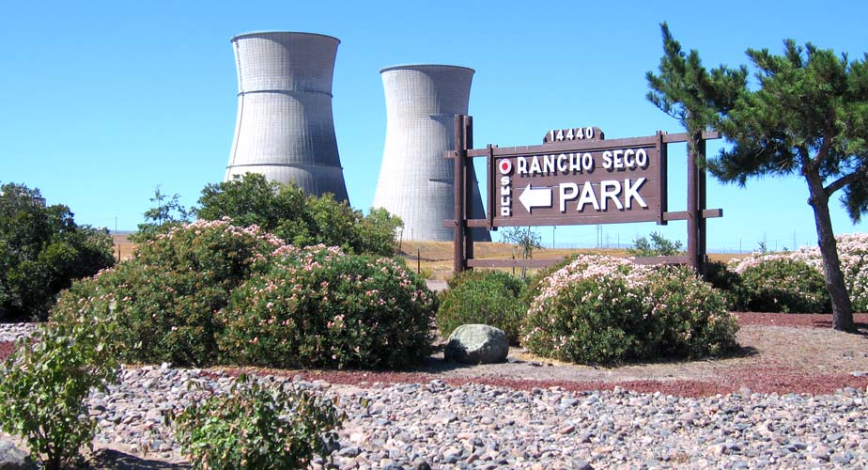
12/7 Nuclear Energy CH 17.2 Obj. TSW explain the advantages and disadvantages of nuclear energy. P. 64 NB
Describe nuclear Fission.
Describe how a nuclear power plant works.
Describe three advantages and three disadvantages of nuclear energy.
HW – 1 page Notes CH 17,P. 63 NB
Quiz on Wednesday CH 16 - 17

Slide 4
Fracking “Gas” Rush Deep Hydraulic Fracturing P. 440 - 441
Read Article & discuss

Slide 5
Activity: Nonrenewable Energy P. 73 NB
Choose 1 of the 4 types of Nonrenewable Energy:
Fossil Fuels: Coal, Oil, Natural Gas
Nuclear Energy: Uranium-235
In groups of 3, Write your Nonrenewable Energy at the top of the poster.
Explain why it is nonrenewable, Include a picture.
How is your nonrenewable resource mined?
Where is the greatest amount of your NR Energy located in the World?
Where is it mined in the US?
How do we use it for energy?

Slide 6
12/8 Hydraulic Fracking CH 17.1 & 17.2 Obj. TSW learn about the environmental impact of hydraulic fracking. P. 66 NB
Read the article “The “Gas” Rush – Deep Hydraulic Fracking. Explain what Fracking is.
By Fracking, how much could the US decrease it’s oil imports by?
Homeowner’s wells that are by hydraulic fracking have found what in their water?

Slide 7
China “Red Alert”
Bejing Air, Artist create Brick from air

Slide 8
Taboo Partner 2 look away
Nonrenewable Energy
Nuclear Energy
Sub- Surface Mining
Consequences of Mining
Reclamation
Solar Panels

Slide 9
Taboo – Partner1 Look away
Renewable Energy
Fossil Fuels
Nuclear Fission
Placer Mining
Mining Law – Endangered Species Act
Nuclear Waste

