Slide 1
The Human Population
Chapter 9 Environmental Science

Slide 2
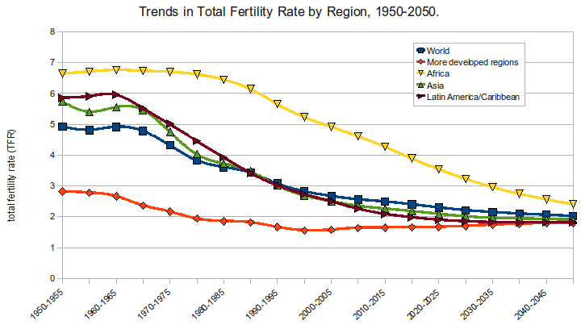
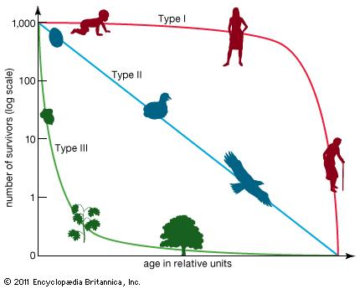
10/5 Forecasting Population Size CH 9.1 Obj. TSW compare Age-Structure Diagrams, survivorship curves and fertility rates of populations. P. 68 NB
What information does an Age-structure diagram have for us?
What does the survivorship curves I, II, III tell you about the population?
Describe the fertility rate.

Slide 3
Journey 2050 - Sustainability
Copy Each of the 12 Limiting Factors for the Human Population’s Carrying Capacity
Research with 1 – 2 students: Social, Environmental, Economic
What is this limiting factor? Explain how we use it/ need it.
How much do we have now?
What will be need in 2050?
How can we meet the need in 2050, what resources do we have, or do we need?
Be prepared to present at the end of class and take notes on others presentations.

Slide 4
Sustainability – Limiting Factors Explain how we use it/ need it. How can we meet the need in 2050? Page 73 NB
Social
Food: Tyra & Valyssia:1.6% land to produce food
Education: Itzel & Samantha: CA education level US
Health: Alicia: Jasmine, Gaby: Increasing Health access, Mexico Universal Health Care
Infrastructure: Marcos & Isaaiah: Buildings & supplies, water, construction
Environmental
Water: Mariah, Patty: Pollution Drought, Acidification
Habitats: Luke & Yajaira: Room for habitats for animals
Health: Eric & Christian: Soil heath - Salinization, soil quality decreases, decrease carrying capacity
GHG: Annie & Zehner: plant more trees to decrease CO 2 emissions. Reduces heat levels.
Economic
Jobs: Alicia & Eman: 6.2% unemployment in CA. One of highest in US. Rebuild infrastructure
Profit: Angelo & Isabel: 7.5% US, CA 7.68% Profit is invested = Growth of Business.
Income: Ethan, Daren:Pay for food/shelter/water. Income for US: 52,000 CA:$60,000
Community: Andrew & Jose: volunteer work, working together – Unity. Communication, trading.

Slide 5
10/6 The Demographic Transition CH 9.1 Obj. TSW learn the 4 stages of the demographic transitions, and characteristics of each. P. 70NB
What is demographic transition?
Describe a characteristic of each stage in the demographic transition?
What countries might be in stages 2 – 4?

Slide 6
Demographic Transition Graph

Slide 7
BRING STARBURSTS TO CLASS TOMORROW!! Carrying Capacity Activity: Page 75 NB
Make a large circle outside.
To survive of each organism requires 2 starbursts.
In the third generation you are mature enough to reproduce.
Each child costs 1 starburst to make and 1 more to maintain, If you do not get two starbursts, the child dies. (4 total for you and your offspring).
The round lasts 15 seconds.
Once you collect 2 starbursts runback to the outside and place them on the sidewalk, then go back for more.
Return your starburst back to the center

Slide 8
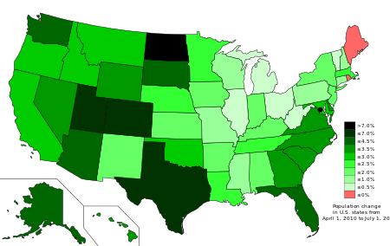
10/7 Changing Population Trends CH 9.2 Obj. TSW analyze problems of rapid human growth, characteristics of undeveloped countries and compare growth rates of regions. P. 72NB
Describe three problems caused by rapid human population growth.
How does the United Nations identify the least developed countries?
Figure 2.5 Growth Rates
Which region will contribute most to the World Population Growth?

Slide 9
Studying Human Populations p.69 NB How have each one of these topics impacted the population of humans on the planet? Write one interesting fact for that topic.
Bubonic Plague
Industrial Revolution
The Ratio between Males and Females
Carrying Capacity & Sustainability
Less-Developed Nations and Population

Slide 10
Relate Tragedy of the Commons to the Carrying Capacity game yesterday and Sustainability. P. 75 NB
Instant Gratification – I feel good now.
I can wait – for something better in the future – Planning/ Investing
Education – Invest in yourself
Job – Just over Broke
Career – Future benefits
Retirement: Benefits- Health, Vision, and Dental

Slide 11
Taboo
Sustainability
Tragedy of the Commons
Carrying Capacity
Population
Demography

Slide 12
Taboo
Undeveloped country
Limiting Factor
Exponential growth
Fertility
Demographic Transition

Slide 13
10/9 Managing Development and Population Growth CH 9.2 Obj. TSW learn and understand how countries are trying to control their population, why fertility rates are dropping and populations of people have become extinct. P. 74 NB
EASTER ISLAND
Name 3 strategies Thailand has to used to control it’s population growth?
Figure 2.8 Worldwide Trends in Fertility. Why are most countries fertility rates dropping to replacement levels?
Lost Populations, What Happened? P. 233 How is the Tragedy of the Commons related to Carrying Capacity of the Human Population?

Slide 14
Activity: Graphing the Human Population 2050 P. 79 NB
CH 9 P. 289
Use the data to graph the number of people in the world.
Add 2015 = 2.26 Billion People
Use Excel
What is the shape of the graph?

Slide 15
How could Tragedy of the Commons happen again to a human population?

Slide 16
List three steps you can take to be more sustainable.

