Slide 1
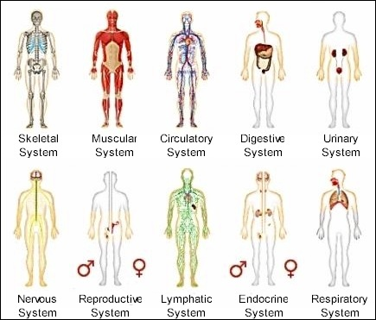
9/14 Review for Body Systems Test Obj. TSW write a well thought out response to a written question about body systems, and accurately find the Claim, Evidence, Reasoning and AXES paragraph for a scientific article. P. 38 NB
What is a claim? How do you know when you have found it in an article?
What is evidence? How do you know when you have found it in an article?
What is the reasoning? How do you know when you have found the support for the evidence?

Slide 2
Cells
Week 5
Macromolecules, Enzymes, Organelles, Microscopes & Cells, Photosynthesis & Cellular Respiration

Slide 3
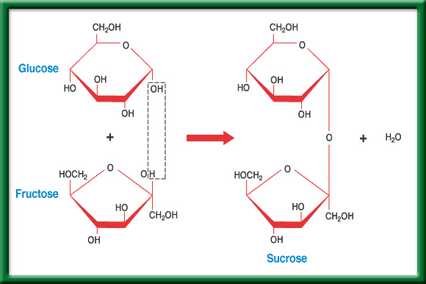
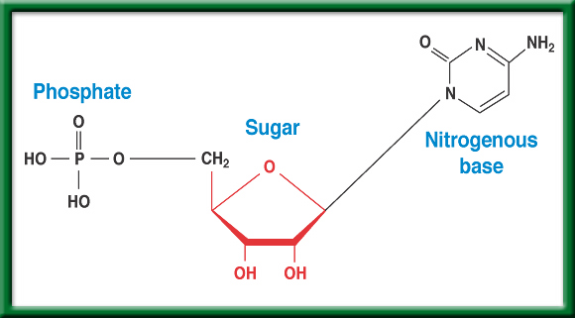
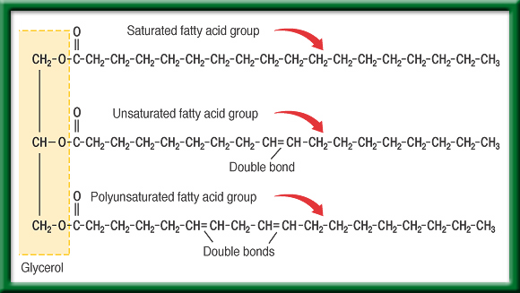
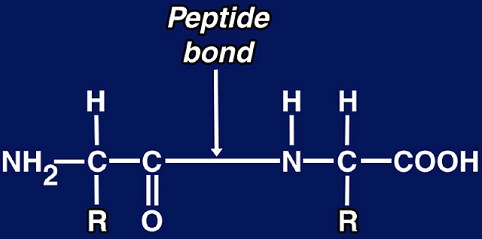
02/16 Life Substances (Macromolecules) 6.3 Obj. TSW explain the four Biomolecules (Macromolecules, Polymers) & how they are made from smaller molecules (monomers) by making a foldable & doing the Monsters in the pond water lab. P. 40NB
cellsalive.com
Carbon is the basic atom that forms molecular chains. Describe what a Biomolecule is, and name the four Biomolecules.
Compare & Contrast the 4 Biomolecules, (Macromolecules).
Why are these Biomolecules important?
Nucleic Acids
Carbohydrates
Lipids
Proteins

Slide 4
Warm Up 02/16 Obj: TSW make observations & develop an experiment in order to explain what was observed in the Color Changing Milk Demo.(pg. 40 NB)
Write down 3 things you observed from the Color Changing Milk Demo.

Slide 5
Color Changing Milk Lab (pg. 39 in NB) “Every time I eat food coloring, I dye a little inside”
Materials:
Plate, Milk, Food Coloring, Q-tips, & dish soap.
Procedure:
Pour enough milk onto the plate to just cover the bottom completely.
Add food coloring using 4-5 drops for each spot.
Take a Q-tip and dip it soap.
Gently place Q tip, soap side down, into the milk & food coloring mixture. Make observations.
Keep the Q-tip in mixture until movement stops.
Be sure to record your work for this lab in your new, handy dandy, Experimental Design Graphical Organizer!
You may use your phones to take pictures of the color changing milk if you wish.

Slide 6
Chapter Summary – 6.3
Life Substances – Biomolecules & Macromolecules
All organic compounds contain carbon atoms, CH₄, C₂H₆.
#1. There are four principal types of organic compounds, or biomolecules, that make up living things: carbohydrates, lipids, proteins, and nucleic acid.
The structure of a biomolecule will help determine its properties and functions.

Slide 7
#1. Biological molecules (Biomolecule, macromolecules) make parts of cells and living things.
#2.
Carbohydrates- compounds composed of carbon, hydrogen, and oxygen atoms. Identifies the type of cell. Ex. C₆H₁₂O₆ - sugar
Proteins- made up of long chains of nitrogen-containing organic molecules called amino acids. Allow for transport of materials in and out of the cell.
Nucleic Acids- organic compounds found in all living cells. Genetic Material.
DNA
RNA
Lipids- smaller biological molecules that do not mix with water. Ex. fats, waxes, oils and steroids.
#3. Without these Biomolecules we would not have life because we would not have cells.

Slide 8
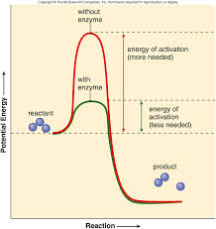
6.3 Section Summary 6.3 – pages 157-163
Take notes P. 41 NB
The structure of proteins
Enzymes are important proteins found in living things. *An enzyme is a protein that changes the rate of a chemical reaction.
They speed the reactions in digestion of food.
Made up of Amino Acids (20)
Enzymes can be used again and again without being used up.
Click image to view movie.

Slide 9
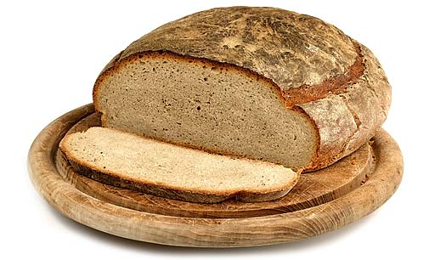
6.3 Section Summary 6.3 – pages 157-163
The structure of carbohydrates
A carbohydrate is a biomolecule composed of carbon (most abundant element with four available electrons to bond or share), hydrogen, and oxygen with a ratio of about two hydrogen atoms and one oxygen atom for every carbon atom.
Starch - Potatoes,
Cellulose - Cotton,

Slide 10
6.3 Section Summary 6.3 – pages 157-163
The structure of carbohydrates
The simplest type of carbohydrate is a simple sugar called a monosaccharide (mah noh SA kuh ride). (ie. glucose, fructose)
The largest carbohydrate molecules are polysaccharides, polymers composed of many monosaccharide subunits. (ie. potatoes, liver)
Element Carbon is the most abundant in living things.

Slide 11
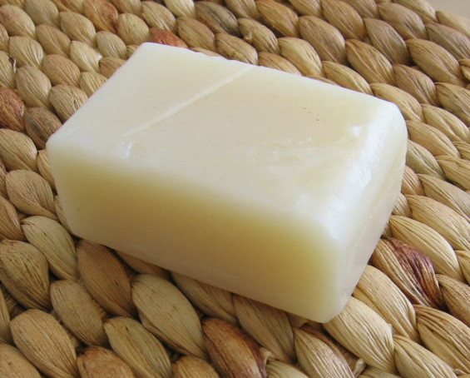
6.3 Section Summary 6.3 – pages 157-163
The structure of lipids
Lipids are large biomolecules that are made mostly of carbon and hydrogen with a small amount of oxygen. (ie. fats, oils, waxes)
They are insoluble in water because their molecules are nonpolar and are not attracted by water molecules.
Butter
Soap

Slide 12
Glycerol Chemistry
To return to the chapter summary click escape or close this document.

Slide 13
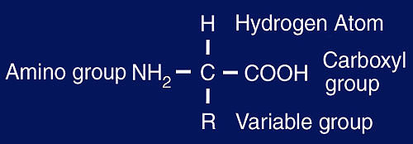
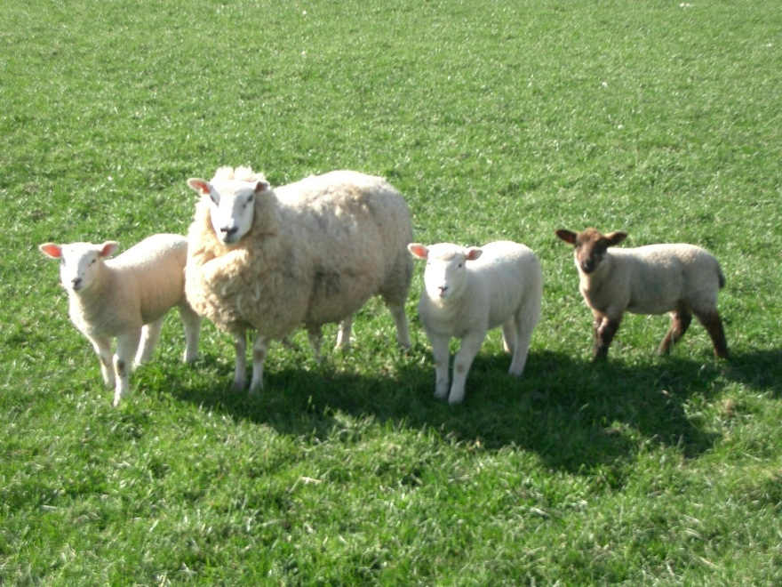
6.3 Section Summary 6.3 – pages 157-163
The structure of proteins
*The basic building blocks of proteins are called amino acids.
There are about 20 common amino acids that can make literally thousands of proteins.
Notice, amino acids contain the element Nitrogen, as do Nucleic Acids
Meat, Muscle, Leather, Wool

Slide 14
6.3 Section Summary 6.3 – pages 157-163
The structure of proteins
Peptide bonds are covalent bonds formed between amino acids.

Slide 15
6.3 Section Summary 6.3 – pages 157-163
The structure of nucleic acids
A nucleic (noo KLAY ihk) acid is a complex biomolecule that stores cellular information in the form of a code.
Nucleic acids are polymers made of smaller subunits called nucleotides.

Slide 16
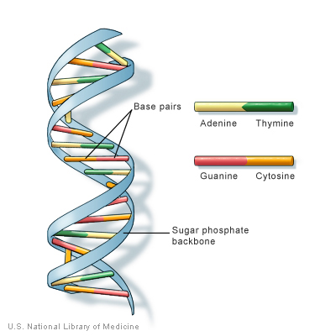
6.3 Section Summary 6.3 – pages 157-163
The structure of nucleic acids
The information coded in DNA contains the instructions used to form all of an organism’s enzymes and structural proteins.
Another important nucleic acid is RNA, which stands for ribonucleic acid. RNA is a nucleic acid that forms a copy of DNA for use in making proteins.

Slide 17
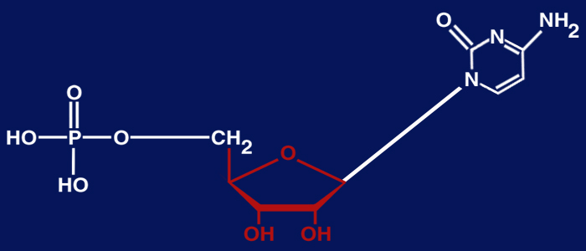
6.3 Section Summary 6.3 – pages 157-163
The structure of nucleic acids
DNA, which stands for deoxyribonucleic acid is a nucleic acid.
Phosphate
Sugar
Nitrogenous base

Slide 18
Nucleotides
To return to the chapter summary click escape or close this document.

Slide 19
02/17 Biomolecules CH 6.3 Obj. TSW analyze the similarities and differences between the 4 types of Biomolecules. P. 42 NB
What elements make up each of the 4 Biomolecules?
How do cells use each of the Biomolecules?
What biomolecules are in milk?

Slide 20
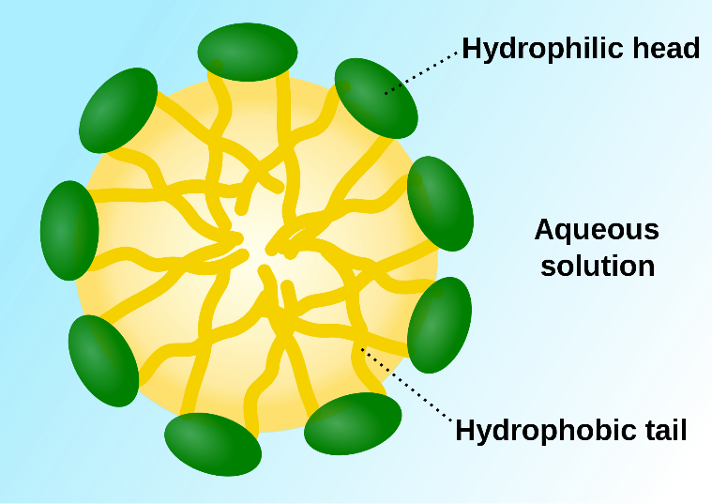
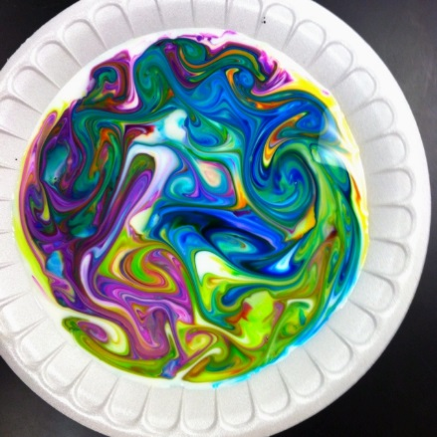
Reflection Milk Lab: The structure of a biomolecule will help determines its properties and functions. P. 41NB
Yesterday in the Milk Lab, you noticed movement of the food coloring when you placed the soap covered Q-tip into the milk.
What is milk made of?
From what you know about our Bio/macromolecules, which ones does milk have?
Do oil and water mix?
How can this help explain the movement of the colored dye in the milk?

Slide 21
Draw a mark at the midpoint of a sheet of paper along the side edge.
Then fold the top and bottom edges in to touch the midpoint.
To return to the chapter summary click escape or close this document.

Slide 22
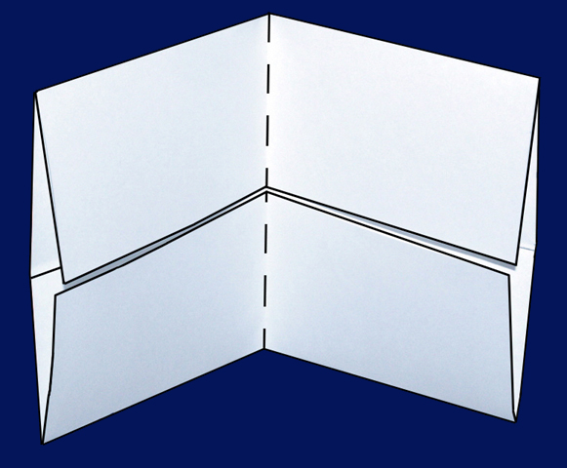
Fold in half from side to side.
To return to the chapter summary click escape or close this document.

Slide 23
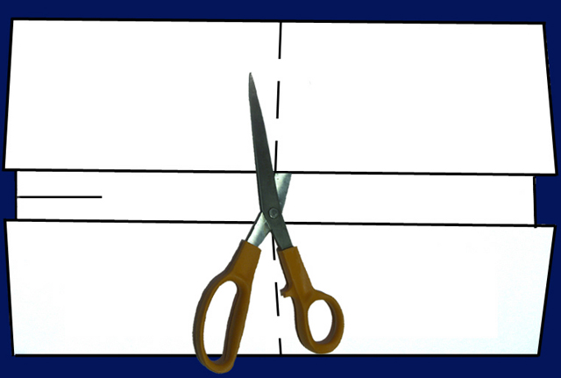
Open and cut along the inside fold lines to form four tabs.
To return to the chapter summary click escape or close this document.

Slide 24
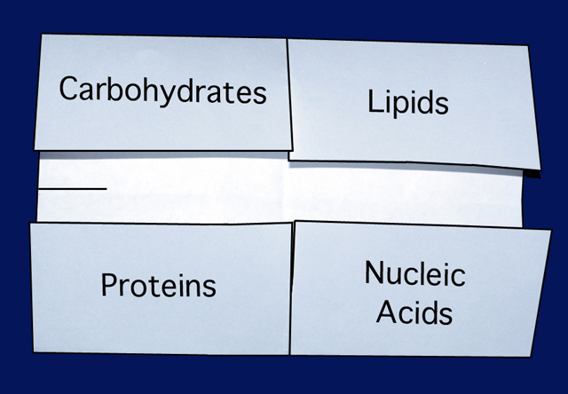
Write an example of each, part of cell membrane.
Give a definition of each.
Draw the molecular formula & a picture of each
Include the Subunit. P. 43NB
Why Macromolecules are important?
Label each tab.
CH 6.3 & 7.2
Saccharides - Sugars
Fatty Acids
Macromolecules
Amino Acids
Nucleotides
To return to the chapter summary click escape or close this document.

Slide 25
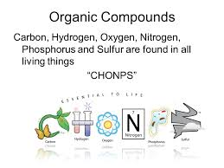
02/18 Building Molecules & Enzymes CH 6.3 Obj. TSW identify the macromolecules living things are made of and describe their properties. P. 44NB
What are the 6 main elements that make up the 4 macromolecules?
What is an Enzyme?
What three environmental factors determine the enzymes function?

Slide 26
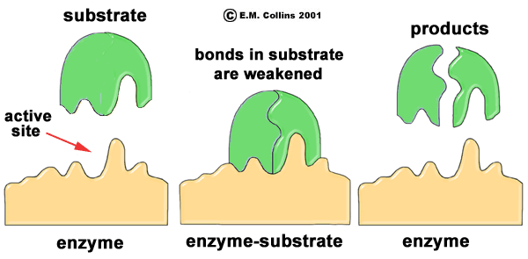
Enzymes
1. CHONPS- Carbon, Hydrogen, Oxygen, Nitrogen, Phosphorus, & Sulfur.
2. Enzymes are a type of protein that catalyze chemical reactions. This means they speed up the rate of chemical reactions.
3. There are three things that impact how well an enzyme will work:
pH
Temperature
Amount of Substrate &/or the amount of Enzyme

Slide 27
Build a Monosaccharide!
Show me a correct monosaccharide for extra credit!
Some Helpful Hints:
Black atoms are Carbon (C).
Carbon always needs to be bonded to 4 other atoms.
White atoms are Hydrogen (H).
Hydrogen only bonds to 1 atom.
Red atoms are Oxygen (O)
Oxygen bonds to 2 atoms.
Every unidentified corner is a Carbon atom.
For example, look at the which identifies the corner on Sucrose. That is a carbon atom.

Slide 28
02/19 Enzymes CH 6.3 Obj. TSW learn how enzymes function and the environmental factors that influence them in and activity/ lab. P. 46NB
What type of macromolecule is an enzyme?
What is the purpose of an enzyme?
Name 3 environmental factors that influence an enzymes function.

Slide 29
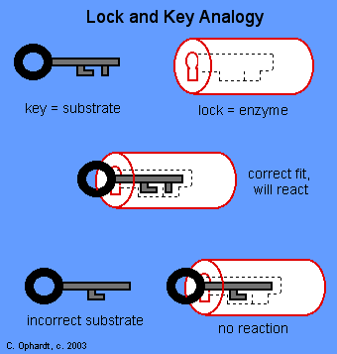
Macromolecules & Subunits Notes p. 45NB
Draw this
Write down these notes below.
Lipid – Fatty Acids
Carbohydrate- Saccharides
Protein( Enzymes)– Amino Acids
Temperature
pH
[Substrate ] & [Enzymes]
[Salt]
Nucleic Acid - Nucleotides
***[ ] means concentration, or amount.

Slide 30
Enzymatic Reaction of Sucrase on Sucrose

Slide 31
Enzymatic Reaction of Sucrase on Sucrose

Slide 32
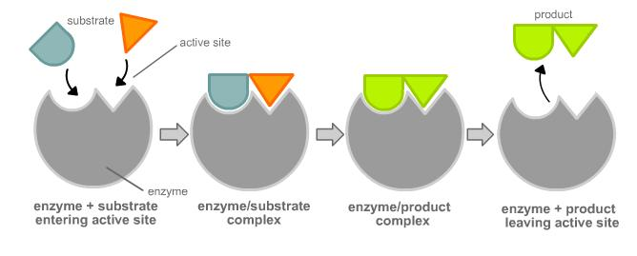
Enzyme Activity
You will be given a substrate or a part of an enzyme.
Find the matching part, that fits your active site.
Bring your matching Enzyme/ Substrate combinations (Lock & Key) to McAllister
I will quiz you on your knowledge of monomers and polymers in endergonic & exergonic reactions.

Slide 33
Catalase Lab
ml H2O2 | Person 1 | Person 2 | Person 3 | Person 4 | Person 5
5 | 100
6
7 |  | 120
8 |  |  | 120
9 |  |  |  | 170
10 |  |  |  |  | 140

Slide 34
Catalase Lab P. 27
1 flask / 2 people
GLX
Pressure Probe
Yeast – 1 tsp.
Hydrogen Peroxide 5ml
Swirl
Make observations.
Write a summary paragraph about the function of enzymes with a picture of a substrate & enzyme & active site. What factors allow for the enzyme to function? What volume of H2O2 did Catalase work the best? Why does the enzyme speed up chemical reactions? Enzymes can be used again & again (Catalytic), how is this important in chemical reactions? At what volumes (ml) did the Catalase work the best? Write the chemical equation.

Slide 35
AXES Paragraph – Catalase Lab
Assertion What is Exothermic Reactions? Use vocabulary.
eXample Discuss an example of an enzyme. Include details from the lab.
Explanation Describe the function of the enzyme, and factors that influence it.
Significance Why are enzymes important for us?

Slide 36
Section 3 Check
Question 5
Describe an enzyme and its function.
CA: Biology/Life Sciences 1b

Slide 37
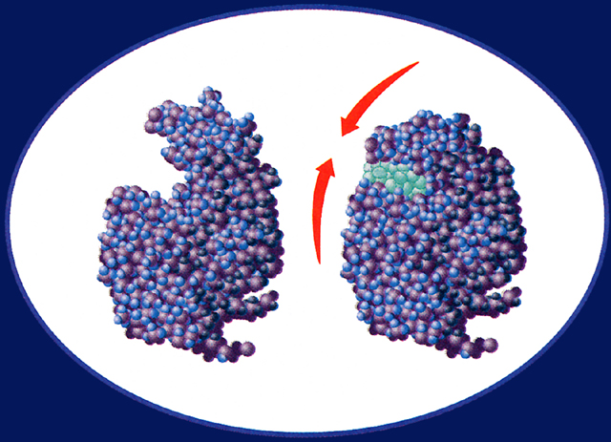
Section 3 Check
An enzyme is a protein that enables other molecules to undergo chemical changes to form new products. Enzymes increase the speed of reactions that would otherwise proceed too slowly.
Substrate
Active site
CA: Biology/Life Sciences 1b

Slide 38
Macromolecules
Protein | Lipids | Carbohydrates | Nucleic Acids

