Slide 1
Defense Against Infectious Diseases 39.1 & 39.2 8/28 TSW understand and explain the role of antibodies in the body’s response to a bacterial infection during the warm up. P. 20 NB
What is a pathogen?
Identify cells, tissues and organs that make up the immune system.
Explain the role of antibodies in response to infection.
T – cell production

Slide 2
Cellular Immunity

Slide 3
Antibody Immunity

Slide 4
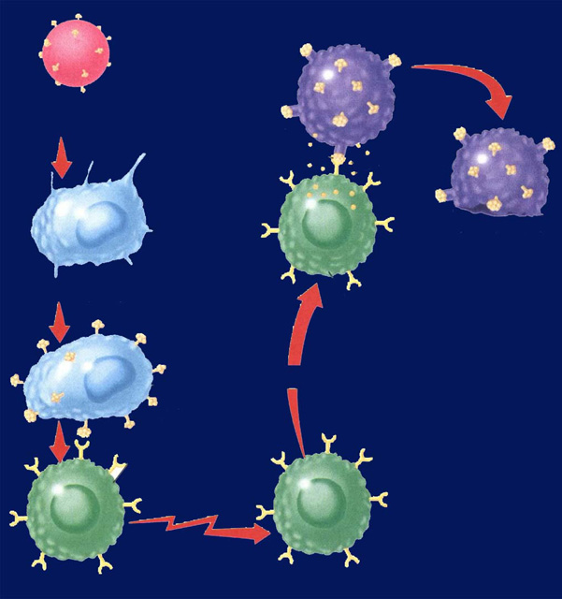
Immune System Responses 39.2 8/31 Obj. TSW compare and contrast Antibody Immunity and Cellular Immunity by diagraming the process in their NB and drawing a Cartoon applying nonspecific & specific immune responses. P.22NB
? Immunity
Identify two types of lymphocytes in Antibody Immunity.
Explain the process of Antibody Immunity.
Explain the process of Cellular Immunity.
? Immunity

Slide 5
Distraction Reaction Lab
Create your title page today
Start your Background information by doing online research and cite your sources.
Copy and Paste Excel Data Table 1 and Graph 1 into word document.
Bar graphs are used not line.
Page 23NB
Notes CH 39

Slide 6
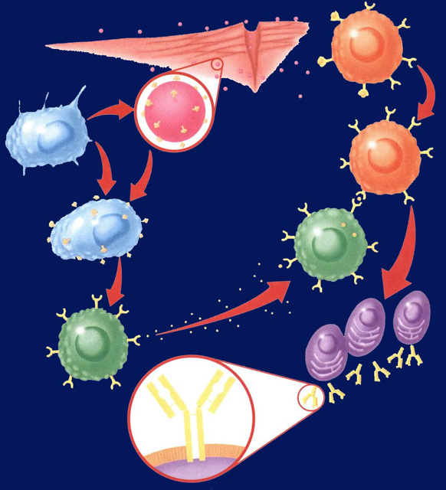
Notebook – Specific Immunity
P. 25 NB Antibody Immunity P. 1037BB
P. 27 NB Cellular Immunity P. 1038 BB
Write a 4 – 5 sentence summary using specific vocabulary to explain the process.
Antibody Immunity
Cellular Immunity

Slide 7
Section 39.2 Summary – pages 1031-1041
Antibody Immunity – Specific Immune Response, Builds Antibodies
E. B cells can bind to antigens directly.
Pathogens enter
tissues through a wound.
B cell
F. Helper T cells bind to antigens on B cells.
B. They are attacked
by macrophages
at the infection site.
Pathogen
Macrophage
G. T cells release chemicals that cause B cells to produce
clones of plasma cells.
C. Antigens of the pathogen are displayed
on the surface of the macrophage.
Antigen
receptor
site
H. Each plasma cell secretes more than 2000 antibodies per second in the blood. Memory B cells and antibodies remain in the blood and respond to future invasions by the same pathogen.
D. Helper T cells have
receptor sites that
recognize and bind to the antigens on the
macrophage.
T cell
Plasma
cells
Antibody
Surface of
plasma cell

Slide 8
Section 39.2 Summary – pages 1031-1041
#3.Cellular Immunity
Specific Immune Response that blows up infected body cells.
Infected cells
Pathogen
engulfed by
Perforin
Foreign
antigen
Infected cell lyses
Macrophage
Cytotoxic T cell
Displays antigens
on surface and
stimulates T cell
Attacks infected
cell
Stimulates
Helper T cell
Cytotoxic T cell

Slide 9
Immune System Poster
Make a cartoon with captions, showing the body’s Immune Response to an infection.
Make 4 Stages:
Stage 1: How the Pathogen gets into the body.
Stage 2: Show the Nonspecific Immune Response.
Stage 3: Show the Specific Immune Response.
Stage 4: Show the Memory Cells Warding off a previous infection.

Slide 10
Foldable (29 NB) P. 1037BB
Macrophage – Definition & Picture inside
A white Blood cell that is nonspecific against pathogens.
T – Cell
B – Cell
Plasma Cell
Antibodies
Antigens

Slide 11
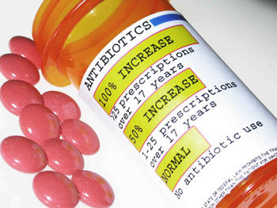
9/1 Specific and Nonspecific Immune Responses CH 39.2 Obj. TSW differentiate between nonspecific & specific immune responses. P. 24 NB
What is a vaccine?
Why do people who have AIDS have complications with normal colds and flu diseases?
What pathogen does antibiotics kill?

Slide 12
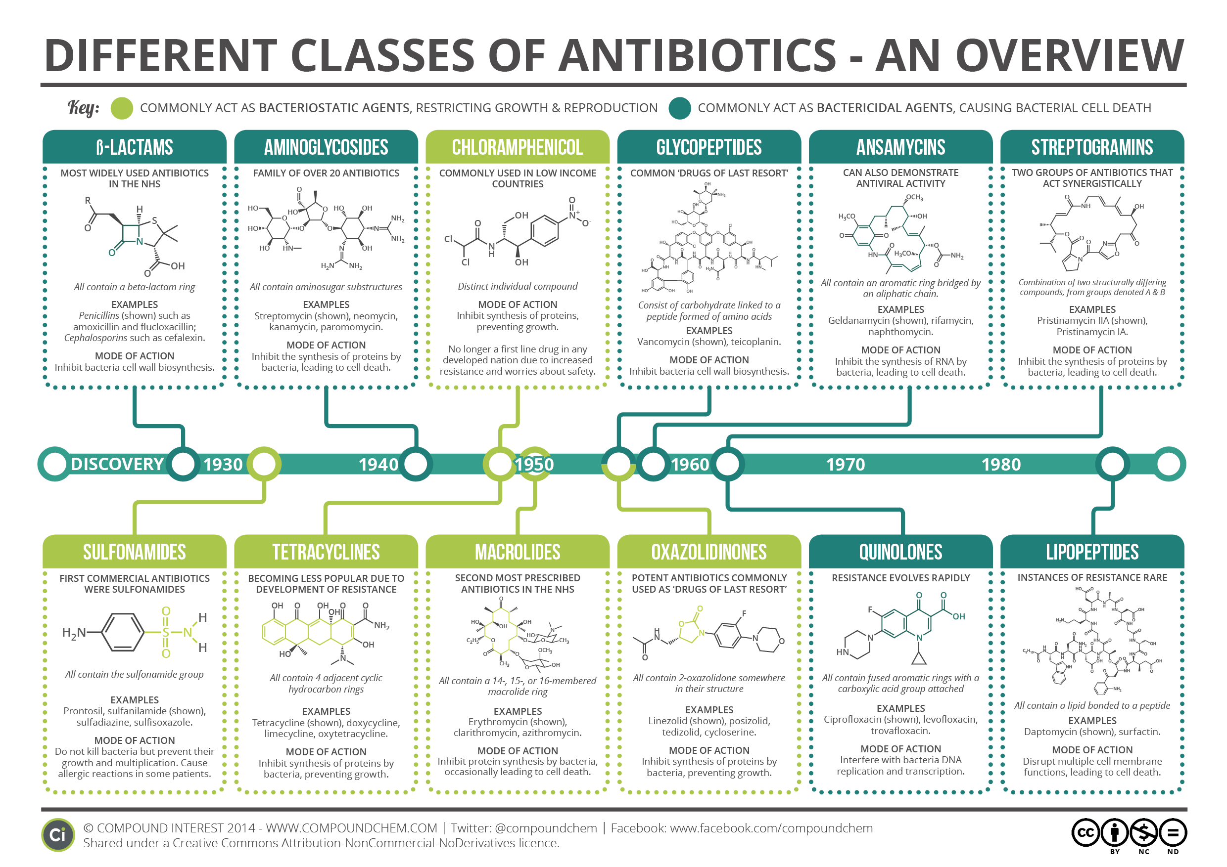

Slide 13
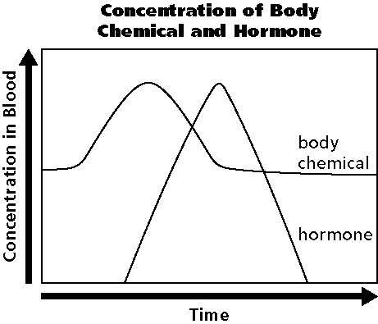
9/2 Homeostasis & Endocrine System CH 35.3 Obj. TSW draw and describe a Negative Feedback System involving the Endocrine System. P. 26 NB
What are the functions of the Endocrine system?
Draw the graph, explain how the body maintains homeostasis.
Why does the hormone production increase?

Slide 14
Section 35.3 Summary – pages 929-935
Control of the Body
Internal control of the body is directed by two systems: the nervous system and the endocrine system.
#1. The endocrine system is made up of a series of glands, called endocrine glands, that release chemicals directly into the bloodstream and stimulates other glands to release theirs.

Slide 15
Section 35.3 Summary – pages 929-935
#2. Control of blood glucose levels
Another example of a negative feedback system involves the regulation of blood glucose levels.
When you have just eaten and your blood glucose levels are high, your pancreas releases the hormone insulin.

Slide 16
#3. The production of the hormone increases due to the level of the body chemical. When the body chemical is back to normal the Hormone is not released any more – Negative Feedback system.

Slide 17
Section 35.3 Summary – pages 929-935
Control of the Body
Ultimately, the functions of all body systems are controlled by the interaction between the nervous and endocrine systems.
Because there are two control systems within the body, coordination between the two systems is needed.

Slide 18
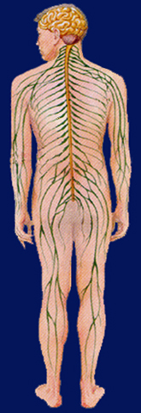
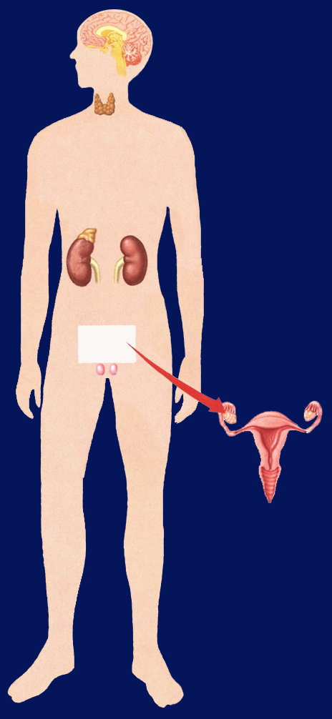
Section 35.3 Summary – pages 929-935
Pituitary
Hypothalamus
Brain (CNS)
Control of the Body
Parathyroid gland
Thyroid gland
Spinal cord (CNS)
Adrenal medulla
Spinal nerves (PNS)
Adrenal cortex
Ovary in female
Thyroid Gland regulates Metabolism in the body.
Testis in male

Slide 19
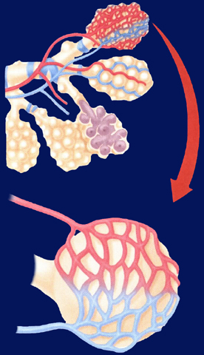
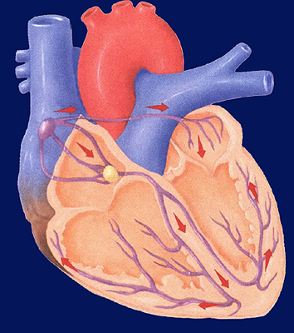
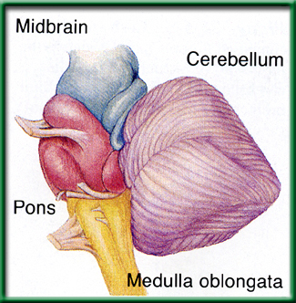
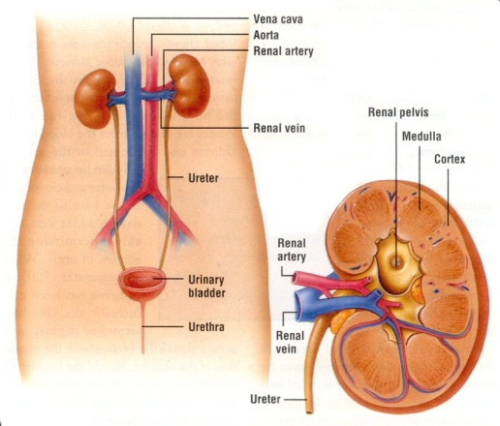
9/3 Respiratory, Circulatory & Excretory Systems CH 37.1 – 37.3 Obj. TSW explain in your warm up how the respiratory, circulatory and excretory systems complement each other to maintain Homeostasis. P. 28 NB P. 66 NB
Explain the process of how gas is exchanged (Alveoli) in the lungs.
The level of CO₂ in the blood affects breathing rate. How would you expect high levels of CO₂ to affect heart rate?
How does the kidney maintain homeostasis in the body?

Slide 20
Measuring your Pulse & Respiration P.31 NB
Respiration – Breaths / minute
Pulse – Heart Beats/ minute
Measure your pulse & respiration and write them down on page 29 NB.

Slide 21
Exercise Lab p. 31 NB
Choose a partner
Choose an exercise
1 minute in length (5 times)
Count strides, Jumping Jacks, Push ups
Duration (Time)- (5 repetitions) or (Time minutes)
Plank, Wall Sit
Control?
What was constant?

Slide 22
Data Table & Graph When do muscles fatigue? P. 31 NB
Time (minutes) | Number of repetitions Sit ups, Push ups, Jumping Jacks Calf Raises Squats
1st minute 1 minute | 10
2nd minute 1minute | 20
3rd minute 1minute | 30
4th minute 1minute | 40
5th minute 1minute | 50
Intervals Wall Sit Plank Superman | Time (seconds)
1 | 30
2 | 45
3 | 50
4 | 20
5 | 15

Slide 23
Muscle Fatigue Lab p. 31 NB
Trials | Number of Repetition | Pulse
1
2
3
4
5

Slide 26
Data Table for Pulse P. 31 NB
 | Trial 1 | Trial 2 | Trial 3 | Trial 4 | Trial 5
Pulse | 68 | 68 | 69 | 72 | 75

Slide 27
Graph your Pulse Rate P. 31NB When does muscle fatigue set in?

Slide 28
The Heart, Lungs & Components of the Blood P. 65 NB P. 982 BB
Draw & Label & Color the components of the Heart & Lungs.
Copy the following Notes:
Red Blood Cells -transports O₂ & CO₂
White Blood Cells- T & B cells Immune system
Platelets – cell fragments involved in blood clotting (Vitamin K)
Plasma – Most of the liquid of blood- proteins, nutrients, enzymes, hormones, salts

Slide 29
Blood Cells
Red Blood Cells
Made in the Red Marrow
Circulatory & Respiratory System
Smaller
More numerous
No nucleus
O2 & CO2
Contain Hemoglobin (Iron – Fe)
White Blood Cells
Made in the Yellow Marrow
Circulatory & Immune System
Larger
Fewer cells
Nucleus
T & B & Macrophage Cells

Slide 30
8 Different Blood Types
A+ A-
B+ B-
O+ O-
AB+ AB-

Slide 31
Exercise Lab
Title: Short – 5 words
Introduction: Exercise & Cardiovascular/ Respiratory system, O₂ & CO₂, pH, pulse
Objective
Hypothesis
Materials: List
Procedure: Specific. Step 1, Step 2, Step 3…
Safety concerns: don’t run with scissors.

Slide 32
Exercise Lab
Constants
Control:1st data point
Data table: Independent & Dependent Variable
Graph:
Data Analysis: What happened over time and why is it important?
Error Analysis:
Conclusion:

Slide 33
Questions to answer in the conclusion Yes in addition to the one’s in the lab report.
How did your steps change with the different activities you did?
What effect did repeating the exercise over time have on the muscle group.
How did your muscles feel?
What physiological factors are responsible for fatigue?
How does the amount of rest you have affect the recovery of the muscles?
How did your results compare to others.

Slide 34
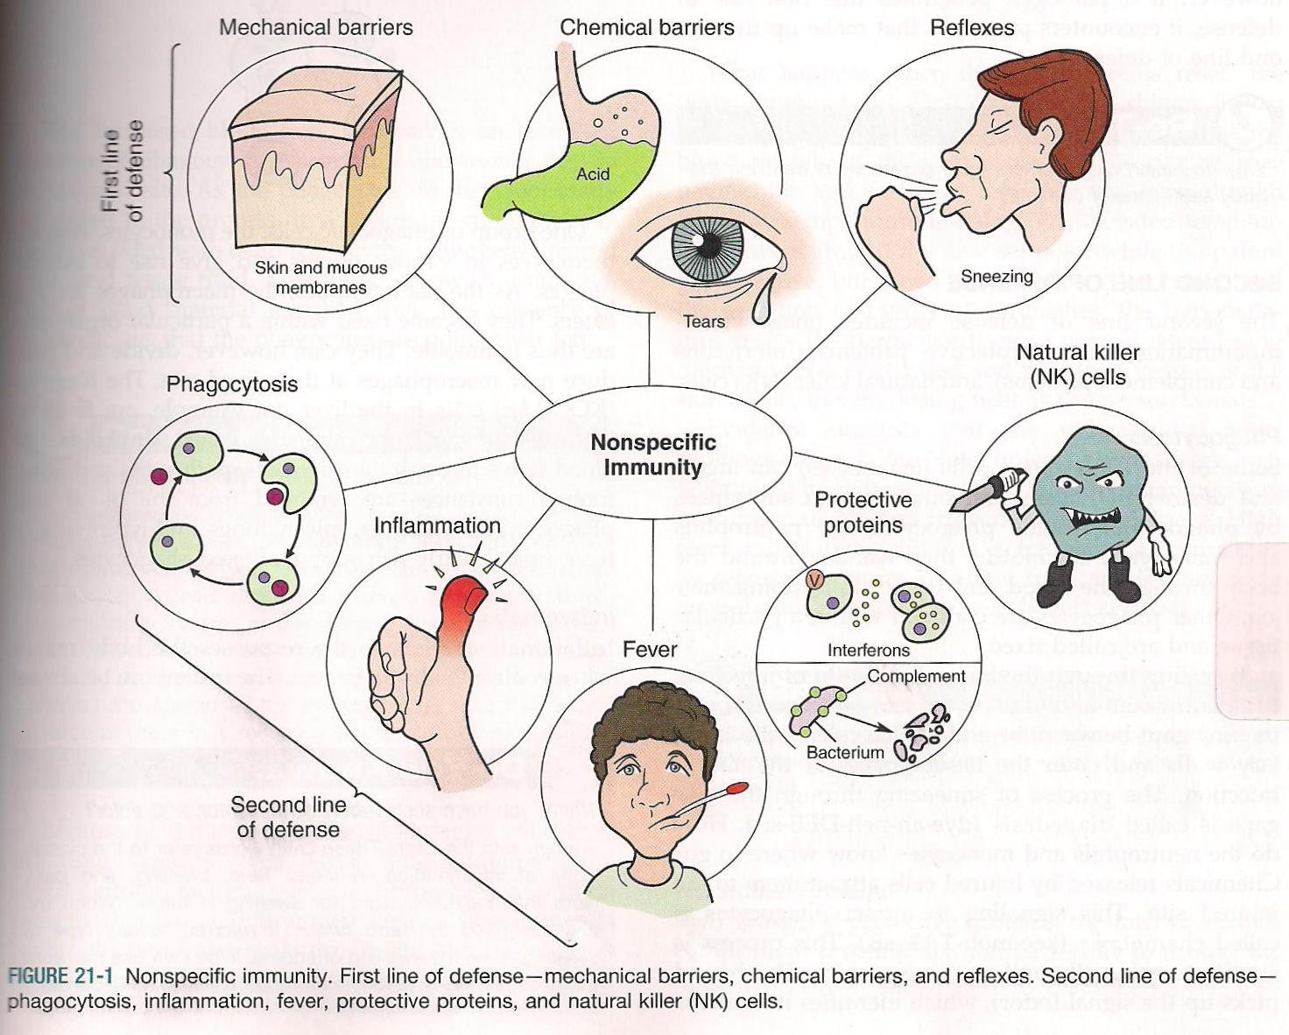
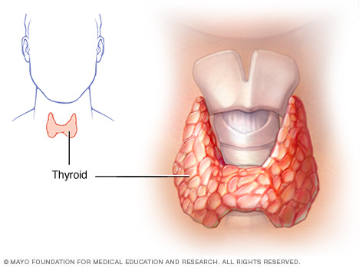
9/4 Metabolism & Homeostasis CH 35 Obj. TSW understand how the body regulates chemical reactions to maintain homeostasis. P. 30NB
Define metabolism.
The thyroid controls what process in the body?
How does the immune system respond to an infection in a nonspecific way?

Slide 35
Finish Doggy Dander article – 3rd period

