Slide 1
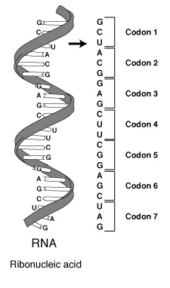
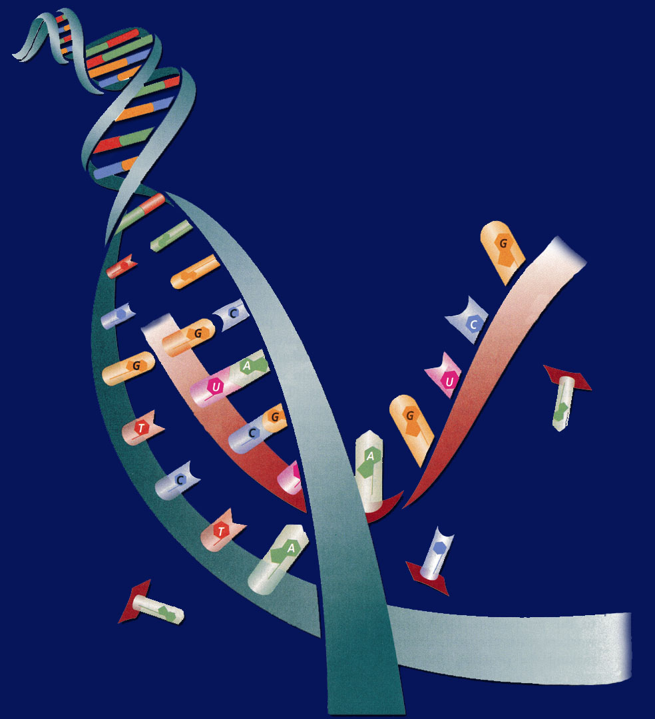
10/3 Protein Synthesis: Transcription 11.2
Obj. TSW explain the process of Protein Synthesis by transcribing and translating DNA sequences from their Mini Lab 11.1 P.64 NB
Learn.genetics.utah.edu/
What is transcription?
Where does Transcription happen?
Why is a codon important to making a protein?
HW – Study for the DNA Quiz tomorrow
Cell Lab is due Thursday/ friday

Slide 2
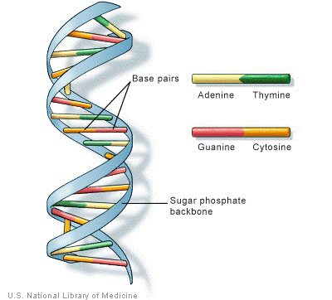
DNA/ RNA Beads p. 59NB
Backbone= Phosphate & Sugar (Red & White)
Nitrogen Bases= Adenine (Blue)=Thymine (Green)
            Cytosine (Yellow )=-Guanine (Orange)
            Uracil (Pink) RNA
Hydrogen bond (clear barbell)
http://learn.genetics.utah.edu/
WS - DNA Model Discussion questions

Slide 3
Protein Synthesis
Transcription Practice p. 65NB
Directions: Using the DNA strand as a template, transcribe mRNA. Make sure to use the correct Nitrogen bases.
ATA CCT TAA CGC GTC
TAT TAG GCA AAA TTC
GTG TGA TTA ATA GCC
CTA AAG GAA TAG GAT
GAT GAA TAC CCA CGA
TAA TAT GCA CAT TAC
GAA CCT TAC GGG GTG
TAT AAC CAG GAG TTT
ATC CGT AGT GTA AAT
GGA TTA CCC TTA CCA

Slide 4
Cracking the Code
Students will take a page of notes on Notebook Paper and tape into their NB page 71 NB

Slide 5


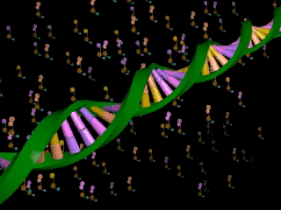






Section 11.2 Summary – pages 288 - 295
Transcription
In the nucleus, enzymes make an RNA copy of a portion of a DNA strand in a process called transcription.
Click image to view movie

Slide 6
Section 11.2 Summary – pages 288 - 295
Transcription
A
DNA strand
RNA strand
RNA strand
C
B
DNA strand

Slide 7
Section 11.2 Summary – pages 288 - 295
Transcription
The main difference between transcription and DNA replication is that transcription results in the formation of one single-stranded RNA molecule rather than a double-stranded DNA molecule.

Slide 8
Section 11.2 Summary – pages 288 - 295
RNA Processing = Gene Expression
Not all the nucleotides in the DNA of eukaryotic cells carry instructions—or code—for making proteins.
Genes usually contain many long noncoding nucleotide sequences, called introns, that are scattered among the coding sequences.

Slide 9
Protein Synthesis Biology
1 large bag M &M’s – Brea & Lilly
1 large bag of Gummy Bears – Daniella
4 Bags of Marshmallows – Jose, Tyra, Brea
1 Box of Rice Krispy Cereal – Angel
1 stick of Butter – Johnell

Slide 10



Chapter Assessment
Question 1
How does DNA control the structures and functions of a cell?
Answer
DNA determines the structure of proteins. Some proteins become important cell structures. Other proteins, such as enzymes, control chemical reactions that perform key life functions.
CA: Biology/Life Sciences
5a

Slide 11
HW CH 11 DNA & Genes p.41 NB
Deoxyribose
Nitrogenous Base
Nucleotide
Base Pair
Hydrogen Bond
Phosphate
Adenine (A) & Nitrogen Bases
Cytosine
*Nucleotides
DNA Replication
Double Helix

Slide 12
HW CH 11 DNA &Genes*
DNA – Double RNA – single
DNA – Deoxyribose RNA – Ribose
DNA – ATCG RNA – AUCG
Amino Acids
Amino Acids
Proteins
Codon*
Threonine

Slide 13
QUIZ
8. What is DNA Replication?
9. What are the two functions of DNA?
10. What are three differences of RNA from DNA?
11. What RNA has stop codons, and what is their function?
12. How are codons and anticodons different?
13. Write the equation for Protein Synthesis.
14. Transcribe & Translate the DNA sequence:ATC, TCA, TAC

Slide 14
DNA Quiz
7. What is the backbone of the molecule made of?
8. What is a gene?
9. What does DNA code for? What is it’s purpose?
10. Write the formula for Protein Synthesis
When you are finished turn you paper upside down and wait quietly to
have me pick it up.

Slide 15
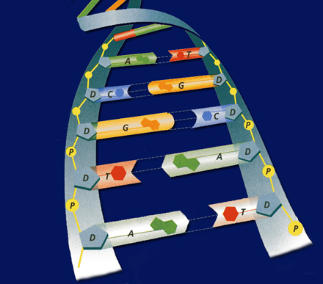
POP QUIZ Write your name on your binder paper.
What is this molecule? Spell it out.
What is the shape of the molecule?
What are the two purposes/ functions of this molecule?
Write the three names for the parts of a nucleotide. Be specific.
The Nitrogen bases are: Adenine, Cytosine, Guanine, & Thymine – Base Pair them together correctly.
What holds the Nitrogen bases together?
DNA is a Nucleic Acid, write an example of another one.
Can a Nucleic Acid leave the nucleus?
9. What is DNA Replication?
What is the name for how DNA
Replications?

Slide 16
How is RNA different from DNA? P.65 NB
DNA
Double stranded
Deoxyribose Sugar
4 Nitrogen Bases: Thymine, Adenine, Guanine, Cytosine
Must stay in the Nucleus
RNA
Single Stranded
Ribose Sugar
4 Nitrogen Bases: Uracil, Adenine, Guanine, Cytosine
RNA leaves the Nucleus to the Ribosomes to assemble Proteins

Slide 17
DNA/ RNA Beads p. 59NB
Backbone= Phosphate & Sugar (Red & White)
Nitrogen Bases= Adenine (Blue)=Thymine (Green)
            Cytosine (Yellow )=-Guanine (Orange)
            Uracil (Pink) RNA
Hydrogen bond (clear barbell)
http://learn.genetics.utah.edu/
WS - DNA Model Discussion questions

Slide 18
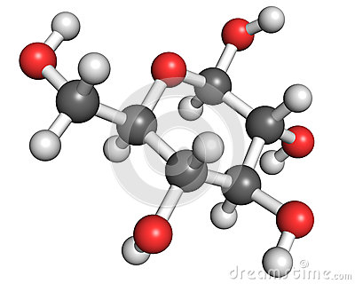
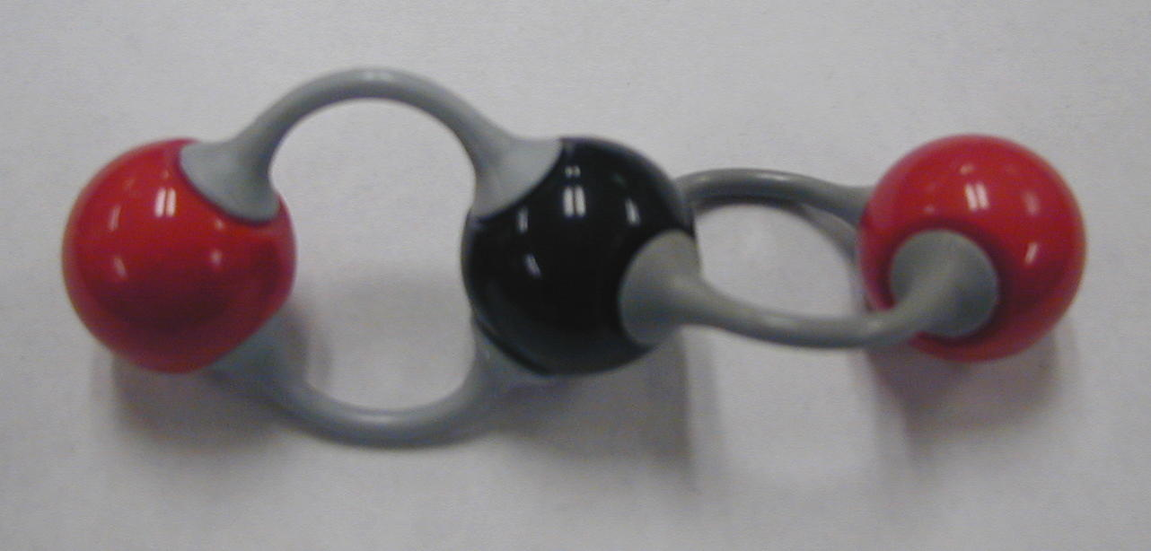
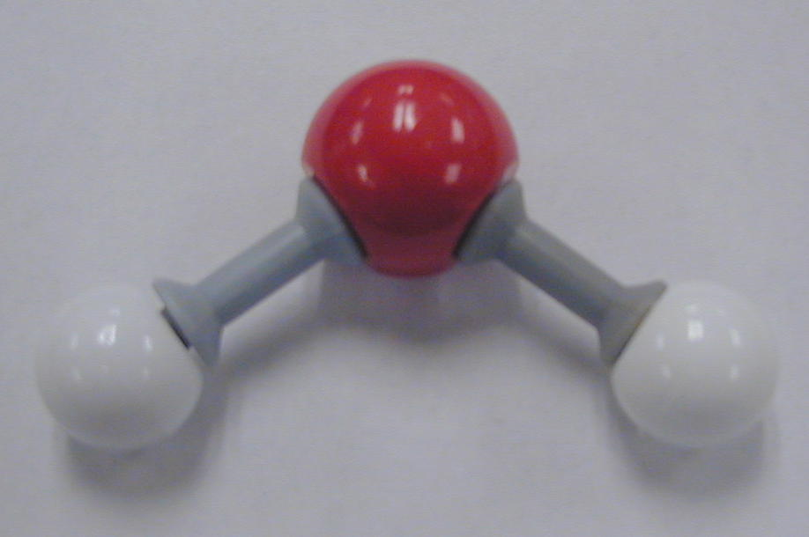
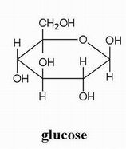
Molecular Models
You may work with a partner.
With the molecular models make and show Mrs. McAllister
Carbon Dioxide = CO₂
Water = H₂O
Oxygen = O₂
Glucose =C₆H₁₂O₆
CH₄
CARBON = Black
HYDROGEN = White
OXYGEN = Red

Slide 19
Chapter Assessment
Question 2
The process through which the order of bases in messenger RNA codes for the order of amino acids in a protein is:
A. transcription
B. translation
C. replication
D. point mutation
The answer is B.
CA: Biology/Life Sciences
4f

Slide 20
Chapter Assessment
Question 3
Why would scientists use nucleotide sequences to identify bodies of crime victims?
Answer
In comparing nucleotide sequences in the DNA of a crime victim with nucleotide sequences from a possible close relative of the crime victim, scientists can determine if the two are related.
CA: Biology/Life Sciences
4e

Slide 21
HW CH 11
9.Phenylalanine Codon are (UUU) (UUC)
10. Codon
11. Amino Acid
12. Amino Acid
13. Stop codons = UGA, UAG, UAA
14. Tryptophan & Methionine

Slide 22
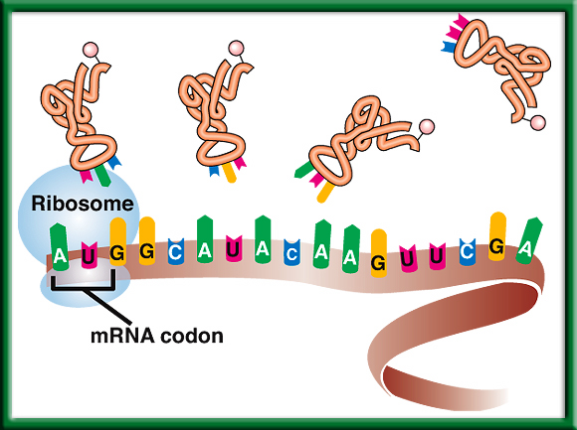
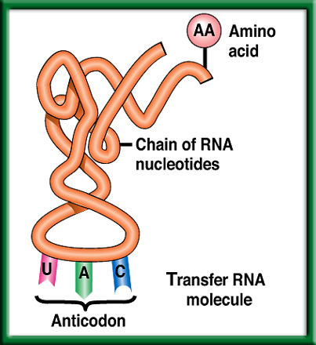
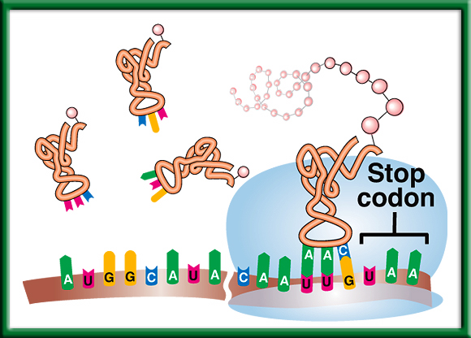
3/20 Protein Synthesis: Translation 11.2
Obj. TSW explain the process of Protein Synthesis by drawing it in their notebooks. p.8 NB
Learn.genetics.utah.com.edu/
Compare & Contrast Codon and Anticodon.
What is the role of tRNA in Protein Synthesis?
Why are Stop Codons important in Translation?
http://www.dnatube.com/video/3448/DNA-Replication

Slide 23
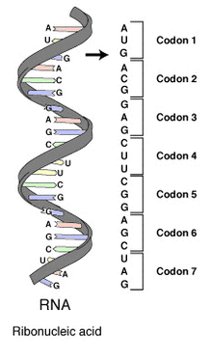
#1. Codon & Anticodon
A Codon is a nucleotide triplet sequence on mRNA, it codes for an amino acid.
  AUG ACG GAG
An Anticodon is a nucleotide triplet sequence on tRNA that carries the Amino acid
  UAC
Both are RNA & Each triplet pairs to code for a particular Amino acid to form a protein.

Slide 24
Section 11.2 Summary – pages 288 - 295
#2. The role of transfer RNA - tRNA
As translation begins, a ribosome attaches to the starting end of the mRNA strand. Then, tRNA molecules, each carrying a specific amino acid, approach the ribosome.
When a tRNA anticodon pairs with the first mRNA codon, the two molecules temporarily join together.
Usually, the first codon on mRNA is AUG, which codes for the amino acid methionine.

Slide 25
#3. Stop Codons
Without the stop codon, the protein would continuously be made.
More Protein is not necessarily better.
Name the 3 codons for STOP:
  UAA, UAG, UGA

Slide 26

Section 11.2 Summary – pages 288 - 295
The Genetic Code P.292 BB p. 67 NB
The Messenger RNA Genetic Code
First Letter
Second Letter
Third Letter
U
C
A
G
U
Phenylalanine (UUU)
Serine (UCU)
Tyrosine (UAU)
Cysteine (UGU)
U
Phenylalanine (UUC)
Serine (UCC)
Tyrosine (UAC)
Cysteine (UGC)
C
Leucine (UUA)
Serine (UCA)
Stop (UAA)
Stop (UGA)
A
Leucine (UUG)
Serine (UCG)
Stop (UAG)
Tryptophan (UGG)
G
C
Leucine (CUU)
Proline (CCU)
Histadine (CAU)
Arginine (CGU)
U
Leucine (CUC)
Proline (CCC)
Histadine (CAC)
Arginine (CGC)
C
Leucine (CUA)
Proline (CCA)
Glutamine (CAA)
Arginine (CGA)
A
Leucine (CUG)
Proline (CCG)
Glutamine (CAG)
Arginine (CGG)
G
A
Isoleucine (AUU)
Threonine (ACU)
Asparagine (AAU)
Serine (AGU)
U
Isoleucine (AUC)
Threonine (ACC)
Asparagine (AAC)
Serine (AGC)
C
Isoleucine (AUA)
Threonine (ACA)
Lysine (AAA)
Arginine (AGA)
A
Methionine;Start (AUG)
Threonine (ACG)
Lysine (AAG)
Arginine (AGG)
G
G
Valine (GUU)
Alanine (GCU)
Aspartate (GAU)
Glycine (GGU)
U
Valine (GUC)
Aspartate (GAC)
Glycine (GGC)
Alanine (GCC)
Glycine (GGC)
C
Valine (GUA)
Alanine (GCA)
Glutamate (GAA)
Glycine (GGA)
A
Valine (GUG)
Alanine (GCG)
Glutamate (GAG)
Glycine (GGG)
G

Slide 27
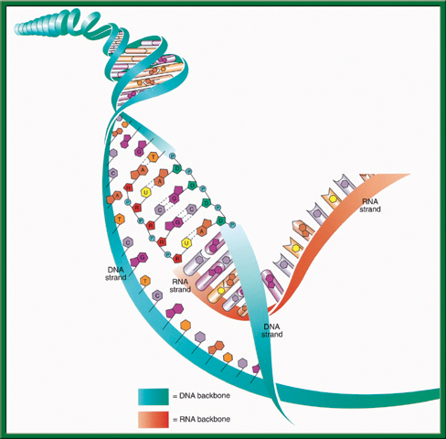
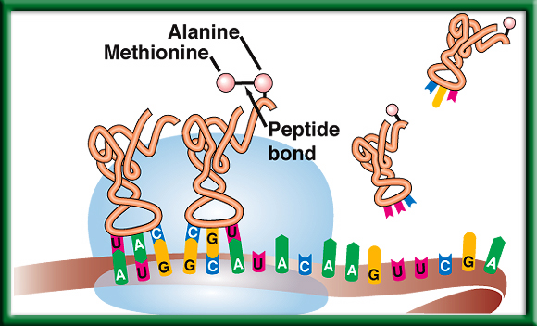
Protein Synthesis p. 9 NB
DNA -> transcription -> RNA -> translation -> Proteins

Slide 28
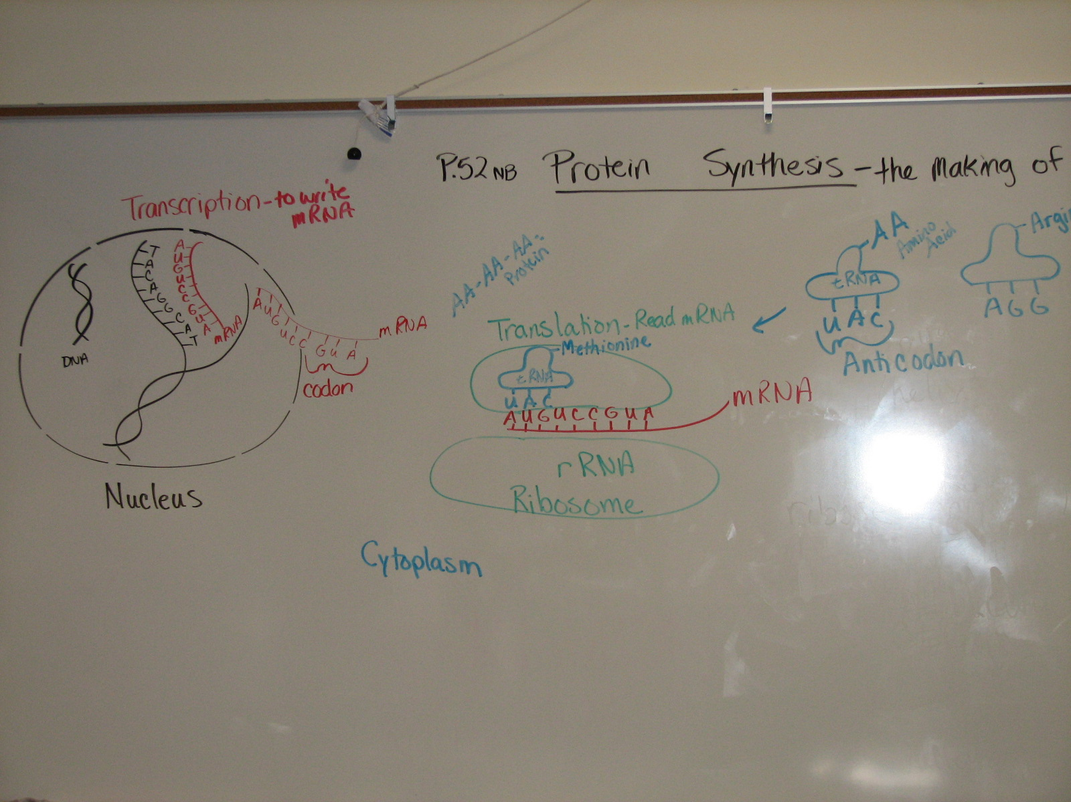
Page 9 NB

Slide 29
Molecular Genetics p. 11NB
DNA Replication – make more DNA for more cells to replace other cells.
Protein Synthesis – to make proteins
DNA-DNA
A = T
T = A
C = G
G = C
DNA RNA
A = U
T = A
C = G
G = C
Protein Synthesis
DNA: TAC CAC AAC
Transcription (nucleus)
mRNA: AUG GUG UUG
Translation (ribosome)
Protein: Methionine, ________, ________ Amino Acid Sequence

Slide 30
Protein Synthesis – Gene Expression Practice P. 11NB
1. DNA: ATA CCT TAA CGC GTC
2. DNA: TAT TAG GCA AAA TTC

Slide 31
Start Epigenetics
How does the environment influence how your genes are expressed?
Page 17 NB
Take ¼ page of Notes & write 3 Questions.

Slide 32
3/21 Protein Synthesis: Translation 11.2
Obj. TSW explain the process of Protein Synthesis Completing a Problem Solving Lab 11.2. P. 10 NB
When making proteins, If a template DNA strand read:
TAC GGT, AGT what would a complementary strand of mRNA be?
2. What Amino Acids would the 3 codons code for?
3. Do the same for: GCA, TGC, ATC (DNA).
Learn.genetics.utah.edu/

Slide 33
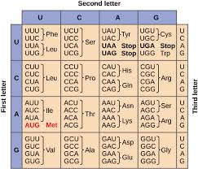
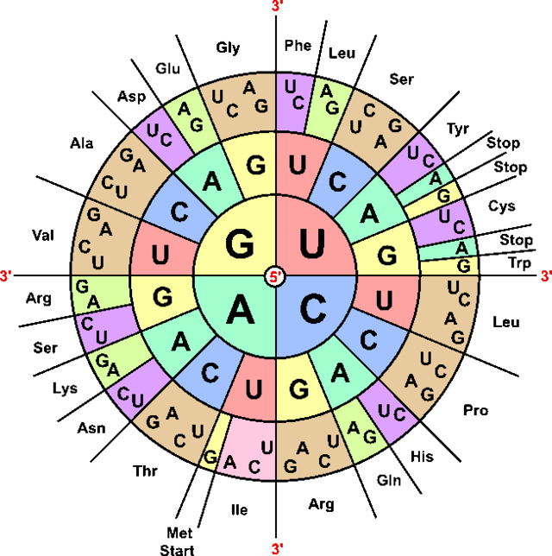
Mini Lab 11.1 P. 13 NB P. 292 BB
DNA → transcription →RNA →translation → Protein
Copy this table in your notebook.
 | A | B | C | D | E
DNA Base Sequence | Process | mRNA Codon | Process | tRNA Anticodon | Amino Acid
AAT
GGG
ATA
AAA
GTT

Slide 34
Mini Lab 11.1 P. 13NB P. 293 BB
DNA → transcription →RNA →translation → Protein
 | A | B | C | D | E
DNA Base Sequence | Process | mRNA Codon | Process | tRNA Anticodon | Amino Acid
AAT | Transcription | UUA | Translation | AAU | Leucine
GGG |  | CCC |  | GGG | Proline
ATA |  | UAU |  | AUA | Tyrosine
AAA |  | UUU |  | AAA | Phenylalanine
GTT |  | CAA |  | GUU | Glutamine
Answer Analysis Questions 1 – 3
A.DNA instructions are located in the nucleus.
Transcription happens in the nucleus.
Translation happens in the Ribosome.
tRNA looks like a triangle with an Amino Acid on the end, and the other side has the Anticodon that base pairs with the codon on the mRNA.
Mutations would be more common, if the sequence of DNA was not strictly adhered to.

Slide 35
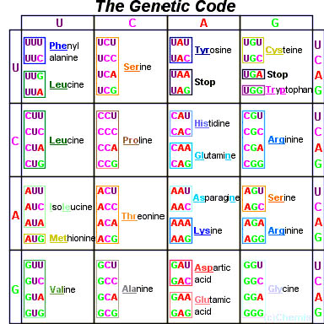
Page 292 Biology Book

Slide 36
Rice Krispie Treat
Protein Synthesis Lab – Thursday
1 Boxes of Rice Krispies
4 Bags of LARGE MARSHMELLOWS
1 large bag of Mini M&M’s
1 large bag of Gummy Bears
1 stick of Butter
1 Microwave?

Slide 37
Protein Synthesis P. 13 NB
Write a paragraph after building your DNA molecule that include the vocabulary words: Double helix, Nitrogen bases, Hydrogen bond, Nucleotide, Backbone, Deoxyribose, Phosphate, Adenine, Thymine, Cytosine, Guanine.

Slide 38



Collect 3 sheets of paper and layer them about 1.5 cm apart vertically. Keep the edges level.
P. 53 NB
To return to the chapter summary click escape or close this document.

Slide 39


Fold up the bottom edges of the paper to form 6 equal tabs.
P. 53NB
To return to the chapter summary click escape or close this document.

Slide 40


Fold the papers and crease well to hold the tabs in place. Staple along the fold. Label each tab.
P. 53NB
RNA – draw & label 3 differences from DNA p. 289
TRANSCRIPTION: from DNA to RNA P. 290
RNA Processing (Introns & Exons) P.291
The Genetic Code p. 291 - 292
TRANSLATION: from mRNA to PROTEIN p. 294 11.9A
PROTEIN SYNTHESIS
DNA->transcription->RNA ->translation->Protein
To return to the chapter summary click escape or close this document.

Slide 41
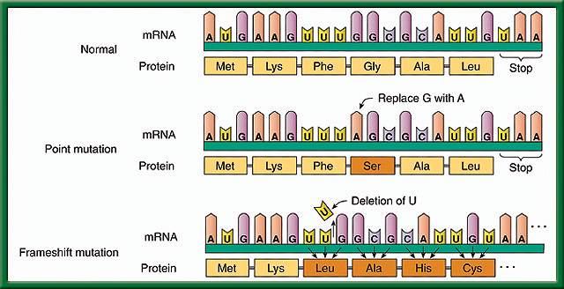
3/22 Mutations: A change in a gene 11.3
Obj. TSW learn how mutations happen, and explain the difference between Point & Frameshift mutation from WU, notes & conclusion of Protein Synthesis Lab. P. 12 NB
What are some causes of mutations?
Compare & Contrast the effects of a point mutation & a frameshift mutation.
Which mutation is worse and why?

Slide 42
#1. Causes of Mutations
Mutagens- change in the DNA caused by the Environment – Pollution, UV Radiation, Drugs, Stress
Random mistakes- proofreading enzymes are not working
#2. Gene Mutations – Point & Frameshift Mutations p.298 BB
Which mutation is worse? Why?
#3. Frameshift Mutation is worse because it changes every amino acid after the deletion or addition of the nucleotide.

Slide 43
Rice Krispy Protein Synthesis P.15 NB
My protein looks like: Round, Flat, Color, M&M or Gummi Bears
Deleting the fifth nucleotide of your DNA will cause a frameshift mutation that changes every amino acid after the deletion. Change how many marshmallows were used.
Changing the 11th nucleotide of your DNA sequence from G to T would be a point mutation and will change the amino acid Serine to STOP codon, however, this is bad because the protein is not complete. Marshmellows would not be smooth.
If the 19th, 20th, 21st nucleotides of your DNA sequence were deleted the 7th codon were deleted the rice krispie treat would not have color.
Two proteins are different by some were flat, round, some were red, some blue, some M&M’s &/ gummy bears.
The protein can be different by the number and the sequence of amino acids.
Conclusion
1.If you were given the

Slide 44
Classwork – Transcription & Translation p. 53 NB
Work on worksheet about Protein Synthesis.
Transcribe the DNA sequence.
Then, translate the Amino Acid sequence to the right of the Codons.

Slide 45
Draw Protein Synthesis
P. 73 NB
Turn your book Landscape Style ←------→
Have 4 different colored pencils.
Write on the RED line at the top: Protein Synthesis: the making of Proteins
Use ¾ of the page
The last ¼ of the page will be a summary/ AXES paragraph.

Slide 47
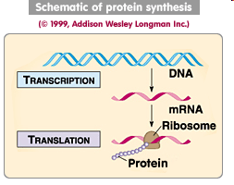
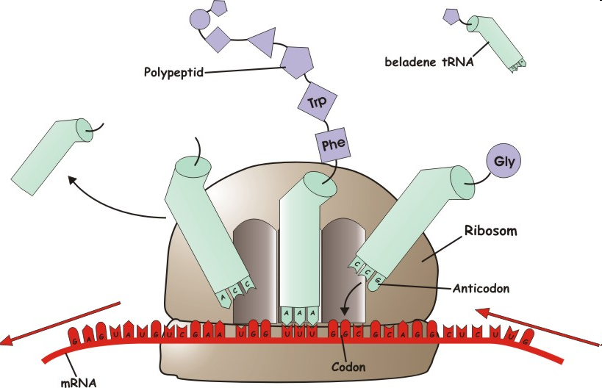
Warm Up Answer

Slide 48
p. 187 BB p. 77 NB
Write the functions for each of the following Cell Organelles:
Plasma Membrane
Nucleus
Cytoplasm
Rough ER
Golgi Apparatus
Mitochondria
Vacuole
Ribosome

Slide 49
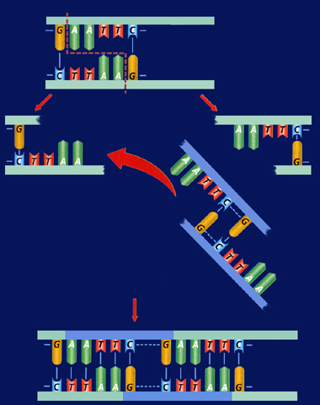
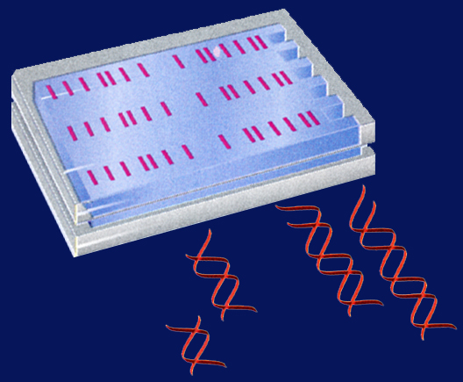
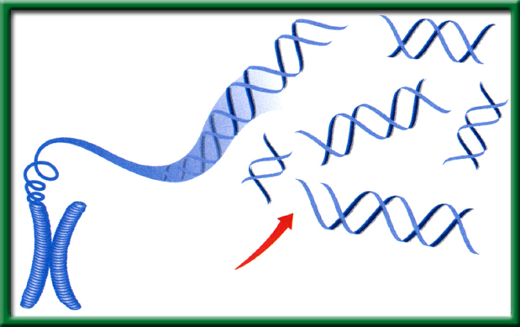
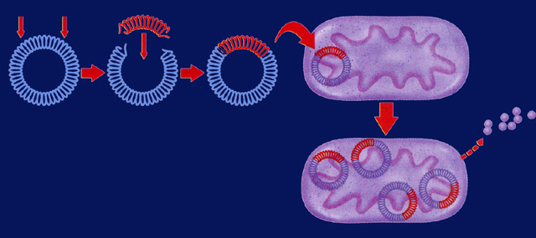
3/23 Applied Genetics 13.2
Obj. TSW be able to explain how basic DNA technology is used to construct recombinant DNA molecules in a Minilab 13.1 p.14 NB
HHMI.org
NOVA.pbs.org
HW – Read CH 13
1pg notes P. 21 NB
Genetic Engineering uses Recombinant DNA, explain.
Explain a transgenic organism.
Explain two ways in which recombinant bacteria are used for human applications.

Slide 50
Genetic Engineering
#1. Recombinant DNA is DNA that has one or more genes from another organism in it’s genome.
#2. A transgenic organism has Recombinant DNA.
#3. Bacteria is a transgenic organism that can have the gene to make insulin for people who have Diabetes. They also can have the gene for Growth Hormone to help people who have Dwarfism be a more normal range of height.

Slide 51

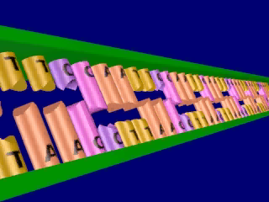
Section 13.2 Summary – pages 341 - 348
Restriction enzymes cleave DNA
Click image to view movie

Slide 52
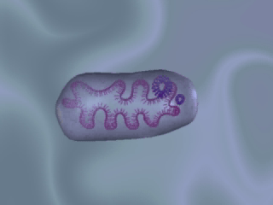
Section 13.2 Summary – pages 341 - 348
Vectors transfer DNA
Biological vectors include viruses and plasmids. A plasmid, is a small ring of DNA found in a bacterial cell.
Click image to view movie

Slide 53
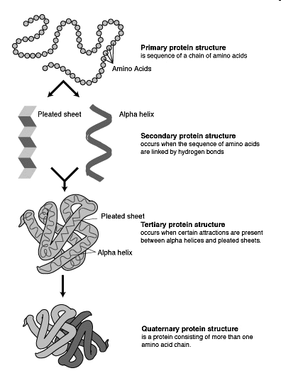
Proteins Notes P. 15 NB
Proteins can come in
many different shapes
and sizes.
The number & sequence of
amino acids determine its
a proteins shape.
An example of
proteins: ENZYMES!
Proteins must have a
specific structure in order
to function properly.

Slide 54
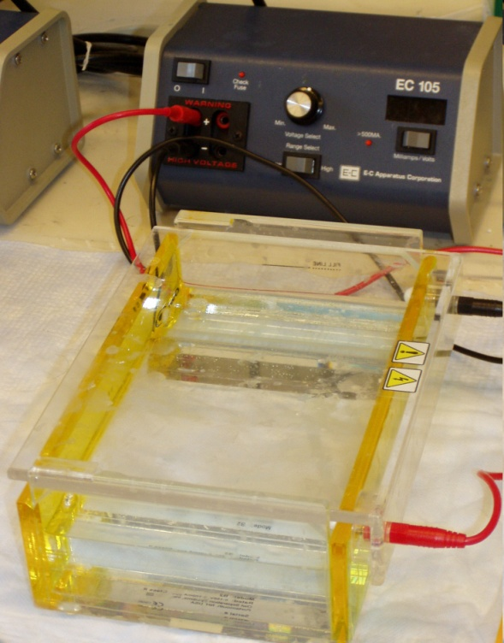
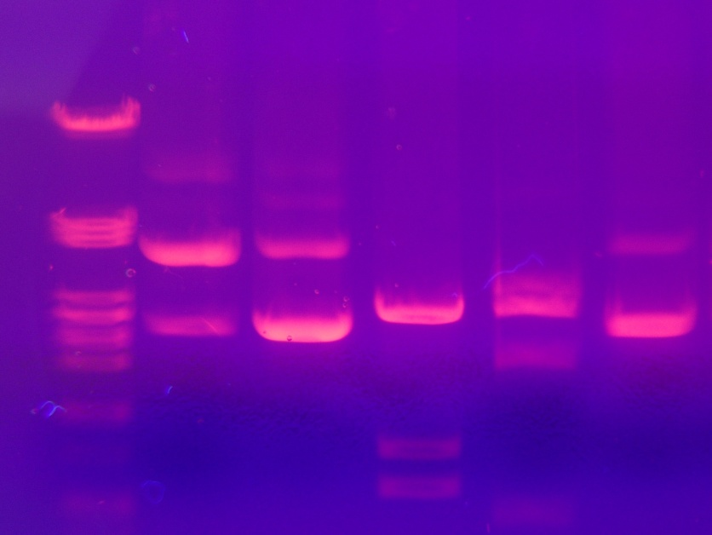
10/10 Gel Electrophoresis CH 13.1
Obj. TSW learn how to build a protein from an amino acid sequence using the hydrophobic and hydrophilic properties of the amino acids. P. 74 NB
What is Gel Electrophoresis?
Why is DNA fingerprinting important?
Explain the field of Genetic Engineering and how a Gel Electrophoresis applies.
Watch Gel Video
HW CH 13
HW Study Guide
Final 10/15

Slide 55
Learning to “Settle”
Quiet focus
It’s OK to not “multitask” every minute of every day.
Deep Breath and relax the shoulders.
This came out of my evaluation. There are too many distractions during class. Too many students out of class and/or going to the bathroom.
Please make every effort to be on time. Set your clock 5 – 10 minutes earlier to help yourself get here on time. Go through the checklist before you leave home to make sure you did not forget anything.

Slide 56
Answers to Warm Up
Gel Electrophoresis is a technique to separate out different lengths of DNA to get a “fingerprint” of that sample.
DNA Fingerprinting (Gel Electrophoresis) is a way to ID a missing person or to ID a person involved in a crime, or if people are related.
Finding ways to change DNA, or use DNA to solve problems is an applied use of molecular genetics. For Example, we can cut a gene out of one organism and put it into the DNA of another organism to make that protein be expressed.

Slide 57
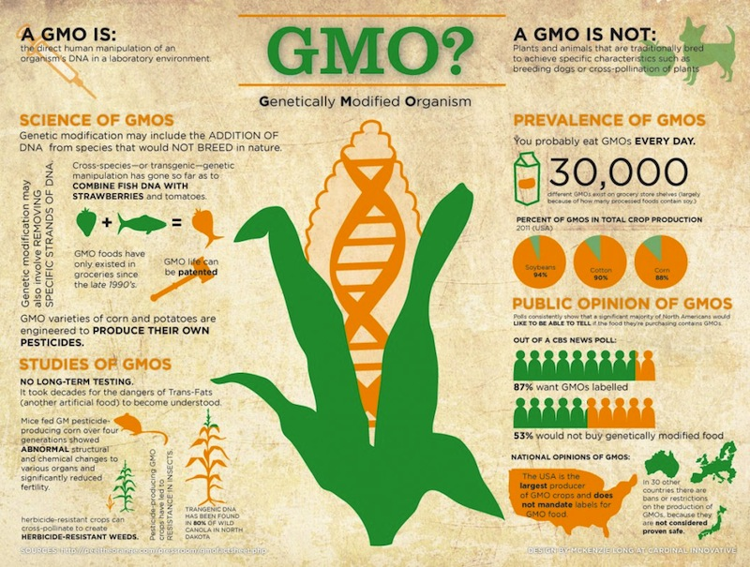
03/24 Genetically Modified Organisms (EEI Curriculum) CH 13.2 P. 348 BB
Obj. TSW demonstrate the pros and cons of Genetically Modified Organisms. p. 16 NB
What are the most common GMO crops?
What are some concerns you have about GMO’s.
What are some benefits to GMO’s that you read from the book: Recombinant DNA in Agriculture?

Slide 58
Genetically Modified Organisms
Bt Corn – Concerns:
  Benefits:
Malaria Resistant Mosquitos: Concerns:
  Benefits:
Golden Rice Concerns:
  Benefits:

Slide 59
Enzymes - Proteins

Slide 60
2015 Midterm Study Guide answers
A. Age in Years
b. Number of Teens
2. The trend is increasing for teens with phones.
3. As teens get older, more have cell phones.
4. A decrease in 60 teens who have cell phones.
5. Eukaryotic: Nucleus, Membrane Bound Organelle, Animal cell, Plant cell
Prokaryotic: No Nucleus, Bacteria
Both: DNA, Ribosomes, Cell Wall, Plasma Membrane,

Slide 61
Study Guide for Midterm Final Biology
6. a. Proteins: Carbon Hydrogen and Oxygen, Nitrogen, Sulfur
b. Lipids: Carbon, Hydrogen, Oxygen
c. Carbohydrates: Carbon, Hydrogen, Oxygen
d. Nucleic Acids: Carbon, Hydrogen, Oxygen, Phosphorus, Nitrogen, Sulfur
7. The Mitochondria converts Glucose into ATP (energy) and it produces Heat, CO2 & H2O.
8. The Chloroplast captures light energy and converts it to sugar ( C6H12O6), Chemical Energy.
9. An Enzyme is a Protein, that speeds up chemical reactions.
10. Draw☺
11. Environmental Factors: Temperature, pH, Ionic Conditions
12. Plant – Cell Wall, Large Vacuole, Chloroplasts,
Animal – Small vacoule
Both: Eukayotic, Cell Organelles, Plasma Membrane, Nucleus, Mitochondria

Slide 62
A type of nucleic acid that has a double helix and contains thymine.
This process uses glucose and oxygen to produce ATP, CO2 (carbon dioxide), and water.
This is a three nucleotide sequence found on tRNA that codes for a specific amino acid.
This macromolecule is composed of amino acid chains.
This type of macromolecule that includes glucose, fructose, and other saccharides. It has oxygen, carbon, and hydrogen atoms.
This type of eukaryotic cell does not have cell walls or chloroplasts.
This type of cell has cell walls, mitochondria, chlorophyll, and it utilizes both cellular respiration and photosynthesis to convert solar or organic energy into ATP.
This nucleic acid is single stranded and contains uracil.

Slide 63
A three base sequence that corresponds with a specific amino acid for protein synthesis.
This is a pathogen that infects other cells and it hijacks a host cell’s machinery to replicate.
This process uses carbon dioxide and water to produce glucose and oxygen.
This is a change in a nucleotide sequence that can cause the readings of the codons after the change to code for different amino acids. Can cause an abnormally short or abnormally long amino acid chain.
This molecule is a pigment found in the chloroplasts of plants and is vital in the process of photosynthesis.
These proteins increase the rate of chemical reactions and are affected by environmental conditions.
This is a type of RNA that makes up part of the ribosome and is essential in protein synthesis.

Slide 64
A process that occurs in the cytosol and involves different forms of RNA. It occurs at the ribosome where the mRNA is read.
This organelle is used in cellular respiration and it is found in both animal and plant cells.

Slide 65
Study Guide
13. AXES Paragraph about folded membranes:
Having folded membranes in cells is better. Organelles in the cell that have folded membranes are: Mitochondria, Golgi Apparatus, Endoplasmic Reticulum, and Chloroplasts. The folded membranes increase the chemical reactions in the cell because it has more surface area. In addition, the chemical reactions are more efficient due to the increased surface area. The chemical reactions help maintain homeostasis in the body.

Slide 66
Study guide
14.Photosynthesis: Glucose & O2 as a Product, Chloroplast, Needs Sunlight, CO2 & H20 as a reactant,
Cellular Respiration: Glucose & O2 as a Reactant, animals, CO2 & H2O as a product,
Both: Mitochondria, Plants
15.

Slide 67
Study Guide
16. DNA: Adenine=Thymine
Cytosine=Guanine
17. RNA: Adenine= Uracil
Cytosine=Guanine
18. Frameshift Mutation: changes every amino acid after the addition or deletion, deletion of a nucleotide, addition of a nucleotide, is more severe
Point Mutation: changes one nucleotide, changes on amino acid,
Both: type of mutation

Slide 68
19. AXES paragraph:
Selective permeability allows some molecules in and out and other not. Glucose is a molecule that the cells need for energy. Carbon dioxide and water are released from the cell. Passive transport allows molecules across the cell membrane without energy. Active transport requires energy. Glucose provides energy for the body to perform cellular respiration, and maintains homeostasis for the body.
20. Virus – pathogen, needs a host cell to live and replicate.

Slide 69
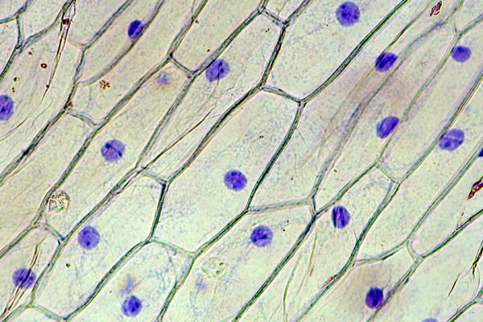
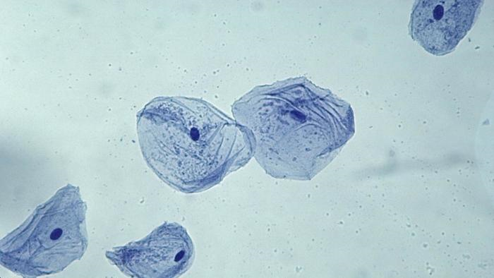
Onion Cell Cheek Cell
Locate and label: the Cell Wall, Plasma Membrane, Cytoplasm, Nucleus

Slide 70
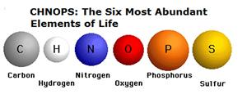
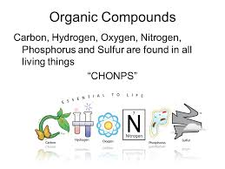
10/12 Building Molecules & Enzymes CH 6.3
Obj. TSW identify the macromolecules living things are made of and describe their properties. P. 78NB
What are the 6 main elements that make up the 4 macromolecules?
What is an Enzyme?
What three environmental factors determine the enzymes function?

Slide 71
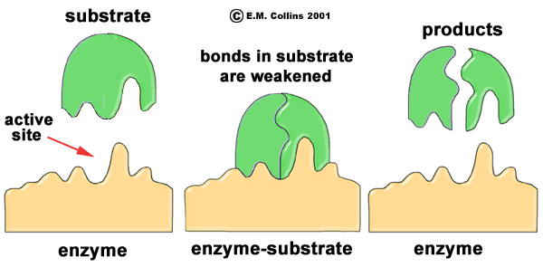
Enzymes
1. CHONPS- Carbon, Hydrogen, Oxygen, Nitrogen, Phosphorus, & Sulfur.
2. Enzymes are a type of protein that catalyze chemical reactions. This means they speed up the rate of chemical reactions.
3. There are three things that impact how well an enzyme will work:
  pH
  Temperature
  Amount of Substrate &/or the amount of Enzyme

Slide 72
10/13 Enzymes CH 6.3
Obj. TSW learn how enzymes function and the environmental factors that influence them in and activity/ lab. P.80NB
What type of macromolecule is an enzyme?
What is the purpose of an enzyme?
Name 3 environmental factors that influence an enzymes function.

Slide 73

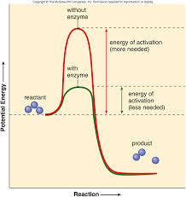
6.3 Section Summary 6.3 – pages 157-163
Take notes P. 85 NB
The structure of proteins
Enzymes are important proteins found in living things. *An enzyme is a protein that changes the rate of a chemical reaction.
They speed the reactions in digestion of food.
Made up of Amino Acids (20)
Enzymes can be used again and again without being used up.
Click image to view movie.

Slide 74
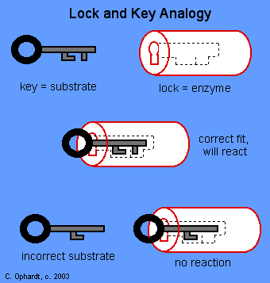
Macromolecules & Subunits Notes p. 45NB
Draw this
Write down these notes below.
Lipid – Fatty Acids
Carbohydrate- Saccharides
Protein( Enzymes)– Amino Acids
  Temperature
  pH
  [Substrate ] & [Enzymes]
  [Salt]
Nucleic Acid - Nucleotides
***[ ] means concentration, or amount.

Slide 75
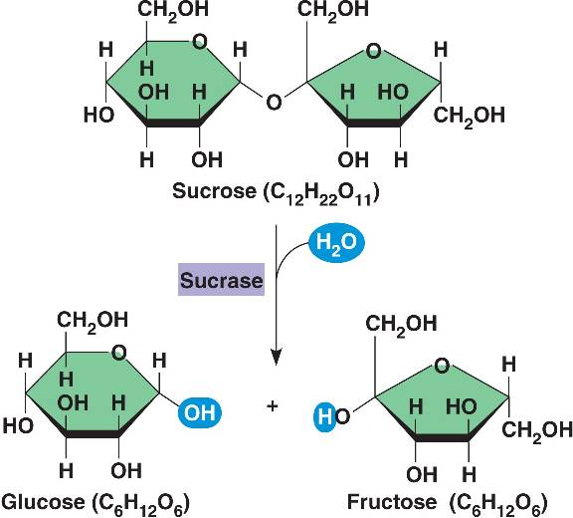
Enzymatic Reaction of Sucrase on Sucrose

Slide 76
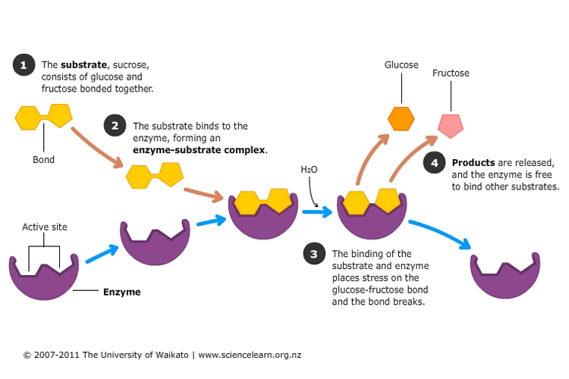
Enzymatic Reaction of Sucrase on Sucrose

Slide 77
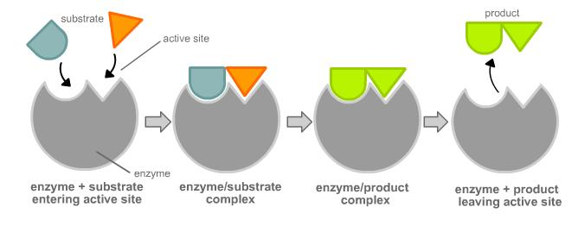
Enzyme Activity
You will be given a substrate or a part of an enzyme.
Find the matching part, that fits your active site.
Bring your matching Enzyme/ Substrate combinations (Lock & Key) to McAllister
I will quiz you on your knowledge of monomers and polymers in endergonic & exergonic reactions.

Slide 78
Catalase Lab
ml H2O2 | Person 1 | Person 2 | Person 3 | Person 4 | Person 5
5 | 100
6
7 |  | 120
8 |  |  | 120
9 |  |  |  | 170
10 |  |  |  |  | 140

Slide 79
Catalase Lab P. 27
1 flask / 2 people
GLX
Pressure Probe
Yeast – 1 tsp.
Hydrogen Peroxide 5ml
Swirl
Make observations.
Write a summary paragraph about the function of enzymes with a picture of a substrate & enzyme & active site. What factors allow for the enzyme to function? What volume of H2O2 did Catalase work the best? Why does the enzyme speed up chemical reactions? Enzymes can be used again & again (Catalytic), how is this important in chemical reactions? At what volumes (ml) did the Catalase work the best? Write the chemical equation.

Slide 80
AXES Paragraph – Catalase Lab
Assertion What is Exothermic Reactions? Use vocabulary.
eXample Discuss an example of an enzyme. Include details from the lab.
Explanation Describe the function of the enzyme, and factors that influence it.
Significance Why are enzymes important for us?

Slide 81
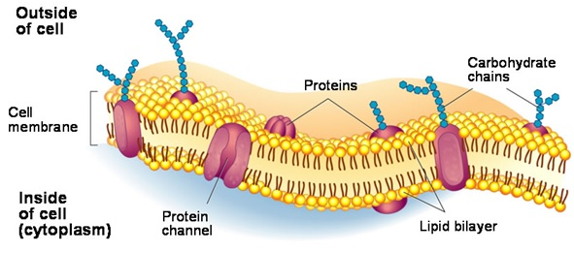
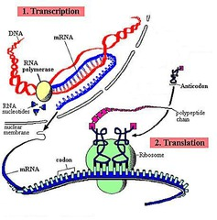
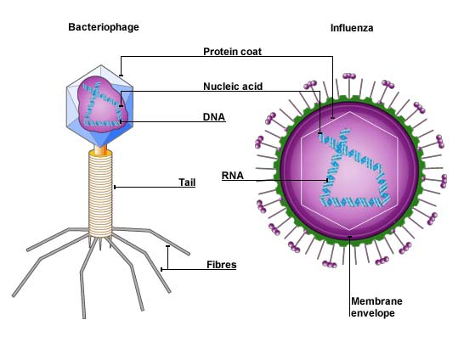
10/14 Review for Midterm Test
Obj. TSW review for the midterm test by answering the following questions relating to their study guide. P. 82 NB
How does selective permeability relate to the plasma membrane?
What is a virus? How does it replicate?
Explain in 3 – 5 sentences the process of protein synthesis.

Slide 82
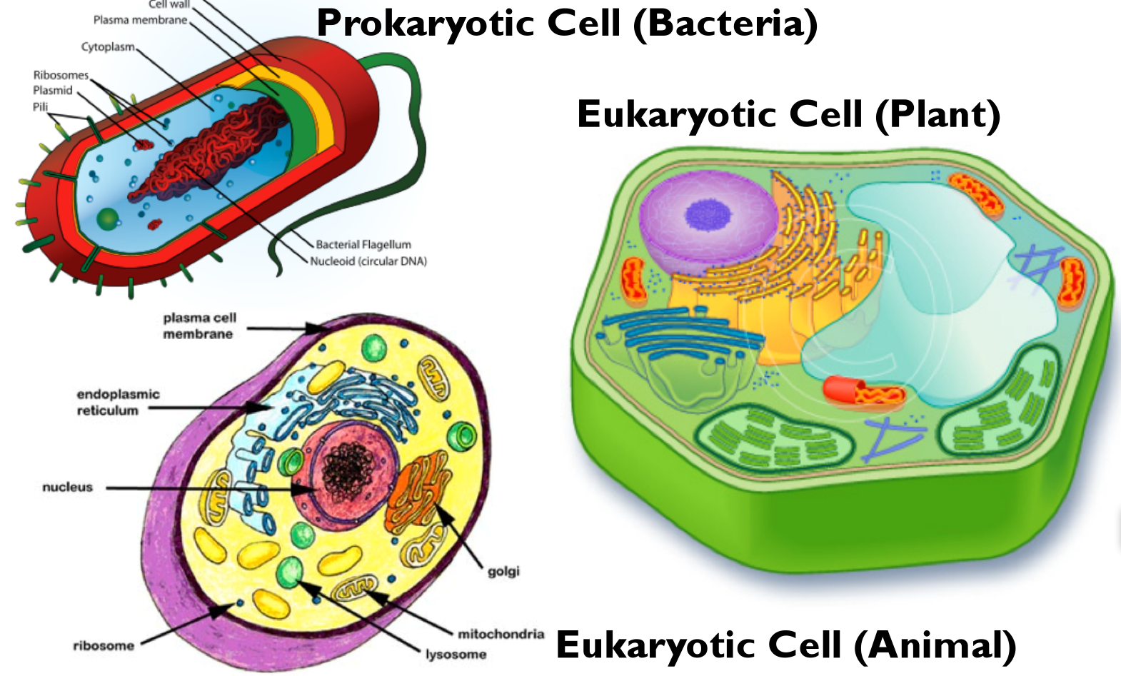
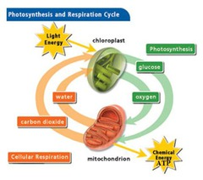
10/17 Review for Midterm
Obj. TSW learn compare and contrast major biological concepts for their study guide. P. 84 NB
Compare & Contrast Eukaryotic and Prokaryotic Cells.
Compare & Contrast Plant & Animal Cells.
Compare & Contrast Photosynthesis & Cellular Respiration.

Slide 83
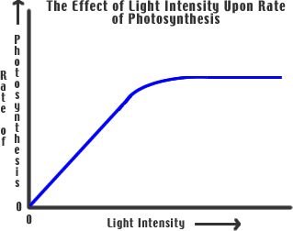
10/18 Review for Midterm
Obj. TSW review variables and the control in a lab and analyze the graph. P. 86 NB
Compare & Contrast Independent and Dependent Variables.
Why is the Control important?
Using the graph, what is the trend? How do you know?

Slide 84
10/19 Review for Midterm
Obj. TSW study for the midterm final on Friday. P. 88NB
Name the 4 Macromolecules:
Name the subunits for the 4 Biomolecules:
Polymers are made up of ________________.

Slide 85
Taboo Person 1 describes the word, and Person 2 tries to guess the word.
Photosynthesis
Chloroplast
Mitochondria
Nucleus
Plasma membrane

Slide 86
Taboo Person 2 Describes the words and Person 1 tries to guess the word.
Protein synthesis
Ribosome
Transcription
Translation
RNA

Slide 87
Taboo
DNA
Nucleotide
Adenine
Cytosine
Hydrogen Bond

