Slide 1
Biology
Ecology Unit
Week 4
Sept. 5th – 8th

Slide 2
Apply what you have learned about Ecosystems, Energy pyramid, and Biodiversity
Design, evaluate, and refine a solution to reducing the impacts of human activities on the environment and biodiversity.

Slide 3
Ecosystem Poster Project NOTES page 37
Wed. Savanna- Siena & Beverly-☺
Thurs. Desert – Eli, David – Sonoran
Thurs. Ocean – Kate, Given, Martin – Artic
Thurs. Grasslands – Micah - African
Thurs. Wetland - Toby
Thurs. Tundra – Lupita & Marisol
Fri. Woods – Lee, JJ, Adrian
Fri. Coastal Desert – Daniel & Hayden
Fri. Ocean- Alexus & Yoselini- Atlantic
Fri. Ocean – Monet, Josh - Indian
Fri. Ocean – Tyler - Atlantic
Fri. Rain Forest – Stephanie & Katrina
Fri. Taiga – Nate
Fri. Ocean – Ysevella – Pacific
Fri. Grasslands – Nika
Mon. Tropical Rain Forest – Kevin Brazil
NOTES: Page 37 NB
Make 3 Columns:
Ecosystem Human Impact & Solutions

Slide 4
Student: ______Biology Class______________________
On a Poster paper Create an Ecosystem. DO NOT use the Southwest Desert,p. 51 BB. You may work by yourself or have 1 – 2 people to work with. Use your resources such as: p.51,75 – 83 Biology Book, Notebook, and the Internet. This Ecosystem Poster Project is due 9/6 – 9/8 and is worth 50 points. Keep this paper to staple to the back of your poster for grading. DUE Sept. 6,7,8th
Ecosystem Poster Rubric
Presentation:
Voice (5 Points)
Explanation of Problem:
(5 Points)
Explanation of Solution:
(5 Points)
Name of Ecosystem (Front) | 5points
Artwork/ Drawing | 5 points
On the back of the Poster, List 10 Biotic and 5 Abiotic Factors for your Ecosystem | 10 points
On the back of the Poster, Describe 5 ways Biotic & Abiotic Factors help each other. | 5 points
On the front of the poster, Label and identify the Producers, 1st, 2nd, & 3rd Level Consumers, & Decomposers (3) Include all Energy Arrows between the related Biotic factors. | 15 points
On the back of the Poster, Draw the Energy Pyramid. Include in your Energy Pyramid each level of your biotic factors for your Ecosystem. | 10 points
Total | 50 points

Slide 5
5/1 Food web Ch 2 & 3
Obj. TSW demonstrate understanding of Energy Pathways by making a Food Web. P.44 NB
What is the source of all energy in this ecosystem?
What path (Food Chain) does this energy take to get to the hawk?
Identify 10 Biotic and 5 Abiotic Factors in this Ecosystem.
Draw a Food Chain.
Start with the producers, include all three levels of consumers.
Students write answers on the board.

Slide 6
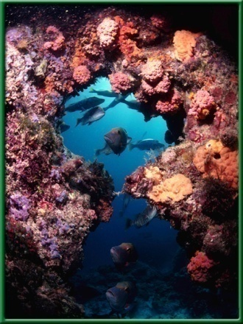
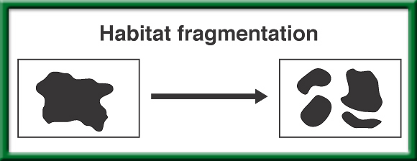
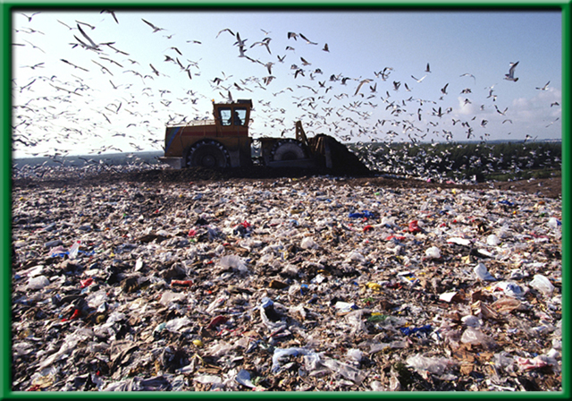
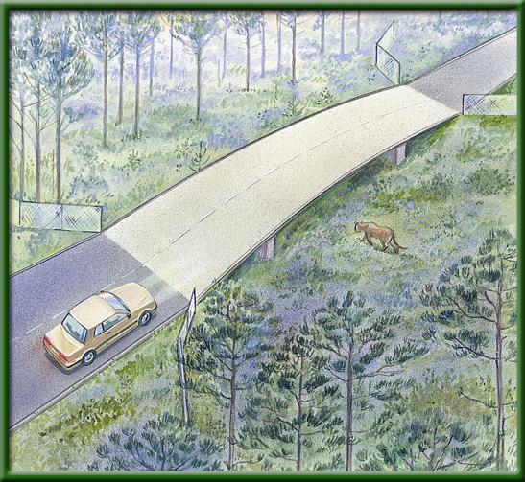
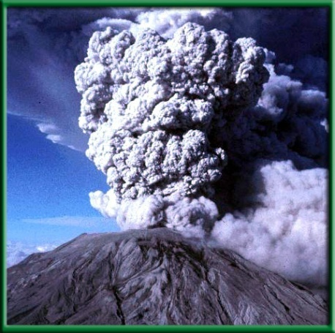
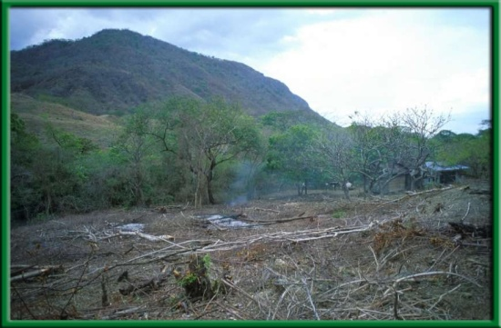
Conservation of Biodiversity 5.1 & 5.2 9/5 Obj. TSW understand the importance of Conservation Biology for the protection of biodiversity by going over the Concept Map and doing critical thinking problems. P. 32 NB
How can habitat degradation cause changes in an area’s biodiversity?
How might Habitat corridors help overcome problems with habitat fragmentation?
What Threats to Biodiversity have accelerated the rate of extinctions?

Slide 7
Warm Up Answers
Habitat degradation harms biodiversity, because it decreases available resources for the organisms.
Habitat corridors help overcome habitat fragmentation by allowing large predators to continue hunting.
Three problems that have increased extinction rates are: Habitat Loss, Invasive Species, Pollution, Climate Change, Overharvesting

Slide 8
P. 35 NB Word Bank
Pollution
Nature
Large Predators
Trash
Variety of Foods
Native Species
Habitat degradation
People
Chemical in runoff
Medicines
Food Webs
Introduction of Exotic Species
Habitat Fragmentation
Stability of Ecosystems
Write a 3 – 5 sentence summary.

Slide 9
5/4 Ecosystems 2.1 Obj. TSW demonstrate that a vital part of an ecosystem is the stability of its producers, consumers and decomposers in their Ecology Study Guide and class discussion & Problem Solving Lab. P.46NB
Compare and Contrast Heterotrophs and Autotrophs with examples of each.
What factors make this picture an Ecosystem, name 3?
How are decomposers important to an ecosystem, name 3.
Trees
Bear
Turtle
Deer
Sleeping
Forever Fish

Slide 10
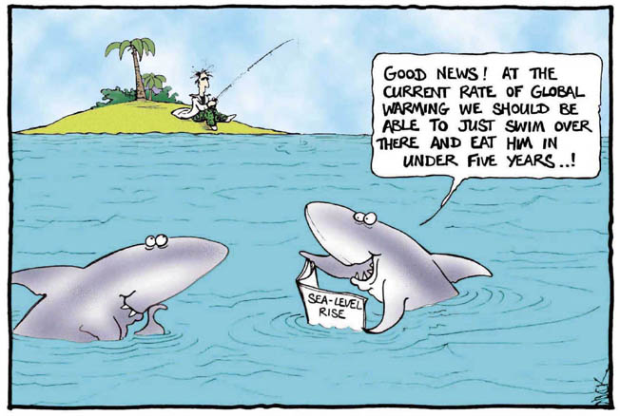
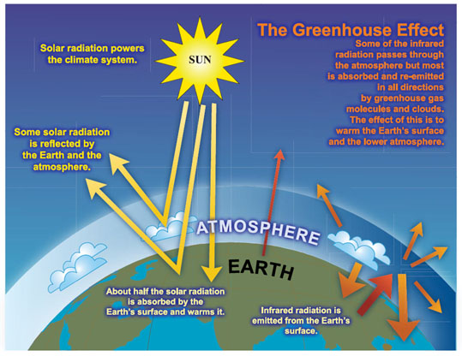
9/6 Global Warming CH 5 Obj. TSW have a greater understanding of what global warming is and it’s possible effects on us through a class discussion on solutions. P. 34 NB
What is Global Warming?
How does the Carbon Cycle play a role (if any) in Global Warming.
Explain the Greenhouse Effect
Page 128 in Biology Book

Slide 11
Global Warming
Global Warming is the gradual increase in temperature for the planet, due to an increase in CO₂.
The carbon cycle plays a role in taking CO₂ into plants in the process of photosynthesis. However, if there is deforestation, then there is not the availability of plants (trees) to take in CO₂ and it stays in the atmosphere.
The greenhouse effect is how the gas CO₂ traps solar radiation at the lower atmosphere and reradiates it back to the surface, warming the planet in general. However, we see radical severe events in weather instead of just a gradual increase, increased melting of glaciers, polar bears swimming farther in their hunting grounds.

Slide 12
Greenhouse Effect We need it, but too much…

Slide 13
NOAA, NASA, .edu. .org
Where/ How to find reliable information about Climate Change?

Slide 14
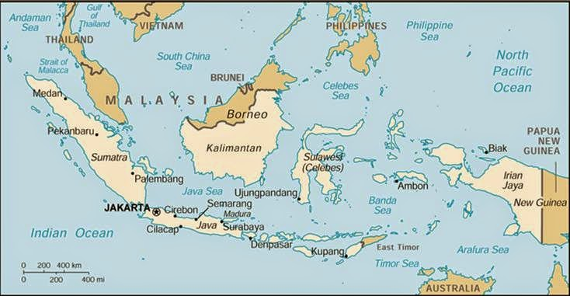
The Day WHO Parachuted Cats into Borneo
Place the events in chronological order
Aerial view of Borneo:

Slide 15
Parachuting Cats in Borneo p. 35 NB
The Day WHO Parachuted Cats into Borneo
Some time ago, World Health Organization sent supplies of DDT to Borneo to Fight mosquitoes that spread malaria among the people. The mosquitoes were quickly wiped out. But billions of roaches moved into the villages and they simply stored the DDT in their bodies. One kind of animal that fed on the roaches was a small lizard. When these lizards ate the roaches, they also eat a lot of DDT. Instead of killing them, DDT only slowed them down. This made it easier for the cats to catch the lizards, one of their favorite foods. About the same time, people also found that hoards of caterpillars had moved into feed on the roofing materials of their homes. They realized the lizards that previously had kept the caterpillars population under control had been eaten by the cats. And now, all over North Borneo, cats that ate the lizards died from DDT poisoning. Then rats moved in because there were no cats to control their population. With the rats came a new danger, THE Plague,. Officials sent out emergency call for cats. Cats were sent in by airplane and dropped by parachute to control the rats.
Biomagnification
Human activity with the best of intentions can have untended consequences.
Map of Borneo

Slide 16
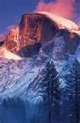
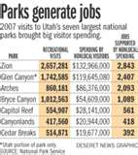
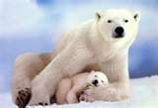
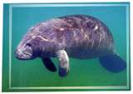
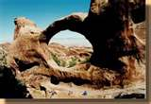
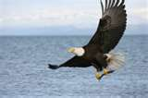
Chapter 5 Assessment p.115,116, 120,128 9/7 Obj. Stds. Will understand how humans impact biodiversity by completing their warm up questions & participating in classroom activities about biodiversity. P. 36 NB
Explain the difference between a threatened and an endangered species.
What is the danger of introducing an Exotic species into an area?
How do you predict Global Warming will affect biodiversity in the future, why?

Slide 17
WU 9/7
Threatened means that in your lifetime it will likely become endangered unless measures are taken to reverse the threat.
Endangered means the species will be extinct in your lifetime unless measures are taken to reverse the threat.
2. Exotic species typically do not have natural predators and therefore exploit resources that native plants and animals need, and decreasing Biodiversity.
3.Global Warming will effect Biodiversity by decreasing available resources to native species.

Slide 18
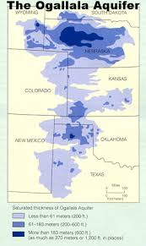
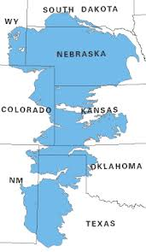
The Greenhouse Effect on Natural Systems p. 39 NB
Consider how climate has changed in the past and the fact that climate is continuing to change. How could life be different in the future? What are some of the issues people need to consider when examining climate change?
Use the article you just read and the Graph of the Greenhouse Effect to answer your question.
Here is a picture of America’s
Largest Aquifer – underground
Body of water.

Slide 19
9/8 Standards Practice Countdown p. CA17, CA22 Obj. TSW demonstrate their knowledge & understanding of Ecological concepts by playing jeopardy. P. 38NB
The diagram to the side shows a food ____, If environmental pollution, and hunting were to decrease the number of rattle snakes in the desert, how might that affect the other organisms? P. 51BB
Which organism in the figure at the side is a 1st order consumer? P.51BB
Correctly sequence the Ecological levels of organization in nature from smallest to largest. P.40BB
Page 51 Bio Book
http://www.footprintnetwork.org/en/index.php/GFN/page/calculators/

Slide 20
Warm up Answers
The picture shows a Food Web.
Kangaroo Rat
Organism ->Population-> Community->Ecosystem-> Biosphere.

Slide 21
How Wolves Change Rivers
The need for Keystone Species in ecosystems p.33 NB NOTES
Kahoots
CH 2 & 3 Ecology

