Slide 1
Leaf Disk Assay Lab
Honors Biology

Slide 2
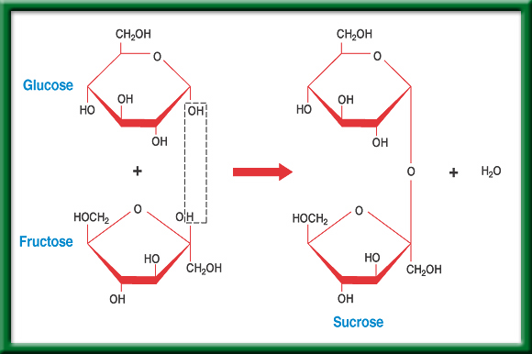
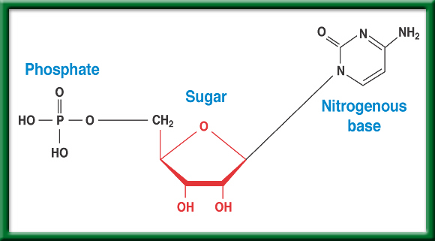
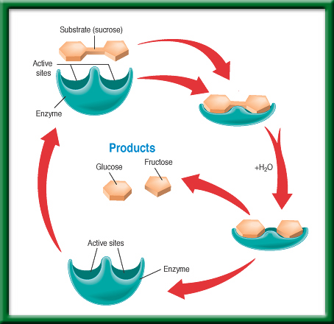
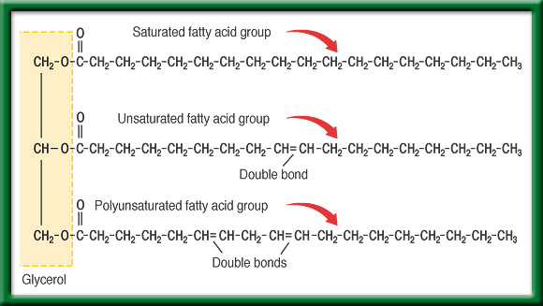
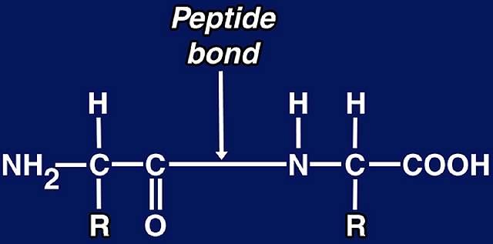
8/26 Life Substances 6.3
Obj. TSW explain the four Biomolecules (Macromolecules, Polymers) & how they are made from smaller molecules (monomers) by making a foldable & doing the Monsters in the pond water lab. P. 14NB
cellsalive.com
Carbon is the basic atom that forms molecular chains. Describe what a Biomolecule is, and name the four Biomolecules.
Compare & Contrast the 4 Biomolecules, (Macromolecules).
Why are these Biomolecules important?
Nucleic Acids
Carbohydrates
Lipids
Proteins

Slide 3








Chapter Summary – 6.3
Life Substances – biomolecules & Macromolecules
All organic compounds contain carbon atoms, CH₄, C₂H₆.
#1. There are four principal types of organic compounds, or biomolecules, that make up living things: carbohydrates, lipids, proteins, and nucleic acid.
The structure of a biomolecule will help determine its properties and functions.

Slide 4
#1. Biological molecules (Biomolecule, macromolecules) make parts of cells and living things.
#2. Carbohydrates- compounds composed of carbon, hydrogen, and oxygen atoms. Identifies the type of cell. Ex. C₆H₁₂O₆ - sugar
Proteins- made up of long chains of nitrogen-containing organic molecules called amino acids. Allow for transport of materials in and out of the cell.
Nucleic Acids- organic compounds found in all living cells. Genetic Material.
    DNA
    RNA
Lipids- smaller biological molecules that do not mix with water. Ex. fats, waxes, oils and steroids.
#3. Without these Biomolecules we would not have life because we would not have cells.

Slide 5
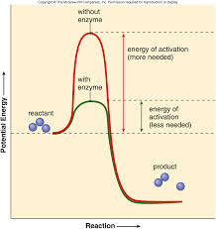
6.3 Section Summary 6.3 – pages 157-163
Take notes P. 15 NB
The structure of proteins
Enzymes are important proteins found in living things. *An enzyme is a protein that changes the rate of a chemical reaction.
They speed the reactions in digestion of food.
Made up of Amino Acids (20)
Enzymes can be used again and again without being used up.
Click image to view movie.

Slide 6
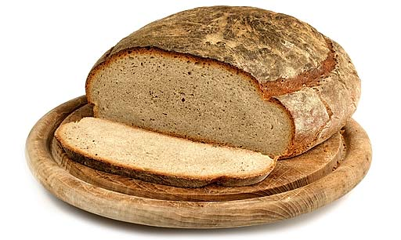
6.3 Section Summary 6.3 – pages 157-163
The structure of carbohydrates
A carbohydrate is a biomolecule composed of carbon (most abundant element with four available electrons to bond or share), hydrogen, and oxygen with a ratio of about two hydrogen atoms and one oxygen atom for every carbon atom.
Starch - Potatoes,
Cellulose - Cotton,

Slide 7
6.3 Section Summary 6.3 – pages 157-163
The structure of carbohydrates
The simplest type of carbohydrate is a simple sugar called a monosaccharide (mah noh SA kuh ride). (ie. glucose, fructose)
The largest carbohydrate molecules are polysaccharides, polymers composed of many monosaccharide subunits. (ie. potatoes, liver)
Element Carbon is the most abundant in living things.

Slide 8

Glucose-Fructose-Sucrose
To return to the chapter summary click escape or close this document.

Slide 9

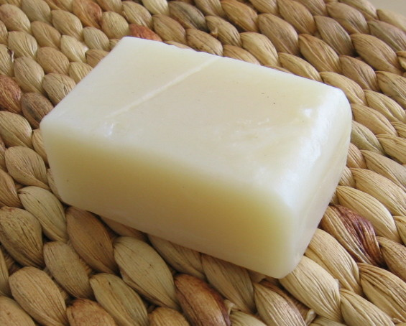
6.3 Section Summary 6.3 – pages 157-163
The structure of lipids
Lipids are large biomolecules that are made mostly of carbon and hydrogen with a small amount of oxygen. (ie. fats, oils, waxes)
They are insoluble in water because their molecules are nonpolar and are not attracted by water molecules.
Butter
Soap

Slide 10
Glycerol Chemistry
To return to the chapter summary click escape or close this document.

Slide 11
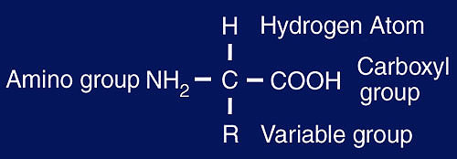
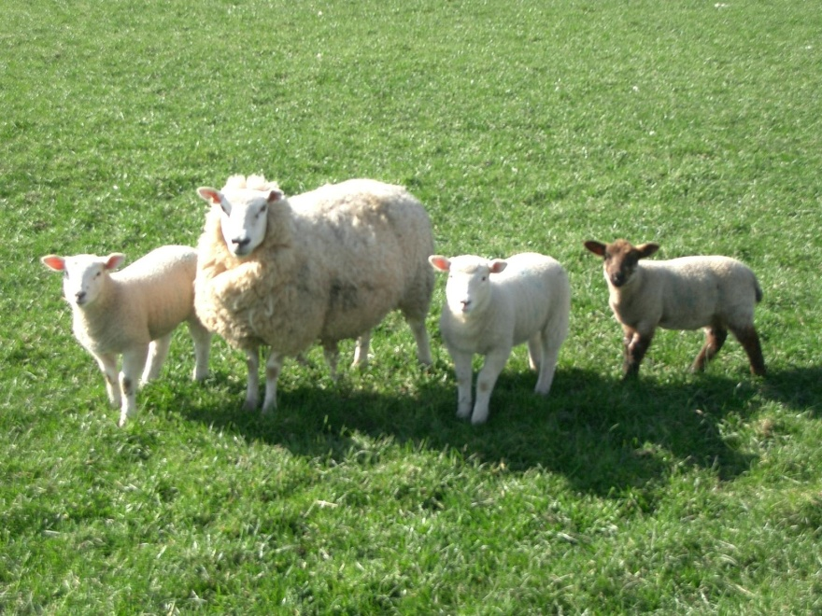

6.3 Section Summary 6.3 – pages 157-163
The structure of proteins
*The basic building blocks of proteins are called amino acids.
There are about 20 common amino acids that can make literally thousands of proteins.
Notice, amino acids contain the element Nitrogen, as do Nucleic Acids
Meat, Muscle, Leather, Wool

Slide 12
6.3 Section Summary 6.3 – pages 157-163
The structure of proteins
Peptide bonds are covalent bonds formed between amino acids.

Slide 13
6.3 Section Summary 6.3 – pages 157-163
The structure of nucleic acids
A nucleic (noo KLAY ihk) acid is a complex biomolecule that stores cellular information in the form of a code.
Nucleic acids are polymers made of smaller subunits called nucleotides.

Slide 14
6.3 Section Summary 6.3 – pages 157-163
The structure of nucleic acids
The information coded in DNA contains the instructions used to form all of an organism’s enzymes and structural proteins.
Another important nucleic acid is RNA, which stands for ribonucleic acid. RNA is a nucleic acid that forms a copy of DNA for use in making proteins.

Slide 15
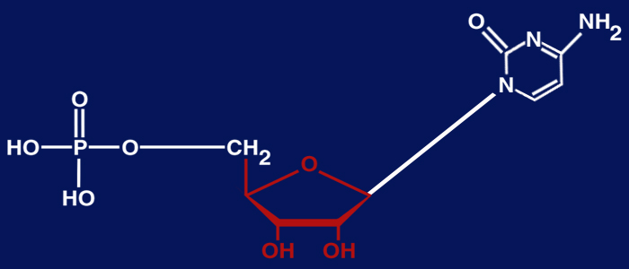
6.3 Section Summary 6.3 – pages 157-163
The structure of nucleic acids
DNA, which stands for deoxyribonucleic acid is a nucleic acid.
Phosphate
Sugar
Nitrogenous base

Slide 16
Nucleotides
To return to the chapter summary click escape or close this document.

Slide 17
Gathering Evidence
Bounty Commercial
Avian Commercial
Which commercial are you likely to believe?
Why?
What is the claim for each commercial?
Is there evidence?
What is your reasoning for your evidence?
WS – The Case of the Missing Meatballs p. 15 NB
HW – Read CH 6.3 & CH 7
Make sure you have 1 whole page notes P. 15 NB
Finish your Bacteria Lab – Due Thursday
Quiz CH 7 Friday

Slide 18
Bacteria Lab
Gather your final data from your Bacteria Lab.
Draw a graph that represents your growth of Bacteria.
What does your data show about the growth of Bacteria?
Examples of Qualitative and Quantitative Data?
What errors occurred?
What can you conclude? Period 3 write a conclusion on Page 9NB.

Slide 19
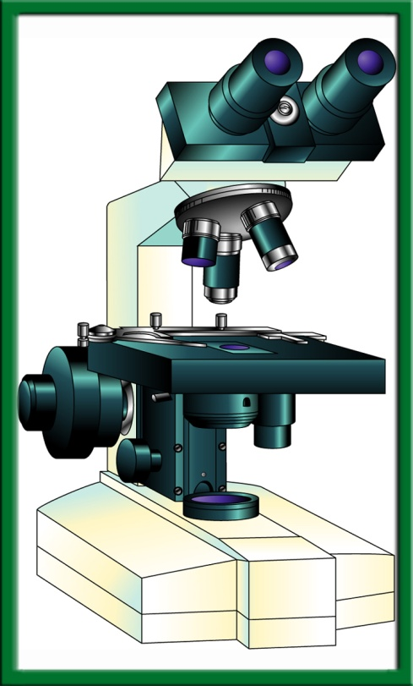
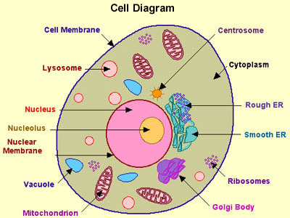
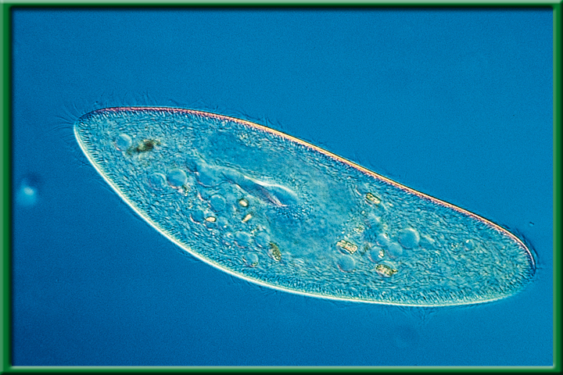
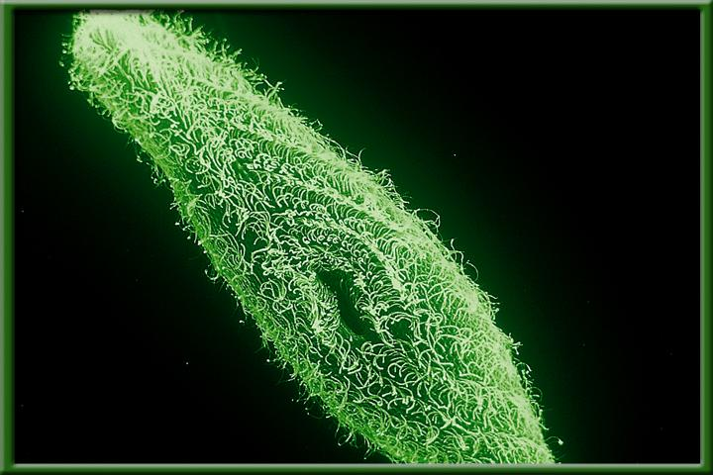
8/27 A View of a Cell CH 7.1
Obj.: TSW demonstrate their knowledge and understanding of Macromolecules by making a foldable. P.16NB
Cellsalive.com
HW – Bacteria Lab due next Wednesday (H. Bio)
HW - CH 6.3 Fri. Notes P. 15 –Period 4,
Foldable – Macromolecule P. 21 NB
Identify the three main ideas of the Cell theory.
Compare & Contrast Prokaryotic & Eukaryotic Cells.
What is the function & location of the nucleus of a cell?

Slide 20
#1. Cell Theory
All organisms are made of one or more cells.
Cells are the basic unit of structure & organization of organisms.
All cell come from preexisting cells.

Slide 21

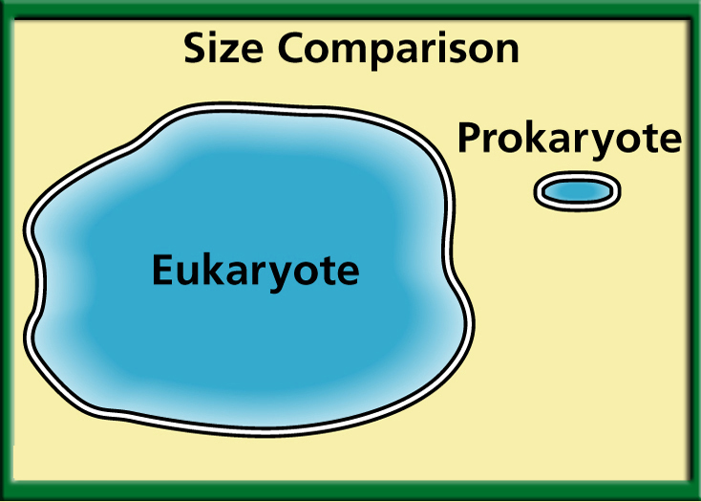
#2 Which Cell is bigger?
To return to the chapter summary click escape or close this document.

Slide 23
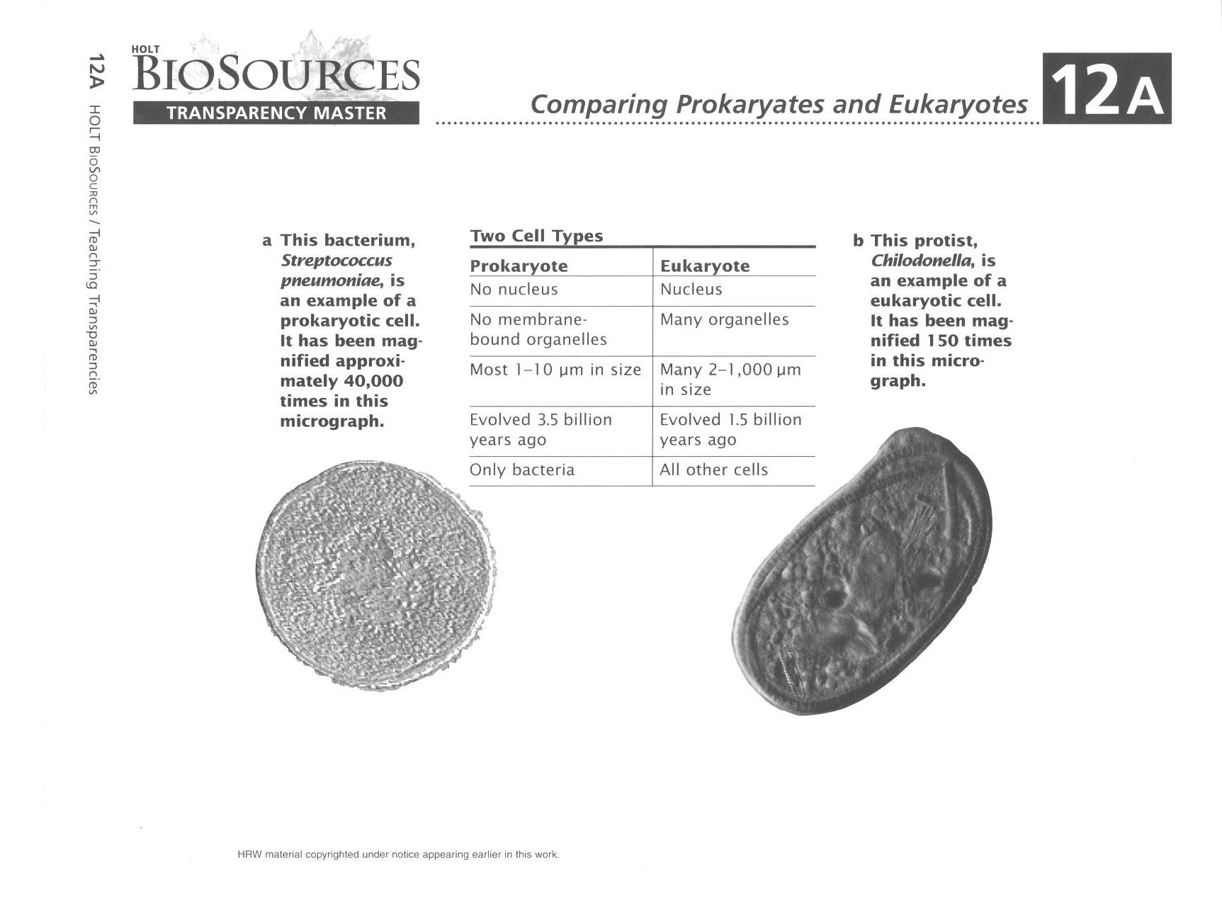
Membrane bound organelles
Multicellular
#2.
Unicellular

Slide 24
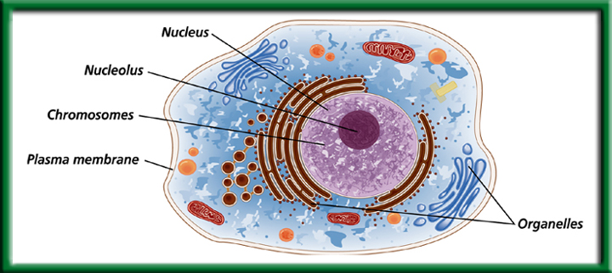
#3. Eukaryotic Cell – Contains a Nucleus
What are some organisms that are Eukaryotic?

Slide 25
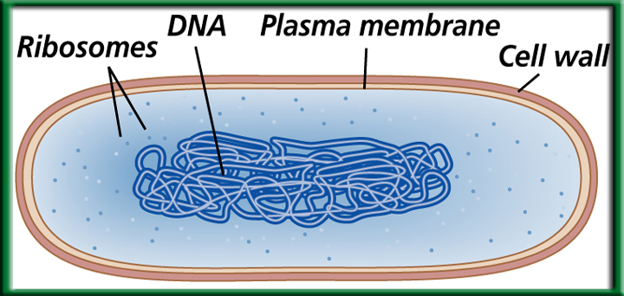
#3. Prokaryotic Cell – does not contain a nucleus.
What organism is prokaryotic?
BACTERIA

Slide 26
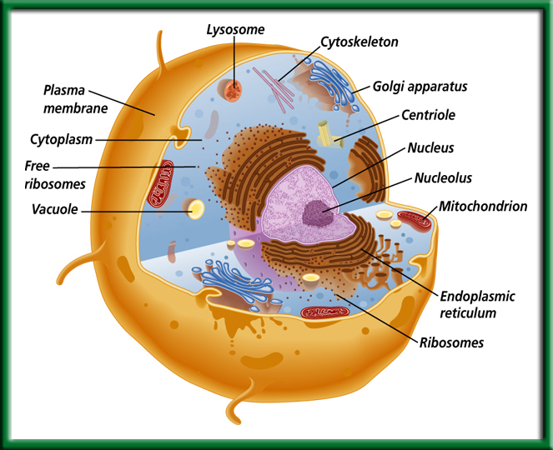
Animal
Cell or Plant cell?
Eukaryotic or
Prokaryotic?
To return to the chapter summary click escape or close this document.

Slide 27
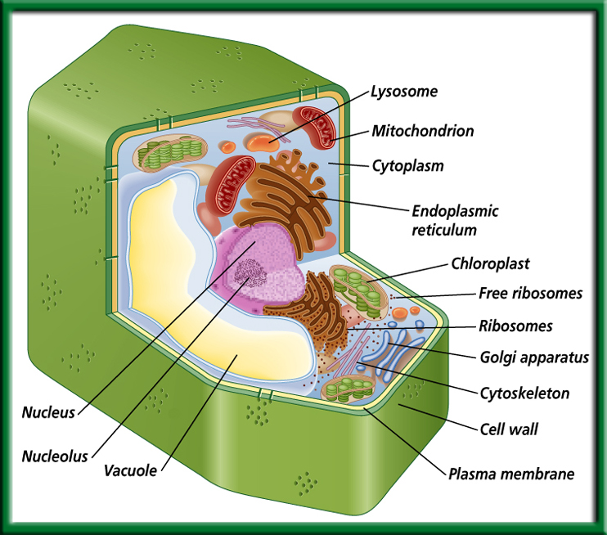
Plant Cell or Animal Cell?
Prokaryotic or Eukaryotic?
To return to the chapter summary click escape or close this document.

Slide 28




Draw a mark at the midpoint of a sheet of paper along the side edge.
Then fold the top and bottom edges in to touch the midpoint.
To return to the chapter summary click escape or close this document.

Slide 29

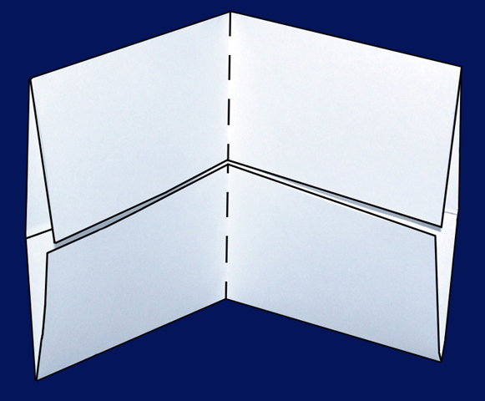
Fold in half from side to side.
To return to the chapter summary click escape or close this document.

Slide 30

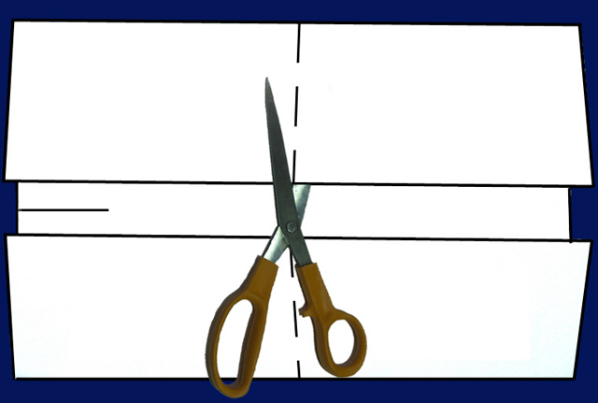
Open and cut along the inside fold lines to form four tabs.
To return to the chapter summary click escape or close this document.

Slide 31

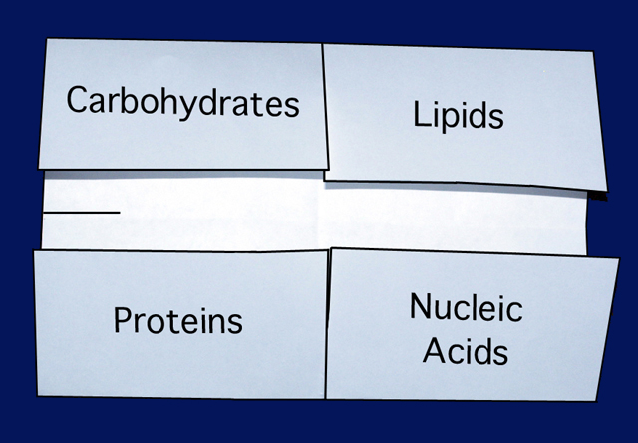
Write an example of each, part of cell membrane.
Give a definition of each.
Draw the molecular formula & a picture of each
Include the Subunit. P. 17NB
Why Macromolecules are important?
Label each tab.
CH 6.3 & 7.2
Saccharides - Sugars
Fatty Acids
Macromolecules
Amino Acids
Nucleotides
To return to the chapter summary click escape or close this document.

Slide 32
Claim: A Fist Bump is cleaner than shaking hands.
Evidence: The fist bump delivered only a tenth as many bacteria as the handshake.
Reasoning: There is less surface area to spread germs.
Conclusions: A fist bump is cleaner than a high five and a hand shake.

Slide 33

Question 1
A large molecule formed when many smaller molecules bond together is called a(n) _______.
A. peptide
C. polymer
B. isotope
D. nucleotide
To return to the chapter summary click escape or close this document.
CA: Biology/Life Sciences
1h

Slide 34
The answer is C.

Slide 35
Question 2
Which of the following are NOT made up of lipids?
A. steroids
C. fats
B. cell membranes
D. enzymes
The answer is D.
To return to the chapter summary click escape or close this document.
CA: Biology/Life Sciences
1b, 1h

Slide 36
Question 3
Which of the following does NOT affect the rate of cell diffusion?
A. pressure
C. concentration
B. motion
D. temperature
The answer is B.
To return to the chapter summary click escape or close this document.
CA: Biology/Life Sciences
1a

Slide 37

Section 3 Check
Question 1
How many covalent bonds does a carbon atom need to form in order to become stable?
A. 1
B. 2
C. 3
D. 4
CA: Biology/Life Sciences
1h

Slide 38
Section 3 Check
Question 2
A __________ is a biomolecule composed of carbon, hydrogen, and oxygen with a ratio of about two hydrogen atoms and one oxygen atom for every carbon atom.
A. carbohydrate
C. protein
B. lipid
D. fatty acid
CA: Biology/Life Sciences
1h

Slide 39
Section 3 Check
The answer is A. Lipids are made mostly of carbon and hydrogen, and proteins contain nitrogen in addition to carbon, hydrogen and oxygen.
CA: Biology/Life Sciences
1h

Slide 40
Section 3 Check
Question 3
In which type of molecule will you find peptide bonds?
A. carbohydrate
C. protein
B. lipid
D. fatty acid
CA: Biology/Life Sciences
1h

Slide 41
Section 3 Check
The answer is C. Amino acids are the basic building blocks of proteins and are linked together by peptide bonds.
CA: Biology/Life Sciences
1h

Slide 42
Section 3 Check
Question 4
What biomolecule is represented in this diagram?
Phosphate
Sugar
Nitrogenous base
A. carbohydrate
C. protein
B. nucleotide
D. lipid
CA: Biology/Life Sciences
1h

Slide 43
Section 3 Check
The answer is B. Nucleotides are the smaller subunits that make up nucleic acids. Nucleotides are composed of three groups: a nitrogenous base, a simple sugar, and a phosphate group.
Phosphate
Sugar
Nitrogenous base
CA: Biology/Life Sciences
1h

Slide 44
Section 3 Check
Question 5
Describe an enzyme and its function.
CA: Biology/Life Sciences
1b

Slide 45
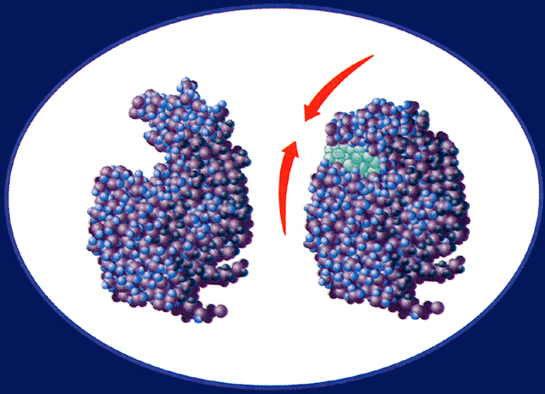
Section 3 Check
An enzyme is a protein that enables other molecules to undergo chemical changes to form new products. Enzymes increase the speed of reactions that would otherwise proceed too slowly.
Substrate
Active site
CA: Biology/Life Sciences
1b

Slide 46
Chapter Assessment p.11
Reproduction
Control
Homeostasis
Adaptation
Hypothesis
Evolution
Stimulus: information, reaction: response to stimulus (characteristics of life)
Independent variable: changes, dependent: what happens as a result of the independent variable. Both part of experiment.
Organism: Possesses characteristics of life. Species: can interbreed and reproduce fertile offspring

Slide 47
Chapter Assessment
Scientific Method
Evolution
SI (Metric)
Homeostasis
Energy – the ability to make change.
True
False – Conclusion
False – Experimental Group
False – Quantitative Data
False – Ethics
True

Slide 48
Chapter 1
Applying Scientific Methods
Real World BioApplications
Group B was the Control Group; it was the group that did not receive additional nitrogen.
Group A was the Experimental Group; it was the group that received additional nitrogen. The experimental group has the Independent Variable- additional nitrogen.
The Independent Variable was the additional application of Nitrogen in the fertilizer. The Dependent Variables are the height and growth of the plants.
Dr. Anderson controlled the temperature, light, amount of soil & water, and humidity conditions for both groups.

Slide 49
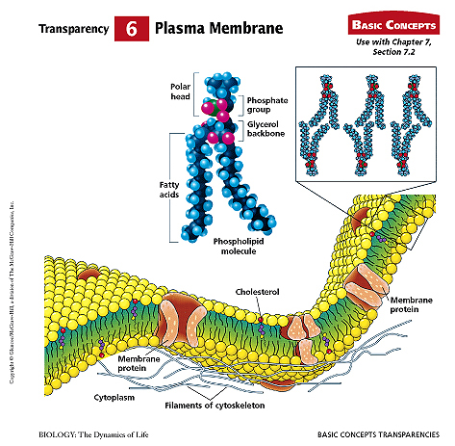
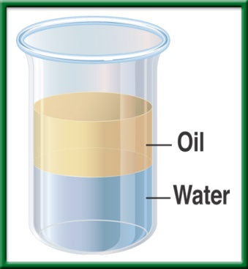
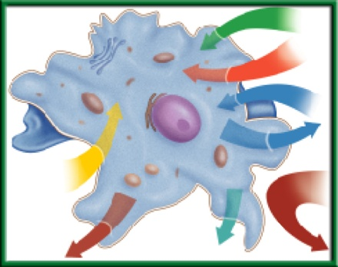
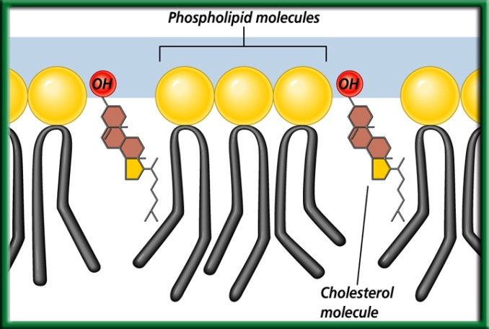
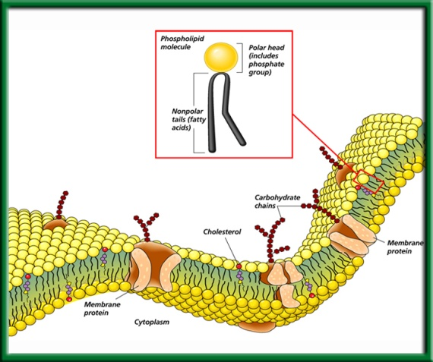
8/28 The Plasma Membrane 7.2
Obj. TSW demonstrate their knowledge and understanding of cells by properties of the plasma membrane by making a 3 – D model . P.18NB
Cellsalive.com
Explain what selectively permeable (semi-permeable) means.
Why is the plasma membrane called a Fluid Mosaic Model?
Draw, color and label the plasma membrane with proteins, carbohydrates and cholesterol embedded in it.

Slide 50
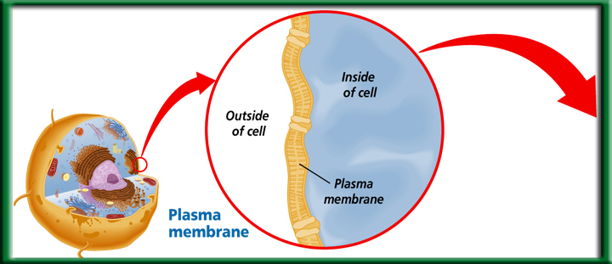
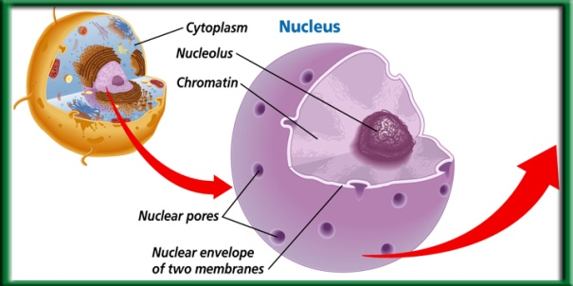
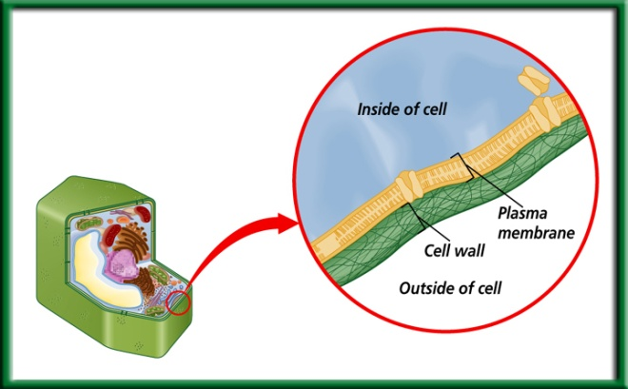
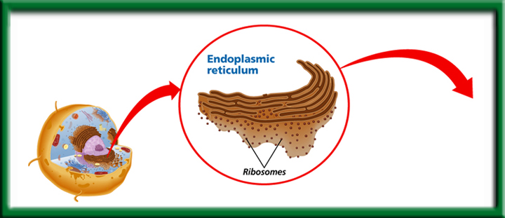
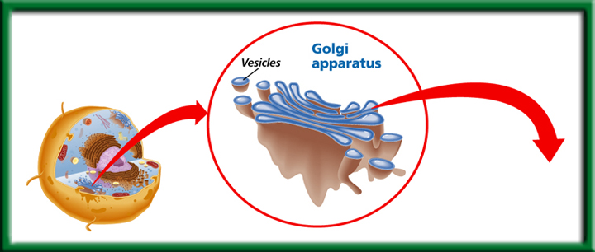
8/29 The Eukaryotic Cell Structure 7.3
Obj. TSW compare and contrast cell organelles by researching Cellsalive.com, watching the cell video, and creating an analogy of the cell in a group. P.20 NB
http://www.susanahalpine.com/anim/Life/memb.htm
Cellsalive.com
What is a cell wall, and what four kinds of organisms have a cell wall?
How does the nucleus control the cell, name the essential parts.
Compare & Contrast the Endoplasmic Reticulum & the Golgi Apparatus in the Assembly, Transport & Storage of proteins.
Watch Cell Video
Take Notes- Cells p.23NB

Slide 51
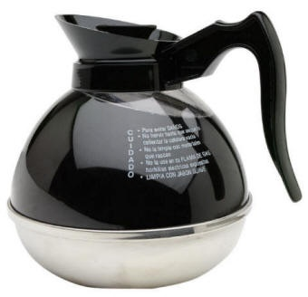
Coffee time
How is the coffee filter similar to a cell membrane?

Slide 52
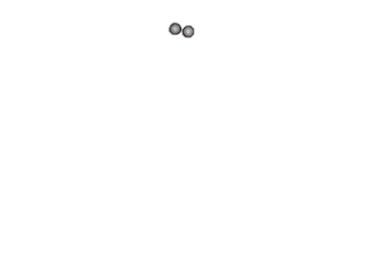
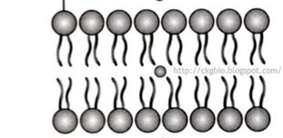
Cell/plasma membrane
Outside of the cell
Inside the cell
#1. Selective permeability: how certain substances can enter the cell while other substances can’t

Slide 53
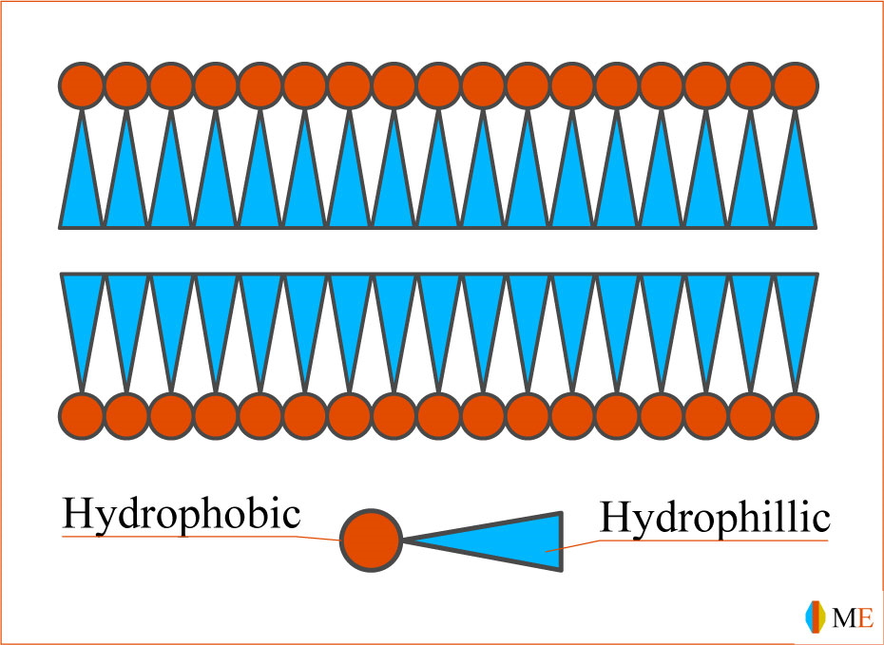
Cell membrane is like a filter
Wastes
Water
Oxygen
Glucose
Outside cell
Wastes
Carbon dioxide
Inside cell
Water

Slide 54
Plasma/cell membrane structure
Phospholipid bilayer: Two layers of phospholipid molecules that form the cell membrane

Slide 55
Phospholipids
`
Polar head: Likes water
Nonpolar tail: Dislikes water
`
Hydrophilic: Likes water. (Polar)
Hydrophobic: Hates water. Will repel it. (Nonpolar)

Slide 56
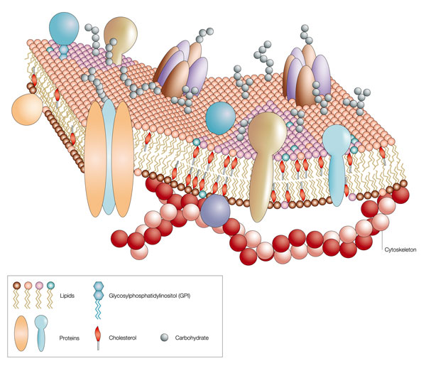
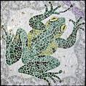
#2. Fluid Mosaic Model p. 21NB
Plasma Membrane- Phospholipid Bilayer
  Polar layers are on the outside
  Non-polar layer are on the inside
Moves like a wave of water on a lake
The proteins/carbohydrates on the outside surface of the cell look like a Mosaic.

Slide 57
#3. Macromolecules are part of the Cell/ Plasma Membrane
Lipids
  helps keep the cell fluid
  Cholesterol (a type of Lipid)
  Helps provide structure & support to cell membrane
Proteins
  Transmit signals, Maintain homeostasis
  Move substances in and out of the semi- permeable
Carbohydrates
  Helps cells identify other cells, not give energy for the cell.

Slide 58
ID the Carbohydrates, Proteins, Lipids, & Cholesterols
What is the function of each of these Macromolecules in the Plasma Membrane?

Slide 59
Macromolecules
Protein | Lipids | Carbohydrates | Nucleic Acids

Slide 60
Biology Lab Scientific Method Finding Monsters in Pond Water
Observation(s): of pond water:
Question(s): asked after looking at pond water:
Hypothesis: Write about what you will find in the pond water: If/ Then statement and it must be Testable.
Procedure:
Get a clean slide and a clean cover slip from the front counter. Return to your lab station. With your pipette, suck up a sample of
Pond Water at your lab station. Drop 3 drops of Pond water onto the middle of the slide. Put the cover slip on at an angle so it
falls flat. Place the slide with the specimen on the flat black stage of the Microscope paying attention to move the stage clip out
of the way for the slide. Make sure the Objective lens is on the lowest power and bring the slide into focus with the big Focus knob. When you find something, then focus with the small Focus knob. Call me over to help you identify what you have found.
Data: Qualitative & Quantitative
Draw a Picture of all the specimens that you have found, describe them with words, and try and count how many you see.
Write the # of Specimens:
Control Group: What are you comparing the pond water too. Tap Water____ / or Plant Water ______
Write the # of Specimens:
Independent Variable: The amount of algae in the water. A lot of Algae _____/Small amount of Algae ____
Dependent Variable: The specimens in the water. When did you find the most specimens? Lots of algae, or little or tap water
or plant water? Why?
Conclusion: Accept or Reject your hypothesis in 3- 4 sentences. What did you learn? What would you change for next time?
Biology Lab Scientific Method
Finding Monsters in Pond Water
Observation(s): of pond water: _______________________________________________________________
Question(s): asked after looking at pond water:
__________________________________________________________________________________________
Hypothesis: Write about what you will find in the pond water: If/ Then statement and it must be Testable.
__________________________________________________________________________________________
Procedure:
Get a clean slide and a clean cover slip from the front counter. Return to your lab station. With your pipette, suck up a sample of
Pond Water at your lab station. Drop 3 drops of Pond water onto the middle of the slide. Put the cover slip on at an angle so it falls flat.
Place the slide with the specimen on the flat black stage of the Microscope paying attention to move the stage clip out of the way
for the slide. Make sure the Objective lens is on the lowest power and bring the slide into focus with the big Focus knob.
When you find something, then focus with the small Focus knob. Call me over to help you identify what you have found.
Data: Qualitative & Quantitative
Draw a Picture of all the specimens that you have found, describe them with words, and try and count how many you see.
Write the # of Specimens:
Control Group: What are you comparing the pond water too. Tap Water____ / or Plant Water ______
Write the # of Specimens:
Independent Variable: The amount of algae in the water. A lot of Algae _____/Small amount of Algae ____
Dependent Variable: The specimens in the water. When did you find the most specimens? Lots of algae, or little or tap
water or plant water? Why? _________________________________________________________________________
Conclusion: Accept or Reject your hypothesis in 3- 4 sentences. What did you learn? What would you change for next time?
___________________________________________________________________________________________________

Slide 61
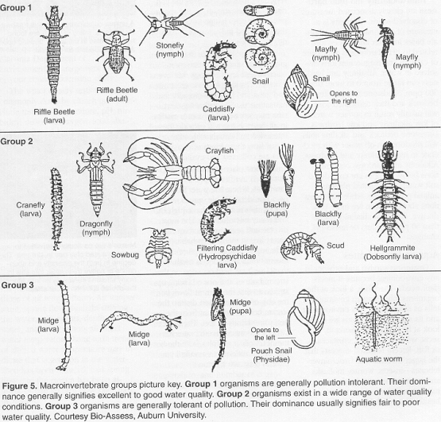
Macroinvertebrates

Slide 62
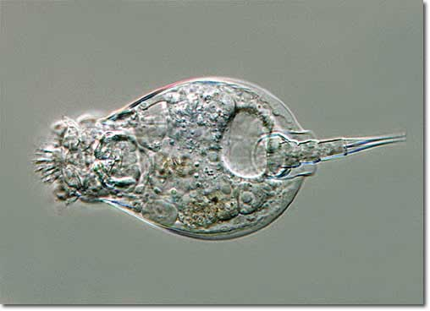
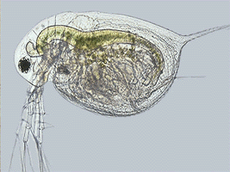
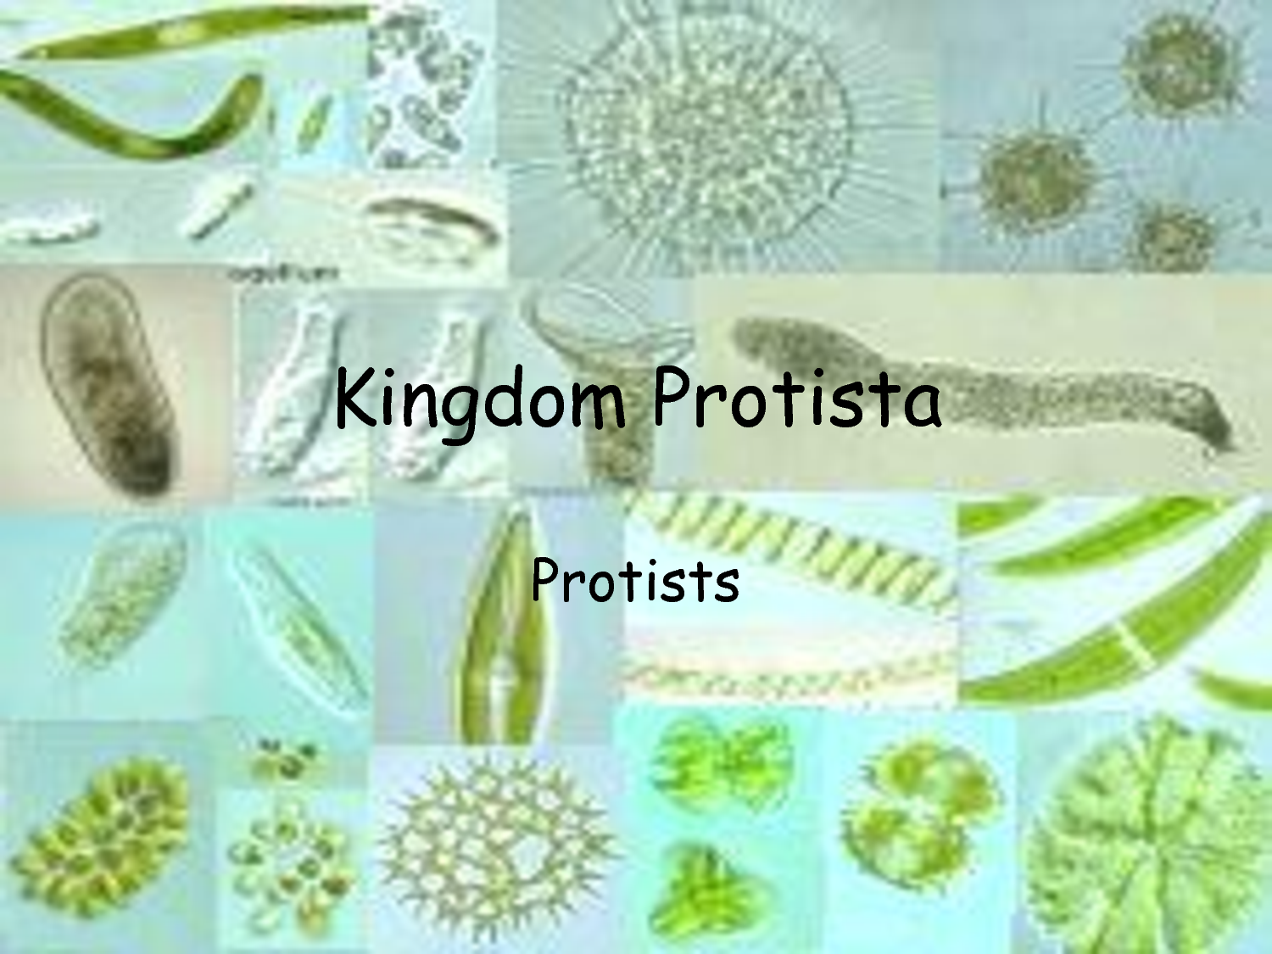
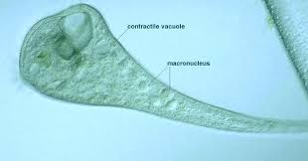
Protists

Slide 63
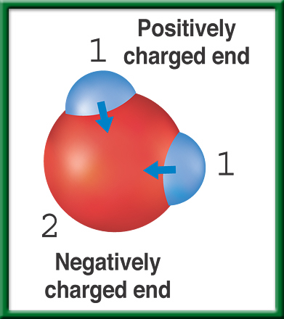
Water Molecule
To return to the chapter summary click escape or close this document.

Slide 64
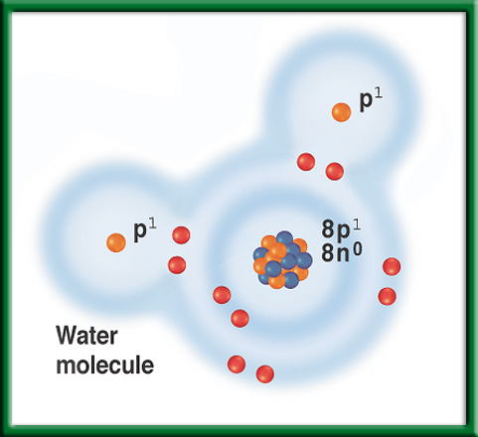
Water Molecule
To return to the chapter summary click escape or close this document.

Slide 65

Summary Section 2 – pages 152-156
Water resists temperature changes
Water resists changes in temperature. Therefore, water requires more heat to increase its temperature than do most other common liquids.

Slide 66
Eukaryotic Cell Structure P. 17 NB
1. manages cell functions; includes chromatin and the nucleolus, which produces ribosomes; involved
in protein synthesis
2. boundary between the cell and its external environment; allows cell to vary shape as needed; controls
the movement of materials that enter and exit the cell
3. provides a large surface area on which chemical reactions can take place; site for lipid synthesis; is cell’s delivery system, providing materials for ribosomes as they synthesize proteins
4. breaks down food molecules to release energy,
which is then stored in other molecules that can power cell reactions easily
5. receives newly synthesized proteins and lipids from the ER and distributes them to the plasma membrane and other cell organelles; chemically modifies proteins, then repackages them for distribution to final destination
6. provides support for organelles; also helps maintain cell shape; includes microtubules and microfilaments

Slide 67
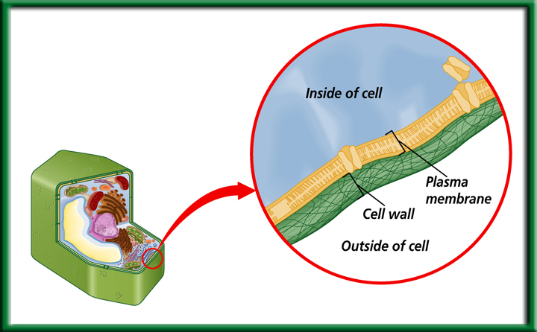
Cell Wall
Made of cellulose, not digestible by humans.
Provides protection and support.
Found in:
Plant Cells, Bacteria, some Protists, and Fungi
To return to the chapter summary click escape or close this document.

Slide 68
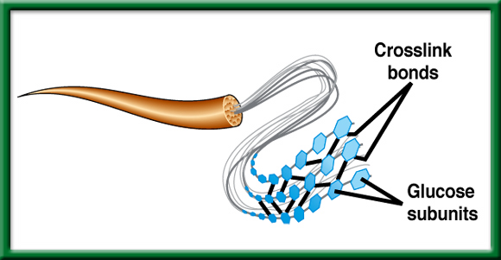
Structure of Cellulose – Cell Wall of Plants
We call it Fiber.
To return to the chapter summary click escape or close this document.

Slide 69
Nucleus- in Eukaryotic Cells
Control center – give directions for making proteins, contains Chromatin (DNA – genetic instructions)
-usually in the center of the cell, contains the nucleolus *(makes ribosomes – make proteins).

Slide 70
Endoplasmic Reticulum
Proteins are assembled on the Ribosomes.
To return to the chapter summary click escape or close this document.

Slide 71
Golgi Apparatus
Modifies Proteins then transports and/ or stores them in vesicles.
Both the ER and the Golgi have folded membranes and work with Proteins.
To return to the chapter summary click escape or close this document.

Slide 72
Plasma Membrane – Selectively Permeable
Phosopholipid Bilayer
Maintains Homeostasis by controlling the movement of materials into & out of cells.
To return to the chapter summary click escape or close this document.

Slide 73
Cellsalive.com P. 25NB
Eukaryotic cell Structure and Organelles
Define these following organelles:
Nucleus
Plasma Membrane
Golgi Apparatus
Rough Endoplasmic Reticulum
Cytoplasm
Vacuole
Ribosomes
Mitochondria

Slide 74
Plasma Membrane Activity
Making a Plasma Membrane
Get into partners
Get necessary papers and Carbohydrates
Write your names on plasma membrane
Color plasma membrane and proteins
Add Carbohydrates after Proteins are attached

Slide 75
HW – Honors Biology
Study for the Quiz tomorrow
  Reread CH 6.3 & CH 7.1 & 7.2
Finish your Plasma Membrane
  Know Phospholipid bilayer
  Know the Macromolecules in the phospholipid Bilayer
  Know the Macromolecules function.
  Id each Macromolecule in the Plasma Membrane
Finish your Macromolecule Foldable
Finish P. 23 functions of organelles Cellsalive.com
Make sure I have your Bacteria Lab

Slide 76
Activity: Make your Desk a Cell p. 23NB
After researching Cellsalive.com for the following organelles: Nucleus, Cytoplasm, Endoplasmic Reticulum, Golgi Body, Vacuole, Mitochondria, Plasma Membrane, Chloroplast & Cell Wall (Plant cell) take notes on page 23 NB. Title: Cell Organelles
Then with a partners and one desk, make a plasma membrane around the desk. On the inside of the desk, Draw and ID the listed organelles above on your desk.
It can be a plant or animal cell
Mrs. McAllister must grade your “cell”.

Slide 77




9/2 Energy Transformers 7.3
Obj. TSW demonstrate understanding of the function of mitochondria in a cell by completing the warm up and doing the cell simile activity. P.22 NB
Cellsalive.com
Compare & Contrast Chloroplasts & Mitochondria.
Why are the inner membranes folded?
Compare & Contrast Animal & Plant cells.
Show web site cellsalive.com
Quiz Friday & NB Check p. 14 - 29
Bacteria Lab due thursday
Lab – Cells – tomorrow
Cell Video

Slide 78
Chloroplast- converts light energy to chemical energy in a process called Photosynthesis
Eukaryotic Cell
To return to the chapter summary click escape or close this document.

Slide 79

Mitochondria
Transforms chemical Energy into ATP & heat.
Found in Plants & Animals
Folded membranes are a must.
*Endosymbiosis* Each mitochondria has its own DNA which is passed down by your mother.
To return to the chapter summary click escape or close this document.

Slide 80
Folded Membranes P.21 NB
Make cell processes more efficient for chemical reactions to happen
The membrane provides a large surface area
The membranes form interconnected compartments.

Slide 81

Animal Cell - Eukaryotic
Small Vacuole
Round
Centriole
Lysosomes
To return to the chapter summary click escape or close this document.

Slide 82

Plant Cells - Eukayotic
Cell Wall
Chloroplast
Large Vacuole
Plant Vacuole
To return to the chapter summary click escape or close this document.

Slide 83



To return to the chapter summary click escape or close this document.

Slide 84
Cell Simile
My cell is like a…
Train Station
Kingdom
Grocery Store
Navy Ship
Department store
Mall
College – Cal Berkley
Ocean
Amusement Park
Tree
School
Bakery Shop
Company
Post Office
Ant Hill

Slide 85



Question 4
Which of these structures transforms energy for the cell?
B.
Endoplasmic reticulum
Golgi apparatus
C.
D.
Nucleus
Mitochondrion
To return to the chapter summary click escape or close this document.
CA: Biology/Life Sciences
1g

Slide 86
The answer is D.
Mitochondrion
To return to the chapter summary click escape or close this document.
CA: Biology/Life Sciences
1g

Slide 87
Review Eukaryotic & Prokaryotic P. 25 NB
Eukaryotic
Summary
Both
Prokaryotic

Slide 88
Folded Membranes
Examples of organelles with folded membranes are: mitochondria, golgi apparatus, endoplasmic reticulum, chloroplast
Advantages:
  Cell processes can be more efficient
  Provides a larger surface area
  Membranes form interconnected compartments for more chemical reactions to happen

Slide 89
Copy on Page 21NB
Structure | Function
Nucleus
Golgi apparatus (body)
Mitochondria
Smooth Endoplasmic Reticulum
Rough Endoplasmic Reticulum
Cell wall
Plasma membrane
Ribosomes
Lysosomes
Vacuole

Slide 90




9/3 Cellular Transport 8.1
Obj. TSW explain how cells regulate their surroundings through their semi permeable membranes by doing the onion, elodea leaf and check cell lab. P. 24 NB
What is Osmosis? Compare & Contrast Isotonic, Hypotonic, and Hypertonic Solutions.
Compare & Contrast Passive Transport & Active Transport.
Compare & Contrast Endocytosis & Exocytosis

Slide 91



Cell Lab
4x- Red Objective lens = 40
10x – Yellow Objective lens = 100
Label on your picture of Cheek Cell, Onion Cell & Elodea Leaf Cell:
Cell Wall
Nucleus
Cytoplasm
Chloroplast
Plasma Membrane
Onion Cell
Elodea Cell
Cheek Cell

Slide 94

Lysosomes
Food particles
A membrane
Bacteria & viruses
Cell proteins
Tail
Vacuoles
Worn- out parts
Digesting it
Digestive enzymes
Page 25 NB

Slide 95
Lab – Scientific Method using Elodea Leaf, Onion Cells & Cheek Cells p. 25 NB
Observation(s):
Questions:
Hypothesis: If, Then, & Testable
Materials: 1 glass slide, 1 cover slip, one toothpick, 1 piece of onion, forceps, Methyl Blue, Iodine
Procedure:
  Get 1 glass slide, 1 cover slip, put 3 drops of Iodine on the slide for the onion, peal the inner membrane off & lay onto the Iodine, then put on the cover slip.
  Get 1 glass slide, 1 cover slip, put 3 drops of Methyl Blue on the slide for the cheek cell, get a toothpick and just touch the inside of your cheek, then swirl the toothpick around in the MB and put on the cover slip.
  Get 1 glass slide, 1 cover slip, put 3 drops of water on the slide, place 1 elodea leaf on the slide, then put on the cover slip.

Slide 96
Cont. Lab Onion & Cheek Cells p. 25 NB
Data:
Qualitative (words, pictures, descriptions) & Quantitative (#’s, graphs, tables) Label the nucleus, plasma membrane, cytoplasm, chloroplast, & cell wall
Control Group: What are you comparing your cheek cells to?
Independent Variable: Brushing teeth, or how many times you touched your cheek.
Dependent Variable: The amount of Cheek Cells
Conclusion: 3 – 5 sentences Accept or Reject your hypothesis, what you learned, what would you do differently? Why did you not see chloroplasts in the onion cell? What was different about the cheek cell? Were the chloroplasts moving in the Elodea Leaf?

Slide 97
Conclusion P. 25 NB
sentences Accept or Reject your hypothesis, what you learned, what would you do differently? Why did you not see chloroplasts in the onion cell? What was different about the cheek cell? Were the chloroplasts moving in the Elodea Leaf?
Accept or Reject? We learned that there are cells in plants and animals. The onion cells look like bricks. The Cheek cells were circular, and the plant cells looked like bricks. I would change nothing about the lab. There were no chloroplasts in the onion cell because it was underground. The Chloroplasts were green in the Elodea Leaf.

Slide 98


9/4 Osmosis CH 8.1 & 8.2
Obj. TSW learn how water moves through a plasma membrane by participating in a demonstration of Osmosis. P. 26 NB
Why do cells have to be small?
Explain what happens to a cell or egg in a Hypotonic solution. Use words like Solute and Solvent.
H. Biology. Explain plasmolysis, why does grass that has been salted in the winter along side roads die?

Slide 99



Section 8.1 Summary – pages 195 - 200
What controls osmosis?
#1.The movement of water.
Unequal distribution of particles, called a concentration gradient, is one factor that controls osmosis.
Before
Osmosis
After
Osmosis
Water molecule
Sugar molecule
Selectively permeable membrane

Slide 100
Section 8.1 Summary – pages 195 - 200
Cells in an isotonic solution
Water movement is Equal
In an isotonic solution, the concentration of dissolved substances in the solution is the same as the concentration of dissolved substances inside the cell.
H₂O
H₂O
Water Molecule
Dissolved Molecule

Slide 101
Section 8.1 Summary – pages 195 - 200
Cells in an isotonic solution
A plant cell has its normal shape and pressure in an isotonic solution.

Slide 102
Section 8.1 Summary – pages 195 - 200
Cells in a hypotonic solution
In a hypotonic solution, water enters a cell by osmosis, causing the cell to swell.
Lysed- to explode
H₂O
H₂O
Water Molecule
Dissolved Molecule

Slide 103

Section 8.1 Summary – pages 195 - 200
Cells in a hypotonic solution
Plant cells swell beyond their normal size as pressure increases.

Slide 104
Section 8.1 Summary – pages 195 - 200
Cells in a hypertonic solution
In a hypertonic solution, water leaves a cell by osmosis, causing the cell to shrink.
H₂O
H₂O
Water Molecule
Dissolved Molecule

Slide 105

Section 8.1 Summary – pages 195 - 200
Cells in a hypertonic solution
Plant cells lose pressure as the plasma membrane shrinks away from the cell wall.

Slide 106

Section 8.1 Summary – pages 195 - 200
#2.Passive Transport
When a cell uses no energy to move particles across a membrane passive transport occurs.
Osmosis
Diffusion
Facilitated Diffusion
Moves from High Concentration to Low Concentration
Concentration gradient
Plasma membrane

Slide 107

Section 8.1 Summary – pages 195 - 200
Passive Transport by proteins
Passive transport of materials across the membrane using transport proteins is called facilitated diffusion.
Channel proteins
Plasma membrane
Concentration gradient

Slide 108
Section 8.1 Summary – pages 195 - 200
Passive transport by proteins
The movement is with the concentration gradient (High to Low), and requires no energy input from the cell.
Carrier proteins
Plasma membrane
Concentration gradient
Step 1
Step 2

Slide 109

Section 8.1 Summary – pages 195 - 200
Active Transport
Movement of materials through a membrane against a concentration gradient (Low to High) is called active transport and requires energy from the cell.
Carrier proteins
Plasma membrane
Concentration gradient
Cellular energy
Step 1
Step 2

Slide 110
Section 8.1 Summary – pages 195 - 200
How active transport occurs
In active transport, a transport protein called a carrier protein first binds with a particle of the substance to be transported.
Exocytosis
Endocytosis
Carrier proteins
Plasma membrane
Concentration gradient
Cellular energy
Step 1
Step 2

Slide 111

Section 8.1 Summary – pages 195 - 200
How active transport occurs
Click image to view movie.

Slide 112

Section 8.1 Summary – pages 195 - 200
How active transport occurs
Click image to view movie.

Slide 113
Section 8.1 Summary – pages 195 - 200
Transport of Large Particles- Active Transport
Endocytosis is a process by which a cell surrounds and takes in material from its environment.
Nucleus
Wastes
Digestion
Endocytosis
Exocytosis

Slide 114
Section 8.1 Summary – pages 195 - 200
Transport of Large Particles
The material is engulfed and enclosed by a portion of the cell’s plasma membrane.
Nucleus
Wastes
Digestion
Endocytosis
Exocytosis

Slide 115
Section 8.1 Summary – pages 195 - 200
Transport of Large Particles – Active Transport
Exocytosis is the expulsion or secretion of materials from a cell.
Nucleus
Wastes
Digestion
Endocytosis
Exocytosis

Slide 116
Section 1 Check
Question 1
The diffusion of water across a selectively permeable membrane is called __________.
Water molecule
Selectively permeable membrane
Sugar molecule
C. exocytosis
D. osmosis
CA: Biology/Life Sciences
1a

Slide 117

Section 1 Check
Question 2
What is the expected result of having an animal cell in a hypertonic solution?
A. The cell shrivels up.
B. The plasma membrane shrinks away from
the cell wall.
C. The cell swells up.
D. The cell retains its normal shape.
CA: Biology/Life Sciences
1a

Slide 118
Section 1 Check
The answer is A. In a hypertonic solution, cells experience osmosis of water out of the cell. Animal cells shrivel because of decreased pressure in the cells.
H₂O
H₂O
Water molecule
Sugar molecule
CA: Biology/Life Sciences
1a

Slide 119
Section 1 Check
Question 3
A grocer mists the celery display with water to keep it looking fresh. What type of solution is the celery now in?
A. isotonic
B. hypotonic
C. hypertonic
D. exotonic
CA: Biology/Life Sciences
1a, 1j

Slide 120
Section 1 Check
The answer is B. Plant cells contain a rigid cell wall and do not burst even in a hypotonic solution.
CA: Biology/Life Sciences
1a, 1j

Slide 121


Section 8.2 Summary – pages 201 - 210
Surface area-to-volume ratio
4 mm
4 mm
1 mm
1 mm
2 mm
2 mm
1 mm
2 mm
Surface area = 1 mm² Volume = 1 mm³
4 mm
Surface area = 4 mm² Volume = 8 mm³
As a cell’s size increases, its volume increases much faster than its surface area.

Slide 122
Section 8.2 Summary – pages 201 - 210
Surface area-to-volume ratio
4 mm
4 mm
1 mm
1 mm
2 mm
2 mm
1 mm
2 mm
Surface area = 6 mm² Volume = 8 mm³
4 mm
Surface area = 24 mm² Volume = 8 mm³
If cell size doubled, the cell would require eight times more nutrients and would have eight times more waste to excrete.

Slide 123
Section 8.2 Summary – pages 201 - 210
Surface area-to-volume ratio
4 mm
4 mm
1 mm
1 mm
2 mm
2 mm
1 mm
2 mm
Surface area = 6 mm² Volume = 8 mm³
4 mm
Surface area = 24 mm² Volume = 8 mm³
The cell would either starve to death or be poisoned from the buildup of waste products.

Slide 124
Osmosis p. 29 NB
If we put an egg that the shell has been dissolved in vinegar for 24 hours into Karo Syrup, then the egg will __________.
If we put an egg that the shell has been dissolved in vinegar for 24 hours into water, then the egg will ___________.
If we put an egg that the shell has been dissolved in vinegar for 24 hours into salt water, then the egg will ___________.
If we put an egg that the shell has been dissolved in vinegar for 24hours into deionized water, then the egg will ____________.
By the third day you should have an AXES Paragraph written about Osmosis, and how cells are impacted by different solutions.

Slide 125
How Osmosis affects cells in…p.27NB
Directions: Draw a picture of a cell, and a description of if the cell swells, shrinks or stays the same. Explain the concentration gradient using the words solute and solvent.
Isotonic
Solution
Hypotonic
Solution Hypertonic solution
How Osmosis affects cells in…

Slide 126

P. 29NB
Simple Diffusion
Energy
Higher Concentration
Lower Concentration
Osmosis
Passive
Facilitated Diffusion
Write a 4 sentence summary

Slide 127
HW CH 8 Cellular Transport
 | Isotonic | Hypotonic | Hypertonic
1. Causes the cell to swell |  | ☺ This is the answer😐
2. Doesn’t change the shape of the cell | ☺
3.Causes Osmosis | ☺ | ☺ | ☺
4. Causes the cell to shrink |  |  | ☺
Channel Protein
Energy
Endocytosis
Passive Transport
Exocytosis
Facilitated Diffusion
Active Transport
Carrier Protein

Slide 128
Osmosis -(Movement of water) Demo Pg. 29NB
Qualitative Data:
  Egg in Karo syrup has shrunk and has a dent in it. Hypertonic Solution.
  Egg in Water has swelled and is stuck in the beaker. Hypotonic Solution.
  Egg in Salt Water* has stayed the same, and moves around in the beaker. Isotonic Solution.

Slide 129
Conclusion:
p. 29
An egg soaked in Salt water had no noticeable change. Therefore, the salt water solution is Isotonic. An egg soaked in water had part of the yolk sticking out and therefore, the solution was hypotonic because the egg swelled. An egg soaked in karo syrup shrunk and attracted a gazillion ants, therefore the solution was hypertonic.
Put egg in Karo syrup into water
Put water Egg into Karo Syrup
Concentration gradient
Solute
Solvent
Equilibrium

Slide 130
Compare & Contrast Cell Transport
Passive Transport Active Transport

Slide 131


2/1 Viruses & Bacteria 18.1 & 18.2 Biology Book,
Obj. TSW differentiate the complexity & general structure of prokaryotic cells, eukaryotic cells and viruses in their drawing in their warm up. P. 24 NB
Draw a virus, bacteria and a Eukaryotic cell.
Explain how a nucleic acid is different in an Eukaryotic Cell, Prokaryotic Cell and a Virus.
Explain how a Eukaryotic Cell, Prokaryotic Cell and Virus are different in structure and complexity .
http://www.npr.org/blogs/krulwich/2009/10/23/114075029/flu-attack-how-a-virus-invades-your-body

Slide 132


Section 18.1 Summary – pages 475-483
What is a virus?
You’ve probably had the flu—influenza—at some time during your life.
Nonliving particles called viruses cause influenza.
Viruses are composed of nucleic acids enclosed in a protein coat and are smaller than the smallest bacterium.

Slide 133
Section 18.1 Summary – pages 475-483
What is a virus?
Most biologists consider viruses to be nonliving because they don’t exhibit all the criteria for life.
They don’t carry out respiration, grow, or develop. All viruses can do is replicate—make copies of themselves—and they can’t even do that without the help of living cells.
A cell in which a virus replicates is called the host cell.

Slide 134
Section 18.1 Summary – pages 475-483
Viral Structure
A virus has an inner core of nucleic acid, either RNA or DNA, and an outer protein coat called a capsid.
Capsid
Nucleic
acid
Envelope

Slide 135

Section 18.1 Summary – pages 475-483
Viral Structure
Nucleic acid
Viral nucleic acid is either DNA or RNA and contains instructions for making copies of the virus.
Capsid
Some viruses have only four genes, while others have hundreds.

Slide 136

Section 18.1 Summary – pages 475-483
Viral Structure
The arrangement of proteins in the capsid of a virus determines the virus’s shape.
Capsid
Nucleic acid
Polyhedral viruses resemble small crystals.

Slide 137

Section 18.1 Summary – pages 475-483
Attachment to a host cell
Capsid
In other viruses, the attachment protein is in the capsid or in the envelope.
Nucleic
acid
Tail
Tail fiber

Slide 138

Section 18.1 Summary – pages 475-483
Lytic cycle
Bacteriophage
Bacterial DNA
Nucleic
acid
Bacterial
host cell
A. Attachment
B. Entry
The bacteriophage
injects its nucleic acid
into the bacterial cell.
E. Lysis and Release
The host cell breaks open and
releases new virus particles.
C. Replication
D. Assembly
The host’s metabolic
machinery makes viral
nucleic acid and proteins.
New virus particles
are assembled.

Slide 139

Section 18.1 Summary – pages 475-483
Lytic cycle
The new viruses can then infect and kill other host cells. This process is called a lytic (LIH tik) cycle.
Click image to play movie

Slide 140

Section 18.1 Summary – pages 475-483
Lysogenic cycle
B. Provirus Formation
A. Attachment and Entry
Provirus
Although
the provirus
is inactive,
it replicates
along with
the host cell’s
chromosome.
Bacterial host
chromosome
C. Cell Division
A lysogenic virus
injects its nucleic
acid into a bacterium.
The viral nucleic acid is called
a provirus when it becomes
part of the host’s chromosome.
LYSOGENIC CYCLE
LYTIC CYCLE
The provirus leaves
the chromosome.
The cell breaks
open releasing
viruses.
Viral nucleic acid and
proteins are made.

Slide 141

Section 18.1 Summary – pages 475-483
Disease symptoms of proviruses
Another lysogenic virus is the one that causes chicken pox.

Slide 142

Section 18.1 Summary – pages 475-483
Retroviruses
The RNA virus with the most complex replication cycle is the retrovirus (reh tro VY rus).
HIV virus

Slide 143

Section 18.1 Summary – pages 475-483
Retroviruses
Retrovirus
RNA
DNA is made from
the viral RNA.
RNA
DNA
Reverse
transcriptase
Entering
cell
Provirus in
host chromosome
mRNA
Retrovirus Cycle
New virus parts
Exiting
cell
New virus
forming

Slide 144

Section 18.1 Summary – pages 475-483
HIV: An infection of white blood cells
Once inside a human host, HIV infects white blood cells.
Normal white blood cells
Newly made viruses are released into the blood stream by exocytosis and infect other white blood cells.

Slide 145

Section 18.1 Summary – pages 475-483
Plant viruses
The first virus to be identified was a plant virus, called tobacco mosaic virus, that causes disease in tobacco plants.
Tobacco mosaic virus causes yellow spots on tobacco leaves, making them unmarketable.

Slide 146

Section 18.1 Summary – pages 475-483
Plant viruses
Not all viral plant diseases are fatal or even harmful.
Some mosaic viruses cause striking patterns of color in the flowers of plants.
Rembrandt tulips

Slide 147

Section 18.2 Summary – pages 484-495
The structure of bacteria
Ribosome
Cytoplasm
Chromosome
Flagellum
Cell Membrane
Gelatinlike
capsule
Cell Wall

Slide 148

Section 18.2 Summary – pages 484-495
Identifying bacteria
Bacterial cell walls also give bacteria different shapes.
Shape is another way to categorize bacteria.

Slide 149

Section 18.2 Summary – pages 484-495
Reproduction by binary fission
Because each new cell has either the original or the copy of the chromosome, the resulting cells are genetically identical.

Slide 150

Section 18.2 Summary – pages 484-495
Sexual reproduction
Conjugation results in a bacterium with a new genetic composition.
This bacterium can then undergo binary fission, producing more cells with the same genetic makeup.

Slide 151



2/5 ATP, the Need for Energy 9.1
Obj. TSW understand the cells need for energy and how it is released and recycled by doing their warm up. P.28 NB
Cellsalive.com
http://player.discoveryeducation.com/index.cfm?guidAssetId=CB05EF29-1E21-41DF-9321-C8D8B9C0AF8D
Why do organisms need a supply of energy, describe three biological activities that require energy.
Describe ATP, and an example of it being needed in a cell function.
How can ADP be “recycled” to form ATP again?
Quiz Friday &
Notebook Check
Show Cell Video

Slide 152


Section 9.1 Summary – pages 221-224
#1 Cell Energy is ATP
Other organisms cannot use sunlight directly.
They eat green plants. In that way, they obtain the energy stored in plants.
Cells need energy to think, move, create.

Slide 153
Section 9.1 Summary – pages 221-224
Work and the need for energy
#2. The name of this energy molecule is adenosine triphosphate or ATP for short.
ATP is composed of an adenosine molecule with three phosphate groups attached.

Slide 154
Section 9.1 Summary – pages 221-224
Work and the need for energy
#2. Active transport (Endocyctosis & Exocytosis), cell division, movement of flagella or cilia, and the production, transport, and storage of proteins are some examples of cell processes that require energy. ATP
There is a molecule in your cells that is a quick source of energy for any organelle in the cell that needs it.

Slide 155
Section 9.1 Summary – pages 221-224
Forming and Breaking Down ATP
The energy of ATP becomes available to a cell when the molecule is broken down.
P
P
P
Adenosine
Adenosine triphosphate (ATP)
P
P
Adenosine diphosphate (ADP)
P
P
Adenosine

Slide 156

To return to the chapter summary click escape or close this document.

Slide 157
Section 9.1 Summary – pages 221-224
How cells tap into the energy stored in ATP
When ATP is broken down and the energy is released, the energy must be captured and used efficiently by cells.
Many proteins have a specific site where ATP can bind.

Slide 158
Section 9.1 Summary – pages 221-224
#3. How cells tap into the energy stored in ATP
Then, when the phosphate bond is broken and the energy released, the cell can use the energy for activities such as making a protein or transporting molecules through the plasma membrane.
ATP
Protein
P
Energy
ADP
ADP

Slide 159
Section 9.1 Summary – pages 221-224
How cells tap into the energy stored in ATP
When ATP has been broken down to ADP, the ADP is released from the binding site in the protein and the binding site may then be filled by another ATP molecule.

Slide 160
Section 1 Check
Question 1
What is the primary difference in the ways that plants and animals obtain energy?
Answer
All living organisms need energy. Plants can trap light energy in sunlight and store it for later use ( Photosynthesis). Animals cannot trap energy from sunlight and must eat plants that contain stored energy (Cellular Respiration).
CA: Biology/Life Sciences
1f, 1g

Slide 161
Section 1 Check
Question 2
Why does the formation of ATP require energy?
CA: Biology/Life Sciences
1i

Slide 162
Section 1 Check
One molecule of ATP contains three phosphate groups, which are charged particles. Energy is required to bond the phosphate groups onto the same molecule because they behave the same way that the poles of magnets do and repel groups with like charges. When the ATP molecule is broken down, the chemical energy stored in it becomes available to the cell for life processes.
CA: Biology/Life Sciences
1i

Slide 163
Section 1 Check
Question 4
What is the function of the protein molecule shown in this diagram?
ATP
Protein
P
Energy
ADP
ADP
CA: Cell Bio 1b, 1i

Slide 164
Section 1 Check
This protein molecule has a specific binding site for ATP. In order to access the energy stored ATP, the protein molecule binds the ATP and uncouples one phosphate group. This action releases energy that is then available to the cell.
ATP
Protein
Energy
P
ADP
ADP
CA: Cell Bio 1b, 1i

Slide 165

9/12 Enzymes CH 6.3
Obj. TSW learn how enzymes function and the environmental factors that influence them in and activity/ lab. P. 38NB
What type of macromolecule is an enzyme?
What is the purpose of an enzyme?
Name 3 environmental factors that influence an enzymes function.

Slide 166

Macromolecules & Subunits Notes p. 37NB
Lipid _{(pm)} – Fatty Acids
Carbohydrate_{(pm)} - Saccharides
Protein _{(pm)} ( Enzymes)– Amino Acids
  Temperature
  pH
  [Substrate ] & [Enzymes]
  [Salt]
Nucleic Acid - Nucleotides

Slide 167

Enzyme Activity
You will be given a substrate or a part of an enzyme.
Find the matching part, that fits your active site.
Bring your matching Enzyme/ Substrate combinations (Lock & Key) to McAllister
I will quiz you on your knowledge of monomers and polymers in endergonic & exergonic reactions.

Slide 168
Catalase Lab
ml H2O2 | Person 1 | Person 2 | Person 3 | Person 4 | Person 5
5 | 100
6
7 |  | 120
8 |  |  | 120
9 |  |  |  | 170
10 |  |  |  |  | 140

Slide 169
Catalase Lab P. 27
1 flask / 2 people
GLX
Pressure Probe
Yeast – 1 tsp.
Hydrogen Peroxide 5ml
Swirl
Make observations.
Write a summary paragraph about the function of enzymes with a picture of a substrate & enzyme & active site. What factors allow for the enzyme to function? What volume of H2O2 did Catalase work the best? Why does the enzyme speed up chemical reactions? Enzymes can be used again & again (Catalytic), how is this important in chemical reactions? At what volumes (ml) did the Catalase work the best? Write the chemical equation.

Slide 170
AXES Paragraph – Catalase Lab
Assertion What is Exothermic Reactions? Use vocabulary.
eXample Discuss an example of an enzyme. Include details from the lab.
Explanation Describe the function of the enzyme, and factors that influence it.
Significance Why are enzymes important for us?

Slide 171
AXES Paragraph - Osmosis
Assertion What is Osmosis? Use vocabulary.
eXample Discuss types of Osmosis. Include type of passive transport.
Explanation Describe the transport, using the concentration gradient, solute, solvent.
Significance Why is Osmosis important for us?

Slide 172
CH 7 HW Answers
F
B
E
A
D
C
*Prokaryotes
Prokaryotes
Eukaryotes
Prokaryotes
Eukaryotes
Balance
Homeostasis
Glucose (sugar)
Plasma Membrane
Selectively Permeability
Organism
False (cell membrane)
True
False (Head- Polar, Tail – nonpolar)
False (Flexible)
True
True
False (Flexible)

Slide 173
CH 7 Answers
Vacuole
Golgi Apparatus
Ribosomes on ER
Endoplasmic Reticulum
Cytoplasm
Nucleus
Chloroplast
Lysosomes
Ribosomes
Vacuoles
Cell Wall
Mitochondria or Chloroplasts
Golgi Apparatus
Chloroplasts
Plastids

Slide 174
CH 7 Answers
True
Cytoskeleton
True
Locomotion
Cilia
Less
Unicellular
Eukaryotic
Animal
Plant
Plasma Membrane
Lysosomes
Cell Wall
Chloroplast
Large Vacuole

Slide 175

9/05 Cell Review (Inside the Cell) Blue Book
Obj. TSW explain what the cell membrane is made of and how it’s semi-permeability helps regulate its surroundings through Osmosis, review Cell concepts and vocabulary for the quiz. P.28 NB
What Macromolecules (biomolecules) make up the plasma membrane?
Why are folded membranes like in the Mitochondria, ER, and Golgi so important?
Explain the Concentration gradient of water in a hypotonic, hypertonic, and an isotonic solution.

Slide 176
Review for Cell Quiz
Using Poster Paper, in groups (10 – 12) of three or less students choose one of the following Cell concepts to teach to the class 20 minutes (only 1 minute each) before class is over:
Similarities & Differences of Eukaryotic, Prokaryotic, Virus
Osmosis – Isotonic, Hypotonic, Hypertonic
Macromolecules – subunits, examples, Where are they in the plasma membrane
Make a Concept Map using the following words: Plasma Membrane, Balance, Homeostasis, Selectively Permeable Membrane, Phospholipids Bilayer, Organism, Water, Glucose
Plant Cells and Animal Cells
Cell Transport – Passive and Active Transport
  Draw Pictures and use Examples, and write definitions in your own words.

Slide 177
Cell Unit Review
2. Reproduction, Growth & Development, Stimulus & Response, Cells, Homeostasis, Adaptation
3. Carbohydrate-sugar, Lipids - fat, Proteins- Meat, enzymes, Nucleic Acids- Nucleotides = Biomolecules
4. Eukaryotic Cell – Membrane bound organelles, nucleus, multicellular, Unicellular, Protists, Animals , Fungi, Plants (cell wall- provides protection for the cell, chloroplasts – color (chlorophyll) and absorbs light, large vacuole)
Organelles that are similar: Nucleus – controls the cell, mitochondria- Makes energy, golgi apparatus-packages &transports Proteins, Ribosomes – site where Proteins are made, Plasma Membrane – Selectively permeable, fluid mosaic model,
Prokaryotic Cells –no membrane bound organelles, NO Nucleus, Bacteria

Slide 178
Review Cells
6. Selective Permeability – feature of plasma membrane, it controls what goes in and out.
7. Organisms with cell walls are plants, bacteria, fungi, Protists
8. Folded Membranes are important because they increase the surface area, increased efficiency, more chemical reactions are possible. Mitochondria, Golgi Apparatus, ER, Chloroplasts
9. Osmosis – diffusion of water across a selectively permeable membrane. (Passive Transport)
Passive transport – the movement of materials without using energy. Flowing down a river.
Active transport – the movement of materials using energy. Paddling up a River.

Slide 179
Inside a Cell
Cell Membrane = Plasma Membrane, it lines the outside of the cell, Selectively Permeable, Fluid Mosaic Model, Phospholipid Bilayer.
Cytoskeleton – helps the cells shape
Mitochondria – The energy the cell needs (ATP)
Nucleus – has a membrane, has the DNA inside, controls the cells functions.
Endoplasmic reticulum – transports Ribosomes (Proteins) through the cell
Golgi Apparatus – Sort & transport Proteins
Lysosome- contain digestive enzymes to break down molecules
Vacuole – contains water and nutients
Chloroplast – not in animal cells, Plant cells☺ photosynthesis – green
Cell Wall – Not in animal cells, Plant cells, Bacteria, Protists, Fungi, provides support and structure for the cell.

Slide 180

2/06 Photosynthesis: Trapping the Sun’s Energy 9.2
Obj. TSW demonstrate how usable energy is captured from sunlight by chloroplasts and is stored through the synthesis of sugar by completing the warm up and participating in a photosynthesis class activity. P.30 NB
Cellsalive.com
HW – Study Guide
What organelle in the plant cell traps the suns energy, what is that process called?
Write and memorize the equation for photosynthesis.
What are the Reactants and the Products for Photosynthesis, what is the catalyst for this process?
Show Photosynthesis video
Osmosis AXES

Slide 181
#1 Chloroplast - Photosynthesis
#2. 6CO₂ + 6H₂0 --→ 6O₂ + C₆H₁₂O₆
#3. Reactants Products

Slide 182






Reactants and Products : Making a cake
Reactants
Catalyst
Product
Angelica’s cake!

Slide 183

Making of Carbohydrates & Cellular Respiration p.33NB
Working with three other students: answer questions 1 – 3. Each students gets to have a job.
Photosynthesis
6 CO₂ + 6 H₂O -> C₆H₁₂O₆ + 6 O₂
Hydrogen
Carbon
Oxygen
Cellular Respiration
C₆H₁₂O₆ + 6 O₂ -> 6 CO₂ + 6 H₂O + 36 ATP + Heat
Disassemble your Glucose & O₂ to the proper carts.
1 Roots – collect 6 H₂O
2 Stomata – Collect 6 CO₂
3 Chloroplasts – collect 6 light energy convert to chemical energy
4 Product of Photosynthesis- make Glucose & 6 O2

Slide 184

Exothermic Reaction – Yeast + Hydrogen Peroxide
Cellular Respiration

Slide 185

Endothermic Reaction - Photosynthesis

Slide 186

9/10 Light-Dependent & Light-Independent Reactions CH 9.2
Obj. TSW demonstrate how light energy is captured by chloroplasts and converted to chemical energy (glucose) from CO₂ and H₂0 by doing a flow chart. p.32 NB
Cellsalive.com
Why is Photolysis important?
Compare and Contrast Light Dependent reactions and Light Independent reactions.
Where does the Calvin Cycle happen in the cell and what does it produce?
Study guide is due Wednesday! P.39NB
Read CH 6.3, 7, 8.1 & 9
Show Videos

Slide 187


#1. Photolysis – Breaks up H₂O (Water) to release O, that makes O₂.
To return to the chapter summary click escape or close this document.

Slide 188

Section 9.2 Summary – pages 225-230
Restoring electrons
The oxygen produced by photolysis is released into the air and supplies the oxygen we breathe.
The electrons are returned to chlorophyll.
The hydrogen ions are pumped into the thylakoid, where they accumulate in high concentration.

Slide 189

#2. How does light energy become chemical energy?
Light Dependent Reaction happens in the light when the light hits the Grana and splits water to make O₂.

Slide 190

#2. How does light energy become chemical energy?
Light Independent Reaction happens in the light or the dark and converts CO₂ in the Calvin Cycle to Sugar – Glucose.

Slide 191
Section 9.2 Summary – pages 225-230
Trapping Energy from Sunlight
Photosynthesis happens in two phases.
The light-dependent reactions convert light energy into chemical energy.
2. The molecules of ATP produced in the light-dependent reactions are then used to fuel the light-independent reactions that produce simple sugars.
The general equation for photosynthesis is written as 6CO₂ + 6H₂O→C₆H₁₂O₆ + 6O₂

Slide 192

Calvin
Cycle
#3. The Calvin Cycle happens in the Stroma of the Chloroplast, and produces the glucose for the plant.
To return to the chapter summary click escape or close this document.

Slide 193
For your Note Card Period 4 Biology
Study Cells, organelles & functions, Transport – Active & Passive, ATP, Photosynthesis, Prokaryotes, Eukaryotes, Osmosis, Folded membranes are important.
Viruses – nonliving because it has a host cell to reproduce
CH 6.3, CH 7, CH 8.1, CH 9.1

Slide 194

How to Make Carbohydrates
6 CO₂ + 6 H₂O -> C₆H₁₂O₆ + 6 O
Carbon Dioxide + Water = Glucose + Oxygen
2. Sunlight – Catalyst
3. The chlorophyll inside the chloroplast

Slide 195
Glucose Synthesis Activity
Photosynthesis: 6 CO₂ + 6 H₂O -> C₆H₁₂O₆ + 6 O
Black = Carbon
White = Hydrogen
Red = Oxygen
Person 1 – Root = H₂O
Person 2 – Stomata = CO₂
Person 3 – Chloroplast = Light Energy (Sun)
Person 4 – Glucose Synthesis/ O₂
Person 5 – Get ATP for Cellular Respiration
Cellular Respiration: C₆H₁₂O₆ + 6O₂→ 6CO₂ +6H₂0 + 36 ATP + Heat
Glucose
C₆H₁₂O₆

Slide 196

Section 9.2 Summary – pages 225-230
Trapping Energy from Sunlight
Click image to view movie.

Slide 197

Chlorophyll
Molecules
Absorption
To return to the chapter summary click escape or close this document.

Slide 198

p. 35NB
Copy this graph and explain what it means in a short paragraph.
Use your knowledge of independent and dependent variables to explain what happens.
Explain the relationship between the two variables
Come up with a better title
To return to the chapter summary click escape or close this document.

Slide 199

Word Bank
Chemical energy
Oxygen
Light Dependent Reactions
Chlorophyll
Stroma
Glucose
Water
Sunlight
Carbon Dioxide
Hydrogen ions
Chloroplasts
Energy
p. 35 NB
Write a 3 – 5 sentence summary

Slide 200
Taboo
Chloroplast
Cell Wall
Plasma Membrane
Passive transport
Active Transport

Slide 201
Honors Biology
Do the Math
What is the Percent change in temperature of your Catalase Reaction?
V1 – V2 x 100%
V1
21 – 36 x 100% = ?
21
76%
Include this in your Data Analysis.

Slide 202
Section 2 Check
Question 1
The process that uses the sun’s energy to make simple sugars is ________.
A. cellular respiration
B. glycolysis
C. photosynthesis
D. photolysis
CA: Biology/Life Sciences
1f

Slide 203
Section 2 Check
The answer is C. Photosynthesis happens in two phases to make simple sugars and convert the sugars into complex carbohydrates for energy storage.
CA: Biology/Life Sciences
1f

Slide 204

Question 1
Why do you add baking soda solution to the water containing the Elodea plants?
Answer
The baking soda supplies carbon dioxide, a necessary component of photosynthesis.
To return to the chapter summary click escape or close this document.

Slide 205
Question 2
Why does the experiment use aquatic plants?
Answer
The oxygen given off by an aquatic plant will form visible bubbles in the water that can be easily observed.
To return to the chapter summary click escape or close this document.

Slide 206
Question 3
What is the independent variable in this experiment?
Answer
The independent variable in this experiment is the color of light that is directed on the Elodea.
To return to the chapter summary click escape or close this document.

Slide 207





Chapter Assessment
Question 4
In which of the following structures do the light-dependent reactions of photosynthesis take place?
A.
C.
B.
D.
CA: Biology/Life Sciences
1f

Slide 208
The answer is D. The light-dependent reactions of photosynthesis take place in the thylakoid membranes of chloroplasts.
CA: Biology/Life Sciences
1f
Chapter Assessment

Slide 209

9/10 Cellular Respiration & Fermentation 9.3
Obj: TSW be able to compare and contrast photosynthesis and cellular respiration by participating in the Making Carbohydrates activity. pg. 34 NB
http://science.pppst.com/biology.html
Homework:
  Review/complete study guide- 9/10
  WS – CH 9 P. 35 NB
  Notebook done & due 9/12
  Cell Benchmark Test 9/12
1) What is Cellular Respiration? Identify the three stages.
2) What is Glycolysis and where does this process take place, what vital molecule is produced?
3) What is fermentation, where does it happen in the cycle?

Slide 210
Warm Up Answers
1) Cellular Respiration: process by which mitochondria break down food molecules (glucose) to produce ATP. The stages are: glycolysis, citric acid cycle, electron transport chain.
2) Glycolysis: series of chemical reactions in the cytoplasm of the cell that breaks down glucose into (2) pyruvic acids- C₃H₆O₃.
3). Fermentation – in the absence of Oxygen during glycolysis, Lactic acid (animals) or alcohol (plants) are produced.
Table 9.1 in text
Cellular Respiration: Food broken down, energy of glucose released, CO2 given off, O2 taken in, does not require light, occurs in all living cells
They both produce Energy.
  Photosynthesis: Food synthesized, energy from sun stored in glucose, CO2 taken in, O2 released, requires light, occurs only cells that contain chlorophyll
  Both: use electron carriers, have cycles of chemical reactions, and form ATP

Slide 211
Cellular Respiration & Yeast
Get into groups of 3 people. Get 1 flask, 1 balloon, 1 sugar cube, and ½ tsp. of Yeast, combine with 50 ml warm water.
Place Balloon on the end of the Flask
Record results
What happens to the balloon?
Why? What is the process called? What are the Products?

Slide 212
Cellular Respiration P. 31
Question: How much Carbon Dioxide will be produced?
Independent Variable: Changed the number of sugar (C6 H12 O6) cubes.
Dependent Variable: More Carbon Dioxide was produced.
Control: 1 sugar cube was the control.

Slide 213
Constant: Same Sugar, Yeast, balloons, Flasks
Materials & Equipment: Yeast – ½ tsp., water – 100 ml, sugar, balloons, Hot plate, Flask
Experimental Set up: Draw only
Safety Concerns: Don’t eat the sugar cubes.
Procedure : Write the steps…. Step 1, Step 2, Step 3,

Slide 214
Leaf Disk Assay Lab
Honor Biology Due Friday
Enter data into Excel
Make a scatter plot graph to show the 50% floating point.
Data Analysis: What does the graph mean? Error analysis
Conclusion: Discuss why measuring the photosynthesis can be a problem. What competing process is occurring at the same time? Include in your discussion the relationship between Photosynthesis and Cellular Respiration by comparing and contrasting the equations.

Slide 215

P.33NB Compare and contrast cellular respiration and photosynthesis.
To return to the chapter summary click escape or close this document.

Slide 216
Photosynthesis & Cellular Respiration
The mechanisms for P & CR are related because they are essentially opposite reactions. Photosynthesis transforms energy from the sun and Cellular Respiration makes use of chemical bond energy.
Photosynthesis = Chloroplast
Cellular Respiration = Cytoplasm, Mitochondria
6CO₂ +6H₂0 → C₆H₁₂O₆ + 6O₂ Photosynthesis
C₆H₁₂O₆ + 6O₂ → 6CO₂ +6H₂0 + 36 ATP + Heat Cellular Respiration

Slide 217

Section 9.3 Summary – pages 231-237
Comparing Photosynthesis and Cellular Respiration
Table 9.1 Comparison of Photosynthesis and Cellular Respiration
Photosynthesis
Cellular Respiration
Food synthesized = Endergonic
Food broken down = Exergonic
Energy from sun stored in glucose
Energy of glucose released
Carbon dioxide taken in
Carbon dioxide given off
Oxygen given off
Oxygen taken in
Produces sugars = C₆H₁₂O₆
Produces CO2 and H₂O
Requires light
Does not require light
Occurs only in presence of chlorophyll
Occurs in all living cells,
including plants

Slide 218
STAGE 1: GLYCOLYSIS
Takes place in the cytoplasm of the cell
Process where glucose is broken down and some energy is released
In the absence of Oxygen, fermentation happens.

Slide 219

Section 9.3 Summary – pages 231-237
Glycolysis
Before citric acid cycle and electron transport chain can begin, pyruvic acid undergoes a series of reactions in which it gives off a molecule of CO₂ and combines with a molecule called coenzyme A to form acetyl-CoA.
Mitochondrial membrane
Outside the mitochondrion
Inside the mitochondrion
CO₂
Coenzyme A
- CoA
Pyruvic acid
Pyruvic acid
Intermediate by-product
Acetyl-CoA
NAD⁺
NADH + H⁺

Slide 220
STAGE 2: CITRIC ACID CYCLE
AKA Krebb’s cycle
Happens in the mitochondria
Produces: carbon dioxide and some ATP

Slide 221
STAGE 3: ELECTRON TRANSPORT CHAIN
Happens in the mitochondria
Series of proteins that transfers energy
Net creation of whole process: 36 ATP

Slide 222
PROBLEM
What happens when our cells run out of oxygen? Can cell respiration occur?

Slide 223
FERMENTATION
Without oxygen cell respiration can not occur.
However, instead of giving up and dying, our cells have another way to create energy without using oxygen→ FERMENTATION
Occurs after glycolysis
Lactic acid fermentation: animal cells (us!)
Alcoholic Fermentation: plant cells

Slide 224
To return to the chapter summary click escape or close this document.

Slide 225
9/11 Review for Cell Biology CH 6.3 – 9.3
Obj. TSW demonstrate comprehension of Cell biology concepts such as Photosynthesis & Cellular Respiration through completing the flow chart, Cell Review activity and the Cell Study Guide. P.36 NB
cellsalive.com
Describe each of the Four Macromolecules (Polymers) with their subunits.
Compare and Contrast Passive and Active Cell Transport.
Compare and Contrast Plant and Animal Cells
Study for Cell Benchmark

Slide 226
#1 Macromolecules
Write the functions of the Macromolecules for the cell membrane.
Protein – Amino Acids
Carbohydrate – Saccharides (sugars)
Lipid – Fatty Acids
  Cholesterol – stabilizes the Plasma Membrane
Nucleic Acid is a Macromolecule, where is it in the cell? What are two examples?
  In the nucleus, made out of nucleotides. Examples are: DNA, RNA

Slide 227
#2 Passive & Active Transport transport materials through the cell/ plasma membrane
Passive transport
No energy required
High to low Concentration
Examples: Osmosis
Diffusion
Faciliated Diffusion Active Transport
Requires Energy
Low to High Concentration
Endocytosis
Exocytosis

Slide 228
Plant Cells & Animal Cells
Both Eukaryotic & perform Cellular Respiration, mitochondria
Plant
Cell Walls
Photosynthesis
Large Vacuole
Chloroplast Animal
Centrioles – cell division
Small Vacuole
lysosomes

Slide 229



P. 33 NB Write a summary paragraph
PHOTOSYNTHESIS (in the chloroplast)
Calvin cycle
Glucose is made
Photolysis
Uses energy from photolysis and CO₂ to produce sugar = glucose → C₆H₁₂O₆
Does not need light!
Uses light energy to break water (H₂O) down to oxygen (O₂ ).
Needs light!
CO₂
H₂O
O₂
Where most of your energy is made. Needs Oxygen
Breaks down sugar into pyruvic acid → 2*(C₃H₆O₃) and ATP (energy) Cytoplasm
Electron
Transport
chain
Citric acid
Or Krebs
Cycle
Pyruvic
acid
36 ATP
Heat
2 ATP
  CELLULAR RESPIRATION (in cytoplasm and mitochondria)

Slide 230
Cytoplasm
Chloroplast
Chloroplast
Chloroplast
Mitochondria
Chloroplast
Mitochondria
Mitochondria

Slide 231
Photosynthesis
  6CO₂ + 6H₂O → C₆H₁₂O₆ + 6O₂
Cellular respiration
  C₆H₁₂O₆ + 6O₂ → 6CO₂ + 6H₂O + 36 ATP
Photosynthesis and cellular respiration depend on each other!

Slide 232
Energy in a cell | Photosynthesis | Cellular respiration
Reactants
Steps of the process
Who does it? |  | All living things Plants, animals, protists, fungi
 | Chloroplast
Equation
P. 39 NB
Sunlight
CO₂ and H₂O
Glucose
Oxygen
Glucose
Oxygen
CO₂, H₂O and ATP & heat (energy!)
Products
Glycolysis
Krebs/Citric acid cycle
Electron transport chain
1. Photolysis (needs light)
2. Calvin cycle (no light)
Autotrophs
(plants) – self-feeding
Where does it happen
(which organelle?)
Cytoplasm
Mitochondria
  6CO₂ + 6H₂O →
  C₆H₁₂O₆ + 6O₂
  C₆H₁₂O₆ + 6O₂ →
  6CO₂ + 6H₂O + 36 ATP

Slide 233


2/12 Cell Biology Review 6.3 – 9.3
Obj. TSW demonstrate understanding of Biology concepts by reviewing for and taking the group collaboration on the Jeopardy. P.38 NB
cellsalive.com
Glencoe.com
What are the two organelles involved in the assembly, sorting and transporting of Proteins?
What is the movement of water called?
What part of the phospholipid bilayer is polar & what part is nonpolar?

Slide 234
#1.The two organelles involved in the assembly, sorting & processing of Proteins are the Rough Endoplasmic Reticulum & Golgi Body.
#2. The movement of water is called Osmosis and it is a type of Passive Transport from High to Low concentration and requires NO energy.
#3. The Plasma Membrane is made of Phospholipid Bilayer that has a polar head (charge) made of Phosphate and a Lipid Tail (no charge) that is NON-polar.

Slide 235
HW CH 9 Energy in A Cell
Chapter Assessment Answers
Light-dependent reaction
Photosynthesis
Electron Transport Chain
Chlorophyll
Photolysis
Glycolysis
Calvin Cycle
Citric Acid Cycle
Aerobic processes require oxygen; anaerobic processes do not.
Both are a complex series of reactions that involve energy, require enzymes, occur in specific organelles, and involve movement of electrons. Photosynthesis H₂O + CO₂ -> C₆H₁₂O₆ + O₂ Cellular Respiration = Energy is released from sugar in the presence of O₂, and CO₂ and H₂0 are given off as wastes.

Slide 236
CH 9 Energy in a Cell
Chapter Assessment
Glucose
Stroma
Photosynthesis
A third phosphate group is bonded to an ADP molecule.
Reflected
6CO₂+ 6H₂O -> C₆H₁₂O₆ + 6O₂
Maintain Homeostasis
Oxygen
Two, four
Light-dependent reaction release oxygen

Slide 237
CH 9 HW Energy in a Cell
Chapter Assessment
A. They require energy.
  B. The energy required for each activity is obtained b the break down of ATP to ADP and inorganic phosphate.
  2. A. Bothe industries use year to produce alcohol and Carbon Dioxide by the process of alcoholic fermentation.
  b. The wine industry uses the alcohol to make wine; the bread industry uses the carbon dioxide to make the bread dough rise.

Slide 238
CH 9 HW Energy in a Cell
Chapter Assessment
If oxygen is present, then the citric acid cycle and the electron transport chain happens. If no oxygen is present than lactic acid (muscles) or alcoholic fermentation follows.
Carbon fixation occurs during the Calvin cycle when a carbon atom from CO₂ is added to a 5 carbon sugar.
The rate of oxygen supplied to the muscle cells limits the level of aerobic respiration. As a result, lactic acid happens in the muscles and causes fatigue.

Slide 239


2/13 Review for Cell Benchmark Test CH 6.3 – 9.3
Obj. TSW demonstrate understanding of biological concepts from the Plasma Membrane to Cellular Respiration on the Cell Benchmark test with a class average of 80% or greater proficient or advanced. P. 40 NB
What does semi-permeable mean?
What part of the phospholipid bilayer is polar & what part is nonpolar?
Name a protein that changes the rate of a chemical reaction and is involved in nearly all metabolic processes in cells?

Slide 240
Cell Organelle Gallery Walk p. 31 NB
You and a partner or two will be given an organelle.
Draw the Organelle
Write the Function of the Organelle
Label the key parts to the Organelle
What is a process that it does to help maintain homeostasis in the cell?
What type of cell or organism does it belong to?

Slide 241
Cell Biology Unit Review p.39NB
Hypothesis – an explanation that can be tested, If / then statement. Ex. If I drop a ball then it will bounce up one foot. It must be measurable.
Theory – an explanation supported by a large body of evidence, usually explaining the Natural world. Ex. Continental Drift, Big Bang, Evolution.
Control – It is part of the experiment that stays the same and the Experimental group is tested against it. The experimental group is what changes.
Characteristics of Life – Orderly structure “Cells”, Homeostatsis, Growth & Development, Stimulus & Response, Reproduction, Metabolism (Energy), Adaptation

Slide 242
Cell Biology Unit Review
4. Macromolecules
Carbohydrates – spaghetti (saccharides)
Lipids – Oil (Fatty Acids)
Nucleic Acids – DNA & RNA (Nucleotides)
Proteins – Meat, enzymes, (Amino Acids)
5. Enzymes – speed up chemical reactions by lowering the activation energy. Environmental Factors are: Temperature, pH, [Salt],[substrate] ,[enzyme], does not get used up.
6. Cell Theories – All organisms are composed of one or more cells, The cell is the basic unit of structure & organization, all cells come from preexisting cells.

Slide 243
Eukaryotic – multicellular, plants & animals, fungi, protists. They are larger in size. They contain nucleus & membrane bound organelles
  Prokaryotic – No nucleus, single celled, Bacteria, no membrane bound organelles, smaller in size.
  Nucleus – center of the cell, controls the cell functions.
  Chloroplast – organelles that captures sunlight
  Chlorophyll - pigment that is green
  Mitochondria – membrane bound organelle, with highly folded membrane that convert energy for the cell. CR
  Golgi Apparatus – Folded organelle that sorts and transports proteins

Slide 244
Taboo
Eukaryotic
Prokaryotic
Passive Transport
Active Transport
Plasma Membrane
Macromolecules

Slide 245
Ribosomes – organelles where proteins are assembled (rough ER)
Plasma Membrane – selectively permeable, Phospholipid Bilayer, organelles that allows some particle to move in or out of the cell, maintaining Homeostasis
Cell Wall – a rigid structure that provides additional support. Plant, Fungi, Protists, Bacteria

Slide 247
Strawberry DNA Extraction Lab
Write the title in your Notebook
1) Will we extract DNA from the strawberries? If so, what will the DNA look like?
Hypothesis:
  If, then statement (for example. If I crush the strawberries and add the buffer, then I will extract 2 tablespoons of DNA.)
Materials:
  Ziplock bag
  Strawberries
  Soap: used to dissolve phospholipid bilayers of the cell membrane
  Salt: break up protein chains around the DNA
  Ethanol: DNA is NOT soluble in ethanol (what does this mean?)
  Funnel
  Cheese cloth
  Test tube

Slide 248
8.Characteristics of Plasma membrane are
The layers that are outside are: carbohydrates & Phosphates, charge, polar, like water, Hydrophilic
Layers of the PM on the inside are: Proteins, cholesterol, fatty acids.
Fluid Mosaic Model: is due to the flexible and wavy nature of the PM, with studded carbohydrates & proteins sticking out like a Mosaic.

Slide 249
9. Selective Permeability – membrane allows some molecules to pass through and others not, - like waste – CO2.
10. Cell walls: Fungi, Plant, Bacteria, Protists
11.Folded Membranes: able to fold in to compact space, increases the surface area, more efficient, more chemical reactions can happen. Mitochondria, chloroplast, golgi & ER
12.Active Transport- Requires energy, The Concentration is from low to High; Endocytosis & Exocytosis
Passive Transport – Requires no energy, the concentration is from High to low; Osmosis, Diffusion, Facilitated Diffusion
Osmosis – diffusion of H2O across a membrane, Hypotonic – cell Swell; Hypertonic- cell shink; Isotonic- cell stays the same

Slide 250
13. Photosynthesis & Cellular Respiration
The mechanisms for P & CR are related because they are essentially opposite reactions. Photosynthesis transforms energy from the sun and Cellular Respiration makes use of chemical bond energy.
Photosynthesis = Chloroplast
Cellular Respiration = Cytoplasm, Mitochondria
6CO₂ +6H₂0 → C₆H₁₂O₆ + 6O₂ Photosynthesis
C₆H₁₂O₆ + 6O₂ → 6CO₂ +6H₂0 + 36 ATP + Heat Cellular Respiration

Slide 251
Procedure
1. Place one or two strawberries in the plastic bag. Close the plastic bag. Now, squish the strawberries! (*make sure not to break the bag*)
2. Add 10 mls of buffer solution and mix.
3. Place the funnel in the test tube and place cheesecloth on top of the funnel.
4. Strain strawberry mixture
5. OBSERVE MIXTURE in the test tube. Remove Strawberry mush into the trashcan from the cheesecloth. Rinse the cheese cloth in the sink.
6. Add 5 mls of rubbing alcohol.
7. OBSERVE MIXTURE and record results.
8. Place stir rod into test tube to extract DNA.

Slide 252
Continued
DNA Extraction Buffer Contains:
  450 mls of water
  50 mls of soap
  1 tsp salt
As you do the lab, make sure you make your observations!

Slide 253
Conclusions!
What did the DNA look like?
How were we able to see it?
Why was it essential to add buffer?
Why was it essential to add ethanol?

