Slide 1
Molecular Genetics
Week 8
2016 - 2017

Slide 2
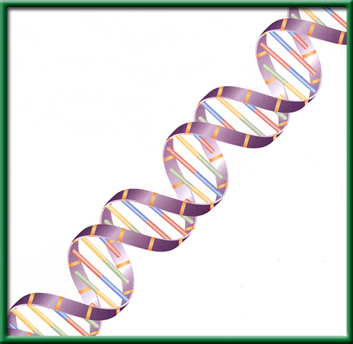
3/6 DNA: The Model of Heredity 11.1
Obj. TSW examine DNA from Strawberries through a process of DNA extraction. P.60 NB
http://learn.genetics.utah.edu/
What Nucleic Acid is responsible for all of our genetic information, please spell it out.
What are the three components (nitrogen bases and backbone) to this Nucleic Acid?
Draw the structure of DNA, describe it in words and label the 3 parts.
HW – Read CH 11 , 1 pg. Notes P. 65 NB

Slide 3







Section 11.1 Summary – pages 281 - 287
The structure of nucleotides
#1. The simple sugar in DNA, called deoxyribose (dee ahk sih RI bos), gives DNA its name— deoxyribonucleic acid.
The phosphate group is composed of one atom of phosphorus surrounded by four oxygen atoms, it has a negative charge.

Slide 4
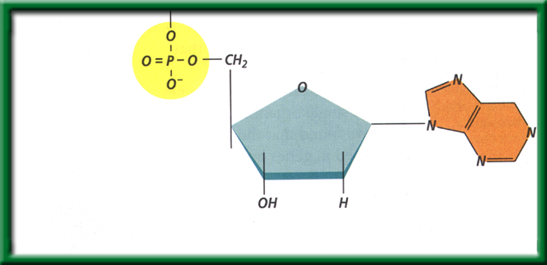
Section 11.1 Summary – pages 281 - 287
The structure of nucleotides
#2. DNA is a polymer made of repeating subunits called nucleotides. The backbone is made up of the Sugar and Phosphate group.
Nitrogenous base
Phosphate group
Sugar (deoxyribose)
Nucleotides have three parts: a simple sugar, a phosphate group, and a nitrogenous base.

Slide 5
Section 11.1 Summary – pages 281 - 287
#2. What are the two functions DNA?
Although the environment influences how an organism develops, the genetic information that is held in the molecules of DNA ultimately determines an organism’s traits.
DNA achieves its control by determining the structure of proteins.

Slide 6
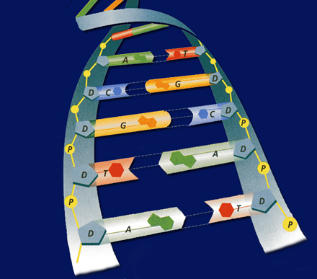
#3. Deoxyribonucleic Acid
Shape= a Double Helix
Backbone =
  Sugar & Phosphate
Nitrogen base
  Guanine
  Thymine
  Adenine
  Cytosine

Slide 7
Strawberry DNA Extraction Lab p. 63 NB
Write the title in your Notebook
Will we extract DNA from the strawberries? If so, what will the DNA look like?
Hypothesis:
  If, then statement that is testable & measurable. For example: If I crush strawberries and add the buffer, then I will extract 2 tablespoons of DNA.)
Materials:
  Ziplock bag
  Strawberries
  Soap: used to dissolve phospholipid bilayers of the cell membrane
  Salt: break up protein chains around the DNA
  Ethanol: DNA is NOT soluble in ethanol (what does this mean?)
  Funnel
  Cheese cloth
  Test tube
  Stirring rod

Slide 8
Procedure
1. Place one strawberry in the plastic bag. Close the plastic bag. Now, squish the strawberry! (*make sure not to break the bag*)
2. Add 10 mls of buffer solution and mix.
3. Place the funnel in the test tube and place cheesecloth on top of the funnel.
4. Strain strawberry mixture
5. OBSERVE MIXTURE in the test tube. Remove Strawberry mush into the trashcan from the cheesecloth. Rinse the cheese cloth in the sink.
6. Add 5 mls of rubbing alcohol.
7. OBSERVE MIXTURE and record results.
8. Place stir rod into test tube to extract DNA.

Slide 9
Continued
DNA Extraction Buffer Contains in 600ml Beaker:
  450 mls of water
  50 mls of soap
  1 tsp salt
As you do the lab, make sure you make your observations!

Slide 10
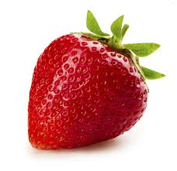
Strawberry DNA Extraction Lab
Prediction: What do you THINK we will have to do in order to extract DNA from a strawberry? Write in complete sentences.

Slide 11
Conclusion And Analysis
Answers
To Precipitate DNA from Solution D
Separate components of the cell A
Break open the cells C
Break up proteins and dissolve cell membranes B

Slide 12
Conclusions! P. 63 NB
Strawberry DNA Extraction AXES Paragraph
What did the DNA look like? What is it’s shape?
How were we able to see it?
Why was it essential to add buffer?
Why was it essential to add ethanol?
What is an example of a Nucleic Acid?
Why is DNA important?

Slide 13
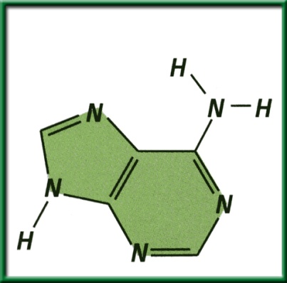
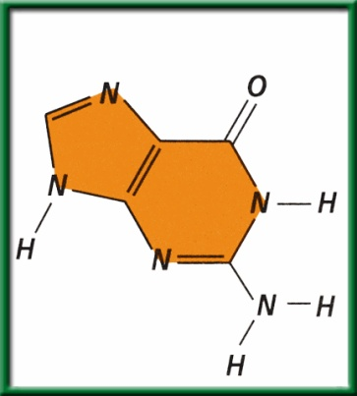
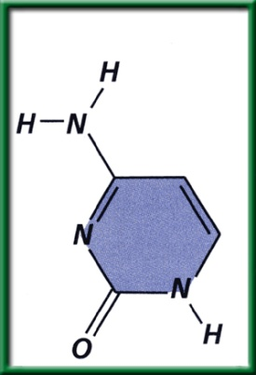
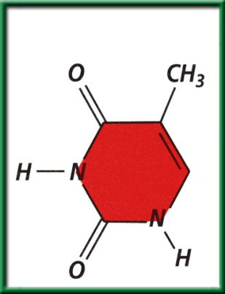
Section 11.1 Summary – pages 281 - 287
The structure of nucleotides
A nitrogenous base is a carbon ring structure that contains one or more atoms of nitrogen.
In DNA, there are four possible nitrogenous bases: adenine (A), guanine (G), cytosine (C), and thymine (T).
Adenine (A)
Guanine (G)
Cytosine (C)
Thymine (T)

Slide 14
#3. (DNA)Nitrogen Base Pairing Rules
ADENINE = THYMINE
CYTOSINE = GUANINE
G = ?
T = ?
A = ?
C = ?

Slide 15
DNA/ RNA Beads p. 59NB
Backbone= Phosphate & Sugar (Red & White)
Nitrogen Bases= Adenine (Blue)=Thymine (Green)
            Cytosine (Yellow )=-Guanine (Orange)
            Uracil (Pink) RNA
Hydrogen bond (clear barbell)
http://learn.genetics.utah.edu/
WS - DNA Model Discussion questions

Slide 16
DNA Model Discussion Questions p. 59NB
Please write in complete sentences.
What is the general Structure of the DNA molecule?
What are the 3 parts of a nucleotide?
Name the 2 molecules which alternate to make the sides or “backbone” of the DNA molecule.
Name the 4 nitrogen bases.
To which molecules does the nitrogenous base attach?
What are the base – pairing rule for DNA?
If there are three thymine bases on your model, how many adenine bases will there be?

Slide 17
DNA Model Discussion Questions
8. Draw a picture of your DNA. Label the sugar, a phosphate, and all the bases on the left and right side of the molecule you constructed.
9. If you were to open the entire DNA molecule along the hydrogen bonds and attached new bases to the sides you would have two new DNA molecules. Would these 2 DNA strands have the same base pairs?
10. Would the two DNA molecules that resulted from replication be the exact copies of each other? Explain. Why is this important?

Slide 18
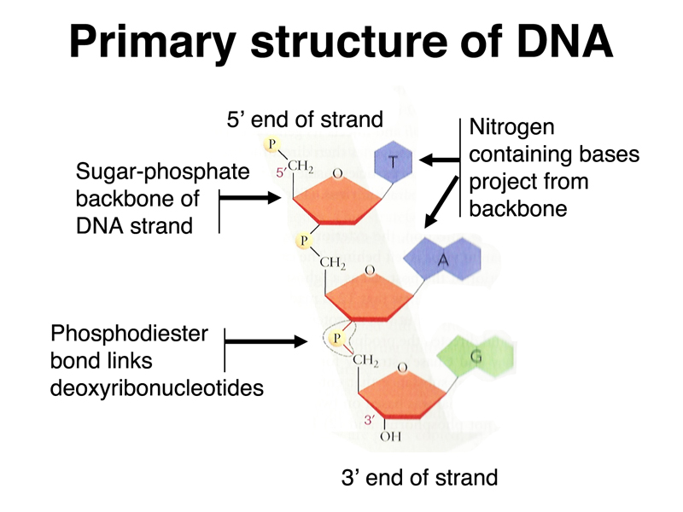
3/9 DNA Structure & Function CH. 11.1
Obj: TSW review DNA structure & function. Pg. 62 NB
Name two functions of DNA.
Draw a nucleotide and label the three components.
Use the base pairing rules you learned yesterday to determine the complimentary sequence of this DNA strand:
5’-TACGGTACT-3’

Slide 19
Section 11.1 Summary – pages 281 - 287
#1. What are the two functions DNA?
1. Although the environment influences how an organism develops, the genetic information that is held in the molecules of DNA ultimately determines an organism’s traits.
2. DNA achieves its control by determining the structure of proteins.

Slide 20
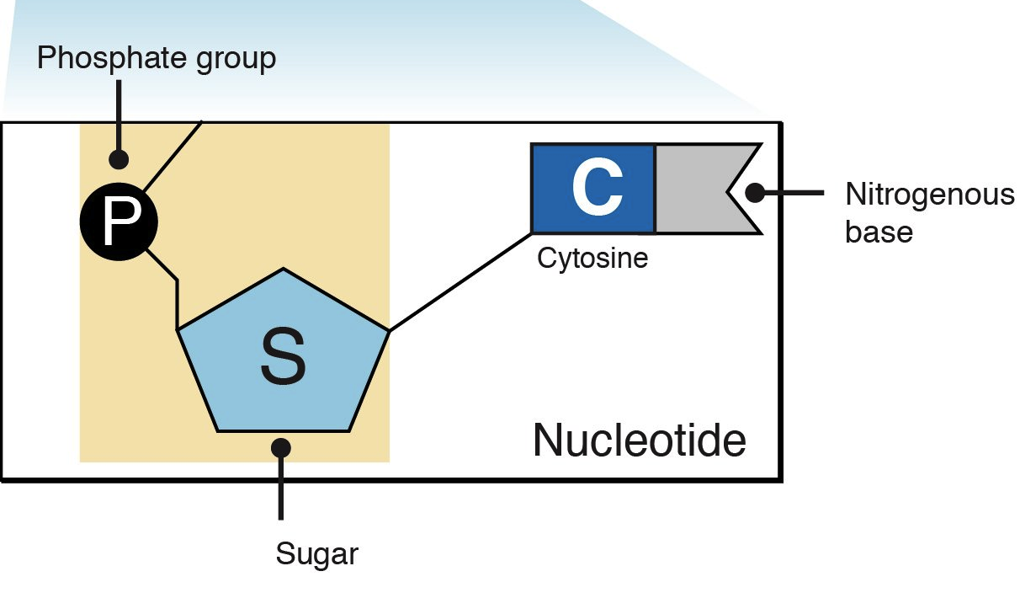
Section 11.1 Summary – pages 281 - 287
2. The structure of nucleotides
A nitrogenous base is a carbon ring structure that contains one or more atoms of nitrogen.
In DNA, there are four possible nitrogenous bases: adenine (A), guanine (G), cytosine (C), and thymine (T).
Adenine (A)
Guanine (G)
Cytosine (C)
Thymine (T)

Slide 21
#3. (DNA)Nitrogen Base Pairing Rules
Hydrogen bonds hold nitrogen bases together
ADENINE = THYMINE
CYTOSINE = GUANINE
G = ?
T = ?
A = ?
C = ?

Slide 22
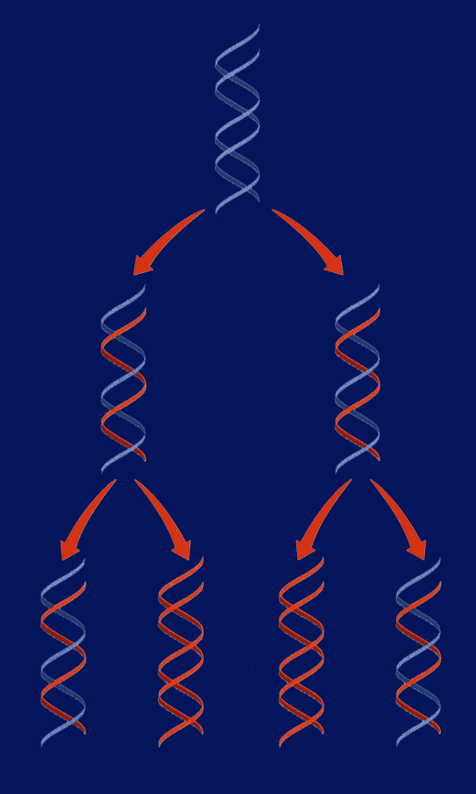
3/10 DNA Replication 11.1
Obj. TSW demonstrate base pairing rules of DNA Replication by constructing a 2-D model of DNA with paper. P.64 NB
What is DNA replication?
Why does DNA replicate?
Diagram DNA being replicated.
Replication Video
HW CH 11 1 page Notes P. 65 NB
Show video DNA Replication

Slide 23
DNA/ RNA Beads p. 65NB
Backbone= Phosphate & Sugar (Red & White)
Nitrogen Bases= Adenine (Blue)=Thymine (Green)
            Cytosine (Yellow )=-Guanine (Orange)
            Uracil (Pink) RNA
Hydrogen bond (clear barbell)
http://learn.genetics.utah.edu/
WS - DNA Model Discussion questions

Slide 24
DNA Model Discussion Questions p. 65NB
Please write in complete sentences.
What is the general Structure of the DNA molecule?
What are the 3 parts of a nucleotide?
Name the 2 molecules which alternate to make the sides or “backbone” of the DNA molecule.
Name the 4 nitrogen bases.
To which molecules does the nitrogenous base attach?
What are the base – pairing rule for DNA?
If there are three thymine bases on your model, how many adenine bases will there be?

Slide 25
Learn.genetics.utah.edu
P. 65 NB
Write a summary paragraph about DNA. Write 3 – 5 sentences about the shape of DNA, the nitrogen bases, the bond that holds them together and what a nucleotide is.
Build a DNA Molecule
Match the nucleotide base pair
  What bases always pair together?
  What holds the base pairs together?

Slide 26
Question
If there is one strand of DNA with the code:
AATCCGGATA
What would its complimentary strand (strand across from it) look like?

Slide 27
Answer
AATCCGGATA
TTAGGCCTAT
A always pairs with T C always pairs with G

Slide 28
Section 11.1 Summary – pages 281 - 287
#1. Replication of DNA
Before a cell can divide by mitosis or meiosis, it must first make a copy of its chromosomes.
The DNA in the chromosomes is copied in a process called DNA replication.
Without DNA replication, new cells would have only half the DNA of their parents.

Slide 29
Section 11.1 Summary – pages 281 - 287
DNA
Replication
Replication of DNA
Replication

Slide 30
DNA Replication
DNA replication: the DNA in chromosomes is copied in this process
If I say a strand contains: AATTCC on one side, what will the complementary strand be? You can predict what the bases will be on the other side! Part of replication uses this logic.
During DNA replication, each strand serves as a pattern, or template, to make a new DNA strand.

Slide 31
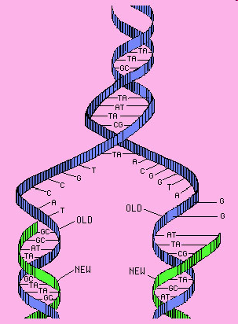
#3. Steps of DNA Replication
STEP 1. Separation of Strands: When a cell begins to copy DNA, the DNA unwinds, and the hydrogen bonds are broken. This allows the bases of nucleotides to be exposed.
Unwinding!
Hydrogen bonds broken!
(like unzipping!)
STEP 2. A new Sugar- Phosphate
backbone forms along the new
strand forms.

Slide 32
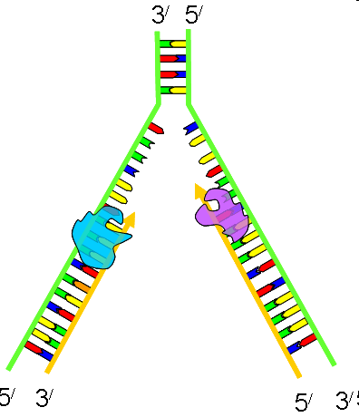
DNA Replication 3’ to 5’ RULE
DNA strands go from 3’ to 5’ or 5’ to 3’
When DNA strands pair,
it is opposite
STEP 3. Base pairing: Free nucleotides pair
with the exposed DNA bases.
STEP 4. Two molecules of DNA are
Formed; each is half original &
Half complementary.

Slide 33
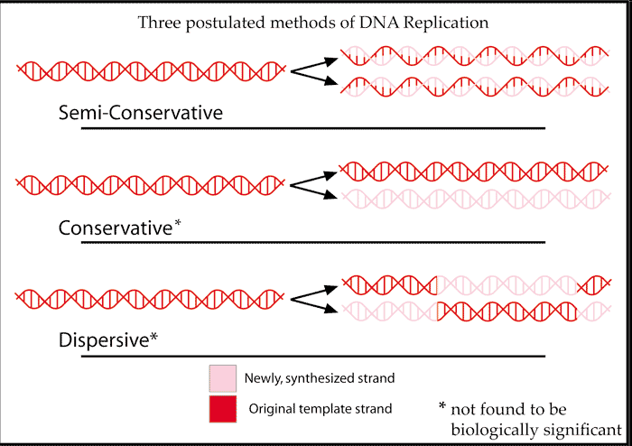
Semi-conservative Replication p. 61 NB
Half of the DNA is Original the other half is new (Complementary)

Slide 34
DNA Replication Practice p. 61 NB
Directions: Using one half of the a DNA helix, show what the correct pairing would be, skip lines in your NB.
ATT CGT TAC CAC CTC
TAT TAG GCA ATA TTC
GTG TGA TTA ATA GCC
CTA AAG GAA TAG GAT
GAT GAA TAC CCA CGA
TAA TAT GCA CAT TAC
GAA CCT TAC GGG GTG
TAT AAC CAG GAG TTT
ATC CGT AGT GTA AAT
GGA TTA CCC TTA CCA

Slide 35
DNA Replication Lab p. 63 NB
Materials:
Scissors, tape, DNA template (on white piece of paper), blank white piece of paper, 4 of each nitrogenous bases (each one different color of paper).
Procedures:
Pair up with a partner
Get supplies: 2 Original Strands of DNA backbone (White), & 1 paper of 4 of each of the Nitrogen Bases
Base pair the nitrogen bases to the Deoxyribose sugar.
Draw your Hydrogen Bonds A=T; C=G
Write Original Strand on the two white DNA Backbones.
After McAllister reviews your model, she will give you 2 Yellow Backbones that are the complementary strands to base pair your Original strand to.
Cut your Original Strand in ½, and base pair the complementary strand to it.
When you have finished your model, answer the questions below in your notebook P.47NB
Questions:
List the 3 functional groups & the 4 nitrogenous bases found in DNA.
List the rules for base pairing in DNA.
What are the two main functions of DNA?
Draw DNA Replication with two different colors.

Slide 36
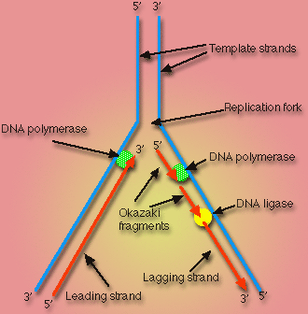
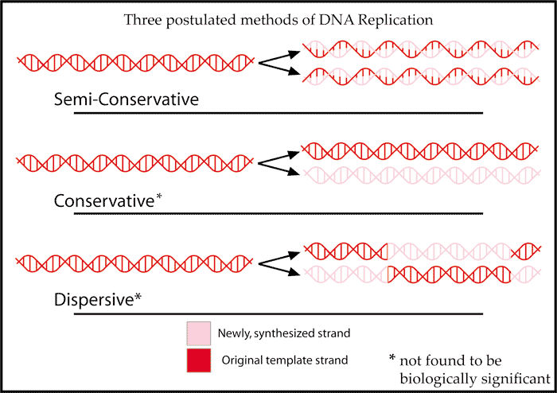
DNA Replication Activity Tape your Replicated DNA p. 63 NB
What is Semi–Conservative Replication?
What are the two main functions of DNA?
Why is DNA Replication important?
List the 3 functional groups & the 4 nitrogenous bases found in DNA.
Draw DNA Replication with two different colors.
List the rules for base pairing in DNA.

Slide 37
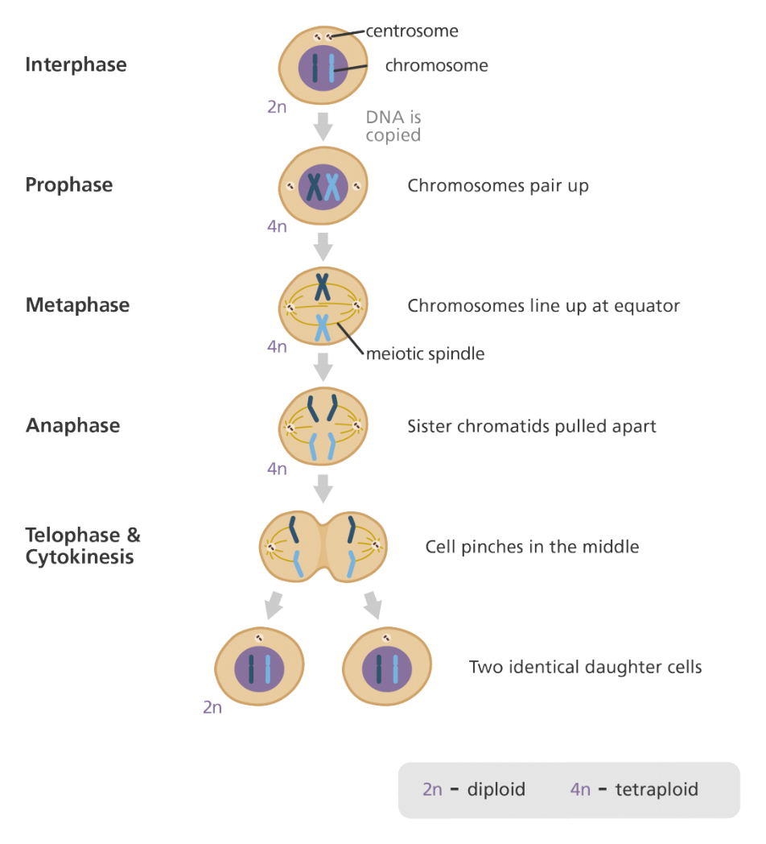
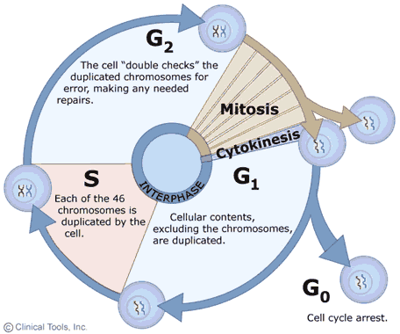
3/13 Cell Growth & Reproduction: Mitosis CH 8.2
Obj. TSW understand the cell cycle and processes at each stage. P. 66 NB
What is mitosis?
Draw the Cell Cycle.
What is the result of Mitosis?

Slide 38
Problem Solving Lab 8.2 P. 204BB p. 61 NB
Read the Observe & Infer section.
Read the Solve the Problem.
Answer the three “Thinking Critically” questions p. 61NB
  Growth 1 phase- Rapid Growth & metabolism of Interphase is the most variable in length.
  The two types of cells have different functions and one is more complex than the other.
  The cycle of some types of cells is faster then others because of the complexity of the proteins made by the cell or the need to produce cells due to rapid wear and tear – like skin cells compared to muscles cells or nerve cells in the spine (do not regenerate).

Slide 39
Mitosis Practice p. 65NB
Get 2 white boards/ lab station
Get 1 Expo marker / 2 students
Draw a nucleus and place your replicated chromosomes inside the nucleus.
With the yellow and red chromosomes, practice the 4 stages of Mitosis, drawing and erasing the nucleus as the stages dictate.
After you show them to me/us, Then draw the phases of Mitosis on
page 63 NB.

Slide 40
Mitosis Rules p. 65 NB
Create a Mental model of how a cell cycle works that shows an end result of 2 identical cells after Mitosis with the same number of chromosomes.
Set up rules for what a cell can and can not do.
What steps does the cell have to go through to create two new identical cells.
Result of Mitosis: 2 identical cells with the same # of chromosomes that make tissues, that form organs, that are part of an organ system and make an organism.

Slide 41
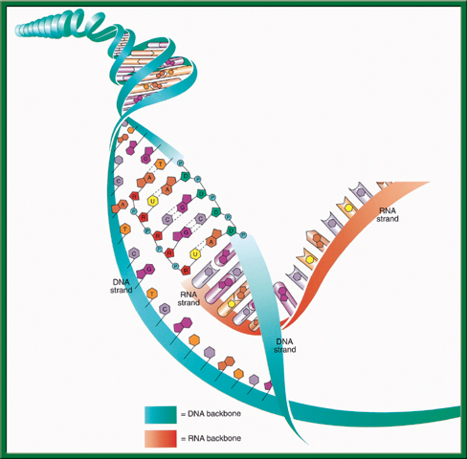
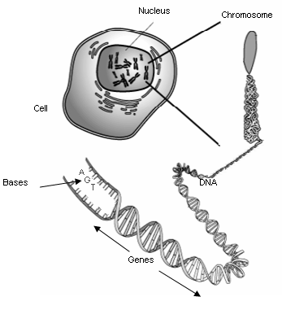
3/14 RNA (Ribonucleic Acid) CH 11.2
Obj. TSW compare and contrast the structure and function of DNA and RNA in the Warm Up, and from the video. P. 68 NB
Describe how RNA’s structure differs from DNA’s structure in three ways?
Identify and describe the functions of the three types of RNA.
What is the main difference between Transcription and DNA Replication?
Study for DNA Quiz: CH 11 Tuesday
Work on your Lab – Final Lab due Friday

Slide 42
Science Article: Endosymbiotic Theory p. 65 NB
Read the article quietly.
Read the article out loud.
Pair up and write the Claim, Evidence and Reasoning
Discuss as a class: Endosymbiotic Theory
Turn the Paper over and write the AXES Paragraph on Endosymbiotic Theory

Slide 43


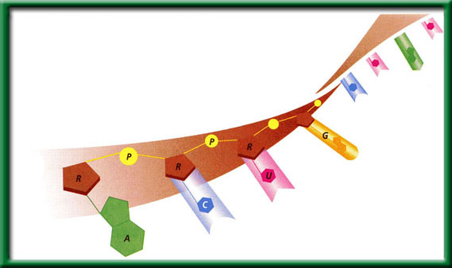
Section 11.2 Summary – pages 288 - 295
#1. RNA
RNA like DNA, is a nucleic acid. RNA structure differs from DNA structure in three ways.
First, RNA is single stranded—it looks like one-half of a zipper —whereas DNA is double stranded.

Slide 44
#1. Transcription
To return to the chapter summary click escape or close this document.

Slide 45
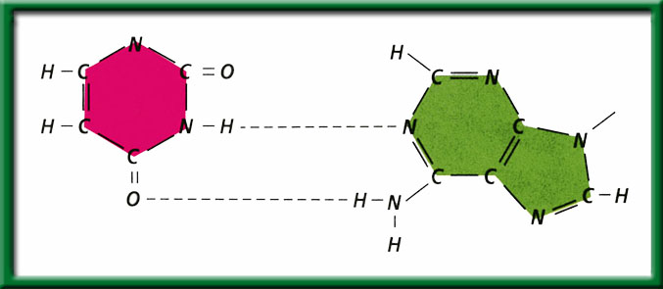
Section 11.2 Summary – pages 288 - 295
#1. RNA
Both DNA and RNA contain four nitrogenous bases, but rather than thymine, RNA contains a similar base called uracil (U).
Uracil forms a base pair with adenine in RNA, just as thymine does in DNA.
Uracil
Hydrogen bonds
Adenine

Slide 46

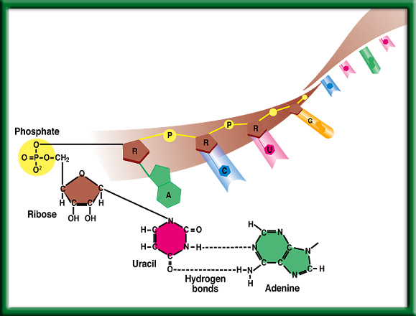
#1. Second: Chemical Difference of DNA and RNA
Uracil is the Nitrogen base that replaces Thymine
To return to the chapter summary click escape or close this document.

Slide 47
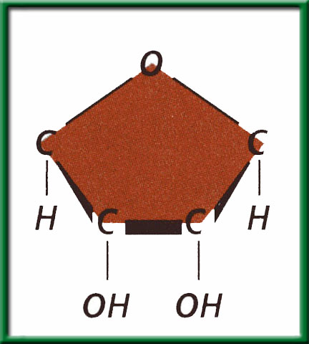
Section 11.2 Summary – pages 288 - 295
#1. RNA
Third: The sugar in RNA is Ribose; DNA’s sugar is deoxyribose.
Ribose

Slide 48
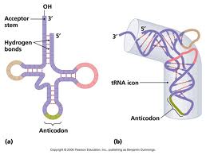
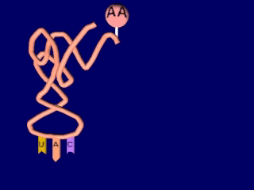
Section 11.2 Summary – pages 288 - 295
#2. RNA
Transfer RNA (tRNA) is the supplier. Transfer RNA delivers amino acids to the ribosome to be assembled into a protein.
Click image to view movie

Slide 49
Section 11.2 Summary – pages 288 - 295
#2. RNA
There are three types of RNA that help build proteins.
Messenger RNA (mRNA), brings instructions from DNA in the nucleus to the cell’s factory floor, the cytoplasm.
On the factory floor, mRNA moves to the assembly line, a ribosome.

Slide 50
Protein Synthesis – Thursday!!!!! 10/6
1 large bag of M & M’s –
1 large bag of Gummy Bears –
4 bags of Marshmallows-
1 stick of Butter – McAllister
1 box Rice Krispy Cereal -

Slide 51
DNA Quiz Friday 9/30
1 piece of Binder Paper & pencil or pen. Write your name on the top right hand side.
1. What is the name of the molecule that holds our genetic information?
2. What is the shape of that molecule?
3. Where is that molecule located in the cell?
4. What are the 4 Nitrogen Bases that code for Amino Acids?
5. Write how the Nitrogen base pair together.
What is the bond that holds the nitrogen bases together?
Draw & Write the three parts of a nucleotide.
8. What is DNA Replication?
9. What are the two functions of DNA?
10. How is RNA different from DNA?

Slide 52
Section 11.2 Summary – page 2888- 295
Genes Expression = Proteins
You learned earlier that proteins are polymers of amino acids.
The sequence of nucleotides in each gene contains information for assembling the string of amino acids that make up a single protein.

Slide 53
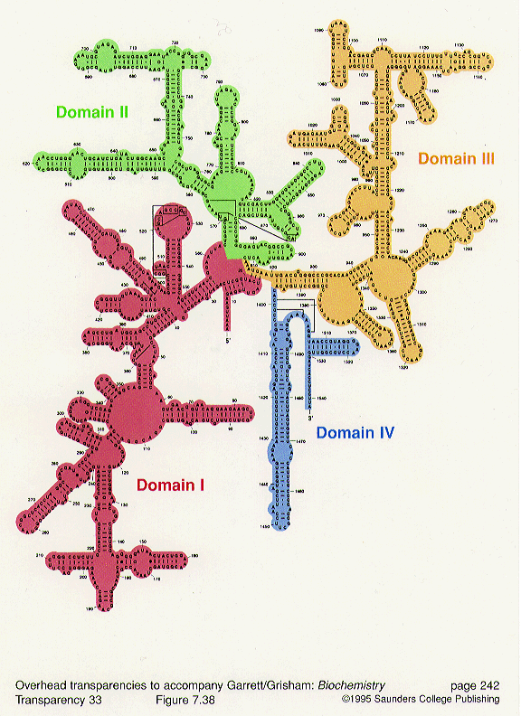
Section 11.2 Summary – pages 288 - 295
#2. RNA
The ribosome, made of ribosomal RNA (rRNA), binds to the mRNA and uses the instructions to assemble the amino acids in the correct order.

Slide 54

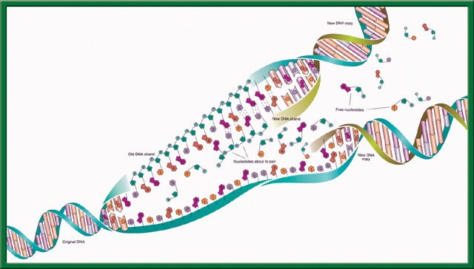
What Process is this?
What are the steps?
What is the name for this particular type of process?
To return to the chapter summary click escape or close this document.

Slide 55
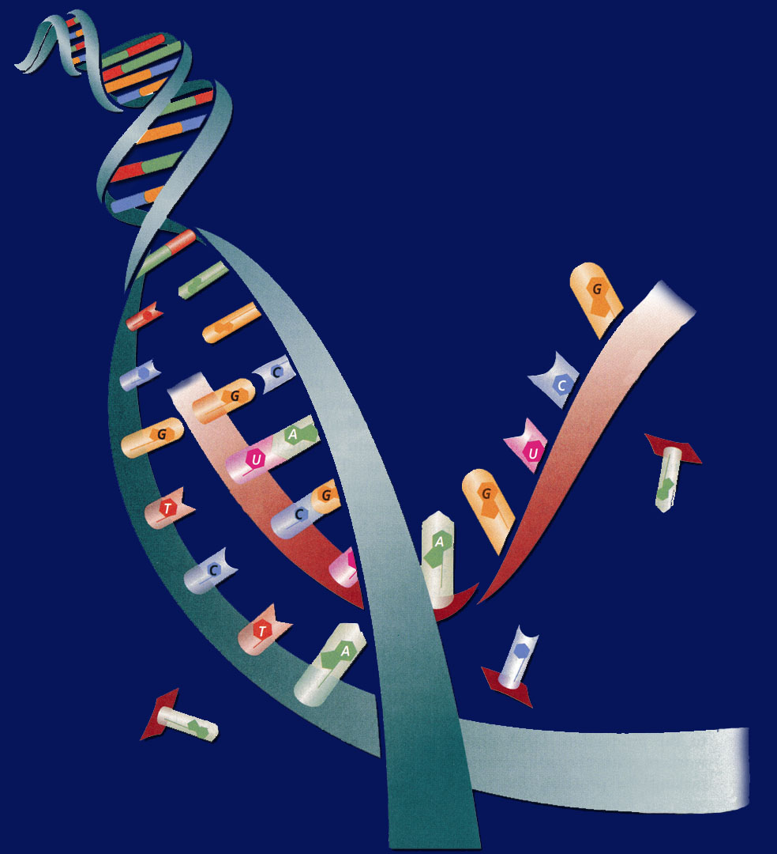
#3. The difference of DNA Replication & Transcription (Making Proteins)
Transcription – first process of making proteins.
DNA Replication – makes more DNA for more cells.

Slide 57
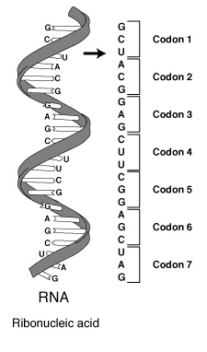
3/15 Protein Synthesis: Transcription 11.2 Week 8
Obj. TSW be able to explain the process of Transcription by making mRNA strand from DNA through practice. P.70 NB
Learn.genetics.utah.edu/
What is transcription?
Where does Transcription happen?
Why is a codon important to making a protein?

Slide 58
Cracking the Code
Answer the Questions on the ½ sheet of paper

Slide 59
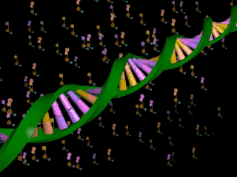
Section 11.2 Summary – pages 288 - 295
Transcription
In the nucleus, enzymes make an RNA copy of a portion of a DNA strand in a process called transcription.
Click image to view movie

Slide 60
Section 11.2 Summary – pages 288 - 295
Transcription
A
DNA strand
RNA strand
RNA strand
C
B
DNA strand

Slide 61
Section 11.2 Summary – pages 288 - 295
Transcription
The main difference between transcription and DNA replication is that transcription results in the formation of one single-stranded RNA molecule rather than a double-stranded DNA molecule.

Slide 62
Section 11.2 Summary – pages 288 - 295
RNA Processing = Gene Expression
Not all the nucleotides in the DNA of eukaryotic cells carry instructions—or code—for making proteins.
Genes usually contain many long noncoding nucleotide sequences, called introns, that are scattered among the coding sequences.

Slide 63


Chapter Assessment
Question 1
How does DNA control the structures and functions of a cell?
Answer
DNA determines the structure of proteins. Some proteins become important cell structures. Other proteins, such as enzymes, control chemical reactions that perform key life functions.
CA: Biology/Life Sciences
5a

Slide 64
HW CH 11 DNA & Genes p.41 NB
Deoxyribose
Nitrogenous Base
Nucleotide
Base Pair
Hydrogen Bond
Phosphate
Adenine (A) & Nitrogen Bases
Cytosine
*Nucleotides
DNA Replication
Double Helix

Slide 65
HW CH 11 DNA &Genes*
DNA – Double RNA – single
DNA – Deoxyribose RNA – Ribose
DNA – ATCG RNA – AUCG
Amino Acids
Amino Acids
Proteins
Codon*
Threonine

Slide 66
QUIZ
8. What is DNA Replication?
9. What are the two functions of DNA?
10. What are three differences of RNA from DNA?
11. What RNA has stop codons, and what is their function?
12. How are codons and anticodons different?
13. Write the equation for Protein Synthesis.
14. Transcribe & Translate the DNA sequence:ATC, TCA, TAC

Slide 67
DNA Quiz
7. What is the backbone of the molecule made of?
8. What is a gene?
9. What does DNA code for? What is it’s purpose?
10. Write the formula for Protein Synthesis
When you are finished turn you paper upside down and wait quietly to
have me pick it up.

Slide 68
POP QUIZ Write your name on your binder paper.
What is this molecule? Spell it out.
What is the shape of the molecule?
What are the two purposes/ functions of this molecule?
Write the three names for the parts of a nucleotide. Be specific.
The Nitrogen bases are: Adenine, Cytosine, Guanine, & Thymine – Base Pair them together correctly.
What holds the Nitrogen bases together?
DNA is a Nucleic Acid, write an example of another one.
Can a Nucleic Acid leave the nucleus?
9. What is DNA Replication?
What is the name for how DNA
Replications?

Slide 69
Chapter Assessment
Question 2
The process through which the order of bases in messenger RNA codes for the order of amino acids in a protein is:
A. transcription
B. translation
C. replication
D. point mutation
The answer is B.
CA: Biology/Life Sciences
4f

Slide 70
Chapter Assessment
Question 3
Why would scientists use nucleotide sequences to identify bodies of crime victims?
Answer
In comparing nucleotide sequences in the DNA of a crime victim with nucleotide sequences from a possible close relative of the crime victim, scientists can determine if the two are related.
CA: Biology/Life Sciences
4e

Slide 71
HW CH 11
9.Phenylalanine Codon are (UUU) (UUC)
10. Codon
11. Amino Acid
12. Amino Acid
13. Stop codons = UGA, UAG, UAA
14. Tryptophan & Methionine

Slide 72
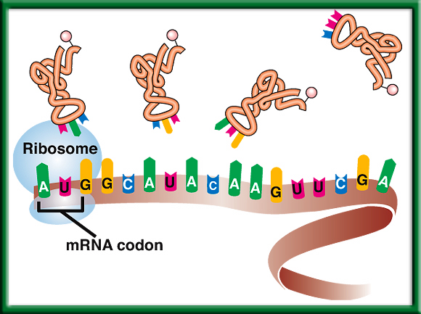
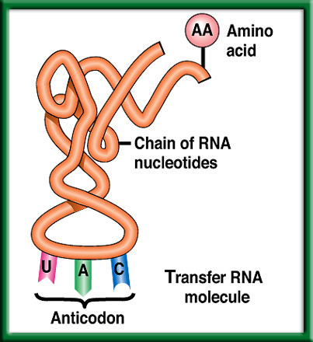
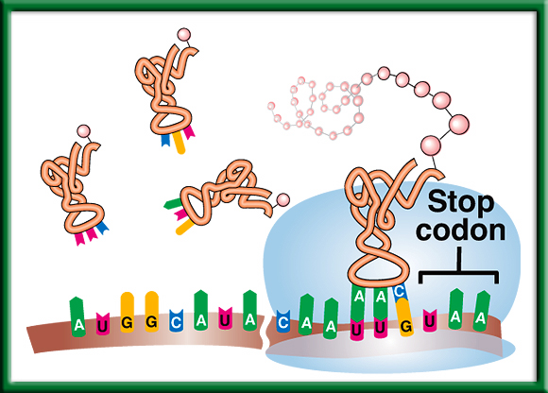
2/24 Protein Synthesis: Translation 11.2
Obj. TSW explain the process of Protein Synthesis by working on their Protein Synthesis foldable and transcribing and translating DNA sequences from their Mini Lab 11.1 P. 52NB
Learn.genetics.utah.com.edu/
Compare & Contrast Codon and Anticodon.
What is the role of tRNA in Protein Synthesis?
Why are Stop Codons important in Translation?
http://www.dnatube.com/video/3448/DNA-Replication

Slide 73
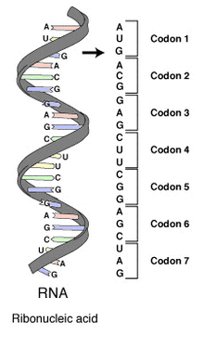
#1. Codon & Anticodon
A Codon is a nucleotide triplet sequence on mRNA, it codes for an amino acid.
  AUG ACG GAG
An Anticodon is a nucleotide triplet sequence on tRNA that carries the Amino acid
  UAC
Both are RNA & Each triplet pairs to code for a particular Amino acid to form a protein.

Slide 74
Section 11.2 Summary – pages 288 - 295
#2. The role of transfer RNA - tRNA
As translation begins, a ribosome attaches to the starting end of the mRNA strand. Then, tRNA molecules, each carrying a specific amino acid, approach the ribosome.
When a tRNA anticodon pairs with the first mRNA codon, the two molecules temporarily join together.
Usually, the first codon on mRNA is AUG, which codes for the amino acid methionine.

Slide 75
#3. Stop Codons
Without the stop codon, the protein would continuously be made.
More Protein is not necessarily better.
Name the 3 codons for STOP:
  UAA, UAG, UGA

Slide 76
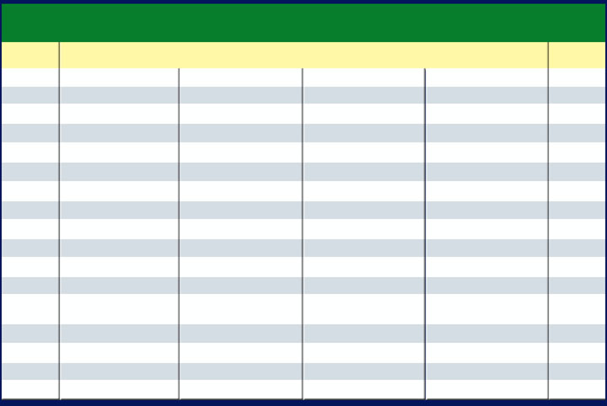
Section 11.2 Summary – pages 288 - 295
The Genetic Code P.292 BB
The Messenger RNA Genetic Code
First Letter
Second Letter
Third Letter
U
C
A
G
U
Phenylalanine (UUU)
Serine (UCU)
Tyrosine (UAU)
Cysteine (UGU)
U
Phenylalanine (UUC)
Serine (UCC)
Tyrosine (UAC)
Cysteine (UGC)
C
Leucine (UUA)
Serine (UCA)
Stop (UAA)
Stop (UGA)
A
Leucine (UUG)
Serine (UCG)
Stop (UAG)
Tryptophan (UGG)
G
C
Leucine (CUU)
Proline (CCU)
Histadine (CAU)
Arginine (CGU)
U
Leucine (CUC)
Proline (CCC)
Histadine (CAC)
Arginine (CGC)
C
Leucine (CUA)
Proline (CCA)
Glutamine (CAA)
Arginine (CGA)
A
Leucine (CUG)
Proline (CCG)
Glutamine (CAG)
Arginine (CGG)
G
A
Isoleucine (AUU)
Threonine (ACU)
Asparagine (AAU)
Serine (AGU)
U
Isoleucine (AUC)
Threonine (ACC)
Asparagine (AAC)
Serine (AGC)
C
Isoleucine (AUA)
Threonine (ACA)
Lysine (AAA)
Arginine (AGA)
A
Methionine;Start (AUG)
Threonine (ACG)
Lysine (AAG)
Arginine (AGG)
G
G
Valine (GUU)
Alanine (GCU)
Aspartate (GAU)
Glycine (GGU)
U
Valine (GUC)
Aspartate (GAC)
Glycine (GGC)
Alanine (GCC)
Glycine (GGC)
C
Valine (GUA)
Alanine (GCA)
Glutamate (GAA)
Glycine (GGA)
A
Valine (GUG)
Alanine (GCG)
Glutamate (GAG)
Glycine (GGG)
G

Slide 77
2/25 Protein Synthesis: Translation 11.2
Obj. TSW explain the process of Protein Synthesis by diagramming all the steps in their notebook. P. 54 NB
When making proteins, If a template DNA strand read TAC GGT, AGT what would a complementary strand of mRNA be?
What Amino Acids would the 3 codons code for?
Do the same for: GCA, TGC, ATC (DNA).
Learn.genetics.utah.edu/

Slide 78
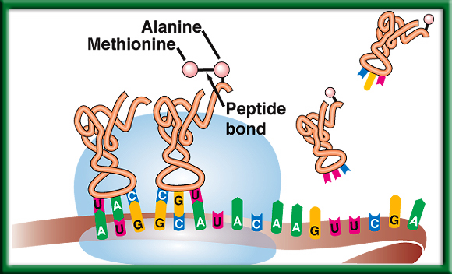
Protein Synthesis p. 59 NB
DNA -> transcription -> RNA -> translation -> Proteins

Slide 79
Mini Lab 11.1 P. 67NB P. 293 BB
DNA → transcription →RNA →translation → Protein
Copy this table in your notebook.
 | A | B | C | D | E
DNA Base Sequence | Process | mRNA Codon | Process | tRNA Anticodon | Amino Acid
AAT
GGG
ATA
AAA
GTT

Slide 80
Mini Lab 11.1 P. 67 NB P. 293 BB
DNA → transcription →RNA →translation → Protein
 | A | B | C | D | E
DNA Base Sequence | Process | mRNA Codon | Process | tRNA Anticodon | Amino Acid
AAT | Transcription | UUA | Translation | AAU | Leucine
GGG |  | CCC |  | GGG | Proline
ATA |  | UAU |  | AUA | Tyrosine
AAA |  | UUU |  | AAA | Phenylalanine
GTT |  | CAA |  | GUU | Glutamine
Answer Analysis Questions 1 – 3
A.DNA instructions are located in the nucleus.
Transcription happens in the nucleus.
Translation happens in the Ribosome.
tRNA looks like a triangle with an Amino Acid on the end, and the other side has the Anticodon that base pairs with the codon on the mRNA.
Mutations would be more common, if the sequence of DNA was not strictly adhered to.

Slide 81
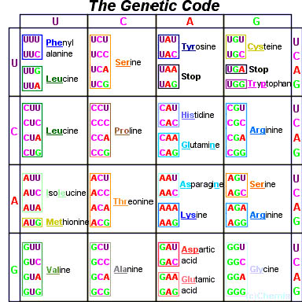
Page 292 Biology Book

Slide 82
Molecular Genetics p. 69 NB
DNA Replication – make more DNA for more cells to replace other cells.
Protein Synthesis – to make proteins
DNA-DNA
A = T
T = A
C = G
G = C
DNA RNA
A = U
T = A
C = G
G = C
Protein Synthesis
DNA: TAC CAC AAC
Transcription (nucleus)
mRNA: AUG GUG UUG
Translation (ribosome)
Protein: Methionine, ________, ________ Amino Acid Sequence

Slide 83
Protein Synthesis
Transcription Practice p. 69NB
Directions: Using the DNA strand as a template, transcribe mRNA. Make sure to use the correct Nitrogen bases.
ATA CCT TAA CGC GTC
TAT TAG GCA AAA TTC
GTG TGA TTA ATA GCC
CTA AAG GAA TAG GAT
GAT GAA TAC CCA CGA
TAA TAT GCA CAT TAC
GAA CCT TAC GGG GTG
TAT AAC CAG GAG TTT
ATC CGT AGT GTA AAT
GGA TTA CCC TTA CCA

Slide 84
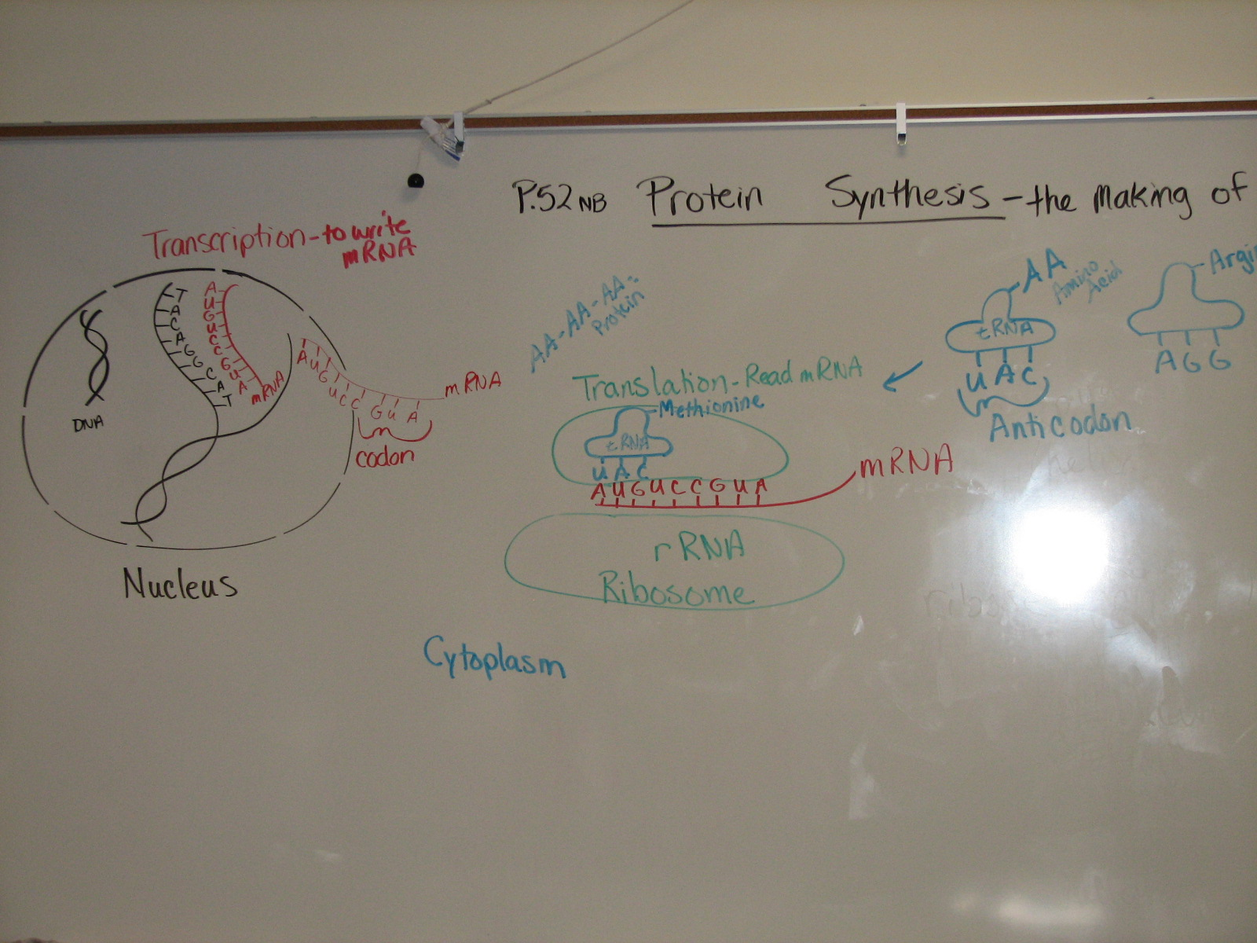

Slide 85
Protein Synthesis – Gene Expression
1. DNA: ATA CCT TAA CGC GTC
2. DNA: TAT TAG GCA AAA TTC

Slide 86
AXES Paragraph P. 71 NB
Write a paragraph after building your DNA molecule that include the vocabulary words: Double helix, Nitrogen bases, Hydrogen bond, Nucleotide, Backbone, Deoxyribose, Phosphate, Adenine, Thymine, Cytosine, Guanine.

Slide 87



Collect 3 sheets of paper and layer them about 1.5 cm apart vertically. Keep the edges level.
P. 53 NB
To return to the chapter summary click escape or close this document.

Slide 88


Fold up the bottom edges of the paper to form 6 equal tabs.
P. 53NB
To return to the chapter summary click escape or close this document.

Slide 89

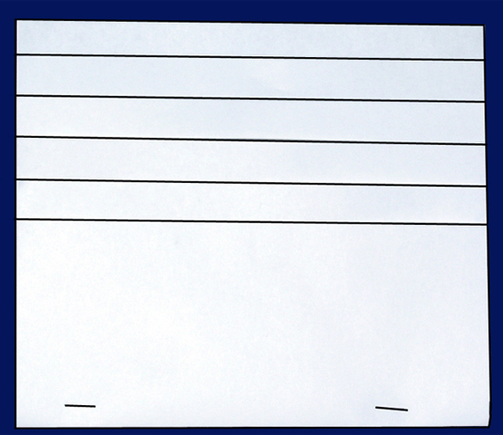
Fold the papers and crease well to hold the tabs in place. Staple along the fold. Label each tab.
P. 53NB
RNA – draw & label 3 differences from DNA p. 289
TRANSCRIPTION: from DNA to RNA P. 290
RNA Processing (Introns & Exons) P.291
The Genetic Code p. 291 - 292
TRANSLATION: from mRNA to PROTEIN p. 294 11.9A
PROTEIN SYNTHESIS
DNA->transcription->RNA ->translation->Protein
To return to the chapter summary click escape or close this document.

