Slide 1
Catalase Lab P. 29
1 flask / 2 people
GLX
Pressure Probe
Yeast – 1 tsp.
Hydrogen Peroxide 5ml
Swirl
Make observations.
Write a summary paragraph about the function of enzymes with a picture of a substrate & enzyme & active site. What factors allow for the enzyme to function? What temperature did Catalase work the best? Why does the enzyme speed up chemical reactions? Enzymes can be used again & again (Catalytic), how is this important in chemical reactions? At what Temp. did the Catalase work the best? Write the chemical equation.

Slide 2
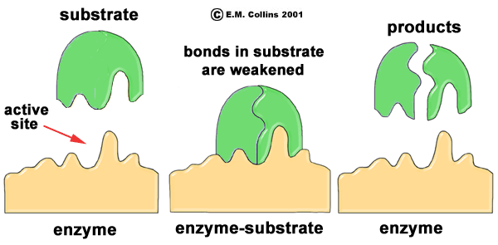
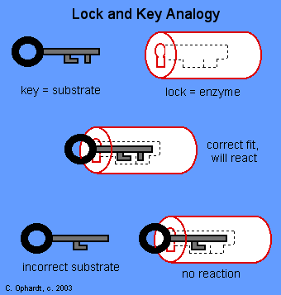
Macromolecules & Subunits Notes p. 31NB
Lipid _{(pm)} – Fatty Acids
Carbohydrate_{(pm)} - Saccharides
Protein _{(pm)} ( Enzymes)– Amino Acids
Temperature
pH
[Substrate ] & [Enzymes]
[Salt]
Nucleic Acid - Nucleotides

Slide 3
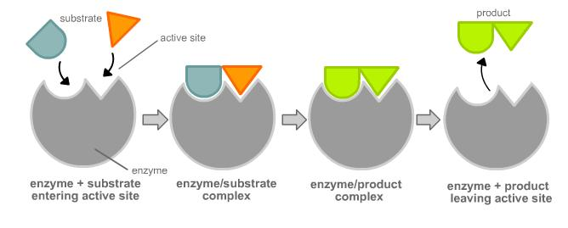
Enzyme Activity
You will be given a substrate or a part of an enzyme.
Find the matching part, that fits your active site.
Bring your matching Enzyme/ Substrate combinations (Lock & Key) to McAllister
I will quiz you on your knowledge of monomers and polymers in endergonic & exergonic reactions.

