Slide 1
Defense Against Infectious Diseases 39.1 & 39.2 1/30 TSW understand and explain the role of antibodies in the body’s response to a bacterial infection during the warm up. P. 20 NB
What is a pathogen?
Identify cells, tissues and organs that make up the immune system.
Explain the role of antibodies in response to infection.
T – cell production

Slide 2
Cellular Immunity

Slide 3
Antibody Immunity

Slide 4
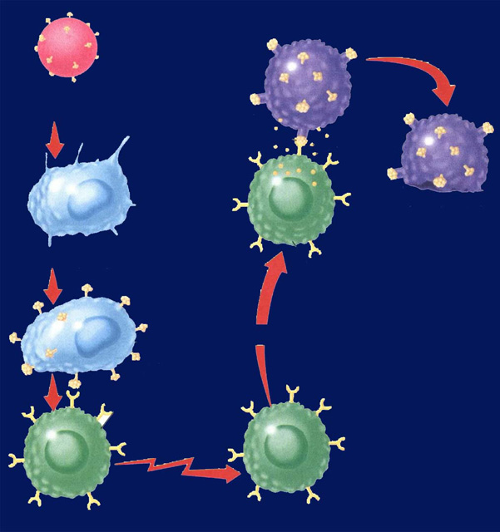
Immune System Responses 39.2 1/31 Obj. TSW compare and contrast Antibody Immunity and Cellular Immunity by diagraming the process in their NB and drawing a Cartoon applying nonspecific & specific immune responses. P.22NB
? Immunity
Identify two types of lymphocytes in Antibody Immunity.
Explain the process of Antibody Immunity.
Explain the process of Cellular Immunity.
? Immunity

Slide 5
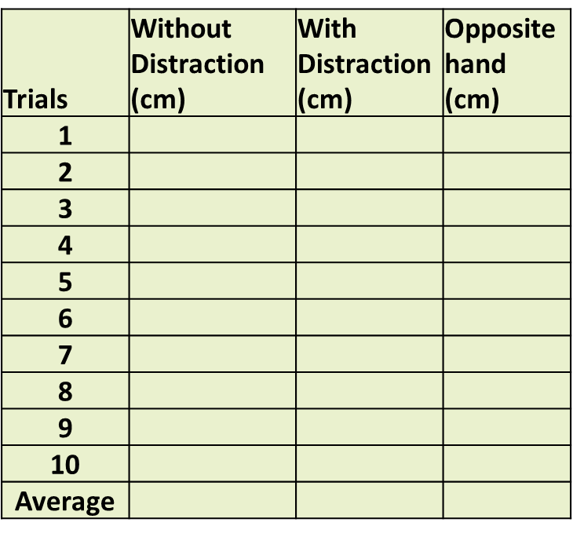
HW – send me (Email) the Data section of the Distraction Reaction Lab
Data: (12 Font, Times new roman)
Table 1: (12 Font, Times new roman)
Distance in (cm) measured with no Distraction, with Distraction and Opposite hand catching a meter stick. (10 font, TNR)

Slide 6
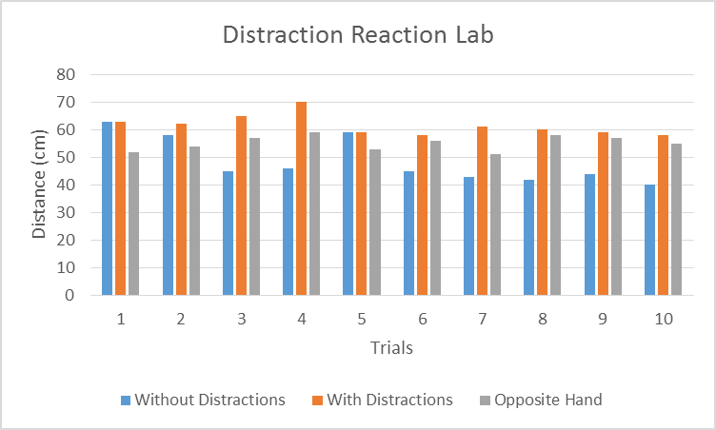
Data: (12 Font Times New Roman)
Graph 1:
Catching the meter stick without distractions, with distraction and with the opposite hand varied over the trials, however without distraction did get faster by the last trial. (10 font TNR)

Slide 7
Distraction Reaction Lab Use Excel to enter data
Create your title page today
Start your Background information by doing online research and cite your sources.
Copy and Paste Excel Data Table 1 and Graph 1 into word document.
Bar graphs are used not line.
Page 23NB
Notes CH 39

Slide 8
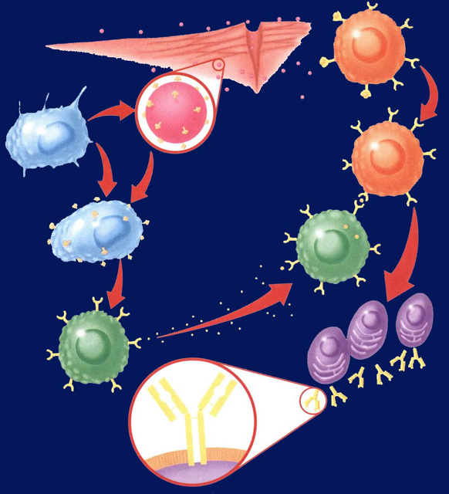
Notebook – Specific Immunity Activity
P. 25 NB Antibody Immunity P. 1037BB
P. 27 NB Cellular Immunity P. 1038 BB
Write a 4 – 5 sentence summary using specific vocabulary to explain the process.
Antibody Immunity
Cellular Immunity

Slide 10
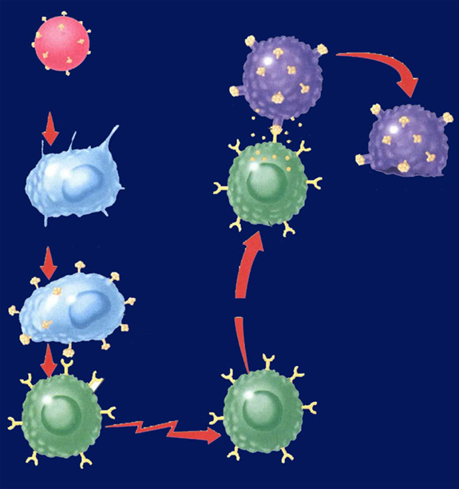

Slide 11
Section 39.2 Summary – pages 1031-1041
Antibody Immunity – Specific Immune Response, Builds Antibodies
E. B cells can bind to antigens directly.
Pathogens enter
tissues through a wound.
B cell
F. Helper T cells bind to antigens on B cells.
B. They are attacked
by macrophages
at the infection site.
Pathogen
Macrophage
G. T cells release chemicals that cause B cells to produce
clones of plasma cells.
C. Antigens of the pathogen are displayed
on the surface of the macrophage.
Antigen
receptor
site
H. Each plasma cell secretes more than 2000 antibodies per second in the blood. Memory B cells and antibodies remain in the blood and respond to future invasions by the same pathogen.
D. Helper T cells have
receptor sites that
recognize and bind to the antigens on the
macrophage.
T cell
Plasma
cells
Antibody
Surface of
plasma cell

Slide 12
Section 39.2 Summary – pages 1031-1041
#3.Cellular Immunity
Specific Immune Response that blows up infected body cells.
Infected cells
Pathogen
engulfed by
Perforin
Foreign
antigen
Infected cell lyses
Macrophage
Cytotoxic T cell
Displays antigens
on surface and
stimulates T cell
Attacks infected
cell
Stimulates
Helper T cell
Cytotoxic T cell

Slide 13
Immune System Poster
Make a cartoon with captions, showing the body’s Immune Response to an infection.
Make 4 Stages:
Stage 1: How the Pathogen gets into the body.
Stage 2: Show the Nonspecific Immune Response.
Stage 3: Show the Specific Immune Response.
Stage 4: Show the Memory Cells Warding off a previous infection.

Slide 14
Foldable (29 NB) P. 1037BB
Macrophage – Definition & Picture inside
A white Blood cell that is nonspecific against pathogens.
T – Cell
B – Cell
Plasma Cell
Antibodies
Antigens

Slide 15
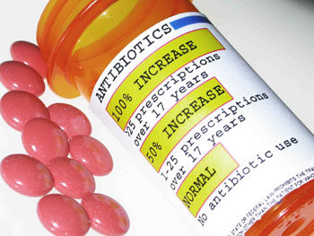
2/1 Specific and Nonspecific Immune Responses CH 39.2 Obj. TSW differentiate between nonspecific & specific immune responses. P. 24 NB
What is a vaccine?
Why do people who have AIDS have complications with normal colds and flu diseases?
What pathogen does antibiotics kill?

Slide 16
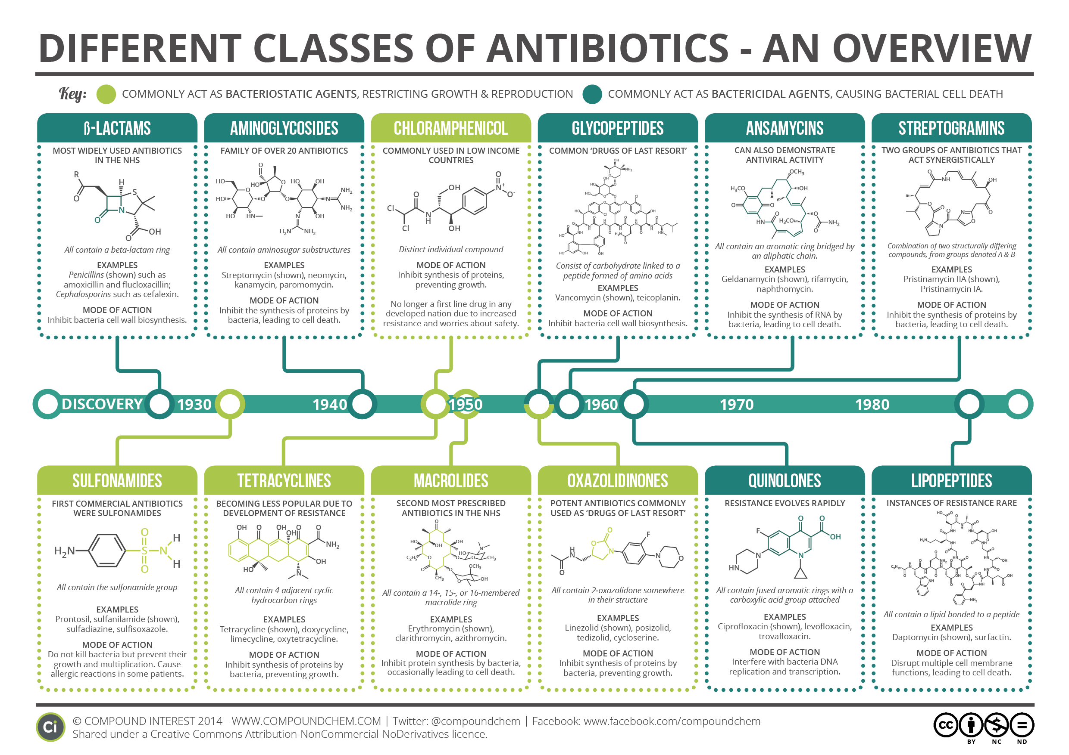

Slide 17
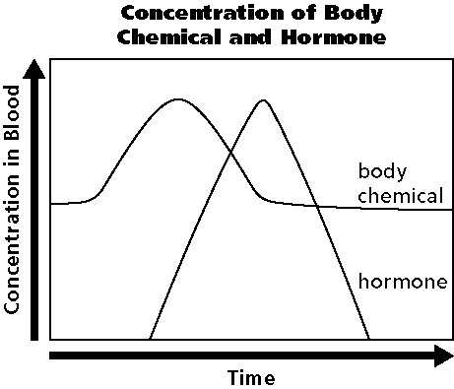
2/2 Homeostasis & Endocrine System CH 35.3 Obj. TSW draw and describe a Negative Feedback System involving the Endocrine System. P. 26 NB
What are the functions of the Endocrine system?
Draw the graph, explain how the body maintains homeostasis.
Why does the hormone production increase?

Slide 18
Negative Feedback
Negative Feedback system is the relationship that maintains homeostasis in the body between the body chemical and hormones.

Slide 19
Section 35.3 Summary – pages 929-935
Control of the Body
Internal control of the body is directed by two systems: the nervous system and the endocrine system.
#1. The endocrine system is made up of a series of glands, called endocrine glands, that release chemicals directly into the bloodstream and stimulates other glands to release theirs.

Slide 20
Section 35.3 Summary – pages 929-935
#2. Control of blood glucose levels
Another example of a negative feedback system involves the regulation of blood glucose levels.
When you have just eaten and your blood glucose levels are high, your pancreas releases the hormone insulin.

Slide 21
#3. The production of the hormone increases due to the level of the body chemical. When the body chemical is back to normal the Hormone is not released any more – Negative Feedback system.

Slide 22
Negative Feedback

Slide 23
Section 35.3 Summary – pages 929-935
Control of the Body
Ultimately, the functions of all body systems are controlled by the interaction between the nervous and endocrine systems.
Because there are two control systems within the body, coordination between the two systems is needed.

Slide 24
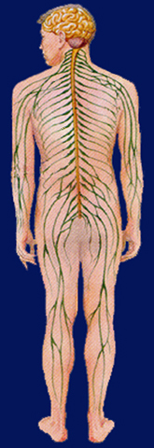
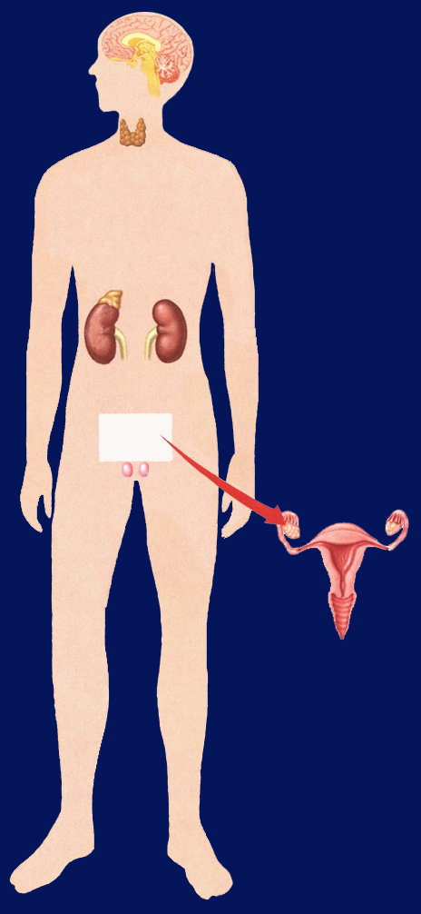
Section 35.3 Summary – pages 929-935
Pituitary
Hypothalamus
Brain (CNS)
Control of the Body
Parathyroid gland
Thyroid gland
Spinal cord (CNS)
Adrenal medulla
Spinal nerves (PNS)
Adrenal cortex
Ovary in female
Thyroid Gland regulates Metabolism in the body.
Testis in male

Slide 25
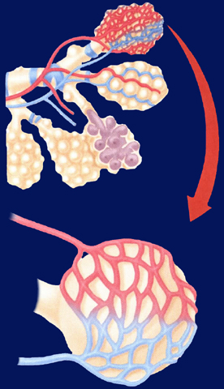
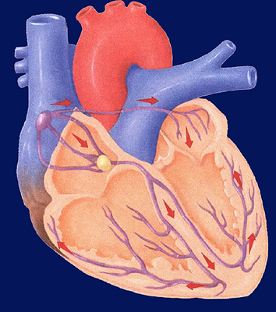
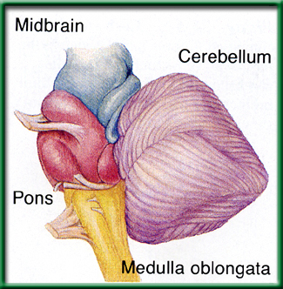
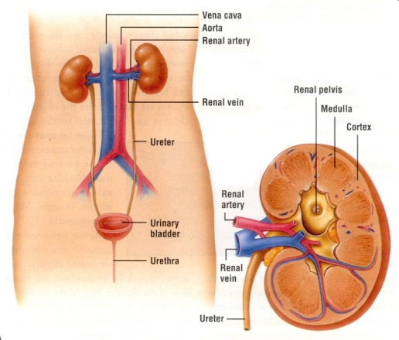
2/3 Respiratory, Circulatory & Excretory Systems CH 37.1 – 37.3 Obj. TSW explain in your warm up how the respiratory, circulatory and excretory systems complement each other to maintain Homeostasis. P. 28 NB P. 66 NB
Explain the process of how gas is exchanged (Alveoli) in the lungs.
The level of CO₂ in the blood affects breathing rate. How would you expect high levels of CO₂ to affect heart rate?
How does the kidney maintain homeostasis in the body?

Slide 26
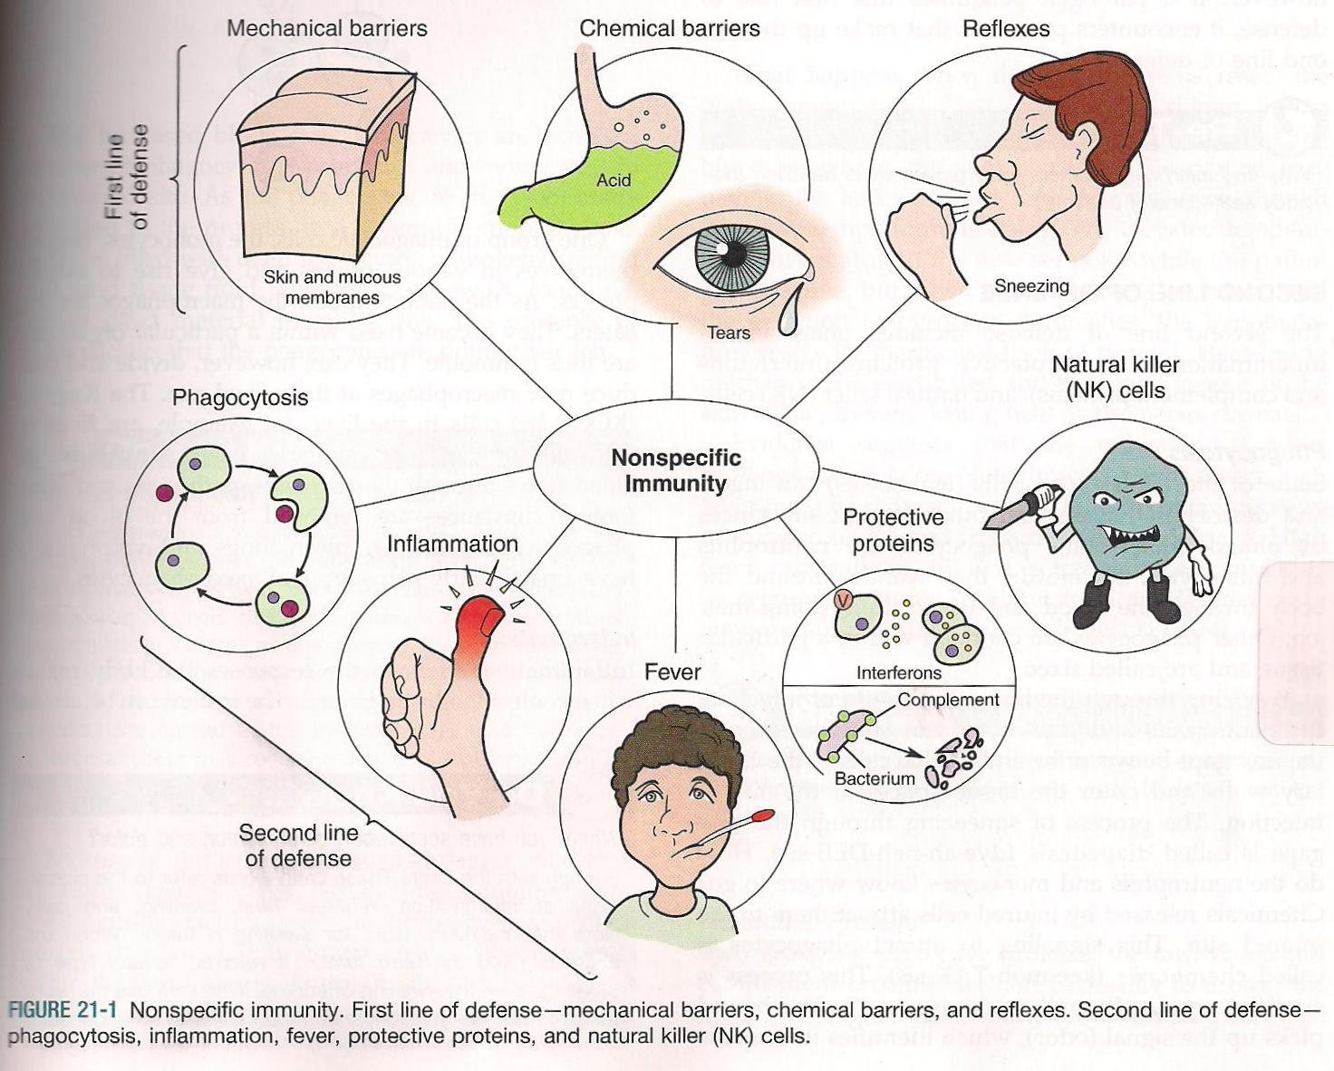
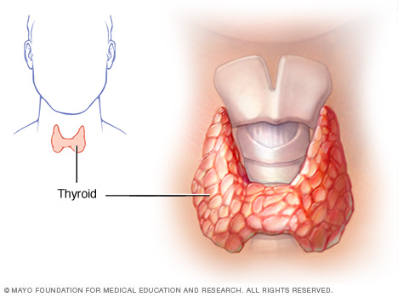
2/6 Metabolism & Homeostasis CH 35.3 & CH 39.2 Obj. TSW understand how the body regulates chemical reactions to maintain homeostasis. P. 30NB
Define metabolism.
The thyroid controls what process in the body?
How does the immune system respond to an infection in a nonspecific way?

Slide 27
Warm Up Answers
Metabolism is the sum total of all the body’s chemical reactions. When you are younger, you have a more efficient, faster metabolism. If you exercise your metabolism is faster.
The Thyroid is the organ that controls the metabolism, growth and development.
The immune system has Macrophages patrolling the bloodstream looking for anything that is “non self”, then engulfs the pathogen, copying it’s antigens to trigger the “Specific” immune response. Inflammation is a reaction to a pathogen in a nonspecific way, it includes: Redness, Heat, Swelling, and Pain.

Slide 28
The Case of the Missing Meatballs p.33 NB
Mrs. De La Cruz took Ms. Schroeder’s Lunch.
Mrs. De La Cruz said a. “ She had a delicious Lunch.”
b. When her lunch fell over her sandwich and apple fell out.
c. She responded too quickly to the question of Mrs. Schoeder’s lunch.
Mrs. De La Cruz has a spaghetti sauce stain on her shirt.
She was in Ms. Schroeder’s room before lunch.
3. Mrs. De La Cruz came to school with her own lunch, but it was not eaten, and she had a stain on her shirt that matches the missing lunch. So also exclaimed how delicious her lunch was – even though her lunch was in her box.
We are 50% - 99.9% sure that Mrs. De La Cruz eat Ms. Schroeder’s lunch.
We are 50% - 80% sure with only 1 – 2 pieced of evidence.
In science it is important to have more than one piece of evidence because you have more support for your reasoning. It narrows down other options, with more evidence it can be tested as a theory.
It is important to support your evidence with reasoning so that it all makes sense and eliminates false accusations.

Slide 29
Marijuana: Breaking down the Buzz p. 33 NB by: Scholastic.com, 2014
Claim: Smoking marijuana on a regular basis can harm the developing teen brain.
Evidence 1: Cigarette smoking causes cancer. Studies show…, Research says…
Reasoning: Legalizing marijuana may make it easier to get, but teens may not fully understand its harmful effects. Smoking marijuana still may harm the bodies organs, especially if they are still developing.
Evidence 2: The risk for marijuana addiction almost double for people who begin using as teens.
Reasoning: The younger the starting age, the greater the chances for addiction.
Conclusion: AXES Paragraph Assertion, Example, Explanation, Significance.

Slide 30
Doggy Dander article
Claim: Doggie dust could be a good to limit the risk of allergies.
Evidence: Scientist saw a profound change in the microbiome of the guts of mice that had eaten dust from homes with dogs.
Evidence: Children exposed to dirt and germs early in life tend to face a lower risk of asthma and allergy as they get older
Reasoning: Growing up with siblings and pets may strengthen a childs’ immune system.
Conclusion: AXES
Assertion: Doggy dander can strengthen our immune system.
eXample: Mice exposed to doggie dander could fight off serious viral infections
Explanation: Cockroach allergens triggered the worse reactions in mice that had eaten dust from dog- free homes.
Significance: RSV is the leading cause of pneumonia in US children, with the findings of doggie dust warding off allergies and strengthening the immune system, children less than a year may have a better fighting chance of staying healthy or recovering fully.

Slide 31
Fist Bumps Article
Claim: Fist bumps are cleaner than handshakes.
Evidence: A handshake transferred more that 2 x as muny bacteria as high Fiving. A fist bump was 1/10 as much bacteria .
Reasoning: A fist bump is likely to put far less skin in contact with another person, transferring less bacteria that could cause health concerns.
Conclusion: AXES Paragraph
Assertion
eXample
Explanation
Significance

Slide 32
Measuring your Pulse & Respiration P.31 NB
Respiration – Breaths / minute
Pulse – Heart Beats/ minute
Measure your pulse & respiration and write them down on page 31 NB.

Slide 33
Exercise Lab p. 31 NB
Choose a partner
Choose an exercise
1 minute in length (5 times)
Count strides, Jumping Jacks, Push ups
Duration (Time)- (5 repetitions) or (Time minutes)
Plank, Wall Sit
Control?
What was constant?

Slide 34
Data Table & Graph When do muscles fatigue? P. 31 NB
Time (minutes) | Number of repetitions Sit ups, Push ups, Jumping Jacks Calf Raises Squats
1st minute 1 minute | 10
2nd minute 1minute | 20
3rd minute 1minute | 30
4th minute 1minute | 40
5th minute 1minute | 50
Intervals Wall Sit Plank Superman | Time (seconds)
1 | 30
2 | 45
3 | 50
4 | 20
5 | 15

Slide 35
Muscle Fatigue Lab p. 31 NB
Trials | Number of Repetition | Pulse
1
2
3
4
5

Slide 38
Data Table for Pulse P. 31 NB
 | Trial 1 | Trial 2 | Trial 3 | Trial 4 | Trial 5
Pulse | 68 | 68 | 69 | 72 | 75

Slide 39
Graph your Pulse Rate P. 31NB When does muscle fatigue set in?

Slide 40
The Heart, Lungs & Components of the Blood P. 33 NB P. 982 BB
Draw & Label & Color the components of the Heart & Lungs.
Copy the following Notes:
Red Blood Cells -transports O₂ & CO₂
White Blood Cells- T & B cells Immune system
Platelets – cell fragments involved in blood clotting (Vitamin K)
Plasma – Most of the liquid of blood- proteins, nutrients, enzymes, hormones, salts

Slide 41
Blood Cells p. 33 NB
Red Blood Cells
Made in the Red Marrow
Circulatory & Respiratory System
Smaller
More numerous
No nucleus
O2 & CO2
Contain Hemoglobin (Iron – Fe)
White Blood Cells
Made in the Yellow Marrow
Circulatory & Immune System
Larger
Fewer cells
Nucleus
T & B & Macrophage Cells

Slide 42
8 Different Blood Types
A+ A-
B+ B-
O+ O-
AB+ AB-

Slide 43
Exercise Lab
Title: Short – 5 - 9 words
Introduction: Exercise & Cardiovascular/ Respiratory system, O₂ & CO₂, pH, pulse
Objective
Hypothesis
Materials: List
Procedure: Specific. Step 1, Step 2, Step 3…
Safety concerns: don’t run with scissors.

Slide 44
Exercise Lab
Constants
Control:1st data point
Data table: Independent & Dependent Variable
Graph:
Data Analysis: What happened over time and why is it important?
Error Analysis:
Conclusion:

Slide 45
Questions to answer in the conclusion Yes in addition to the one’s in the lab report.
How did your steps change with the different activities you did?
What effect did repeating the exercise over time have on the muscle group.
How did your muscles feel?
What physiological factors are responsible for fatigue?
How does the amount of rest you have affect the recovery of the muscles?
How did your results compare to others.

Slide 46
AXES Paragraph Exercise Lab P. 35 NB (Use your transition words: Then, Next, Although, However, In addition to.)
Name all Body systems involved in the Exercise Lab.
Describe your understanding of what homeostasis is?
Write a complete sentence(s) giving an example(s) from the lab of homeostasis.
How does the body use Negative Feedback Mechanisms to maintain homeostasis?
Include two body systems and how they help maintain homeostasis.

Slide 47
2/7 Reading a Table and Graph Obj. TSW learn how to read a graph and interpret data from it. P. 32NB
Trials | Without Distractions | With Distractions | Opposite Hand
1 | 63 | 63 | 52
2 | 58 | 62 | 54
3 | 45 | 65 | 57
4 | 46 | 70 | 59
5 | 59 | 59 | 53
6 | 45 | 58 | 56
7 | 43 | 61 | 51
8 | 42 | 60 | 58
9 | 44 | 59 | 57
10 | 40 | 58 | 55
In the data table, What can be concluded from the data without distractions? With Distractions?
In the graph, What was the independent and dependent variables. What was the control for the lab?
Create a better title for the graph that represents the true nature of the lab.

Slide 48
Answers to WU
The conclusion to the data without distractions is that it got faster as more trials were done. With the distractions, the reaction time did not get faster.
The Independent Variable is the number of trials, (X – axis). The Dependent Variable is the Number of repetitions, (Y – axis). The control in the lab was my original resting respiration rate, or pulse rate.
A better title for the lab could be: Reaction Lab with meter sticks, Distraction/Reaction Meter Stick Lab, How quick can you catch a meterstick?

Slide 49
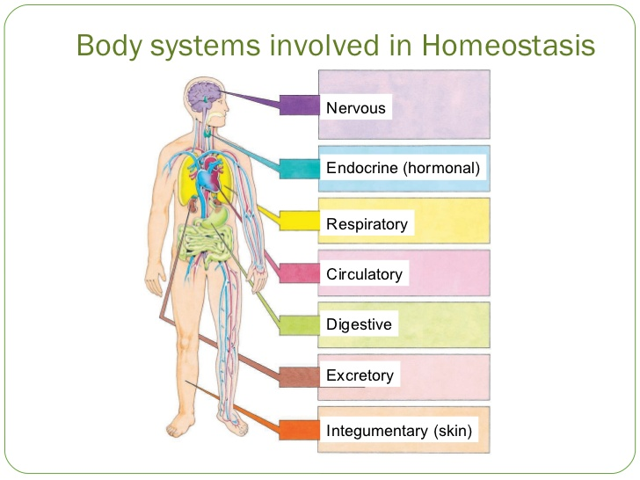
2/9 Review for Physiology Test Obj. TSW demonstrate understanding of how the body maintains homeostasis. p. 34NB
CH 39 Explain the function of the immune system, name a cell, tissue and organ.
CH 36 Explain the function of the nervous system, name a cell, tissue and organ.
Name any two body systems and explain how they work together to maintain homeostasis.

Slide 50
Answers to Warm UP
Immune system helps protect the body from disease causing pathogens. The T & B cell are two cells, the lymph and thymus gland are tissues, and the organs are spleen, Tonsils, Appendix.
Nervous System communicates with the outside world and sends messages inside the body. The three types of nerve cells are sensory neuron, Interneuron (brain or in spine), Motor neuron. Tissues would surround the spine, the Organ is the Brain.
The Respiratory system works with the Circulatory system to maintain homeostasis by the blood carrying O2 to the muscles, and then it will carry away CO2 to the Lungs to be exhaled.

Slide 51
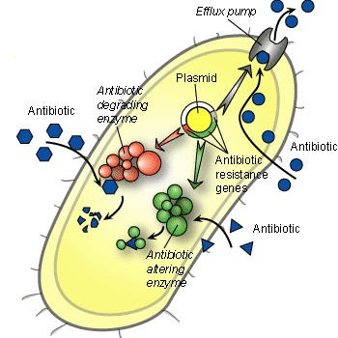
2/10 Body Systems Obj. TSW relate the knowledge they learned about body systems. P. 36 NB
Name 3 body systems you feel confident you understand.
For each Body System, explain it’s function.
Explain how two of those body systems work together to maintain homeostasis.
How bacteria create a resistance to antibiotics.

Slide 52
How does Bacteria build a resistance to antibiotics? P. 35 NB
1.Antibiotic Degrading Enzymes break up absorbed antibiotics.
2.The Bacteria builds a Efflux Pump to immediately pump out any absorbed antibiotic.
3. Antibiotic altering Enzyme surrounds the absorbed antibiotics and renders it useless & ineffective.

Slide 53
2/11 Quote of the Day
The future belongs to those who believe in the beauty of their dreams.
- Eleanor Roosevelt

Slide 54
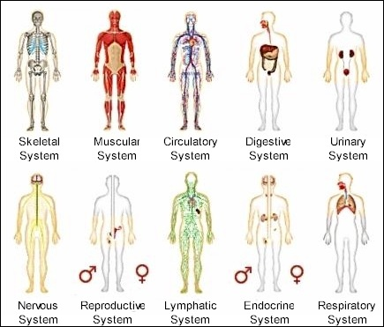
2/13 Review for Body Systems Test Obj. TSW write a well thought out response to a written question about body systems, and accurately find the Claim, Evidence, Reasoning and AXES paragraph for a scientific article. P. 38 NB
What is a claim? How do you know when you have found it in an article?
What is evidence? How do you know when you have found it in an article?
What is the reasoning? How do you know when you have found the support for the evidence?

Slide 55
Physiology Study Guide P. 31 NB
Non-specific Defenses: Skin, Mucus Membranes, Macrophage, fever
Defends against pathogens. Any non-self pathogen
Inflammation
A fever can be helpful in curing a disease because it weakens or disrupts the infections activities/reproduction.
Antibiotics are effective against Bacteria infections.
Bacteria become resistant to antibiotics by random mutations and become immune to the drugs.
Antigen – protein on a nonself-pathogen or protein on our cells.
Antibodies – Proteins, good, in response to infection. (Specific Immunity)

Slide 56
7. Vaccine is a dead or weakened strain of a pathogen, to support the immune system.
8. Vaccines trigger the immune system to make antibodies.
9. Antibiotics are able to effectively treat bacterial infections.
10. Individuals with HIV are more likely to get sick with infections because HIV weakens your immune system by stopping the T cells from functioning properly.
11. When you are sick, your white blood cells make antibodies against specific invaders.

