Slide 1
Biology UNIT 2 Energy
Week 6
Fall Sept. 18th – 22nd

Slide 2
Research Activity P. 41 NB
https://solarsystem.nasa.gov/planets/solarsystem
If you had to be one of our planets in our solar system, which one would you be and why?
List 5 facts about it

Slide 3
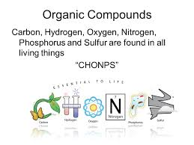
9/13 Building Molecules CH 6.3 Obj. TSW identify the macromolecules living things are made of and describe their properties. P. 44NB
What are the 6 main elements that make up the 4 macromolecules?
What is an Enzyme?
What three environmental factors determine the enzymes function?

Slide 4
2. Enzymes are Proteins and they speed up chemical reactions. Temperature, pH, Amount of substrate or enzyme, Ionic Conditions (Salt).

Slide 5
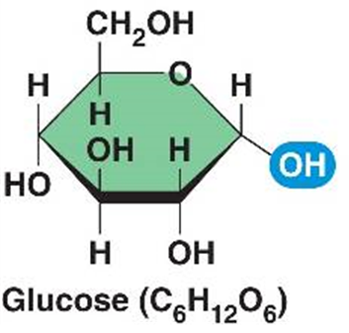
Using your Cycles in Nature, build the molecule that is most evident for your cycle: P. 45 NB H₂O, CO₂, NH₃, NO, NO₂, NO₃, O₂, CH₄, C₆H₁₂O₆
Carbon = Black
Oxygen = Red
Hydrogen = White
Nitrogen = Blue

Slide 6
Build a Monosaccharide!
Show me a correct monosaccharide for extra credit!
Some Helpful Hints:
Black atoms are Carbon (C).
Carbon always needs to be bonded to 4 other atoms.
White atoms are Hydrogen (H).
Hydrogen only bonds to 1 atom.
Red atoms are Oxygen (O)
Oxygen bonds to 2 atoms.
Every unidentified corner is a Carbon atom.
For example, look at the which identifies the corner on Sucrose. That is a carbon atom.

Slide 7
Enzymatic Reaction of Sucrase on Sucrose

Slide 8
Catalase Lab
ml H2O2 | Person 1 | Person 2 | Person 3 | Person 4 | Person 5
5 | 100
6
7 |  | 120
8 |  |  | 120
9 |  |  |  | 170
10 |  |  |  |  | 140

Slide 9
Catalase Lab P. 27
1 flask / 2 people
GLX
Pressure Probe
Yeast – 1 tsp.
Hydrogen Peroxide 5ml
Swirl
Make observations.
Write a summary paragraph about the function of enzymes with a picture of a substrate & enzyme & active site. What factors allow for the enzyme to function? What volume of H2O2 did Catalase work the best? Why does the enzyme speed up chemical reactions? Enzymes can be used again & again (Catalytic), how is this important in chemical reactions? At what volumes (ml) did the Catalase work the best? Write the chemical equation.

Slide 10
AXES Paragraph – Catalase Lab
Assertion What is Exothermic Reactions? Use vocabulary.
eXample Discuss an example of an enzyme. Include details from the lab.
Explanation Describe the function of the enzyme, and factors that influence it.
Significance Why are enzymes important for us?

Slide 11
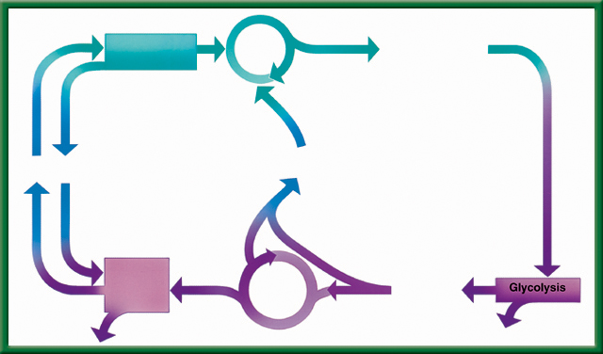
9/18 Cellular Respiration & Fermentation 9.3 Obj: TSW be able to compare and contrast photosynthesis and cellular respiration by completing the flow chart activity. pg. 50 NB
1) What is Cellular Respiration? Identify the three stages.
2) How is it related to Photosynthesis?
3) What is fermentation, where does it happen in the cycle?

Slide 12
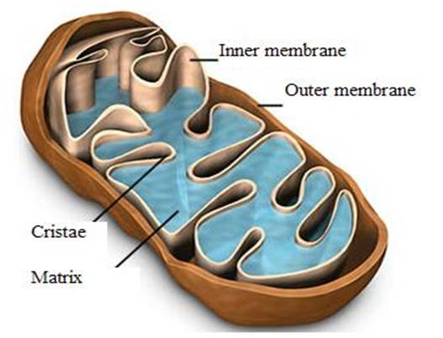
1. Cellular Respiration – converts glucose in to ATP and Heat in the mitochondria. The three stages are Glycolysis, Krebs Cycle, and the Electron Transport Chain. All living organisms perform Cellular Respiration, including plants.

Slide 13
#2. The reactants for Photosynthesis (CO2 & H2O) are the Products for Cellular Respiration.

Slide 14
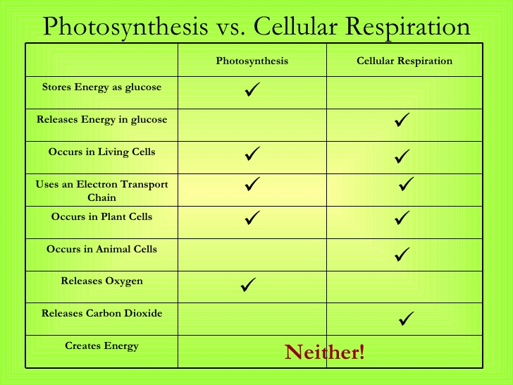
2. P.50 NB Compare and contrast cellular respiration and photosynthesis.
3. Fermentation happens during glycolysis when not enough oxygen is present.
To return to the chapter summary click escape or close this document.

Slide 15
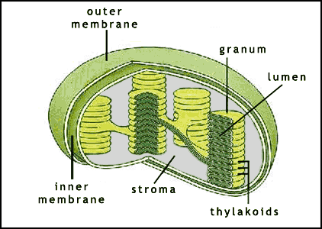
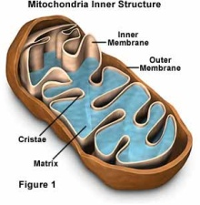
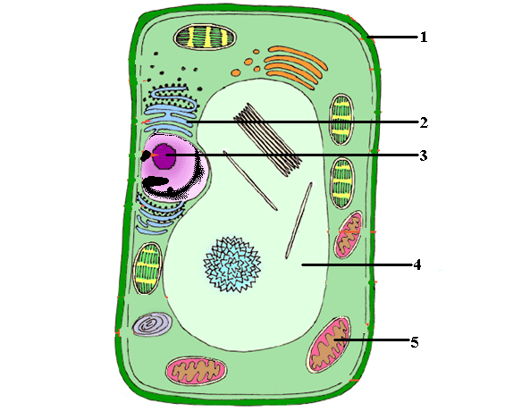
P. 51 NB Write a summary paragraph
PHOTOSYNTHESIS (in the chloroplast)
Calvin cycle
Glucose is made
Photolysis
Uses energy from photolysis and CO₂ to produce sugar = glucose → C₆H₁₂O₆
Does not need light!
Uses light energy to break water (H₂O) down to oxygen (O₂ ).
Needs light!
CO₂
H₂O
O₂
Where most of your energy is made. Needs Oxygen
Breaks down sugar into pyruvic acid → 2*(C₃H₆O₃) and ATP (energy) Cytoplasm
Electron
Transport
chain
Citric acid
Or Krebs
Cycle
Pyruvic
acid
36 ATP
Heat
2 ATP
CELLULAR RESPIRATION (in cytoplasm and mitochondria)

Slide 16
Macromolecules
Protein | Lipids | Carbohydrates | Nucleic Acids

Slide 17
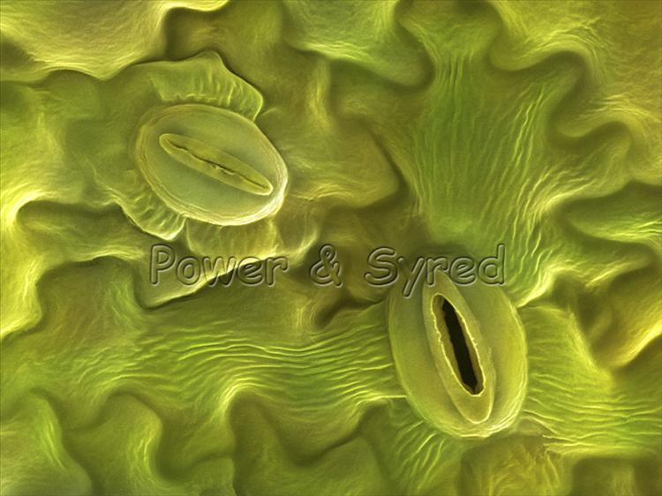
How to Make Carbohydrates Activity p. 51NB
6 CO₂ + 6 H₂O -> C₆H₁₂O₆ + 6 O
Carbon Dioxide + Water = Glucose + Oxygen
2. Sunlight – Catalyst
3. The chlorophyll inside the chloroplast
4. There were 6 molecules of O2 left over.
5. The extra oxygen atoms give air to other organisms.
The O2 diffuse into the atmosphere through the stomata.
6 H₂O + 6 CO₂ →(light) Catalyst → C₆H₁₂O₆ + O₂

Slide 18
Glucose Synthesis Activity
Photosynthesis: 6 CO₂ + 6 H₂O -> C₆H₁₂O₆ + 6 O
Black = Carbon
White = Hydrogen
Red = Oxygen
Person 1 – Root = H₂O
Person 2 – Stomata = CO₂
Person 3 – Chloroplast = Light Energy (Sun)
Person 4 – Glucose Synthesis/ O₂
Person 5 – Get ATP for Cellular Respiration
Cellular Respiration: C₆H₁₂O₆ + 6O₂→ 6CO₂ +6H₂0 + 36 ATP + Heat
Glucose
C₆H₁₂O₆

Slide 19
Taboo
Chloroplast
Cell Wall
Plasma Membrane
Passive transport
Active Transport

Slide 20
Taboo
Cellular Respiration
Photosynthesis
Mitochondria
Theory
Scientific Method
Nucleic Acid

Slide 21
Honors Biology Do the Math
What is the Percent change in temperature of your Catalase Reaction?
V1 – V2 x 100%
V1
21 – 36 x 100% = ?
21
76%
Include this in your Data Analysis.

Slide 22
Section 2 Check
Question 1
The process that uses the sun’s energy to make simple sugars is ________.
A. cellular respiration
B. glycolysis
C. photosynthesis
D. photolysis
CA: Biology/Life Sciences 1f

Slide 23
Section 2 Check
The answer is C. Photosynthesis happens in two phases to make simple sugars and convert the sugars into complex carbohydrates for energy storage.
CA: Biology/Life Sciences 1f

Slide 24
Question 1
Why do you add baking soda solution to the water containing the Elodea plants?
Answer
The baking soda supplies carbon dioxide, a necessary component of photosynthesis.
To return to the chapter summary click escape or close this document.

Slide 25
Question 2
Why does the experiment use aquatic plants?
Answer
The oxygen given off by an aquatic plant will form visible bubbles in the water that can be easily observed.
To return to the chapter summary click escape or close this document.

Slide 26
Question 3
What is the independent variable in this experiment?
Answer
The independent variable in this experiment is the color of light that is directed on the Elodea.
To return to the chapter summary click escape or close this document.

Slide 27
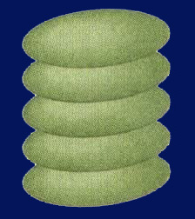
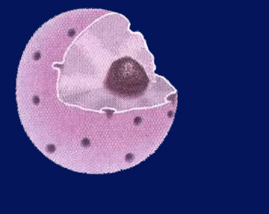
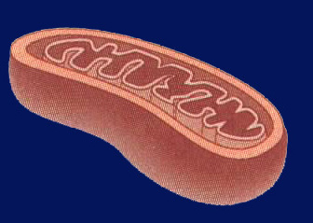
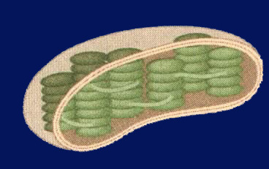
Chapter Assessment
Question 4
In which of the following structures do the light-dependent reactions of photosynthesis take place?
A.
C.
B.
D.
CA: Biology/Life Sciences 1f

Slide 28
The answer is D. The light-dependent reactions of photosynthesis take place in the thylakoid membranes of chloroplasts.
CA: Biology/Life Sciences 1f
Chapter Assessment

Slide 29
Quote of the Day
Everything you can imagine is real.
- Pablo Picasso

Slide 30
Kahoots Energy Quiz

Slide 31
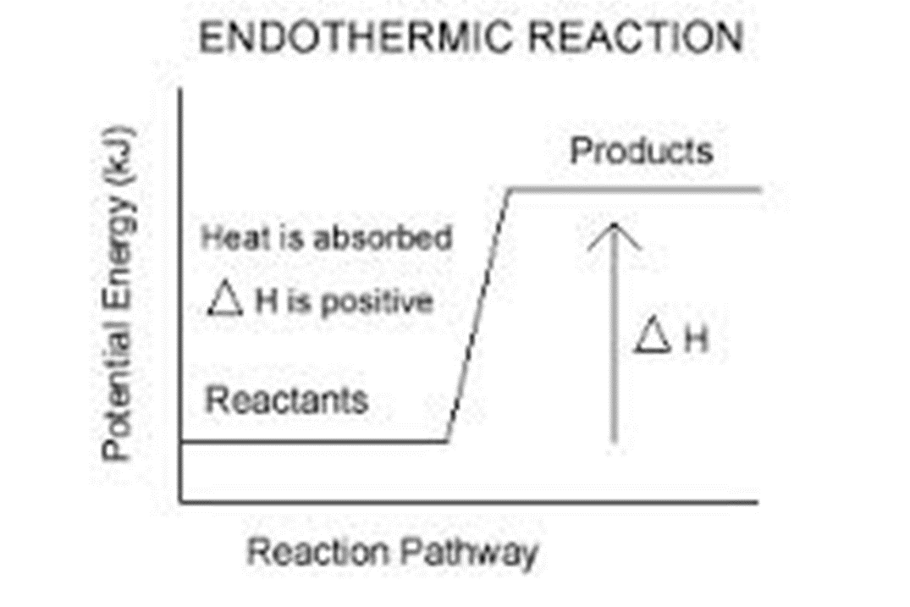
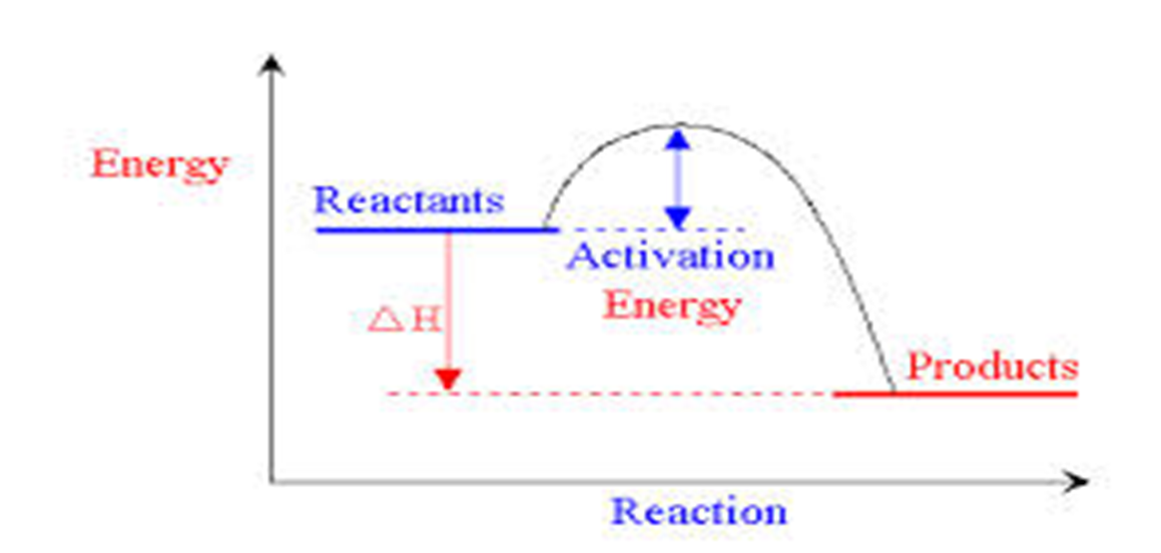
9/19 Energy in Cells Obj. TSW learn how energy is stored in the bonds of molecules and released when bonds are broken. P. 52 NB
Copy this graph of an endothermic reaction. Describe in complete sentences how energy is stored using the Independent and dependent variables.
Copy this graph of an exothermic reaction. Describe in complete sentences how energy is released using the Independent and dependent variables in our explanation.
What molecule in plants stores energy, what is the product we feel in an exothermic reaction?
Exothermic Reaction

Slide 32
Endothermic Reaction – Photosynthesis p. 45 NB Stores energy in Chemical Bonds - Glucose

Slide 33
Exothermic Reaction – Yeast + Hydrogen Peroxide Cellular Respiration P. 45NB Releases Heat

Slide 34
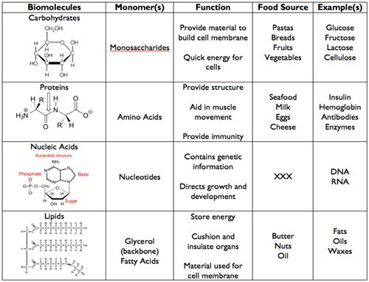
9/20 Monomers & Polymers CH 6.3 Obj. TSW learn the 4 macromolecules and the subunits that make them. P. 54 NB
Review your notebook or CH 6.3 and write the 4 Macromolecules/ Biomolecules or Life Molecules.
Read carefully through the book and write the subunits for each of the Biomolecules. What are each of the Biomolecules made of?
What elements make up each Polymer? (CHONPS)

Slide 35
Taboo
Cellular Respiration
Vacuole
Prokayotic
Osmosis
Passive Transport
Macromolecule

Slide 36
Taboo
Photosynthesis
Nucleus
Eukaryotic Cell
Active Transport
DNA
Protein

Slide 37
Taboo
Scientific Method
Independent Variable
Plasma Membrane
Bacteria
Prokaryotic
Chloroplast

Slide 38
Dependent Variable
Control
Selective Permeability
Endoplasmic Reticulum
Cell Wall
Vacuole

Slide 39
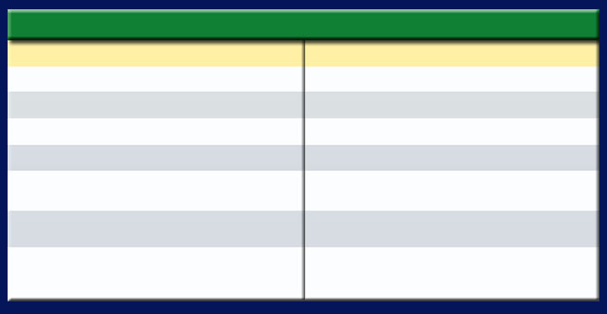
Section 9.3 Summary – pages 231-237
Comparing Photosynthesis and Cellular Respiration Notes p. 57 NB
Table 9.1 Comparison of Photosynthesis and Cellular Respiration
Photosynthesis
Cellular Respiration
Food synthesized = Endergonic
Food broken down = Exergonic
Energy from sun stored in glucose
Energy of glucose released
Carbon dioxide taken in
Carbon dioxide given off
Oxygen given off
Oxygen taken in
Produces sugars = C₆H₁₂O₆
Produces CO₂, H₂O, ATP & Heat
Requires light
Does not require light
Occurs only in presence of chlorophyll
Occurs in all living cells,
including plants

Slide 40
Photosynthesis & Cellular Respiration AXES Paragraph READ your highlighted parts of your article, Write an AXES paragraph on page 57NB Assertion eXample Explanation Significance
The mechanisms for P & CR are related because they are essentially opposite reactions. Photosynthesis transforms energy from the sun and Cellular Respiration makes use of chemical bond energy and converts it to ATP & Heat
Photosynthesis = Chloroplast
Cellular Respiration = Cytoplasm, Mitochondria
6CO₂ +6H₂0 → C₆H₁₂O₆ + 6O₂ Photosynthesis
C₆H₁₂O₆ + 6O₂ → 6CO₂ +6H₂0 + 36 ATP + Heat Cellular Respiration

Slide 41
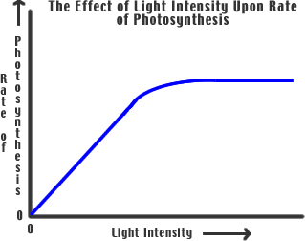
9/21 Reading a graph for information Obj. TSW review variables and the control in a lab and analyze the graph. P. 56 NB
Compare & Contrast Independent and Dependent Variables.
Why is the Control important?
Using the graph, what is the trend? How do you know?

Slide 42
Leaf Disk Assay Lab
Enter data into Excel
Make a scatter plot graph to show the 50% floating point.
Data Analysis: What does the graph mean? Error analysis
Conclusion: Discuss why measuring the photosynthesis can be a problem. What competing process is occurring at the same time? Include in your discussion the relationship between Photosynthesis and Cellular Respiration by comparing and contrasting the equations.
 | Sodiun Bicarbonate | Water
0 Minute
1 Minute
2 minute
3 minute
4 minute
5 minute

Slide 43
Gallery Walk – Cell UNIT Review Describe, Draw, and Explain the importance of each of the following concepts/ processes on a poster paper, for a Gallery Walk review. Page 51NB
Osmosis
Plasma Membrane
Eukaryotic Cell
Prokaryotic Cell
Photosynthesis
Cellular Respiration
Folded Membranes
Active & Passive Transport
Macromolecules
Scientific Method

Slide 44
Warm Up Answers
1) Cellular Respiration: process by which mitochondria break down food molecules (glucose) to produce ATP. The stages are: glycolysis, citric acid cycle, electron transport chain.
2) Glycolysis: series of chemical reactions in the cytoplasm of the cell that breaks down glucose into (2) pyruvic acids- C₃H₆O₃.
3). Fermentation – in the absence of Oxygen during glycolysis, Lactic acid (animals) or alcohol (plants) are produced.
Table 9.1 in text
Cellular Respiration: Food broken down, energy of glucose released, CO2 given off, O2 taken in, does not require light, occurs in all living cells
They both produce Energy.
Photosynthesis: Food synthesized, energy from sun stored in glucose, CO2 taken in, O2 released, requires light, occurs only cells that contain chlorophyll
Both: use electron carriers, have cycles of chemical reactions, and form ATP

Slide 45
Cellular Respiration & Yeast
Get into groups of 3 people. Get 1 flask, 1 balloon, 1 sugar cube, and ½ tsp. of Yeast, combine with 50 ml warm water.
Place Balloon on the end of the Flask
Record results
What happens to the balloon?
Why? What is the process called? What are the Products?

Slide 46
Cellular Respiration P. 31
Question: How much Carbon Dioxide will be produced?
Independent Variable: Changed the number of sugar (C6 H12 O6) cubes.
Dependent Variable: More Carbon Dioxide was produced.
Control: 1 sugar cube was the control.

Slide 47
Constant: Same Sugar, Yeast, balloons, Flasks
Materials & Equipment: Yeast – ½ tsp., water – 100 ml, sugar, balloons, Hot plate, Flask
Experimental Set up: Draw only
Safety Concerns: Don’t eat the sugar cubes.
Procedure : Write the steps…. Step 1, Step 2, Step 3,

Slide 48
Enzymes, Cataylase & Potatoes Page 47 NB
Get into groups of 3 people. Get 1 flask, 1 balloon, H2O2, and 1 piece of Potato – raw, 1 piece of potato cooked.
Place Balloon on the end of the Flask
Record results
What happens to the balloon?
What do you know about enzyme function?
Under what conditions do they function best?
Why? What is the process called? What are the Products?

Slide 49
Enzyme Lab P. 47NB
Question: How much Carbon Dioxide will be produced?
Independent Variable: Changed the number of pieces of potato, or more H2O2.
Dependent Variable: More Carbon Dioxide was produced.
Control: 10 mL of H2O2 & 1 piece of potato.

Slide 50
Enzyme – Catalyse Lab Page 47 NB
Constant: Same potato, H2O2, balloons, Flasks
Materials & Equipment: H2O2½ tsp., balloons, Hot plate, Flask
Experimental Set up: Draw only
Safety Concerns: Don’t eat the potatos.
Procedure : Write the steps…. Step 1, Step 2, Step 3,
Answer Analysis questions on the lab.

Slide 51
STAGE 1: GLYCOLYSIS
Takes place in the cytoplasm of the cell
Process where glucose is broken down and some energy is released
In the absence of Oxygen, fermentation happens.

Slide 52
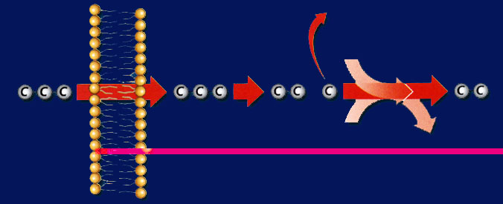
Section 9.3 Summary – pages 231-237
Glycolysis
Before citric acid cycle and electron transport chain can begin, pyruvic acid undergoes a series of reactions in which it gives off a molecule of CO₂ and combines with a molecule called coenzyme A to form acetyl-CoA.
Mitochondrial membrane
Outside the mitochondrion
Inside the mitochondrion
CO₂
Coenzyme A
- CoA
Pyruvic acid
Pyruvic acid
Intermediate by-product
Acetyl-CoA
NAD⁺
NADH + H⁺

Slide 53
STAGE 2: CITRIC ACID CYCLE
AKA Krebb’s cycle
Happens in the mitochondria
Produces: carbon dioxide and some ATP

Slide 54
STAGE 3: ELECTRON TRANSPORT CHAIN
Happens in the mitochondria
Series of proteins that transfers energy
Net creation of whole process: 36 ATP

Slide 55
PROBLEM
What happens when our cells run out of oxygen? Can cell respiration occur?

Slide 56
FERMENTATION
Without oxygen cell respiration can not occur.
However, instead of giving up and dying, our cells have another way to create energy without using oxygen→ FERMENTATION
Occurs after glycolysis
Lactic acid fermentation: animal cells (us!)
Alcoholic Fermentation: plant cells

Slide 57
To return to the chapter summary click escape or close this document.

