Slide 1
Introduction to the Physiology Systems P. 1048 BB Directions: Copy the 11 Body systems down in your Notebook. Write the Organ Systems of the Body and match the organ or functions to that system. Use the Internet or CH 34 – 39 in your biology book. P. 61 NB
Circulatory Digestive Endocrine
Integumentary Lymphatic/ Immune Muscular
Nervous Reproductive Respiratory
Skeletal Urinary/ Excretory

Slide 2
Circulatory/ Cardiovascular Digestive Endocrine
Integumentary Lymphatic/ Immune Muscular
Nervous Reproductive Respiratory
Skeletal Urinary/ Excretory
Urinary/ excretory Rids the body of nitrogen containing wastes.
Endocrine Is affected by the removal of the thyroid gland.
Skeletal Provides support & Levers on which the muscular system can act.
Cardiovascular Includes the heart.
Integumentary Protects underlying organs from drying out & mechanical damage.
Immune Protects the body; destroys bacteria & tumor cells.
Digestive Breaks down food into small particles that can be absorbed.

Slide 3
Circulatory Digestive Endocrine
Integumentary Lymphatic/ Immune Muscular
Nervous Reproductive Respiratory
Skeletal Urinary/ Excretory
8. Respiratory/Circulatory Removes carbon dioxide from the blood.
9. Respiratory/Circulatory Delivers oxygen & nutrients to body tissues.
Muscular Moves the limbs; allows you to make facial expressions.
Urinary/Excretory Conserves body water or eliminates excess water/ waste.
Reproductive Provides for conception & birth.
Endocrine Controls the body with chemicals called hormones.
Integumentary Is damaged when you cut your finger or get a severe burn/ sunburn.

Slide 4
Circulatory/Cardiovascular Digestive Endocrine
Integumentary Lymphatic/ Immune Muscular
Nervous Reproductive Respiratory
Digestive Urinary/ Excretory
Cardiovascular Blood vessels, Heart
Endocrine Pancreas, pituitary, adrenal glands.
Urinary/Excretory Kidney’s, bladder, urethra.
Reproductive Testis, vas deferens, urethra.
Digestive Esophagus, Large Intestine, Rectum.
Skeletal Breastbone, vertebrae, skull.
Nervous Brain, nerves, spinal cord.

Slide 5
Agenda 5/13
WU
Distraction/ Reaction Lab slide 101
Or PhET – Digestive system
CM CH 35
Foldable – Digestive System slide 104
Measuring BMI

Slide 6
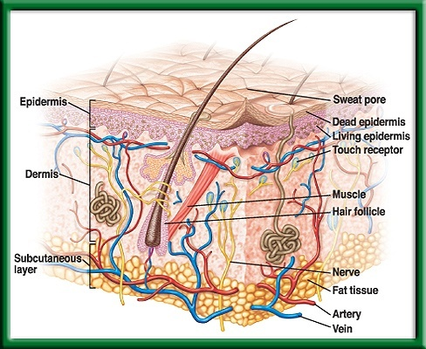
Skin: The Body’s Protection 34.1 5/12 Obj. TSW understand the role of the skin in providing nonspecific defenses against infection by discussing our warm up answers. P.60 NB
What are the two layers of the skin?
What are four of the functions of our skin?
Why is our skin considered our first line of defense against disease?

Slide 7
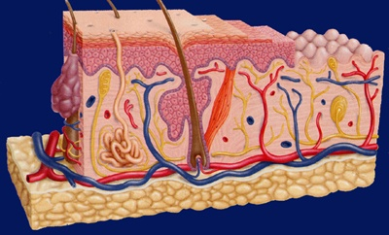
Section 34.1 Summary – pages 893-898
#1. Structure and Functions of the Integumentary System
Skin is composed of two principal layers—the epidermis and dermis.
Epidermis
Dermis

Slide 8
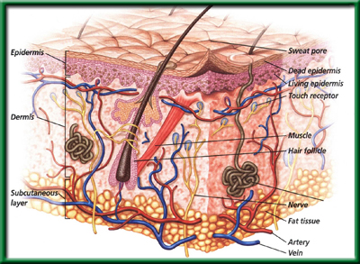
Section 34.1 Summary – pages 893-898
#1. Epidermis: The outer layer of skin

Slide 9
Section 34.1 Summary – pages 893-898
#1. Epidermis: The outer layer of skin
Although dead, these cells still serve an important function as they contain a protein called keratin (KER uh tun).
Keratin helps protect the living cell layers underneath from exposure to bacteria, heat, and chemicals.

Slide 10
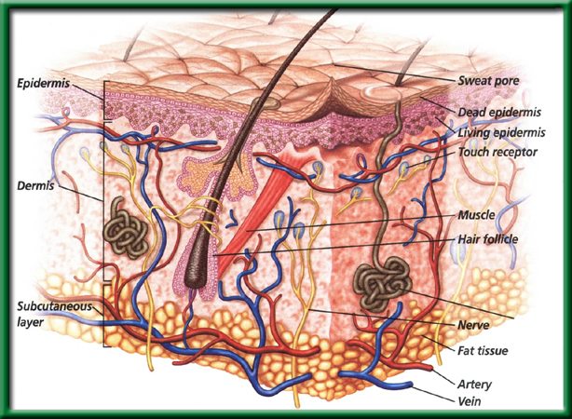
Section 34.1 Summary – pages 893-898
#1.Dermis: The inner layer of skin

Slide 11
Section 34.1 Summary – pages 893-898
#2. Functions of the integumentary system
One function of skin is to help maintain homeostasis by regulating your internal body temperature.
When your body temperature rises, the many small blood vessels in the dermis dilate, blood flow increases, and body heat is lost by radiation.

Slide 12
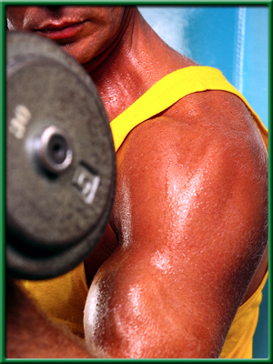
Section 34.1 Summary – pages 893-898
#2. Functions of the integumentary system
When you are cold, the blood vessels in the skin constrict and heat is conserved.
Glands in the dermis produce sweat in response to an increase in body temperature.
As sweat evaporates, water changes state from liquid to vapor and heat is lost.

Slide 13
Section 34.1 Summary – pages 893-898
#2. Functions of the integumentary system
Skin also functions as a sense organ.
Nerve cells in the dermis receive stimuli from the external environment and relay information about pressure, pain, and temperature to the brain.

Slide 14
Section 34.1 Summary – pages 893-898
#2. Functions of the integumentary system
When exposed to ultraviolet light, skin cells produce vitamin D, a nutrient that aids the absorption of calcium into the bloodstream.

Slide 15
Section 34.1 Summary – pages 893-898
#3. Functions of the integumentary system
Our Skin is the first line of defense because it serves as a protective layer to underlying tissues.
It shields the body from physical and chemical damage and from invasion by microbes.

Slide 16
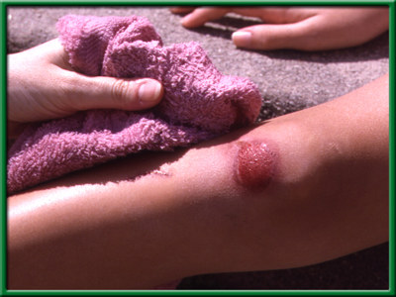
Section 34.1 Summary – pages 893-898
Functions of the integumentary system
Cuts or other openings in the skin surface allow bacteria to enter the body, so they must be repaired quickly. The skin responds to injury by producing new cells and signaling a response to fight infection.
Pathogens – bacteria or virus (microbes)

Slide 17
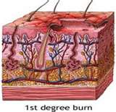
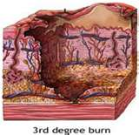
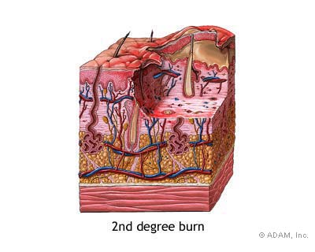

Slide 18
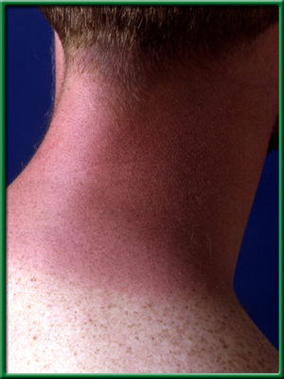
Section 34.1 Summary – pages 893-898
Skin Injury and Healing
First-degree burns, such as a mild sunburn, involve the death of epidermal cells and are characterized by redness and mild pain.
First-degree burns usually heal in about one week without leaving a scar.

Slide 19
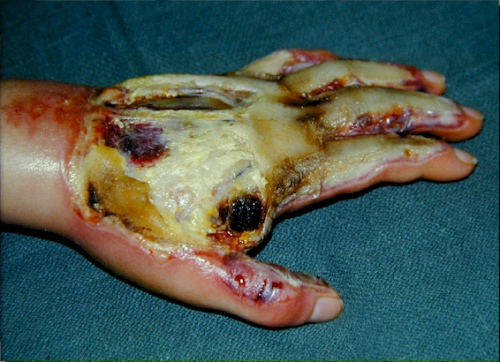
Skin injury and healing: burns
3rd degree burns:
Destroy both epidermis and dermis
Skin function is lost and skin grafts maybe required to replace lost skin
Some healthy skin can be removed from another area and placed on the hurt part

Slide 20
Section 34.1 Summary – pages 893-898
Skin Injury and Healing
Second-degree burns involve damage to skin cells of both the epidermis and the dermis and can result in blistering and scarring.
The most severe burns are third-degree burns, which destroy both the epidermis and the dermis.
With this type of burn, skin function is lost, and skin grafts may be required to replace lost skin.

Slide 21
What has the greatest danger to a patient who has had damage to the skin?
Loss of oils produced by the skin
Excessive muscle contractions in the damaged area.
Infections in uncovered tissues
Damaged tissue entering the blood stream

Slide 22
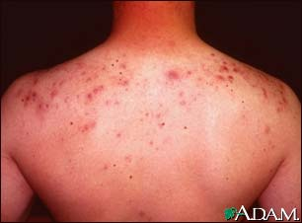
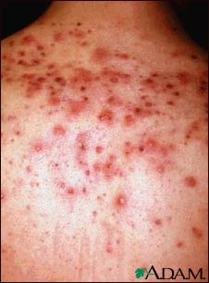
Zits/ Pimples
Acne is a skin condition characterized by whiteheads, blackheads, and inflamed red pimples or "zits."
Alternative Names:Acne vulgaris; Cystic acne; Pimples; Zits
Causes
Acne occurs when tiny holes on the surface of the skin, called pores, become clogged. Each pore is an opening to a canal called a follicle, which contains a hair and an oil gland. Normally, the oil glands help keep the skin lubricated and help remove old skin cells. When glands produce too much oil, the pores can become blocked, accumulating dirt, debris, and bacteria. The blockage is called a plug
https://health.google.com/health/ref/Acne

Slide 23
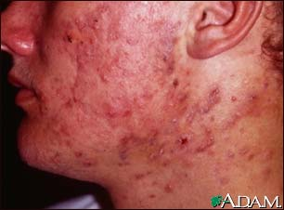
Ways to keep skin healthy
Change your pillow case often.
Wash your face at least twice a day
Moisturize with a skin conditioner that has glycerin.
Do not pick at zits.
Exercise to release stress
Regulate hormones

Slide 25
Good Morning! 12/5/13
Objective: You will learn about the different systems found in the human body; their components and functions.
Agenda:
1) Introduce body systems activity
2) Work on posters
*Turn in notebooks before you leave!!!!
Warm-up: What is one thing you learned in the human body video from yesterday?

Slide 26
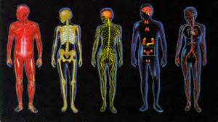
Body Systems Poster Project:
Each group will be assigned to complete one of the following body systems:
Endocrine system
Nervous System
Muscular System
Digestive System
Circulatory System
Respiratory System
Immune System
Integumentary System
Skeletal System
Urinary System

Slide 27
Each group’s project should include the following:
Pg 61 NB Notes on SYstem
The diagram of the body system should be presented on poster paper. Keep your diagram large, so that your illustrations are very clear. You may draw, trace, or use pictures to illustrate your system. Use colored markers or pencils.
Clearly print the labels of all the body parts that make up the system. If you draw the diagram, use a ruler to draw a straight line from the body part to the label. Remember to check your spelling.

Slide 28
Period 1
Reggie & Andre – Nervous
Mena, Arkadeus, Nelly – Skeletal
Salman, Jessica D., Sarah, Cameron – Circulatory
Mikaela, Mallory, Prava, Jaime– Immune
Laura, Hanna, Pawan, Brycelyn– Muscular
Pretti, Viktoria, Maria– Respiratory
Edith, Jennifer, Rosario, Jessica L.– Digestive
Bianca, Julissa, Lindsey– Integumentary
Ujjval, Baheer, Matt, Liam- Endocrine
Gina, Justus, Marina, Levi - Excretory

Slide 29
Period 4
William L – Nervous
Sam, Claire, Vika & Anastasiya – Skeletal
Eric, John, Adam & Mikin – Circulatory
William C, Roman, Antonio & Virak – Immune
Landon, Jenna, Valerie & Gagandeep – Muscular
Kara & Alissa – Respiratory
Zak, Mendy & Beatrice– Digestive
Lupita & Stan– Integumentary
Shabnam , Gabe, Emily & Justin - Endocrine

Slide 30
On your poster include: Innerbody.com
Name the System at the Top
Trace the body shape of the person onto the paper.
Draw, Print the cells, tissues, organs that represent the system of that organism.
Write the function of your system and why it is important.
Explain how the system works. (this may be the same as your prompt)
How does your system coordinate with other systems?
Write a few examples of what happens if the system does not function properly. This section should include different diseases you can get if the system is not working properly.
Address the specific prompt that you were given about your body system (on the small piece of paper).

Slide 31
Where to get your information?
Text books-anatomy and physiology
resource books
Internet- if you have a question about a websites reliability, ASK!
Homeostasis?

Slide 32
 | 5 | 4 | 3 | 2 | 1
Picture or diagram of your system | Detailed, complete, colored, labeled | Detailed and complete. Colored | Mostly complete, illustrates system, may be colored | Does not illustrate the system. Not colored | No effort
Clear description/ function of your system and how it works | Complete sentences, completely explains the topic in a few sentences | Complete sentences, the topic is mostly clear, but the description has some components that are confusing | Mostly complete sentences. Description is basic, leaves the audience with a few questions | Incomplete sentences. The audience has many questions after reading this description | No effort
Diseases | Clear description of possible diseases | Description of some diseases mentioned | One disease mentioned and described | Disease mentioned, no description | No disease or problem mentioned
Addresses specific prompt | Prompt completely addressed | Prompt mostly addressed | Response to prompt basic, not well explained | Very little response to prompt | Prompt not addressed
organized | Logical layout of poster. Titles, spacing good | Logical layout | Mostly organized, some components messy | Some components organized | Unorganized or random
Strong effort | good use of class time, 100% efficient | Okay use of class time. On task most of the time | Occasionally off task | Frequently off task | Off task, poor use of time
Presentation is clear and complete | Stated title, clear description of topic and discussion. Ask for questions | Stated title, clear description of topic and discussion | Good description of topic. | Described topic, poor description or rushed | Poor description of topic, missing components
Everyone participated | All members speak or explain examples | Most members speak | two members speak | Only one member speaks | Only one member speaks. Obvious lack of participation in group

Slide 33
Bones: The Body’s Support 34.2 12/06 Obj.: TSW learn how bone is formed and identify the structure and functions of the skeletal system by completing your warm up/ Physiology Project. P.152NB
Compare & Contrast the four main kinds of movable joints and provide an example of each.
How is compact bone structurally different from spongy bone?
Why is the skeletal system important?

Slide 34
Most missed questions on the ecology Benchmark
An uncut lawn becomes a meadow and eventually a forest. This process is an example of
Aphotic zones
Primary succession
Estuary
Secondary succession

Slide 35
Secondary succession
Which of the following problems do immigration and emigration pose for demographers (people who study populations)?
Demographers must provide for more city services.
Demographers can not identify the age structure of immigrants
Demographers find it difficult to make predictions about populations.
Demographers study growth rates, age structures and geographic distributions of populations.

Slide 36
Demographers find it difficult to make prediction about populations.
In most stable freshwater environments, populations of Daphnia are almost entirely female and reproduce asexually. However, males are observed in low oxygen environments or when food is scarce. Based on there observations, a researcher suggests that male Daphnia develop in response to unfavorable environmental conditions. This is an example of:
Result
Hypothesis
Theory
Procedure

Slide 37
Hypothesis
Energy Flow in an ecosystem is not cyclic because energy is:
Destroyed as it is used.
Converted to many kinds of useful energy.
Increased as you go up the energy pyramid.
No longer useful when it is converted to heat.

Slide 38
No longer useful when it is converted to heat.
In the North Sea, tuna(fish) feed on Herring (Fish) and Herring feed on Sand eels. Cod (Fish) and seabirds also feed on the eels. Assuming that North Sea Fisherman over fish Cod and Herring to the point that their population s greatly decrease, what is the most likely result on the tuna and seabird populations?
Tuna and seabird populations will both increase.
Tuna population will increase while seabirds will decrease.
Tuna population will decrease while seabirds will increase.
Tuna and seabird populations will both decrease.

Slide 39
Tuna population will decrease while seabirds will increase.
Assume that 10,000 calories of energy is captured by grass in a field. Insects consume the grass. Birds consume the insects. How much energy is available to the birds?
10,000 calories
1,000 calories
100 calories
10 calories

Slide 40
100 calories

Slide 41
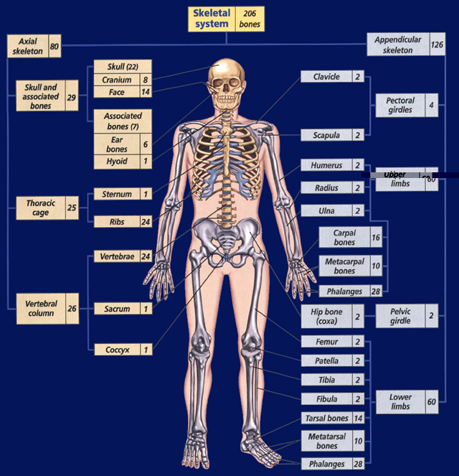
Section 34.2 Summary– pages 899-904
Skeletal System Structure
The adult human skeleton contains about 206 bones.
Its two main parts are shown.

Slide 42
Section 34.2 Summary– pages 899-904
Joints: Where bones meet
Joints are often held together by ligaments.
A ligament is a tough band of connective tissue that attaches one bone to another.
In movable joints, the ends of bones are covered by cartilage.
This layer of cartilage allows for smooth movement between the bones.

Slide 43
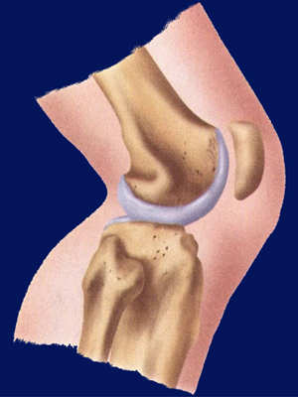
Section 34.2 Summary– pages 899-904
Joints: Where bones meet
In addition, joints such as those of the shoulder and knee have fluid-filled sacs called bursae located on the outside of the joints.
The bursae act to decrease friction and keep bones and tendons from rubbing against each other.

Slide 44
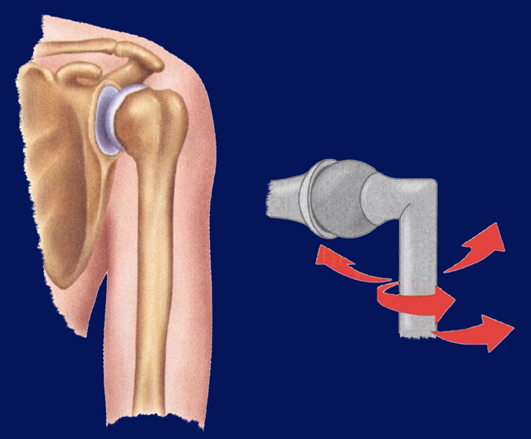
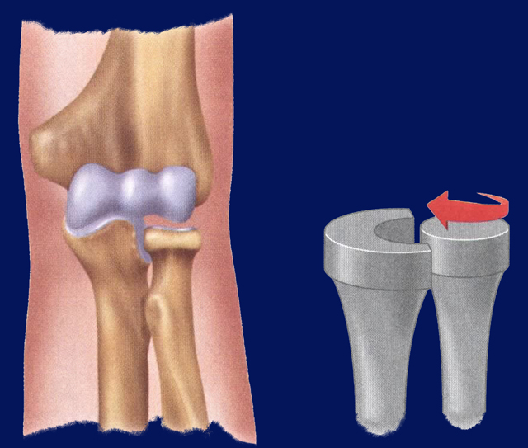
Section 34.2 Summary– pages 899-904
Joints: Where bones meet
Tendons, which are thick bands of connective tissue, attach muscles to bones.
Ball and Socket
Pivot

Slide 45
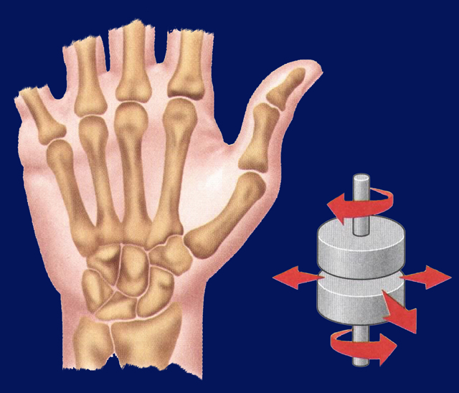
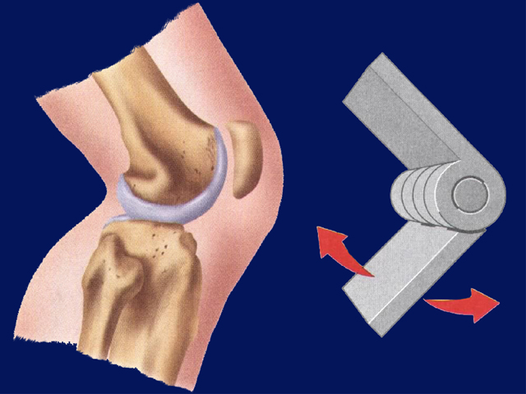
Section 34.2 Summary– pages 899-904
Joints: Where bones meet
Hinge
Gliding

Slide 46
Section 34.2 Summary– pages 899-904
Joints: Where bones meet
One common joint disease is arthritis, an inflammation of the joints.
One kind of arthritis results in bone spurs, or outgrowths of bone, inside the joints.
Such arthritis is especially painful, and often limits a person’s ability to move his or her joints.

Slide 47
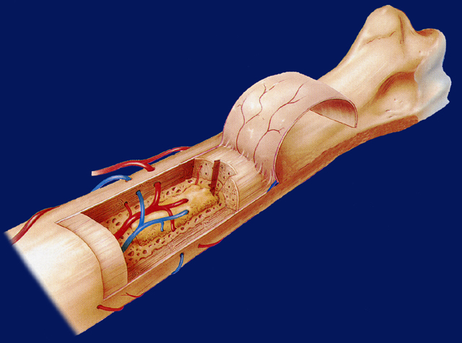
Section 34.2 Summary– pages 899-904
Compact and spongy bone
Bones are composed of two different types of bone tissue: compact bone and spongy bone.
Spongy bone
Marrow cavity
Humerus
Compact bone
Periosteum
Artery
Vein

Slide 48
Section 34.2 Summary– pages 899-904
Compact and spongy bone
Surrounding every bone is a layer of hard bone, or compact bone.
Spongy bone
Marrow cavity
Humerus
Compact bone
Periosteum
Artery
Vein

Slide 49
Section 34.2 Summary– pages 899-904
Compact and spongy bone
Cartilage
Spongy
bone
Running the length of compact bone are tubular structures known as osteon or Haversian (ha VER zhen) systems.
Marrow
cavity
Compact
bone
Compact bone is made up of repeating units of osteon systems.
Membrane
Blood
vessel

Slide 50
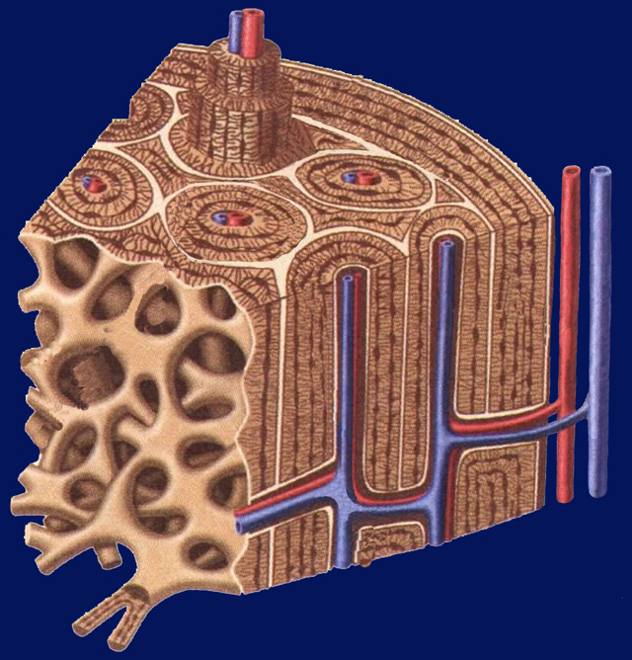
Section 34.2 Summary– pages 899-904
Compact and spongy bone
Osteon systems
Capillary
Living bone cells, or osteocytes (AHS tee oh sitz), receive oxygen and nutrients from small blood vessels running within the osteon systems.
Vein
Artery
Spongy bone

Slide 51
Section 34.2 Summary– pages 899-904
Compact and spongy bone
Cartilage
Spongy
bone
Compact bone surrounds less dense bone known as spongy bone because, like a sponge, it contains many holes and spaces.
Marrow
cavity
Compact
bone
Membrane
Blood
vessel

Slide 52
Section 34.2 Summary– pages 899-904
Bone growth
Your bones grow in both length and diameter.
Growth in length occurs at the ends of bones in cartilage plates.
Growth in diameter occurs on the outer surface of the bone.
After growth stops, bone-forming cells are involved in repair and maintenance of bone.

Slide 53
Section 34.2 Summary– pages 899-904
Skeletal System Functions
The primary function of your skeleton is to provide a framework for the tissues of your body.
The skeleton also protects your internal organs, including your heart, lungs, and brain.

Slide 54
Section 34.2 Summary– pages 899-904
Skeletal System Functions
Muscles that move the body need firm points of attachment to pull against so they can work effectively.
The skeleton provides these attachment points.
Bones also produce blood cells. Red marrow is the production site for red blood cells, white blood cells and cell fragments involving blood clotting.

Slide 55
Section 34.2 Summary– pages 899-904
Bones store minerals
Your bones serve as storehouses for minerals, including calcium and phosphate.
Calcium is needed to form strong, healthy bones and is therefore an important part of your diet.

Slide 56
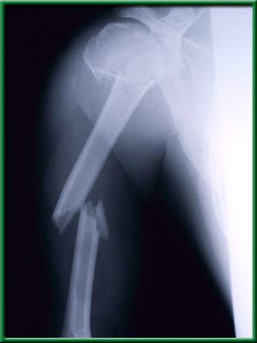
Section 34.2 Summary– pages 899-904
Bone injury and disease
Bones tend to become more brittle as their composition changes with age.
For example, a disease called osteoporosis (ahs tee oh puh ROH sus) involves a loss of bone volume and mineral content, causing the bones to become more porous and brittle.

Slide 57
Section 2 Check
Question 1
What type of joint is illustrated in this image?
A. ball and socket
B. hinge
C. pivot
D. gliding

Slide 58
Section 2 Check
The answer is C. Pivot joints allow bones to twist around each other.

Slide 59
Section 2 Check
Question 2
Where, on the body, would you find bursae?
A. skull
B. hands
C. shoulder
D. pelvis

Slide 60
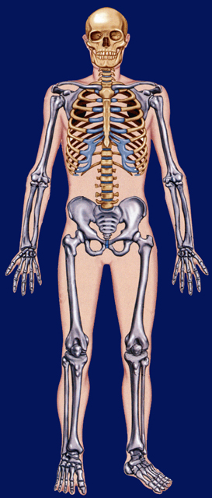
Section 2 Check
The answer is C, shoulder. Bursae are fluid-filled sacs located on the outside of the joints. They act to decrease friction.

Slide 61
Section 2 Check
Question 3
What disease causes the bones to become brittle?
A. arthritis
B. osteoporosis
C. a sprain
D. phosphate deficiency

Slide 62
The answer is B. Osteoporosis involves a loss of bone volume and mineral content.

Slide 63
Skin Poster
Title- at the top
Function of Skin-There are 4.
Parts of the Skin –Include Epidermis & Dermis
Disease- focus on one
Picture - labeled

Slide 64
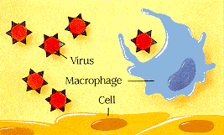
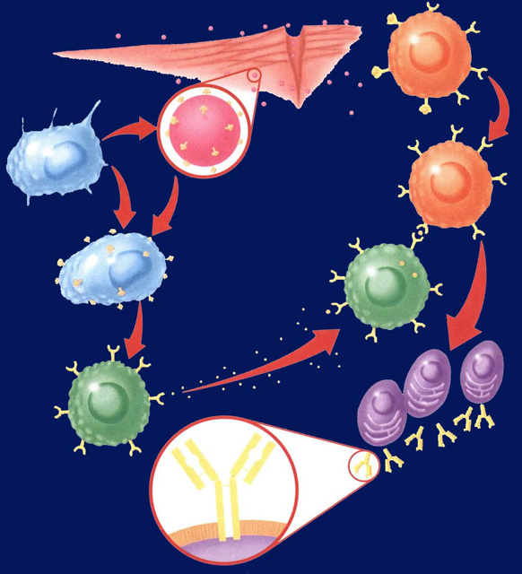
Immune System Poster – CH 18
What is a Virus?
What is a Bacteria
Draw pictures of both and label them
What do they need to grow and reproduce?
How do we use medicine to treat them?

Slide 65
Pathogens
DNA
Virus is a disease causing particle containing DNA
Virus needs a home cell to reproduce.
There is NO medicine (at the moment) to fight viruses.
Bacteria is a disease causing organism that is prokaryotic
They need an environment and food to reproduce.
Antibiotics are prescribed to fight off bacteria
VIRUS
Cell
White Blood Cell
Bacteria

Slide 66
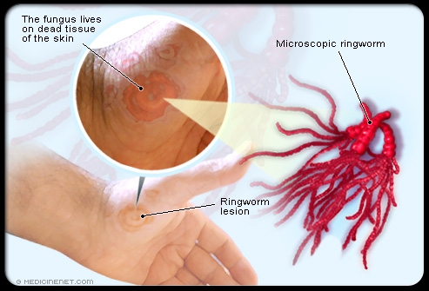
Immune System Poster
Skin protects us from sun, keeps us warm, keeps bacteria out, and lets us feel things
Ring Worm- A parasitic fungus that infects the skin, causing a ring-like rash

Slide 67
Skin Deep Basic Concepts 34.1
Skin oils prevent it from drying out, soft & pliable, inhibit the growth of some bacteria.
The primary function of the sweat glands is to maintain a normal body temperature during exercise or in the heat.
Sensory nerves are sensitive to external stimuli such as pressure, pain, heat, & cold (goose bumps)
Differences in the pigmentation of the skin result from greater or lesser amount of the pigment (Protein) Melanin found in the Epidermis.

Slide 68
Skin Deep Basic Concepts 34.1
The hair follicle is located in the dermis layer. It is involved with protecting the skin from injury & sun and provides insulation, or coolness.
They provide protection for the living cell layers beneath them.
Hands & feet have ridges & grooves that provide traction & increase friction.
Fat provides insulation & protects against heat loss. It also cushions the body against mechanical injury & store energy.

Slide 69
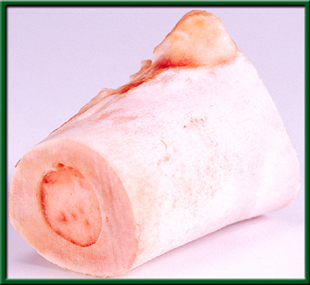
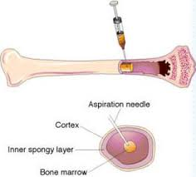
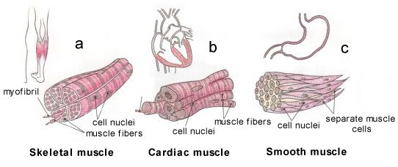
12/6 The Human Body Unit 10 CH 34.2 & 34.3 Obj. TSW learn about the different parts of the body by doing a poster of each system and presenting it to the class. P. 62 NB
Compare & Contrast compact bone and spongy bone.
Compare & contrast Red Marrow and Yellow marrow.
Identify the three types of muscle.

Slide 70
Bones: The Body’s Foundation 34.2 12/6 Obj. TSW learn how bone is formed and identify the structure and functions of the skeletal system and compete putting Mr. Bones together. P.62 NB
Compare and contrast the axial and the appendicular skeletons.
How does bone form?
Compare and contrast red and yellow marrow.

Slide 71
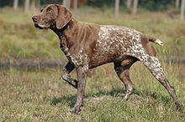

Slide 72
Section 34.2 Summary– pages 899-904
Skeletal System Structure

Slide 73
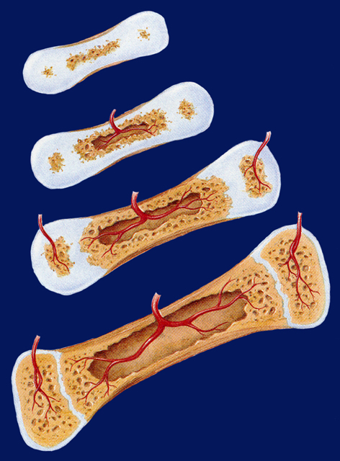
Section 34.2 Summary– pages 899-904
Formation of Bone
Cartilage
The skeleton of a vertebrate embryo is made of cartilage.
Blood supply
Bone
By the ninth week of human development, bone begins to replace cartilage.
Marrow cavity

Slide 74
Section 34.2 Summary– pages 899-904
Formation of Bone
Cartilage
Blood vessels penetrate the membrane covering the cartilage and stimulate its cells to become potential bone cells called osteoblasts.
Blood supply
Bone
Marrow cavity

Slide 75
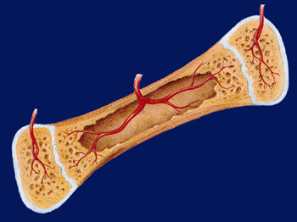
Section 34.2 Summary– pages 899-904
Formation of Bone
These potential bone cells secrete a protein called collagen in which minerals in the bloodstream begin to be deposited.
Marrow cavity

Slide 76
Section 34.2 Summary– pages 899-904
Formation of Bone
The deposition of calcium salts and other ions hardens
the newly formed
bone cells, now
called osteocytes.
Marrow cavity

Slide 77
Section 34.2 Summary– pages 899-904
Skeletal System Functions
Bones also produce blood cells.
Red marrow—found in the humerus, femur, sternum, ribs, vertebrae, and pelvis—is the production site for red blood cells, white blood cells, and cell fragments involved in blood clotting.

Slide 78
Section 34.2 Summary– pages 899-904
Skeletal System Functions
Yellow marrow, found in many other bones, consists of stored fat.
Yellow bone marrow

Slide 79
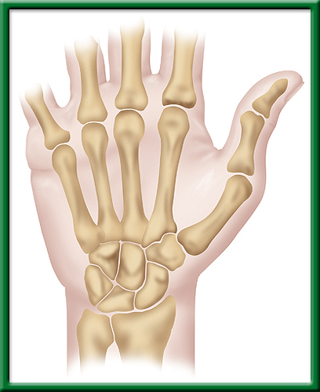
Skeletal Hand
To return to the chapter summary click escape or close this document.

Slide 80
Bones 34.2 4/29 Obj. Stds. will learn how bone is formed and identify the structure and functions of the skeletal system. P.116 NB
Compare & contrast a ligament and a tendon.
Compare & contrast osteocytes & osteoblasts.
Identify sources of Calcium in your diet.

Slide 81
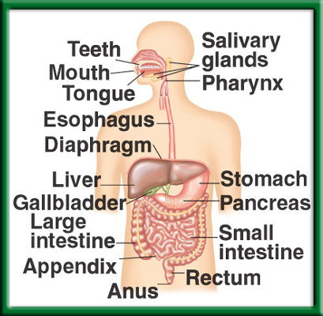
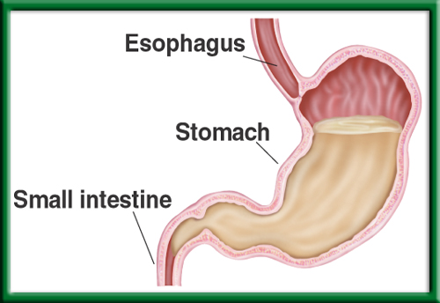
Digestive & Endocrine Systems CH 35.1 & 35.3 5/13 Obj. TSW identify & explain the parts of the human digestive & endocrine systems, then make a Booklet explaining in detail the two systems. P.62 NB
List the parts and functions of the digestive system, how does it maintain homeostasis?
Explain peristalsis.
What is adrenaline? What system is it part of & what response does it produce?

Slide 82
#1. The Digestive System
It maintains homeostasis by regulating water, energy, vitamins, minerals and waste from food.
To return to the chapter summary click escape or close this document.

Slide 83
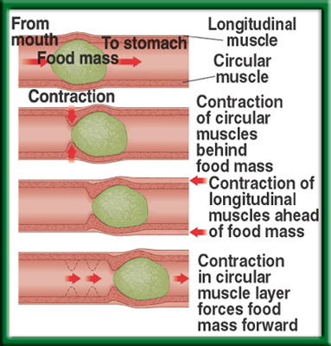
#2. Peristalsis
Muscular contractions that moves food through the digestive system.
To return to the chapter summary click escape or close this document.

Slide 84
#2.
Stomach
To return to the chapter summary click escape or close this document.

Slide 85
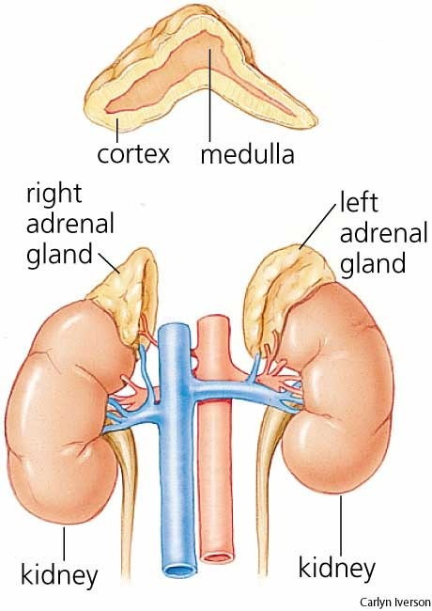
#3. Adrenal Gland secretes adrenaline in times of stress and creates the Fight or Flight Response

Slide 86
Problem Solving Lab 35.2 P. 928BB P. 67 NB
BMI = 22.7; Normal Weight
The person could reduce his or her calorie intake, &/or increase activity level.
His Calorie intake is in balance with his expenditure.
The test may overestimate the amount of body fat for a person who is well muscled, & may underestimate the amount of body fat for a person who is very thin but not well muscled.
OBESE = 25% greater chance of having : Cancer, Diabetes, Heart Disease or a Stroke

Slide 87
Muscles
Antibodies
Carbohydrates
Proteins
Chemicals for blood clotting
Amino acids
Glycerol
Body functions
Fatty acids
The liver
Indigestible cellulose
Glycogen
Fat
Body cells
Hormones
Cell structure
Enzymes
Simple sugars
3 – 4 sentence summary
P. 65NB

Slide 88
Mini Lab 35.1 p.927 BB
P. 65NB
Condensed soup means you need to add a liquid like water, milk or other liquid.
Soup A better for a person with diabetes.
Soup A has less sugar & may be better for a person with diabetes.
Soup B has less salt & may be better for a person with heart disease.
Soup B is better for someone who has to reduce there calorie intake.
Soup A is better for someone reducing there calories
The conventional – for taste, the Heart Healthy because I want to be healthy and set a good example for my brothers and sisters who may be at risk for heart disease.
 | Total Fat | Sat. Fat | Cholesterol | Sodium | Total Carb. | Fiber | Protein | Calories | Fat Calories
A | 2g | 1g | 15mg | 980mg | 9g | 1g | 3g | 70 | 20
B | 1.5g | .5g | 0mg | 460mg | 18g | 1g | 1g | 90 | 15

Slide 89
Mini Lab 35.1 p.927 BB
P. 65NB
Yes, the soup provides more than 30% of sodium.
How might sodium affect someone with heart disease?
2. 6g Fat x 9 Cal/g = 54 Calories of saturated fat/ serving. 54 calories/ 140 calories = 39%
Yes, although it is high in sodium.
What might make the soup healthy?
Vitamin A, low calories, decent amount of protein, 20 % fiber.

Slide 90
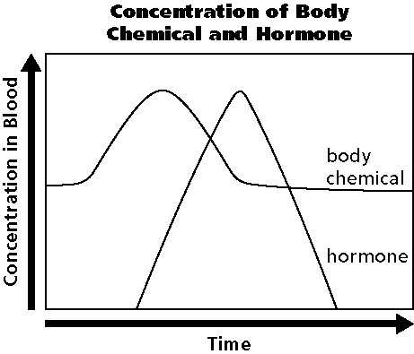
12/ 10 Homeostasis & Endocrine System CH 35.3 Obj. TSW draw and describe a Negative Feedback System involving the Endocrine System. P. 66 NB
What are the functions of the Endocrine system?
Draw the graph, explain how the body maintains homeostasis.
Why does the hormone production increase?

Slide 91
Digestive System Story Book Use the Internet & CH 35 P. 917 – 923 BB Due May 21st
Include the Mouth, Enzymes, Esophagus, Stomach, Liver, Gall Bladder, Pancreas, Sm. Intestine, Large Intestine, Rectum, Anus.
Include pictures of the digestive system
Tell a story from the perspective of a piece of food traveling through the digestive system
Include facts about the Dig. System, ie. Length of Sm. Intestine., specific enzymes used at the site.
Use appropriate vocabulary words – Peristalsis
Where are Proteins, Carbohydrates and Lipids digested and absorbed?

Slide 92
Physiology Project due Jan. 7th
Research Physiology Web sites:
Describe what the particular organ system or subsystem does.
Name and describe its major parts, at least 3.
Write a paragraph summarizing what you saw when you did research. P. 145 NB
Cite you sources.
At the Interactive Body Atlas and Disease site:
http://health.discovery.com
Pick one of the 150 conditions & disorders of the human body.
Describe the major organs & body parts involved.
Describe how the condition or disorder affects these organs.
Describe possible treatments or cures.
Write a one page report on your findings. P. 147 NB
(Honors Bio. –Type your report and have your previous paragraph attached to the back).
Cite your Sources

Slide 93
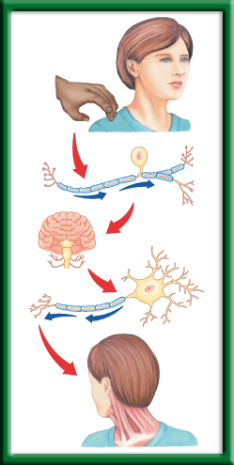
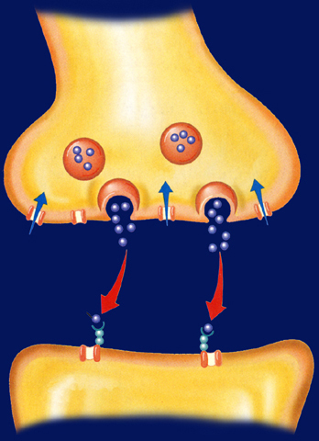
12/11 Nervous System 36.1 Obj. TSW explain the roles of the sensory neurons, interneurons, and motor neurons in sensation, thought and response by doing a lab on reaction response. P.68 NB
Describe, draw, and label a neuron.
Explain the functions of each type of neuron: sensory, interneuron, and motor.
What is a reflex, write an example?

Slide 94
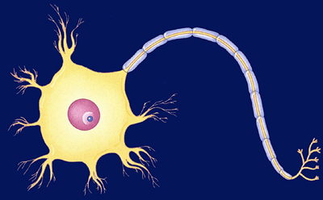
Section 36.1 Summary – pages 943 - 950
Neurons: Basic Units of the Nervous System
Neurons conduct impulses throughout the nervous system. Draw this picture
Dendrite
Myelin sheath
Axon
Nucleus
Axon endings
Cell body

Slide 95
Section 36.1 Summary – pages 943 - 950
Neurons: Basic Units of the Nervous System
Neurons fall into three categories: sensory neurons, motor neurons, and interneurons.
Sensory neurons carry impulses from the body to the spinal cord and brain.

Slide 96
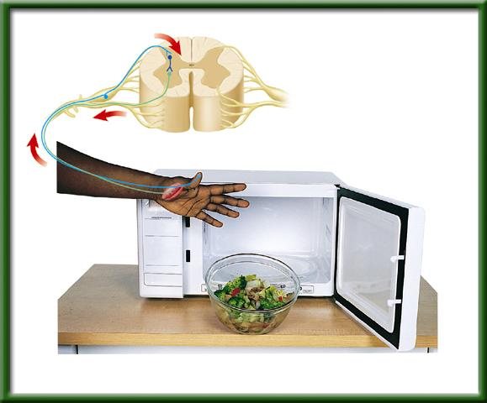
Section 36.1 Summary – pages 943 - 950
Neurons: Basic Units of the Nervous System
Interneurons are found within the brain and spinal cord.
Sensory neuron
Interneuron
Spinal cord
Motor neuron
Receptor in skin
Direction of impulse
Muscle contracts

Slide 97
Section 36.1 Summary – pages 943 - 950
Neurons: Basic Units of the Nervous System
Motor neurons carry the response impulses away from the brain and spinal cord to a muscle or gland.
Sensory neuron
Interneuron
Spinal cord
Motor neuron
Receptor in skin
Direction of impulse
Muscle contracts

Slide 98
Section 36.1 Summary – pages 943 - 950
Two systems work together
Brain
Together, the central nervous system (CNS) and the peripheral nervous system (PNS) respond to stimuli from the external environment.
Spinal cord

Slide 99
Sensory Neuron
-You sense the touch
How the Central Nervous System Works
Interneuron
-The brain processes that you have been touched.
Motor Neuron
-You turn your head to see who touched your shoulder

Slide 100
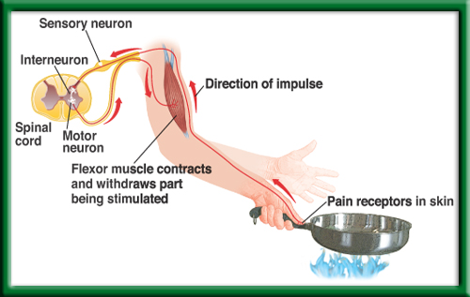
Simple Reflex
To return to the chapter summary click escape or close this document.

Slide 101
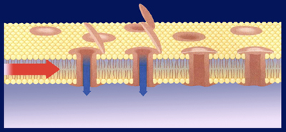
Nerve Impulses & Reflex Reactions 36.1 12/12 Obj. Stds. Will explain how an sensory, interneurons and motor neurons are involved in impulses, reflex reactions and the CNS & PNS. P. 70NB
Summarize how nerve impulses travels within the nervous system.
Compare & Contrast the functions of the central and peripheral nervous systems.
Why is it nearly impossible to stop a reflex from taking place?
Nervous System
Central
Nervous
System (CNS)
Peripheral
Nervous
System
(PNS)
Somatic
Nervous
System
Autonomic
Nervous
System
Sympathetic
Nervous
System
Parasympathetic
Nervous
System

Slide 102
Word Bank
Dermis
Temperature
Nerve endings
Heat
Cold
Light pressure
Eyelids
Skin surface
Tip of tongue
Palms of hands
Epidermis
Fingertips
Organs
Muscle tissue
Lower layers
Heavy pressure
Soles of feet
p. 69 NB 3 sentence summary

Slide 103
Copy this table on page 69NB. p.948BB
Trials | Without Distraction (cm) | With Distraction (cm) | Opposite hand (cm)
1
2
3
4
5
6
7
8
9
10
Average

Slide 104
Mini Lab 36.1 Distractions & reaction Time P. 948BB P. 69NB
Your reaction time should
improve with time due to
muscle memory.
2. The distraction of counting backwards probably increased your reaction time and measurement.
3. Other factors besides your distraction that may increase your reaction time are: being sick, overly tired, sound, motivation, looking away & hungry.

Slide 105
Foldable: Digestive System p. 63NB
Carbohydrates:
Proteins:
Lipids:
Where are they digested? Where are they absorbed? What Enzymes are part of the processes?

Slide 106
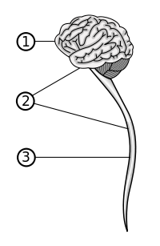
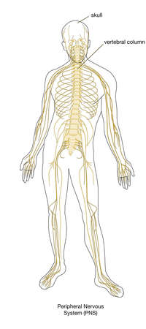
Foldable P. 71 NB
Central nervous system (front) | Peripheral nervous system (inside)
Brain Spinal cord
Definition: | Definition

Slide 107
Section 1 Check
Question 1
Describe how an impulse is relayed throughout your body.
Answer
Sensory receptors produce an impulse. The sensory impulse is carried to the spinal cord and then to your brain. From there, an impulse is sent out to your motor neurons which transmit the impulse to the muscles involved in the response.
CA: Biology/Life Sciences 9d, 9e

Slide 108
Section 36.1 Summary – pages 943 - 950
The autonomic nervous system
The autonomic nervous system carries impulses from the CNS to internal organs.
These impulses produce responses that are involuntary, or not under conscious control.

Slide 109
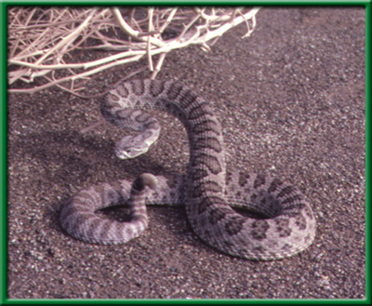
Section 36.1 Summary – pages 943 - 950
The autonomic nervous system
The sympathetic nervous system causes the release of hormones, such as epinephrine and norepinephrine, that results in the fight-or-flight response.
A fight-or-flight response can occur when you see a rattlesnake.

Slide 110
Section 36.1 Summary – pages 943 - 950
The autonomic nervous system
The parasympathetic nervous system on the other hand, controls many of the body’s internal functions when it is at rest.
Both the sympathetic and parasympathetic systems send signals to the same internal organs.

Slide 111
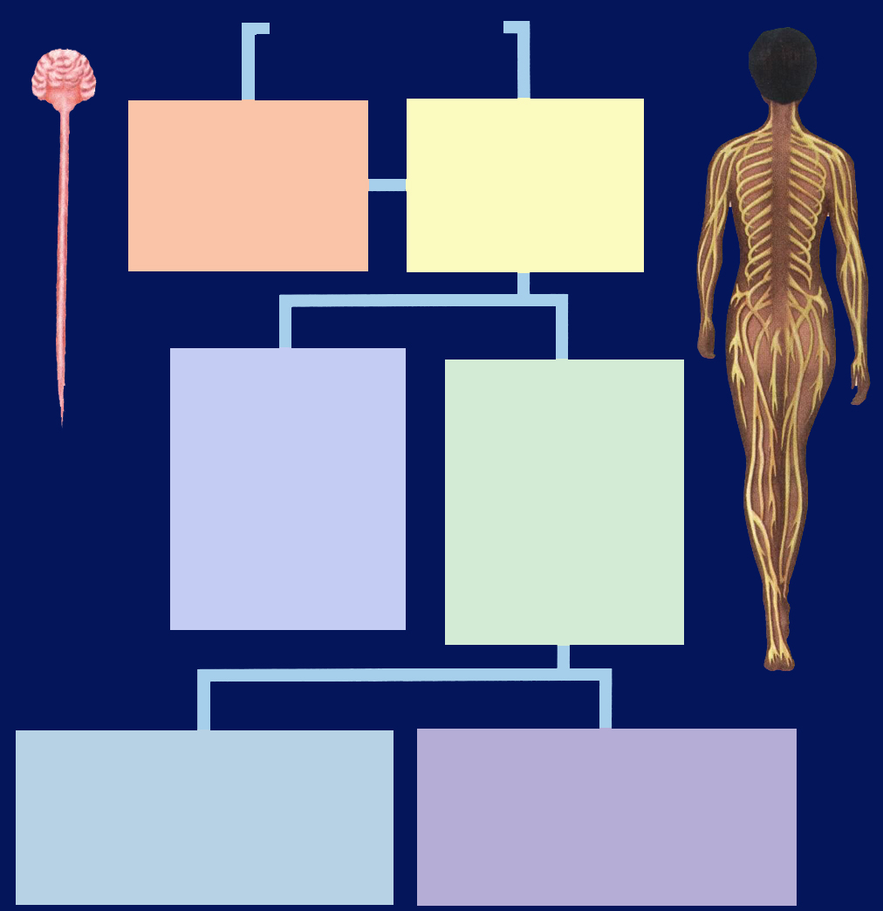
Section 36.1 Summary – pages 943 - 950
The autonomic nervous system
Nervous System
Central Nervous System (CNS)
Peripheral Nervous System (PNS)
Somatic Nervous System (voluntary)
Relays information to and from skin and skeletal muscles.
Autonomic Nervous System (involuntary)
Relays information to internal organs.
Sympathetic Nervous System
Controls organs in times of stress.
Parasympathetic Nervous System
Controls organs when body is at rest

Slide 112
Section 36.1 Summary – pages 943 - 950
Sensory neuron
Reflexes in the somatic system
Direction of impulse
Motor neuron
Flexor muscle contracts and withdraws part being stimulated
Pain receptors in skin

Slide 113
Nervous System
To return to the chapter summary click escape or close this document.

Slide 114
Section 36.1 Summary – pages 943 - 950
A neuron at rest
Plasma membrane
Outside cell
Open ion channel
Gated Na+ channel
Open ion channel
Gated Na+ channel
Na+/K+ pump

Slide 115
Section 36.1 Summary – pages 943 - 950
Motor Neuron NA K Pump
Click image to view movie.

Slide 116
Section 36.1 Summary – pages 943 - 950
How an impulse is transmitted
When a stimulus excites a neuron, gated sodium channels in the membrane open up and sodium ions rush into the cell.
As the positive sodium ions build up inside the membrane, the inside of the cell becomes more positively charged than the outside.
This change in charge, called depolarization, moves like a wave down the length of the axon.

Slide 117
Section 36.1 Summary – pages 943 - 950
How an impulse is transmitted
—
—
+
+
+
K+
Gated K+ channel
Outside cell
Na+
Na+
Gated Na+ channel
Inside cell
+
+
—
—
—
Na+

Slide 118
Section 36.1 Summary – pages 943 - 950
How an impulse is transmitted
+
+
—
—
+
+
K+
K+
Gated K+ channel
Gated K+ channel
Impulse
Gated Na+ channel
Gated Na+ channel
Na+
Na+/K+ pump
—
—
+
+
—
—
Na+

Slide 119
Section 36.1 Summary – pages 943 - 950
How an impulse is transmitted
+
+
+
+
+
+
3Na+
Gated K+ channel
Impulse
Na+/K+ pump
Gated Na+ channel
—
—
—
—
—
—

Slide 120
Section 36.1 Summary – pages 943 - 950
How an impulse is transmitted
Click image to view movie.

Slide 121
12/13 Transmitting Electrochemical Impulses 36.1 Obj.: TSW explain the function of the nervous system and the role of the neurons in transmitting electrochemical impulses by doing the Nervous system poster project. P.72NB
Describe an impulse, what ions are involved?
How is an impulse transmitted down an axon?
Since neurons don’t actually touch, how does the impulse travel to the next neuron?

Slide 122
Section 1 Check
The myelin sheath insulates the axon, hindering the movement of ions across its plasma membrane. The ions must move down the sheath until they reach a gap. This greatly increases the speed at which the impulse travels.
Dendrite
Dendrite
Myelin sheath
Axon
Nucleus
Axon endings
Cell body
CA: Biology/Life Sciences 9d, 9e

Slide 123
Section 3 Check
Since the neurons do not touch, the chemical message is sent through Neurotransmitters across a synaptic cleft (space). Ca2+ is involved in triggering the release of neurotransmitters. When the neurotransmitters reach the receptors on the dendrite the ions ( Na+ & K+) the impulse is sent to the next neuron .
Increased synthesis
Axon
Increased release
Decreased enzymatic breakdown
Synaptic space
Dendrite
CA: Biology/Life Sciences 9e

Slide 124
The Effects of Drugs 36.3 4.3 Obj.: Stds. Will relate their understanding of neurons to how drugs effect neurotransmitters. p.98NB
How can drugs affect levels of neurotransmitters between neurons?
How does nicotine affect the body?
Compare and Contrast depressants and stimulants.

Slide 125
Chapter Summary – 36.3
The Effects of Drugs
Drugs act on the body’s nervous system.
Some medicinal uses of drugs include relieving pain and treating cardiovascular problems and nervous disorders.
The misuse of drugs involves taking a medicine for an unintended use. Drug abuse involves using a drug for a non-medical purpose.

Slide 126
Chapter Assessment
Table 36.1 Commonly Abused Drugs
Category • Substance
Commercial or Street Name
Potential Health Hazard
Cannabinoid
• Marijuana
• Grass, joints, pot, reefer, weed
Respiratory problems, impaired learning
Stimulants
• Cocaine
• Blow, coke, crack, rock
Increased heart rate and blood pressure, irregular heart beat, heart failure, and weight loss
• Methylphenidate
• Ritalin, Skippy, vitamin R
• Nicotine
• Chew, cigarettes, cigars
• Methamphetamine
• Ice, speed, glass
• MDMA
• Ecstasy, Eve
Depressants
• Benzodiazepines
• Librium, Valium, Xanax, downers, sleeping pills
Respiratory depression and arrest, lowered blood pressure, poor concentration
• Barbiturates
• Barbs, red birds, yellows
Hallucinogens
Chronic mental disorders, nausea, flashbacks
• LSD
• Cubes, microdot
Opioids
• Heroin
• H, junk, skag, smack
Respiratory depression and arrest, collapsed veins
Other
Headache, nausea, vomiting, unconsciousness, sudden death
• Inhalants
• Paint thinners, gasoline, butane, nitrates, laughing gas
• Anabolic steroids
Liver and kidney cancer, acne, high blood pressure
• Juice
• Ketamine
• Special K, vitamin K
Respiratory depression and arrest, nausea, vomiting

Slide 127
1/4 The Senses Obj. Stds. Will explain examples of how the nervous system regulates communication between different parts of the body and the body’s interactions with the environment. P.170NB
http://science.education.nih.gov/supplements/nih2/Addiction/default.htm
When you have a cold, why is it difficult to taste food?
How would a person’s vision be affected if his or her rod cells didn’t function?
Why might an ear infection lead to problems with balance?

Slide 128
Olfactory Senses
To return to the chapter summary click escape or close this document.

Slide 129
Section 36.2 Summary – pages 951 - 955
Sensing Chemicals
Tastes that you experience can be divided into four basic categories: sour, salty, bitter, and sweet.
As seen with the sequence of electrochemical changes a neuron undergoes as it is depolarized, each of the different tastes produces a similar change in the cells of taste buds.

Slide 130
Section 36.2 Summary – pages 951 - 955
Sensing Chemicals
As these cells are depolarized, signals from your taste buds are sent to the cerebrum.
There, the signal is interpreted and you notice a particular taste.

Slide 131
Section 36.2 Summary – pages 951 - 955
Rod and cone cells
The Eye
Visual field
Visual cortex in cerebrum
Optic nerve
Lens
Top view of brain
Retina
Depth perception
Brain image projections

Slide 132
Internal Structure of the Ear
To return to the chapter summary click escape or close this document.

Slide 133
Section 36.1 Summary – pages 943 - 950
Anatomy of the brain
Motor area
Cerebrum
Sensory area
Speech area
Language area
Vision area
Taste area
General interpretation area
Intellect, learning, and personality
Balance area
Hearing area
Brain stem
Cerebellum

Slide 134
Section 36.2 Summary – pages 951 - 955
Your sense of touch
Free nerve ending
Heat
Hair Shaft
Light Touch
Opening of sweat gland
Heavy pressure
Cold

Slide 135
Section 36.1 Summary – pages 943 - 950
White matter and gray matter
The myelin sheath gives axons a white appearance.
In the brain and spinal cord, masses of myelinated axons make up what is called “white matter.”
The absence of myelin in masses of neurons accounts for the grayish color of “gray matter” in the brain.

Slide 136
Section 36.1 Summary – pages 943 - 950
Connections between neurons
Dendrite
Axon
Impulse
Synapse
Impulse
Dendrite
Axon

Slide 137
Section 36.1 Summary – pages 943 - 950
Connections between neurons
Vesicle fuses with membrane (exocytosis)
Vesicle with neurotransmitters inside
Dendrite
Axon
Impulse
Axon
Calcium channel
Neurotrans-mitters released into synapse
Synapse
Synaptic space
Neurotransmitter diffuses across synapse and binds with receptor on dendrite
Impulse
Dendrite
Dendrite
Axon

Slide 138
12/ 16 Respiratory, Circulatory & Excretory Systems CH 37.1 – 37.3 Obj. TSW explain in your warm up how the respiratory, circulatory and excretory systems complement each other to maintain Homeostasis. P. 74NB
Explain the process of how gas is exchanged (Alveoli) in the lungs.
The level of CO₂ in the blood affects breathing rate. How would you expect high levels of CO₂ to affect heart rate?
How does the kidney maintain homeostasis in the body?

Slide 140
How is an impulse transmitted?
An impulse is a change in polarization (at the gated Na+/ K+ channels) of the nodes on a neuron.
An impulse is transmitted when there is a depolarization, (that moves like a wave down the axon of the neuron to the next neuron).
Depolarization is when a nerve cell that is normally negative on the inside has a build up of positively charged Na+ ions.
A nerve cell at resting state (no impulse) is negatively charged on the inside and positively charged on the outside.

Slide 141
Nerve Impulse Poster p. 944, 949 BB
Write the standard: Students will know the roles of sensory neurons, interneurons, & motor neurons in sensation, thought & response.
Draw the three neurons, labeling all the parts, define each on the poster.
Show an Impulse (Ex. Bright light, touch, pie or hot plate) that includes the sensory, interneuron, and motor neuron response.
Make sure to include a definition of a Reflex Reaction.

Slide 142
Nerve Impulse Poster
Write the standard: Students will know the roles of sensory neurons, interneurons, & motor neurons in sensation, thought & response.
Draw one neuron, labeling all the parts, define each of the type of neuron on the poster.

Slide 143
Section 37.1 Summary – pages 971-974
Control of Respiration
Breathing is usually an involuntary process.
It is partially controlled by an internal feedback mechanism that involves signals being sent to the medulla oblongata about the chemistry (pH) of your blood.

Slide 144
Section 37.1 Summary – pages 971-974
Control of Respiration
The medulla oblongata responds to higher levels of carbon dioxide in your body by sending nerve signals to the rib muscles and diaphragm.
The nerve signals cause these muscles to contract, and you inhale.

Slide 145
Section 37.1 Summary – pages 971-974
Alveoli: The place of gas exchange
External respiration involves the exchange of oxygen or carbon dioxide between the air in the alveoli and the blood that circulates through the walls of the alveoli.

Slide 146
Section 37.1 Summary – pages 971-974
Blood transport of gases
Once oxygen from the air diffuses into the blood vessels surrounding the alveoli, it is pumped by the heart to the body cells, where it is used for cellular respiration.
Cellular respiration is the process by which cells use oxygen to break down glucose and release energy in the form of ATP.

Slide 147
Section 37.1 Summary – pages 971-974
Passageways and Lungs
Pharynx
Respiration, the process of gas exchange, is another important function performed by the respiratory system.
Nasal cavity
Medulla oblongata
Epiglottis
Larynx
Esophagus
Trachea
Bronchus
Right lung
Bronchiole
Left lung
Diaphragm

Slide 148
Section 37.1 Summary – pages 971-974
Alveoli: The place of gas exchange
Alveoli (al VEE uh li) are the sacs of the lungs where oxygen and carbon dioxide are exchanged by diffusion between the air and blood.
The clusters of alveoli are surrounded by networks of tiny blood vessels, or capillaries.

Slide 149
Section 37.1 Summary – pages 971-974
Alveoli: The place of gas exchange
Alveoli
Blood in these vessels has come from the cells of the body and contains wastes from cellular respiration.
O₂ – rich blood
Capillary network
CO₂ – rich blood
Alveolus

Slide 150
Section 37.1 Summary – pages 971-974
Respiration and Lung Function
Click image to view movie.

Slide 151
Section 37.1 Summary – pages 971-974
Blood transport of gases
Carbon dioxide is a waste product of the process.
The carbon dioxide diffuses into the blood, which carries it back to the lungs.
Carbon dioxide from the body diffuses from the blood into the air spaces in the alveoli.

Slide 152
Section 37.2 Summary – pages 975-984
The passage of blood
Superior vena cava
Pulmonary artery
Aorta
Pulmonary vein
LA
RA
LV
RV
Capillaries
Inferior vena cava
Left lung
Right lung

Slide 153
Section 37.2 Summary – pages 975-984
Pericardium
Superior vena cava
Right lung
Arch of aorta
Pulmonary trunk
Right atrium
Right ventricle
Left atrium
Left ventricle
Right coronary artery
Rib (cut)
Left lung
Left coronary artery
Cut edge of pericardium
Diaphragm

Slide 154
How the Human Body Responds to Heat
To return to the chapter summary click escape or close this document.

Slide 155
Problem Solving Lab 37.1
Copy the table & answer the questions 1 – 3
Prepare to discuss them as a class.
Pulse Oximeter
Sphigmomenometer
Blood Pressure cuff

Slide 156
12/17 The Circulatory System CH 37.2 Obj. TSW learn about the types and components of blood, and the parts of the Circulatory system by doing an exercise activity. P. 76 NB
What are the components to the Blood?
Identify and explain the difference between two main types of blood cells.
What are the blood types, how do you determine inheritance with Rh factors?

Slide 157
Section 37.2 Summary – pages 975-984
Heartbeat regulation
The heart rate is set by the pacemaker, a bundle of nerve cells located at the top of the right atrium.
Sinoatrial node (Pacemaker)
This pacemaker generates an electrical impulse that spreads over both atria.
Atrioventricular node

Slide 158
Section 37.2 Summary – pages 975-984
Blood pressure
Blood pressure is the force that the blood exerts on the blood vessels.
Blood pressure rises and falls as the heart contracts and then relaxes.
Blood pressure rises sharply when the ventricles contract, pushing blood through the arteries.

Slide 159
Section 37.2 Summary – pages 975-984
Blood pressure
The high pressure is called systolic pressure.
Blood pressure then drops dramatically as the ventricles relax.

Slide 160
Section 37.2 Summary – pages 975-984
Blood pressure
The lowest pressure occurs just before the ventricles contract again and is called diastolic pressure.
Mercury column
Rubber cuff
Blood Pressure
120
Systolic pressure
Air control valve
100
80
Systemic blood pressure (mm Hg)
Diastolic pressure
Capillaries
60
Venules
Large veins
40
Small arteries
Small veins
Vena cavae
Large arteries
20
Aorta
Arterioles
Bulb
0
Distance from left ventricle

Slide 161
Components of the Blood
Red Blood Cells -transports O2 & CO2
White Blood Cells- T & B cells Immune system
Platelets – cell fragments involved in blood clotting (Vitamin K)
Plasma – Most of the liquid of blood- proteins, nutrients, enzymes, hormones, salts

Slide 162
Blood Cells
Red Blood Cells
Made in the Red Marrow
Circulatory & Respiratory System
Smaller
More numerous
No nucleus
O2 & CO2
Contain Hemoglobin (Iron – Fe)
White Blood Cells
Made in the Yellow Marrow
Circulatory & Immune System
Larger
Fewer cells
Nucleus
T & B & Macrophage Cells

Slide 163
8 Different Blood Types
A+ A-
B+ B-
O+ O-
AB+ AB-

Slide 164
Exercise Lab p. 75 NB
Choose a partner
Choose an exercise
1 minute in length (5 times)
Count strides, Jumping Jacks, Push ups
Duration (Time)- (5 repetitions) or (Time minutes)
Plank, Wall Sit
Control?
What was constant?

Slide 165
Data Table & Graph When do muscles fatigue?
Time (minutes) | Number of repetitions Sit ups, Push ups, Jumping Jacks Calf Raises Squats
1st minute 1 minute | 10
2nd minute 1minute | 20
3rd minute 1minute | 30
4th minute 1minute | 40
5th minute 1minute | 50
Interval Wall Sit Plank Superman | Time (seconds)
1 | 30
2 | 45
3 | 50
4 | 20
5 | 15

Slide 166
Exercise Lab
Title: Short – 5 words
Introduction: Exercise & Cardiovascular/ Respiratory system, O2 & CO2, pH, pulse
Objective
Hypothesis
Data table: Independent & Dependent Variable
Materials: List
Procedure: Specific. Step 1, Step 2, Step 3…
Safety concerns: don’t run with scissors.

Slide 167
Exercise Lab
Constants
Control:1st data point
Data Analysis: What happened over time and why is it important?
Graph:
Error Analysis:
Conclusion:

Slide 168
Questions to answer in the conclusion Yes in addition to the one’s in the lab report.
What effect did repeating the exercise over time have on the muscle group.
How did your muscles feel?
What physiological factors are responsible for fatigue?
How does the amount of rest you have affect the recovery of the muscles?
How did your results compare to others.

Slide 169
Chapter Summary – 37.3
The Urinary System
The urinary system consists of the kidneys, ureters, the urinary bladder, and the urethra.
The nephrons of the kidneys filter wastes from the blood.
The urinary system helps maintain the homeostasis of body fluids.

Slide 170
Chapter Assessment
Question 1
What organ(s) are reddish in color and located just above the waist, behind the stomach?
A. kidneys
B. lungs
C. heart
D. ureters
CA: Biology/Life Sciences 9g

Slide 171
Chapter Assessment
The answer is A, kidneys.
Vena cava
Aorta
Renal artery
Kidney
Renal vein
Ureters
Urinary bladder
Urethra
CA: Biology/Life Sciences 9g

Slide 172
Chapter Assessment
Question 2
According to the table, where is blood pressure the highest?
Blood Pressure
A. in the veins
120
Systolic pressure
B. in the capillaries
100
80
60
Diastolic pressure
Systemic blood pressure (mm Hg)
Capillaries
Small veins
Large veins
C. in the arteries
Venules
Vena cavae
40
Large arteries
Small arteries
Aorta
Arterioles
20
D. in the vena cava
0
Distance from left ventricle
CA: Biology/Life Sciences 9a

Slide 173
Chapter Assessment
The answer is C. Blood pressure rises sharply when the ventricles contract, pushing blood through the arteries.
CA: Biology/Life Sciences 9a

Slide 174
Chapter Assessment
Question 3
What prevents blood from flowing back into the atria?
A. heart valves
B. pericardium
C. capillaries
D. blood pressure
CA: Biology/Life Sciences 9a

Slide 175
Chapter Assessment
The answer is A. Heart valves are located between the atria and ventricles. They are one-way valves that keep blood from flowing back into the atria.
CA: Biology/Life Sciences 9a

Slide 176
Chapter Assessment
Question 4
Why is the blood that comes to the alveoli from the body’s cells high in carbon dioxide?
Answer
Cellular respiration is the process by which cells use oxygen to break down glucose and release energy. Carbon dioxide is a waste product of that process. It diffuses into the blood and is carried back to the lungs.
CA: Biology/Life Sciences 9a

Slide 177
Chapter Assessment
Question 5
What prevents food from entering the trachea?
A. the windpipe
B. teeth
C. the epiglottis
D. tonsils
The answer is C.

Slide 178
Chapter Assessment
Question 6
How is oxygen carried by the blood?
Answer
Oxygen becomes loosely bound to the hemoglobin in blood cells that have entered the lungs. These cells carry oxygen from the lungs to the body’s cells.
CA: Biology/Life Sciences 9a

Slide 179
Chapter Assessment
Question 7
Which veins carry blood that is rich in oxygen?
A. the venae cavae
B. the pulmonary veins
C. ventricles
D. the atrial veins
CA: Biology/Life Sciences 9a

Slide 180
Chapter Assessment
The answer is B. Pulmonary veins are the only veins that carry oxygen rich blood.
Right pulmonary artery (lung)
Aorta
Left pulmonary artery (lung)
Right pulmonary veins (lungs)
Capillaries in lungs
Vena cava
Left pulmonary veins (lungs)
Heart
Systemic veins
Systemic arteries
CA: Biology/Life Sciences 9a

Slide 181
Exercise Lab

Slide 182
P.163NB
Label your table as shown.
 | Organs | Function
Respiratory
Circulatory
Excretory, urinary
Excretory &
To return to the chapter summary click escape or close this document.

Slide 183
The Heart (front)
R. Atrium
Tricuspid value
L. Atrium
R. Ventricle
L. Ventricle
Aortic Valve
Pulmonary Valve
Tricuspid
Mitral Valve
Aorta
10. Pulmonary Artery
11. Left Pulmonary Artery
12. Right Pulmonary Artery
13.Superior Vena Cava
14. Inferior Vena Cava
15. Pulmonary Veins
16. Pulmonary Veins
17. Septum

Slide 184
Heart –Blood Flow
Superior / Inferior Vena Cava -> R. Atruim-> Tricuspid Valve->R. Ventricle->Pulmonary Valve->Pulmonary Artery->Lungs->Pulmonary Vein-> Left Atruim->Mitral Valve->Left Ventricle-> Aortic Valve->Aorta-> Rest of the Body.

Slide 185
The Heart worksheet
Blood Vessels
Capilaries, Veins, Arteries.
Circulatory System
Ventricle
Aorta
Capillary
Food & Oxygen
Vein
Inferior Vena Cava
Superior Vena Cava
Atrium

Slide 186
12/18 The Excretory/ Urinary System Ch 37.3 Obj. TSW learn about the excretion of waste from the body after waste has been filtered out of the blood to maintain homeostasis. P. 78 NB
What organs are involved in the Excretory system?
How does the excretory/ Urinary system maintain homeostasis?
Identify at least 5 molecules/ components in the renal artery to be filtered, Explain Figure 37.15.

Slide 187
Organs involved in the Excretory System
Excess salts, nitrogen water are removed from the kidneys to maintain osmotic balance in the body. Blood pH is maintained also by the filtration of Hydrogen Ions from the blood.

Slide 188
Renal Artery
Urea, water, salts, nutrients, glucose, blood cells, amino acids
Blood cells and amino acids are reabsorbed into the blood stream
Reabsorption of water & other substances maintain homeostasis.

Slide 189
Inside the Artificial Kidney- Real world Bioapplications TSW understand diffusion and homeostasis to the function of a nephron & the process of hemodialysis in an artificial kidney machine.
Urea, Uric Acid, glucose, & salts
The glomerulus & Bowman’s capsule actually filter the blood
These substances become more concentrated because water is reabsorbed into capillaries.
Glucose is reabsorbed into capillaries after passing through Bowman’s capsule.

Slide 190
The importance of Homeostasis in organisms.
Waste material in the blood diffuse through the tubing into the solution surrounding the tubing.
Answers should discuss the idea of substances moving from an area of high concentration to an area of low concentration.
You would expect to find blood cells, water, glucose, & proteins in the tube leading back to the person’s vein.
These substances don’t leave the tubing because either they are too big to pass through the selectively permeable tubing, as with the blood cell and large proteins, or there is no net movement of these substances in the surrounding fluid were similar to those in the blood.

Slide 191
Dialysis Lab

Slide 192
Defense Against Infectious Diseases 39.1 & 39.2 1/06 TSW understand and explain the role of antibodies in the body’s response to a bacterial infection during the warm up. P. 80NB
What is a pathogen?
Identify cells, tissues and organs that make up the immune system.
Explain the role of antibodies in response to infection.
T – cell production

Slide 193
Section 39.1 Summary – pages 1023-1030
Reservoirs of pathogens
The major nonliving reservoirs of infectious diseases are soil and water.
Soil harbors pathogens such as fungi and bacterium that causes botulism, a type of food poisoning.

Slide 194
Section 39.1 Summary – pages 1023-1030
Reservoirs of pathogens
Water contaminated by feces of humans and other animals is a reservoir for several pathogens, especially those responsible for intestinal diseases. Cholera, Dysentery

Slide 195
Section 39.1 Summary – pages 1023-1030
Transmission of disease
Pathogens can be transmitted to a host from reservoirs in four main ways: by direct contact, by an object, through the air, or by an intermediate organism called a vector.
The common cold, influenza, and STDs are spread by direct contact.

Slide 196
Section 39.1 Summary – pages 1023-1030
Transmission of disease
Diseases transmitted by vectors are most commonly spread by insects and arthropods.
Diseases such as malaria and the West Nile virus are transmitted by mosquitoes.

Slide 197
Section 39.1 Summary – pages 1023-1030
Transmission of disease
Lyme disease and Rocky Mountain spotted fever are diseases that are transmitted by ticks.

Slide 198
Section 39.1 Summary – pages 1023-1030
Damage to the host by viruses and bacteria
Most of the damage done to host cells by bacteria is inflicted by toxins.
Toxins are poisonous substances that are sometimes produced by microorganisms.

Slide 199
Section 39.1 Summary – pages 1023-1030
Patterns of Diseases

Slide 200
Section 39.1 Summary – pages 1023-1030
Treating Diseases
An antibiotic is a substance produced by a microorganism that, in small amounts, will kill or inhibit the growth and reproduction of other microorganisms, especially bacteria.
Although antibiotics can be used to cure some bacterial infections, antibiotics do not have an affect on viruses.

Slide 201
Section 39.1 Summary – pages 1023-1030
Treating Diseases
With the continued use of antibiotics, bacteria can become resistant to the drugs.
That means the drugs become ineffective.
Penicillin, an antibiotic produced by a fungus, was used for the first time in the 1940s and is still one of the most effective antibiotics known.

Slide 202
Section 39.2 Summary – pages 1031-1041
Inflammation of body tissues
If bacteria or other pathogens enter and damage body tissues, inflammation (ihn fluh MAY shun) results.
Inflammation is characterized by four symptoms—redness, swelling, pain, and heat.

Slide 203
Section 39.2 Summary – pages 1031-1041
Inflammation of body tissues
Histamine released—
blood vessels dilate
Injury
Inflammation begins when damaged tissued cells called mast cells, and white blood cells called basophils release histamine (HIHS tuh meen).

Slide 204
Section 39.2 Summary – pages 1031-1041
Inflammation of body tissues
Histamine released—
blood vessels dilate
Injury
Histamine causes blood vessels in the injured area to dilate, which makes them more permeable to tissue fluid.

Slide 205
Section 39.2 Summary – pages 1031-1041
Inflammation of body tissues
Histamine released—
blood vessels dilate
Injury
These dilated blood vessels cause the redness of an inflamed area.
Fluid that leaks from the vessels into the injured tissue helps the body destroy toxic agents and restore homeostasis.

Slide 206
Section 39.2 Summary – pages 1031-1041
Phagocytosis of pathogens
Phagocytes (FA guh sites) are white blood cells that destroy pathogens by surrounding and engulfing them.
Phagocytes include monocytes, which develop into macrophages, neutrophils, and eosinophils.

Slide 207
Section 39.2 Summary – pages 1031-1041
Phagocytosis of pathogens
Macrophages are white blood cells that provide the first defense against pathogens that have managed to enter the tissues.
Macrophages are found in the tissues of the body.
Lysosomal enzymes inside the macrophage digest the particles it has engulfed.
Macrophage

Slide 208
Section 39.2 Summary – pages 1031-1041
Phagocytosis of pathogens
If the infection is not stopped by the tissue macrophages, another type of phagocyte, called a neutrophil, is attracted to the site.
They also destroy pathogens by engulfing and digesting them.

Slide 209
Section 39.2 Summary – pages 1031-1041
Phagocytosis of pathogens
Blood
capillary
These cells squeeze through blood vessel walls to move into the infected area.
Once they reach the site of the infection they mature and are now called macrophages.
Macrophage
Connective
tissue

Slide 210
Section 39.2 Summary – pages 1031-1041
Phagocytosis of pathogens
Blood
capillary
They then begin consuming pathogens and dead neutrophils by phagocytosis.
Macrophage
Connective
tissue

Slide 211
Section 39.2 Summary – pages 1031-1041
Phagocytosis of pathogens
Swelling
occurs
Tissue fluid moves
into injured area
After a few days, infected tissue harbors a collection of live and dead white blood cells, multiplying and dead pathogens, and body fluids called pus.
Phagocytes
Pus

Slide 212
Section 39.2 Summary – pages 1031-1041
Acquired Immunity
Non-specific Immune Response
Click image to view movie

Slide 213
Section 39.2 Summary – pages 1031-1041
Cellular Immunity
Click image to view movie

Slide 214
Notebook
P. 81 NB Antibody Immunity P. 1037BB
P. 83 NB Cellular Immunity P. 1038 BB
P. 87 NB Foldable
Write a 4 – 5 sentence summary using specific vocabulary to explain the process.
Antibody Immunity
Cellular Immunity

Slide 215
Section 39.2 Summary – pages 1031-1041
Protective proteins
Phagocytes alone cannot destroy viruses.
One way your body can counteract viral infections is with interferons.
Interferons are proteins that protect cells from viruses.
Interferons are host-cell specific.

Slide 216
Section 39.2 Summary – pages 1031-1041
Acquired Immunity
The cells of your innate immune system continually survey your body for foreign invaders.
When a pathogen is detected, these cells begin defending your body right away.

Slide 217
Section 39.2 Summary – pages 1031-1041
Acquired Immunity
As the infection continues, another type of immune response that counteracts the invading pathogen is also mobilized.
Certain white blood cells gradually develop the ability to recognize a specific foreign substance.

Slide 218
Section 39.2 Summary – pages 1031-1041
Acquired Immunity
Antigens are foreign substances that stimulate an immune response, and antibodies are proteins in the blood that correspond specifically to each antigen.
The development of acquired immunity is the job of the lymphatic system.

Slide 219
Immune Responses 39.2 1/07 Obj. TSW compare and contrast Antibody Immunity and Cellular Immunity in their warm up and draw the parts of the immune system in the foldable. P.82NB
? Immunity
http://www.sfaf.org/aids101/immunology.html
Identify two types of lymphocytes in Antibody Immunity.
Explain the process of Antibody Immunity.
Explain the process of Cellular Immunity.
? Immunity

Slide 220
Section 39.2 Summary – pages 1031-1041
Antibody Immunity
Acquired immunity involves the production of two kinds of immune responses: antibody immunity and cellular immunity.
Antibody immunity is a type of chemical warfare within your body that involves several types of cells. Two types of Lymphocytes are the T & B cells

Slide 221
Section 39.2 Summary – pages 1031-1041
Infected cells
Cellular Immunity
Pathogen
engulfed by
Perforin
Foreign
antigen
Infected cell lyses
Macrophage
Cytotoxic T cell
Displays antigens
on surface and
stimulates T cell
Attacks infected
cell
Stimulates
Helper T cell
Cytotoxic T cell

Slide 222
Section 39.2 Summary – pages 1031-1041
Antibody Immunity
E. B cells can bind to antigens directly.
Pathogens enter
tissues through a wound.
B cell
F. Helper T cells bind to antigens on B cells.
B. They are attacked
by macrophages
at the infection site.
Pathogen
Macrophage
G. T cells release chemicals that cause B cells to produce
clones of plasma cells.
C. Antigens of the pathogen are displayed
on the surface of the macrophage.
Antigen
receptor
site
H. Each plasma cell secretes more than 2000 antibodies per second in the blood. Memory B cells and antibodies remain in the blood and respond to future invasions by the same pathogen.
D. Helper T cells have
receptor sites that
recognize and bind to the antigens on the
macrophage.
T cell
Plasma
cells
Antibody
Surface of
plasma cell

Slide 223
Foldable (87 NB) P. 1037BB
Macrophage – Definition & Picture inside
A white Blood cell that is nonspecific against pathogens.
T – Cell
B – Cell
Plasma Cell
Antibodies
Antigens

Slide 224
Folded view>>
T-Cell
B- Cell
Plasma cell
Antibodies
Antigens
Macrophage
white blood cells that provide the first defense against pathogens that have managed to enter the tissues.
Produce Plasma cells
Make antibodies. Each plasma cell makes 2000 antibodies per second in the blood
Protein that are produced to label the antigens on the pathogen “Attack this!”
Trigger immune response in the body.
Bind to the macrophage and triggers B-Cells

Slide 225
CM – Viruses & Bacteria CH 18 Viral Reproductive Cycles
Use the following words to fill in the blanks:
Lytic Cycle,
Host Cell
Copies viral genes
Lysogenic cycle
Host cell’s chromosome
A provirus
Alters
Continue
Viral DNA
Replication of host cell
Makes viral protein coat
Write a 3 – 4 sentence
summary

Slide 226
Penicillin Treatment P. 167
Patient 1 took all their 500mg dosages. Patient 2 stopped taking doses after dose 4.
Patient 2 dose change is due to him/ her not taking the dose.
Patient 1 the pathogens deceased except for dose 5 . Patient 2 the pathogens increased after dose 5 and continued until more dosages were taken.
Yes, the more dosages taken the less survival rate of pathogens.

Slide 227
Penicillin Treatment
For Patient 2 the pathogen on day 10 is more resistant to the medication.
You must continue to take your medication after you begin to feel better to kill any resistant bacteria.
Bacteria is the microorganism, only antibiotics will kill bacteria, not viruses.
If Patient 2 takes the drug for the entire treatment then they will not have the infection.

Slide 228
Antibiotic Resistance CH 39.1 1/8 TSW develop an understanding of how Bacteria develop a resistance to antibiotics by completing a worksheet and class discussion. P. 84 NB
Bacteria resistance to Antibiotics
Bacteria &Viruses are Pathogens. Which disease causing agent is treated with antibiotics?
Name an example of an antibiotic.
What problems can antibiotic resistant bacteria cause?

Slide 229
How does Bacteria build a resistance to antibiotics? P. 84 NB
1.Antibiotic Degrading Enzymes break up absorbed antibiotics.
2.The Bacteria builds a Efflux Pump to immediately pump out any absorbed antibiotic.
3. Antibiotic altering Enzyme surrounds the absorbed antibiotics and renders it useless & ineffective.

Slide 230
Antibiotics and Bacteria Resistance P. 85 NB Directions: Read the Yellow piece of paper, use the graphs on the back to answer questions 1 – 8.
1. What is the difference between patient 1 and patient 2 doses received? Which days were different?
Patient 1 was consistent with 500mg, Patient 2 was not consistent, and stopped taking the antibiotics.
2. What might have happened to cause the dose change?
Patient 2 stopped taking the antibiotics because they were feeling better.
3. What is the difference between patient 1 and patient 2 with respect to the percent of pathogen that survived? Explain.
Patient 1, no pathogens survived. Patient 2, the percent of pathogen survival increased to 65%.
4. Is there any correlation between doses taken and percent of pathogen that survives?
Regular dosage will lead to decrease in pathogen survival.

Slide 231
p. 85 NB
5. For patient 2, hypothesize how the pathogen at Day 10 is different than at Day 1.
The pathogen for patient 2 has become more resistant to the antibiotics.
6. Based on the data above, why do doctors recommend taking all of a medication even if you see symptoms disappear after only a few days of treatment?
The pathogens will build a resistance to the antibiotics if they are not taken as directed.
7. If penicillin is an antibiotic, then what microorganism has likely cased the infection? Explain.
Bacteria. Viruses do NOT respond to antibiotics.
8. Patient 2 has realized what was happening and got a new stronger antibiotic prescribed by a doctor. If he/she takes the drug for the entire treatment, what might happen?
The bacteria will die and the patient will be healthy.

Slide 232
Online Questions
Immune System
What are antibodies? What cells make them?
What is the acquired immune system?
What is innate immune system?
Nervous system
What are nerves?
What is the central nervous system?
What is the peripheral nervous system?
Pathogen resistence homeostasis

Slide 233
Immune System CH 39 1/09 TSW demonstrate knowledge and comprehension of the immune, nervous, skeletal & Integumentary body systems. P. 86NB
Name the main parts of the immune system.
Name types of cells that are part of the immune system and where are they made?
What is penicillin & why is it not as effective on bacteria as it once was 50 years ago?
MRSA

Slide 234
Antibody & Cellular Immunity Basic Concepts 39.2 P. 169 NB
1. Non-self antigens are protein recognized by the body as foreign substances.
Antibody immunity protects the body by first attacking the invading pathogen. Then antibodies specific to that invading antigen are produced.
3. T & B cells are lymphocytes. T cells are produced in the Bone Marrow, and mature in the Thymus Gland and send messages to B Cells. B cells are produced and mature in the bone marrow, and produce plasma cells that produce antibodies. T cell do not form antibodies.
4. Cellular Immunity

Slide 235
Antibody & Cellular Immunity Basic Concepts 39.2 P. 169 NB
Memory B and T cells are lymphocytes that are specialized for responding to a second attack.
6. Helper T cells are required in the chain of events that leads to antibody production. They also stimulate the production of cytotoxic T (Killer) cells needed for a cellular immune response.
7. Cytotoxic T (killer) cells bind to infected cells and break through cell walls, causing infected cells to undergo lysis.

Slide 236
Section 39.1 Summary – pages 1023-1030
Infectious
pathogen
identified
Step 2
Step 1
Pathogen grown
in pure culture
Step 4
Identical pathogen
identified
Step 3
Pathogen injected
into healthy animal
Healthy animal
becomes sick

Slide 237
Section 39.1 Summary – pages 1023-1030
Exceptions to Koch’s postulates
Some organisms, such as the pathogenic bacterium that causes the sexually transmitted disease syphilis (SIH fuh lus), have never been grown on an artificial medium.
Viral pathogens also cannot be cultured this way because they multiply only within cells.
As a result, living tissue must be used as a culture medium for viruses.

Slide 238
Section 39.1 Summary – pages 1023-1030
The Spread of Infectious Diseases
For a disease to continue and spread, there must be a continual source of the disease organisms.
This source can be either a living organism or an inanimate object on which the pathogen can survive.

Slide 239
Section 39.1 Summary – pages 1023-1030
Reservoirs of pathogens
The body can be a reservoir of disease-causing organisms.
People may transmit pathogens directly or indirectly to other people.

Slide 240
Section 39.2 Summary – pages 1031-1041
Phagocytosis of pathogens
Swelling
occurs
Tissue fluid moves
into injured area
Phagocytes
Pus
Pus formation usually continues until the infection subsides.
Eventually, the pus is cleared away by macrophages.

Slide 241
Section 39.1 Summary – pages 1023-1030
Reservoirs of pathogens
Animals are other living reservoirs of microorganisms that cause disease in humans.
Some types of influenza, commonly known as the flu, rabies, and Lyme disease are transmitted to humans from animals.

Slide 242
Section 39.1 Summary – pages 1023-1030
What is an infectious disease?
Not all microorganisms are pathogenic. In fact, the presence of some microorganisms in your body is beneficial.
These microorganisms have a symbiotic relationship with your body.

Slide 243
Section 39.1 Summary – pages 1023-1030
Human Infectious Disease
Disease
Cause
Transmission
Affected Organ System
Smallpox
Virus
Skin
Droplet
Chicken pox
Virus
Skin
Droplet
Rabies
Virus
Nervous
Animal bite
Poliomyelitis
Virus
Nervous
Virus
Contaminated water
Colds
Viruses
Respiratory system
Direct contact
Influenza
Viruses
Direct contact
Respiratory
HIV/AIDS
Virus
Immune
Exchange of body fluids
Hepatitis B
Virus
Liver
Exchange of body fluids
Tetanus
Bacteria
Nervous
Puncture wound
Food poisoning
Bacteria
Digestive
Contaminated food/water
Strep throat
Bacteria
Respiratory
Droplet
Diptheria
Bacteria
Droplet
Respiratory
Tuberculosis
Bacteria
Respiratory
Droplet
Spinal meningitis
Bacteria
Nervous
Droplet

Slide 244
Section 39.1 Summary – pages 1023-1030
Determining What Causes a Disease
Not all diseases are caused by pathogens.
Some disorders are inherited, such as hemophilia (hee muh FIH lee uh), which is caused by a recessive allele on the X chromosome, and sickle-cell anemia.
Others, such as osteoarthritis (ahs tee oh ar THRI tus), may be caused by wear and tear on the body as it ages.

Slide 245
Section 39.2 Summary – pages 1031-1041
Skin and body secretions
Sweat, tears, and saliva all contain the enzyme lysozyme, which is capable of breaking down the cell walls of some bacteria.

Slide 246
Section 39.2 Summary – pages 1031-1041
Lymph
nodes
Tonsils
The lymphatic system
Right lymphatic
duct
Your lymphatic (lihm FA tihk) system not only helps the body defend itself against disease, but also maintains homeostasis by keeping body fluids at a constant level.
T-cell
Thoracic
duct
Intestinal
lymph nodes
Thymus
gland
Appendix
Spleen
B-cell
Lymph
vessels
Bone marrow

Slide 247
Passive & Active Immunity 39.2 1/09 Obj. Stds. Will understand how a vaccine protects from disease and why an individual with AIDS has more difficulty fighting off a common virus during a lab activity. p.86NB
http://www.sfaf.org/aids101/immunology.html
Compare & contrast Passive & Active Immunity.
What is a vaccine and how does it protect an individual from infectious disease?
Why can’t an individual with AIDS fight off and survive infections by microorganisms that are usually benign.

Slide 248
Section 39.2 Summary – pages 1031-1041
Passive and Active Immunity
Acquired immunity to a disease may be either passive or active.
Passive acquired immunity develops as a result of acquiring antibodies that are generated in another host.

Slide 249
Section 39.2 Summary – pages 1031-1041
Passive and Active Immunity
Active acquired immunity develops when your body is directly exposed to antigens and produces antibodies in response to those antigens.

Slide 250
Section 39.2 Summary – pages 1031-1041
Passive Immunity
Natural passive immunity develops when antibodies are transferred from a mother to her unborn baby through the placenta or to a newborn infant through the mother’s milk.

Slide 251
Section 39.2 Summary – pages 1031-1041
Passive Immunity
Artificial passive immunity involves injecting into the body antibodies that come from an animal or a human who is already immune to the disease.

Slide 252
Section 39.2 Summary – pages 1031-1041
Active Immunity
Active immunity is obtained naturally when a person is exposed to antigens.
The body produces antibodies that correspond specifically to these antigens.

Slide 253
Section 39.2 Summary – pages 1031-1041
Protective proteins
Phagocytes alone cannot destroy viruses.
One way your body can counteract viral infections is with interferons.
Interferons are proteins that protect cells from viruses.
Interferons are host-cell specific.

Slide 254
Section 39.2 Summary – pages 1031-1041
Protective proteins
Human interferons will protect human cells from viruses but cannot protect cells of other species from the same virus.
Interferon is produced by a body cell that has been infected by the virus.
The interferon diffuses to uninfected neighboring cells, which then produce antiviral proteins that can prevent the virus from multiplying.

Slide 255
To return to the chapter summary click escape or close this document.

Slide 256
Write a 3 – 4 sentence summary
Word Bank
Foreign substances
Two ducts
Tissue fluid
Lymph
White blood cells
Lymph veins
Protect body
Nodes
Bloodstream
Lymphocytes
Lymph capillaries

Slide 257
Basic Concepts the AIDS Epidemic p.173 NB
1.The virus is called the Human Immunodeficiency Virus.
2.The person may or may not have AIDS.
But they can transmit the virus to another person.
3.The outer knobs consist of proteins, which are antigens.
A vaccine against AIDS could possibly be developed to
trigger the body to produce antibodies specific to the
antigen the HIV knobs.
4. HIV is a retrovirus made of RNA.
5. The virus’s attachment protein is attaching itself to a receptor in the plasma membrane of a helper T – cell. The virus then penetrates the cell leading to the fusion of the viral and T – cell membranes. The virus uses the host cell’s RNA to synthesize viral DNA in the host cell.

Slide 258
Bacteria vs. Viruses 18.1 & 18.2, & 39.1 5/24 Obj. Stds. Will understand the differences between bacteria & viruses, involving growth & replication, the body’s primary defense against the two infections & an effective treatment of each. P.168NB
Name three differences between bacteria & viruses.
Compare & Contrast the growth & replication of bacteria, & viruses.
Describe the body’s primary defense against infection for bacteria & viruses and treatment for each.

Slide 259
CH 39 Immunity from disease -Problem Solving p. 87NB
a. As a control skin is scratched but no allergic material is rubbed in. The Dr.
can them determine whether the patient is reacting to the scratching rather
than the test material.
Just rubbing the material into the scratch might not cause a reaction. Dr. may
try a test where the suspected allergen is injected under the skin so that it mixes with blood.
2.a. Milk was drunk every day, but an allergic reaction did not occur ever day.
A reaction occurred on days 1,7, 14. On day 1, the person ate milk, eggs, fish,
and chocolate. On day 7, the person ate milk, fish, chocolate, and nuts. On day 14,
the person ate milk, eggs, and chocolate. Milk has been eliminated. The only
other food common on all days is chocolate.

Slide 260
Immune System p.1031, 1037 – 1040 5/25 Obj. TSW explain how the human immune system responds to infection and disease. P.170 NB
How does the skin provide protection from infection?
What is the role of antibodies in the body’s response to infection?
How does a vaccination protect an individual from infectious disease?

Slide 261
Standards Practice Countdown 12/14 Obj. TSW demonstrate how easily viruses and other infectious diseases can be spread by participating in a classroom activity. P. 164
Viruses can reproduce only under which condition? P. CA16
What is the main function of the projections that cover the HIV? P. CA 16
What is a virus? P. CA 28
http://www.avert.org/worldstats.htm

Slide 263
Section 18.1 Summary – pages 475-483
Viral Structure
A virus has an inner core of nucleic acid, either RNA or DNA, and an outer protein coat called a capsid.
Capsid
Nucleic
acid
Envelope

Slide 264
Section 18.1 Summary – pages 475-483
Lytic cycle
The new viruses can then infect and kill other host cells. This process is called a lytic (LIH tik) cycle.
Click image to play movie

Slide 265
Section 18.1 Summary – pages 475-483
Lysogenic cycle
Not all viruses kill the cells they infect.
Some viruses go through a lysogenic cycle, a replication cycle in which the virus’s nucleic acid is integrated into the host cell’s chromosome.
Click image to play movie

Slide 266
Section 18.1 Summary – pages 475-483
Attachment to a host cell
Capsid
A protein in the tail fibers of the bacteriophage T4 recognizes and attaches the T4 to its bacterial host cell.
Nucleic
acid
Tail
Tail fiber

Slide 267
Section 18.1 Summary – pages 475-483
Viral Structure
Nucleic acid
The protein arrangement also plays a role in determining what cell can be infected and how the virus infects the cell.
Capsid

Slide 268
Section 39.2 Summary – pages 1031-1041
AIDS and the Immune System
By 1983, the pathogen causing this immune system disease had been identified as a retrovirus, now known as Human Immunodeficiency (ih myew noh dih FIH shun see) Virus, or HIV.
HIV kills helper T cells and leads to the disorder known as Acquired Immune Deficiency Syndrome, or AIDS.

Slide 269
Section 39.2 Summary – pages 1031-1041
AIDS and the Immune System
HIV is transmitted when blood or body fluids from an infected person are passed to another person through direct contact, or through contact with objects that have been contaminated by infected blood or other body fluids.

Slide 270
Section 39.2 Summary – pages 1031-1041
AIDS and the Immune System
Proteins
The HIV virus is basically two copies of RNA wrapped in proteins, then further wrapped in a lipid coat.
RNA
Lipid coat

Slide 271
Section 39.2 Summary – pages 1031-1041
AIDS and the Immune System
Proteins
The knoblike outer proteins of the virus attach to a receptor on a helper T cell.
The virus can then penetrate the cell, where it may remain inactive for months.
RNA
Lipid coat

Slide 272
Section 39.2 Summary – pages 1031-1041
AIDS and the Immune System
HIV contains the enzyme reverse transcriptase, which allows the virus to use its RNA to synthesize viral DNA in the host cell.

Slide 273
Section 39.2 Summary – pages 1031-1041
AIDS and the Immune System
The first symptoms of AIDS may not appear for eight to ten years after initial HIV infection.
During this time, the virus reproduces and infects an increasing number of T cells.
Infected persons may eventually develop AIDS.

Slide 274
Section 39.2 Summary – pages 1031-1041
AIDS and the Immune System
During the early stages of the disease, symptoms may include swollen lymph nodes, a loss of appetite and weight, fever, rashes, night sweats, and fatigue.
In most cases, as AIDS progresses, infectious diseases or certain forms of cancer take advantage of the body’s weakened immune system and homeostasis is severely disrupted.

Slide 275
Standards Practice Countdown 1/13 Obj. TSW demonstrate how their knowledge and understanding of Physiology, specifically virus & bacteria and how they cause diseases by doing their study guide. P. 90
What is a vaccine? P. CA28
How does penicillin affect a bacterial cell? P. CA 28
What is your first, second & third line of defense against infectious disease?
Antibiotics

Slide 276
Physiology Exam Study Guide Answers P.95 NB NERVOUS SYSTEM – Chapter 36
1. A nerve impulse travels from one cell to another by passing from where to where? The Nerve Impulse travels from the AXON of one nerve cell to the DENDRITE of another.
2. What do sensory neurons do? Sensory Neurons carry impulses from the body to the spinal cord &/ or brain.
3. What path does a reflex impulse take (hint: does a reflex go to the brain?)? A Reflex travels from the body to the spinal cord and back to the body (motor neuron). It does not go to the brain directly.
4. What are the parts of the Central Nervous System and Peripheral Nervous System? CNS – Brain & Spinal Cord; PNS – all the nerves off the spinal cord.

Slide 277
NERVOUS SYSTEM – Chapter 36 p.175 NB
5. What are the 3 types of neurons and what do they do?
Sensory-carries impulses from the body to the spinal cord or brain
Interneurons- process incoming impulses (Brain & / or spinal cord) and pass response to motor neurons,
Motorneurons – carries response impulses away from the brain and spinal cord, action on muscle or gland.
6. What type of neuron carries impulses to the brain? Sensory Neuron
7. What does the Parasympathetic Nervous System do? N/A
8. Describe how nerve impulses are transmitted, including depolarization and Na/K pumps. Nerve impulses are sent by depolarization of Na/ K + ions that create a positive charge on the inside of the neuron. It moves like a wave down the Axon of the neuron. Neurotransmitters are chemicals sent across a synapse to continue the message.
9. Review examples of reflex reactions. Tap the shoulder, Hot plate, Knee jerk reflex when tendon is hit.

Slide 278
ENDOCRINE SYSTEM – Ch 35 P. 175 NB
10. What are the functions of the endocrine system? Does the endocrine system have a positive or negative feedback system? The endocrine system releases chemicals from glands (Pituitary Gland- Brain) to send messages to other glands to release chemical or have a reaction happen. Example – Hunger-> Eat-> Full; Thirsty -> drink water -> Hydrated
It is a Negative Feedback System.☺
11. What is the fight-or-flight response due to? Adrenaline is released from the Adrenal gland on top of the kidneys to take Flight or Fight to a Stimulus.
12. What endocrine gland secretes a hormone that regulates the rate of metabolism in the body? Thyroid Gland

Slide 279
RESPIRATION, CIRCULATION, EXCRETION – Ch. 37 P. 175 NB
13. How does the respiratory system depend on the nervous system?
The brain signals the Diaphragm to contract and relax.
14. What is cellular respiration and where does it happen? CR is a process of taking in glucose and O2 and getting energy and releasing CO2. If happens in the Mitochondria
15. Breathing is homeostatic, coordinated and involuntary. TRUE
16. What does your body need to do once it has processed energy from food in order to maintain homeostasis?
It has to excrete waste.
17. Which organ filters blood? Kidneys

Slide 280
IMMUNE SYSTEM – Ch. 39 p. 175NB
18. In your body, what is produced in response to an antigen? ANTIBODIES☺
19. What is the name for a reaction of swelling, pain, heat, and redness? Inflammation
20. What is the name for a pathogen that passes from one host to another? VIRUS
21. How do many pathogens injure their host? They destroy specific types of cells in the body. Ex. HIV infects T- Cells only and destroys the immune system.
22. How is active immunity stimulated? The body has to be exposed to ANTIGENS from the Pathogen.
23. Describe HIV and AIDS and how it is transmitted and how it affects the human body. HIV – Human Immunodeficiency Virus after 8 – 10 years it develops into AIDS- Acquired Immunodeficiency Syndrome that attack the T Cells of the Immune system, and decrease the bodies ability to fight off diseases.

Slide 281
IMMUNE SYSTEM – Ch. 39 P. 175NB
24. Remember that antibiotics like Penicillin ONLY work to fight off bacteria! Why? Antibiotics destroy the cell walls of Bacteria. Antibiotics do not work on viruses.
25. What can happen over time if bacteria are over-exposed to antibiotics like Penicillin? Bacteria will become immune/ resistant to the antibiotics.
26. What is a mosquito called if it is a carrier of the malaria pathogen? Host and also a Vector
27. Why can a fever be considered helpful to curing a disease? The increase in temperature will decrease the reproduction rate of the virus.
28. What are the parts of acquired immunity? Lymphatic System, Immune System. Specifically the Antibody Immunity and Cellular Immunity
29. What has the greatest danger to a patient who has had damage to the skin? INFECTION by Pathogens
30. How are vaccines made and how do they work? The vaccine contains a dead or weakened form of the virus or bacteria to build antibodies against it.
31. What type of pathogen requires a host cell? VIRUS

Slide 282
Standards Practice Countdown P. CA 27 (CH 36) 1/14 Obj. TSW demonstrate how their knowledge and understanding of Physiology by having at least a 75% or better average on the physiology quiz. P. 92 NB
Which is NOT a function of the endocrine system? P. CA 27
Which does NOT describe how an impulse is transmitted? P. CA27
What do interneurons do? P. CA 27

Slide 283
Physiology Written Question
Physiology
BI9. As a result of the coordinated structures and functions of organ systems, the internal environment of the human body remains relatively stable (homeostatic) despite changes in the outside environment. As a basis for understanding this concept:
BI9. a. Students know how the complementary activity of major body systems provides cells with oxygen and nutrients and removes toxic waste products such as carbon dioxide.
BI9. b. Students know how the nervous system mediates communication between different parts of the body and the body’s interactions with the environment.
BI9. c. Students know how feedback loops in the nervous and endocrine systems regulate conditions in the body.
BI9. d. Students know the functions of the nervous system and the role of neurons in transmitting electrochemical impulses.
BI9. e. Students know the roles of sensory neurons, interneurons, and motor neurons in sensation, thought, and response.
BI10. Organisms have a variety of mechanisms to combat disease. As a basis for understanding the human immune response:
BI10. a. Students know the role of the skin in providing nonspecific defenses against infection.
BI10. b. Students know the role of antibodies in the body’s response to infection.
BI10. c. Students know how vaccination protects an individual from infectious diseases.
BI10. d. Students know there are important differences between bacteria and viruses with respect to their requirements for growth and replication, the body’s primary defenses against bacterial and viral infections, and effective treatments of these infections.
BI10. e. Students know why an individual with a compromised immune system (for example, a person with AIDS) may be unable to fight off and survive infections by microorganisms that are usually benign.

Slide 284
What to study!!!!!!!!
Evolution Study Guide: P. 31NB CH 15
Ecology Study Guide: P.53 NB CH 2 - 5
Physiology Study Guide: P. 95 NB CH 34 - 39
Review Biology CST Released Questions

Slide 285
Physiology Exam Study Guide Answers P.95 NB NERVOUS SYSTEM – Chapter 36
1. The Nervous system includes: the Central & Peripheral Nervous systems that send messages through the body using chemicals and nerve cells called neurons.
2. What are the parts of the Central Nervous System and Peripheral Nervous System? CNS – Brain & Spinal Cord; PNS – all the nerves off the spinal cord.
3. What do sensory neurons do? Sensory Neurons carry impulses from the body to the spinal cord &/ or brain. Sight, smell, taste, touch, hearing
4. Interneuron – a type of nerve cell in the spinal cord (Reflex) or the brain that takes impulses from the sensory neuron and sends it to the motor neuron in a muscle or gland.
5. Motor Neuron – a type of neuron that receives the message and takes action in a muscle for movement or a gland to release a chemical like a hormone (adrenaline).

Slide 286
Physiology Exam Study Guide Answers P.95 NB NERVOUS SYSTEM – Chapter 36
6.
This is a Reflex Reaction, the brain is not involved initially, only after the action has happened.

Slide 287
Physiology Exam Study Guide Answers Nervous System CH 36 P.95 NB
7.

Slide 288
NERVOUS SYSTEM – Chapter 36 p.95 NB
8. The Nerve Impulse travels from the AXON of one nerve cell to the DENDRITE of another.
A wave of depolarization moves down the axon like a wave and creates a positive charge on the inside of the neuron. Na/ K + ions are exchanged at the nodes between myelin sheaths. When the impulse has passed the nerve cell return to it’s normal resting state. Neurotransmitters are chemicals sent across a synapse to continue the message to the next neuron.

Slide 289
IMMUNE SYSTEM – CH 39 P. 95NB
Immune system is the body system that protects you from disease and builds antibodies to fight infections. With memory B & T cells you are won’t get infected with the same virus again – common cold.
10. HIV and AIDS HIV – Human Immunodeficiency Virus after 8 – 10 years it develops into AIDS- Acquired Immunodeficiency Syndrome that attack the T Cells of the Immune system, and decrease the bodies ability to fight off diseases. It is transmitted through contaminated blood, needles, and unprotected sex. People do not die from AIDS, they die from complications due to AIDS.
Active immunity is stimulated by the body being exposed to ANTIGENS from the Pathogen.
What is the name for a reaction of swelling, pain, heat, and redness? Inflammation

Slide 290
IMMUNE SYSTEM – CH 39 P. 95NB
11. A pathogen is anything that can cause a disease: Bacteria, Virus, Fungi, Protozoa
It’s survival on day 10 from day 1 are that the pathogen has become resistant to the antibiotic. The person is infected with a bacteria. Bacteria will become immune/ resistant to the antibiotics if not taken as directed.
12. A fever be considered helpful in curing a disease by increasing the temperature that will decrease the reproduction rate of the virus.
13.A Virus is not considered alive because it needs a host cell to replicate.
14. A vaccine is a dead or weakened stain of a pathogen that will allow the body to build antibodies against it.

Slide 291
ENDOCRINE SYSTEM – CH 35 P. 95 NB
15. The endocrine system releases chemicals from glands (Pituitary Gland in the Brain) to send messages to other glands to release their chemicals or have a reaction happen. Example – Hunger-> Eat-> Full; Thirsty -> drink water -> Hydrated It is a Negative Feedback System.☺
16.Adrenaline is a body chemical that released from the Adrenal glands on the Kidneys, in times of stress. It is known as “Fight or Flight” response.
What endocrine gland secretes a hormone that regulates the rate of metabolism in the body? Thyroid Gland

Slide 292
ENDOCRINE SYSTEM – CH 35 P. 95 NB
17.
18. The hormone production was triggered by the increase in body chemical.
This picture show a Negative Feedback system through the decrease of the body chemical once the hormone has been released. Once the body chemical returned to it normal amount (homeostatic) the production of the hormone decreases as well.

Slide 293
RESPIRATION, CIRCULATION, EXCRETION – CH 37 P. 95 NB
19.Circulatory System – pumps blood ( blood cells, platelets, plasma & fragments) through Arteries, Veins, Capillaries to the organs for nutrients and oxygen then collect CO2 and waste from the cells.
20. A, B, AB, O are the four Blood Types. O is the universal donor & AB is the universal recipient.

Slide 294
Digestive System CH 35 P. 95 NB
21. Digestive system supplies the body with nourishment & energy through the digestive tract ( mouth, esophagus, stomach, SI,LI, colon). Cellular Respiration is the burning of food for energy-ATP. CR is a process of taking in glucose and O2 and getting energy and releasing CO2. If happens in the Mitochondria
Homeostasis
23. Respiratory System - Lungs, Bronchi, Alveoli, work to exchange CO2 for O2. The brain and the respiratory system depend on each other by the brain sending signals the Diaphragm to contract and relax.

Slide 295
Urinary/ Excretory System CH 37 P. 95NB
Your excretory system filters the blood through the Kidneys. Your body needs to excrete waste once it has processed energy from food in order to maintain homeostasis.
Integumentary System – Skin – 1st line of defense against disease. The four functions are: temperature regulation (homeostatsis), sensitivity – touch, Vitamin D production, protect from disease.

Slide 296
1/10 The Endocrine System 35.3 & 36.1 Obj. TSW understand and give examples of how feedback loops in the nervous and endocrine systems regulate conditions in the body by completing your warm up. P.88 NB
http://www.cde.ca.gov/ta/tg/sr/documents/rtqbio.pdf
How are the Endocrine and the Nervous systems linked together?
How does Negative Feedback control hormones and maintain homeostasis?
How are the Respiratory and the Nervous Systems linked together?

Slide 297
1. The Nervous system & Endocrine system work together in an example of seeing/ hearing an emergency situation and Adrenaline, body chemical that released from the Adrenal glands on the Kidneys, in times of stress. It is known as “Fight or Flight” response. Then the body can run or fight at the scene.

Slide 298
The Human Body WS P. 91NB
Protects tissues & organs
Helps regulate the body temperature
Produces vitamin D
Contains many sensory receptors
Softer, underlying tissues
Muscle attachment
Vital organs
Blood Cells
Calcium & Phosphorus & Fat

Slide 299
The Human Body
10. O2 passes from the alveoli in the lungs to the bloodstream
11.O2 breaks down glucose to produce ATP for cells & to release CO2
12. CO2 passed from the cell to the bloodstream.
13. CO2 passes from the bloodstream to the alveoli in the lungs. .

Slide 300
14. Glands, bloodstream, target tissues , alter the metabolism of the target tissue cells
Testies, prostate gland, penis, producing transferring sperm cells.
Ovaries, uterus, egg cells, sperm cells, fetus
Skeletal system manufacture blood cells that travel through the circulatory system to bring oxygen & nutrients to the cells of the muscular system

Slide 301
The Human Body
18.Circulation system carries water products from food breakdown to the urinary system to be eliminated.
Hormones secreted by the glands in the endocrine system alter the metabolism of target tissues in the reproductive system.
Oxygen supplied by respiratory system is carried by circulatory systems to cells; waste products from metabolism are carried by circulatory system to urinary and respiratory systems from excretion.
Fluids from capillaries of circulatory system bathe the cells and then are absorbed by the lymphatic system.

Slide 302
Section 35.3 Summary – pages 929-935
Control of the Body
Internal control of the body is directed by two systems: the nervous system and the endocrine system.
The endocrine system is made up of a series of glands, called endocrine glands, that release chemicals directly into the bloodstream.

Slide 303
Section 35.3 Summary – pages 929-935
Control of the Body
Ultimately, the functions of all body systems are controlled by the interaction between the nervous and endocrine systems.
Because there are two control systems within the body, coordination between the two systems is needed.

Slide 304
Section 35.3 Summary – pages 929-935
Pituitary
Hypothalamus
Brain (CNS)
Control of the Body
Parathyroid gland
Thyroid gland
Spinal cord (CNS)
Adrenal medulla
Spinal nerves (PNS)
Adrenal cortex
Ovary in female
Thyroid Gland regulates Metabolism in the body.
Testis in male

Slide 305
Section 35.3 Summary – pages 929-935
Hypothalamus
Interaction of the nervous system and endocrine system
The hypothalamus (hi poh THA luh mus) is the portion of the brain that connects the endocrine and nervous systems.

Slide 306
Section 35.3 Summary – pages 929-935
Interaction of the nervous system and endocrine system
When a change in homeostasis is detected, the hypothalamus stimulates the pituitary (pit TEW uh ter ee) gland.
The pituitary gland is controlled by the hypothalamus, and the two are connected by nerves and blood vessels.

Slide 307
Section 35.3 Summary – pages 929-935
Hypothalamus
Interaction of the nervous system and endocrine system
Pituitary
In response to messages received by the hypothalamus, the pituitary gland releases its own chemicals or stimulates other glands to release theirs.

Slide 308
Section 35.3 Summary – pages 929-935
Endocrine control of the body
The chemicals secreted by endocrine glands into the bloodstream are called hormones.
Hormones convey information to other cells in your body, giving them instructions regarding your metabolism, growth, development, and behavior.

Slide 309
Section 35.3 Summary – pages 929-935
Endocrine control of the body
Once released by the glands, the hormones travel in the bloodstream and then attach to specific binding sites found on the plasma membranes, or in the nuclei, of target cells.
These binding sites on cells are called receptors.

Slide 310
Section 35.3 Summary – pages 929-935
Example of endocrine control
Human Growth Hormone (hGH) is a good example of an endocrine system hormone.
When your body is actively growing, blood glucose levels are slightly lowered as the growing cells use up the sugar.

Slide 311
Section 35.3 Summary – pages 929-935
Low blood sugar is detected
Hypothalamus stimulates pituitary to release hGH
Example of endocrine control
Increased sugar in blood signals back to hypothalamus to slow stimulation of pituitary
Pituitary
hGH stimulates liver to convert glycogen into glucose and releases glucose into blood

Slide 312
Section 35.3 Summary – pages 929-935
Negative Feedback Control
Regulation of the endocrine system is controlled most often through one type of internal feedback mechanism called a negative feedback system.
In a negative feedback system, the hormones, or their effects, are fed back to inhibit the original signal.
Once homeostasis is reached, the signal is stopped and the hormone is no longer released.

Slide 313
Section 35.3 Summary – pages 929-935
Feedback control of hormones
The majority of endocrine glands operate under negative feedback systems.
A gland synthesizes and secretes its hormone, which travels in the blood to target cells where the appropriate response occurs.
Information regarding the hormone level or its effect on target cells is fed back, usually to the hypothalamus or pituitary gland, to regulate the gland’s production of the hormone.

Slide 314
Section 35.3 Summary – pages 929-935
Control of blood water levels
Hypothalamus
The hypothalamus, which is able to sense the concentration of water in your blood, determines when your body is dehydrated.

Slide 315
Section 35.3 Summary – pages 929-935
Control of blood water levels
In response, it stimulates the pituitary gland to release antidiuretic (AN tih di yuh reh tihk) hormone (ADH).
ADH reduces the amount of water in your urine.
It binds to receptors in kidney cells, promoting the reabsorption of water and reducing the amount of water excreted in urine.

Slide 316
Section 35.3 Summary – pages 929-935
Control of blood water levels
Information about blood water levels is constantly fed back to the hypothalamus so it can regulate the pituitary’s release of ADH.
If the body becomes overhydrated, the hypothalamus stops stimulating release of ADH

Slide 317
Section 35.3 Summary – pages 929-935
Control of blood glucose levels
Another example of a negative feedback system involves the regulation of blood glucose levels.
When you have just eaten and your blood glucose levels are high, your pancreas releases the hormone insulin.

Slide 318
Section 35.3 Summary – pages 929-935
Control of blood glucose levels
Then, insulin signals liver and muscle cells to take in glucose, thus lowering blood glucose levels.
Pancreas

Slide 319
Section 35.3 Summary – pages 929-935
Control of blood glucose levels
When blood glucose levels become too low, another pancreatic hormone, glucagon, is released.
Glucagon binds to liver cells, signaling them to release stored glycogen as glucose.

Slide 320
Section 35.3 Summary – pages 929-935
Thyroid and Parathyroid Hormones
The main metabolic and growth hormone of the thyroid is thyroxine.
This hormone affects the rate at which the body uses energy and determines your food intake requirements.
The thyroid gland also secretes calcitonin (kal suh TOH nun) —a hormone that regulates calcium levels in the blood.

Slide 321
Section 35.3 Summary – pages 929-935
Thyroid and Parathyroid Hormones
Calcitonin binds to the membranes of kidney cells and causes an increase in calcium excretion.
Calcitonin also binds to bone-forming cells, causing them to increase calcium absorption and synthesize new bone.

Slide 322
Section 35.3 Summary – pages 929-935
Thyroid and Parathyroid Hormones
Parathyroid gland
Another hormone involved in mineral regulation, parathyroid hormone (PTH), is produced by the parathyroid glands, which are attached to the thyroid gland.

Slide 323
Section 35.3 Summary – pages 929-935
Thyroid and Parathyroid Hormones
PTH causes the release of calcium and phosphate from bone tissue.
It also increases the rate at which the kidneys remove calcium and magnesium from urine and return them to the blood.
Calcitonin and parathyroid hormone (PTH) have opposite effects on blood calcium levels.

Slide 324
Section 35.3 Summary – pages 929-935
Blood calcium levels decreased
Blood calcium levels increased
Parathyroids
Thyroid
Thyroid and Parathyroid Hormones
Intestine
PTH
Calcitonin
Ca²⁺ absorbed to blood
Kidney
Ca²⁺ absorbed to blood
Ca²⁺ excreted
Bone
Ca²⁺ released to blood
Ca²⁺ absorbed

Slide 325
Section 35.3 Check
Question 1
Which two systems in you body work together to maintain homeostasis?
A. skeletal and muscular
B. nervous and immune
C. endocrine and immune
D. endocrine and nervous
CA: Biology/Life Sciences 9c

Slide 326
Section 35.3 Check
The answer is D. The functions of all body systems are ultimately controlled by the nervous and endocrine systems.
CA: Biology/Life Sciences 9c

Slide 327
Section 35.3 Check
Question 3
How is homeostasis maintained by the endocrine glands?
CA: Biology/Life Sciences 9c

Slide 328
Section 35.3 Check
Most endocrine glands operate under a negative feedback system. A gland synthesizes and secretes a hormone. Information regarding the hormone level is fed back, usually to the hypothalamus or pituitary gland, to regulate the production of the hormone.
Pituitary
CA: Biology/Life Sciences 9c

Slide 329
Gland Function Chart
To return to the chapter summary click escape or close this document.

Slide 330
Human Body Systems
The Skeletal System.
The Respiratory System.
The muscular, Nervous & Skeletal Systems interact to provide Mobility.
The Ovaries in females are analogous to the testes in males because both produce gametes (haploid) – (sex cells) sperm in males & eggs in females.
The urinary system keeps a homeostatic balance of water, salts, & other compounds in the body. In addition, the urinary system assures that levels of wastes do not accumulate.
In the circulatory system, the heart acts as a muscular pump (Cardiac muscle). Arteries, veins, & capillaries transport circulatory fluids throughout the body. The blood contains components for body defense, gas exchange, and nutrients for cells.
The Digestive System.
The Endocrine System

Slide 331
Negative Feedback Systems
The Hypothalamus & Pituitary Glands are located in the brain.
FSH, LH & Testosterone are involved in the male feedback system.
FSH, LH, estrogen & progesterone are involved in the female feedback system.
The Hypothalamus signals the pituitary to release FSH & LH, which stimulate sperm production. Increased production of sperm feedback into the system to inhibit FSH & LH.
LH released from Pit. Stimulates the CL. The CL releases Prog., which causes the uterine lining to thicken & increase its blood supply. If Prog. Level becomes too high, the Hypo is inhibited from signaling the Pit to release FSH & LH. As a result, the CL degenerates and the progesterone levels drop. This drop in turn causes the uterus to shed.
Estrogen
The fertilization of an egg breaks the cycle.

Slide 332
The Digestive & Endocrine Systems
Starches are large polysaccharides.
Action of Pepsin on proteins are not mechanical digestion.
The surface area of the small intestine is greatly increased by a large number of villi.
The Small Intestine is part of the digestive tract.
Synthesis of vitamins K and some B vitamins occurs in the large intestine as the work of anaerobic bacteria.
Vitamins are used by the body to maintain growth & metabolism.
Water is the most abundant substance in the body.
The body’s preferred energy source is carbohydrates.
As a result of digestion, proteins are broken down into amino acids.
Cellulose is important in the diet as a source of fiber.
Pepsin works best in the presence of hydrochloric acid.

Slide 333
CH 35 The Digestive & Endocrine Systems
The pancreas produces the hormones insulin and glucagon. Insulin signals the liver cells & muscle cells to take in glucose, lowering blood glucose levels.
The blood glucose levels rose steadily & then stayed steady over 4 days. W/O the pancreas, no insulin was present in the blood to signal the uptake of glucose into body cells.
The amount of fatty acids rose sharply right away. When glucose does not enter the cells, proteins & fats w/in the cells are broken down as sources of energy. Fatty acids are a by-product of fats being broken down.
After day 3 the amount of acid builds up, & the patient is at risk.
By giving the patient insulin, you would be able to lower blood glucose levels, & the effects of the operation could be overcome.

Slide 334
Regulation of Blood Glucose Concentration
The amount & kind of food consumed & production of the hormones glucagon & insulin.
The process occurs in the liver.
Glucose-regulating hormones are produced in response to blood glucose concentration.
Negative Feedback Control
Glucagon is produced by the pancreas. It stimulates the liver to produce glucose from stored glycogen.
Insulin is produced by the pancreas. Insulin accelerates the transport of glucose from the blood into cells and the conversion of glucose into glycogen in the liver.
Blood glucose concentration rises after a meal. Thus, the doctor would have difficulty determining the significance of blood glucose concentrations if a person had recently eaten a meal.

Slide 335
**Homeostasis | P. 155 NB | Maintaining a constant internal environmental balance
Respiratory |  | System that allows you to breathe. We breathe in Oxygen and breathe out Carbon Dioxide.
Circulatory |  | System that allows us to pump blood, oxygen and nutrients to our cells.
Excretory, Urinary |  | System that gets rid of waste by filtering the blood through the kidneys.
Lungs
Heart

Slide 336
Physiology Review CH 34 – 39 1/13 Obj. TSW explain how a reflex impulse is spread through the body & identify blood type compatibility during our warm up. P. 90 NB
Blood Sample
How is the path of a reflex impulse spread in the diagram?
What type of neuron carries impulses to the brain?
Which type of blood cell can the blood sample donate to with no harm?
1
2
3

Slide 337
Review Most Frequently missed question on the Physiology quiz

Slide 338
Safety Instructions for Dissection Yes, there will be a quiz today.
Do not scream
Do not run
Any injury, notify Mrs. McAllister
All specimens parts must stay in the dissection tray.
All Dissection equipment – 2 probes, 1 scalpel, 1 pair of scissors, 1 pair of forceps, 1 razor
Hold the specimen in the tray with the forceps
All Dissection equipment must be cleaned and dried along with the dissection tray or points will be deducted from your lab.
Dispose of all Frog parts in the trash – NOT the sink.

Slide 339
Safety Quiz Write in complete sentences.
What should you do if you injure yourself?
Where should the specimen be at all times once you get it?
What do you use to hold the frog while cutting?
Where do you dispose of the frog parts after you are all done?
How should your dissection kit & tray be when handed in?

Slide 340
Final Review 1/12 Obj. TSW explain details of the body systems in their warm up. P. 182NB
What part of the figure to the left is affected most by drugs?
Which graph A or B demonstrates an epidemic?
Which cell destroys invaders by consuming them?
B
A
C
D

Slide 341
Ecology Review for Final Obj. To review ecology to do well on the final. P. 92 NB
List in order from smallest to largest the hierarchy of organization.
Why is biodiversity important?
Draw the energy pyramid and label each trophic level with the appropriate autotroph or heterotroph and examples of each with units of energy.

Slide 342
Evolution Review for the Final Obj. TSW review Evolution to do well on the final. P. 94 NB
Explain Evolution and give an example.
Why does Natural Selection act on the phenotype not the genotype?
Why is variation important to a population?

Slide 343
The selective pressure come from the environment and it is the phenotype that interacts with the environment.

Slide 344
Baseball Rules
Make equal teams of three.
Put your desks facing each other or in a circle.
Pick one person to be the spokesperson for each time.
Your spokesperson has a choice of:
a level one question– 1st base,
a level two question – 2nd base,
a level three question– 3rd base. There are no Home Runs.
If the spokesperson gets the question right, they get up and go to that base. They advance each time their team gets a question right by the number of bases for that right answer. If they get the question wrong, the same question moves on to the next team and they have a chance to get it right.
Everyone in the group will get 1 point for every team member who passes home.
The person that is on base cannot answer any of the team’s questions.
Play Ball!

Slide 346
STDs: Sexually Transmitted Diseases

Slide 347
Statistics
Just under half of teens are NOT sexually active until 17 years of age
2/3 seniors have had sex
1 in 4 sexually active teens become infected with an STD
1 in 4 adults in the US have an STD
25% of American adults have had some form of genital herpes

Slide 348
STDs
sexually transmitted disease (STD) AKA
sexually transmitted infection (STI) AKA
venereal disease (VD)
STDs have a significant probability of transmission between humans by means of human sexual behavior
Including:
vaginal intercourse
oral sex
anal sex
So this means… you do not have to have INTERCOURSE to get an STD!

Slide 349
Herpes
Genital herpes is a STD caused by the herpes simplex viruses
Most individuals have no or only minimal signs or symptoms
Symptoms:
one or more blisters on or around the genitals or rectum.
Blisters can form on ANY PART of the body that comes in contact with the virus… think this one through
The blisters break, leaving tender ulcers (sores) that may take two to four weeks to heal

Slide 350
Herpes: Continued
another outbreak can appear weeks or months after the first, but it almost always is less severe and shorter than the first outbreak.
1 of 5 people who are sexually active in the US have genital herpes
Can be transmitted ‘between’ outbreaks… so they will appear ‘normal’
NO TREATMENT!! Just antiviral medication to help… like HIV

Slide 352
Gonorrhea
Gonorrhea is a STD caused by Neisseria gonorrhoeae, a bacterium
Gonorrhea can grow and multiply easily in the warm, moist areas of the reproductive tract, including:
the cervix (opening to the womb) and uterus (womb) in women
the urethra (urine canal) in women and men
The bacterium can also grow in the mouth, throat, eyes, and anus.

Slide 353
Gonorrhea
700,000 people each year become infected with Gonorrhea
Gonorrhea is spread through contact with:
Genetalia
Mouth
anus.
Ejaculation does not have to occur for gonorrhea to be transmitted or acquired
People who have had gonorrhea and received treatment may get infected again if they have sexual contact with a person infected with gonorrhea.

Slide 354
Gonorrhea: Symptoms
Some people do not have symptoms…
They appear anywhere from 2-30 days after contact
Symptoms for men include:
a burning sensation when urinating
or a white, yellow, or green
Sometimes men with gonorrhea get painful or swollen testicles.
Symptoms for women include:
a painful or burning sensation when urinating
increased vaginal discharge
vaginal bleeding between periods.

Slide 356
Chlamydia
Chlamydia is a STD caused by the bacterium, Chlamydia trachomatis
Chlamydia can damage a woman's reproductive organs.
Even though symptoms of chlamydia are usually mild or absent, serious complications that cause irreversible damage, including:
infertility, can occur "silently" before a woman ever recognizes a problem.
An estimated 2,291,000 non-institutionalized U.S. civilians ages 14-39 are infected with Chlamydia
Women are frequently re-infected if their sex partners are not treated.

Slide 357
Chlamydia
Chlamydia can be transmitted during vaginal, anal, or oral sex.
Any sexually active person can be infected with chlamydia.
The greater the number of sex partners, the greater the risk of infection.
Chlamydia is known as a "silent" disease because ¾ of infected women and 1/2 of infected men have no symptoms.
Women: the bacteria initially infect the cervix and the urethra
Symptoms in Women:
abnormal vaginal discharge
burning sensation when urinating
lower abdominal pain
low back pain
Nausea
Fever
pain during intercourse
bleeding between menstrual periods.
Chlamydial infection of the cervix can spread to the rectum.

Slide 358
Chlamydia
Symptoms in Men:
a discharge
burning sensation when urinating
burning and itching around the opening of the penis.
Pain and swelling in the testicles
Men or women who have anal intercourse may acquire chlamydial infection in the rectum
which can cause rectal pain, discharge, or bleeding.
Chlamydia can also be found in the throats of women and men having oral sex with an infected partner.

Slide 360
Syphilis
Syphilis is a STD caused by the bacterium Treponema pallidum.
often been called “the great imitator” because so many of the symptoms are indistinguishable from those of other diseases.
Its reported over 36,000 cases of syphilis in 2008… the number is rising
Syphilis is passed from person to person through direct contact with a syphilis sore
Sores occur mainly on the external genitals, anus, rectum, lips and in the mouth.
Transmission of the organism occurs during vaginal, anal, or oral sex.

Slide 363
HPV
It is important for girls to get HPV vaccine before their first sexual contact – because they won’t have been exposed to human papillomavirus.
Once a girl or woman has been infected with the virus, the vaccine might not work as well or might not work at all.

Slide 364
HPV
Genital human papillomavirus (HPV) is the most common sexually transmitted virus in the United States. More than half of sexually active men and women are infected with HPV at some time in their lives.
About 20 million Americans are currently infected, and about 6 million more get infected each year. HPV is usually spread through sexual contact.
Most HPV infections don’t cause any symptoms, and go away on their own. But HPV can cause cervical cancer in women. Cervical cancer is the 2nd leading cause of cancer deaths among women around the world. In the United States, about 10,000 women get cervical cancer every year and about 4,000 are expected to die from it.
http://www.cdc.gov/vaccines/pubs/vis/downloads/vis-hpv-gardasil.pdf

