Slide 1
Cells
Plasma Membrane & Organelles, Structure of DNA
Week 7

Slide 2
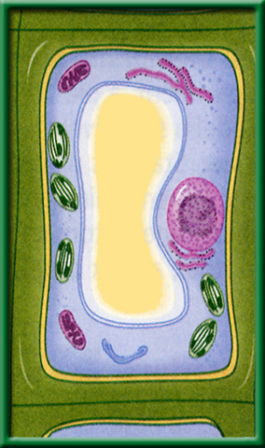
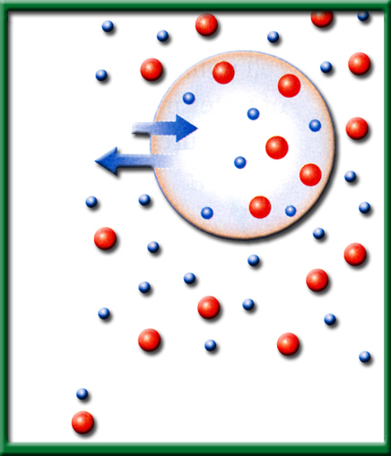
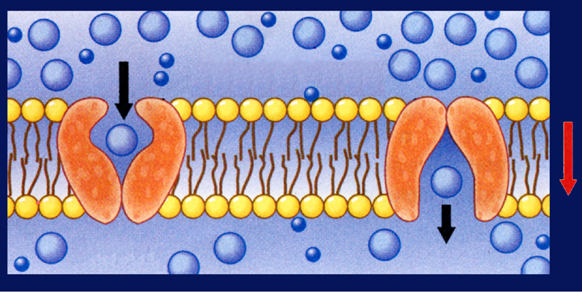
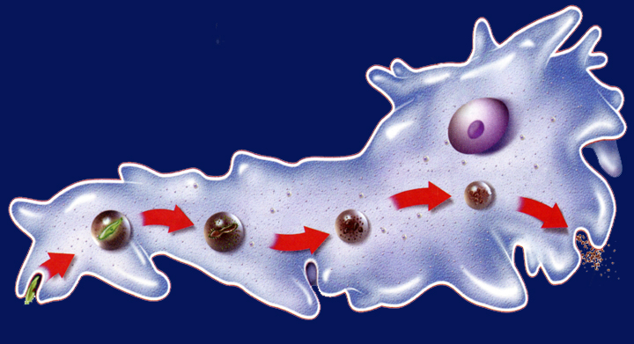
2/24 Cellular Transport 8.1
Obj. TSW explain how cells regulate their surroundings through their semi permeable membranes by comparing and contrasting organelles in a plant and animal cell.
P. 48 NB
What is Osmosis?
Compare & Contrast Isotonic, Hypotonic, and Hypertonic Solutions.
Compare & Contrast Passive Transport & Active Transport.
  HW – Read CH 8.3, 1 page notes. P.53 NB

Slide 3
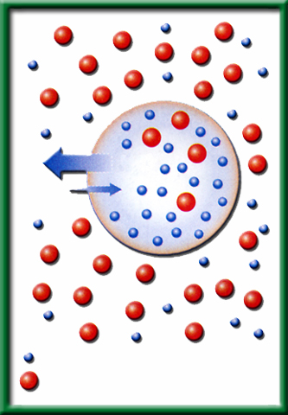
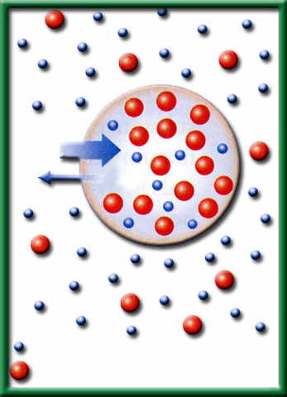
2/27 Osmosis CH 8.1 & 8.2
Obj. TSW learn how water moves through a plasma membrane by participating in a demonstration of Osmosis. P. 50 NB
Why do cells have to be small?
Solvent is a solution, solute is the substance like sugar and salt. Explain what happens to a cell or egg in a Hypotonic solution. Use words like Solute and Solvent.
Explain plasmolysis, why does grass that has been salted in the winter along side roads die?

Slide 4


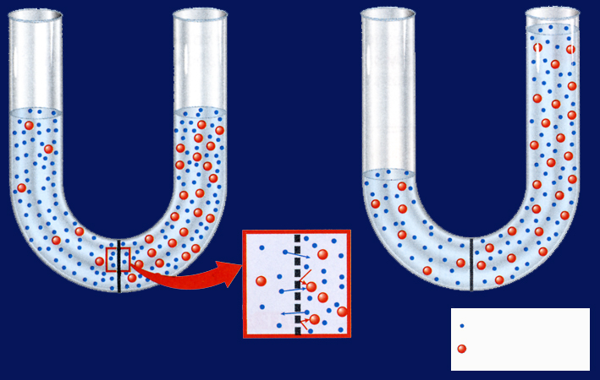






Section 8.1 Summary – pages 195 - 200
What controls osmosis?
#1.The movement of water.
Unequal distribution of particles, called a concentration gradient, is one factor that controls osmosis.
Before
Osmosis
After
Osmosis
Water molecule
Sugar molecule
Selectively permeable membrane

Slide 5
Section 8.1 Summary – pages 195 - 200
Cells in an isotonic solution
Water movement is Equal
In an isotonic solution, the concentration of dissolved substances in the solution is the same as the concentration of dissolved substances inside the cell.
H₂O
H₂O
Water Molecule
Dissolved Molecule

Slide 6
Section 8.1 Summary – pages 195 - 200
Cells in an isotonic solution
A plant cell has its normal shape and pressure in an isotonic solution.

Slide 7
Section 8.1 Summary – pages 195 - 200
Cells in a hypotonic solution
In a hypotonic solution, water enters a cell by osmosis, causing the cell to swell.
Lysed- to explode
H₂O
H₂O
Water Molecule
Dissolved Molecule

Slide 8
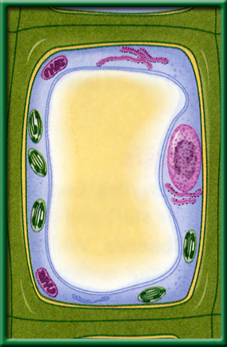
Section 8.1 Summary – pages 195 - 200
Cells in a hypotonic solution
Plant cells swell beyond their normal size as pressure increases.

Slide 9
Section 8.1 Summary – pages 195 - 200
Cells in a hypertonic solution
In a hypertonic solution, water leaves a cell by osmosis, causing the cell to shrink.
H₂O
H₂O
Water Molecule
Dissolved Molecule

Slide 10
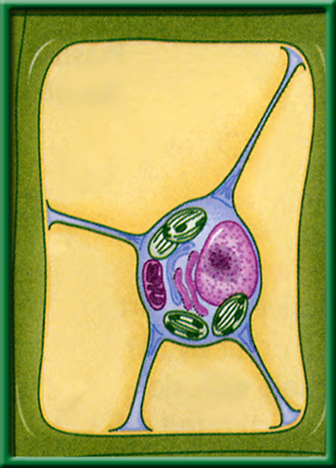
Section 8.1 Summary – pages 195 - 200
Cells in a hypertonic solution
Plant cells lose pressure as the plasma membrane shrinks away from the cell wall.

Slide 11
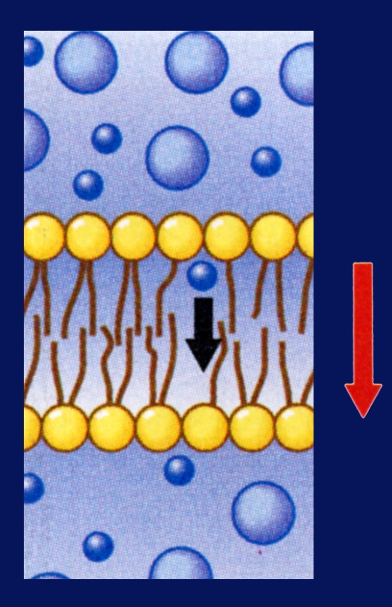
Section 8.1 Summary – pages 195 - 200
#2.Passive Transport
When a cell uses no energy to move particles across a membrane passive transport occurs.
Osmosis
Diffusion
Facilitated Diffusion
Moves from High Concentration to Low Concentration
Concentration gradient
Plasma membrane

Slide 12
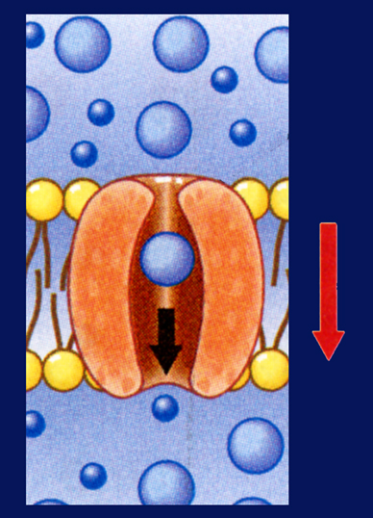
Section 8.1 Summary – pages 195 - 200
Passive Transport by proteins
Passive transport of materials across the membrane using transport proteins is called facilitated diffusion.
Channel proteins
Plasma membrane
Concentration gradient

Slide 13
Section 8.1 Summary – pages 195 - 200
Passive transport by proteins
The movement is with the concentration gradient (High to Low), and requires no energy input from the cell.
Carrier proteins
Plasma membrane
Concentration gradient
Step 1
Step 2

Slide 14
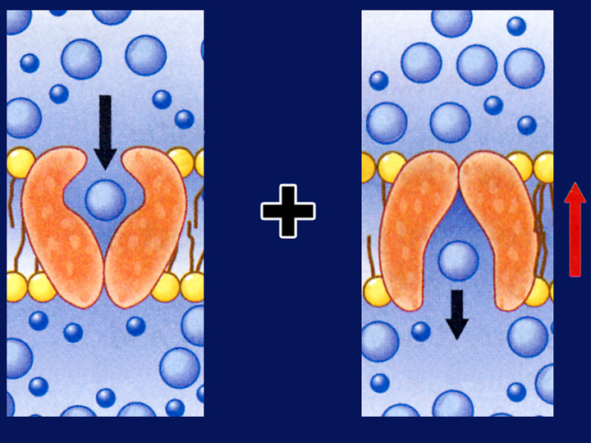
Section 8.1 Summary – pages 195 - 200
Active Transport
Movement of materials through a membrane against a concentration gradient (Low to High) is called active transport and requires energy from the cell.
Carrier proteins
Plasma membrane
Concentration gradient
Cellular energy
Step 1
Step 2

Slide 15
Section 8.1 Summary – pages 195 - 200
How active transport occurs
In active transport, a transport protein called a carrier protein first binds with a particle of the substance to be transported.
Exocytosis
Endocytosis
Carrier proteins
Plasma membrane
Concentration gradient
Cellular energy
Step 1
Step 2

Slide 16
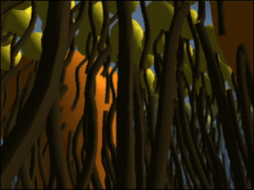
Section 8.1 Summary – pages 195 - 200
How active transport occurs
Click image to view movie.

Slide 17
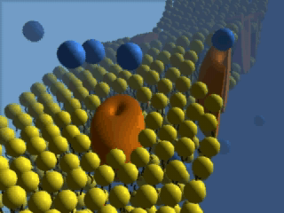
Section 8.1 Summary – pages 195 - 200
How active transport occurs
Click image to view movie.

Slide 18
Section 8.1 Summary – pages 195 - 200
Transport of Large Particles- Active Transport
Endocytosis is a process by which a cell surrounds and takes in material from its environment.
Nucleus
Wastes
Digestion
Endocytosis
Exocytosis

Slide 19
Section 8.1 Summary – pages 195 - 200
Transport of Large Particles
The material is engulfed and enclosed by a portion of the cell’s plasma membrane.
Nucleus
Wastes
Digestion
Endocytosis
Exocytosis

Slide 20
Section 8.1 Summary – pages 195 - 200
Transport of Large Particles – Active Transport
Exocytosis is the expulsion or secretion of materials from a cell.
Nucleus
Wastes
Digestion
Endocytosis
Exocytosis

Slide 21


Section 1 Check
Question 1
The diffusion of water across a selectively permeable membrane is called __________.
Water molecule
Selectively permeable membrane
Sugar molecule
C. exocytosis
D. osmosis
CA: Biology/Life Sciences
1a

Slide 22

Section 1 Check
Question 2
What is the expected result of having an animal cell in a hypertonic solution?
A. The cell shrivels up.
B. The plasma membrane shrinks away from
the cell wall.
C. The cell swells up.
D. The cell retains its normal shape.
CA: Biology/Life Sciences
1a

Slide 23
Section 1 Check
The answer is A. In a hypertonic solution, cells experience osmosis of water out of the cell. Animal cells shrivel because of decreased pressure in the cells.
H₂O
H₂O
Water molecule
Sugar molecule
CA: Biology/Life Sciences
1a

Slide 24
Section 1 Check
Question 3
A grocer mists the celery display with water to keep it looking fresh. What type of solution is the celery now in?
A. isotonic
B. hypotonic
C. hypertonic
D. exotonic
CA: Biology/Life Sciences
1a, 1j

Slide 25
Section 1 Check
The answer is B. Plant cells contain a rigid cell wall and do not burst even in a hypotonic solution.
CA: Biology/Life Sciences
1a, 1j

Slide 26

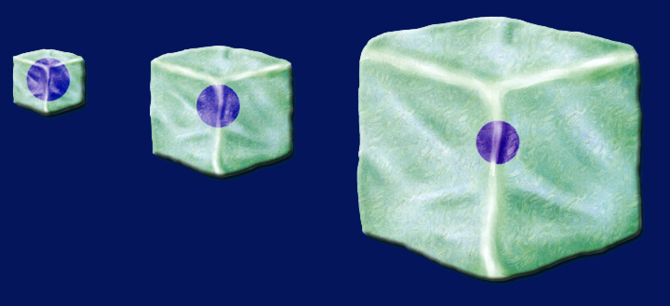
Section 8.2 Summary – pages 201 - 210
Surface area-to-volume ratio
4 mm
4 mm
1 mm
1 mm
2 mm
2 mm
1 mm
2 mm
Surface area = 1 mm² Volume = 1 mm³
4 mm
Surface area = 4 mm² Volume = 8 mm³
As a cell’s size increases, its volume increases much faster than its surface area.

Slide 27
Section 8.2 Summary – pages 201 - 210
Surface area-to-volume ratio
4 mm
4 mm
1 mm
1 mm
2 mm
2 mm
1 mm
2 mm
Surface area = 6 mm² Volume = 8 mm³
4 mm
Surface area = 24 mm² Volume = 8 mm³
If cell size doubled, the cell would require eight times more nutrients and would have eight times more waste to excrete.

Slide 28
Section 8.2 Summary – pages 201 - 210
Surface area-to-volume ratio
4 mm
4 mm
1 mm
1 mm
2 mm
2 mm
1 mm
2 mm
Surface area = 6 mm² Volume = 8 mm³
4 mm
Surface area = 24 mm² Volume = 8 mm³
The cell would either starve to death or be poisoned from the buildup of waste products.

Slide 29
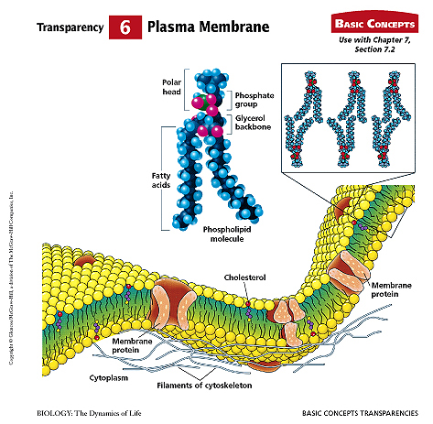
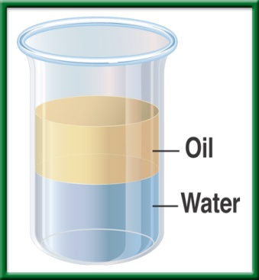
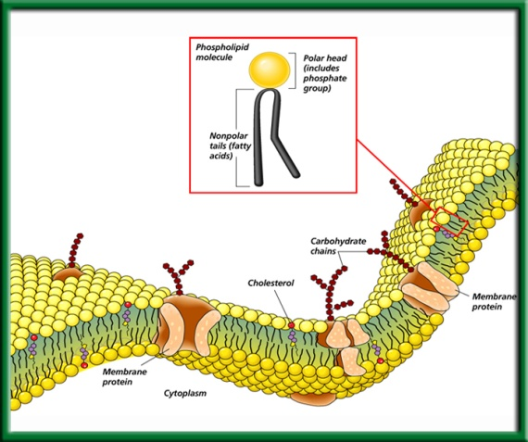
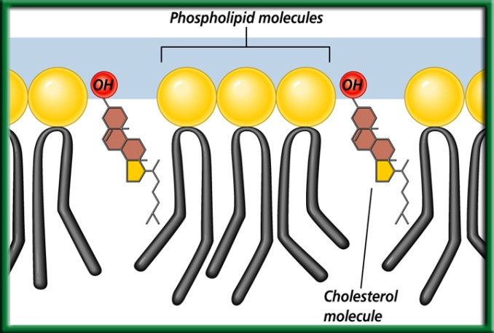
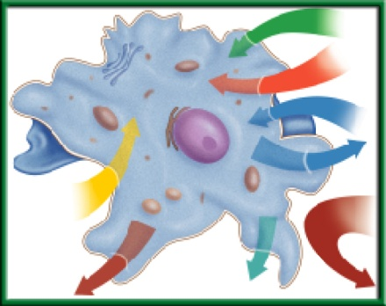
2/28 The Plasma Membrane 7.2
Obj. TSW demonstrate their knowledge and understanding of how the plasma membrane is semipermeable & taking notes. P.52NB
Cellsalive.com
Explain what selectively permeable (semi-permeable) means.
Why is the plasma membrane called a Fluid Mosaic Model?
Write the 4 Macromolecules/ biomolecules. For each one, explain it’s location and how it helps the cell function.
HW – NOTES CH 8.1 P. 53 NB

Slide 30
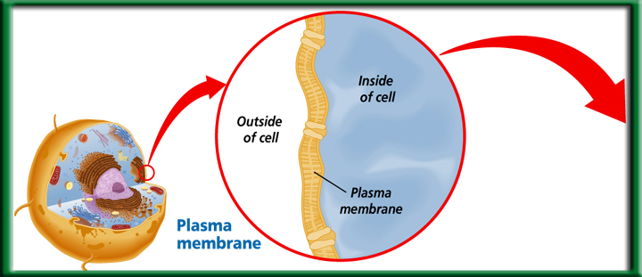

Plasma Membrane – Selectively Permeable
Phosopholipid Bilayer
Maintains Homeostasis by controlling the movement of materials into & out of cells.
To return to the chapter summary click escape or close this document.

Slide 31
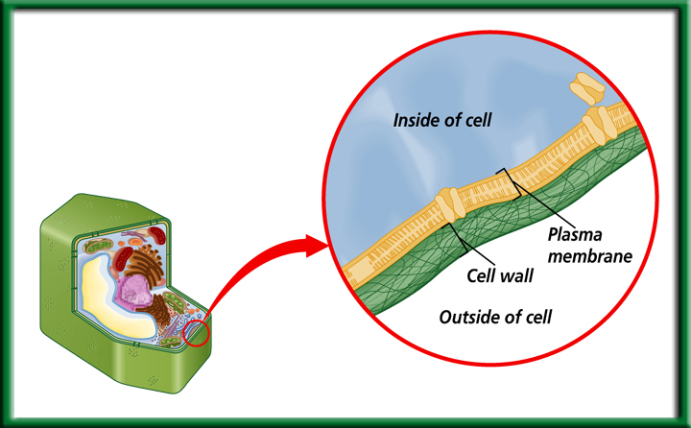
Cell Wall
Made of cellulose, not digestible by humans.
Provides protection and support.
Found in:
Plant Cells, Bacteria, some Protists, and Fungi
To return to the chapter summary click escape or close this document.

Slide 32

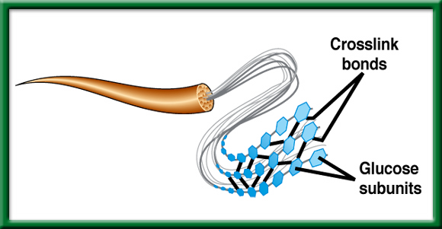
Structure of Cellulose – Cell Wall of Plants
We call it Fiber.
To return to the chapter summary click escape or close this document.

Slide 33
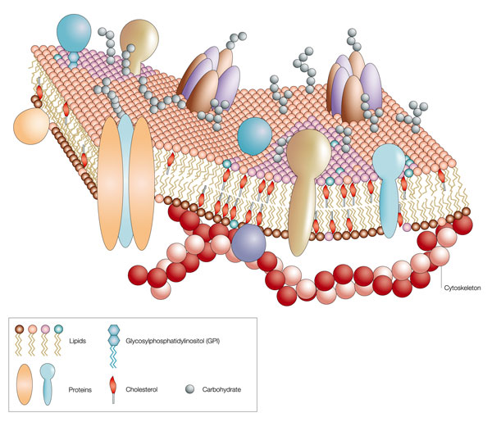
ID the Carbohydrates, Proteins, Lipids, & Cholesterols
What is the function of each of these Macromolecules in the Plasma Membrane?

Slide 34
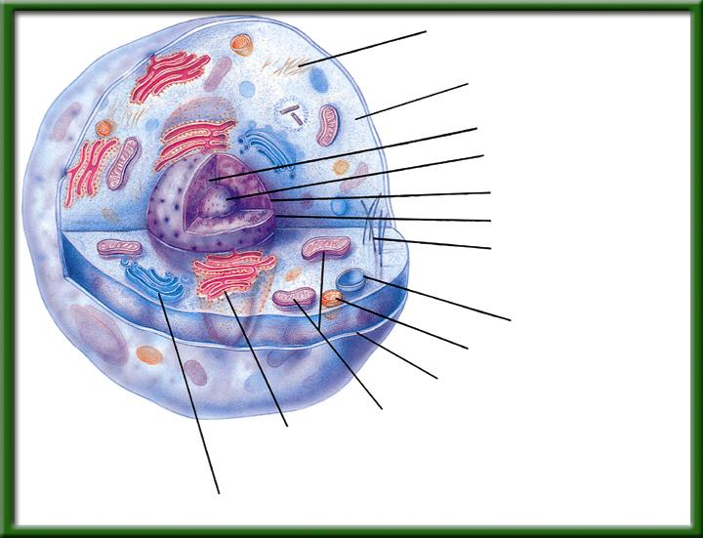

Slide 35
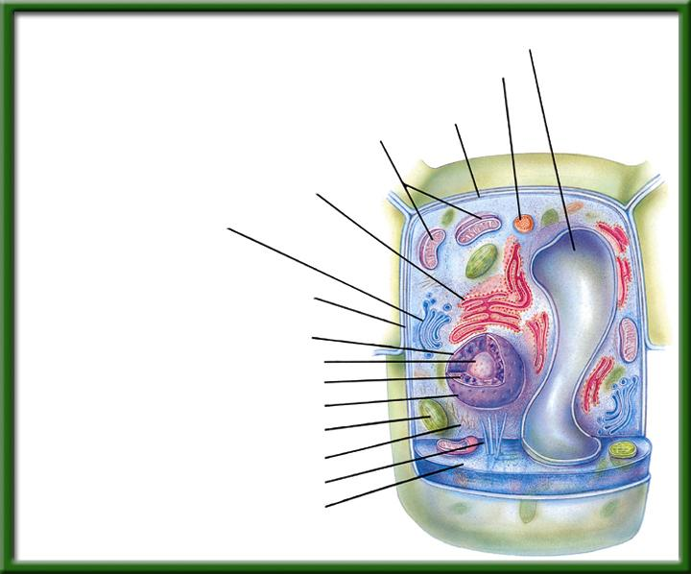

Slide 36


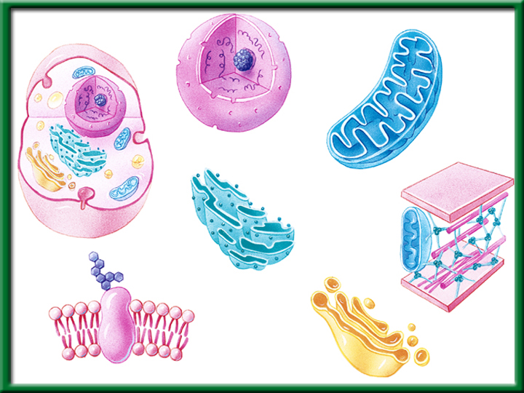
To return to the chapter summary click escape or close this document.

Slide 37
Activity: Make your Desk a Cell p. 53NB
After researching Cellsalive.com for the following organelles: Nucleus, Cytoplasm, Endoplasmic Reticulum, Golgi Body, Vacuole, Mitochondria, Plasma Membrane, Chloroplast & Cell Wall (Plant cell) take notes on page3 NB. Title: Cell Organelles
Then with a partners and one desk, make a plasma membrane around the desk. On the inside of the desk, Draw and ID the listed organelles above on your desk.
It can be a plant or animal cell
Mrs. McAllister must grade your “cell”.

Slide 38
Osmosis p. 49 NB
If we put an egg that the shell has been dissolved in vinegar for 24 hours into Karo Syrup, then the egg will __________.
If we put an egg that the shell has been dissolved in vinegar for 24 hours into water, then the egg will ___________.
If we put an egg that the shell has been dissolved in vinegar for 24 hours into salt water, then the egg will ___________.
By the third day you should have an AXES Paragraph written about Osmosis, and how cells are impacted by different solutions.

Slide 39
How Osmosis affects cells in…p.51NB
Directions: Draw a picture of a cell, and a description of if the cell swells, shrinks or stays the same. Explain the concentration gradient using the words solute and solvent.
Isotonic
Solution
Hypotonic
Solution
Hypertonic Solution
How Osmosis affects cells in…

Slide 40
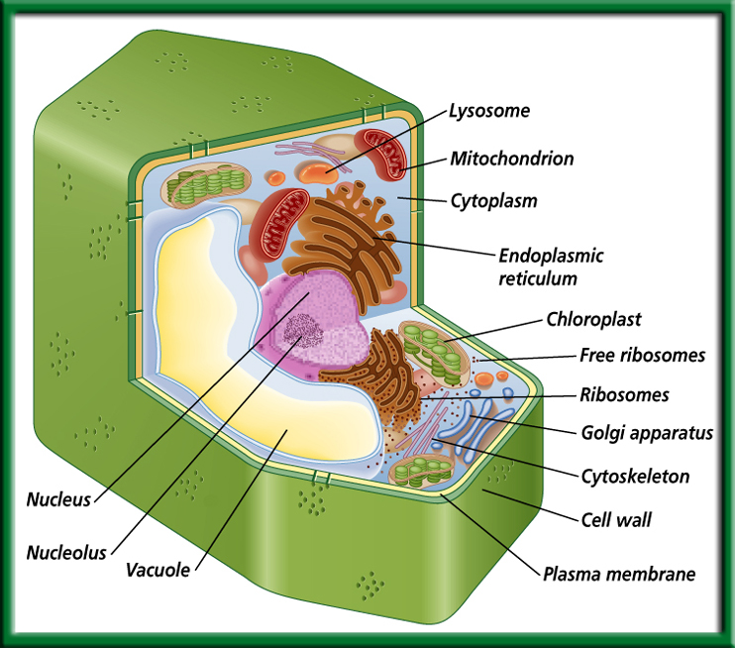
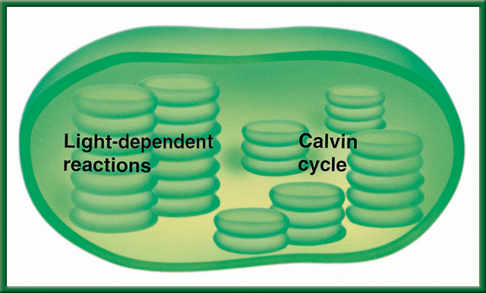
3/1 Photosynthesis: Trapping the Sun’s Energy 9.2
Obj. TSW demonstrate how usable energy is captured from sunlight by chloroplasts and is stored through the synthesis of sugar by completing the warm up and participating in a photosynthesis class activity. P.54 NB
Cellsalive.com
HW – Study Guide
What organelle in the plant cell traps the suns energy, what is that process called?
Write and memorize the equation for photosynthesis.
What are the Reactants and the Products for Photosynthesis, what is the catalyst for this process?
Show Photosynthesis video
Osmosis AXES

Slide 41
#1 Chloroplast - Photosynthesis
#2. 6CO₂ + 6H₂0 --→ 6O₂ + C₆H₁₂O₆
#3. Reactants Products

Slide 42
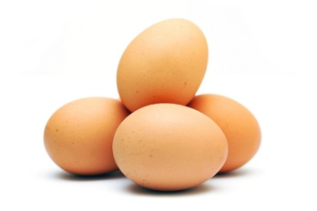
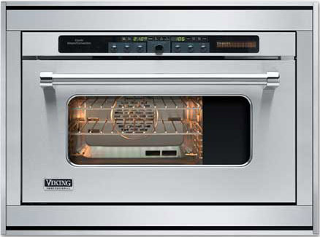
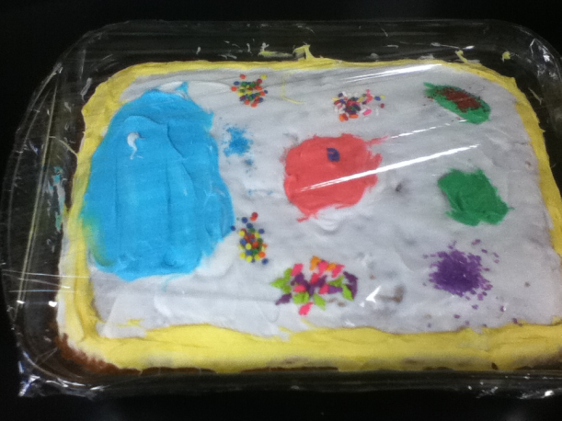
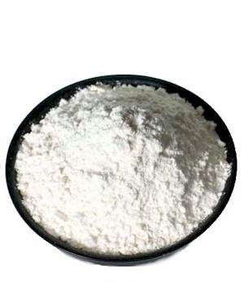
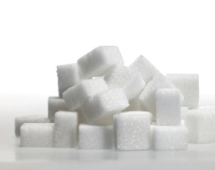
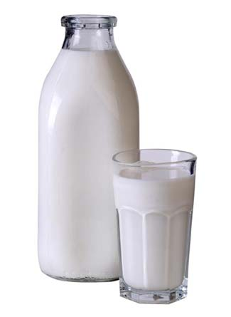
Reactants and Products : Making a cake
Reactants
Catalyst
Product
Angelica’s cake!

Slide 43
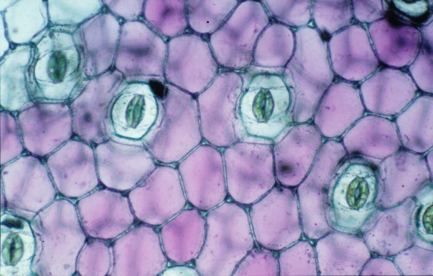
Making of Carbohydrates & Cellular Respiration p.51NB
Working with three other students: answer questions 1 – 3. Each students gets to have a job.
Photosynthesis
6 CO₂ + 6 H₂O -> C₆H₁₂O₆ + 6 O₂
Hydrogen
Carbon
Oxygen
Cellular Respiration
C₆H₁₂O₆ + 6 O₂ -> 6 CO₂ + 6 H₂O + 36 ATP + Heat
Disassemble your Glucose & O₂ to the proper carts.
1 Roots – collect 6 H₂O
2 Stomata – Collect 6 CO₂
3 Chloroplasts – collect 6 light energy convert to chemical energy
4 Product of Photosynthesis- make Glucose & 6 O2

Slide 44
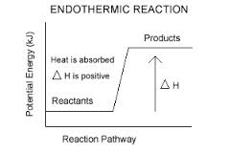
Endothermic Reaction - Photosynthesis

Slide 45
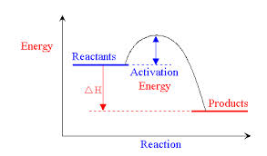
Exothermic Reaction – Yeast + Hydrogen Peroxide
Cellular Respiration

Slide 46
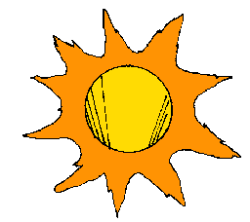
3/3 Light-Dependent & Light-Independent Reactions CH 9.2
Obj. TSW demonstrate how light energy is captured by chloroplasts and converted to chemical energy (glucose) from CO₂ and H₂0 by doing a flow chart. 58 NB
Why is Photolysis important?
Compare and Contrast Light Dependent reactions and Light Independent reactions.
Where does the Calvin Cycle happen in the cell and what does it produce?
Study guide is due today! P. 59NB
Read CH 6.3, 7, 8.1 & 9
Show Videos
Cellsalive.com

Slide 47

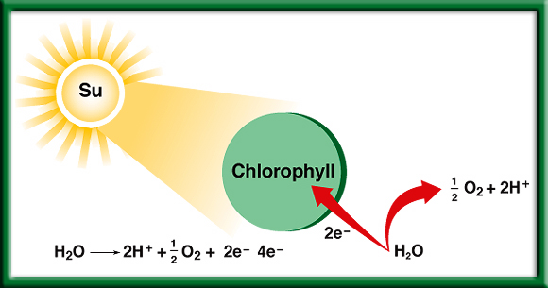
#1. Photolysis – Breaks up H₂O (Water) to release O, that makes O₂.
To return to the chapter summary click escape or close this document.

Slide 48


Section 9.2 Summary – pages 225-230
Restoring electrons
The oxygen produced by photolysis is released into the air and supplies the oxygen we breathe.
The electrons are returned to chlorophyll.
The hydrogen ions are pumped into the thylakoid, where they accumulate in high concentration.

Slide 49
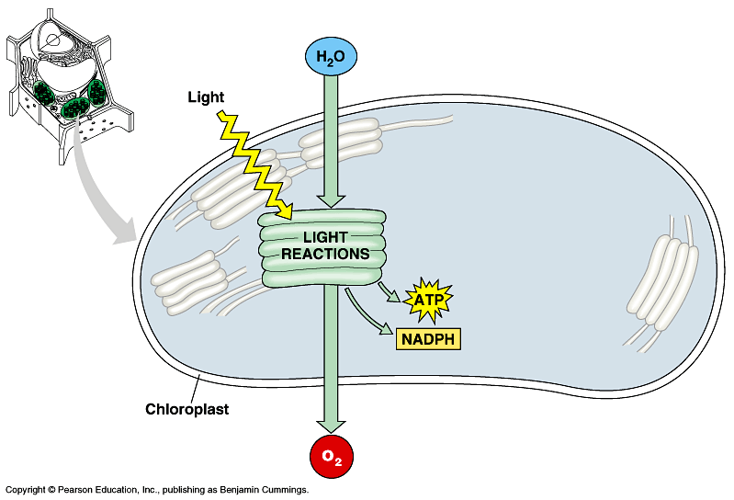
#2. How does light energy become chemical energy?
Light Dependent Reaction happens in the light when the light hits the Grana and splits water to make O₂.

Slide 50
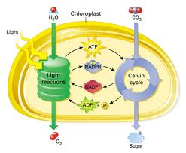
#2. How does light energy become chemical energy?
Light Independent Reaction happens in the light or the dark and converts CO₂ in the Calvin Cycle to Sugar – Glucose.

Slide 51
Section 9.2 Summary – pages 225-230
Trapping Energy from Sunlight
Photosynthesis happens in two phases.
The light-dependent reactions convert light energy into chemical energy.
2. The molecules of ATP produced in the light-dependent reactions are then used to fuel the light-independent reactions that produce simple sugars.
The general equation for photosynthesis is written as 6CO₂ + 6H₂O→C₆H₁₂O₆ + 6O₂

Slide 52
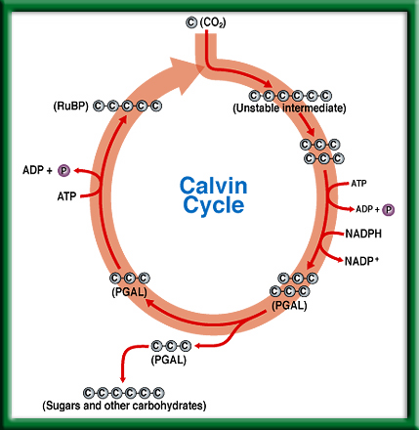
Calvin
Cycle
#3. The Calvin Cycle happens in the Stroma of the Chloroplast, and produces the glucose for the plant.
To return to the chapter summary click escape or close this document.

Slide 53
For your Note Card Period 4 Biology
Study Cells, organelles & functions, Transport – Active & Passive, ATP, Photosynthesis, Prokaryotes, Eukaryotes, Osmosis, Folded membranes are important.
Viruses – nonliving because it has a host cell to reproduce
CH 6.3, CH 7, CH 8.1, CH 9.1

Slide 54
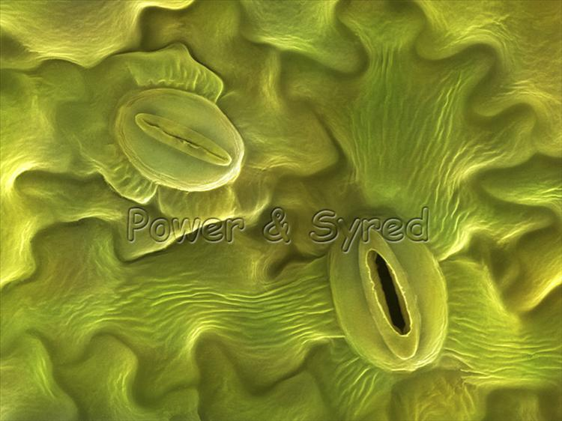
How to Make Carbohydrates Activity p. 55NB
6 CO₂ + 6 H₂O -> C₆H₁₂O₆ + 6 O
Carbon Dioxide + Water = Glucose + Oxygen
2. Sunlight – Catalyst
3. The chlorophyll inside the chloroplast

Slide 55
Glucose Synthesis Activity
Photosynthesis: 6 CO₂ + 6 H₂O -> C₆H₁₂O₆ + 6 O
Black = Carbon
White = Hydrogen
Red = Oxygen
Person 1 – Root = H₂O
Person 2 – Stomata = CO₂
Person 3 – Chloroplast = Light Energy (Sun)
Person 4 – Glucose Synthesis/ O₂
Person 5 – Get ATP for Cellular Respiration
Cellular Respiration: C₆H₁₂O₆ + 6O₂→ 6CO₂ +6H₂0 + 36 ATP + Heat
Glucose
C₆H₁₂O₆

Slide 56
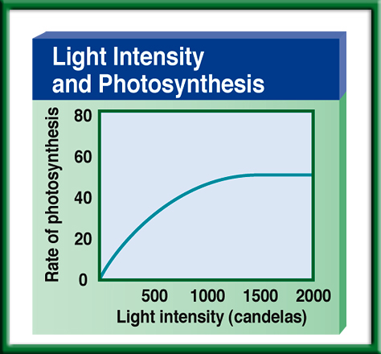
p. 35NB
Copy this graph and explain what it means in a short paragraph.
Use your knowledge of independent and dependent variables to explain what happens.
Explain the relationship between the two variables
Come up with a better title
To return to the chapter summary click escape or close this document.

Slide 57
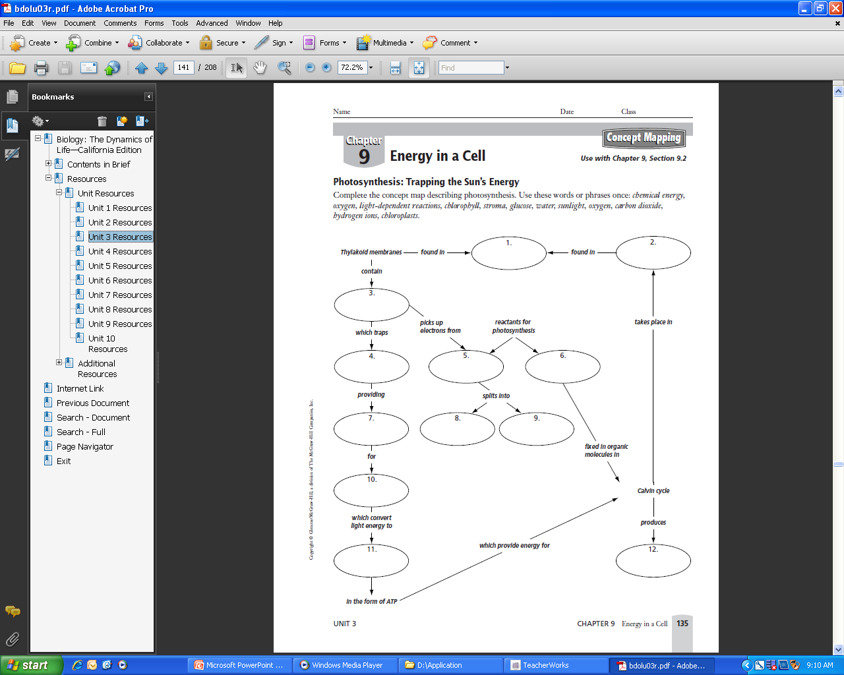
Word Bank
Chemical energy
Oxygen
Light Dependent Reactions
Chlorophyll
Stroma
Glucose
Water
Sunlight
Carbon Dioxide
Hydrogen ions
Chloroplasts
Energy
p. 35 NB
Write a 3 – 5 sentence summary

Slide 58
Taboo
Chloroplast
Cell Wall
Plasma Membrane
Passive transport
Active Transport

Slide 59
Taboo
Enzyme
Macromolecule
Eukaryotic
Vacuole
Independent Variable
Control

Slide 60
Taboo
Active Transport
Dependent Variable
Hypothesis
Carbohydrate
Lipids
Osmosis

Slide 61
Taboo
Cellular Respiration
Photosynthesis
Mitochondria
Theory
Scientific Method
Nucleic Acid

Slide 62
Honors Biology
Do the Math
What is the Percent change in temperature of your Catalase Reaction?
V1 – V2 x 100%
V1
21 – 36 x 100% = ?
21
76%
Include this in your Data Analysis.

Slide 63
Section 2 Check
Question 1
The process that uses the sun’s energy to make simple sugars is ________.
A. cellular respiration
B. glycolysis
C. photosynthesis
D. photolysis
CA: Biology/Life Sciences
1f

Slide 64
Section 2 Check
The answer is C. Photosynthesis happens in two phases to make simple sugars and convert the sugars into complex carbohydrates for energy storage.
CA: Biology/Life Sciences
1f

Slide 65

Question 1
Why do you add baking soda solution to the water containing the Elodea plants?
Answer
The baking soda supplies carbon dioxide, a necessary component of photosynthesis.
To return to the chapter summary click escape or close this document.

Slide 66
Question 2
Why does the experiment use aquatic plants?
Answer
The oxygen given off by an aquatic plant will form visible bubbles in the water that can be easily observed.
To return to the chapter summary click escape or close this document.

Slide 67
Question 3
What is the independent variable in this experiment?
Answer
The independent variable in this experiment is the color of light that is directed on the Elodea.
To return to the chapter summary click escape or close this document.

Slide 68

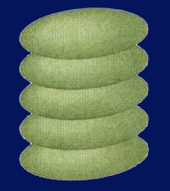
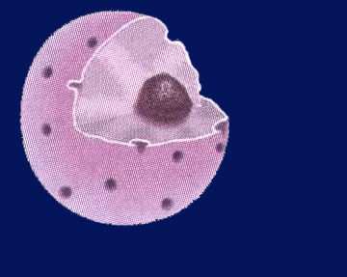
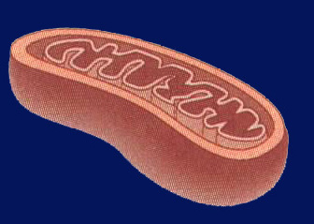
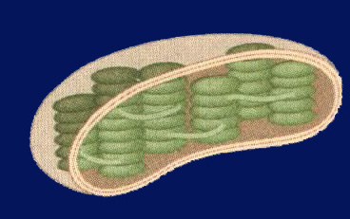
Chapter Assessment
Question 4
In which of the following structures do the light-dependent reactions of photosynthesis take place?
A.
C.
B.
D.
CA: Biology/Life Sciences
1f

Slide 69
The answer is D. The light-dependent reactions of photosynthesis take place in the thylakoid membranes of chloroplasts.
CA: Biology/Life Sciences
1f
Chapter Assessment

Slide 70
Quote of the Day
Everything you can imagine is real.
- Pablo Picasso

Slide 71

3/2 Cellular Respiration & Fermentation 9.3
Obj: TSW be able to compare and contrast photosynthesis and cellular respiration by completing the flow chart activity. pg. 56 NB
http://science.pppst.com/biology.html
1) What is Cellular Respiration? Identify the three stages.
2) How is it related to Photosynthesis?
3) What is fermentation, where does it happen in the cycle?

Slide 72


1. Cellular Respiration – converts glucose in to ATP and Heat in the mitochondria.
All living organisms perform Cellular Respiration, including plants.

Slide 73

#2. The reactants for Photosynthesis (CO2 & H2O) are the Products for Cellular Respiration.

Slide 74

2.
P.55 NB Compare and contrast cellular respiration and photosynthesis.
3. Fermentation happens during glycolysis when not enough oxygen is present.
To return to the chapter summary click escape or close this document.

Slide 75



P. 56 NB Write a summary paragraph
PHOTOSYNTHESIS (in the chloroplast)
Calvin cycle
Glucose is made
Photolysis
Uses energy from photolysis and CO₂ to produce sugar = glucose → C₆H₁₂O₆
Does not need light!
Uses light energy to break water (H₂O) down to oxygen (O₂ ).
Needs light!
CO₂
H₂O
O₂
Where most of your energy is made. Needs Oxygen
Breaks down sugar into pyruvic acid → 2*(C₃H₆O₃) and ATP (energy) Cytoplasm
Electron
Transport
chain
Citric acid
Or Krebs
Cycle
Pyruvic
acid
36 ATP
Heat
2 ATP
  CELLULAR RESPIRATION (in cytoplasm and mitochondria)

Slide 76
Taboo
Cellular Respiration
Vacuole
Prokayotic
Osmosis
Passive Transport
Macromolecule

Slide 77
Taboo
Photosynthesis
Nucleus
Eukaryotic Cell
Active Transport
DNA
Protein

Slide 78
Taboo
Scientific Method
Independent Variable
Plasma Membrane
Bacteria
Prokaryotic
Chloroplast

Slide 79
Dependent Variable
Control
Selective Permeability
Endoplasmic Reticulum
Cell Wall
Vacuole

Slide 80

Section 9.3 Summary – pages 231-237
Comparing Photosynthesis and Cellular Respiration p. 57 NB
Table 9.1 Comparison of Photosynthesis and Cellular Respiration
Photosynthesis
Cellular Respiration
Food synthesized = Endergonic
Food broken down = Exergonic
Energy from sun stored in glucose
Energy of glucose released
Carbon dioxide taken in
Carbon dioxide given off
Oxygen given off
Oxygen taken in
Produces sugars = C₆H₁₂O₆
Produces CO₂, H₂O, ATP & Heat
Requires light
Does not require light
Occurs only in presence of chlorophyll
Occurs in all living cells,
including plants

Slide 81
Photosynthesis & Cellular Respiration AXES Paragraph Bottom of page 57NB
The mechanisms for P & CR are related because they are essentially opposite reactions. Photosynthesis transforms energy from the sun and Cellular Respiration makes use of chemical bond energy.
Photosynthesis = Chloroplast
Cellular Respiration = Cytoplasm, Mitochondria
6CO₂ +6H₂0 → C₆H₁₂O₆ + 6O₂ Photosynthesis
C₆H₁₂O₆ + 6O₂ → 6CO₂ +6H₂0 + 36 ATP + Heat Cellular Respiration

Slide 82
Gallery Walk – Cell UNIT Review
Describe, Draw, and Explain the importance of each of the following concepts/ processes on a poster paper, for a Gallery Walk review. Page 51NB
Osmosis
Plasma Membrane
Eukaryotic Cell
Prokaryotic Cell
Photosynthesis
Cellular Respiration
Folded Membranes
Active & Passive Transport
Macromolecules
Scientific Method

Slide 83
Quiz Corrections
Staple the quiz to your Notebook paper
For each question you got wrong, Explain what was wrong about your answer.
Tell me the correct answer, and why it is the correct answer.
EX. Exocytosis is not part of Passive Transport. Exocytosis is part of Active transport because it requires energy to get rid of wastes.

Slide 84
Warm Up Answers
1) Cellular Respiration: process by which mitochondria break down food molecules (glucose) to produce ATP. The stages are: glycolysis, citric acid cycle, electron transport chain.
2) Glycolysis: series of chemical reactions in the cytoplasm of the cell that breaks down glucose into (2) pyruvic acids- C₃H₆O₃.
3). Fermentation – in the absence of Oxygen during glycolysis, Lactic acid (animals) or alcohol (plants) are produced.
Table 9.1 in text
Cellular Respiration: Food broken down, energy of glucose released, CO2 given off, O2 taken in, does not require light, occurs in all living cells
They both produce Energy.
  Photosynthesis: Food synthesized, energy from sun stored in glucose, CO2 taken in, O2 released, requires light, occurs only cells that contain chlorophyll
  Both: use electron carriers, have cycles of chemical reactions, and form ATP

Slide 85
Cellular Respiration & Yeast
Get into groups of 3 people. Get 1 flask, 1 balloon, 1 sugar cube, and ½ tsp. of Yeast, combine with 50 ml warm water.
Place Balloon on the end of the Flask
Record results
What happens to the balloon?
Why? What is the process called? What are the Products?

Slide 86
Cellular Respiration P. 31
Question: How much Carbon Dioxide will be produced?
Independent Variable: Changed the number of sugar (C6 H12 O6) cubes.
Dependent Variable: More Carbon Dioxide was produced.
Control: 1 sugar cube was the control.

Slide 87
Constant: Same Sugar, Yeast, balloons, Flasks
Materials & Equipment: Yeast – ½ tsp., water – 100 ml, sugar, balloons, Hot plate, Flask
Experimental Set up: Draw only
Safety Concerns: Don’t eat the sugar cubes.
Procedure : Write the steps…. Step 1, Step 2, Step 3,

Slide 88
Enzymes, Cataylase & Potatoes Page 47 NB
Get into groups of 3 people. Get 1 flask, 1 balloon, H2O2, and 1 piece of Potato – raw, 1 piece of potato cooked.
Place Balloon on the end of the Flask
Record results
What happens to the balloon?
What do you know about enzyme function?
Under what conditions do they function best?
Why? What is the process called? What are the Products?

Slide 89
Enzyme Lab P. 47NB
Question: How much Carbon Dioxide will be produced?
Independent Variable: Changed the number of pieces of potato, or more H2O2.
Dependent Variable: More Carbon Dioxide was produced.
Control: 10 mL of H2O2 & 1 piece of potato.

Slide 90
Enzyme – Catalyse Lab Page 47 NB
Constant: Same potato, H2O2, balloons, Flasks
Materials & Equipment: H2O2½ tsp., balloons, Hot plate, Flask
Experimental Set up: Draw only
Safety Concerns: Don’t eat the potatos.
Procedure : Write the steps…. Step 1, Step 2, Step 3,
Answer Analysis questions on the lab.

Slide 91
Leaf Disk Assay Lab
Honor Biology Due Friday
Enter data into Excel
Make a scatter plot graph to show the 50% floating point.
Data Analysis: What does the graph mean? Error analysis
Conclusion: Discuss why measuring the photosynthesis can be a problem. What competing process is occurring at the same time? Include in your discussion the relationship between Photosynthesis and Cellular Respiration by comparing and contrasting the equations.

Slide 92
STAGE 1: GLYCOLYSIS
Takes place in the cytoplasm of the cell
Process where glucose is broken down and some energy is released
In the absence of Oxygen, fermentation happens.

Slide 93

Section 9.3 Summary – pages 231-237
Glycolysis
Before citric acid cycle and electron transport chain can begin, pyruvic acid undergoes a series of reactions in which it gives off a molecule of CO₂ and combines with a molecule called coenzyme A to form acetyl-CoA.
Mitochondrial membrane
Outside the mitochondrion
Inside the mitochondrion
CO₂
Coenzyme A
- CoA
Pyruvic acid
Pyruvic acid
Intermediate by-product
Acetyl-CoA
NAD⁺
NADH + H⁺

Slide 94
STAGE 2: CITRIC ACID CYCLE
AKA Krebb’s cycle
Happens in the mitochondria
Produces: carbon dioxide and some ATP

Slide 95
STAGE 3: ELECTRON TRANSPORT CHAIN
Happens in the mitochondria
Series of proteins that transfers energy
Net creation of whole process: 36 ATP

Slide 96
PROBLEM
What happens when our cells run out of oxygen? Can cell respiration occur?

Slide 97
FERMENTATION
Without oxygen cell respiration can not occur.
However, instead of giving up and dying, our cells have another way to create energy without using oxygen→ FERMENTATION
Occurs after glycolysis
Lactic acid fermentation: animal cells (us!)
Alcoholic Fermentation: plant cells

Slide 98
To return to the chapter summary click escape or close this document.

